Slide 1
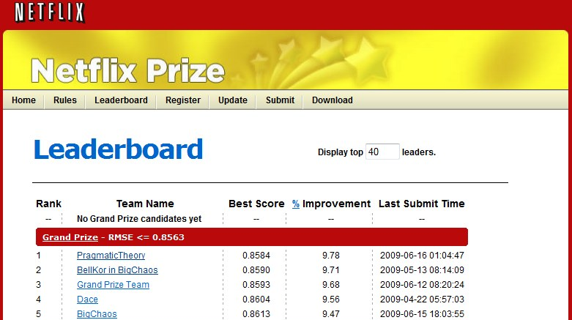
ALS: introduction
Originally proposed to improve Netflix’s own recommendation system RMSE by 10% on a test dataset consisting of 2.8 million data points
Collaborative filtering algorithm designed to be scalable to very large datasets
* Zhou, Y. et. al, Large-Scale Parallel Collaborative Filtering for the Netflix Prize (2008)

Slide 2
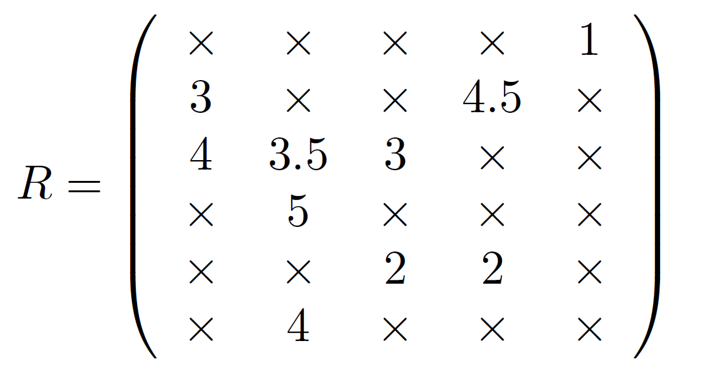
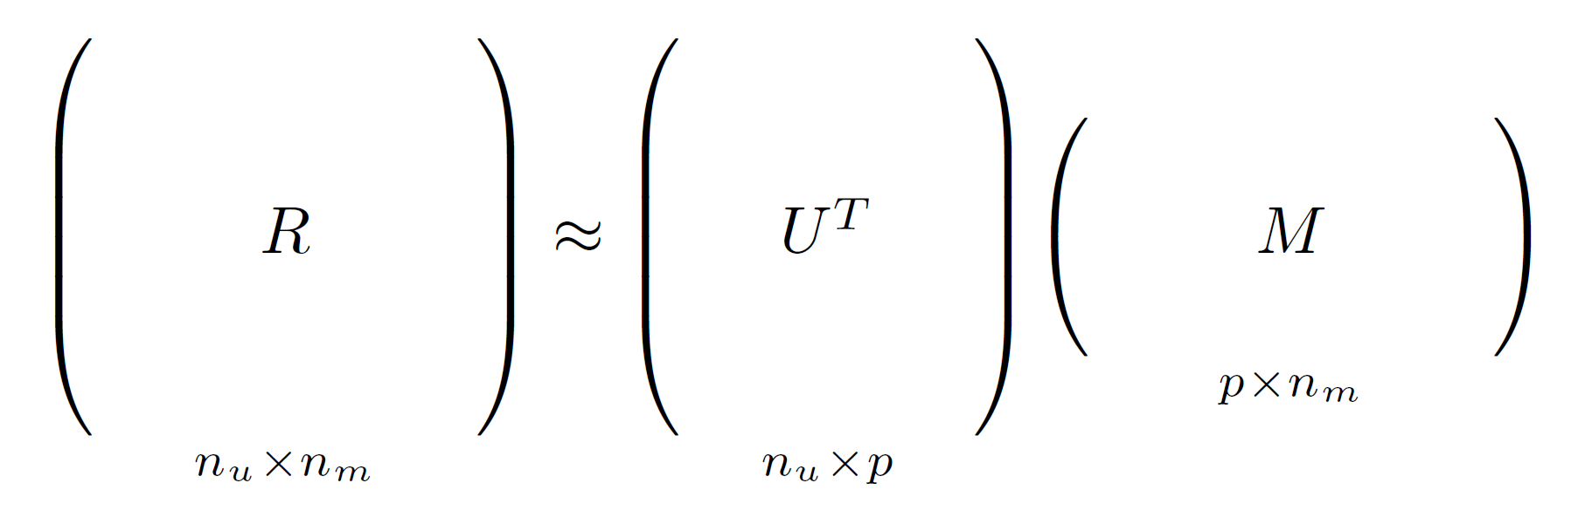

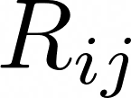





ALS: matrix factorization
User feature matrix
Rating matrix
Movie feature matrix
rating provided by user on movie
Issue: huge and sparse
number of users
number of movies
Why factorization?
number of hidden features (?)
What’s the meaning of ?

Slide 3
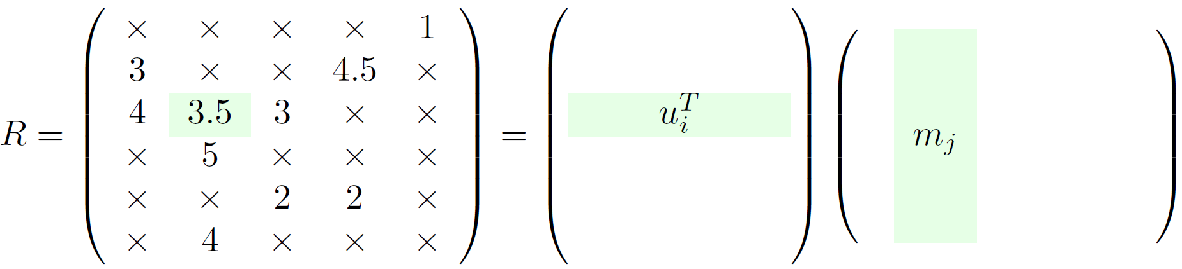
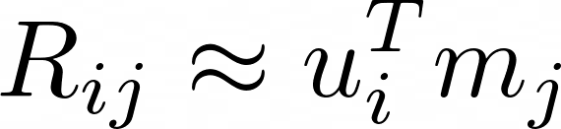

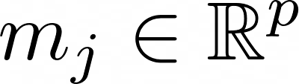
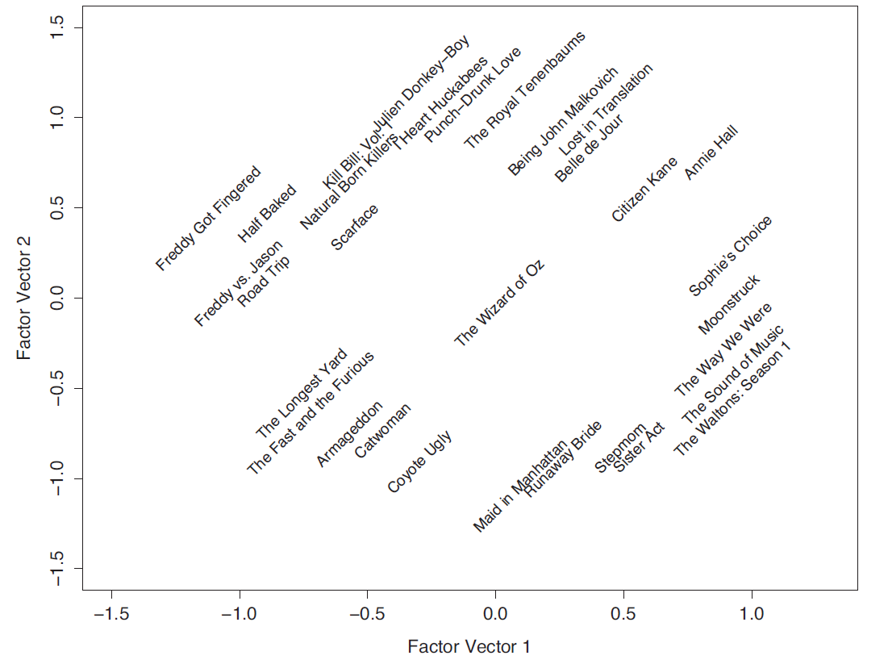
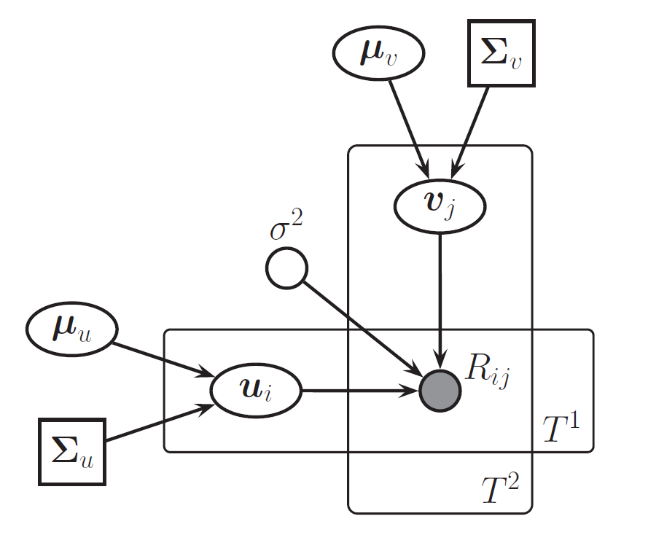

ALS: probabilistic framework
user feature vector
movie feature vector
Latent factors model
Movies feature space
Murphy K., Machine Learning: a probabilistic perspective

Slide 4
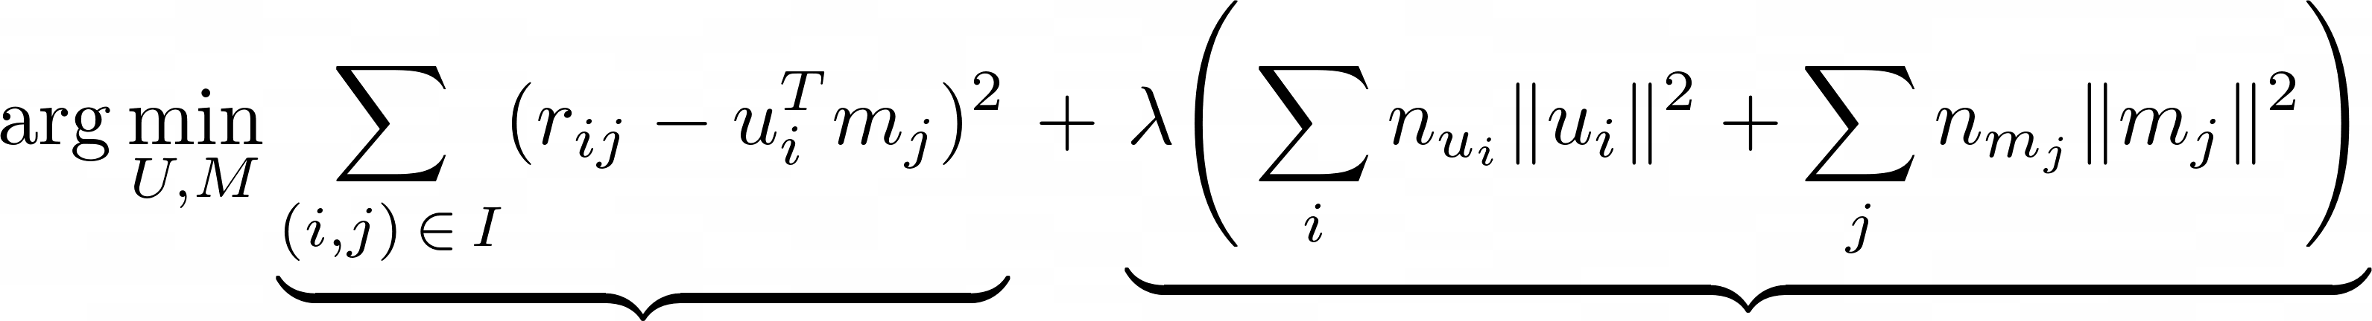
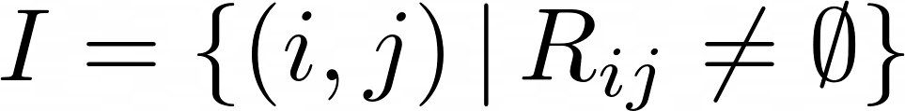


ALS: algorithm
Greedy solution to:
minimize MSE over the known ratings
suitable Tikhonov regularization to avoid overfitting
is the set of (the indicies of) the known ratings in
is the number of ratings provided by user
is the number of ratings provided for movie

Slide 5
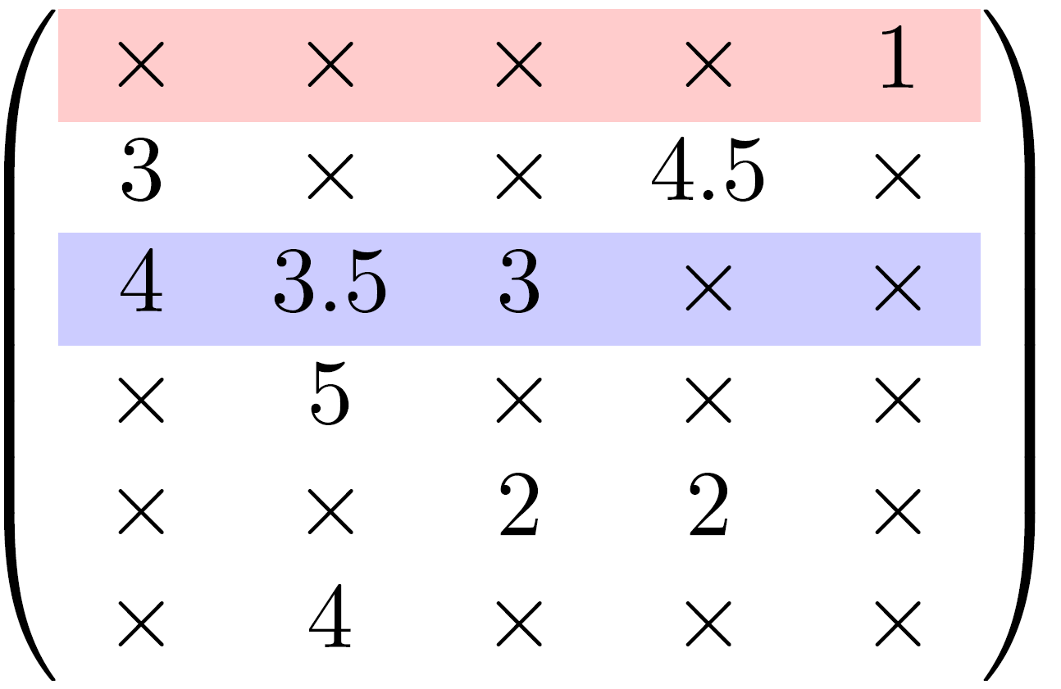
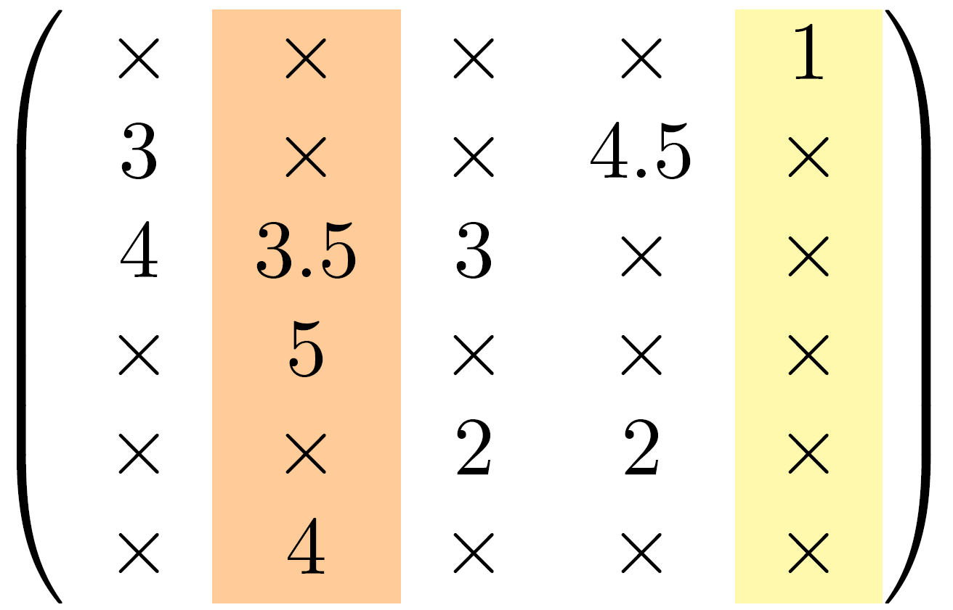
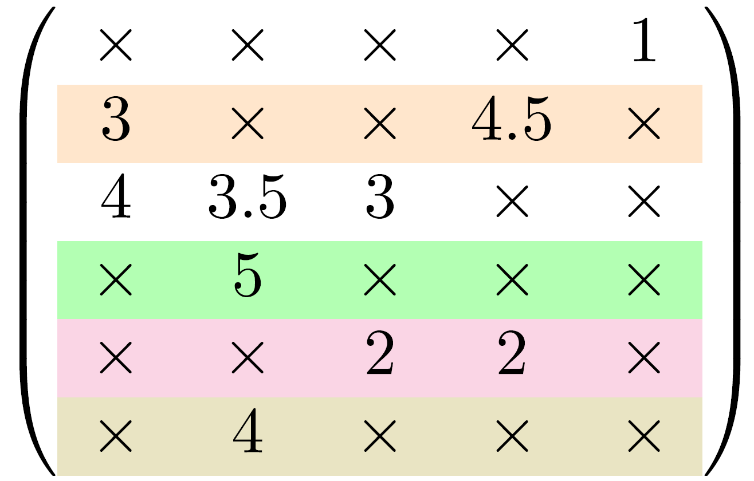
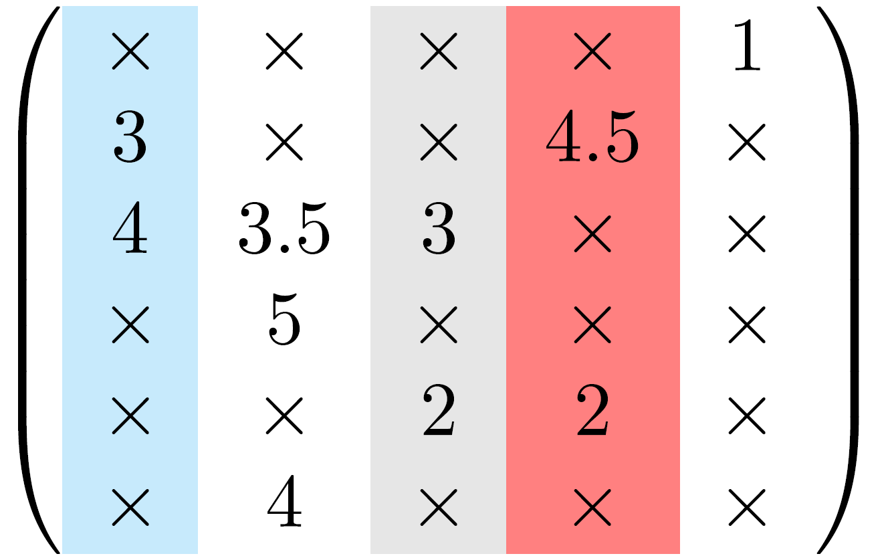


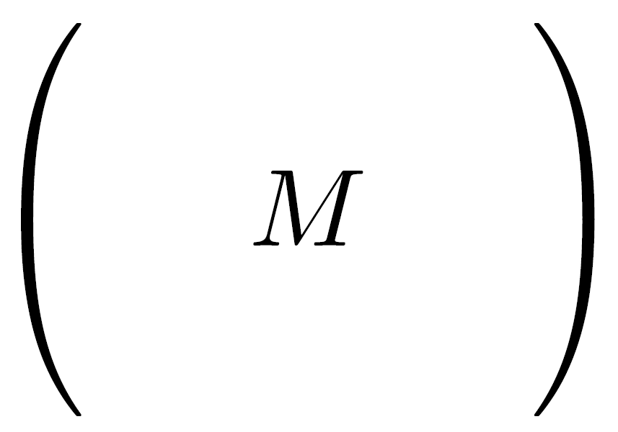


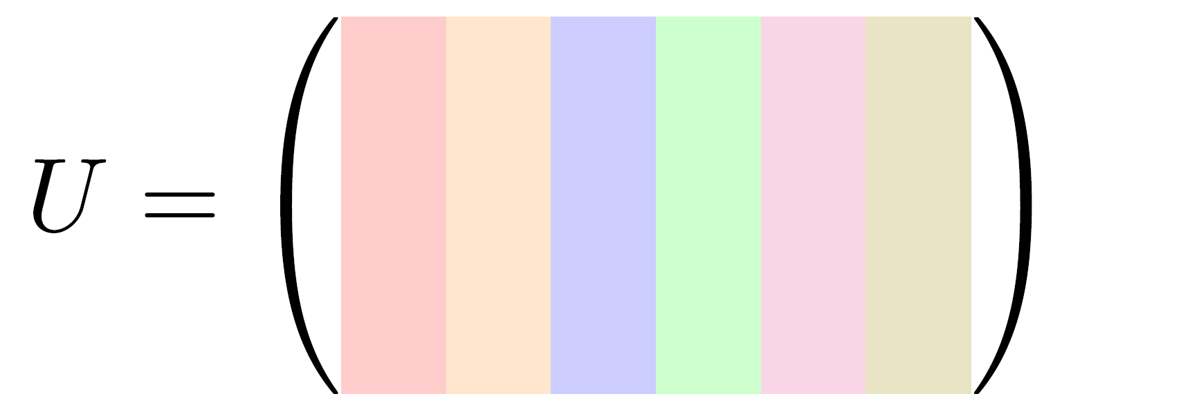
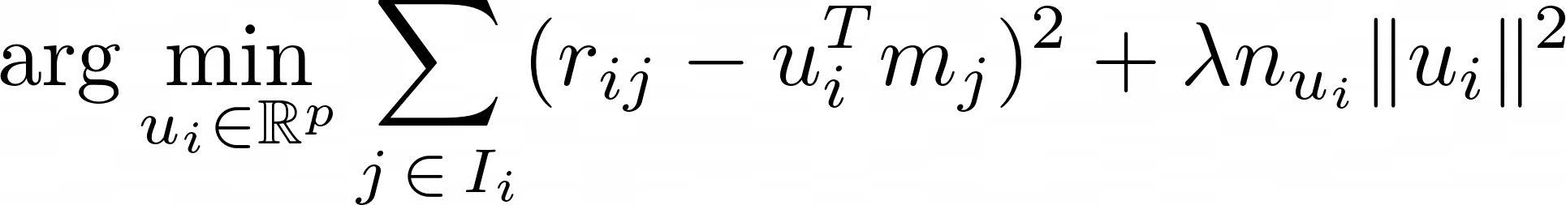
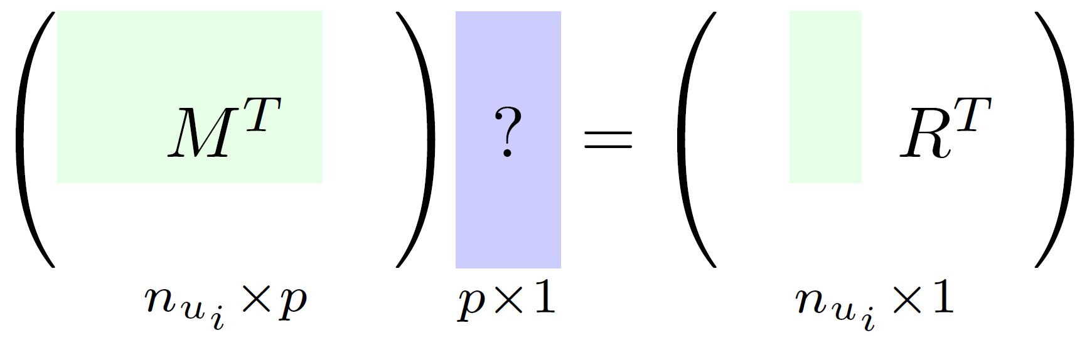
ALS: parallel computation
1. Distribute by rows and by columns
2. Solve given
initialized at random
Each column solves an RLS problem*
*

Slide 6
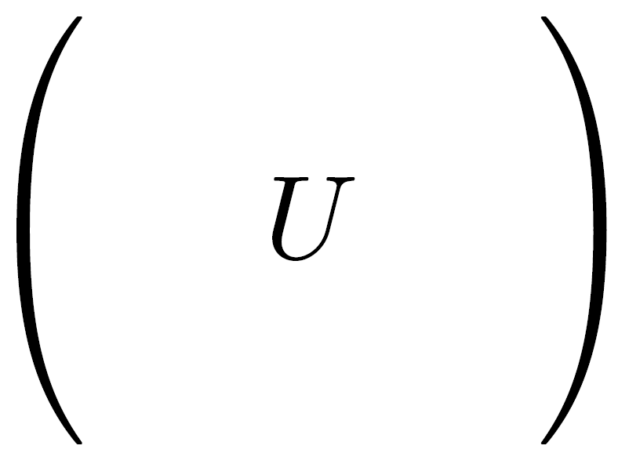


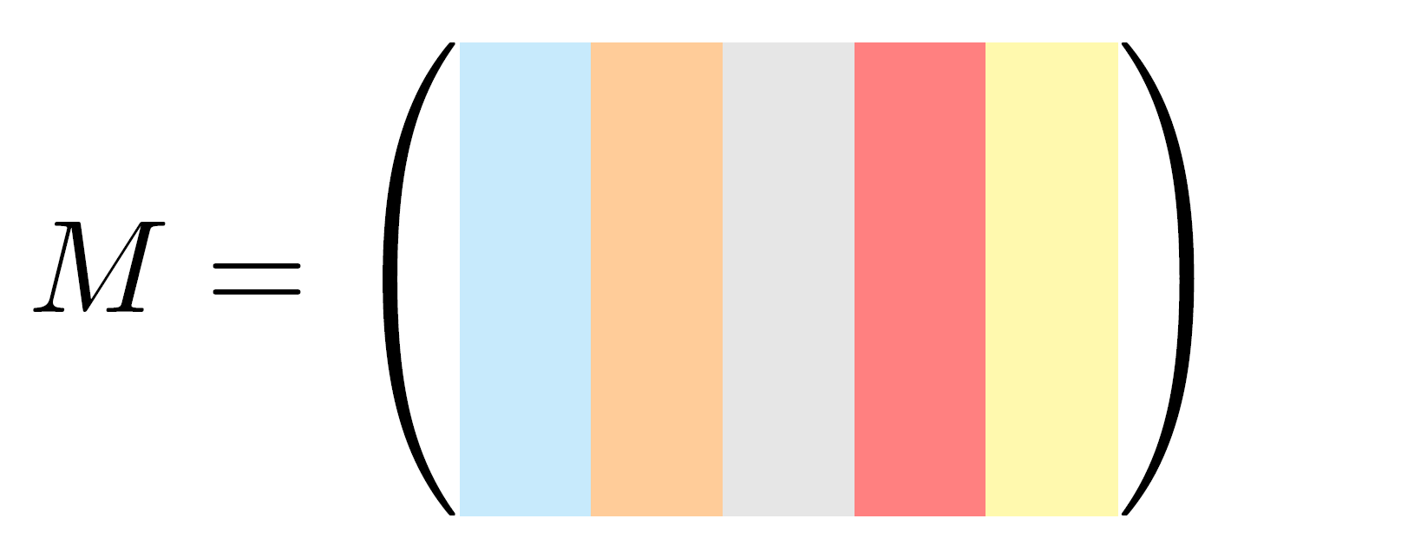
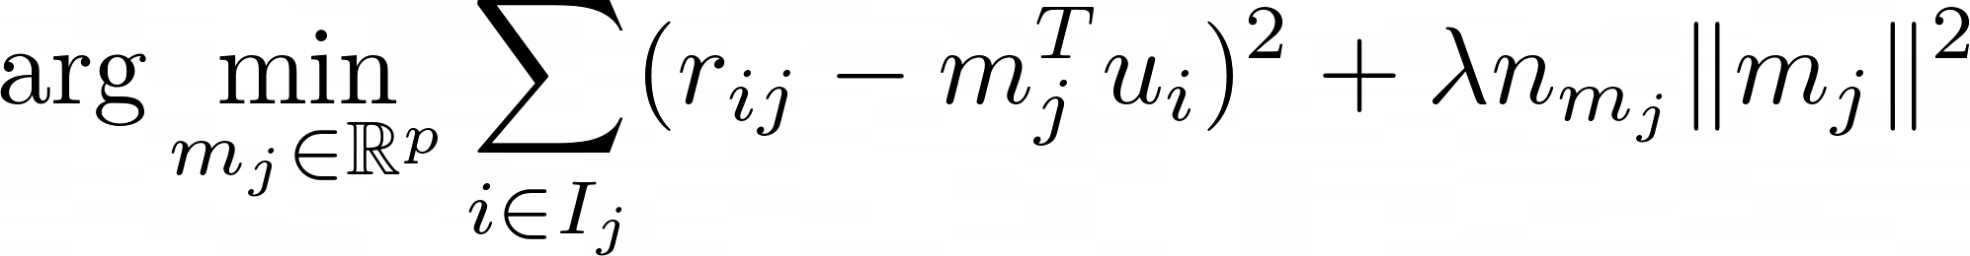
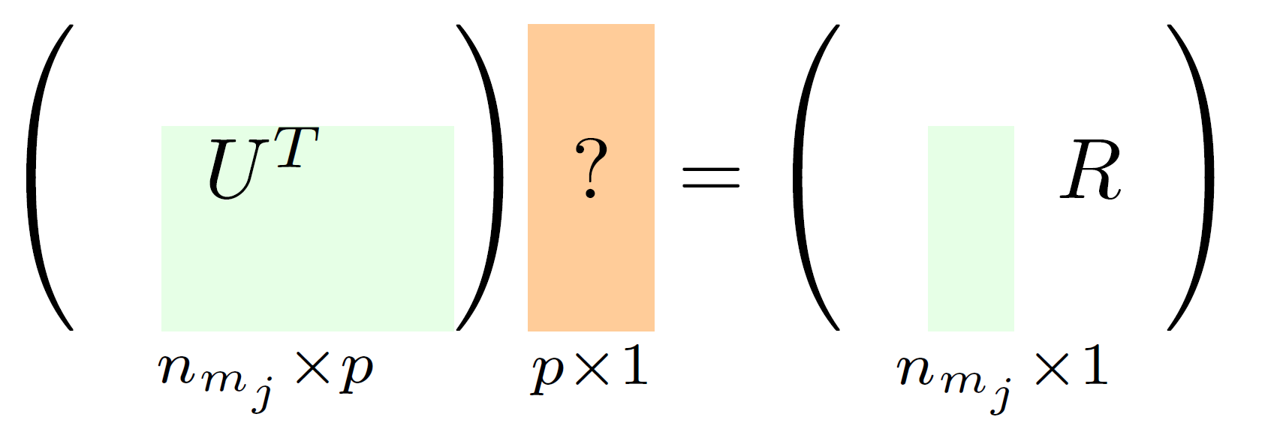
ALS: parallel computation
3. Solve given
computed at step 2
Each column solves an RLS problem*
Repeat until a stop condition (i.e. maximum number of iterations, minimum RMSE improvement)
*

Slide 7


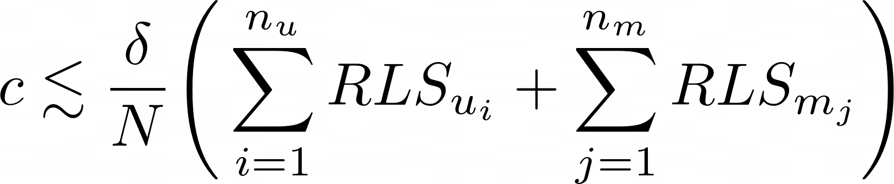

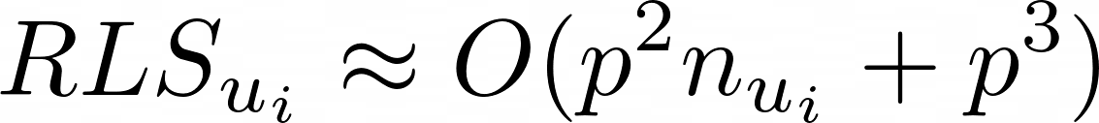
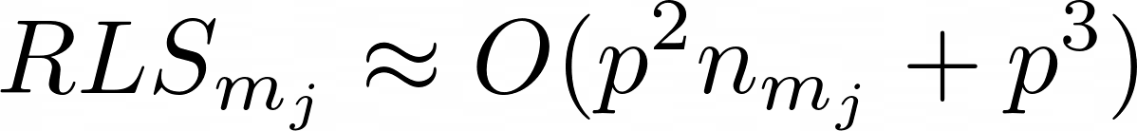

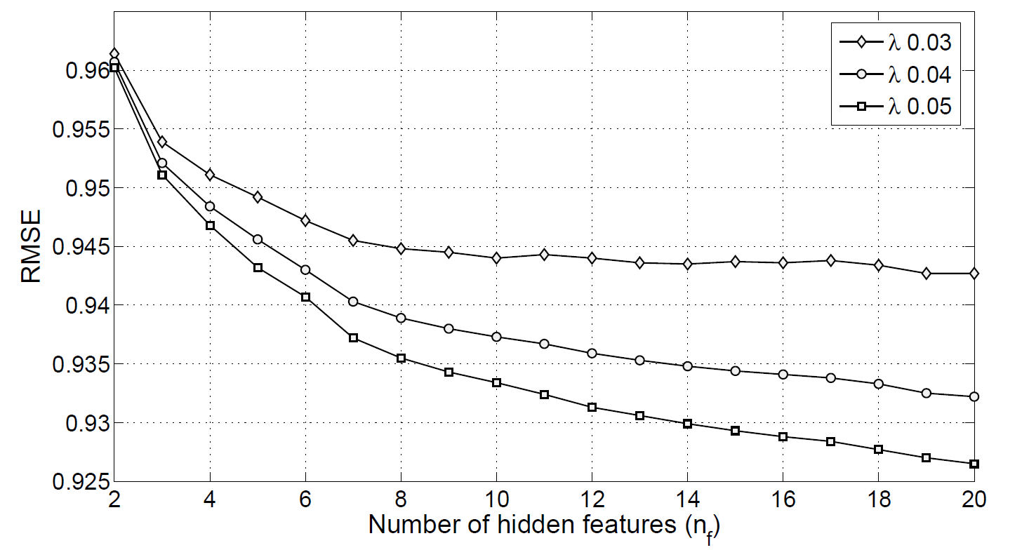
ALS: time complexity & tuning
Running time : almost linear speedup in the number of nodes
maximum number of iterations
with
Hyperparameters to be cross-validated: ,
The larger the better
but super expensive!*
* Image from the original paper

