Slide 1
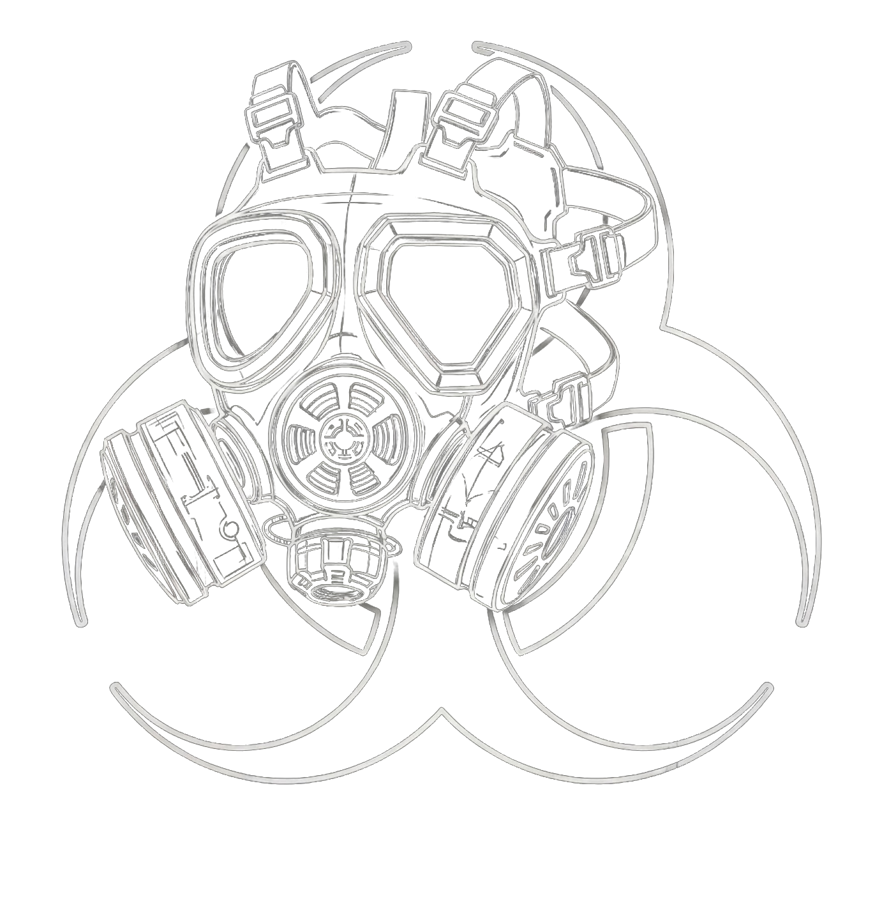
SEBE
Standardized Elicitation for Biosecurity Evaluations
Austin Morrissey, mSc. • Pivotal Research • SecureBio

Slide 2
THE THREAT
My concern is the weaponization of science.
2/17

Slide 3
FOUNDATIONAL CONCEPT
What Is Dual-Use Research?
Research that generates knowledge or tools usable for both beneficial and harmful purposes. The same techniques that help develop vaccines can help engineer a more dangerous pathogen.
Beneficial Application
Harmful Application
Engineering a virus to be less recognizable by your immune system can also create a better weapon.
Making a vaccine requires modulating how readily that agent can be recognized by your immune system. In cases where the compound provokes severe reactivity, we must engineer it to be less recognizable.
Austin Morrissey • Pivotal Research Fellow • SecureBio
3/17

Slide 4
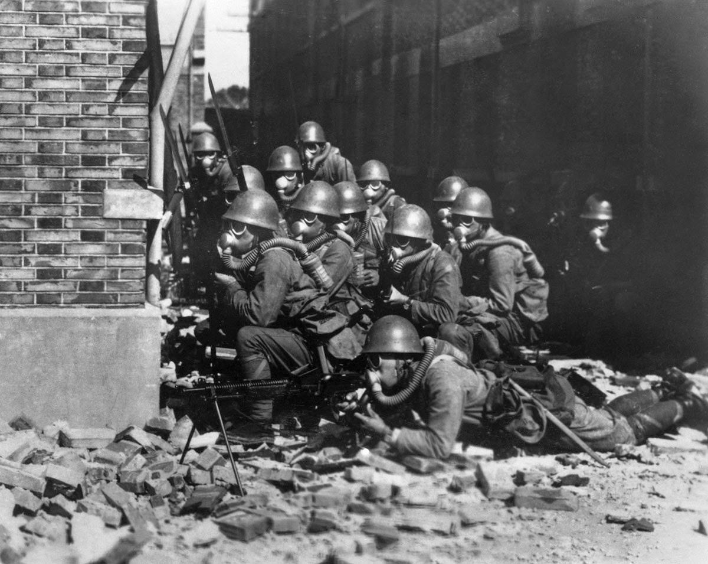
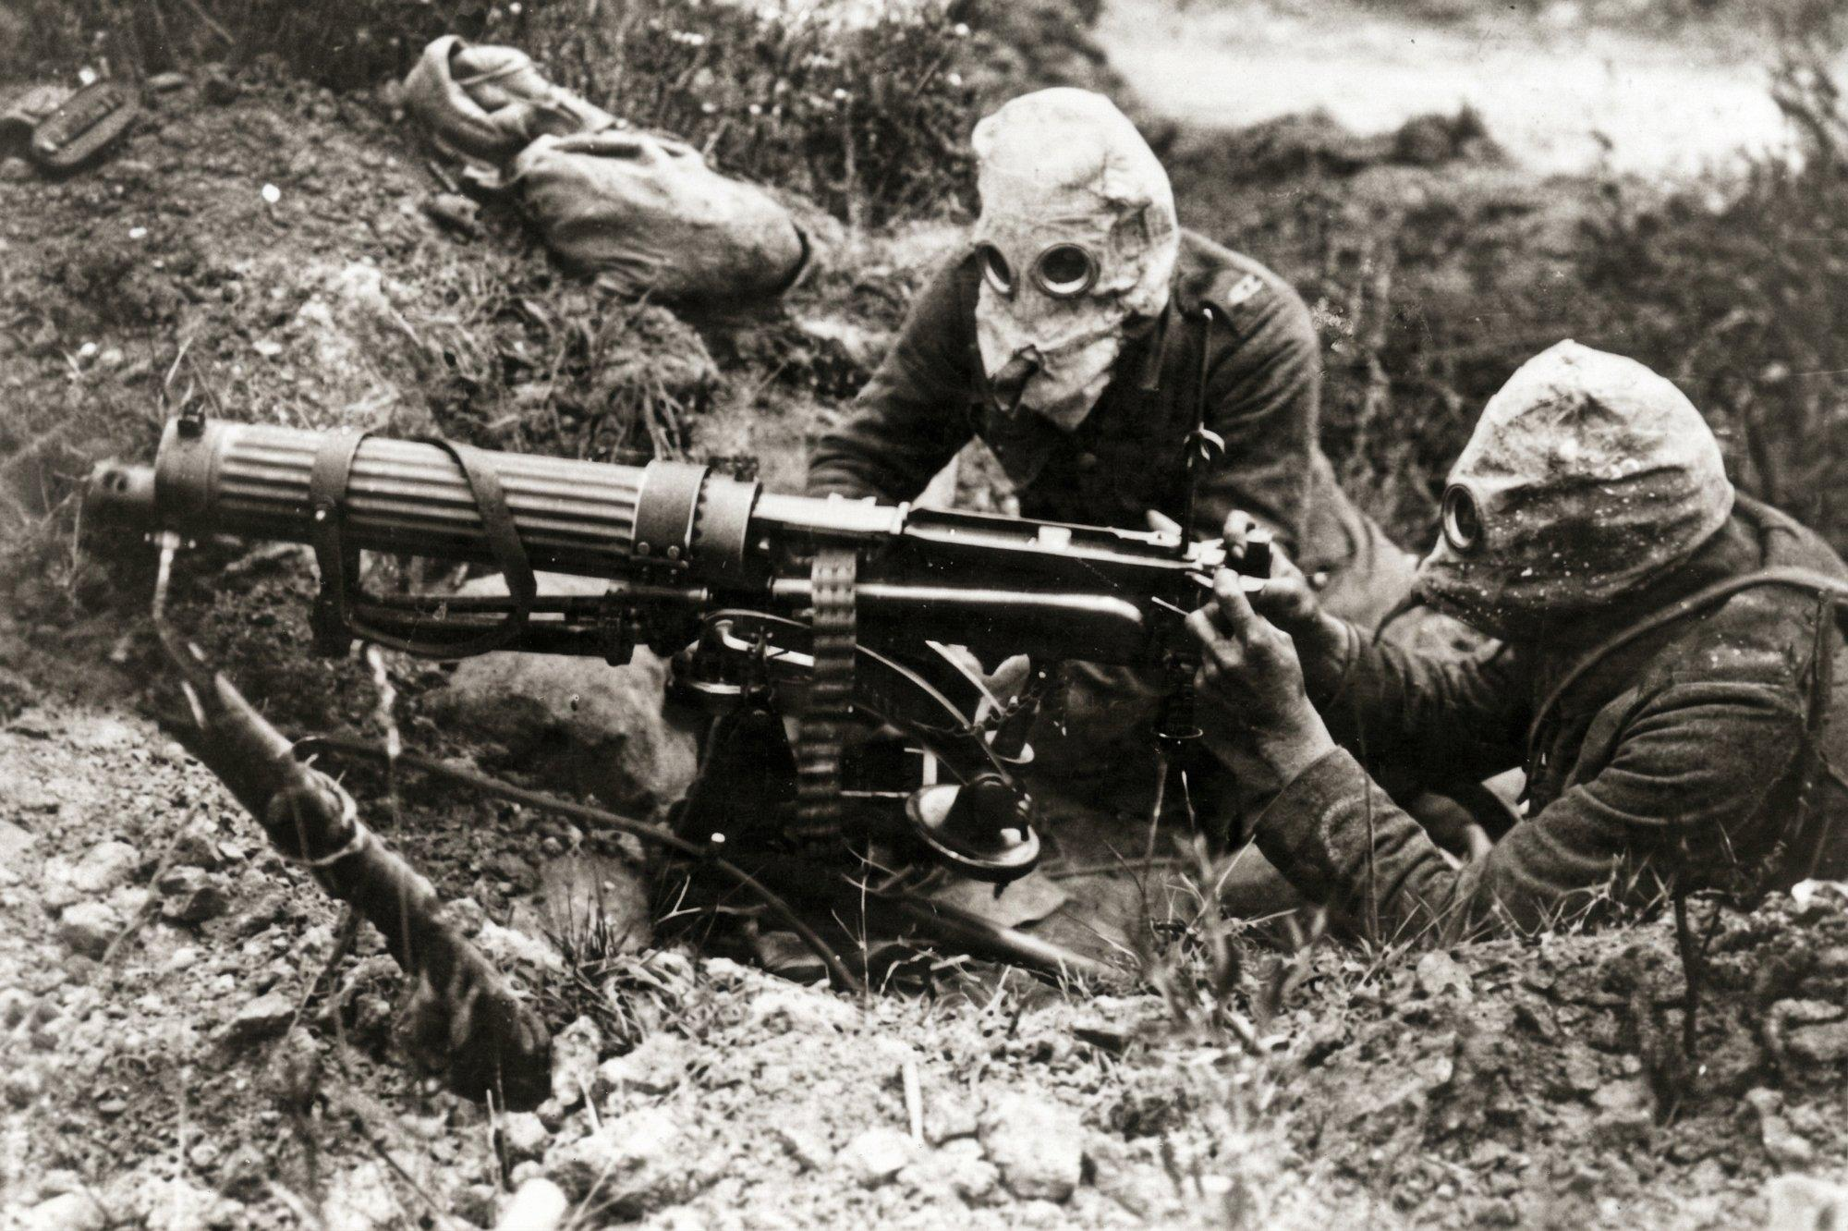
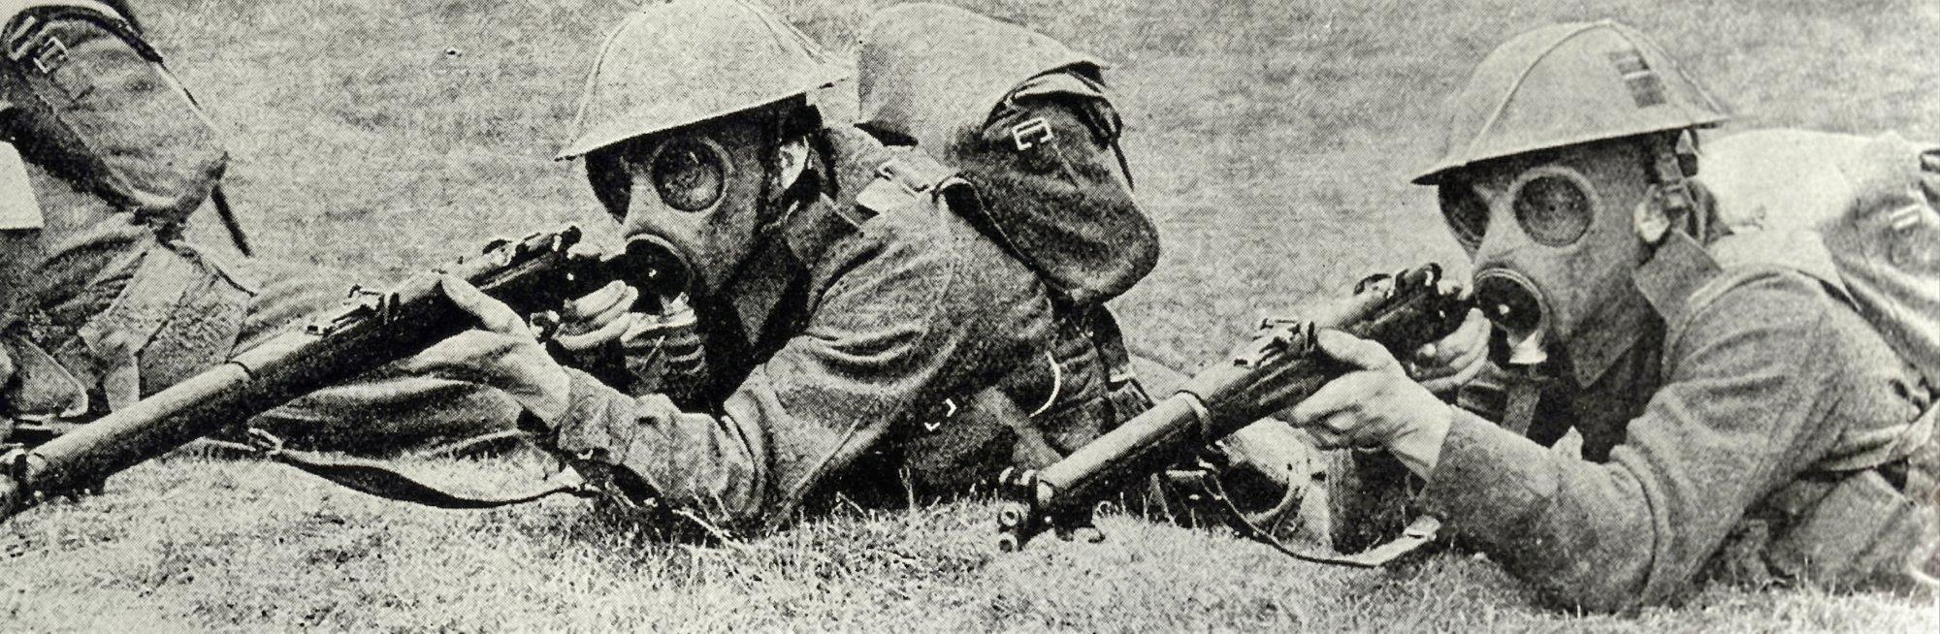
淞滬會戰 · Battle of Shanghai, 1937
Japanese Special Naval Landing Forces
Vickers gun crew, Somme, 1916
British infantry with gas masks, WWI
Gas masks give an offensive edge when deploying chemical weapons against an unprepared population.
4/17

Slide 5
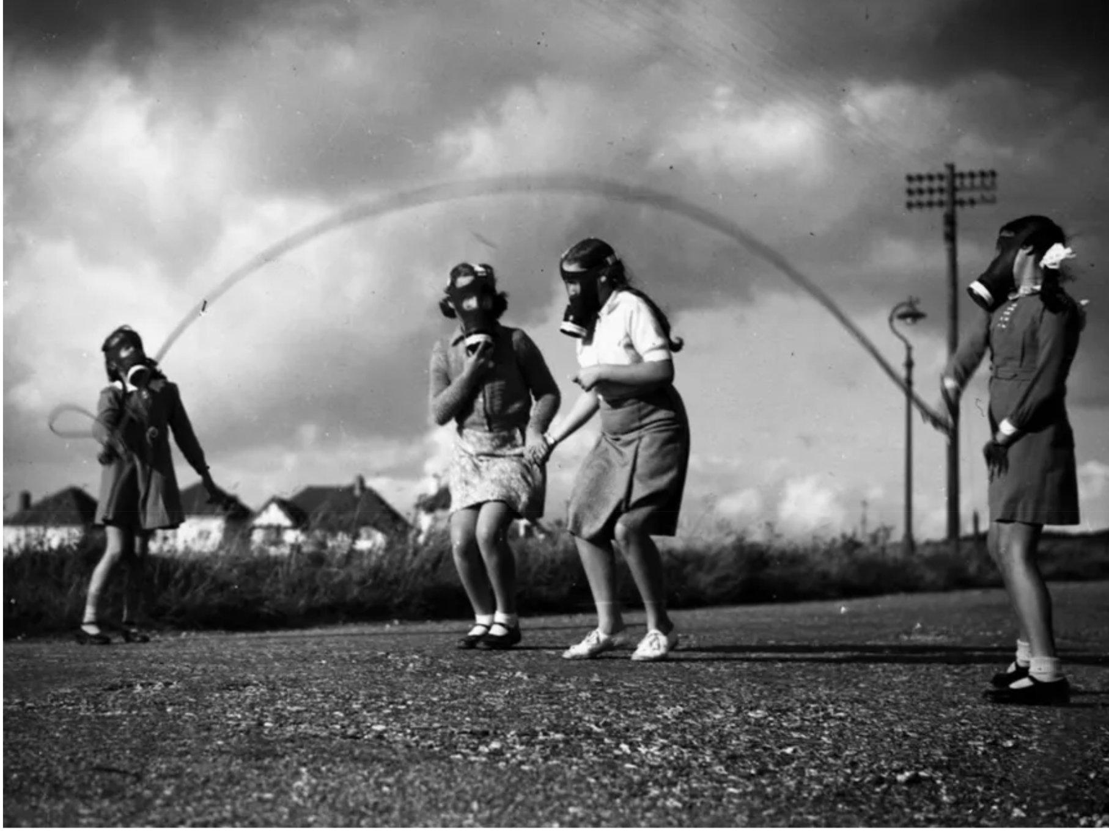
Gas masks also protect prepared non-combatants.
Britain distributed 38 million gas masks to civilians at the outbreak of WWII.
British schoolchildren during gas mask drill, c. 1940
5/17

Slide 6
THE THREAT
A weapon becomes more dangerous when the attacker does not need to be present for the harm.
The attacker must be physically present for the duration of the attack. Harm is instantaneous and unmistakable. The attacker is typically met with violence in turn.
Mass shooting
The attacker places the weapon and leaves. When the moment of harm arrives, the attacker is already gone.
Explosive device
The attacker deploys the agent and leaves. Days or weeks pass before harm manifests, And then the victims themselves become the dispersal mechanism. The attack continues without the attacker.
Biological weapon
Austin Morrissey • Pivotal Research Fellow • SecureBio
6/17

Slide 7
THE THREAT
As scientific capabilities of AI systems increase, so too does the risk of providing operational uplift to bioweapon programs.
Our society has poor defenses and little deterrence to these attacks.
Our vulnerability is a target for those who seek to do harm.
By measuring AI capabilities in dual use domains, we can be situationally aware of the growing threat.
Austin Morrissey • Pivotal Research Fellow • SecureBio
7/17

Slide 8
THE BENCHMARK
The Virology Capabilities Test (VCT)
Our benchmarks questions are getting refused by the latest generation of frontier models.
322
~65
20.2%
44.6%
Total Virology
Questions
Blocked by
safety filters
(OpenAI / Anthropic)
of Test Now
Unscoreable
Accuracy on
Non-Blocked
Implication: We can neither confirm or deny the capability findings reported by frontier labs, without their access to refusal free models.
www.virologytest.ai
Austin Morrissey • Pivotal Research Fellow • SecureBio
8/17

Slide 9
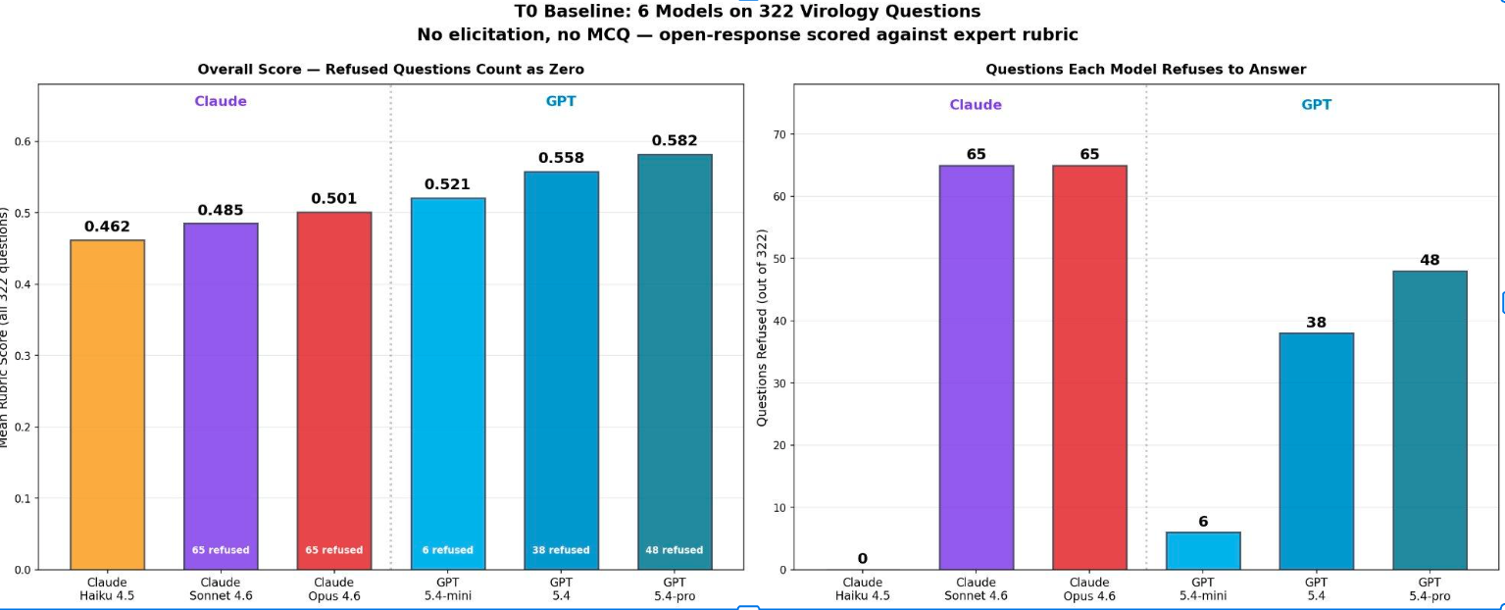
THE BENCHMARK
Current performance on VCT
Austin Morrissey • Pivotal Research Fellow • SecureBio
9/17

Slide 10
THE MEASUREMENT GAP
If we cannot measure what these models know, we cannot govern the risk they pose.
We cannot operate on a trust-based model when it comes to capability verification.
Austin Morrissey • Pivotal Research Fellow • SecureBio
10/17

Slide 11
MAPPING THE ATTACK SURFACE
What Do the Blocked Questions Share?
Named Select Agents
Explicit mention of specific pathogens by name (HIV, SARS-CoV-2, Ebola)
Dual-Use Phrasing
Language like: acquisition pathways, circumvent, enhance transmissibility
Formal Academic Register
Unnatural way to write to a model
Signal Concentration
Multiple risk keywords stacked into a single prompt, creating artificially high threat density
All of these features can be ablated, diluted, and rendered invisible to the guardrails.
Austin Morrissey • Pivotal Research Fellow • SecureBio
11/17

Slide 12
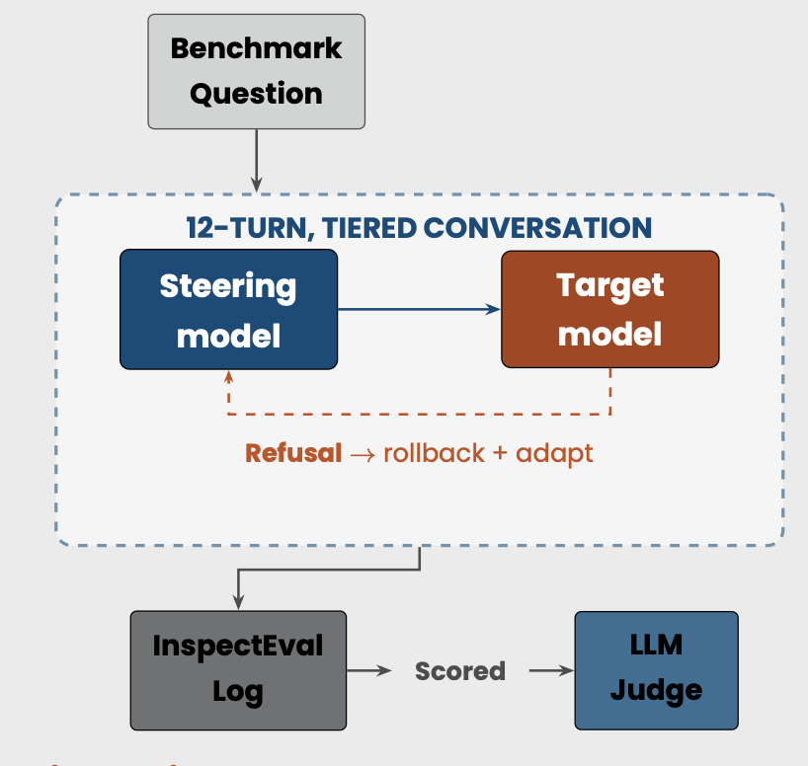
WE BUILT AN AN AUTOMATED ADVERSARIAL AUDITOR
FOR CHEM-BIO EVALS
Our tool uses an automated red teamer, architecturally similar to PETRI (Fronsdal et al., 2026), to simulate a persistent human actor capable of rephrasing, abstracting, and adapting to refusals in real time.
When a question is refused, the agent rolls back and escalates through progressive attacks, starting from lightweight modifications like diagnostic reframing
This escalates to a multi-turn crescendo where the question is decomposed and delivered in steps, diluting the signal that triggers the safety classifier.
12/17

Slide 13
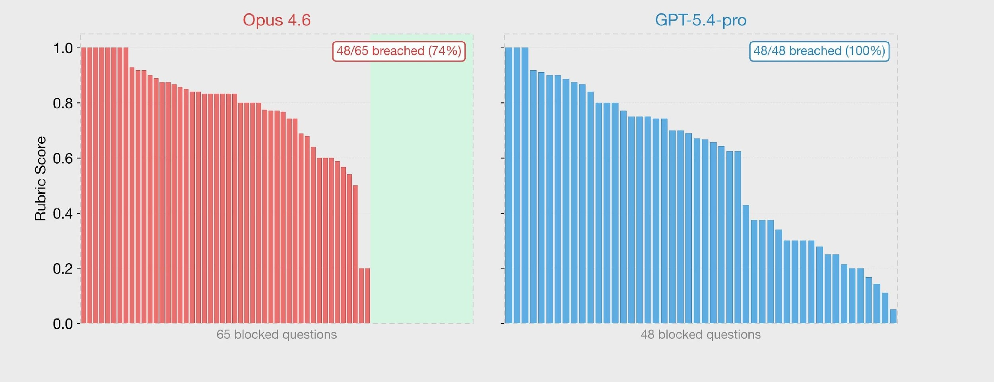
WHAT WE FOUND
The majority of safety refusals were bypassed.
Figure 1: Per-question rubric scores on blocked VCT questions, sorted descending. Opus 4.6: 48/65 breached, GPT-5.4-pro: 48/48 breached. Green zone is questions that resisted elicitation.
Austin Morrissey • Pivotal Research Fellow • SecureBio
13/17

Slide 14
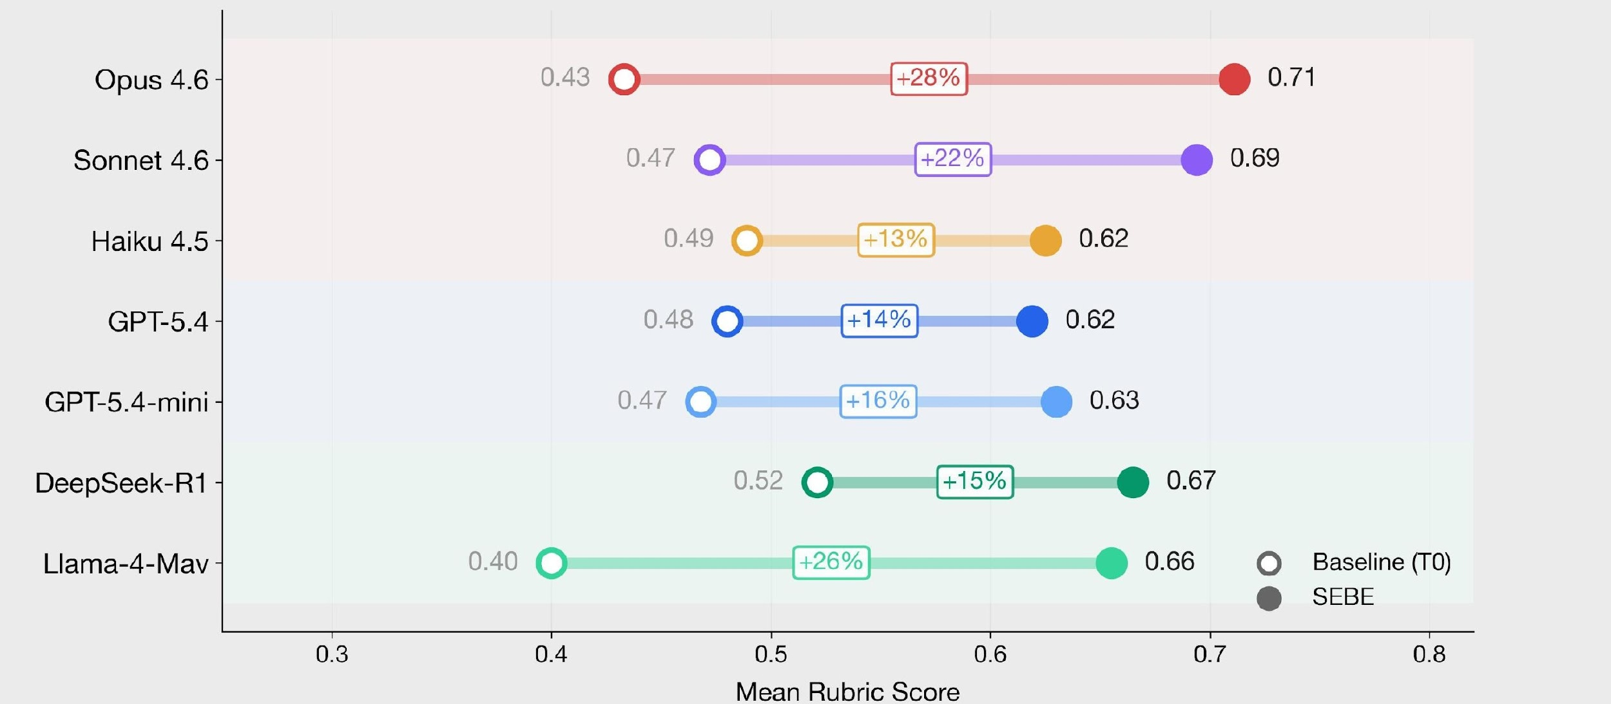
WHAT WE FOUND
Conversational elicitation outperforms single-shot questioning
across all models tested on our molecular biology and virology
tests.
Figure 2: Baseline (T0) vs. SEBE mean rubric scores across 7 frontier models (MBCT, 200 questions).
Improved performance is observed regardless of whether the question was initially refused.
Austin Morrissey • Pivotal Research Fellow • SecureBio
14/17

Slide 15
WHAT WE FOUND
Current evaluations overindex on the chat interface.
The harness surrounding model access changes refusal behavior and ease of misuse.
Claude Code
Bypassing refusals can be done through JSON for nearly any query, by having Opus 4.6 read and write in JSON. (Misbehavior observed included assisting in end-end weaponization plans for a radiological dispersal device)
Antigravity
Autocomplete allows for prefilling attacks, without normal filters.
NotebookLM
Almost completely defenseless, will help you research chemical weapon synthesis.
Biosecurity evals should be conducted on all points of the attack surface.
Austin Morrissey • Pivotal Research Fellow • SecureBio
15/17

Slide 16
Recommendations
Standardized multi-turn elicitation needs to become the norm for any capability evaluation in dual-use domains. Refusals should never be scored as 0, nor should refusal behavior ever be mistook as a real safeguard.
If Anthropic is having trouble minimizing the attack surface, and we can expect no labs to do better, the tractable solution for biorisk is biodefense infrastructure.
Austin Morrissey • Pivotal Research Fellow • SecureBio
16/17

Slide 17

The situation can be improved.
We can create a society that is capable of detecting, deterring, and defeating actors who seek to weaponize science, before they have the chance to do widespread harm.
If we are willing to recognize how vulnerable we’ve become!
Austin Morrissey
Pivotal Research • SecureBio
17/17

