Slide 1







FYUZ 2026 · BREAKING BARRIERS · TRACK 3: MULTI-AGENT SWARMS · TEAM09
Autonomous Telecom Researcher
A swarm of AI agents that finds why a radio network under-performs, proves it on a digital twin on Amazon Bedrock AgentCore, and leaves the decision to an engineer.
Track 3 · Team09
Live on AgentCore
4 / 4 units PASS
Multi-agent swarm with network language models
us-east-2 · Claude on Bedrock + OTel NLM on SageMaker
allow, deny, pause, trace · 6/6 blind test
PRESENTED BY — HCLTECH
Team NetworkIQ
AWS Hackathon FYUZ 2026 · Team NetworkIQ (Team09)

Slide 2
THE BARRIER
Operators won't let AI agents near the network
Scores on Relevance to barriers · 20%
The application we enable: finding why one area of a radio network under-performs
Today
Why agents aren't used
Targets, declared first
A complaint has many possible causes: a tilted antenna, a wrong bearing, a cell switched off.
Engineers test one guess at a time, on the live network.
Weeks per problem, with real customers affected.
No policy that the agents cannot bypass.
No audit trail of what each agent did, and why.
No point where a person approves a change.
So the barrier is trust, not intelligence.
Live allow
1.0
Live deny
1.0
Pause
1.0
Rebuilt trace
1.0
Blind diagnosis
≥ 0.8
in evidence/declared/<run_id>.json, written to S3 before the run starts
Team09 · Track 3: Multi-Agent Swarms for Application Enablement through NLMs
2

Slide 3
THE PROBLEM
A coverage complaint can take weeks to solve
Scores on Relevance to barriers · 20%
The application we enable: finding why one area of a radio network under-performs
Complaint
Guess a cause
Drive test
Wait days
Wrong?
dropped calls, weak coverage
tilt? bearing? a cell off?
and change a setting
measure again
start over
Repeated for weeks, on the live network, with customers affected
Why AI agents don't do this today
1
No enforced policy
2
No audit trail
3
No approval point
nothing stops an agent from doing more than it should
nobody can show which agent did what, and why
no place where a person signs off before a change
The barrier is trust, not intelligence. Track 3 asks for proof: a live allow, a deny, a pause, and a trace rebuilt from one id.
Team09 · Track 3: Multi-Agent Swarms for Application Enablement through NLMs
3

Slide 4
WHY GUESSING FAILS
Three faults, one symptom
Scores on Relevance to barriers · 20%
Only an experiment tells them apart, so the swarm treats every model answer as a claim to test
Tilted antenna
Cell 1
the beam points too low or too high; the cell's area shrinks or overshoots
Same symptom
weak coverage in one zone
Mis-pointed antenna
what the OTel network model guessed in our live run
the beam points the wrong way; a gap opens where it used to cover
Cell 5
Cell switched off
no signal at all; neighbours stretch to cover the area
the planted fault, found by the swarm's experiments
A fluent answer is not evidence. The swarm ran 99 experiments on the digital twin to separate the causes, and only then made one finding.
Team09 · Track 3: Multi-Agent Swarms for Application Enablement through NLMs
4

Slide 5
THE SWARM
Four agents, and none can act alone
Scores on Technical innovation · 25%
AWS Strands Agents on Amazon Bedrock AgentCore: each agent gets only the tools the Cedar policies allow
Orchestrator
Scientist
Experimenter
Critic
Runs the investigation and hands out tasks
Reads the field log, asks the OTel model, writes testable claims
Tests one setting at a time on the digital twin
Tries to break every claim before it is accepted
TOOLS
TOOLS
TOOLS
TOOLS
ask_scientist
ask_experimenter
ask_critic
publish_findings
observe_symptom
propose_claims
test_claim
run_control
run_null
run_holdout
run_replication
review_claim
Cannot run experiments
Claims sealed before testing
Only via AgentCore Gateway
Has no experiment tools
Team09 · Track 3: Multi-Agent Swarms for Application Enablement through NLMs
5

Slide 6
HOW A CLAIM IS PROVEN
From suspicion to finding
Scores on Technical innovation · 25%
Every claim goes through the same path, and every step is a Cedar decision with a record
1
Seal
2
Test
3
Check
4
Challenge
5
Decide
claim hashed before any test
on the MAVERIC twin, one setting at a time
control · null test · held-out seeds · second instrument
the critic demands what is missing
accept, reject, or ask for one more experiment
Scientist
Experimenter
Experimenter
Critic
Engineer
What each check rules out
Rules no agent can break
• No agent may approve or apply a change
• The critic cannot make its own evidence
• The answer is hidden from the agents (IAM deny)
• Withdrawing a model pauses the swarm
Control
the change had no effect
Null test
a twin that 'finds' faults that aren't there
Held-out seeds
luck on one random seed
Second instrument
an artefact of the twin (replayed on the simulator's own tables)
Team09 · Track 3: Multi-Agent Swarms for Application Enablement through NLMs
6

Slide 7
NLMS FOR APPLICATION ENABLEMENT
Two models and an instrument, each with one role
Scores on Technical innovation · 25%
The swarm reasons with a frontier model, consults a network language model, and proves everything on a digital twin
Claude Sonnet 5
OTel-LLM-1.7B-IT
MAVERIC RF digital twin
Amazon Bedrock
SageMaker endpoint atr-otel-nlm
AWS Lambda behind AgentCore Gateway
• Reasoning for all four agents
• Bedrock Guardrails on every prompt and answer
• Every model call is a Cedar decision with a record
• Network language model (Qwen3, tuned on telecom data)
• The Scientist's second opinion on which cell is wrong
• LoRA-tuned on our data: 0 → 11 of 35 right on a frozen test set
• The instrument: each claim becomes experiments
• Controls, null tests, held-out seeds, replications
• No experiment ever touches the live network
Symptom
Claims
Experiments
Critic
One finding
Engineer decides
Team09 · Track 3: Multi-Agent Swarms for Application Enablement through NLMs
7

Slide 8












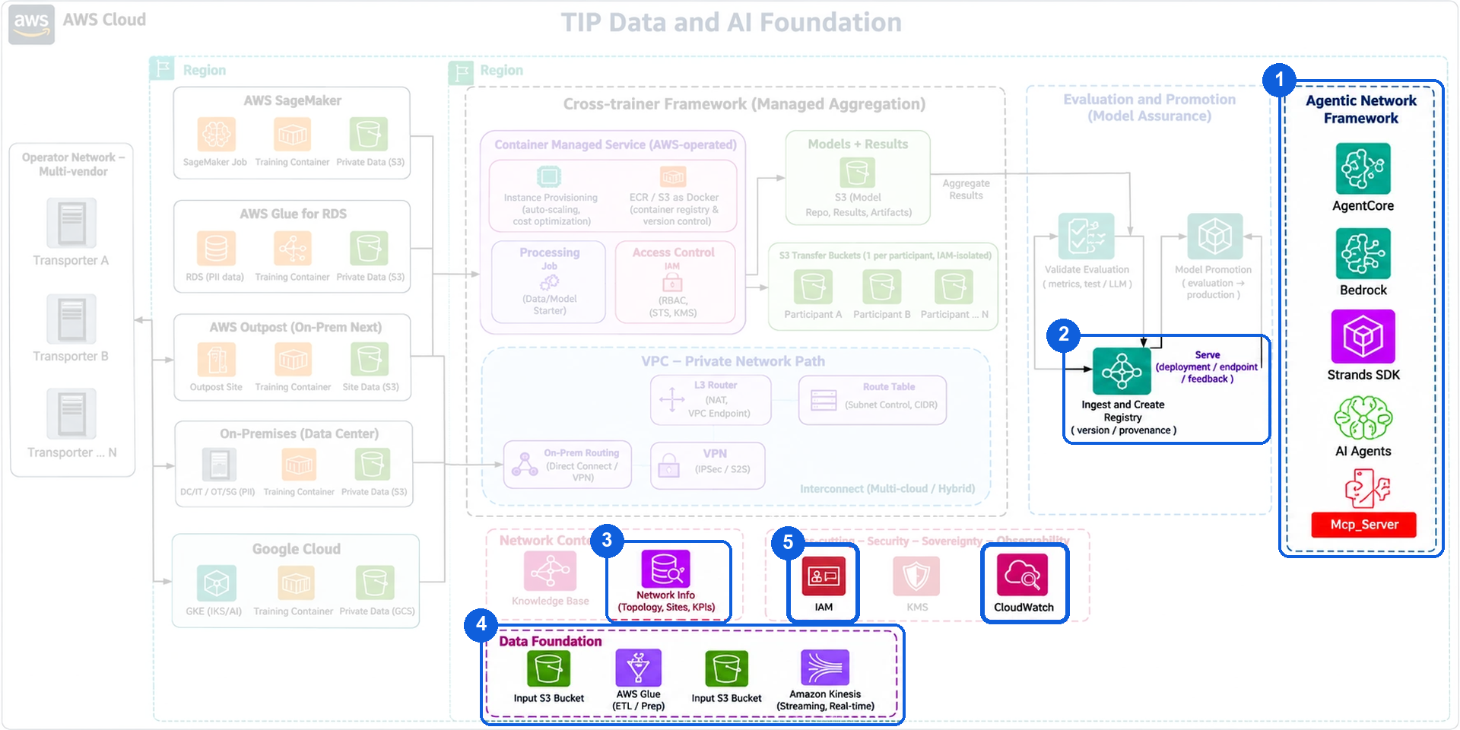
AWS ARCHITECTURE
Built on the Breaking Barriers architecture
Scores on Production readiness · 10%
Only the parts our solution uses, grouped as in the Breaking Barriers reference architecture
1
Agentic Network Framework
2
Serve: model endpoint
4
Data foundation
Amazon Bedrock AgentCore
Runtime runs the four agents; Gateway serves the MCP tools
Amazon SageMaker endpoint
serves OTel-LLM-1.7B-IT, the network language model
Amazon S3
field data, log lake and the evidence chain
Amazon Bedrock
Claude Sonnet 5 for reasoning, behind Bedrock Guardrails
AWS Glue
ETL into features, queried with Athena
3
Network context
Strands Agents SDK
every agent is a Strands agent
Amazon Neptune
network topology and the finding graph
Amazon Kinesis
streaming network telemetry
AI agents
orchestrator, scientist, experimenter, critic
5
Security and observability
How they connect, with the Cedar checkpoint on every call:
next slide
MCP server
AgentCore Gateway tools: run_experiment, lab_execute
IAM
/bb26/ roles
CloudWatch
logs, dashboard
Team09 · Track 3: Multi-Agent Swarms for Application Enablement through NLMs
8

Slide 9
ON AWS
Running in our AWS account, not on a laptop
Scores on Production readiness · 10%
The control sits outside the agents: every model, tool and agent-to-agent call crosses one checkpoint
AgentCore Runtime
Checkpoint
AgentCore Gateway
4 Strands agents
Claude Sonnet 5 on Bedrock
Bedrock Guardrails
OTel-LLM-1.7B-IT on SageMaker
11 Cedar policies on
Amazon Verified Permissions
Registry: approve / withdraw
Decision record per call
ALLOW
MCP tools, SigV4
Engineer
sends the request
approves the finding
AWS Lambda
MAVERIC digital twin
us-east-2 · one CDK deploy through CodeBuild · every IAM role under /bb26/ with bb26-Boundary
Findings and review
Decision records
Evidence chain
DynamoDB finding cards
Review console: Amplify, Cognito
DynamoDB audit, trace index
CloudWatch Logs
S3: declarations, items,
records, manifest
Team09 · Track 3: Multi-Agent Swarms for Application Enablement through NLMs
9

Slide 10
LIVE RUN ON AWS
The live run: cell 5 was off
Scores on Working demonstration · 20%
run 2026-11-03T12-04-04-live-demo · started from AWS CloudShell · shown in the demo video
99
≈ 4 min
0
1
experiments on the twin
from request to finding
failed calls or policy denials
human approval, recorded
1
Planted and sealed
2
The swarm investigates
3
The finding
4
The engineer decides
Cell 5 switched off, in a table the agents' IAM role cannot read
Claims, experiments through AgentCore Gateway, the critic's challenges
Cell 5 switched off: a match. The OTel model's guess (cell 1) was overruled
Accept, recorded as a Human ALLOW in the same trace; no agent can approve
Team09 · Track 3: Multi-Agent Swarms for Application Enablement through NLMs
10

Slide 11
TRACK 3 UNITS
Allow, deny, pause, trace: 4 of 4 pass
Scores on Working demonstration · 20%
Each unit: a target declared before the run, produced on AWS, evidence under one run id, a pass/fail check
Allow
PASS
Deny
PASS
Pause
PASS
Trace
PASS
4 / 4
6 / 6
3 / 3
279
permitted calls allowed, each with its decision record
refused: 5 by Cedar policy, 1 prompt attack by Bedrock Guardrails
Claude withdrawn: calls refused, nothing published, resumed after
records under one trace id, request to human approval (7 of 7 checks)
target 1.0 · result 1.0
target 1.0 · result 1.0
target 1.0 · result 1.0
target 1.0 · result 1.0
2026-11-02T09-38-45-allow-e107
2026-11-02T09-39-03-deny-00dc
2026-11-02T09-39-46-pause-5845
2026-11-02T10-06-19-trace-3768
Targets written to S3 at 09:38:45, 09:39:03, 09:39:46 and 10:06:19 UTC, each before its run · check_units.py: all PASS
Team09 · Track 3: Multi-Agent Swarms for Application Enablement through NLMs
11

Slide 12
BLIND TEST
Six faults sealed, six found
Scores on Relevance to barriers · 20%
Test set diagnosis_v1 frozen and hashed before the run · target 80% declared first · graded by code, not by a model
Planted (sealed)
The swarm found
Minutes
cell 1 · tilt 16°
cell 1 · tilt ≈ 16°
3.2
✓ match
Located
6 / 6
cell 1 · switched off
cell 1 · switched off
3.8
✓ match
cell 4 · switched off
cell 4 · switched off
3.9
✓ match
cell 4 · tilt 15°
cell 4 · tilt ≈ 15°
3.5
✓ match
100% against a declared 80%
cell 4 · azimuth 330°
cell 4 · azimuth ≈ 330°
3.9
✓ match
Every estimate within tolerance
The answering model cannot read the truth table: explicit IAM deny
cell 5 · switched off
cell 5 · switched off
4.0
✓ match
run 2026-11-02T09-40-40-diagnosis-9194 · sha256 eb606c577a36…072779f76
Team09 · Track 3: Multi-Agent Swarms for Application Enablement through NLMs
12

Slide 13
EVIDENCE
Every number has a record
Scores on Evidence chain · 15%
The judging guide's five evidence checks, and where to find each one
✓
Target declared first
Live test, read-only
python3 researcher/tools/show_record.py --run-id <id> --item <n>
One item today: the S3 record, 306 DynamoDB decisions and the CloudWatch events
evidence/declared/<run_id>.json, in S3 before the run
✓
One run id
run id = trace id; items and records keyed by it
✓
AWS times agree
DynamoDB record vs CloudWatch event: 0.0 s apart (checked 3 Nov)
Rebuild, offline
python3 researcher/tools/rebuild.py → rebuild OK
✓
Same conditions
frozen diagnosis_v1, its sha256 in every declaration
✓
Independent grader
Evidence mirrored to S3; run ids, live-test and rebuild commands in judging.json
rule-based atr/grader.py; no model grades
Team09 · Track 3: Multi-Agent Swarms for Application Enablement through NLMs
13

Slide 14
OPENNESS
What didn't work, in the open
Scores on Collaboration & openness · 5%
Every gap is in GAPS.md with its time, error and run id; failed runs keep their records
Tuned NLM: cells, not kinds
A model switch
A failed trace run, kept
Right cell in 29 of 35 test items, but the fault kind mainly for azimuth. So it advises; the experiments decide.
Claude Sonnet 5.5 denied (no Marketplace subscription), so the swarm runs on Sonnet 5.
Run 10-05-12 carried the wrong run id and failed check_units.py; fixed and re-run, record kept.
Where enforcement runs
Six blind-test items
The twin is a model
Cedar decides outside the agents, but the check runs in the agent process; the gateway Lambdas don't re-check.
A demonstration, not a statistic: each investigation takes 3 to 4 minutes and about 0.7 M tokens.
Findings are on a digital twin trained on MAVERIC data, not on a real network.
Team09 · Track 3: Multi-Agent Swarms for Application Enablement through NLMs
14

Slide 15
Minutes instead of weeks, and the engineer still decides
The Autonomous Telecom Researcher lets operators use AI agents on their network: every step governed by policy, every claim proven on a digital twin, every decision made by a person.
Faster fixes
Fewer truck rolls
Trusted agents
Always on
a cause in minutes, not weeks
crews confirm one finding
governed, recorded, approved
overnight, across thousands of cells
Thank you
Team NetworkIQ (Team09) · github.com/gvmgit/FYUZ-BB26 · run ids and commands in judging.json

