Slide 1
FarmingAI
AI Agent for Smart Farming Advice
Problem Statement No. 14 — Smart Agriculture
IBM University Engagement Project Submission
“Exploring the Power of Agentic AI with Groq Llama 3.3/4 and IBM Bob”

Slide 2
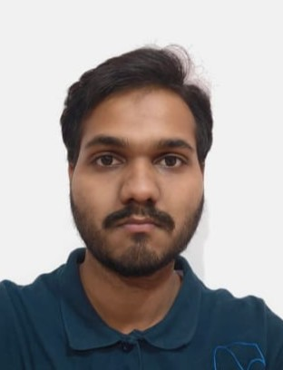
Project Title – FarmingAI — AI Agent for Smart Farming Advice
Domain of Project – Agriculture
Student Name | Recent Passport Photo | Email ID | Mobile number [WhatsApp]
Girish Varaprasad Neelagund |  | gvneelagund9205@gmail.com | 8431092291

Slide 3
Problem Statement -
Problem Statement : FarmingAI — Smart Farming Advisory (PS No. 14)
• The Challenge: Farmers face unpredictable weather, pest/disease outbreaks, fragmented guidance, and volatile market prices—leading to crop failure, inefficient irrigation, and debt.
• The Objective: Build an autonomous multi-agent AI system delivering hyper-personalized, timely farming recommendations based on individual farm profiles and live conditions.
• Multi-Agent Solution Swarm: Coordinated specialized agents for sowing advisory, live weather & irrigation, vision-based pest detection, MSP market analysis, and scientific knowledge retrieval.

Slide 4
Proposed Solution -
Proposed Solution: FarmingAI — Autonomous Multi-Agent Smart Farming Assistant
• Autonomous Multi-Agent Architecture: FarmingAI orchestrates 5 specialized agents via FarmingOrchestrator to deliver comprehensive, profile-conditioned farm management guidance.
• Curated Agricultural RAG Engine: Integrates a verified 12-topic extension knowledge base with keyword/tag retrieval, preventing hallucinations and grounding advice in trusted agronomic science.
• Multimodal Intelligence & Live Sync: Combines real-time OpenWeatherMap data for dynamic irrigation schedules with Groq Llama 4 Vision for instant crop pest and disease leaf diagnostics.
• Interactive Farmer Dashboard: A responsive 7-tab Streamlit dashboard delivering unified master action plans, Plotly cost break-downs, break-even financial analysis, and contextual chat.

Slide 5
Technology Used
• Streamlit & Python 3.11+: Modular dashboard architecture powering the 7-tab farmer interface, reactive session state, and intuitive parameter controls.
• Groq LPU Inference & Llama Models: High-speed inference using Llama-3.3-70B for orchestration & RAG, Llama-3.1-8B for quick analytics, and Llama-4-Scout for multimodal vision.
• OpenWeatherMap API: Live meteorological telemetry and 5-day forecasts driving dynamic, soil-aware irrigation schedules.
• Curated Agricultural RAG Engine: 12-topic extension corpus with keyword/tag-based retrieval and 10-parameter farmer profile conditioning.
• Plotly & Pandas: Interactive crop budget Donut charts, break-even cost analysis visualizations, and 7-day temperature spline plots.
• IBM Bob & Watsonx Orchestration: Visual multi-agent design patterns aligned with IBM University Engagement submission guidelines.

Slide 6
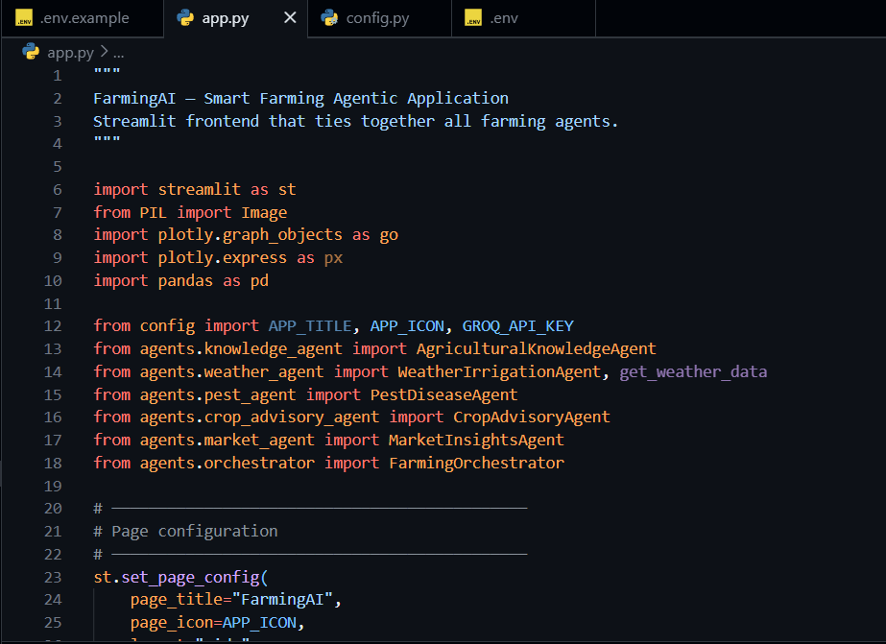
Required Files created for FarmingAI -
App.py
Requirements.txt
Config.py
.env
• app.py — Primary Streamlit dashboard & multi-agent UI orchestration
• config.py — Environment settings, API keys & Groq model configurations
• requirements.txt — Production dependencies (streamlit, groq, plotly, requests)
• .env — Secure isolation of Groq & OpenWeatherMap API credentials
• run.bat — Single-click automated environment launch script
• agents/ — Modular multi-agent implementation directory:
orchestrator.py, crop_advisory_agent.py, weather_agent.py,
pest_agent.py, market_agent.py, knowledge_agent.py

Slide 7
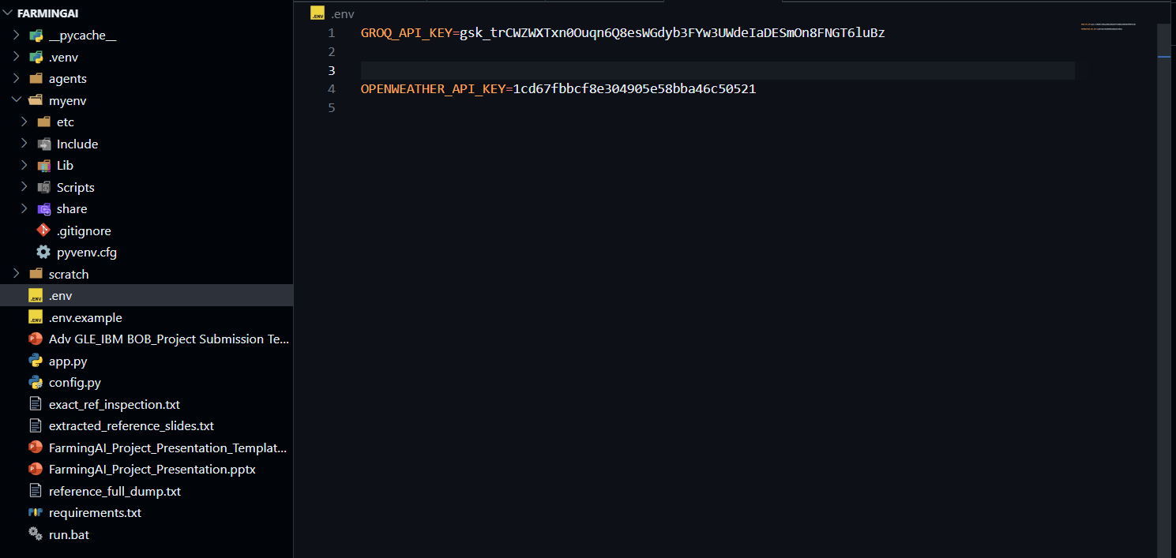
IBM Bob Agent Workflow Screenshots:

Slide 8
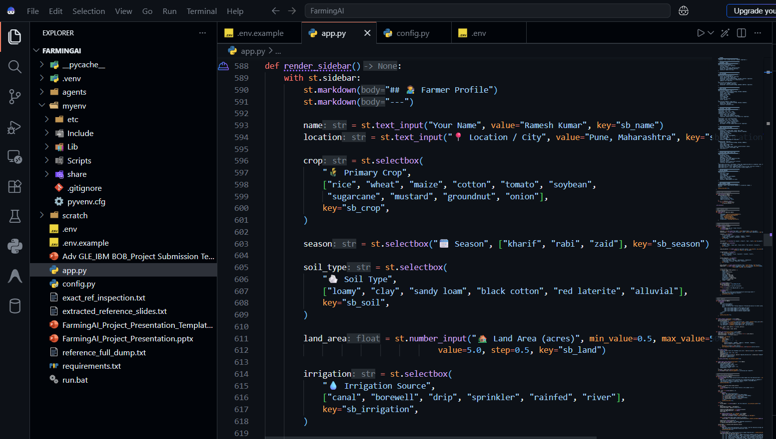

Slide 9

Role of Agentic AI in the solution
Role of Agentic AI in FarmingAI
• Autonomous Multi-Agent Specialization: Replaces rigid single prompts with 5 autonomous agents (Crop, Weather, Pest, Market, RAG) coordinated by FarmingOrchestrator.
• Context-Aware Hyper-Personalization: Grounds agronomic reasoning in 10 farmer profile variables (soil, crop, acreage, sowing date, irrigation type).
• Dynamic Meteorological Adaptation: Actively queries live weather forecasts and adjusts irrigation and spraying windows in real time.
• Multimodal Diagnostic Reasoning: Combines computer vision with agronomic reasoning for instant leaf disease identification and treatment via Groq Llama 4 Vision.
• Unified Action Synthesis: Synthesizes isolated agronomic data into a single coherent, time-phased master plan for the farmer.

Slide 10
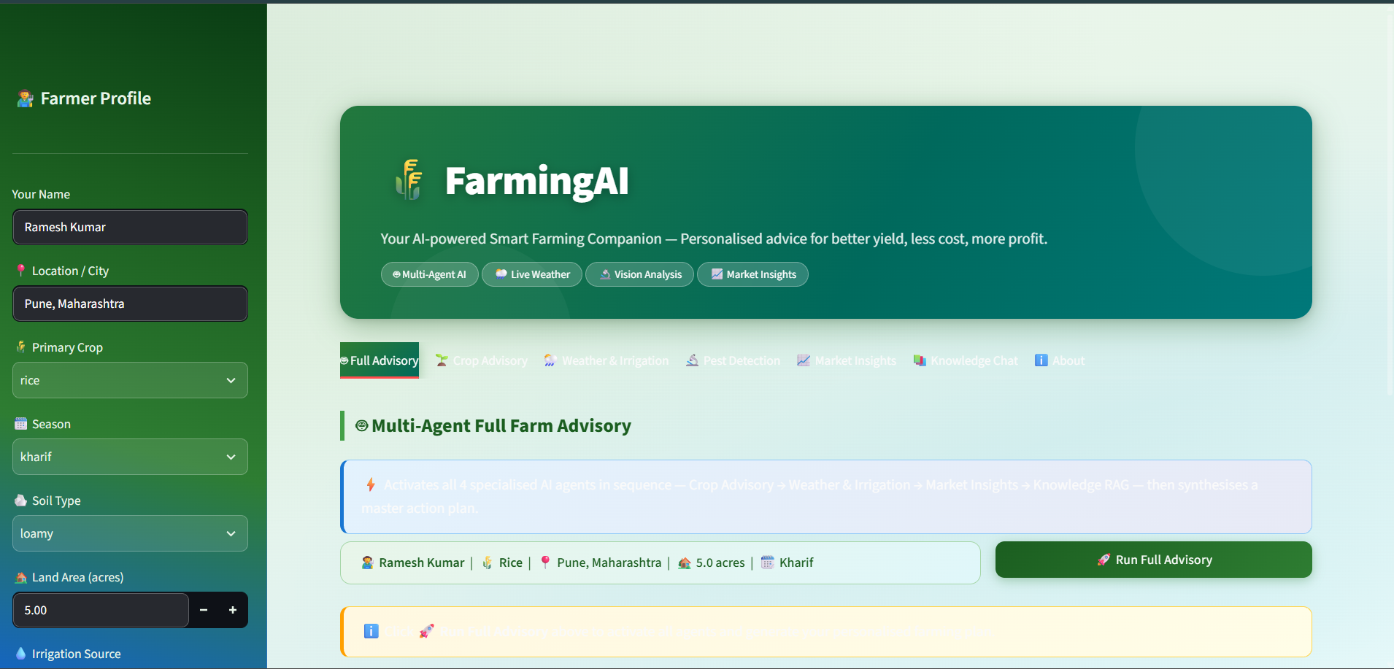
Project Output Screenshot

Slide 11
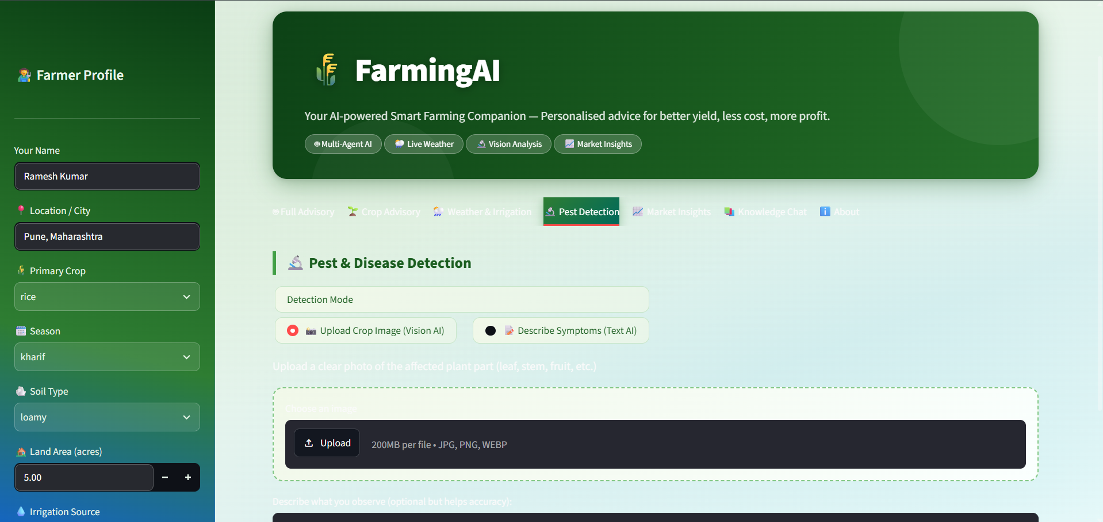
Project Output Screenshot

Slide 12
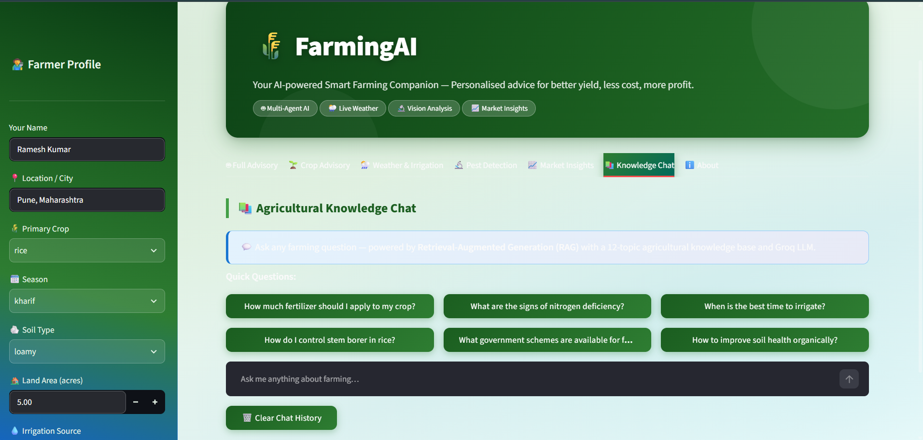
Project Output Screenshot

Slide 13
Novelty and Uniqueness
FarmingAI stands out by combining Agentic AI swarms, verified RAG, and live data:
• Multi-Agent Swarm: Autonomous collaboration across 5 specialized agronomic agents.
• Hallucination-Free RAG: Curated 12-topic extension corpus guarantees factual grounding.
• Hyper-Personalization: Recommendations conditioned on 10 farmer profile parameters.
• Multimodal Vision AI: Instant leaf pest & disease pathology via Groq Llama 4 Vision.
• Real-Time Weather Sync: Live meteorological API dynamically adjusts irrigation schedules.
• Financial Break-Even Analysis: MSP procurement trends, crop budgeting, and revenue projections.
• Master Action Plan: Synthesizes isolated advisories into a single time-phased farming roadmap.

Slide 14
Git Hub Link
• Public GitHub Repository URL:
[Insert Public GitHub Repository URL — e.g., https://github.com/username/FarmingAI]
• Required Project Deliverables Uploaded to Repository:
1) Complete source code (app.py, config.py, agents/ directory, requirements.txt)
2) Problem statement document (ProblemStatement_No14_SmartAgriculture.pdf)
3) Final project presentation (FarmingAI_Project_Presentation.pptx)
4) Comprehensive documentation (README.md with setup, API keys & execution guide)

Slide 15
Future Scope
1. Dense Vector RAG & IoT Soil Sensor Integration
Upgrade keyword retrieval to dense vector embeddings (ChromaDB / FAISS) and ingest live IoT hardware telemetry (soil moisture, N-P-K, pH sensors) for closed-loop automated irrigation.
2. Multilingual Voice Interface & Real-Time Mandi Feeds
Implement voice speech-to-text / text-to-speech in regional Indian languages (Hindi, Kannada, Telugu, Marathi) and live API integration with government eNAM mandi price feeds.
3. Satellite NDVI Crop Health & IBM watsonx.ai Deployment
Incorporate Sentinel-2 satellite imagery for remote vegetation health indexing, and deploy enterprise agent workflows on IBM watsonx.ai with IBM Granite models.

Slide 16
Certificates Earned:
Please add your credly certificate

Slide 17
Certificates Earned:
Add your IBM BOB Certificate

Slide 18


