Slide 1

Flask_limiter
Presented by
Sai Manikanta

Slide 2
Flask_limiter
Flask-Limiter provides rate limiting features to flask routes.

Slide 3
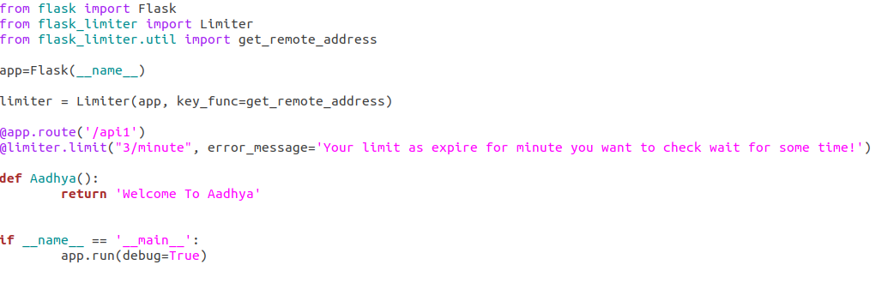
Key_func→ flask limiter work compare the result to determine if the no of request be exceed
Notes:
Key_func-- flask limiter work comapre the result to determine if the no of requ be exceed.

Slide 4
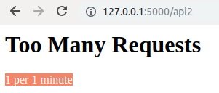
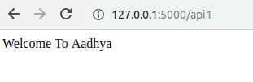
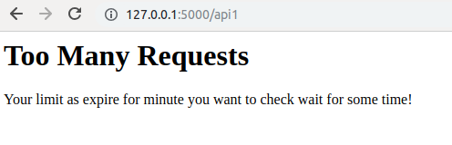
With_Limiter Vs WithOut_Limiter
WithOut_Limiter
With_Limiter

Slide 5
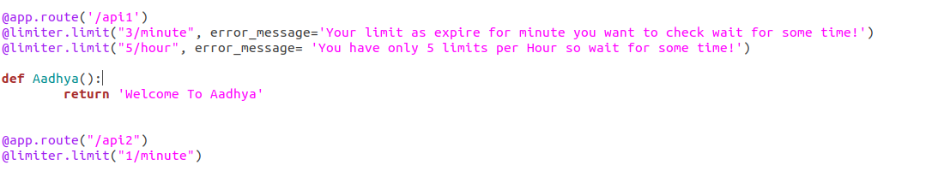
Multiple Decorators

Slide 6
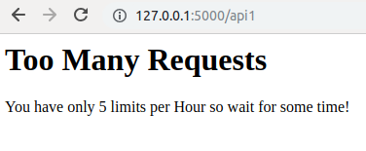
Multiple_Limiters
1-Limiter
Multiple_Limiters

Slide 7

Thank U
For Ur Support!

