Slide 1
Modeling the Effects of Auditory Neuropathy on the Auditory Brainstem Response
Graham Voysey
Binaural Hearing Lab
M.S. Thesis Defense
18 August, 2016

Slide 2
Motivation
So I can ask this question two ways, but let me ask it this way: What should we leave in? What's the bare minimum we should leave in as we try to understand what's important about the function of the cochlea?
-- David Mountain, 2014
→ And how can you tell? ←

Slide 3
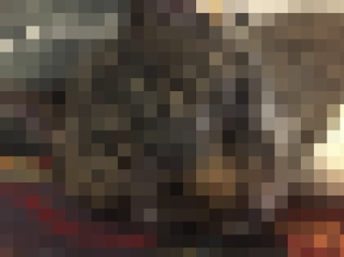
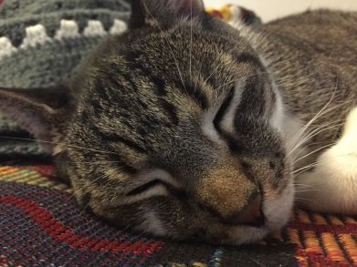
Motivation: Big Picture
Hidden Hearing Loss is not diagnosed by standard audiometric threshold testing
Audiometry tests for detection, not discrimination.
NHT performance differences
Mechanism(s) of HHL currently under debate;
No objective diagnostics for loss of discrimination currently exist

Slide 4
Potential Causes of HHL
Central Processing Disorder: A polite way of saying “We have no idea. Your ear seems fine; maybe it’s all in your head”
Sometimes, deficits or disorders actually are central (e.g., tinnitus)
Auditory Neuropathy (Cochlear Synaptopathy):
What would peripheral damage that does not affect thresholds or middle ear mechanics, but does affect the fidelity of the transmission of sound from the ear to higher areas look like?
And, where would it happen?
Auditory Nerve is a good place to start looking.

Slide 5
An Objective Measure of HHL

Slide 6
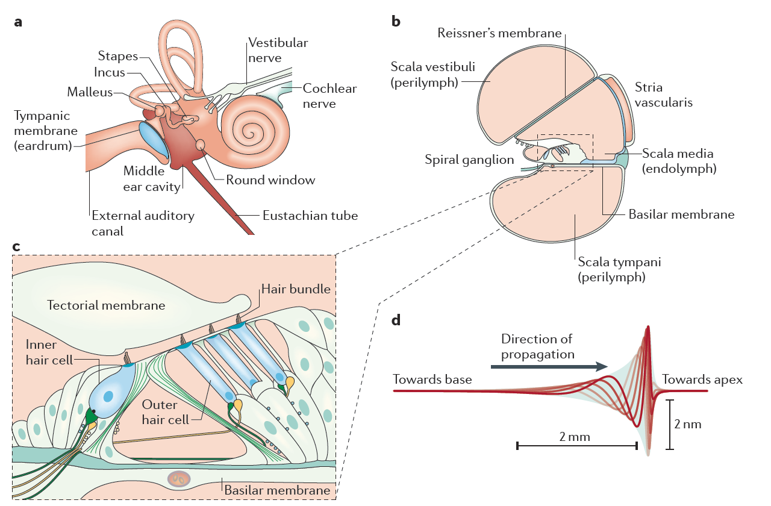
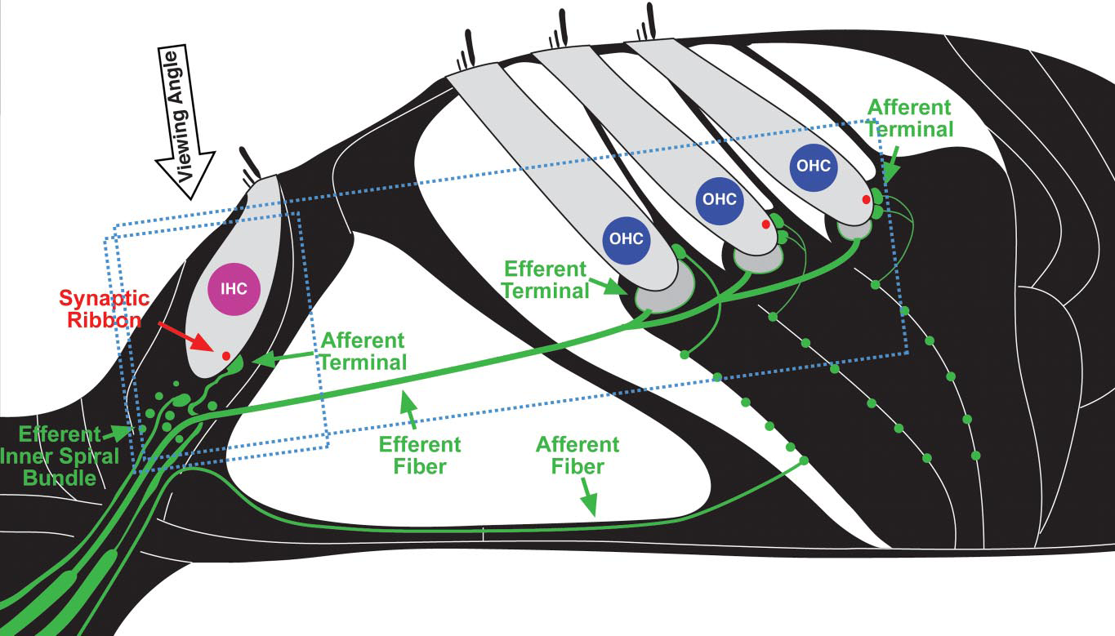
Mechanics of Hearing (Review)
Basilar Membrane motion → Spikes on AN fibers
Beginning of tonotopic organization
Many fibers per IHC
Fibers have two (or three) categories according to their spontaneous firing rate
Kujawa & Liberman (09), Hudspeth (14)
Hudspeth, 2014

Slide 7
Auditory Nerve Fiber Rates

Slide 8
Auditory Nerve Distributions

Slide 9
Auditory Nerve Projections

Slide 10
Deafferentiation in Noise or Time

Slide 11
Deafferentiation is Selective

Slide 13
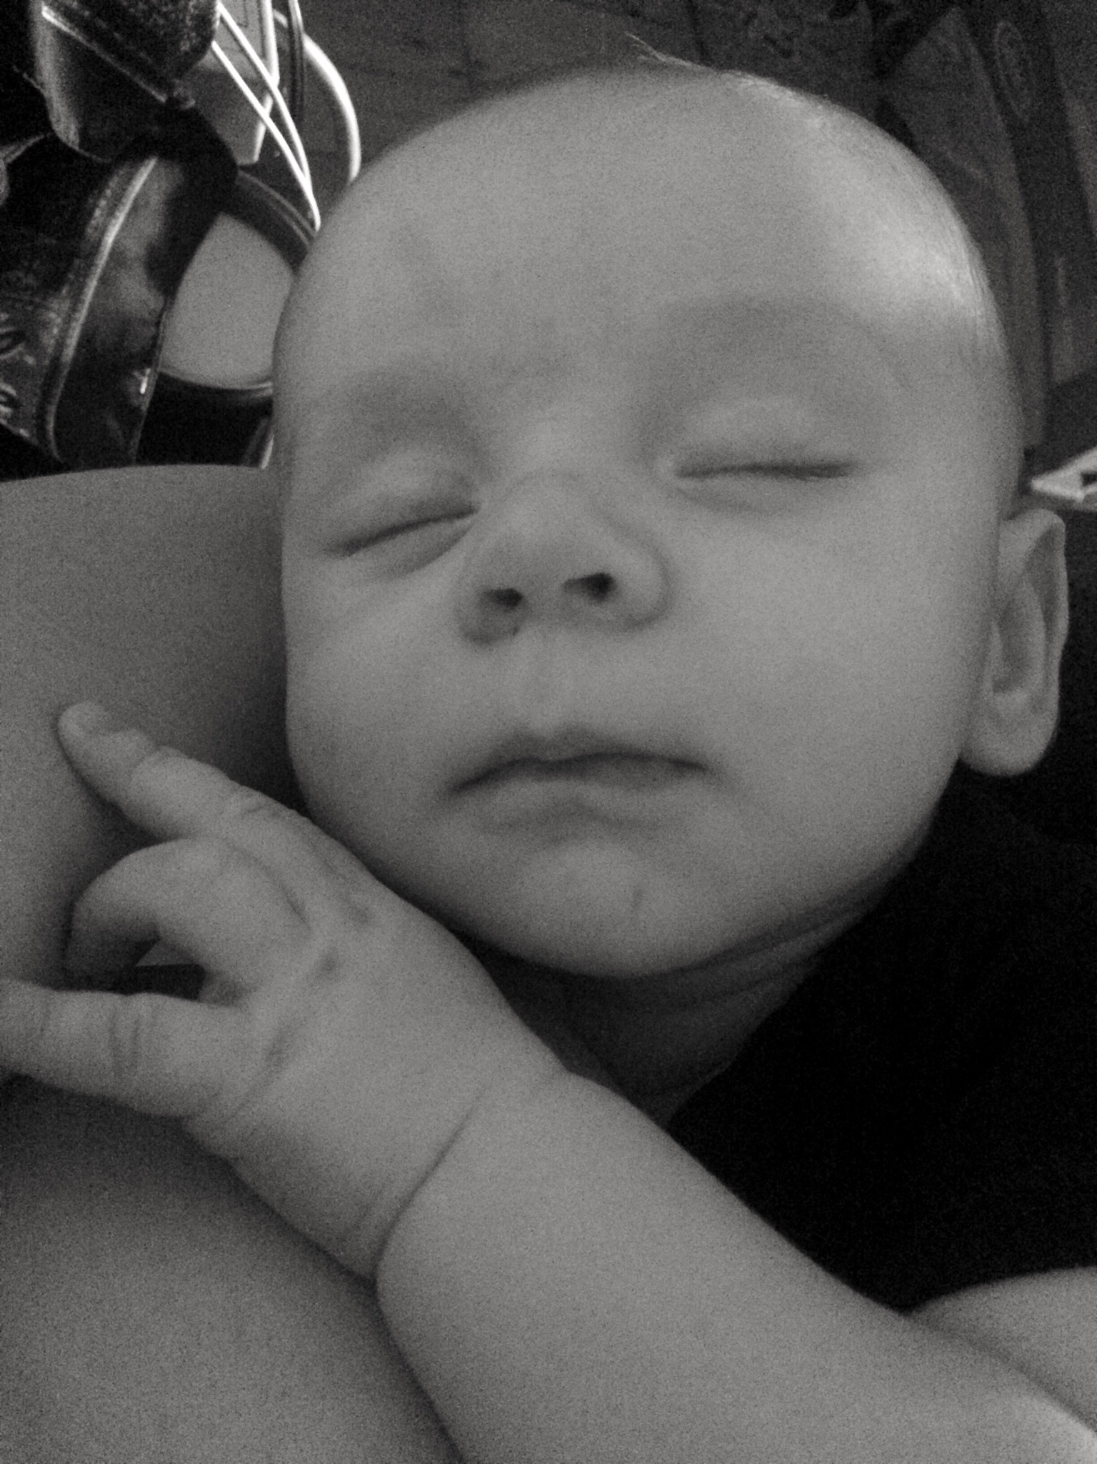
Acknowledgements
Committee
Steve Colburn
Barb Shinn-Cunningham
Allyn Hubbard
Heidi Nakajima
BU Alumni and Visitors
Sarah Verhulst
Laurel Carney
Gerard Encina-Llamas
Daryl Kelvasa
Auditory Biophysics Lab
Dave Mountain
Dave Anderson
Aleks Zosuls
Andy Brughera
Personal
My family!
Auditory Neuroscience Lab
Goldbarg Mehraei
Le Wang

Slide 14


Slide 15
