Slide 1
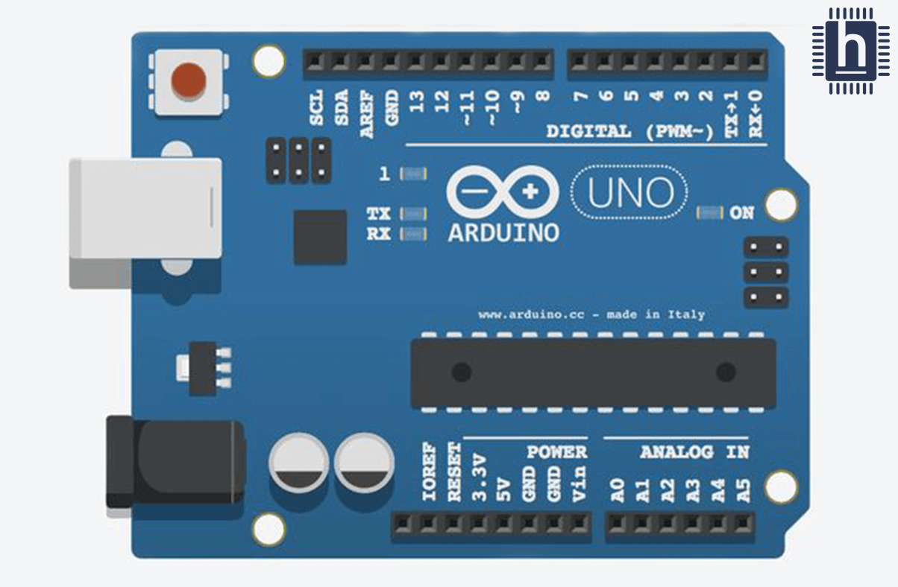

Tricolor_LED
(Common Cathode mode)
Dr. G. V. Prasanna Anjaneyulu

Slide 2
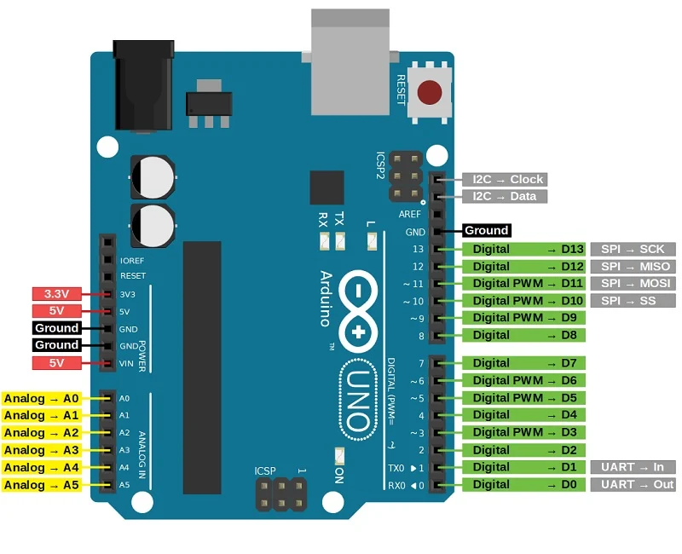
Dr. G. V. Prasanna Anjaneyulu

Slide 3
Apparatus
1.PC with Arduino IDE
2.Arduino UNO Board
3.USB cable
4.Tri-Color LED
5.Bread board
6.1kΩ resistor
7.Jumper wires
Dr. G. V. Prasanna Anjaneyulu

Slide 4
Apparatus
1.PC with Arduino IDE
2.Arduino UNO Board
3.USB cable
4.Tri-Color LED
5.Bread board
6.1kΩ resistor
7.Jumper wires
Dr. G. V. Prasanna Anjaneyulu

Slide 5
Apparatus
1.PC with Arduino IDE
2.Arduino UNO Board
3.USB cable
4.Tri-Color LED
5.Bread board
6.1kΩ resistor
7.Jumper wires
Dr. G. V. Prasanna Anjaneyulu

Slide 6

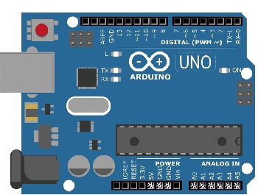
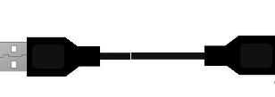
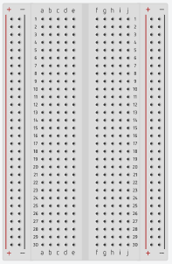
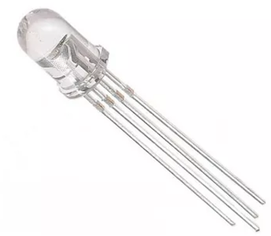
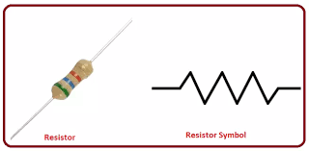
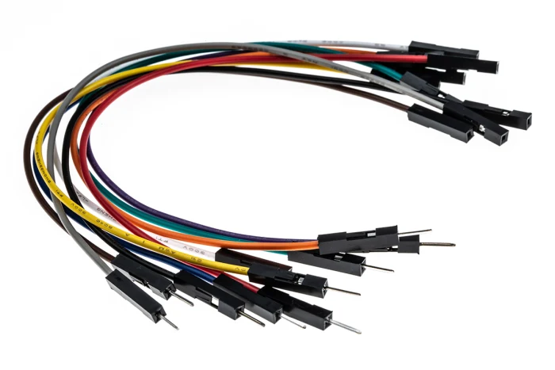
Dr. G. V. Prasanna Anjaneyulu

Slide 7
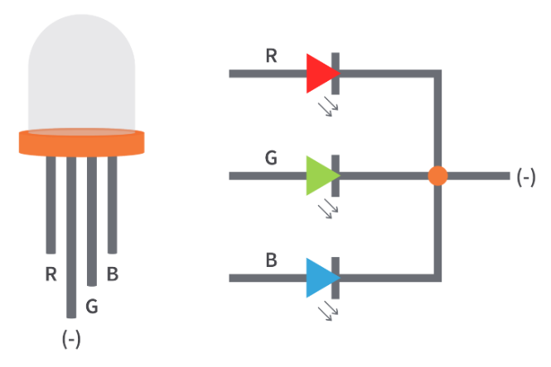
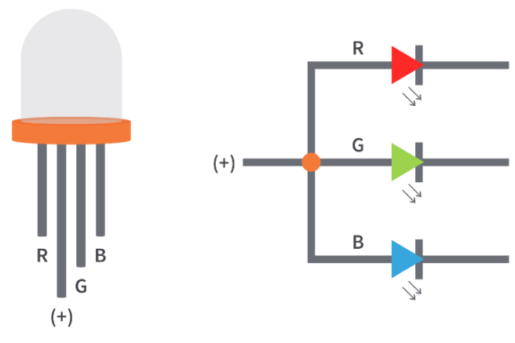
LED
Dr. G. V. Prasanna Anjaneyulu
Common Cathode
Common Anode

Slide 8
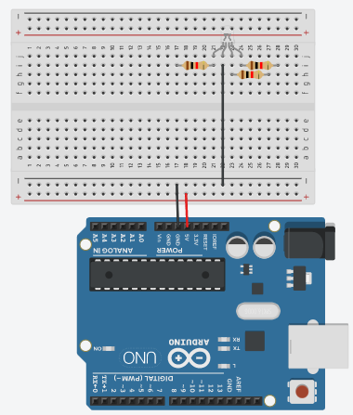
Implementation
Dr. G. V. Prasanna Anjaneyulu

Slide 9
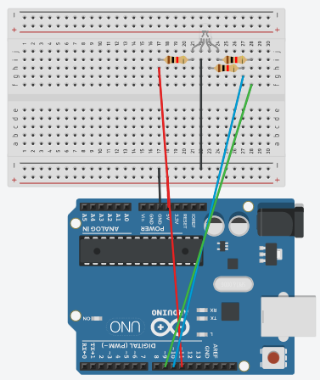
Contd……
Dr. G. V. Prasanna Anjaneyulu

Slide 10
Program
//program for TricolorLED in CommonCathode mode
void setup()
{
pinMode(11,OUTPUT);//RED
pinMode(10,OUTPUT);//BLUE
pinMode(9,OUTPUT);//GREEN
}
void loop()
{
digitalWrite(11,HIGH);//RED
delay(1000);
digitalWrite(11,LOW);
delay(1000);
digitalWrite(10,HIGH);//RED
delay(1000);
digitalWrite(10,LOW);
delay(1000);
digitalWrite(9,HIGH);//RED
delay(1000);
digitalWrite(9,LOW);
delay(1000);
}
Dr. G. V. Prasanna Anjaneyulu

Slide 11
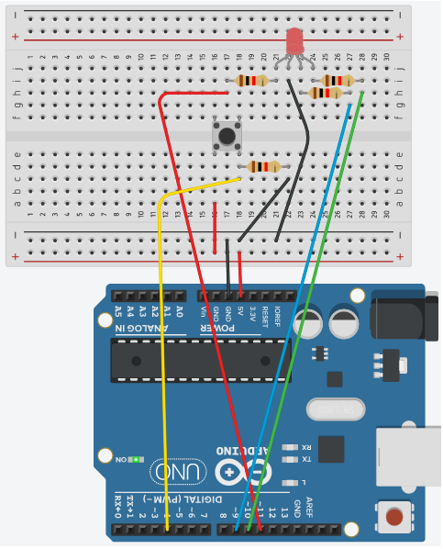
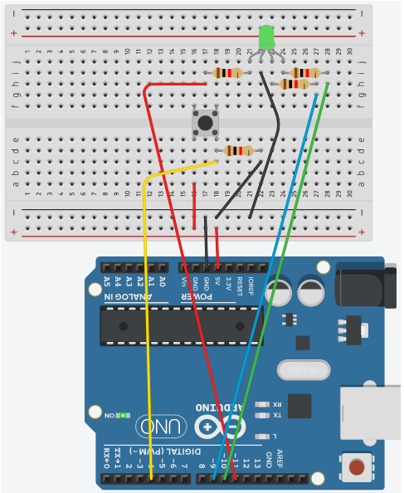
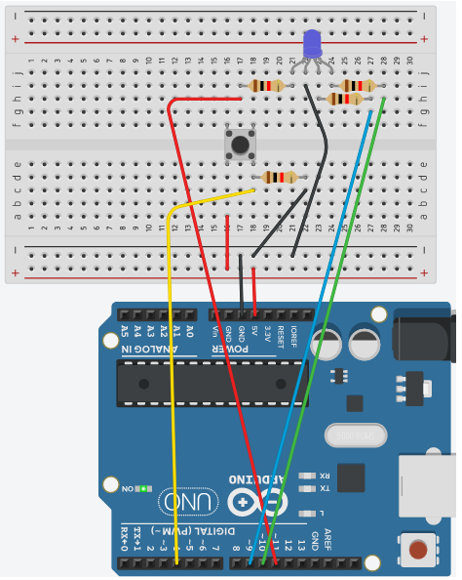
Dr. G. V. Prasanna Anjaneyulu

Slide 12
Tricolor_LED with PushButton
(CommonCathode mode)
Dr. G. V. Prasanna Anjaneyulu

Slide 13
Apparatus
1.PC with Arduino IDE
2.Arduino UNO Board
3.USB cable
4.Tri-Color LED
5.Bread board
6.1kΩ resistor
7.Jumper wires
8.Pushbutton switch
Dr. G. V. Prasanna Anjaneyulu

Slide 14
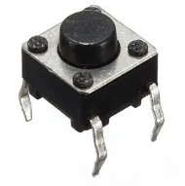
Dr. G. V. Prasanna Anjaneyulu

Slide 15
LED
Dr. G. V. Prasanna Anjaneyulu

Slide 16
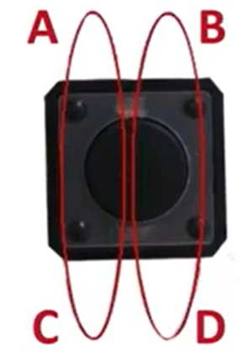
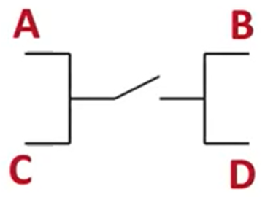
Dr. G. V. Prasanna Anjaneyulu

Slide 17
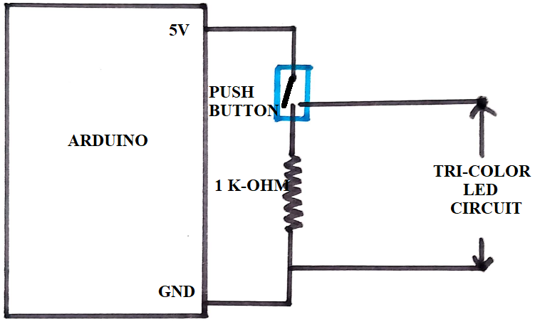
CIRCUIT Diagram
Dr. G. V. Prasanna Anjaneyulu

Slide 18
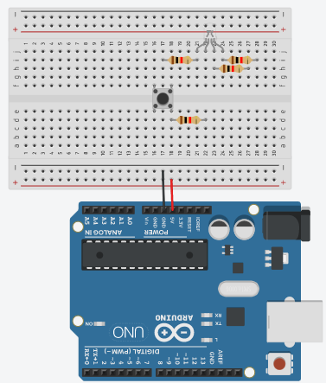
Implementation
Dr. G. V. Prasanna Anjaneyulu

Slide 19
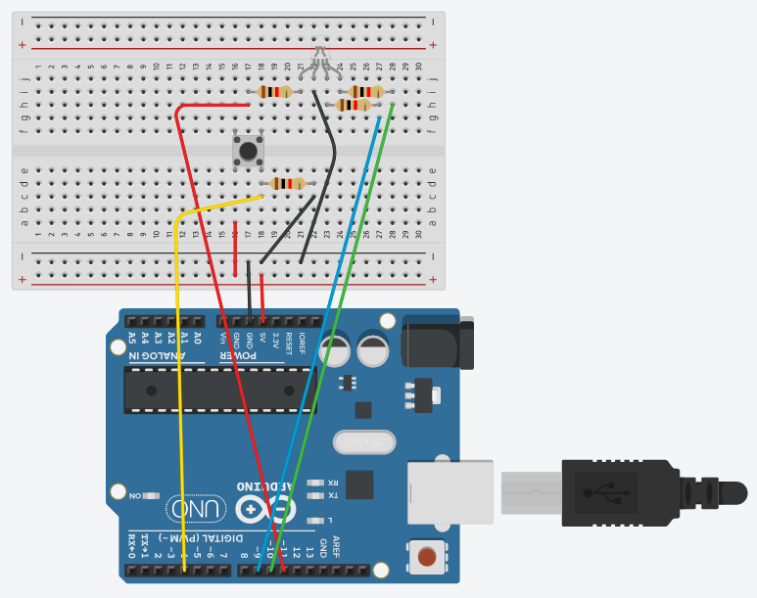
Implementation
Dr. G. V. Prasanna Anjaneyulu

Slide 20
Program
//program for TricolorLED in CommonCathode mode with PushButton
void setup()
{
pinMode(11,OUTPUT);//RED
pinMode(10,OUTPUT);//BLUE
pinMode(9,OUTPUT);//GREEN
pinMode(4,INPUT);
}
void loop()
{
if(digitalRead(4)== HIGH)
{
digitalWrite(11,HIGH);//RED
delay(1000);
digitalWrite(11,LOW);
delay(1000);
digitalWrite(10,HIGH);//RED
delay(1000);
digitalWrite(10,LOW);
delay(1000);
digitalWrite(9,HIGH);//RED
delay(1000);
digitalWrite(9,LOW);
delay(1000);
}
}
Dr. G. V. Prasanna Anjaneyulu

Slide 21
Once push button switch on the following three steps in sequence done
Dr. G. V. Prasanna Anjaneyulu

