Slide 1
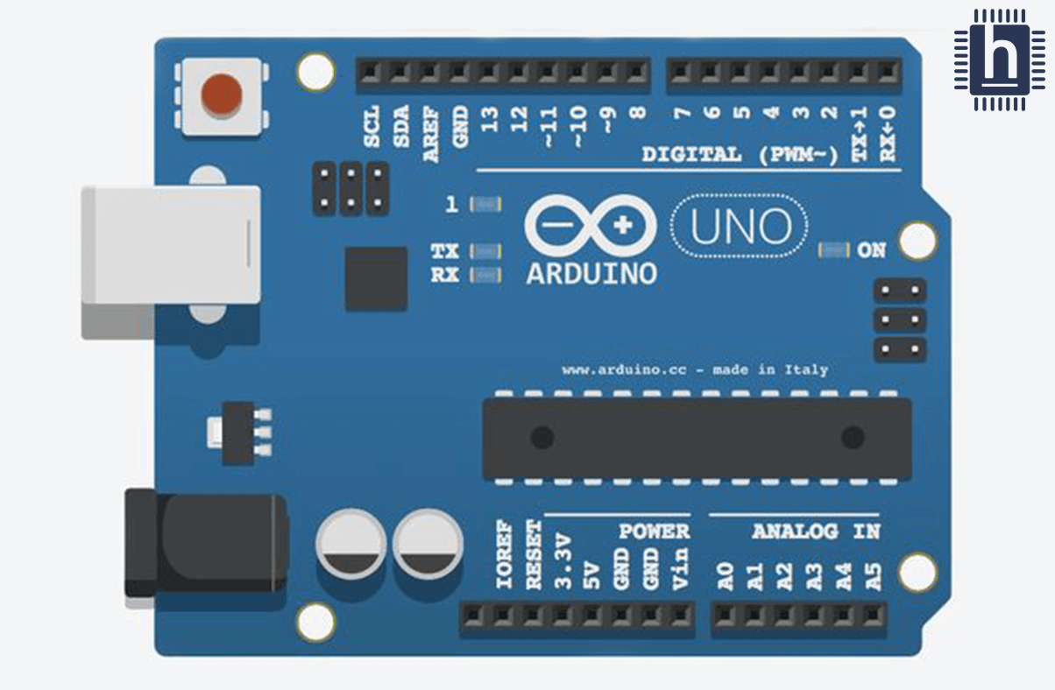
LCD_Pushbutton_Counter
Dr. G. V. Prasanna Anjaneyulu

Slide 2
Apparatus
1.PC with Arduino IDE
2.Arduino UNO Board
3.USB cable
4.LCD[16X2)
5.Bread board
6. Resistors -2
7.Jumper wires
8.Potentiometer
9.Pushbutton
Dr. G. V. Prasanna Anjaneyulu

Slide 3
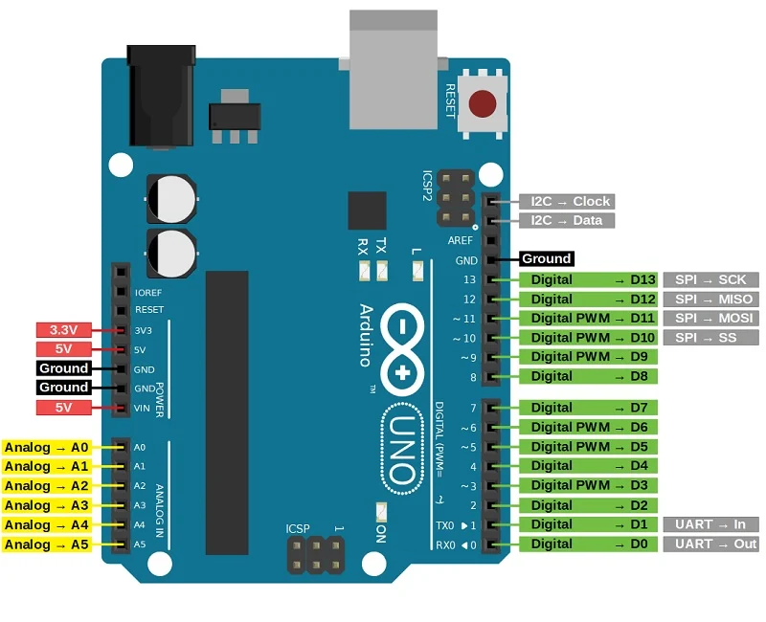
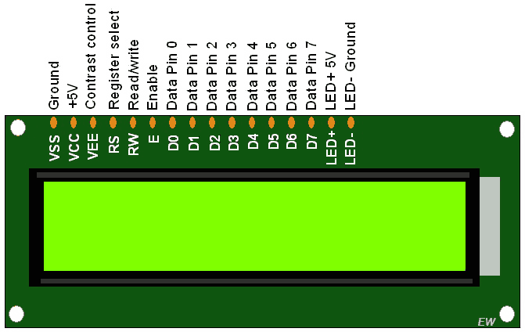
Dr. G. V. Prasanna Anjaneyulu

Slide 4

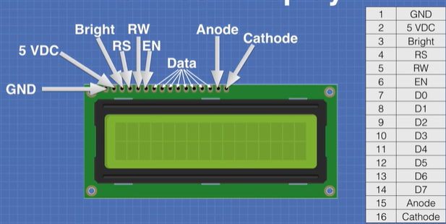
Dr. G. V. Prasanna Anjaneyulu

Slide 5
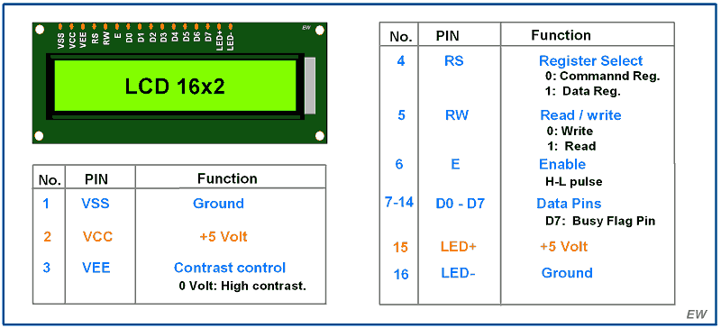
Dr. G. V. Prasanna Anjaneyulu

Slide 6
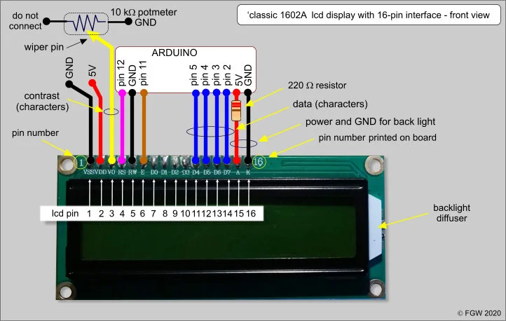
Dr. G. V. Prasanna Anjaneyulu

Slide 7
LiquidCrystal lcd(12,11,5,4,3,2);
Dr. G. V. Prasanna Anjaneyulu
Data pins
Enable LCD
Register Select

Slide 8
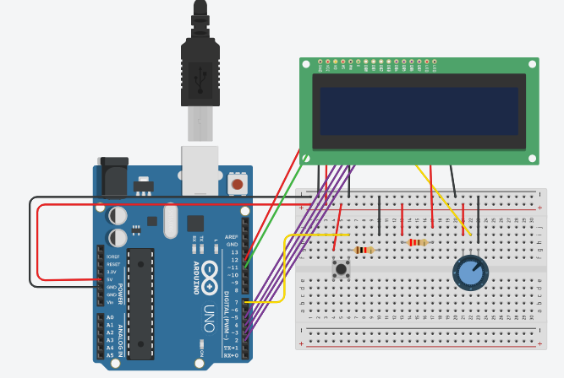
Implementation
Dr. G. V. Prasanna Anjaneyulu

Slide 9
Program
// program for LCD_interfacing_with_pushButton
#include<LiquidCrystal.h>
LiquidCrystal lcd(12,11,5,4,3,2);//RS,E,D4,D5,D6,D7
int count=0;
void setup()
{
pinMode(7,INPUT);
lcd.clear();
lcd.begin(16,2);
}
void loop()
{
if(digitalRead(7)==HIGH);
{
lcd.setCursor(0,0);
lcd.print(count++);
while(digitalRead(7)==HIGH);
}
}
Dr. G. V. Prasanna Anjaneyulu

