Slide 1
LED_Brightness_Control
with ARDUINO

Slide 2
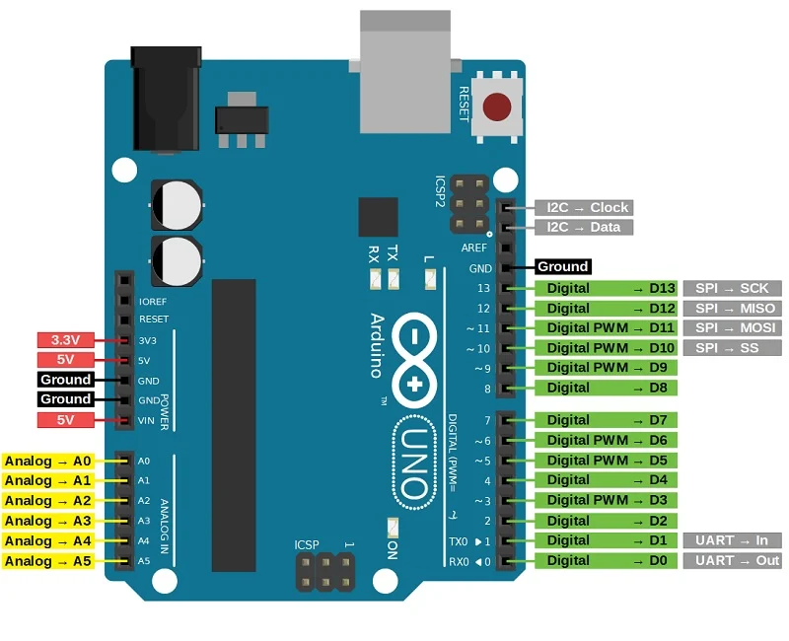

Slide 3
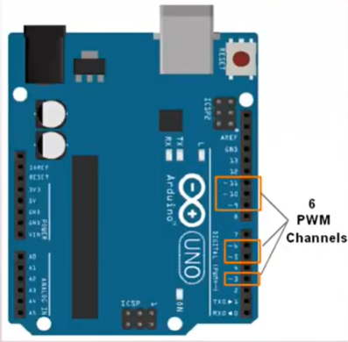
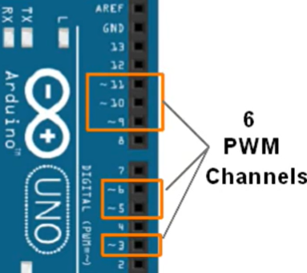

Slide 4
Apparatus
1.PC with Arduino IDE
2.Arduino UNO Board
3.USB cable
4.LED
5.Bread board
6.10kΩ Potentiometer
7.Jumper wires
8. 220 ohm resistor

Slide 5


Slide 6



Slide 7






Slide 8
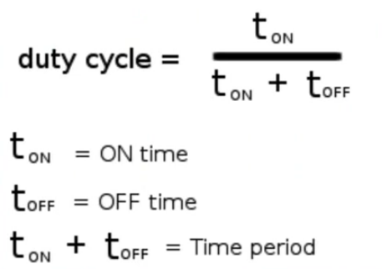

Slide 9

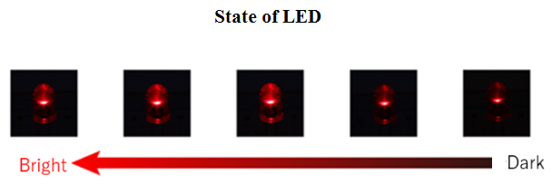

Slide 10
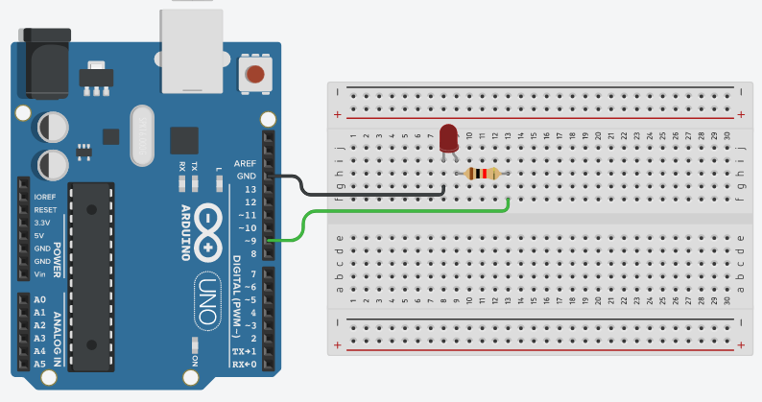

Slide 11
Program
// Brightness_LED_CONTROL
int dutyCycleValue=1;
void setup()
{
pinMode(9, OUTPUT); //here, 9 is one of PWM pins
}
void loop()
{
if(dutyCycleValue<=255)
{
analogWrite(9, dutyCycleValue);
delay(1000); // Wait for 1000 millisecond(s)
dutyCycleValue++;
}
}

Slide 12
Assignment
Repeat same instead of LED use Buzzer(piezo)
Then Buzzer sound will vary from minimum to maximum

Slide 13
