Slide 1
8.DC_Motor Speed & Direction Control
With ARDUINO
Dr. G. V. Prasanna Anjaneyulu

Slide 2
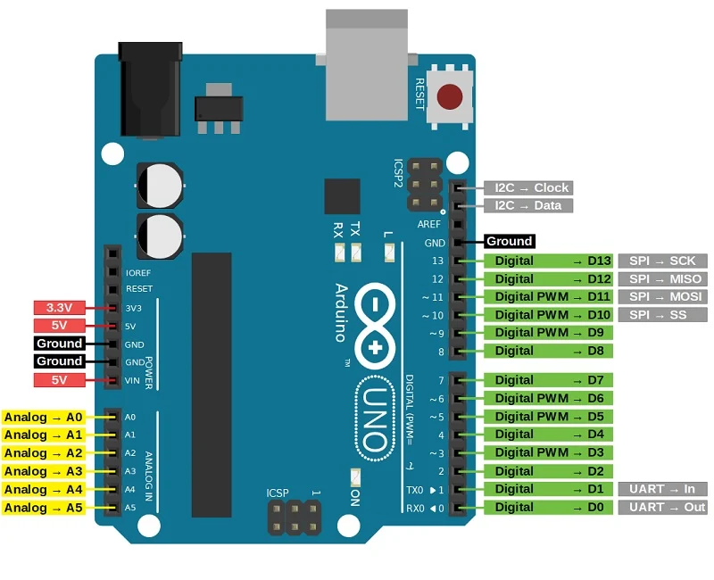
Dr. G. V. Prasanna Anjaneyulu
DC_Motor_Speed_Direction_Control by Dr. GVP

Slide 3
Note
In built microcontroller cann’t run DC motor because motor draws large current
Even if it runs, but it cannot reverse the direction of motor
So L293D driver IC is used
With this IC 2-DC motors are controlled at a time
DC_Motor_Speed_Direction_Control by Dr. GVP

Slide 4
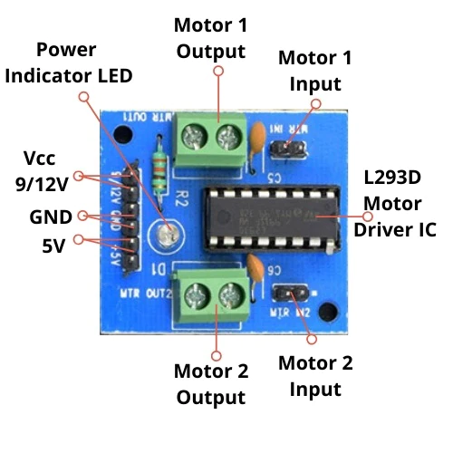
L293D Driver-IC
Dr. G. V. Prasanna Anjaneyulu
DC_Motor_Speed_Direction_Control by Dr. GVP

Slide 5
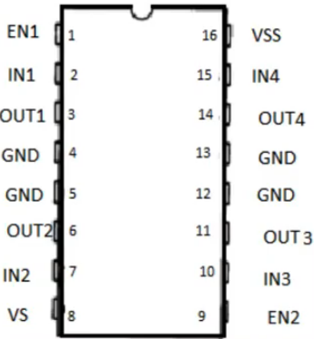
Apparatus
1.PC with Arduino IDE
2.Arduino UNO Board
3.USB cable
4.DC motor
5.Bread board
6.1kΩ resistor
7.Jumper wires
8.L293D motor IC
Dr. G. V. Prasanna Anjaneyulu
DC_Motor_Speed_Direction_Control by Dr. GVP

Slide 6
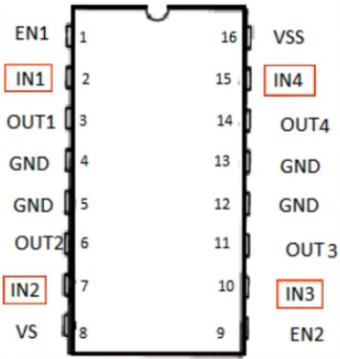
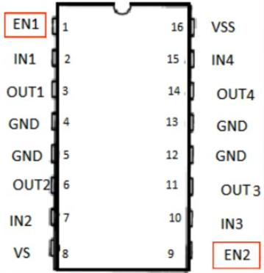
L293D Motor Driver IC
By using this we can control 2-motors at a time, but here using for 1-motor control only.
For Speed control EN1, EN2 used
For Direction control IN1-IN2,IN3-IN4 used
Speed Control
Direction Control
Dr. G. V. Prasanna Anjaneyulu
DC_Motor_Speed_Direction_Control by Dr. GVP

Slide 7
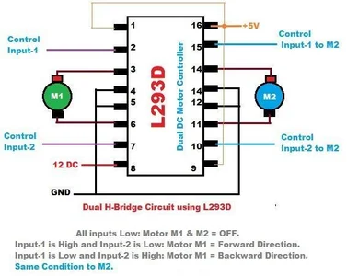
Dr. G. V. Prasanna Anjaneyulu
DC_Motor_Speed_Direction_Control by Dr. GVP

Slide 8
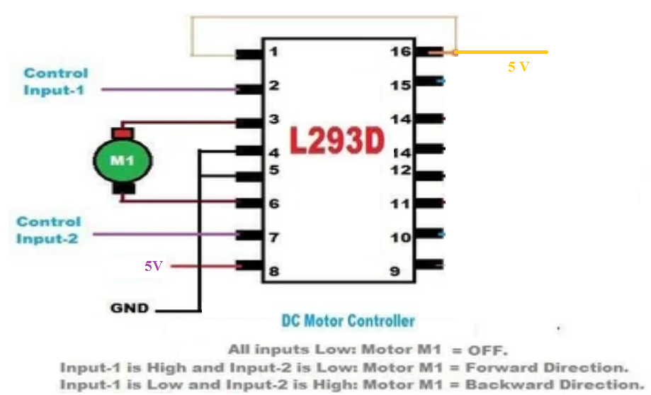
Single DC motor Control circuit
Dr. G. V. Prasanna Anjaneyulu
DC_Motor_Speed_Direction_Control by Dr. GVP

Slide 9
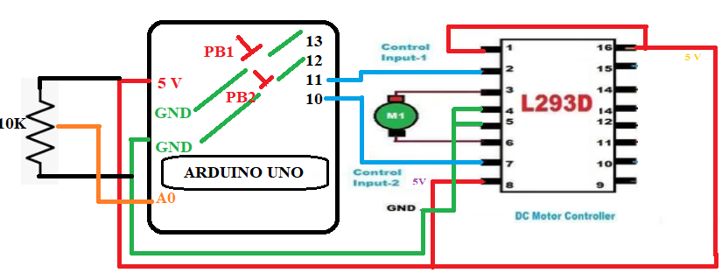
Circuit Diagram
Dr. G. V. Prasanna Anjaneyulu
DC_Motor_Speed_Direction_Control by Dr. GVP

Slide 10
Program
// speed_direction_control_DC-Motor
const int potPin = A0;
const int fwdbuttonPin = 13;
const int bckbuttonPin = 12;
const int ICpin2 = 11;
const int ICpin7 = 10;
int potValue = 0;
int motorValue = 0;
int fwdbuttonState = 0;
int bckbuttonState = 0;
void setup()
{
pinMode(fwdbuttonPin, INPUT_PULLUP);
pinMode(bckbuttonPin,INPUT_PULLUP);
pinMode(ICpin2, OUTPUT);
pinMode(ICpin7, OUTPUT);
}
void loop()
{
potValue = analogRead(potPin);
motorValue = map(potValue, 0, 1023, 0, 255);
fwdbuttonState = digitalRead(fwdbuttonPin);
bckbuttonState = digitalRead(bckbuttonPin);
delay (500);
if(fwdbuttonState == LOW || bckbuttonState == LOW)
{
analogWrite(fwdbuttonState == LOW ? ICpin2 : ICpin7, motorValue);
digitalWrite(fwdbuttonState == LOW ? ICpin7 : ICpin2, LOW);
}
else
{
digitalWrite(ICpin2, LOW);
digitalWrite(ICpin7, LOW);
}
}
Dr. G. V. Prasanna Anjaneyulu
DC_Motor_Speed_Direction_Control by Dr. GVP

Slide 11
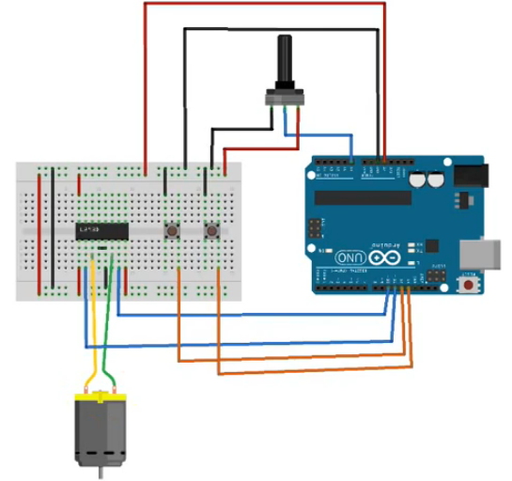
Circuit Diagram
Dr. G. V. Prasanna Anjaneyulu
DC_Motor_Speed_Direction_Control by Dr. GVP

