Slide 1
Sequence-to-Sequence (Seq2Seq) Learning / Modeling
Greg Placencia, PhD
https://github.com/gvplacencia/nlp

Slide 2
What is Seq2Seq Learning/Modeling?
Neural Networks (ANNs) trained to convert (i.e. transform) sequences from one domain to sequences in another domain
Useful for tasks where input and output sequences vary in lengths
E.g. translate sentences in English into the same sentences translated to French
Not the same as transformers in Foundation Models
Large Language Models (LLM)
Generative Pretrained Transformers (GPT)
Those use Attention Mechanisms

Slide 3
Applications in Text Analysis
Machine translation
Text summarization – Generating concise summaries of longer text documents
Question answering questions based on a given text corpora
Chatbot response generation

Slide 4
Text Preprocessing for Feature Extraction in NLP
Data Acquisition
Cleaning
Normalization
Tokenization
Stopwords Removal
POS Tagging
NER (Named Entity Recognition)
Stemming and Lemmatization

Slide 5
Some History
Recurrent Neural Networks (RNNs) are an early example
Backpropagation makes them hard to train
Vanishing / Exploding Gradient Problem potentially caused by “unrolling”
Gated Recurrent Units (GRU) have helped overcome the issue
Long Short Term Memory (LSTM)
Long Term Memory (LTM) not modified by weights and biases
Short Term Memory (STM) modified by weights and biases
Sigmoid activation function integrates LTM and STM

Slide 6
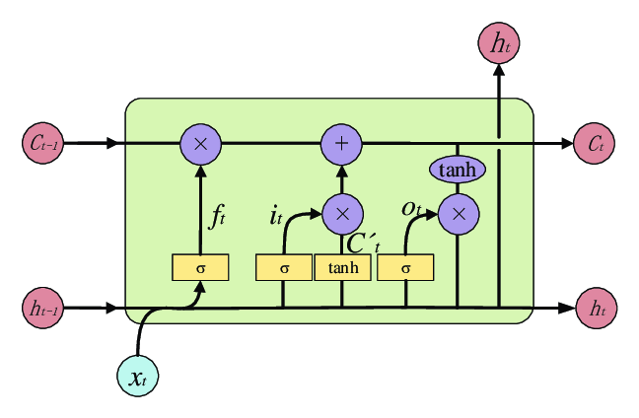
Some History
Long Short Term Memory (LSTM)
Long Term Memory (LTM) not modified by weights and biases
Forget Gate (f_{t}) determines percentage of LTM (C_{t-1}) to remember using sigmoid activation function
Short Term Memory (STM) uses weights and biases
Input (x_{i}) and STM (h_{t-1}) use sigmoid activation function to know how much of a memory to keep and how “memorable” it is using Tanh activation function
[3]

Slide 7
Word Embedding and Word2Vec
Need to convert words to numbers to use an ANN
Tokens -> Embedding Layer
Words
Symbols
<EOS>
Embedding Layer

Slide 8
Encoder-Decoder Architecture
Fundamental components of seq2seq models
Encoder processes input sequences
Decoder generates output sequences
Embedding Layer creates values for each domain
Both have different tokens: input words and symbols
Both have fully connected layers (ANNs) with their own weights and biases

Slide 9
Encoder
Encoder works the same in both the training and testing phase
Processes each token in the input-sequence into a vector of fixed length
‘context vector’ encapsulates the whole meaning of the input-sequence
Encoder passes context vector onto the decoder after going through all tokens
Helps decoder make accurate predictions
Parameters are updated using backpropagation over time.

Slide 10
Decoder
Context vector initializes long and short term decoder memories
Tries to predict the target-sequence token by token using Softmax function
For any time – step t, output yt_pred is the probability distribution over entire vocabulary in the output dataset
Token with the maximum probability is chosen to be the predicted word.
Continues to predict until i predicts <EOS> token or hit a max output length
Teacher forcing sometimes used to improve model outcomes
Feed true output/token (not predicted output) from the previous time-step as input to the current time-step
Input to the time-step 2 will be y1_true=[0 1 0 0 0 0] and not y1_pred

Slide 11

Softmax Function
\sigma = softmax
\vec{z} = input vector
e^{z_{i}} = standard exponential function for input vector
K = number of classes in the multi-class classifier
e^{z_{j}} = standard exponential function for output vector
e^{z_{j}} = standard exponential function for output vector

Slide 12
Sample Case [5]
English sentence Input:
“nice to meet you”
French translation Output:
“ravi de vous rencontrer”

Slide 13
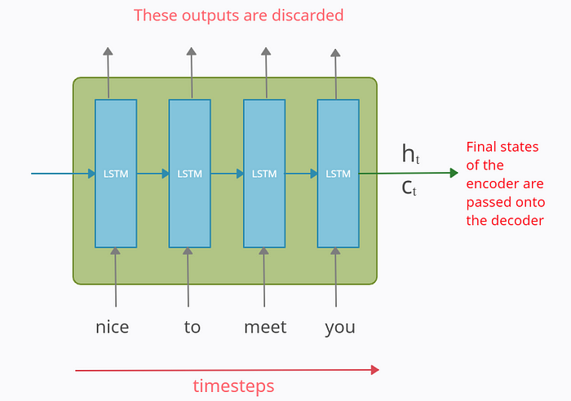
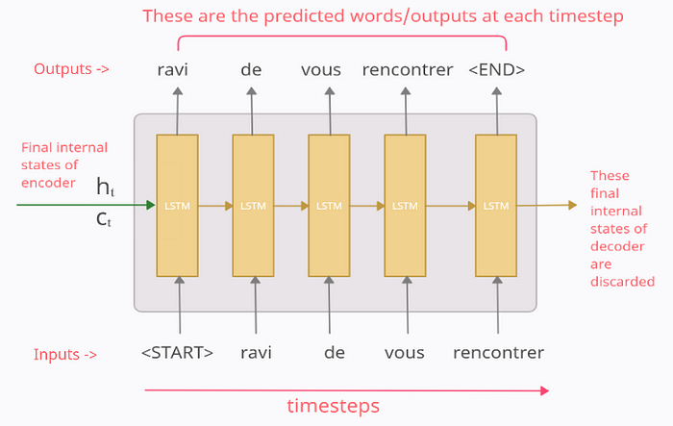
Sample Case [5]
h_{i} = hidden state
c_{i} = cell state

Slide 14
Training – Vectorize Data [5]
Raw data
X = “nice to meet you” → Y_true = “ravi de vous rencontrer”
Special symbols like “<START>” and “<END>” can start and end of target-sequence
Can be any string not in the corpus, e.g. <EOS> to not confuse model
X = “nice to meet you” → Y_true = “<START> ravi de vous rencontrer <END>”
Vectorize input and output data using one-hot-encoding (ohe)
X = (x1, x2, x3, x4) → Y_true = (y0_true, y1_true, y2_true, y3_true, y4_true, y5_true)
x_{i}’s and y_{i}’s represent ohe vectors for input-sequence and output-sequence respectively

Slide 15
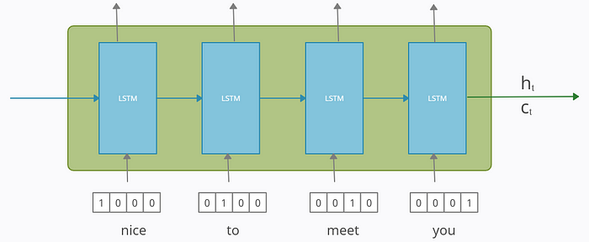
Training – Vectorize Data [5]
For input X
‘nice’ → x1 : [1 0 0 0]
‘to’ → x2 : [0 1 0 0 ]
‘meet’ →x3 : [0 0 1 0]
‘you’ → x4 : [0 0 0 1]
For Output Y_true
‘<START>’ → y0_true : [1 0 0 0 0 0]
‘ravi’ → y1_true : [0 1 0 0 0 0]
‘de’ → y2_true : [0 0 1 0 0 0]
‘vous’ → y3_true : [0 0 0 1 0 0]
‘rencontrer’ → y4_true : [0 0 0 0 1 0]
‘<END>’ → y5_true : [0 0 0 0 0 1]

Slide 16
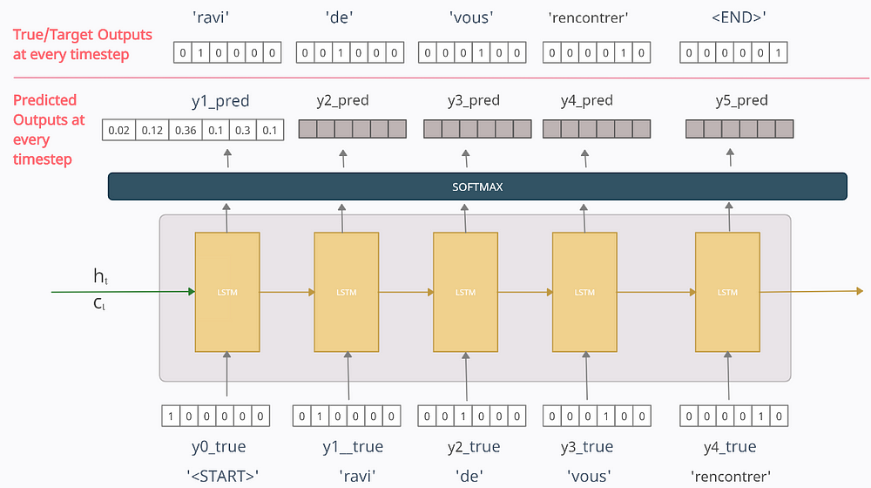
Training – Vectorize Data [5]

Slide 17
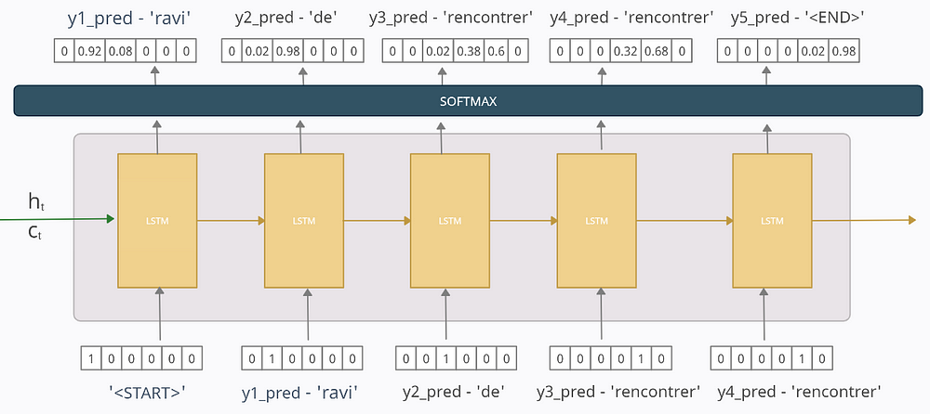
Training – Poor Trained Model [5]

Slide 18
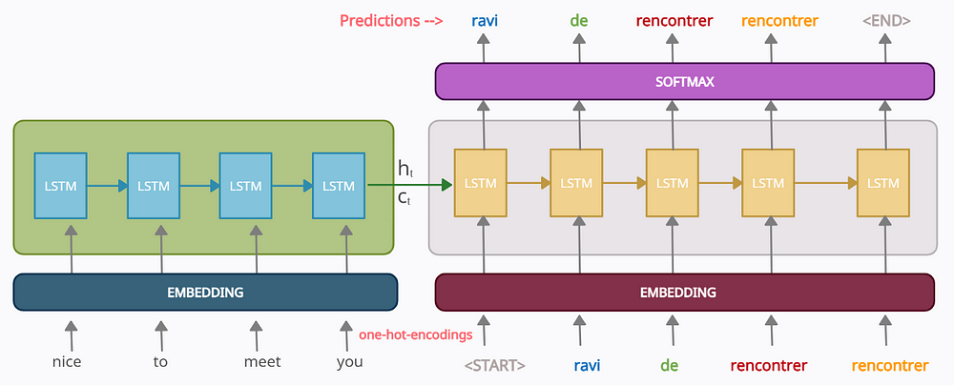
Training – Embedding Layer [5]

Slide 19
Sample Case
“Let’s go” -> [Seq2Seq model]
[Seq2Seq model] -> “allons-y”
[Seq2Seq model] -> vamanos
“my name is …” -> [Seq2Seq model]
[Seq2Seq model] -> “mon nom est … ”
[Seq2Seq model] -> “mi nombre es … ”
Actually it’s “Me llamo …”
“the cat sat on the mat” -> [Seq2Seq model]
[Seq2Seq model] -> “le chat etait assis sur le tapis”
[Seq2Seq model] -> “el gato se sentó en la estera”

Slide 20
Potential Issues
Some languages like Chinese and Japanese use ideograms
Each character has its own meaning
Meaning changes when different characters are combined.
Solution: Need to tokenize entire words instead of tokenizing each character
Requires a lot of work

Slide 21
Training – Vectorize Data
Input X: ‘你’-> x1:[1,0], ‘好’->x2:[0,1]
In Japanese
Kanji: 今日は
Hiragana: こんにちは
Output Y_true:
‘<START>’->y0_true:[1,0,0,0,0,0,0]
こ->y1_true: [0,1,0,0,0,0,0] ん->y２_true: [0,0,1,0,0,0,0]
に->y3_true: [0,0,0,1,0,0,0]ち->y４_true: [0,0,0,0,1,0,0]
は ->y5_true: [0,0,0,0,0,1,0]
<END> ->y6_true: [0,0,0,0,0,0,1]

Slide 22
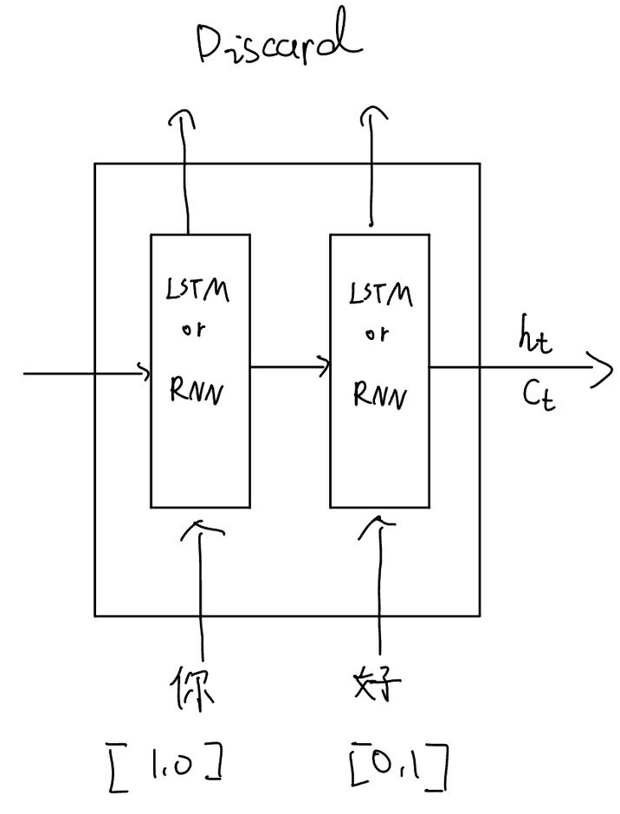
Train and Test Encoder

Slide 23
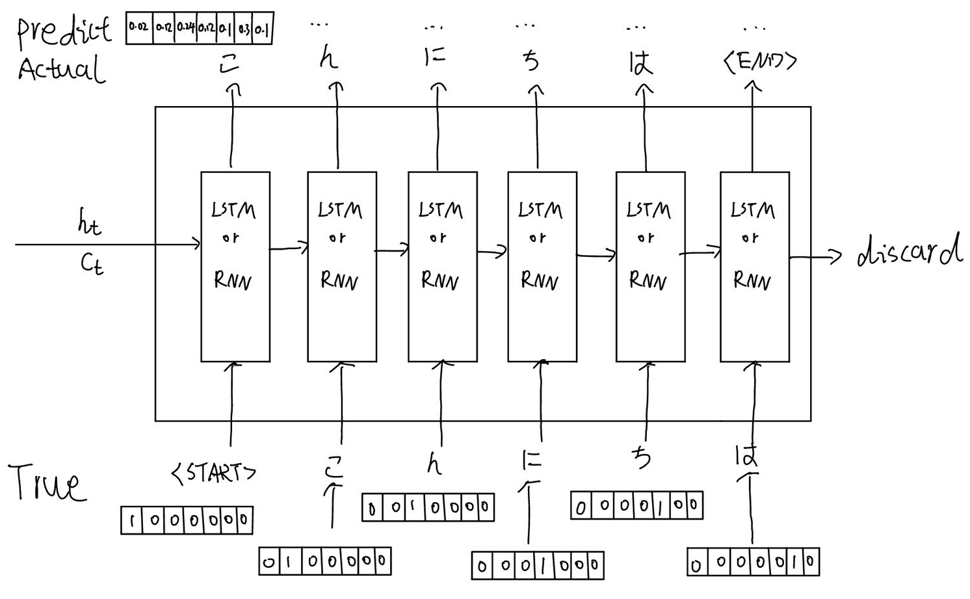
Decoder Training Phase: Teacher Forcing Example
Some training needs a forced correct translation
“Teacher Forcing” feeds true output/token (not predicted output/tokens) from the previous time-step as input to the current time-step.

Slide 24
Calculate Loss
Calculated for predicted outputs for each time-step
Errors are backpropagated through time to update model parameters
Loss function used is the categorical cross-entropy loss function between the target-sequence/Y_true and the predicted-sequence/Y_pred such that
Y_true = [y0_true, y1_true, y2_true, y3_true, y4_true, y5_true]
Y_pred = [‘<START>’, y1_pred, y2_pred, y3_pred, y4_pred, y5_pred]

Slide 25
Decoder in test phase
Real-world applications won't have Y_true, only X.
When testing our model, the predicted output (not true output) from previous time-step is fed as input to the current time-step.
Rest is the same as training phase.

Slide 26
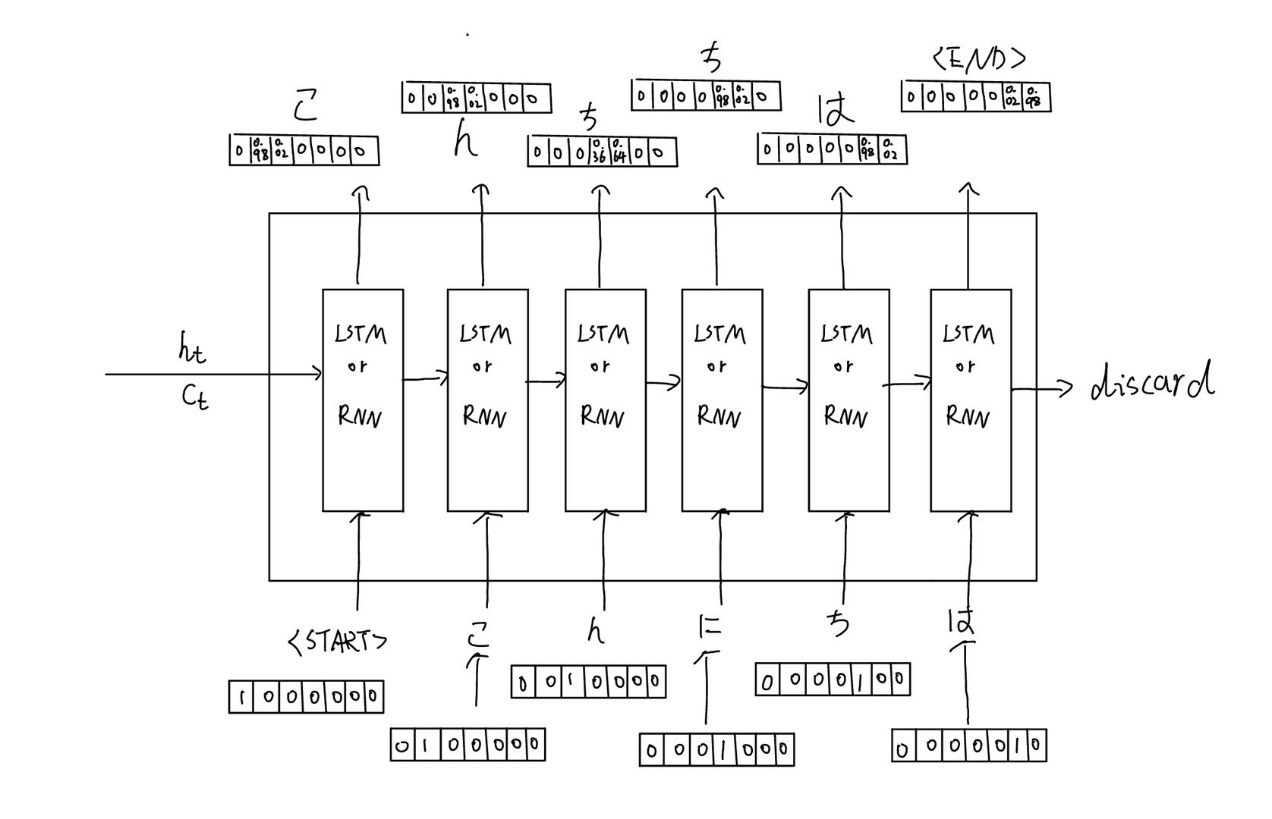
Testing
So according to our trained model, the predicted-sequence at test time is “こんちちは”. Hence though the model was incorrect on the 3rd prediction, we still fed it as input to the next time-step. The correctness of the model depends on the amount of data available and how well it has been trained. The model may predict a wrong output but nevertheless, the same output is only fed to the next time-step in the test phase.

Slide 27
Limitations of traditional seq2seq models
Need for better context alignment
Proposed future steps
Foundation Models
Attention
Large Language Models
Transformers

Slide 28
Demo

Slide 29
References
[1] Chollet, F. (2017). The keras blog. The Keras Blog ATOM. https://blog.keras.io/a-ten-minute-introduction-to-sequence-to-sequence-learning-in-keras.html#:~:text=Sequence%2Dto%2Dsequence%20learning%20(,etait%20assis%20sur%20le%20tapis%22 (Accessed Sep. 15, 2024).
[2] Chollet, F. (2023). “Keras documentation: Character-level recurrent sequence-to-sequence model,” Keras, https://keras.io/examples/nlp/lstm_seq2seq/ (Accessed Sep. 15, 2024).
[3] Eswarsai, “Exploring different types of LSTMs,” Medium, https://medium.com/analytics-vidhya/exploring-different-types-of-lstms-6109bcb037c4 (Accessed Sep. 16, 2024).

Slide 30
References
[4] Dobilas, Saul. “LSTM Recurrent Neural Networks — How to Teach a Network to Remember the Past.” Medium, 5 Mar. 2022, towardsdatascience.com/lstm-recurrent-neural-networks-how-to-teach-a-network-to-remember-the-past-55e54c2ff22e. (Accessed Sept 16, 2024).
[5] K. Moses, “Encoder-Decoder Seq2Seq models, clearly explained!!,” Medium, Jul. 30, 2024. [Online]. Available: https://medium.com/analytics-vidhya/encoder-decoder-seq2seq-models-clearly-explained-c34186fbf49b. (Accessed Sept 16, 2024).
[6] I. Sutskever, O. Vinyals, and Q. Le V., “Sequence to Sequence Learning with Neural Networks,” arXiv.org, Sep. 10, 2014. https://arxiv.org/abs/1409.3215. (Accessed Sept 16, 2024).

Slide 31
References
[7] R. Kompella, “Neural Machine Translation — Using seq2seq with Keras,” Medium, Jul. 19, 2022. [Online]. Available: https://towardsdatascience.com/neural-machine-translation-using-seq2seq-with-keras-c23540453c74. (Accessed Sept 16, 2024).
[8] B. F. Chollet, “A ten-minute introduction to sequence-to-sequence learning in Keras.” https://blog.keras.io/a-ten-minute-introduction-to-sequence-to-sequence-learning-in-keras.html#:~:text=Sequence%2Dto%2Dsequence%20learning%20(,etait%20assis%20sur%20le%20tapis%22. (Accessed Sept 16, 2024).
[9] S. Alla, “Implementing Seq2Seq models for text summarization with KERAS,” Paperspace Blog, Apr. 09, 2021. https://blog.paperspace.com/implement-seq2seq-for-text-summarization-keras/. (Accessed Sept 16, 2024).

