Slide 1
Hash Functions and MAC

Slide 2
Cryptographic Hash Functions
Typical hash functions take inputs of variable lengths to return outputs of a fixed length.
Cryptographic hash functions add security features to typical hash functions, making it more difficult to detect the contents of a message or information about recipients and senders.

Slide 3
Cryptographic hash functions exhibit three properties:
1. Pre-Image Resistance
  This property means that it should be computationally hard to reverse a hash function.
  In other words, if a hash function h produced a hash value z, then it should be a difficult process to find any input value x that hashes to z.
2. Second Pre-Image Resistance
  This property means given an input and its hash, it should be hard to find a different input with the same hash.

Slide 4
  In other words, if a hash function h for an input x produces hash value h(x), then it should be difficult to find any other input value y such that h(y) = h(x).
3. Collision Resistance
  This property means it should be hard to find two different inputs of any length that result in the same hash. This property is also referred to as collision free hash function.
  In other words, for a hash function h, it is hard to find any two different inputs x and y such that h(x) = h(y).

Slide 5
Popular Hash Functions
Message Digest (128 bit): MD2, MD4, MD5 and MD6
Secure Hash Function (SHA): SHA-0, SHA-1, SHA-2, and SHA-3
  SHA-0, a 160-bit hash function
  SHA-2 family has four variants, SHA-224, SHA-256, SHA-384, and SHA-512 depending up on number of bits in their hash value.

Slide 6
RACE Integrity Primitives Evaluation Message Digest (RIPEMD):
  includes RIPEMD, RIPEMD-128, and RIPEMD-160
Whirlpool: 512-bit
  derived from AES
  WHIRLPOOL-0, WHIRLPOOL-T, and WHIRLPOOL.

Slide 7
Applications of Hash Functions
Password Storage: Hash functions provide protection to password storage.
Data Integrity Check: Message authentication assures that data received are exactly as sent. It is used to generate the checksums on data files also.
Digital signatures: To sign a message, we first take a cryptographic hash of the message and then encrypt it with the receiver's public key.

Slide 8
Birthday attack
Birthday attack is a type of cryptographic attack that belongs to a class of brute force attacks. It exploits the mathematics behind the birthday problem in probability theory.
The success of this attack largely depends upon the higher likelihood of collisions found between random attack attempts and a fixed degree of permutations.

Slide 9
Birthday paradox problem
It says that if you have 23 people in a room then there is at least a 50% chance that two have the same birthday.
Having the same birthday is the analogue of a “collision” in a hash function.
Assume we have 2 people in a room. There are 365² possible birthdays they can have.

Slide 10
How many ways is it possible for them to have different birthdays?
The first person’s birthday can occur on 365 possible days. Then the second persons birthday can only occur on 364 possible days.
So the probability that 2 people have different birthdays is 365x364/365²
So the probability that 23 people have different birthdays is
365x364x363 … 343/365²³ = 0.4927

Slide 11
So the probability that 2 people have same birthdays is 1-0.4927 = 50%.
The probability increases rapidly as the group size increases. In a group of 50 people, the probability is already over 97%.
A birthday attack takes advantage of this statistical property by trying to find two different input messages that produce the same hash value (collision).

Slide 12
If an attacker can find a collision, they can potentially trick a system into thinking that two different messages are the same.
They can be used to create fake messages or forge digital signatures.
Most modern cryptographic systems are designed to be resistant to birthday attacks.

Slide 13
Message Authentication
Message authentication is a procedure to verify that received messages come from the alleged source and have not been altered.
Message authentication may also verify sequencing and timeliness.

Slide 14
Message Authentication Code
This involves the use of a secret key to generate a small fixed-size block of data, known as a cryptographic checksum or MAC, that is appended to the message.
This technique assumes that two communicating parties, say A and B, share a common secret key K.
When A has a message to send to B, it calculates the MAC as a function of the message and the key:

Slide 15
MAC = C(K, M) where
M = input message
C = MAC function
K = shared secret key
MAC = message authentication code
The message plus MAC are transmitted to the intended recipient.
The recipient performs the same calculation on the received message, using the same secret key, to generate a new MAC. (Figure 12.4a).

Slide 16
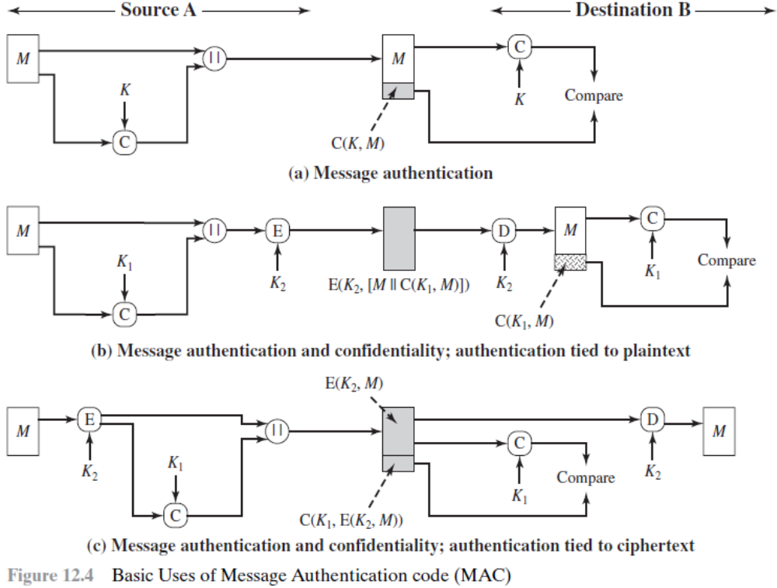

Slide 17
The receiver is assured that the message has not been altered.
If an attacker alters the message but does not alter the MAC, then the receiver’s calculation of the MAC will differ from the received MAC.
A MAC function is similar to encryption. One difference is the MAC function is a many-to-one function.

Slide 18
MACs Based on Hash Functions: HMAC
HMAC treats the hash function as a “black box.” This has two benefits.
First, an existing implementation of a hash function can be used as a module in implementing HMAC.
Second, if it is ever desired to replace a given hash function in an HMAC implementation, all that is required is to remove the existing hash function module and drop in the new module.

Slide 19
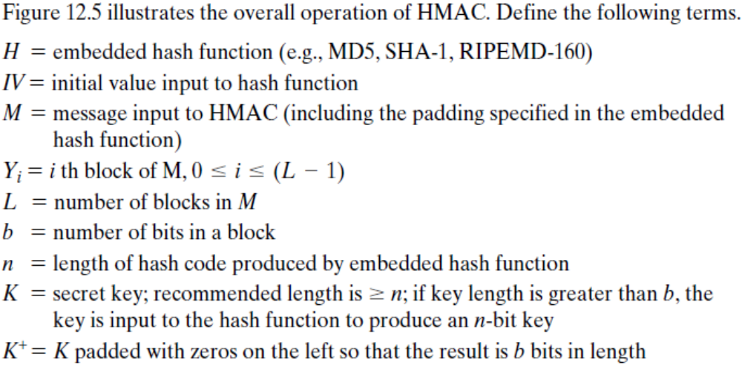
HMAC Algorithm

Slide 20
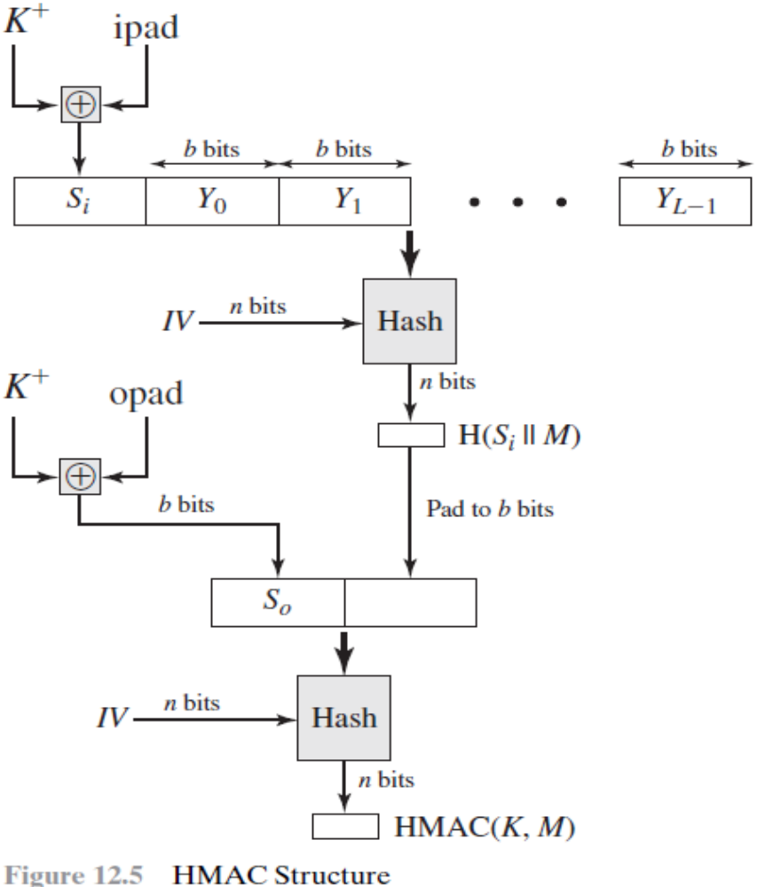

Slide 21
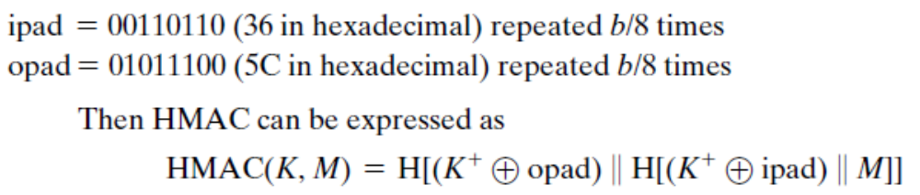

Slide 22
We can describe the algorithm as follows.
1. Append zeros to the left end of K to create a b-bit string K⁺.
2. XOR (bitwise exclusive-OR) K⁺ with ipad to produce the b-bit block S_{i}.
3. Append M to S_{i}.
4. Apply H to the stream generated in step 3.
5. XOR K⁺ with opad to produce the b-bit block S_{o}.
6. Append the hash result from step 4 to S_{o}.
7. Apply H to the stream generated in step 6 and output the result.

Slide 23
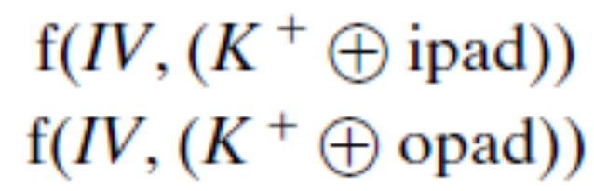
A more efficient implementation is possible, as shown in Figure 12.6. Two quantities are precomputed:

Slide 24
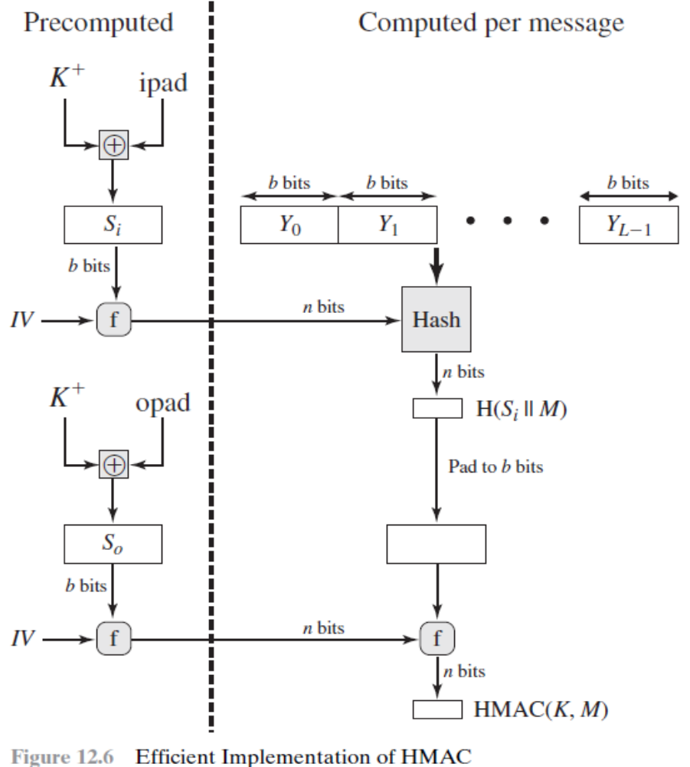

Slide 25
MAC s Based on Block Ciphers: CMAC
Cipher-Based Message Authentication Code (CMAC)
The message is an integer multiple n of the cipher block length b. For AES, b = 128, and for triple DES, b = 64.
The message is divided into n blocks (M₁, M₂,…, M_{n}).
The algorithm makes use of a k-bit encryption key K and a b-bit constant, K₁.
For AES, the key size k is 128, 192, or 256 bits; for triple DES, the key size is 112 or 168 bits.
CMAC is calculated as follows (Figure 12.8).

Slide 26
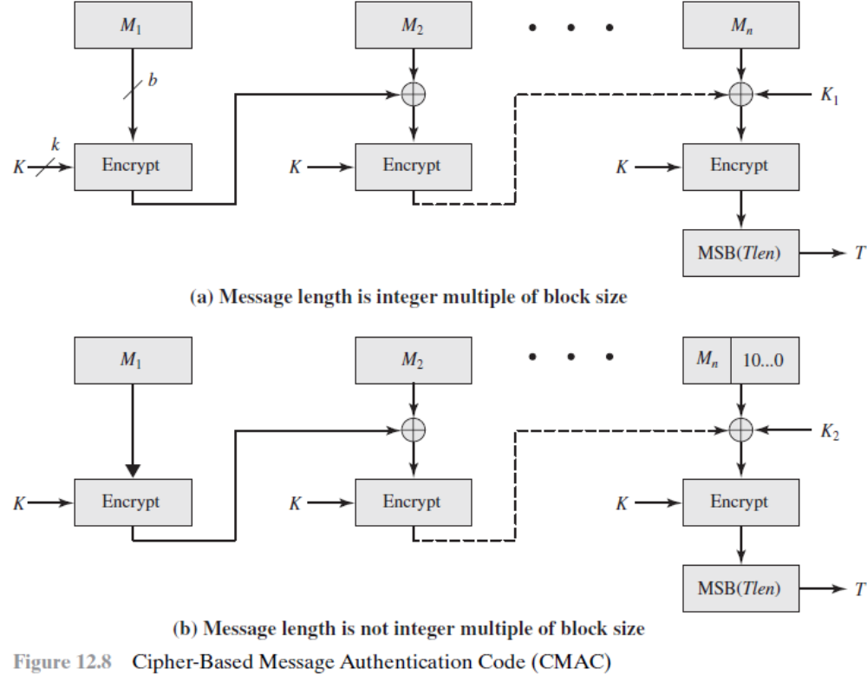

Slide 27
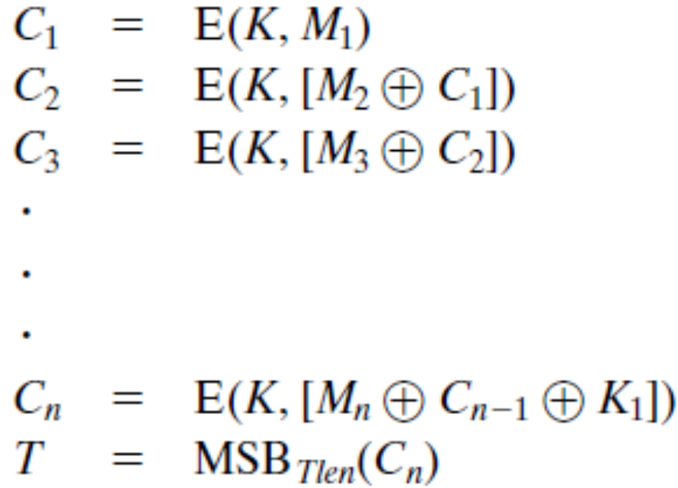
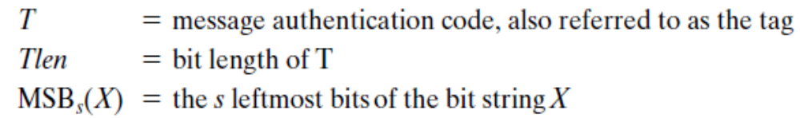

Slide 28
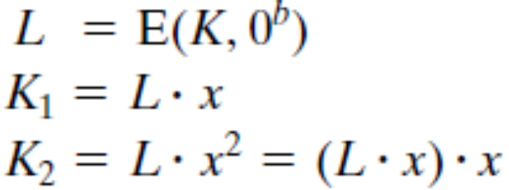
If the message is not an integer multiple of the cipher block length, then the final block is padded to the right (least significant bits) with a 1 and as many 0s as necessary so that the final block is also of length b.
The CMAC operation then proceeds as before, except that a different b-bit key K₂ is used instead of K₁.
The two b-bit keys are derived from the k-bit encryption key as follows.

Slide 29
      Digital Signatures

Slide 30
SERVICES
Message Authentication
Message authentication is also referred to as data-origin authentication.
Bob can verify that the message is sent by Alice because Alice’s public key is used in verification.

Slide 31
SERVICES
Message Integrity
Integrity of the message is preserved because we cannot get the same signature if the message is changed.
The digital signature schemes today use a hash function in the signing and verifying algorithms.

Slide 32
Nonrepudiation
If Alice signs a message and then denies it, can Bob later prove that Alice actually signed it?
For example, if Alice sends a message to a bank (Bob) and asks to transfer $10,000 from her account to Ted’s account, can Alice later deny that she sent this message?

Slide 33
Alice may have changed her private or public key during this time; she may also claim that the file containing the signature is not authentic.
One solution is a trusted third party. People can create an established trusted party among themselves.
Figure 13.4 shows how a trusted party can prevent Alice from denying that she sent the message.

Slide 34
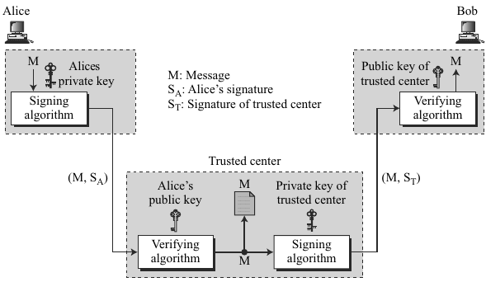

Slide 35
Confidentiality
A digital signature does not provide confidential communication.
If confidentiality is required, the message and the signature must be encrypted using either a secret-key or public-key cryptosystem.
Figure 13.5 shows how this extra level can be added to a simple digital signature scheme.

Slide 36
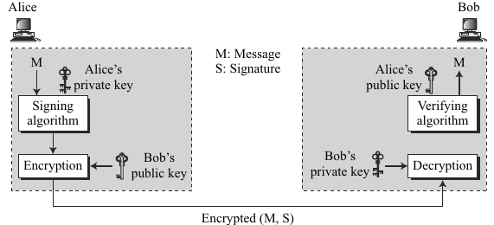

Slide 37
ATTACKS ON DIGITAL SIGNATURE
Attack Types
Three kinds of attacks: key-only, known-message, and chosen-message.
1. Key-Only Attack
In the key-only attack, Eve has access only to the public information released by Alice.
To forge a message, Eve needs to create Alice’s signature to convince Bob that the message is coming from Alice. This is the same as the ciphertext-only attack.

Slide 38
2. Known-Message Attack
In the known-message attack, Eve has access to one or more message-signature pairs.
Eve tries to create another message and forge Alice’s signature on it. This is similar to the known-plaintext attack.

Slide 39
3. Chosen-Message Attack
In the chosen-message attack, Eve somehow makes Alice sign one or more messages for her.
Eve now has a chosen-message/signature pair.
Eve later creates another message, with the content she wants, and forges Alice’s signature on it. This is similar to the chosen-plaintext attack.

Slide 40
Forgery Types
If the attack is successful, the result is a forgery. Two types of forgery: existential and selective.
1. Existential Forgery
In an existential forgery, Eve may be able to create a valid message-signature pair, but not one that she can really use.
In other words, a document has been forged, but the content is randomly calculated. Eve cannot benefit from it very much.

Slide 41
2. Selective Forgery
In selective forgery, Eve may be able to forge Alice’s signature on a message with the content selectively chosen by Eve.
Although this is beneficial to Eve, and may be very detrimental to Alice, the probability of such forgery is low.

Slide 42
DIGITAL SIGNATURE SCHEMES
RSA Digital Signature Scheme
To sign and verify a message, private and public keys of the sender, not the receiver, are used.T
The sender uses her own private key to sign the document; the receiver uses the sender’s public key to verify it.

Slide 43
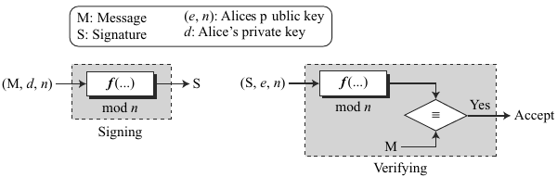

Slide 44
Key Generation
Key generation in the RSA digital signature scheme is exactly the same as key generation in the RSA cryptosystem.
Alice chooses two primes p and q and calculates n = p × q. Alice calculates φ(n) = (p − 1) (q − 1). She then chooses e, the public exponent, and calculates d, the private exponent such that e × d = 1 mod φ(n).
Alice keeps d; she publicly announces n and e.

Slide 45
Signing
Alice creates a signature out of the message using her private exponent, S = M^{d} mod n and sends the message and the signature to Bob.
Verifying
Bob receives M and S. Bob applies Alice’s public exponent to the signature to create a copy of the message M′ = S^{e} mod n.
Bob compares the value of M′ with the value of M. If the two values are congruent, Bob accepts the message.

Slide 46
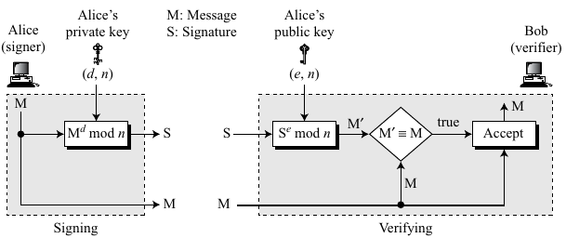

Slide 47
Example
For the security of the signature, the value of p and q must be very large.
Suppose that Alice chooses p = 823 and q = 953, and calculates n = 784319. The value of φ(n) is 782544. Now she chooses e = 313 and calculates d = 160009. At this point key generation is complete.
Now imagine that Alice wants to send a message with the value of M = 19070 to Bob. She uses her private exponent, 160009, to sign the message:

Slide 48
Alice sends the message and the signature to Bob. Bob receives the message and the signature. He calculates
Bob accepts the message because he has verified Alice’s signature.

Slide 49
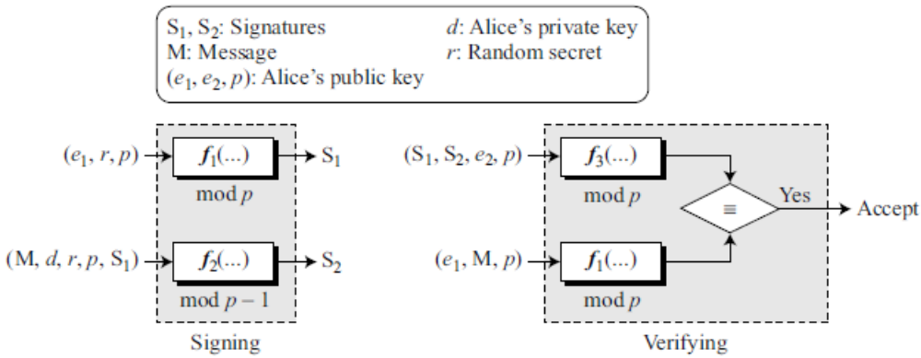
ElGamal Digital Signature Scheme
Figure gives the general idea:

Slide 50
Key Generation
The key generation procedure here is exactly the same as the one used in the cryptosystem.
Let p be a large prime number and e₁ be a primitive element in Z_{p}*.
Alice selects her private key d to be less than p − 1. She calculates e₂ = e₁^{d}.
Alice’s public key is the tuple (e₁, e₂, p); Alice’s private key is d.

Slide 51
Signing
1. Alice chooses a secret random number r. Alice needs a new r each time she signs a new message.
2. Alice calculates the first signature
S₁ = e₁^{r} mod p.
3. Alice calculates the second signature
S₂ = (M − d × S₁) × r⁻¹ mod (p − 1), where r⁻¹ is the multiplicative inverse of r modulo p.
4. Alice sends M, S₁, and S₂ to Bob.

Slide 52
Verifying
1. Bob checks to see if 0 < S₁ < p
2. Bob checks to see if 0 < S₂ < p − 1
3. Bob calculates V₁ = e₁^{M} mod p
4. Bob calculates V₂ = e₂^{S}₁ × S₁^{S}₂ mod p
5. If V₁ is congruent to V₂, the message is accepted; otherwise, it is rejected.

Slide 53
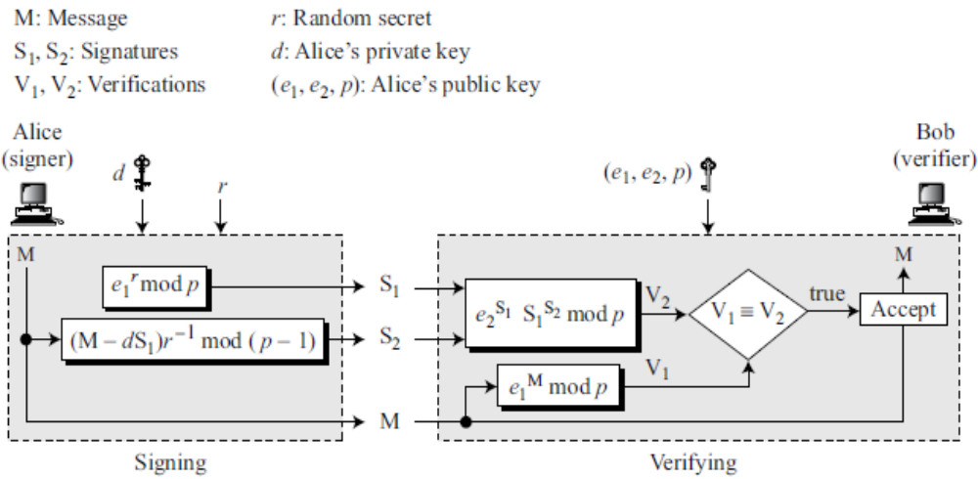

Slide 54
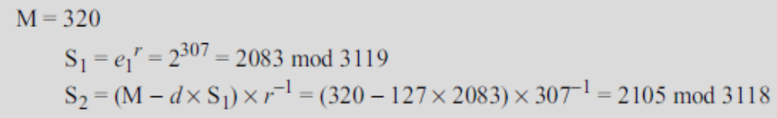
Example
Alice chooses p = 3119, e₁ = 2, d = 127 and calculates e₂ = 2¹²⁷ mod 3119 = 1702.
She also chooses r to be 307. She announces e₁, e₂, and p publicly; she keeps d secret.
The following shows how Alice can sign a message.

Slide 55
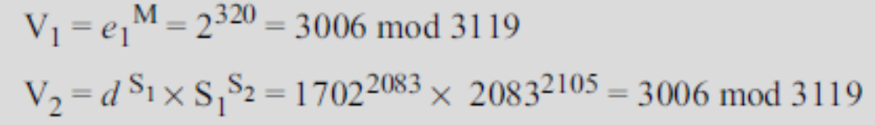
Alice sends M, S₁, and S₂ to Bob. Bob uses the public key to calculate V₁ and V₂.
Because V₁ and V₂ are congruent, Bob accepts the message.

Slide 56
Schnorr Digital Signature Scheme
The problem with the ElGamal digital signature scheme is that p needs to be very large.
The recommendation is a p of at least 1024 bits. This could make the signature as large as 2048 bits.
To reduce the size of the signature, Schnorr proposed a new scheme based on ElGamal, but with a reduced signature size.
Figure gives the general idea:

Slide 57
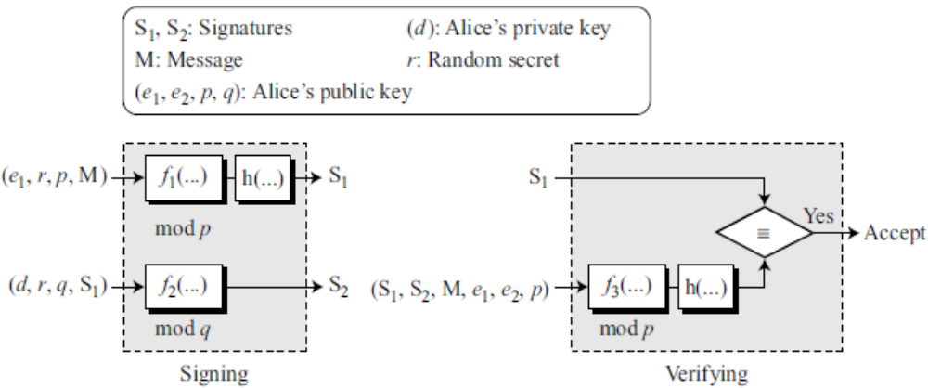

Slide 58
Key Generation
1. Alice selects a prime p, which is usually 1024 bits in length.
2. Alice selects another prime q, which is the same size as the digest created by the cryptographic hash function. The prime q needs to divide (p − 1).

Slide 59
3. Alice chooses e₁ to be the q^{th} root of 1 modulo p. To do so, Alice chooses a primitive element in Z_{p}, e₀, and calculates e₁ = e₀^{(p−1)/q} mod p.
4. Alice chooses an integer, d, as her private key.
5. Alice calculates e₂ = e₁^{d} mod p.
6. Alice’s public key is (e₁, e₂, p, q); her private key is (d);

Slide 60
Signing
1. Alice chooses a random number r, between 1 and q.
2. Alice calculates the first signature
S₁ = h(M | e₁^{r} mod p). The message is prepended to the value of e₁^{r} mod p.
3. Alice calculates the second signature
S₂ = r + d × S₁ mod q.
4. Alice sends M, S₁, and S₂.

Slide 61
Verifying Message
1. Bob calculates V = h (M | e₁^{S}₂ e₂^{−S}₁ mod p).
2. If S₁ is congruent to V modulo p, the message is accepted; otherwise, it is rejected.

Slide 62
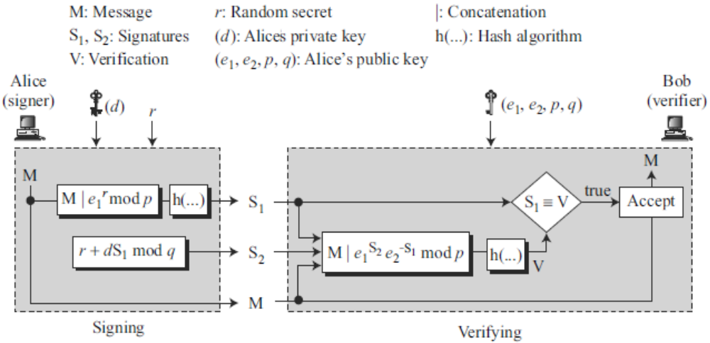

Slide 63
Example
Suppose we choose q = 103 and p = 2267. Note that p = 22 × q + 1.
We choose e₀ = 2, which is a primitive in Z₂₂₆₇*. Then (p −1) / q = 22, so we have e₁ = 2²² mod 2267 = 354.
We choose d = 30, so e₂ = 354³⁰ mod 2267 = 1206.
Alice’s private key is now (d); her public key is (e₁, e₂, p, q).

Slide 64
Alice wants to send a message M. She chooses r = 11 and calculates e₂^{r} = 354¹¹ = 630 mod 2267.
Assume that the message is 1000 and concatenation means 1000630.
Also assume that the hash of this value gives the digest h(1000630) = 200. This means S₁ = 200.
Alice calculates S₂ = r + d × S₁ mod q = 11 + 1026 × 200 mod 103 = 11 + 24 = 35.
Alice sends the message M =1000, S₁ = 200, and S₂ = 35.

Slide 65
Digital Signature Standard (DSS)
DSS uses a digital signature algorithm (DSA) based on the ElGamal scheme with some ideas from the Schnorr scheme.
Figure gives the general idea:

Slide 66
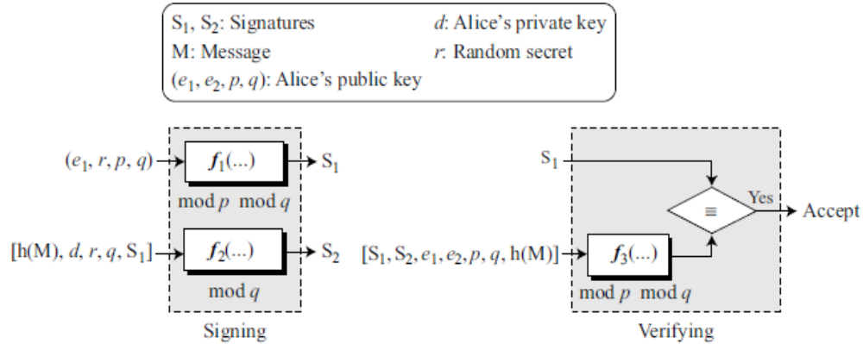

Slide 67
Key Generation
1. Alice chooses a prime p, between 512 and 1024 bits in length. The number of bits in p must be a multiple of 64.
2. Alice chooses a 160-bit prime q in such a way that q divides (p − 1).
3. Alice uses two multiplication groups <Z_{p}*, × > and <Z_{q}*, ×>; the second is a subgroup of the first.

Slide 68
4. Alice creates e₁ to be the q^{th} root of 1 modulo p (e₁^{p} = 1 mod p). To do so, Alice chooses a primitive element in Z_{p}, e₀, and calculates e₁ = e₀^{(p−1)/q} mod p.
5. Alice chooses d as the private key and calculates e₂ = e₁^{d} mod p.
6. Alice’s public key is (e₁, e₂, p, q); her private key is (d).

Slide 69
Signing
1. Alice chooses a random number r (1 ≤ r ≤ q).
2. Alice calculates the first signature
S₁ = (e₁^{r} mod p) mod q.
3. Alice creates a digest of message h(M).
4. Alice calculates the second signature
S₂ = (h(M) + d S₁)r⁻¹mod q.
5. Alice sends M, S₁, and S₂ to Bob.

Slide 70
Verifying
1. Bob checks to see if 0 < S₁ < q.
2. Bob checks to see if 0 < S₂ < q.
3. Bob calculates a digest of M using the same hash algorithm used by Alice.
4. Bob calculates
5. If S₁ is congruent to V, the message is accepted; otherwise, it is rejected.

Slide 71
Example
Alice chooses q = 101 and p = 8081. Alice selects e₀ = 3 and calculates e₁ = e₀^{(p−1)/q} mod p = 6968.
Alice chooses d = 61 as the private key and calculates e₂ = e₁^{d} mod p = 2038.
Now Alice can send a message to Bob.
Assume that h(M) = 5000 and Alice chooses r = 61:

Slide 72
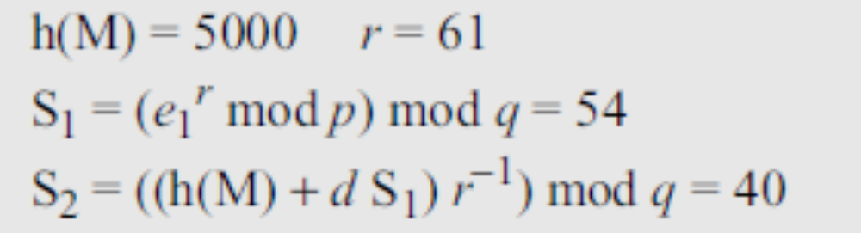
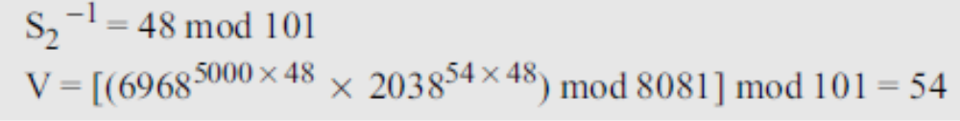
Alice sends M, S₁, and S₂ to Bob. Bob uses the public keys to calculate V.
Because S₁ and V are congruent, Bob accepts the message

Slide 73
Time Stamped Signatures
Sometimes a signed document needs to be timestamped to prevent it from being replayed by an adversary, called timestamped digital signature scheme.
For example, if Alice signs a request to her bank, Bob, to transfer some money to Eve, the document can be intercepted and replayed by Eve if there is no timestamp on the document.

Slide 74
Including the actual date and time on the documents may create a problem if the clocks are not synchronized and a universal time is not used.
One solution is to use a nonce (a one-time random number). A nonce is a number that can be used only once.
When the receiver receives a document with a nonce, he makes a note that the number is now used by the sender and cannot be used again.

Slide 75
Blind Signatures
Sometimes we have a document that we want to get signed without revealing the contents of the document to the signer.
For example, a scientist, say Bob, might have discovered a very important theory that needs to be signed by a notary public, say Alice, without allowing Alice to know the contents of the theory.
David Chaum has developed some patented blind digital signature schemes for this purpose.

Slide 76
The main idea is as follows:
a. Bob creates a message and blinds it. Bob sends the blinded message to Alice.
b. Alice signs the blinded message and returns the signature on the blinded message.
c. Bob unblinds the signature to obtain a signature on the original message.

Slide 77
Blinding can be done using a variation of the RSA scheme.
Bob selects a random number, b, and calculates the blinded message B = M × b^{e} mod n, in which e is Alice’s public key. Note that b is called the blinding factor.
Bob sends B to Alice.
Alice signs the blinded message using the RSA digital signature algorithm S_{b} = B^{d} mod n, in which d is Alice’s private key.

Slide 78
Note that S_{b} is the signature on the blind version of the message.
Bob simply uses the multiplicative inverse of his random number b to remove the blind from the signature. The signature is S = S_{b} b⁻¹ mod n.

