Slide 1
Module-1

Slide 2
Computer Security Concepts
Computer Security:
The protection afforded to an automated information system in order to attain the applicable objectives of preserving the integrity, availability, and confidentiality of information system resources (includes hardware, software, firmware, information/data, and telecommunications).

Slide 3
This definition introduces three key objectives/ goals of computer security:
• Confidentiality: This term covers two related concepts:
  Data confidentiality: Assures that private or confidential information is not made available or disclosed to unauthorized individuals.
  Privacy: Assures that individuals control or influence what information related to them may be collected and stored and by whom and to whom that information may be disclosed.

Slide 4
• Integrity: This term covers two related concepts:
  Data integrity: Assures that information and programs are changed only in a specified and authorized manner.
  System integrity: Assures that a system performs its intended function in an unimpaired manner, free from deliberate or inadvertent unauthorized manipulation of the system.
• Availability: Assures that systems work promptly and service is not denied to authorized users.

Slide 5
These three concepts form what is often referred to as the CIA triad. The three concepts embody the fundamental security objectives for both data and for information and computing services.
Characterization of these three objectives in terms of requirements is:

Slide 6
• Confidentiality: Preserving authorized restrictions on information access and disclosure, including means for protecting personal privacy and proprietary information. A loss of confidentiality is the unauthorized disclosure of information.
• Integrity: Guarding against improper information modification or destruction, including ensuring information nonrepudiation and authenticity. A loss of integrity is the unauthorized modification or destruction of information.

Slide 7
• Availability: Ensuring timely and reliable access to and use of information. A loss of availability is the disruption of access to or use of information or an information system.
Two commonly mentioned additional concepts are as follows:
• Authenticity: The property of being genuine and being able to be verified and trusted. This means verifying that users are who they say they are and that each input arriving at the system came from a trusted source.

Slide 8
• Accountability: The security goal that generates the requirement for actions of an entity to be traced uniquely to that entity. Because truly secure systems are not yet an achievable goal, we must be able to trace a security breach to a responsible party. Systems must keep records of their activities to permit later forensic analysis to trace security breaches or to aid in transaction disputes.

Slide 9
The Challenges of Computer Security
1. Security requirements seem to be straightforward: confidentiality, authentication, nonrepudiation, or integrity. But the mechanisms used to meet those requirements can be quite complex, and understanding them may involve rather subtle reasoning.
2. In developing a particular security mechanism or algorithm, one must consider potential attacks on those security features.

Slide 10
3. Typically, a security mechanism is complex, and it is not obvious from the statement of a particular requirement that such elaborate measures are needed. It is only when the various aspects of the threat are considered that elaborate security mechanisms make sense.
4. Having designed various security mechanisms, it is necessary to decide where to use them. This is true both in terms of physical placement (e.g., at what points in a network are certain security mechanisms needed) and in a logical sense (e.g., at what layer or layers of an architecture such as TCP/IP should mechanisms be placed).

Slide 11
5. Security mechanisms require that participants be in possession of some secret information (e.g., an encryption key), which raises questions about the creation, distribution, and protection of that secret information.
There also may be a reliance on communications protocols whose behavior may complicate the task of developing the security mechanism. For example, if the proper functioning of the security mechanism requires setting time limits on the transit time of a message from sender to receiver, then any protocol or network that introduces variable, unpredictable delays may render such time limits meaningless.

Slide 12
6. Computer and network security is essentially a battle of wits between a perpetrator who tries to find holes and the designer or administrator who tries to close them. The great advantage that the attacker has is that he or she need only find a single weakness, while the designer must find and eliminate all weaknesses to achieve perfect security.
7. There is a natural tendency on the part of users and system managers to perceive little benefit from security investment until a security failure occurs.

Slide 13
8. Security requires regular, even constant, monitoring, and this is difficult in today’s short-term, overloaded environment.
9. Security is still too often an afterthought to be incorporated into a system after the design is complete rather than being an integral part of the design process.
10. Many users and even security administrators view strong security as an impediment to efficient and user-friendly operation of an information system or use of information.

Slide 14
The OSI Security Architecture
The OSI security architecture focuses on security attacks, mechanisms, and services:
• Security attack: Any action that compromises the security of information owned by an organization.
• Security mechanism: A process (or a device incorporating such a process) that is designed to detect, prevent, or recover from a security attack.
• Security service: A processing or communication service that enhances the security of the data processing systems and the information transfers of an organization. The services are intended to counter security attacks, and they make use of one or more security mechanisms to provide the service.

Slide 15
Threat
A potential for violation of security, which exists when there is a circumstance, capability, action, or event that could breach security and cause harm. That is, a threat is a possible danger that might exploit a vulnerability.
Attack
An assault on system security that derives from an intelligent threat; that is, an intelligent act that is a deliberate attempt to evade security services and violate the security policy of a system.

Slide 16
Security Attacks
A passive attack attempts to learn or make use of information from the system but does not affect system resources.
An active attack attempts to alter system resources or affect their operation

Slide 17
Passive attacks (Figure) are in the nature of eavesdropping on, or monitoring of, transmissions. The goal of the opponent is to obtain information that is being transmitted. Two types of passive attacks are the release of message contents and traffic analysis.
Passive attacks are very difficult to detect, because they do not involve any alteration of the data. Neither the sender nor receiver is aware that a third party has read the messages or observed the traffic pattern.
The emphasis in dealing with passive attacks is on prevention (usually by means of encryption) rather than detection.

Slide 18
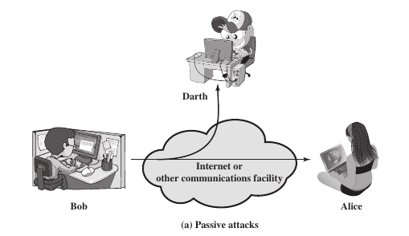

Slide 19
Active attacks (Figure) involve some modification of the data stream or the creation of a false stream and can be subdivided into four categories: masquerade, replay, modification of messages, and denial of service.
A masquerade takes place when one entity pretends to be a different entity (path 2 of Figure). A masquerade attack usually includes one of the other forms of active attack.
For example, authentication sequences can be captured and replayed after a valid authentication sequence has taken place, thus enabling an authorized entity with few privileges to obtain extra privileges by impersonating an entity that has those privileges.

Slide 20
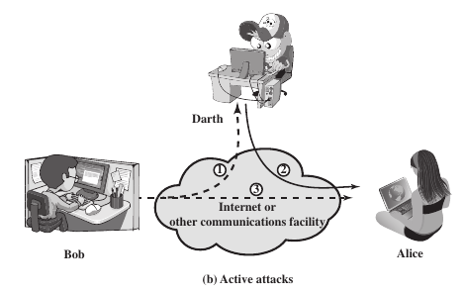

Slide 21
Replay involves the passive capture of a data unit and its subsequent retransmission to produce an unauthorized effect (paths 1, 2, and 3 active).
Modification of messages simply means that some portion of a legitimate message is altered, or that messages are delayed or reordered, to produce an unauthorized effect (paths 1 and 2 active).
For example, a message meaning “Allow John Smith to read confidential file accounts” is modified to mean “Allow Fred Brown to read confidential file accounts.”

Slide 22
The denial of service prevents or inhibits the normal use or management of communications facilities (path 3 active).
This attack may have a specific target; for example, an entity may suppress all messages directed to a particular destination.
Another form of service denial is the disruption of an entire network, either by disabling the network or by overloading it with messages so as to degrade performance.

Slide 23
Passive attacks are difficult to detect, measures are available to prevent their success.
On the other hand, it is quite difficult to prevent active attacks absolutely because of the wide variety of potential physical, software, and network vulnerabilities.
Instead, the goal is to detect active attacks and to recover from any disruption or delays caused by them.

Slide 24
Phishing
Phishing is a cybercrime where a person posing as a legitimate contact attempts to steal sensitive data from targets by email, phone, or text message.
Phishing is a method in which a target is contacted by someone posing as a trusted or known user or website to trick unsuspecting users into providing sensitive information.
Usually, unsuspecting users are directed to a fake login page, which will prompt them to enter their user account credentials.

Slide 25
Ransomware
Ransomware is a type of malware that infects your system by encrypting your files and folders and then demanding a ransom in exchange for the decryption key.
Some infamous ransomware attacks are WannaCry, Cryptowall, and NotPetya.

Slide 26
DoS attack
A DoS attack is an attack that makes computer systems inaccessible to their legitimate users by flooding the target site with multiple requests that trigger a crash.
DDoS attacks are similar, but instead of using one device, multiple connected devices are used to attack the target site.

Slide 27
Security Services
Security service is a service that is provided by a protocol layer of communicating open systems and that ensures adequate security of the systems or of data transfers.
It is also defined as processing or communication service that is provided by a system to give a specific kind of protection to system resources; security services implement security policies and are implemented by security mechanisms.
Security services are classified into five categories

Slide 28
Authentication
In the case of communicating a single message, the function of authentication service is to assure the recipient that the message is from the source that it claims to be from.
In the case of an ongoing interaction, such as the connection of a terminal to a host, two aspects are involved. First, at the time of connection initiation, the service assures that the two entities are authentic.
Second, the service must assure that the connection is not interfered with a third party who masquerade as one of the two legitimate parties for the purposes of unauthorized transmission or reception.

Slide 29
Two specific authentication services are defined:
Peer entity authentication:
Two entities are considered peers if they implement to same protocol in different systems; for example two TCP modules in two communicating systems. It attempts to provide confidence that an entity is not performing either a masquerade or an unauthorized replay of a previous connection.
Data origin authentication:
Provides authentication of the source of a data unit. It does not provide protection against the duplication or modification of data units. This type of service supports applications like electronic mail, where there are no prior interactions between the communicating entities.

Slide 30
Access Control
In the context of network security, access control is the ability to limit and control the access to host systems and applications.
To achieve this, each entity trying to gain access must first be identified, or authenticated, so that access rights can be tailored to the individual.

Slide 31
Data Confidentiality
Confidentiality is the protection of transmitted data from passive attacks. With respect to the content of a data transmission, several levels of protection can be identified. The broadest service protects all user data transmitted between two users over a period of time.
The other aspect of confidentiality is the protection of traffic flow from analysis. This requires that an attacker not be able to observe the source and destination, frequency, length, or other characteristics of the traffic on a communications facility.

Slide 32
Data Integrity
A connection-oriented integrity service, one that deals with a stream of messages, assures that messages are received as sent with no duplication, insertion, modification, reordering, or replays. The destruction of data is also covered under this service.
Thus, the connection-oriented integrity service addresses both message stream modification and denial of service.

Slide 33
On the other hand, a connectionless integrity service, one that deals with individual messages, generally provides protection against message modification only.
Because the integrity service relates to active attacks, we are concerned with detection rather than prevention.
If a violation of integrity is detected, then the service may simply report this violation, and some other portion of software or human intervention is required to recover from the violation.

Slide 34
Nonrepudiation
Nonrepudiation prevents either sender or receiver from denying a transmitted message.
Thus, when a message is sent, the receiver can prove that the alleged sender in fact sent the message.
Similarly, when a message is received, the sender can prove that the alleged receiver in fact received the message.

Slide 35
Security Mechanisms
SPECIFIC SECURITY MECHANISMS
May be incorporated into the appropriate protocol layer in order to provide some of the OSI security services.
Encipherment
The use of mathematical algorithms to transform data into a form that is not readily intelligible. The transformation and subsequent recovery of the data depend on an algorithm and zero or more encryption keys.
Access Control
A variety of mechanisms that enforce access rights to resources.

Slide 36
Digital Signature
Data appended to, or a cryptographic transformation of, a data unit that allows a recipient of the data unit to prove the source and integrity of the data unit and protect against forgery (e.g., by the recipient).
Data Integrity
A variety of mechanisms used to assure the integrity of a data unit or stream of data units.
Authentication Exchange
A mechanism intended to ensure the identity of an entity by means of information exchange.

Slide 37
Traffic Padding
The insertion of bits into gaps in a data stream to frustrate traffic analysis attempts.
Routing Control
Enables selection of particular physically secure routes for certain data and allows routing changes, especially when a breach of security is suspected.
Notarization
The use of a trusted third party to assure certain properties of a data exchange.

Slide 38
PERVASIVE SECURITY MECHANISMS
Mechanisms that are not specific to any particular OSI security service or protocol layer.
Trusted Functionality
That which is perceived to be correct with respect to some criteria (e.g., as established by a security policy).
Security Label
The marking bound to a resource (which may be a data unit) that names or designates the security attributes of that resource.

Slide 39
Event Detection
Detection of security-relevant events.
Security Audit Trail
Data collected and potentially used to facilitate a security audit, which is an independent review and examination of system records and activities.
Security Recovery
Deals with requests from mechanisms, such as event handling and management functions, and takes recovery actions.

Slide 40
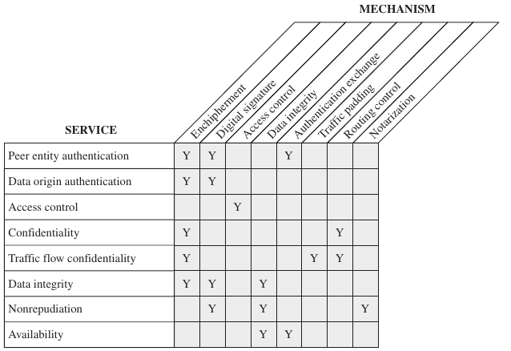
Relationship Between Security Services and Mechanisms

Slide 41
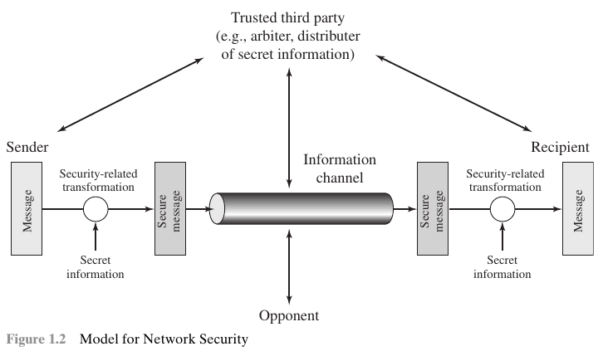
A Model for Network Security

Slide 42
All the techniques for providing security have two components:
• A security-related transformation on the information to be sent. Examples include the encryption of the message, which scrambles the message so that it is unreadable by the opponent, and the addition of a code based on the contents of the message, which can be used to verify the identity of the sender.
• Some secret information shared by the two principals and, it is hoped, unknown to the opponent. An example is an encryption key used in conjunction with the transformation to scramble the message before transmission and unscramble it on reception.

Slide 43
A trusted third party may be needed to achieve secure transmission.
For example, a third party may be responsible for distributing the secret information to the two principals while keeping it from any opponent.
Or a third party may be needed to arbitrate disputes between the two principals concerning the authenticity of a message transmission.

Slide 44
This general model shows that there are four basic tasks in designing a particular security service:
1. Design an algorithm for performing the security-related transformation. The algorithm should be such that an opponent cannot defeat its purpose.
2. Generate the secret information to be used with the algorithm.
3. Develop methods for the distribution and sharing of the secret information.
4. Specify a protocol to be used by the two principals that makes use of the security algorithm and the secret information to achieve a particular security service.

Slide 45
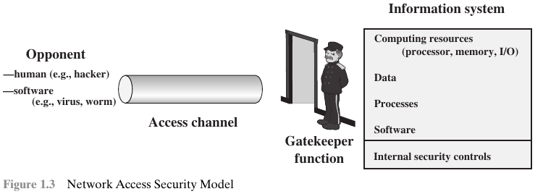
There are other security-related situations of interest that do not fit this model. A general model of these other situations is illustrated:

Slide 46
One type of unwanted access is the placement in a computer system of logic that exploits vulnerabilities in the system and that can affect application programs as well as utility programs, such as editors and compilers.
Programs can present two kinds of threats:
Information access threats: Intercept or modify data on behalf of users who should not have access to that data.
Service threats: Exploit service flaws in computers to inhibit use by legitimate users.
Viruses and worms are two examples of software attacks.

Slide 47
The security mechanisms needed to cope with unwanted access fall into two broad categories (Figure).
The first category might be termed a gatekeeper function. It includes password-based login procedures that are designed to deny access to all but authorized users and screening logic that is designed to detect and reject worms, viruses, and other similar attacks.
Once either an unwanted user or unwanted software gains access, the second line of defense consists of a variety of internal controls that monitor activity and analyze stored information in an attempt to detect the presence of unwanted intruders.

Slide 48
Classical Encryption Techniques

Slide 49
An original message is known as the plaintext, while the coded message is called the ciphertext.
The process of converting from plaintext to ciphertext is known as enciphering or encryption; restoring the plaintext from the ciphertext is deciphering or decryption.
The many schemes used for encryption constitute the area of study known as cryptography.

Slide 50
Such a scheme is known as a cryptographic system or a cipher.
Techniques used for deciphering a message without any knowledge of the enciphering details fall into the area of cryptanalysis.
Cryptanalysis is what the layperson calls “breaking the code.”
The areas of cryptography and cryptanalysis together are called cryptology.

Slide 51
Symmetric Cipher Model
A symmetric encryption scheme has five ingredients (Figure):
• Plaintext: This is the original intelligible message or data that is fed into the algorithm as input.
• Encryption algorithm: The encryption algorithm performs various substitutions and transformations on the plaintext.
• Secret key: The secret key is also input to the encryption algorithm. The key is a value independent of the plaintext and of the algorithm. The algorithm will produce a different output depending on the specific key being used at the time.

Slide 52
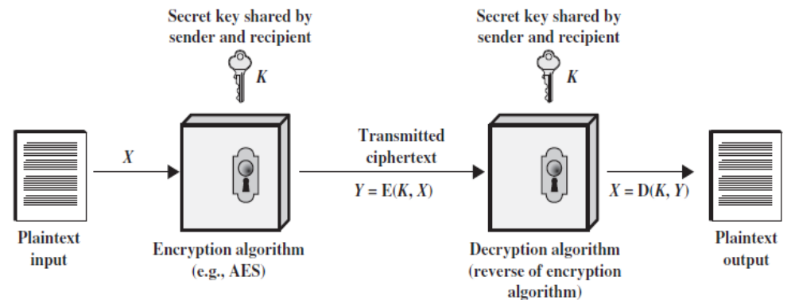

Slide 53
• Ciphertext: This is the scrambled message produced as output. It depends on the plaintext and the secret key. For a given message, two different keys will produce two different ciphertexts.
• Decryption algorithm: This is essentially the encryption algorithm run in reverse. It takes the ciphertext and the secret key and produces the original plaintext.

Slide 54
There are two requirements for secure use of conventional encryption:
1. We need a strong encryption algorithm. The opponent should be unable to decrypt ciphertext or discover the key even if he or she is in possession of a number of ciphertexts together with the plaintext that produced each ciphertext.
2. Sender and receiver must have obtained copies of the secret key in a secure fashion and must keep the key secure.

Slide 55
Let us take a closer look at the essential elements of a symmetric encryption scheme (Figure).
A source produces a message in plaintext, X = [X₁, X₂, X₃,…. X_{M}]. The M elements of X are letters in some finite alphabet.
For encryption, a key of the form K = [K₁, K₂, K₃,…. K_{J}] is generated.
If the key is generated at the message source, then it must also be provided to the destination by means of some secure channel.
Alternatively, a third party could generate the key and securely deliver it to both source and destination.

Slide 56
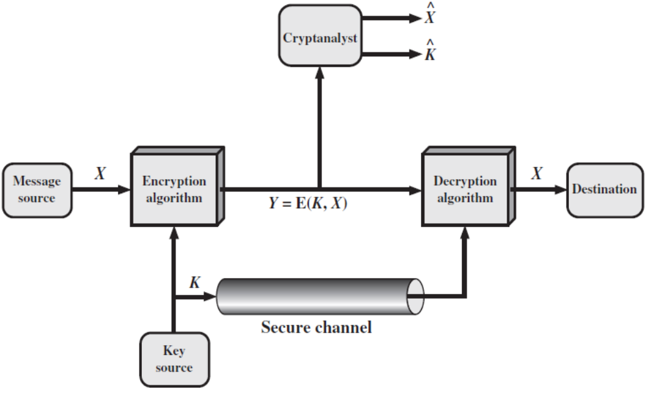

Slide 57
With the message X and the encryption key K as input, the encryption algorithm forms the ciphertext Y = [Y₁, Y₂, Y₃,…. Y_{N}]. We can write this as Y = E(K, X)
The intended receiver, in possession of the key, is able to invert the transformation: X = D(K, Y).
A cryptanalyst, observing Y but not having access to K or X, may attempt to recover X or K or both X and K. It is assumed that the opponent knows the encryption (E) and decryption (D) algorithms.

Slide 58
Cryptography
Cryptographic systems are characterized along three independent dimensions:
The type of operations used for transforming plaintext to ciphertext. All encryption algorithms are based on two general principles: substitution, in which each element in the plaintext (bit, letter, group of bits or letters) is mapped into another element, and transposition, in which elements in the plaintext are rearranged. Most systems, referred to as product systems, involve multiple stages of substitutions and transpositions.

Slide 59
2. The number of keys used. If both sender and receiver use the same key, the system is referred to as symmetric, single-key, secret-key, or conventional encryption. If the sender and receiver use different keys, the system is referred to as asymmetric, two-key, or public-key encryption.
3. The way in which the plaintext is processed. A block cipher processes the input one block of elements at a time, producing an output block for each input block. A stream cipher processes the input elements continuously, producing output one element at a time.

Slide 60
Cryptanalysis and Brute-Force Attack
The objective of attacking an encryption system is to recover the key in use. Two general approaches to attacking a conventional encryption scheme:
• Cryptanalysis: Cryptanalytic attacks rely on the nature of the algorithm plus perhaps some knowledge of the general characteristics of the plaintext or even some sample plaintext–ciphertext pairs.
• Brute-force attack: The attacker tries every possible key on a piece of ciphertext until an intelligible translation into plaintext is obtained. On average, half of all possible keys must be tried to achieve success.

Slide 61
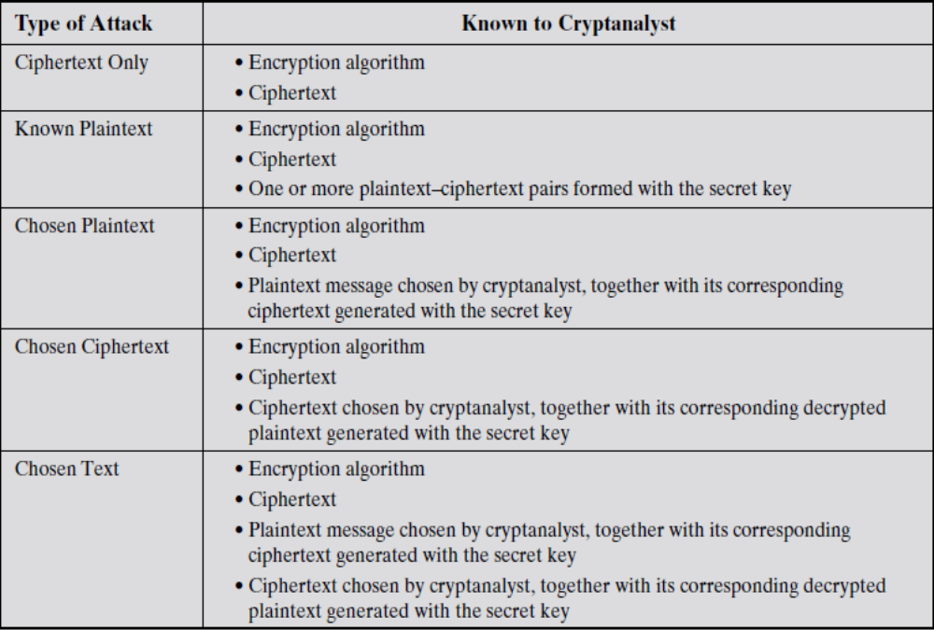

Slide 62
The most difficult problem is presented when all that is available is the ciphertext only.
The analyst may know that certain plaintext patterns will appear in a message. For example, a file that is encoded in the Postscript format always begins with the same pattern, or there may be a standardized header or banner to an electronic funds transfer message, and so on. All these are examples of known plaintext. With this knowledge, the analyst may be able to deduce the key on the basis of the way in which the known plaintext is transformed.

Slide 63
If the analyst is able somehow to get the source system to insert into the system a message chosen by the analyst, then a chosen-plaintext attack is possible. In general, if the analyst is able to choose the messages to encrypt, the analyst may deliberately pick patterns that can be expected to reveal the structure of the key.
Chosen ciphertext and chosen text are less commonly employed as cryptanalytic techniques.

Slide 64
An encryption scheme is unconditionally secure if the ciphertext generated by the scheme does not contain enough information to determine uniquely the corresponding plaintext, no matter how much ciphertext is available.
An encryption scheme is said to be computationally secure if either of the two criteria are met:
1. The cost of breaking the cipher exceeds the value of the encrypted information.
2. The time required to break the cipher exceeds the useful lifetime of the information.

Slide 65
Substitution Techniques
In substitution technique, letters of plaintext are replaced by other letters or by numbers or symbols. If the plaintext is viewed as a sequence of bits, then substitution involves replacing plaintext bit patterns with ciphertext bit patterns.
Caesar Cipher
The earliest known use of a substitution cipher was by Julius Caesar. The Caesar cipher involves replacing each letter of the alphabet with the letter standing three places further down the alphabet.

Slide 66
For example,
plain: meet me after the toga party
cipher: PHHW PH DIWHU WKH WRJD SDUWB
Let us assign a numerical equivalent to each letter : a-0,b-1,...z-25
Then the algorithm can be expressed as follows. For each plaintext letter p, substitute the ciphertext letter C:
C = E(3, p) = (p + 3) mod 26

Slide 67
A shift may be of any amount, so that the general Caesar algorithm is
C = E(k, p) = (p + k) mod 26
where k takes on a value in the range 1 to 25.
The decryption algorithm is simply
p = D(k, C) = (C - k) mod 26
If it is known that a given ciphertext is a Caesar cipher, then a brute-force cryptanalysis is easily performed: simply try all the 25 possible keys.

Slide 68
Monoalphabetic Ciphers
With only 25 possible keys, the Caesar cipher is far from secure. A dramatic increase in the key space can be achieved by allowing an arbitrary substitution.
If the “cipher” line can be any permutation of the 26 alphabetic characters, then there are 26! or greater than 4x10²⁶ possible keys.
This is 10 orders of magnitude greater than the key space for DES and would seem to eliminate brute-force techniques for cryptanalysis.

Slide 69
There is, however, another line of attack. If the cryptanalyst knows the nature of the plaintext (e.g., noncompressed English text), then the analyst can exploit the regularities of the language.
As a first step, the relative frequency of the letters can be compared to a standard frequency distribution for English, such as shown in Figure.

Slide 70
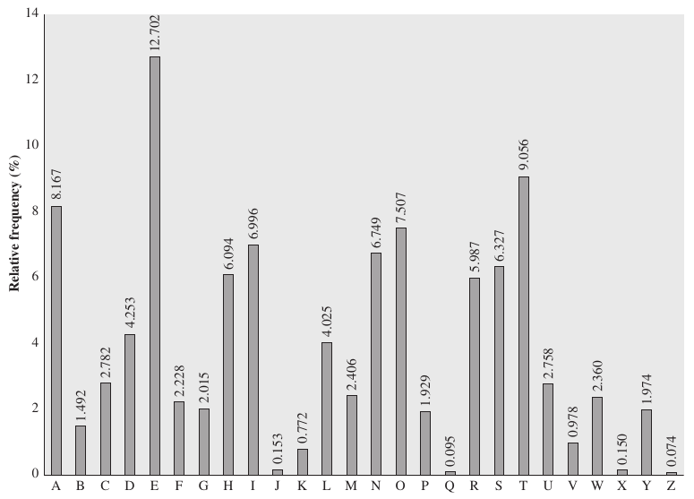

Slide 71
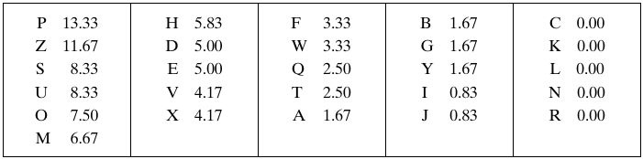
To see how such a cryptanalysis might proceed, a partial example ciphertext to be solved is:
UZQSOVUOHXMOPVGPOZPEVSGZWSZOPFPESXUDBMETSXAIZVUEPHZHMDZSHZOWSFPAPPDTSVPQUZWYMXUZUHSXEPYEPOPDZSZUFPOMBZWPFUPZHMDJUDTMOHMQ
The relative frequencies of the letters in the ciphertext (in percentages) are as follows:

Slide 72
Comparing this breakdown with Figure, it seems likely that cipher letters P and Z are the equivalents of plain letters e and t, but it is not certain which is which.
The letters S, U, O, M, and H are all of relatively high frequency and probably correspond to plain letters from the set {a, h, i, n, o, r, s}.
The letters with the lowest frequencies (namely, A, B, G, Y, I, J) are likely included in the set {b, j, k, q, v, x, z}.

Slide 73
A powerful tool is to look at the frequency of two-letter combinations, known as digrams.
The most common such digram is th. In our ciphertext, the most common digram is ZW, which appears three times. So we make the correspondence of Z with t and W with h. Then, by our earlier hypothesis, we can equate P with e.
Now notice that the sequence ZWP appears in the ciphertext, and we can translate that sequence as “the.” This is the most frequent trigram (three-letter combination) in English, which seems to indicate that we are on the right track.

Slide 74
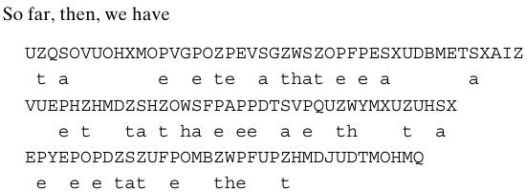
Next, notice the sequence ZWSZ in the first line. We do not know that these four letters form a complete word, but if they do, it is of the form th_t. If so, S equates with a.

Slide 75
Monoalphabetic ciphers are easy to break because they reflect the frequency data of the original alphabet.
A countermeasure is to provide multiple substitutes for a single letter, known as homophones.
For example, the letter e could be assigned a number of different cipher symbols, such as 16, 74, 35, and 21, with each homophone assigned to a letter in rotation or randomly.

Slide 76
Even with homophones, each element of plaintext affects only one element of ciphertext, and multiple-letter patterns (e.g., digram frequencies) still survive in the ciphertext, making cryptanalysis relatively straightforward.
Two principal methods are used in substitution ciphers to lessen the extent to which the structure of the plaintext survives in the ciphertext: One approach is to encrypt multiple letters of plaintext, and the other is to use multiple cipher alphabets.

Slide 77
Playfair Cipher
The best-known multiple-letter encryption cipher is the Playfair, which treats digrams in the plaintext as single units and translates these units into ciphertext digrams.
The Playfair algorithm is based on the use of a 5 x 5 matrix of letters constructed using a keyword.

Slide 78
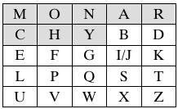
In this example, the keyword is monarchy. The matrix is constructed by filling in the letters of the keyword (minus duplicates) from left to right and from top to bottom, and then filling in the remainder of the matrix with the remaining letters in alphabetic order.

Slide 79
The letters I and J count as one letter. Plaintext is encrypted two letters at a time, according to the following rules:
1. Repeating plaintext letters that are in the same pair are separated with a filler letter, such as x, so that balloon would be treated as ba lx lo on.
2. Two plaintext letters that fall in the same row of the matrix are each replaced by the letter to the right, with the first element of the row circularly following the last. For example, ar is encrypted as RM.

Slide 80
3. Two plaintext letters that fall in the same column are each replaced by the letter beneath, with the top element of the column circularly following the last. For example, mu is encrypted as CM.
4. Otherwise, each plaintext letter in a pair is replaced by the letter that lies in its own row and the column occupied by the other plaintext letter. Thus, hs becomes BP and ea becomes IM (or JM, as the encipherer wishes).

Slide 81
The Playfair cipher is a great advance over simple monoalphabetic ciphers. For one thing, whereas there are only 26 letters, there are 26 x 26 = 676 digrams, so that identification of individual digrams is more difficult.
Furthermore, the relative frequencies of individual letters exhibit a much greater range than that of digrams, making frequency analysis much more difficult.
For these reasons, the Playfair cipher was for a long time considered unbreakable.

Slide 82
Hill Cipher
The Hill Algorithm: This encryption algorithm takes m successive plaintext letters and substitutes for them m ciphertext letters.
The substitution is determined by m linear equations in which each character is assigned a numerical value (a = 0, b = 1, c, z = 25).
For m = 3, the system can be described as

Slide 83
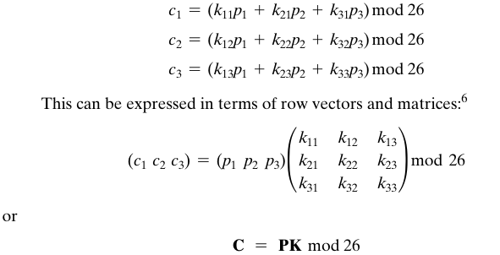

Slide 84

where C and P are row vectors of length 3 representing the plaintext and ciphertext, and K is a 3 x 3 matrix representing the encryption key. Operations are performed mod 26.
For example, consider the plaintext “paymoremoney” and use the encryption key

Slide 85
The first three letters of the plaintext are represented by the vector (15 0 24).
Then(15 0 24)K = (303 303 531) mod 26 = (17 17 11) = RRL.
Continuing in this fashion, the ciphertext for the entire plaintext is RRLMWBKASPDH.
Decryption requires using the inverse of the matrix K. We can compute det K = 23, and therefore, (det K)⁻¹ mod 26 = 17.
We can then compute the inverse as

Slide 86
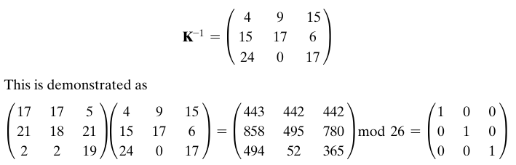
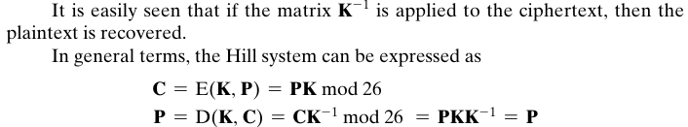

Slide 87
As with Playfair, the strength of the Hill cipher is that it completely hides single-letter frequencies.
Indeed, with Hill, the use of a larger matrix hides more frequency information. Thus, a 3 x 3 Hill cipher hides not only single-letter but also two-letter frequency information.
Although the Hill cipher is strong against a ciphertext-only attack, it is easily broken with a known plaintext attack.

Slide 88
Polyalphabetic Ciphers
Another way to improve on the simple monoalphabetic technique is to use different monoalphabetic substitutions as one proceeds through the plaintext message.
Vigenère Cipher
The best known, and one of the simplest, polyalphabetic ciphers is the Vigenère cipher.
In this scheme, the set of related monoalphabetic substitution rules consists of the 26 Caesar ciphers with shifts of 0 through 25.

Slide 89
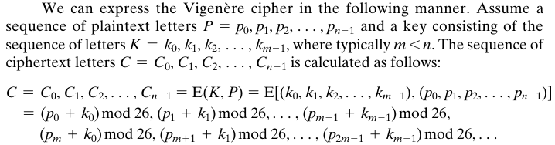

Slide 90


A general equation of the encryption process is
Similarly, decryption is a generalization of
To encrypt a message, a key is needed that is as long as the message. For example, if the keyword is deceptive, the message “we are discovered save yourself” is encrypted as

Slide 91
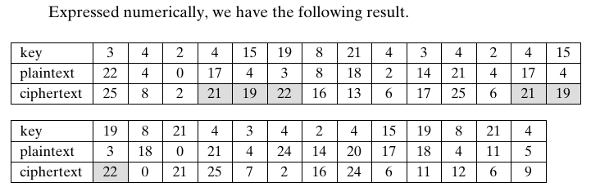

Slide 92
The strength of this cipher is that there are multiple ciphertext letters for each plaintext letter, one for each unique letter of the keyword. Thus, the letter frequency information is obscured.
If the keyword length is m, then the cipher consists of m monoalphabetic substitution ciphers.
For example, with the keyword DECEPTIVE, the letters in positions 1, 10, 19, and so on are all encrypted with the same monoalphabetic cipher.
Thus, we can use the known frequency characteristics of the plaintext language to attack each of the monoalphabetic ciphers separately.

Slide 93

The periodic nature of the keyword can be eliminated by using a nonrepeating keyword that is as long as the message itself.
Vigenère proposed what is referred to as an autokey system, in which a keyword is concatenated with the plaintext itself to provide a running key. For our example,

Slide 94
Vernam Cipher
The ultimate defense against such a cryptanalysis is to choose a keyword that is as long as the plaintext and has no statistical relationship to it. Such a system was introduced by an AT&T engineer named Gilbert Vernam in 1918.
His system works on binary data (bits) rather than letters. The system can be expressed succinctly as follows (Figure):

Slide 95
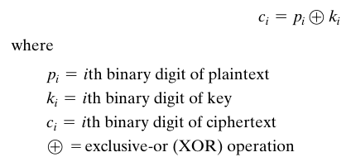

Slide 96
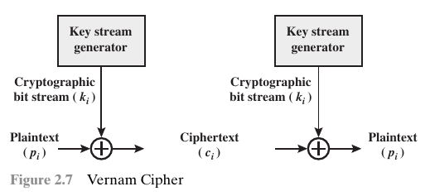

Slide 97

Decryption simply involves the same bitwise operation:
The essence of this technique is the means of construction of the key. Vernam proposed the use of a running loop of tape that eventually repeated the key.

Slide 98
One-Time Pad
It was suggested to use a random key that is as long as the message, so that the key need not be repeated.
In addition, the key is to be used to encrypt and decrypt a single message, and then is discarded. Each new message requires a new key of the same length as the new message.
Such a scheme, known as a one-time pad, is unbreakable.
Because the ciphertext contains no information whatsoever about the plaintext, there is simply no way to break the code.

Slide 99
For example consider the ciphertext
ANKYODKYUREPFJBYOJDSPLREYIUNOFDOIUERFPLUYTS
We now show two different decryptions using two different keys:

Slide 100
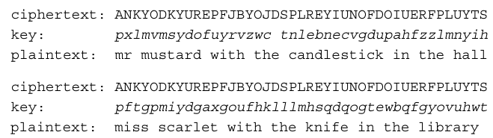

Slide 101
Suppose that a cryptanalyst had managed to find these two keys. Two plausible plaintexts are produced.
How is the cryptanalyst to decide which is the correct decryption (i.e., which is the correct key)?
If the actual key were produced in a truly random fashion, then the cryptanalyst cannot say that one of these two keys is more likely than the other.
The security of the one-time pad is entirely due to the randomness of the key.

Slide 102
The one-time pad offers complete security but, in practice, has two fundamental difficulties:
1. There is the practical problem of making large quantities of random keys. Any heavily used system might require millions of random characters on a regular basis.
2. Next, the problem of key distribution and protection. For every message to be sent, a key of equal length is needed by both sender and receiver.

Slide 103
Transposition Techniques
This is achieved by performing some sort of permutation on the plaintext letters. This technique is referred to as transposition cipher.
The simplest such cipher is the rail fence technique, in which the plaintext is written down as a sequence of diagonals and then read off as a sequence of rows.
For example, to encipher the message “meet me after the toga party” with a rail fence of depth 2, we write the following:

Slide 104

The encrypted message is
MEMATRHTGPRYETEFETEOAAT
This sort of thing would be trivial to cryptanalyze.
A more complex scheme is to write the message in a rectangle, row by row, and read the message off, column by column, but permute the order of the columns.

Slide 105
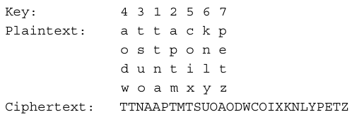
The order of the columns then becomes the key to the algorithm. For example,

Slide 106
Thus, in this example, the key is 4312567.
To encrypt, start with the column that is labeled 1, in this case column 3. Write down all the letters in that column. Proceed to column 4, which is labeled 2, then column 2, then column 1, then columns 5, 6, and 7.
A pure transposition cipher is easily recognized because it has the same letter frequencies as the original plaintext.

Slide 107
The transposition cipher can be made significantly more secure by performing more than one stage of transposition.
The result is a more complex permutation that is not easily reconstructed.
Thus, if the foregoing message is reencrypted using the same algorithm,

Slide 108
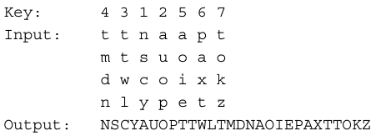
Designate the letters in the original plaintext message by the numbers designating their position. Thus, with 28 letters in the message, the original sequence of letters is

Slide 109
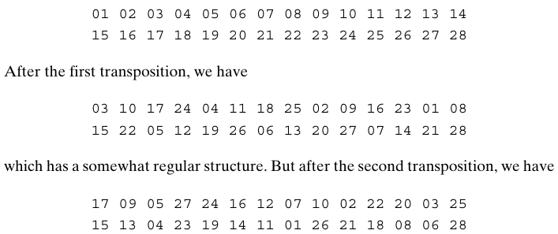

Slide 110
Steganography
A plaintext message may be hidden in one of two ways.
The methods of steganography conceal the existence of the message, whereas the methods of cryptography render the message unintelligible to outsiders by various transformations of the text.
Steganography

Slide 111
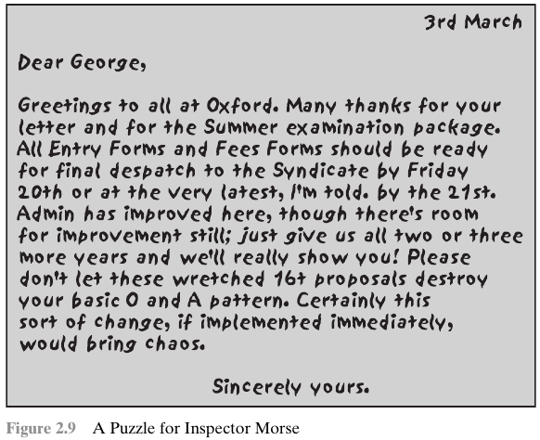

Slide 112
A simple form of steganography, is one in which an arrangement of words or letters within a text spells out the real message.
For example, the sequence of first letters of each word of the overall message spells out the hidden message.
Figure shows an example in which a subset of the words of the overall message is used to convey the hidden message.

Slide 113
Various other techniques have been used historically:
1. Character marking: Selected letters of printed or typewritten text are overwritten in pencil. The marks are ordinarily not visible unless the paper is held at an angle to bright light.
2. Invisible ink: A number of substances can be used for writing but leave no visible trace until heat or some chemical is applied to the paper.

Slide 114
3. Pin punctures: Small pin punctures on selected letters are ordinarily not visible unless the paper is held up in front of a light.
4. Typewriter correction ribbon: Used between lines typed with a black ribbon, the results of typing with the correction tape are visible only under a strong light.
Although these techniques may seem archaic, they have contemporary equivalents.

Slide 115
For example, hiding a message by using the least significant bits of frames on a CD. The Kodak Photo CD format’s maximum resolution is 3096 * 6144 pixels, with each pixel containing 24 bits of RGB color information.
The least significant bit of each 24-bit pixel can be changed without greatly affecting the quality of the image.
The result is that you can hide a 130-kB message in a single digital snapshot.

Slide 116
Steganography has a number of drawbacks when compared to encryption.
It requires a lot of overhead to hide a relatively few bits of information.
Also, once the system is discovered, it becomes virtually worthless. This problem can be overcome if the insertion method depends on some sort of key.
Alternatively, a message can be first encrypted and then hidden using steganography.

