Slide 1

JOB SEQUENCING WITH DEADLINES

Slide 2
The problem is stated as below.
There are n unit time jobs to be processed on a machine.
Each job i has a deadline d_{i}≥ 0 and profit p_{i}≥0 .
Pi is earned if the job i is completed by its deadline.
The job is completed if it is processed on a machine for unit time.
Only one machine is available for processing jobs.
Only one job is processed at a time on the machine.

Slide 3
A feasible solution is a subset of jobs J such that each job is completed by its deadline.
Value of feasible solution is sum of profits of all jobs in J
An optimal solution is a feasible solution with maximum profit value.

Slide 4
Example : Let n = 4, (p₁,p₂,p₃,p₄) = (100,10,15,27), (d₁,d₂,d₃,d₄) = (2,1,2,1)

Slide 5
GREEDY ALGORITHM TO OBTAIN AN OPTIMAL SOLUTION
Consider the jobs in the non increasing order of profits subject to the constraint that the resulting job sequence J is a feasible solution.
In the example considered before, the non-increasing profit vector is
  (100 27 15 10) (2 1 2 1) p₁ p₄ p₃ p₂ d₁ d₄ d₃ d₂

Slide 6
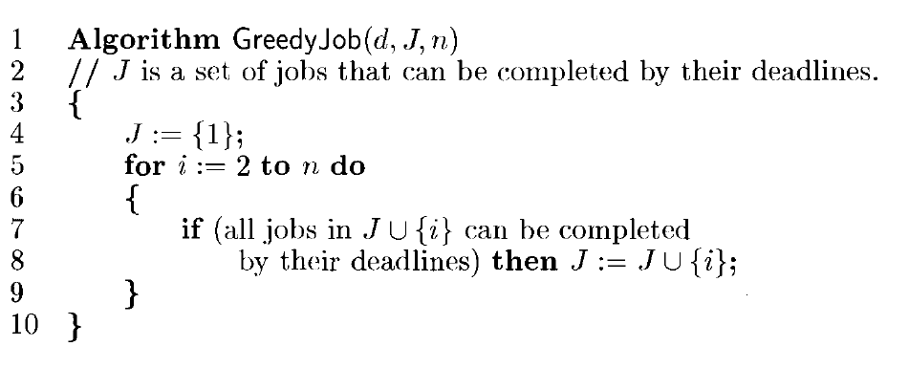

Slide 7
J = { 1} is a feasible one
J = { 1, 4} is a feasible one with processing sequence ( 4,1)
J = { 1, 3, 4} is not feasible
J = { 1, 2, 4} is not feasible
J = { 1, 4} is optimal

Slide 8
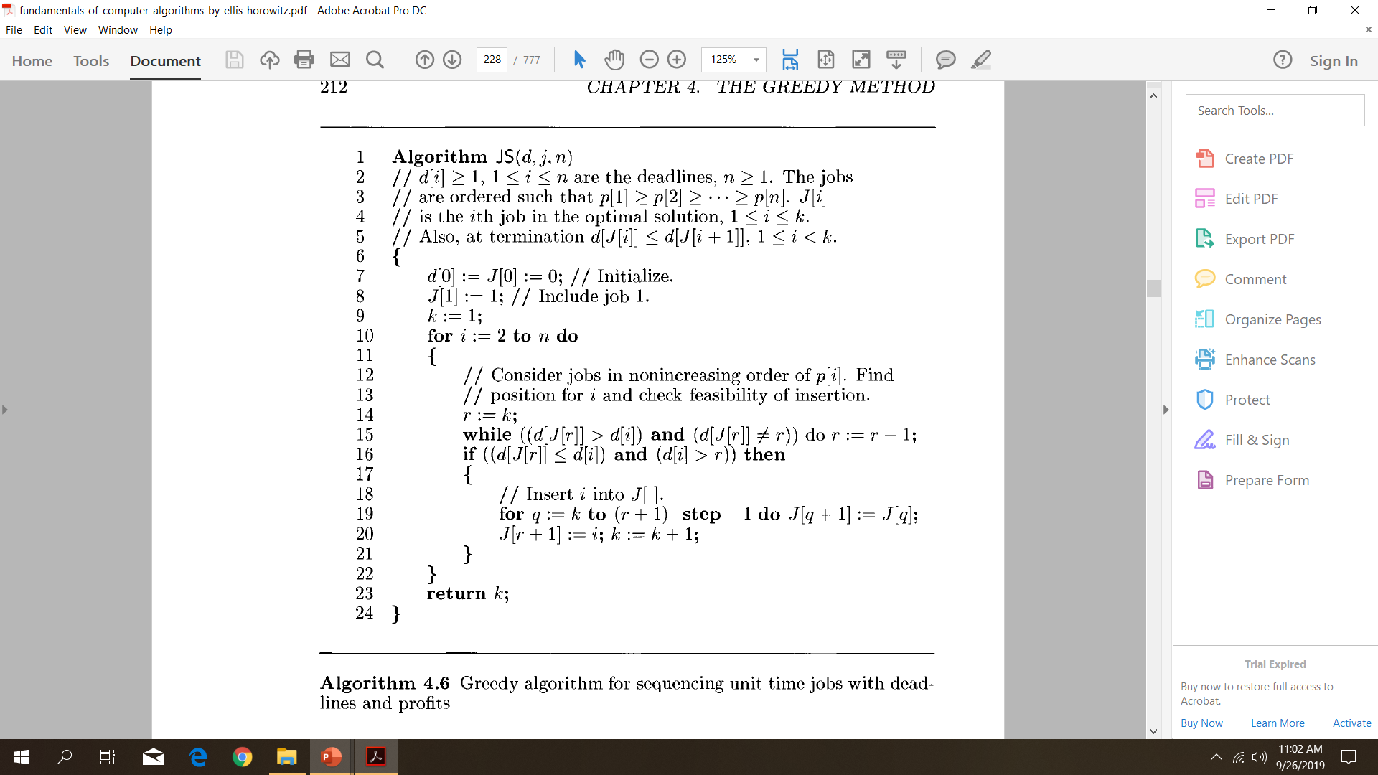

Slide 9
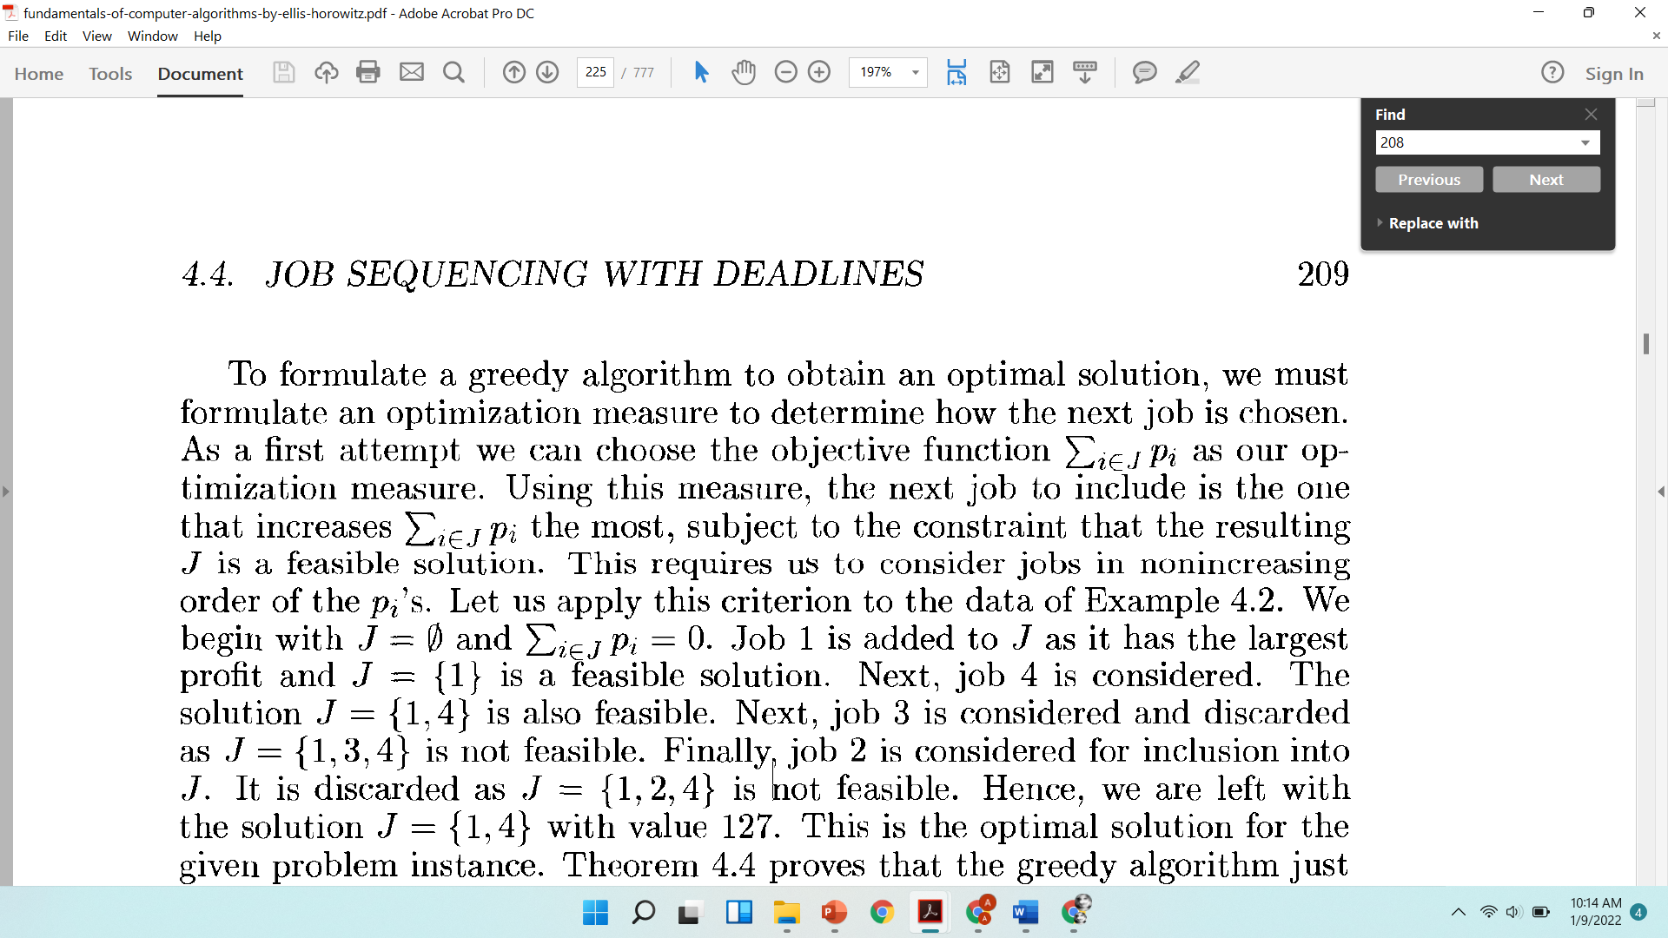
Consider jobs in nonincreasing order of the profits.
Begin with J = 0 and initially job 1is addedto J as it has the largest profit and J = {1}is a feasiblesolution .
Next,job4 is considered.
The solutionJ = {1,4}is also feasible.
Next,job3 is considered and discarded as J = {1, 3,4}is not feasible.
Finally,job2 is considered for inclusion into J.
It is discardedas J = {1,2,4is}not feasible.
Hence,we are left with the solutionJ = {1,4}with value 127

Slide 10
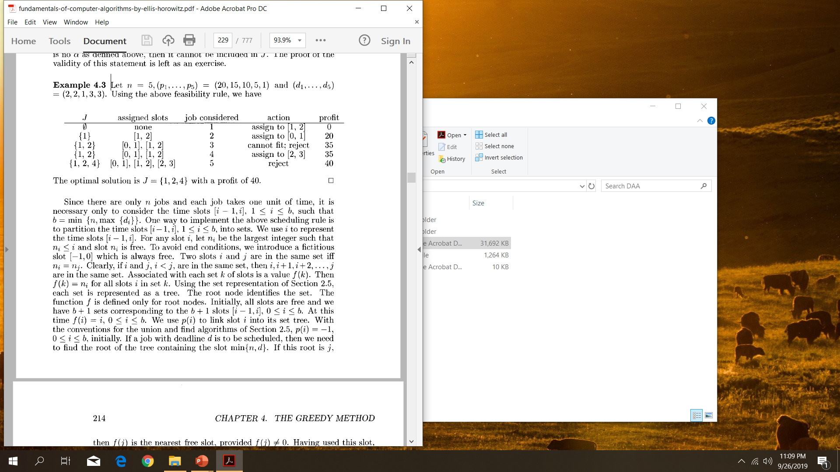
Example Let n = 5,(p1,.,p5) =(20,15,10,5) and (di,...,d5) = (2,2,1, 3,3)

Slide 11
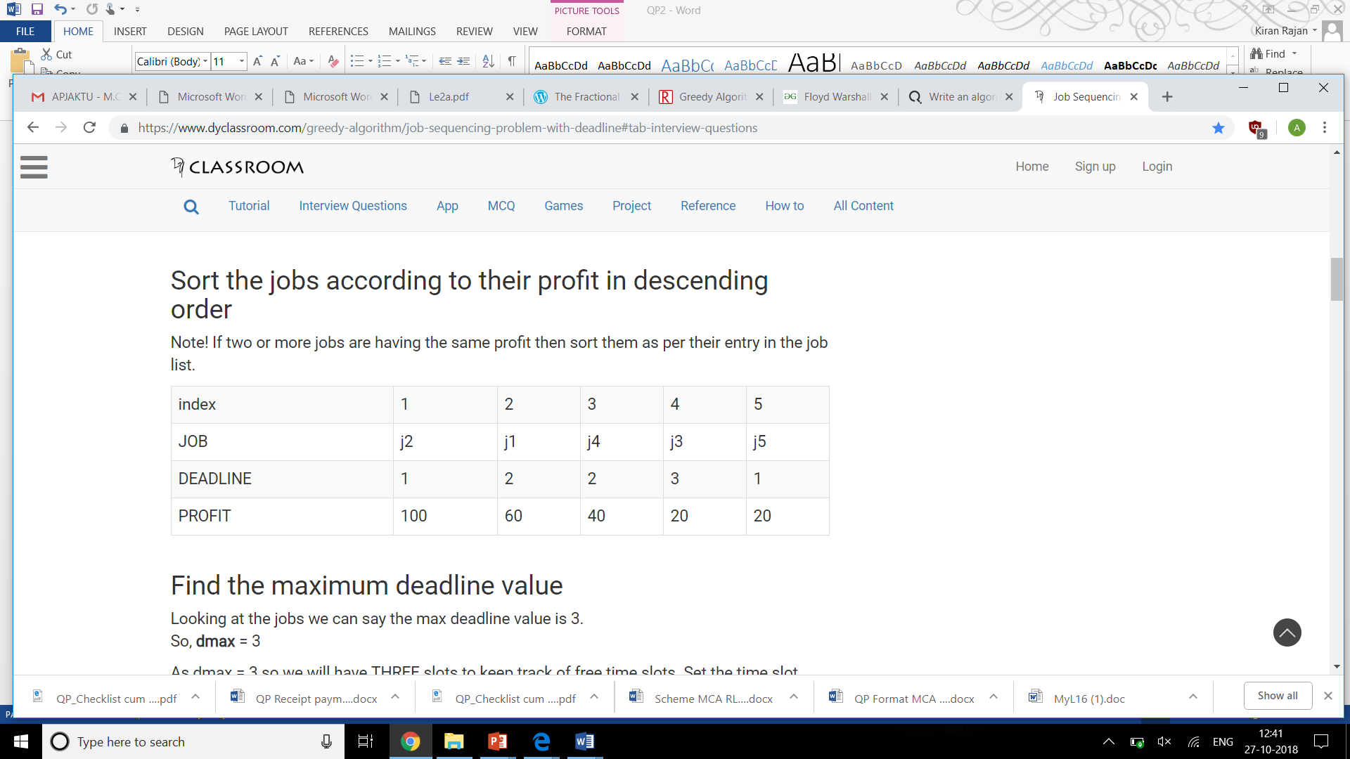
Solve the following job sequencing problem

Slide 12
Answer
Job Deadline Profit
j2 1 100
j1 2 60
j4 2 40
j3 3 20
j5 1 20
Required Jobs: j2 --> j1 --> j3
Max Profit: 180

