Slide 1

Kruskal’s algorithm

Slide 2
Here edges in tree considered in non decreasing order (increasing order) of cost
If ‘t’ be a set of edges so far selected for spanning tree ,such that it is possible to complete ‘t’ to a tree
‘t’ may not be a tree at all stages in algorithm
initially ‘t’ may be a forest

Slide 3
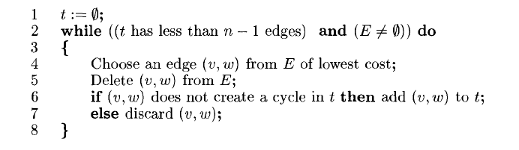

Slide 4

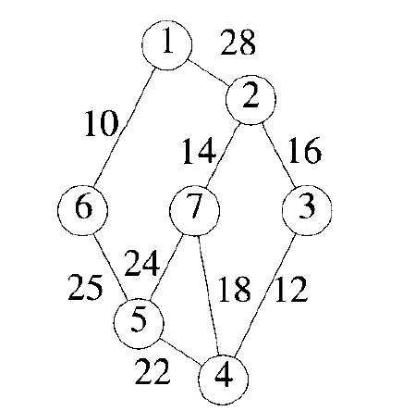
example

Slide 5
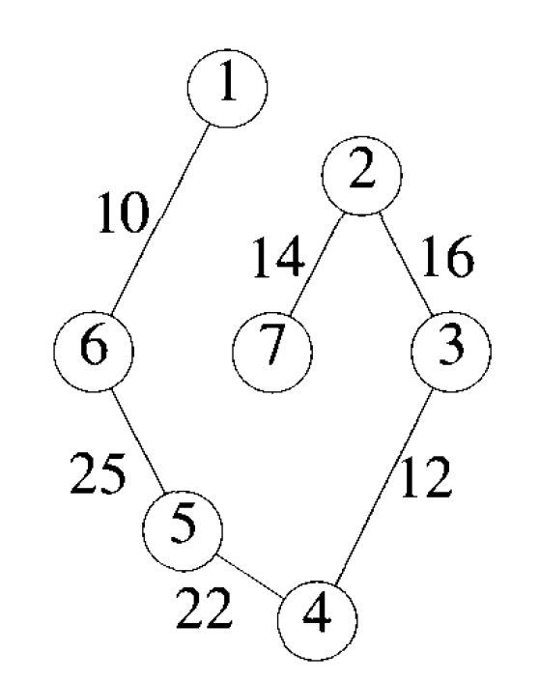
Minimal Spanning Tree

Slide 6
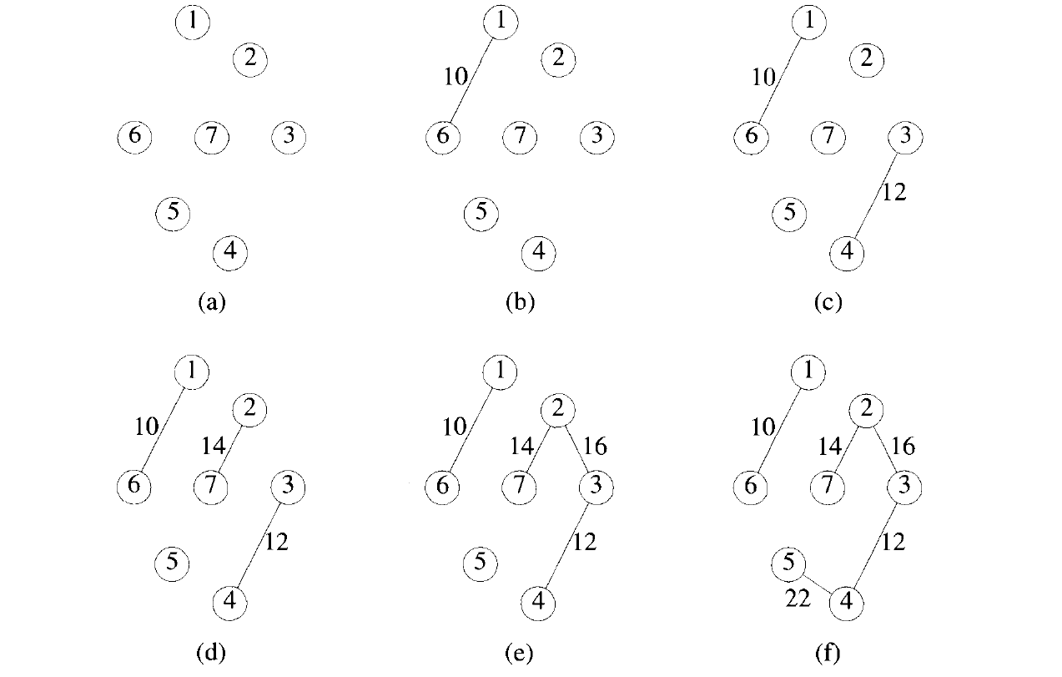

Slide 7
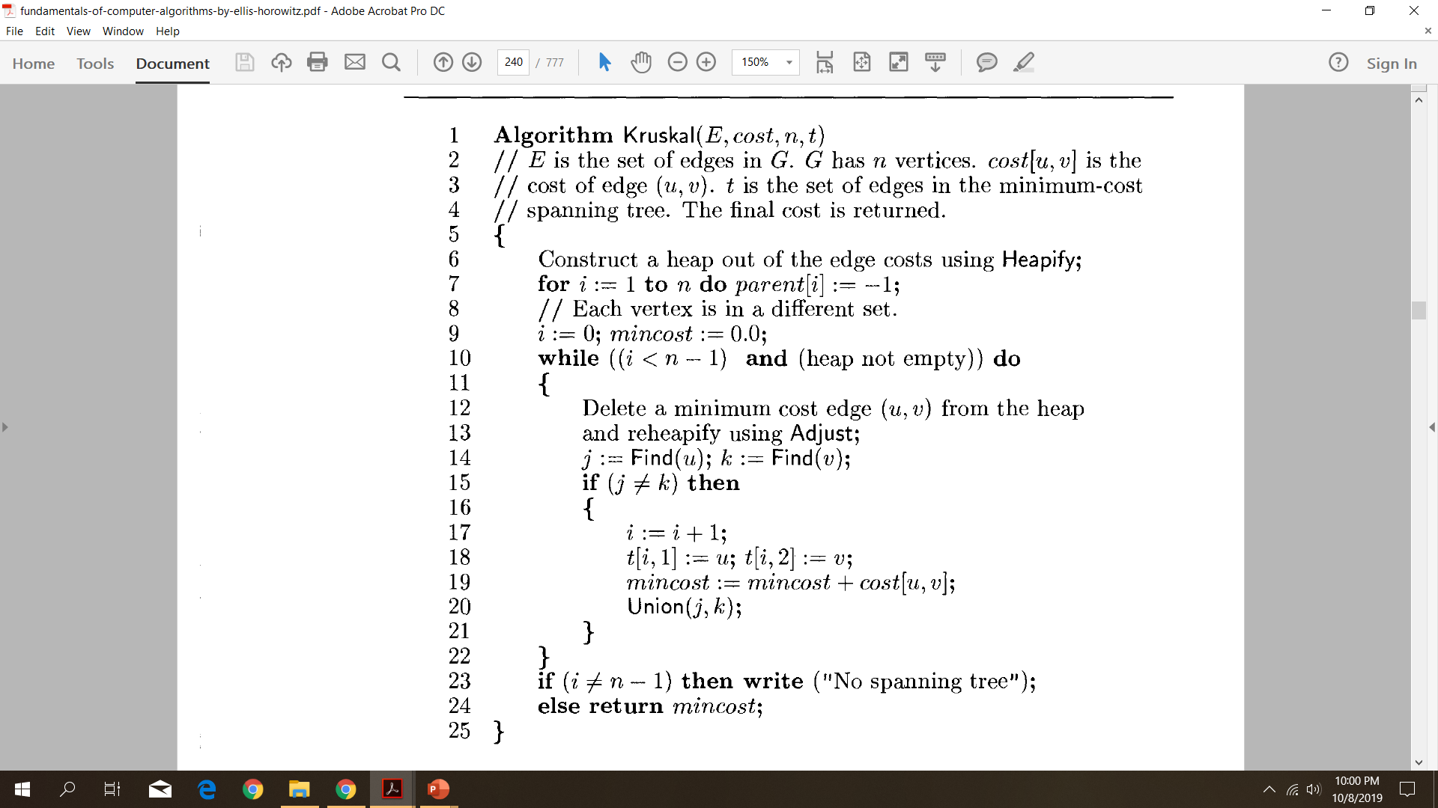

Slide 8
Initially E is the set of all edges in G.
Determine an edge with minimum cost(line 4)
delete this edge(line5).
If the edges are maintained as a minheap,then the next edge to consider can be obtained in O(log|E|) time
If the selected edge (v,w) are already connected ,then the edge(v,w) is discarded.One possible grouping is to place all vertices in the same connected component of t into a set Then, two vertices v and w are connected in t iff they are in the same set
Else (v,w)is to be added to t

Slide 9

The set t can be represented as a sequential list using a two-dimensional array t[l:n ,1:2].
Edge(u,v) can be added to t by the assignments t[i,1]:=u; and t[i,2] :=v;.
These t containing u and v are combined (line20).
Line 23 determines whether a spanning tree was found.

Slide 10
Construct the minimum spanning tree (MST) for the given graph using Kruskal’s algorithm

Slide 11
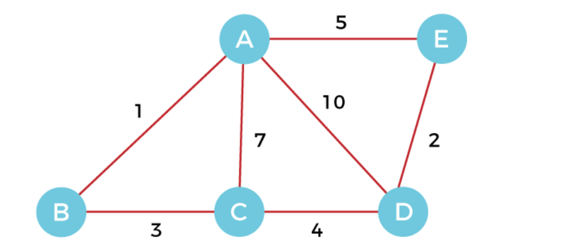

Slide 13
Minimum Connector Algorithms
Kruskal’s algorithm
Select the shortest edge in a network
Select the next shortest edge which does not create a cycle
Repeat step 2 until all vertices have been connected
Prim’s algorithm
Select any vertex
Select the shortest edge connected to that vertex
Select the shortest edge connected to any vertex already connected
Repeat step 3 until all vertices have been connected

