Slide 1
Exploratory Data Analysis
Cab G2M
Brian Orina Bundi
3/16/2021

Slide 2
Background – G2M(cab industry) Case Study
• XYZ is a private equity firm in US. Due to remarkable growth in the Cab Industry in last few years and multiple key players in the market, it is planning for an investment in Cab industry.
Objective :- Provide actionable insights to help XYZ firm in identifying the right company for making investment.
The analysis has been divided into three parts:
• Data Understanding
• Finding the most profitable Cab company
• Recommendations for investment

Slide 3
Data Exploration
15 Features.
4 derived features(Month,Year,Day,Margins).
Total data points 355,032.
Assumptions:-
Profit of rides are calculated keeping other factors constant and only Price_Charged and Cost_of_Trip features used to calculate profit.

Slide 4
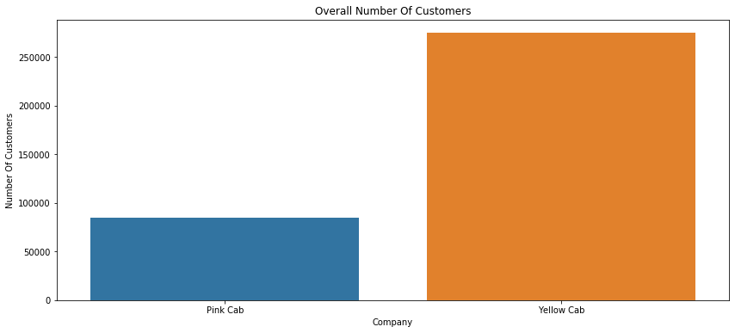
Data Understanding
Yellow cab has the majority of transactions between the two cabs.

Slide 5
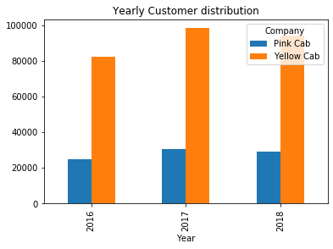
Yearly Customer Distribution
Yellow Cab has had the majority of customers accross the three years.

Slide 6
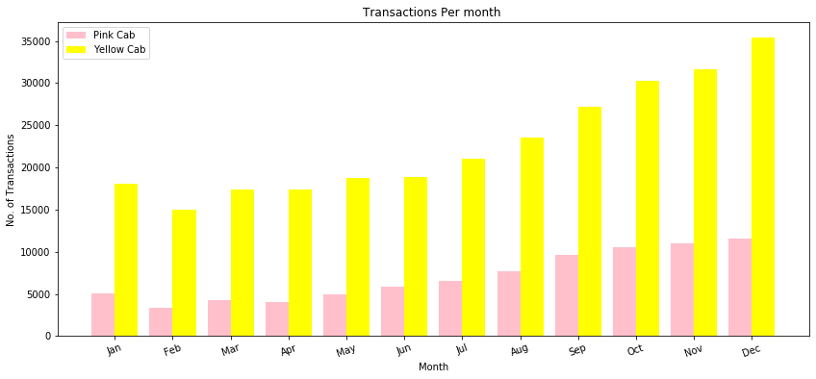
Monthly Transactions Analysis
The busiest Months are the holiday months heading towards January for both Cabs with Yellow cab taking the lions share

Slide 7
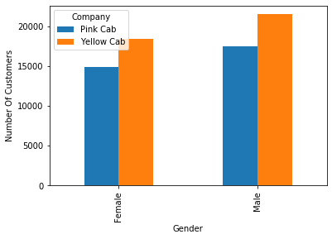
Gender Distribution
Most of the customers for both Cabs are Male with the Yellow Cab taking the lions share in both

Slide 8
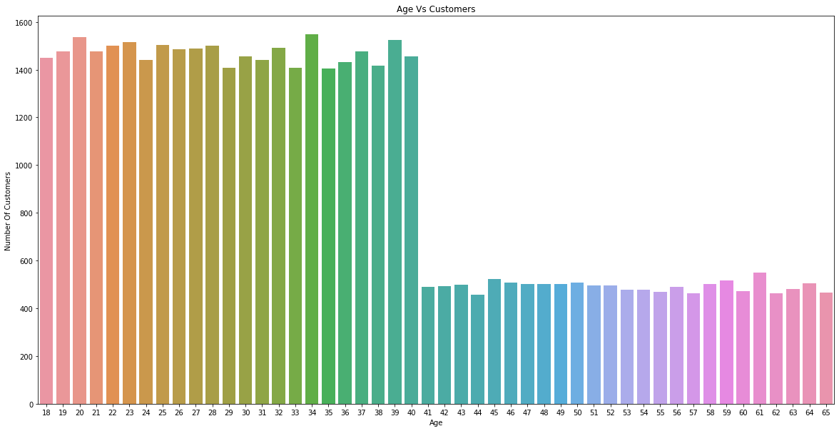
General Age Distribution Analysis
Most of the Customers are Young i.e below 40 Years of age

Slide 9
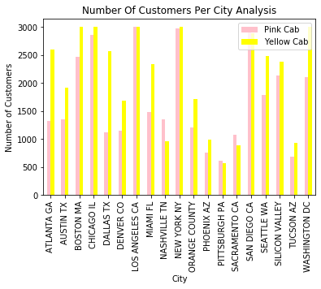
City Customer Analysis
Yellow cab leads on most of the cities with Pink Cab only leading in 4 cities:-
San Diego
Nashvilee
Sacramento
Pittsburgh

Slide 10
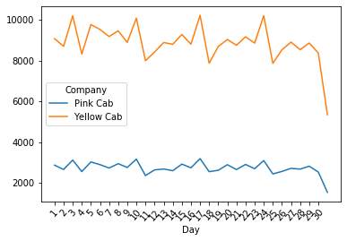
Day Of the Month Analysis

Slide 11
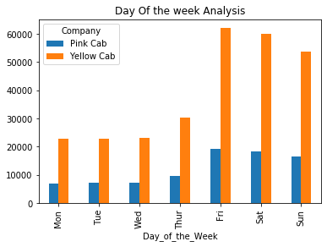
Day Of the week Analysis
On average most of the customers use the cabs as from Friday heading into the weekend.

Slide 12
Most frequent Customers for both Cabs(Customer Retention)
Pink Cab(Customer_ID) | Frequency
8120 | 18
6159 | 17
7927 | 17
8595 | 17
8915 | 16
Yellow Cab(Customer_ID) | Frequency
1360 | 47
1803 | 47
494 | 47
636 | 46
126 | 45
Yellow cab customers frequent the cabs more often showing that they have a high customer retainability. Also the most frequent Pink Customers are also Yellow Cab Customers.

Slide 13
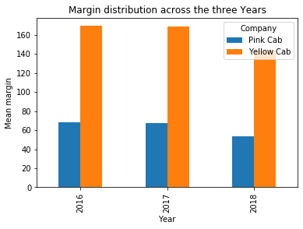
Margin Analysis
Yellow cab has had the most Profit compared to Pink Cab across the three years this very little fluctuations(Decrease in profit)

Slide 14
Recommendations and Conclusion
I believe that Yellow cab gonna maintain its monopoly in the market for a longer period of time because:-
Yellow cab has a very high customer retainability rate compared to Pink Cab.
Through the three Years yellow cab has had the most customers and is not showing any signs of letting go off this trend.
Yellow cab a high customer following in high population cities like New York.
Most of the young aged customers prefer Yellow Cab. It is to be noted that the young aged customers are the biggest consumers in this cab business.
Yellow cab seems to be making ahigher profit margin compared to pink cabb

Slide 15

Brian Orina Bundi.
Thank You

