Slide 1

ICICI BANK INTERNSHIP PROJECT
Project Title: Financial News Sentiment Analyzer
Project Guide: Sayan Sen
Project Mentor: Arockia Liborious
Presented by:
GV Ritesh Raman
22135049
IIT (BHU) Varanasi

Slide 2

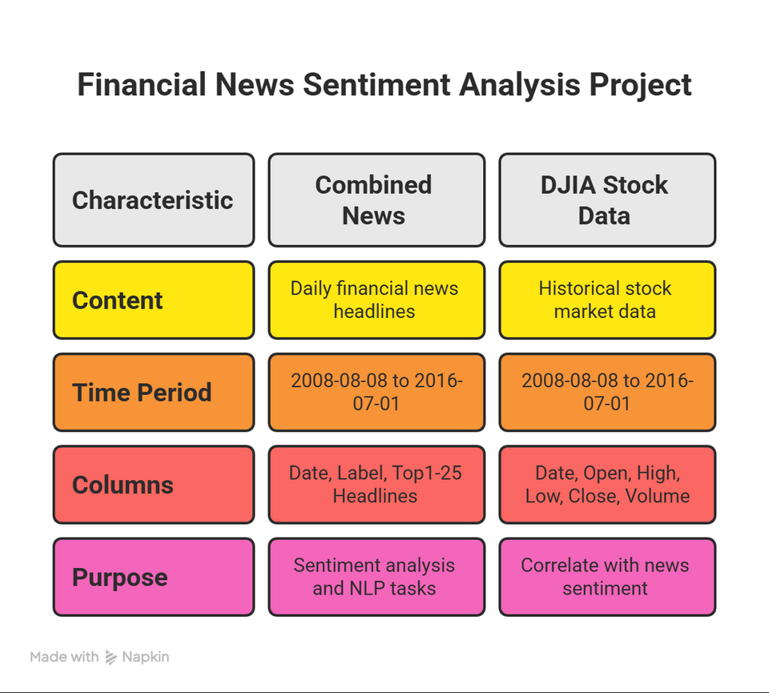
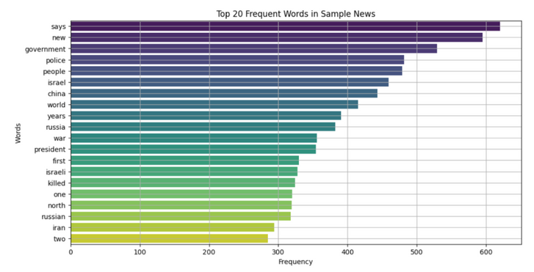
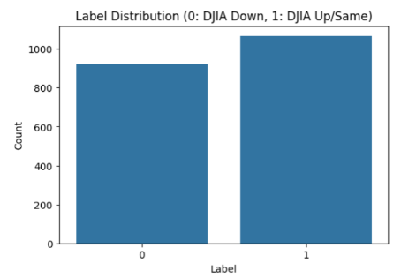
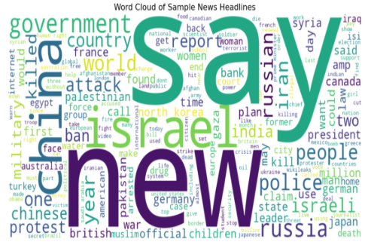
Objectives and Data Overview:
Objectives:
Develop an NLP model to classify financial news sentiment.
Correlate news sentiment with stock market fluctuations.
Provide real-time risk assessments based on breaking financial news.
Dataset:
Literature Review:
Reviewed papers on financial sentiment, ML ,DL and transformer models (e.g., FinBERT).
Identified gaps & shaped a finance‑focused, explainable prediction pipeline.

Slide 3
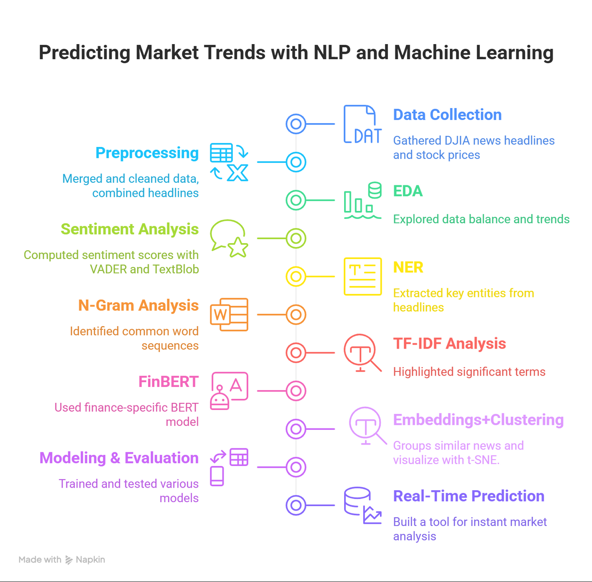
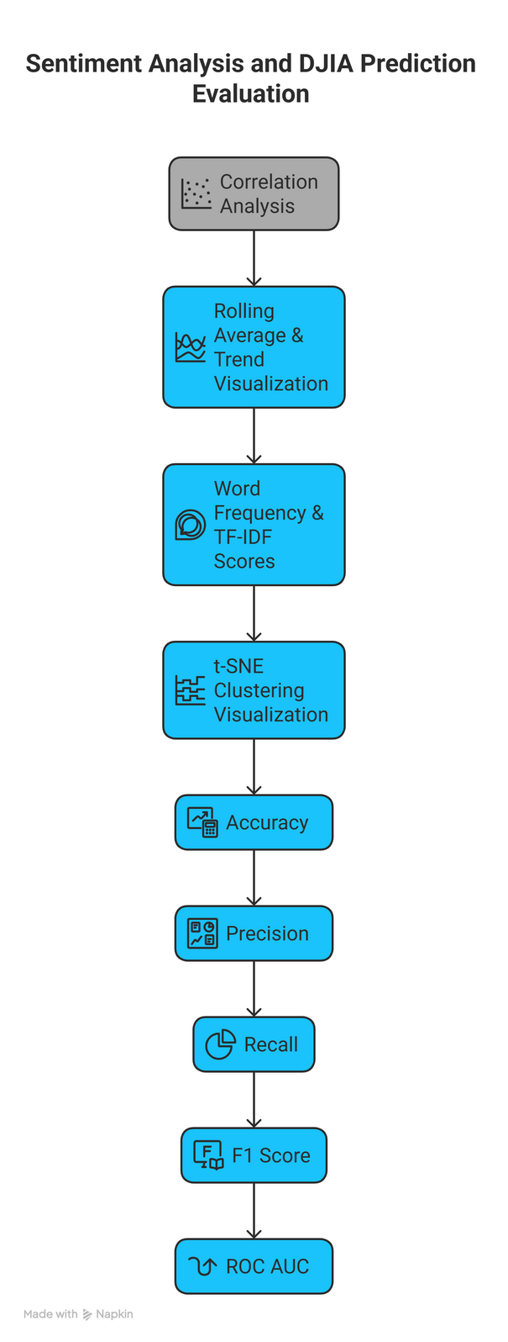
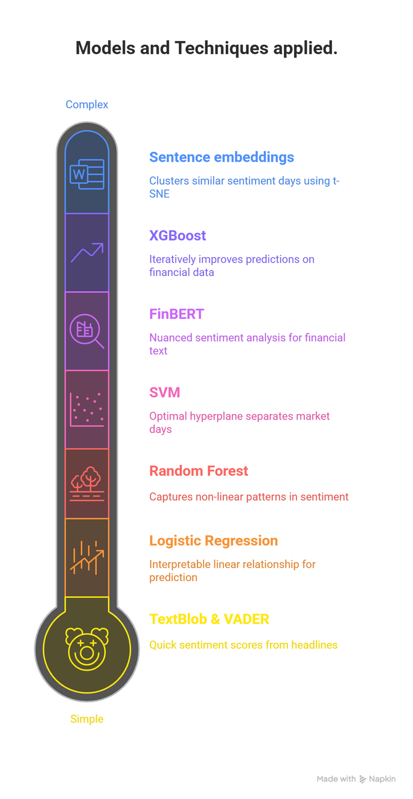
Project Workflow and Methodology:
Models and Techniques applied.
Evaluation Metrices.

Slide 4
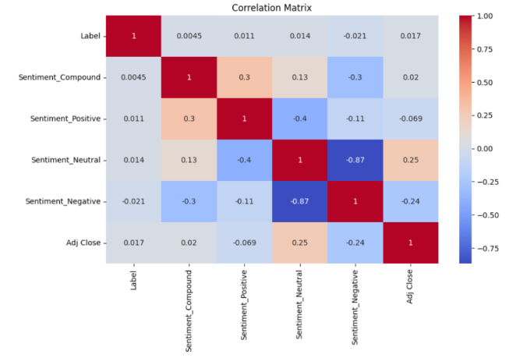
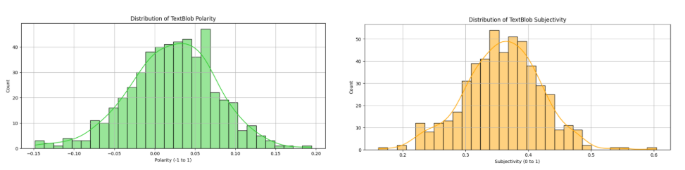
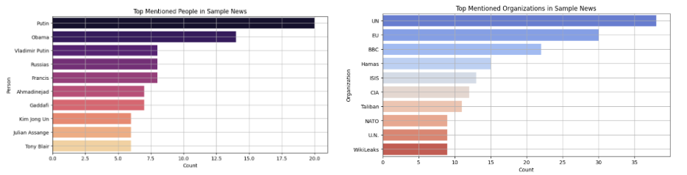
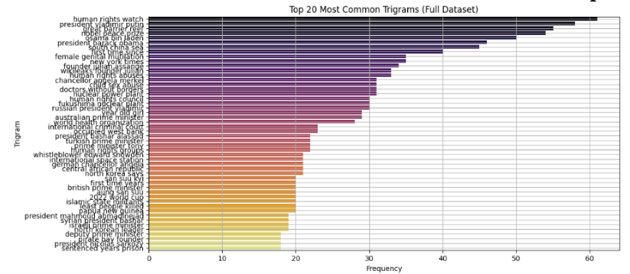
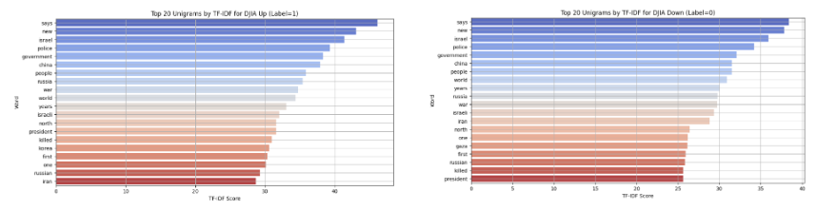
Results: Exploratory & Rule-Based NLP Analysis
VADER:
TEXTBLOB:
NER:
N-GRAMS:
TF-IDF:

Slide 5
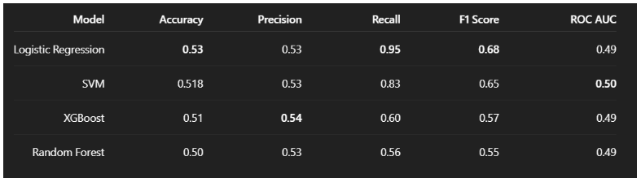
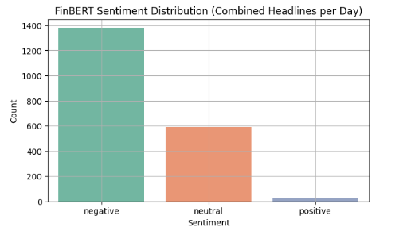
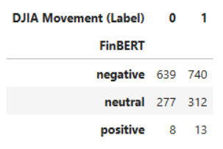
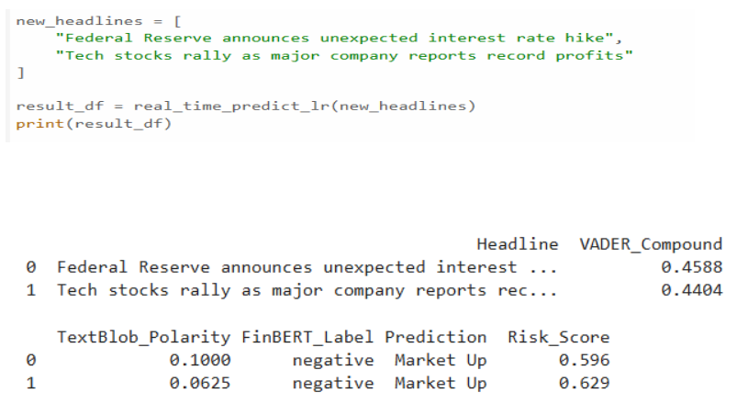
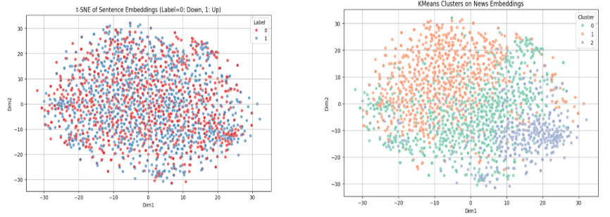
Results: Supervised Models & Advanced NLP
Model Development and Evaluation :
FinBERT Sentiment Analysis:
Real-Time Prediction:
Sentence Embeddings + Clustering:

Slide 6
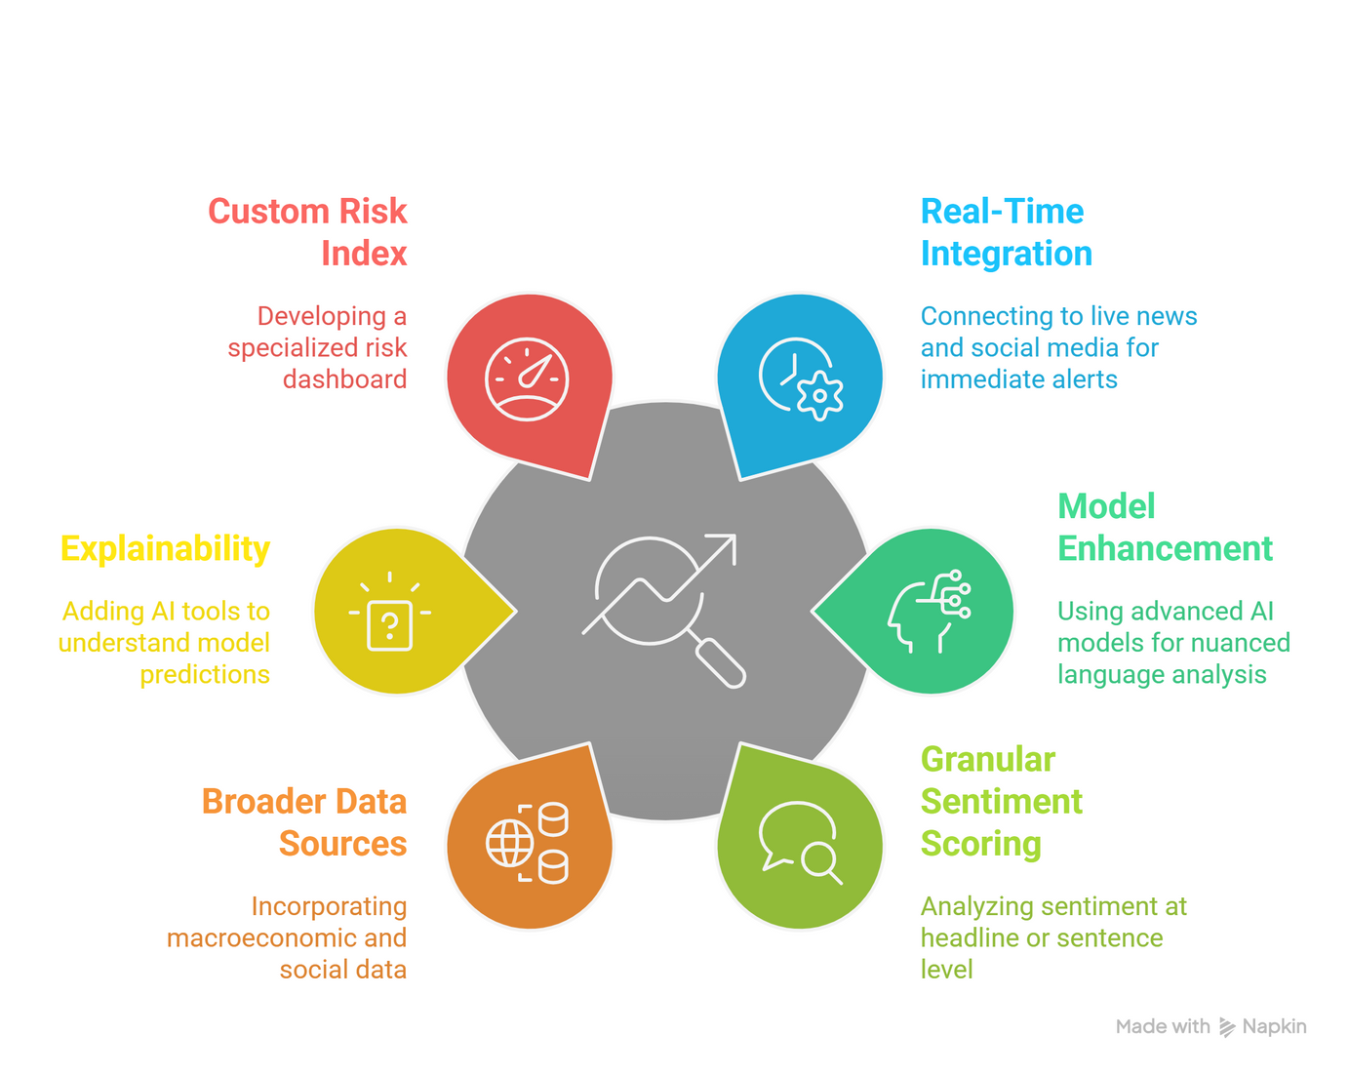
Conclusions and Future Scopes
Conclusions:
Future Scope:
This project set out to address the challenge of transforming unstructured financial news headlines into actionable insights to predict daily DJIA market movements — directly supporting ICICI Bank Ltd’s objective of enabling near real‑time risk assessment and decision support.
By combining exploratory NLP techniques (VADER, TextBlob, NER, TF‑IDF) with advanced models like FinBERT, Logistic Regression, and clustering on embeddings, we successfully built a pipeline that analyzes sentiment trends and forecasts market direction.
In real-world terms, this system helps investment teams at ICICI Bank monitor market sentiment automatically, flag high‑risk news events faster, and make more data‑driven, proactive investment decisions.

Slide 7
THANK YOU

Slide 8
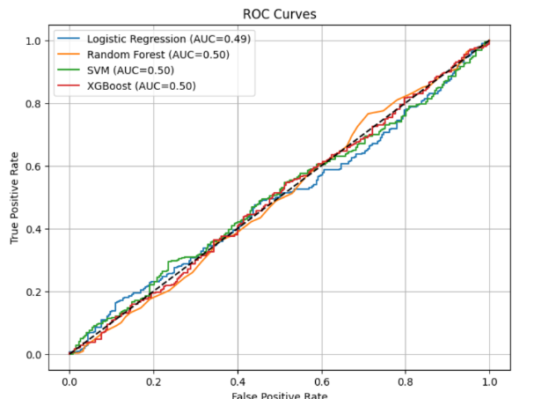
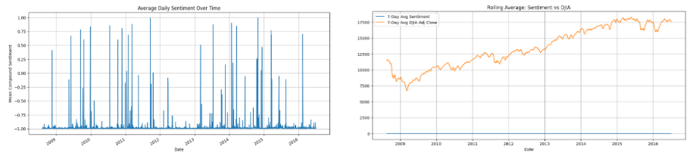
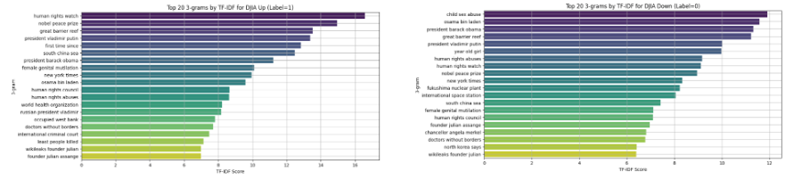
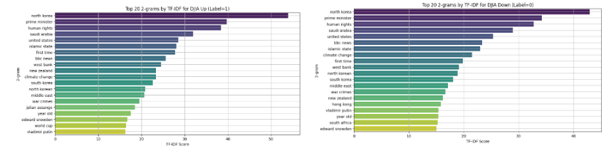
Appendix
Reference and links:
Literature Review: link , Github Repository: link
Tools & libraries:
Python (v3.11), Pandas (v2.0+), NumPy (v1.24+), Scikit-learn (v1.3+), NLTK (v3.8+), spaCy (v3.6+), TextBlob (v0.17+), VADER Sentiment, Transformers (v4.40+), Sentence-Transformers (v2.6+), XGBoost (v2.0+), Matplotlib (v3.7+), Seaborn (v0.12+)
Extra Visualisations:

