Slide 1



WhatsApp, Doc? A First Look at WhatsApp Public Group Data
Kiran Garimella & Gareth Tyson
Kiran Garimella & Gareth Tyson. “WhatApp Doc?: A first look at WhatsApp public group data”
AAAI International Conference on Web and Social Media (ICWSM), Stanford, CA (2018).

Slide 2

What’s WhatsApp?
An messaging platform for the web & mobile apps
Similar to SMS on steroids
WhatsApp groups have become a popular phenomena
Notes:
Over 1.2 billion users
E.g. In India 94% of all Android devices have it

Slide 3

Can we use public groups for social research?
(spoiler alert: yes)

Slide 4

Methodology & open source tooling

Slide 5
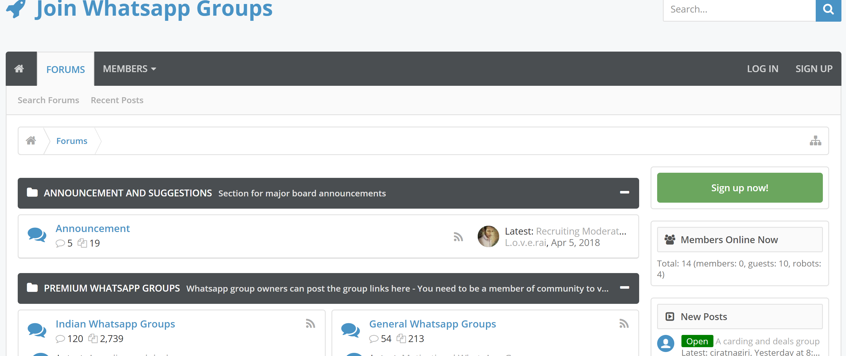
Step 1: Obtain a list of group URLs
Use public listings
https://joinwhatsappgroup.com/
Use search engines
Search for chat.whasapp.com

Slide 6
Step 2: Join the groups
Create a dedicated WhatsApp account
Run our script (which uses the web.whatsapp.com interface)

Slide 7
Step 3: Receive the updates
Messages will start to come through (via your phone & web interface)
Our script extracts from the phone’s local database file
This is much easier than parsing web output
group_id_anonymised
phone_num_anonymised
message_length
message_num_words
message_lang
timestamp
media_url
media_mime_type
media_size
media_name
media_caption

Slide 8
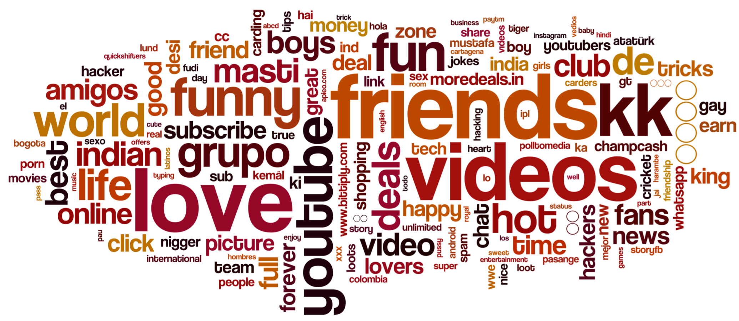
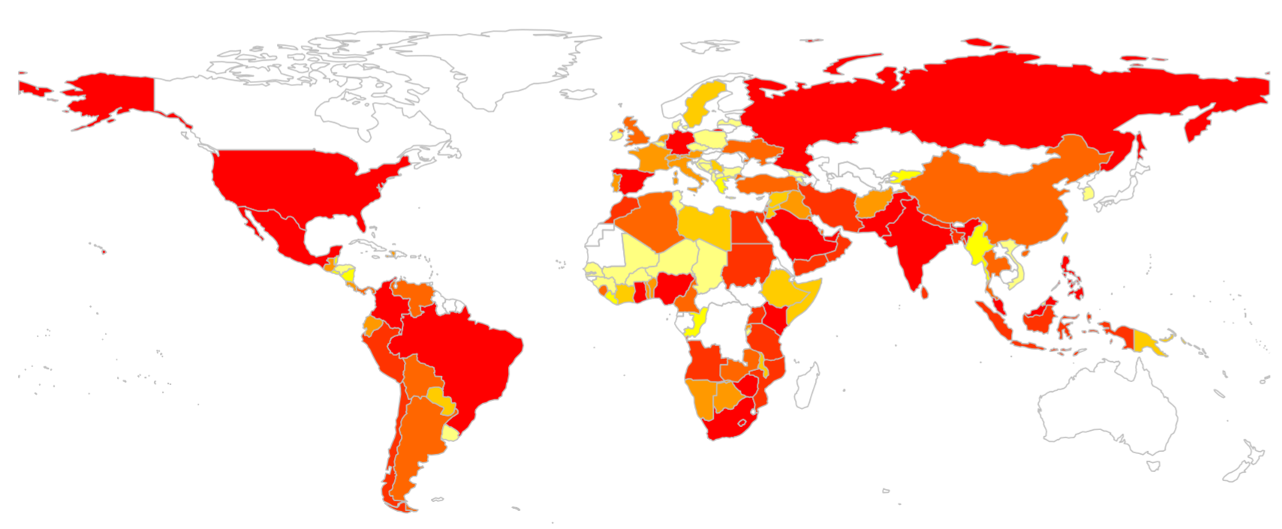
Our public data
We ran the crawler for 6 months
We collected data for 178 groups
Notes:
45,794 users 454,000 messages

Slide 9
Please download!
Code: https://github.com/gvrkiran/whatsapp-public-groups
Analytics Scripts: https://github.com/gvrkiran/whatsapp-public-groups/tree/master/analysis
Data: https://github.com/gvrkiran/whatsapp-public-groups/blob/master/anonymised_data_to_share.tsv

Slide 10
WhatsApp, Doc? A First Look at WhatsApp Public Group Data
Come speak to us!
kiran.garimella@epfl.ch gareth.tyson@qmul.ac.uk
Kiran Garimella & Gareth Tyson. “WhatApp Doc?: A first look at WhatsApp public group data”
AAAI International Conference on Web and Social Media (ICWSM), Stanford, CA (2018).

