Slide 1
Scalable Facility Location for Massive Graphs on Pregel-like Systems
Kiran Garimella, Gianmarco De Francisci Morales, Aristides Gionis (Aalto University)
and Mauro Sozio (Telecom ParisTech)

Slide 2
Scalable Facility Location for Massive Graphs on Pregel-like Systems

Slide 3
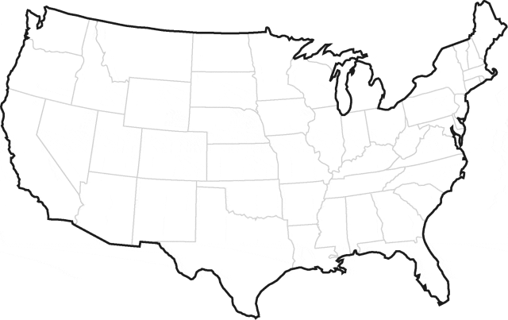
Facility Location Example

Slide 4
Example

Slide 5
Example

Slide 6
Example

Slide 7
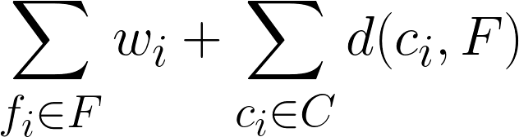
Facility Location problem
Facilities F (warehouses)
Locations C (supermarkets)
Each facility f_{i} has a cost to ‘open’ – w_{i}
Each location c_{i} is ‘served’ by a facility, based on its distance d(c_{i},f_{i})
Minimize:
Cost of opening facilities + Cost of serving locations

Slide 8
Graph setting
Assume input is a graph.
All pairs distances not available, not feasible to compute.
Use shortest path distances on the graph.

Slide 9
Graph setting
a
b
c
e
d

Slide 10
Traditional Setting
a
b
c
e
d
All pairs distances assumed to be known. O(n²) space, time.

Slide 11
Graph setting
a
b
c
e
d
Distances computed using shortest paths on the graph.

Slide 12
Facility Location problem
Input
Graph G(V,E)
Facilities F, Locations C
Each vertex (facility f_{i}) has a cost to ‘open’ – w_{i}
Each vertex (location c_{i}) is ‘served’ by a facility, based on its shortest path distance d(c_{i},f_{i})
Output
F V, C V,
Assignment of C to F
Such that
Cost of opening facilities + Cost of serving locations is minimized

Slide 13
Applications
Planning, resource management
Social networks
Finding influential users
Outbreak detection
Web
Cache placement
Compression
Ranking

Slide 14
 | A | B | C | D | E
A | 0 | 1 | 1 | 2 | 3
B | 1 | 0 | 1 | 2 | 3
C | 1 | 1 | 0 | 1 | 2
D | 2 | 2 | 1 | 0 | 1
E | 3 | 3 | 2 | 1 | 0
C
A
D
E
B

Slide 15
Scalable Facility Location for Massive Graphs on Pregel-like Systems

Slide 16
Pregel-like systems
Bulk Synchronous Parallel
Apache Giraph
Think like a vertex
I know my local state
I know my neighbors
I can send/receive messages to vertices
Synchronous computation in iterations
Fit for modern shared-nothing architectures
Notes:
Each iteration each vertex sends and receives messages and does compuation on messages received in the previous iterations
No global knowledge, only local knowledge

Slide 17
Contributions
First distributed implementation of the Facility Location Algorithm scaling to web-sized graphs.
Preserving approximation guarantees from state-of-the-art ( )
First distributed implementations of All Distances Sketches and Maximal Independent Set

Slide 18
Algorithm
Three stages
Neighborhood estimation using All Distances Sketches (pre-processing)
Facility opening
Facility selection (Maximal Independent Set, post-processing)

Slide 19
All Distances Sketches
Approximate neighborhood estimation for graphs
“How many vertices are at a distance d from vertex v?”
Each node has an associated hash
For each distance, store the k minimum hashes for each node.
Can be used for both weighted and un-weighted graphs
Logarithmic size
Fits the Giraph model

Slide 20
Stage 2: Facility Opening

Slide 21
Facility Opening
Notes:
Each node is neither a facility nor a location

Slide 22

Facility Opening
A
B

Slide 23

Facility Opening
A
B

Slide 24

Facility Opening
A
B

Slide 25
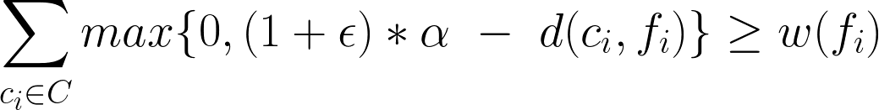
Facility Opening
A
B

Slide 26
Facility Opening
A
B

Slide 27
Facility Opening
Estimated using All Distances Sketch
A
B

Slide 28
Facility Opening
A
B
Facility ‘open’

Slide 29
Facility Opening
Locations ‘frozen’
A
B

Slide 30

Facility Opening
Locations ‘frozen’
A
B

Slide 31

Facility Opening
Locations ‘frozen’
A
B

Slide 32
Facility Opening
Stop when all vertices are either frozen locations or open facilities.
parallel iterations

Slide 33
Facility Opening
Locations
Facilities
c₁
f₁
c₂
f₂
c₃
f₃
c₄
f₄
c₅
Bipartite graph (H) with facilities on one side and locations on other.

Slide 34
Problem

Slide 35
Facility Selection
Locations
Facilities
c₁
f₁
c₂
f₂
c₃
f₃
c₄
f₄
c₅
Each location is assigned to multiple facilities
Maximal independent set on H²

Slide 36
Facility Selection
Locations
Facilities
c₁
f₁
c₂
f₁
f₄
f₂
c₃
f₃
c₄
f₄
f₃
f₂
c₅
H²

Slide 37
Maximal Independent Set
Locations
Facilities
c₁
f₁
c₂
f₁
f₄
f₂
c₃
f₃
c₄
f₄
f₃
f₂
c₅
H²

Slide 38
Maximal Independent Set
Locations
Facilities
c₁
f₁
c₂
f₁
f₄
f₂
c₃
f₃
c₄
f₄
f₃
f₂
c₅
H²

Slide 39
Maximal Independent Set
Can’t explicitly construct H²
Can be solved using message passing.

Slide 40
Experiments
Comparison to sequential algorithm
Time taken
Scalability

Slide 41
Datasets

Slide 42
Comparison with a Sequential Algorithm
Compared with greedy algorithm by Charikar and Guha (1999).
Doesn’t scale for graphs > 10k vertices

Slide 43
Comparison with a Sequential Algorithm

Slide 44
Comparison with a Sequential Algorithm

Slide 45
Time taken by each phase

Slide 46
Total time taken
R² = 0.9

Slide 47
Scalability

Slide 48
Conclusions
First distributed implementation of Facility Location algorithm
First distributed implementations of All Distances Sketches and Maximal Independent Set
Designed for graph setting, suited for large scale
Preserving approximation guarantees
Code available at https://github.com/gvrkiran/giraph-facility-location

Slide 49
Acknowledgements
SIGIR and HICT for the travel grants
Yahoo! For the the faculty research grant

Slide 50
Thank you!
kiran.garimella@aalto.fi
@gvrkiran

Slide 51
H²
Locations
Facilities
c₁
f₁
c₂
f₁
f₄
f₂
c₃
f₃
c₄
f₄
f₃
f₂
c₅

Slide 52
H²
Locations
Facilities
MIS: Every edge of the graph has at least one end point not in S and every vertex not in S has at least one neighbor in S.

Slide 53
Locations
Facilities

Slide 54
Locations
Facilities

