Slide 1



From “I love you babe” to “leave me alone” – Romantic Relationship Breakups on Twitter
Kiran Garimella, Ingmar Weber, and Sonya Dal Cin

Slide 2
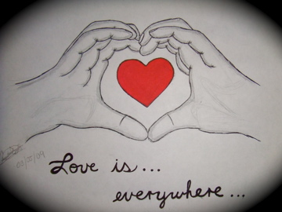
Source: http://fc07.deviantart.net/fs71/f/2010/093/1/5/Love_is_Everywhere_by_Chanti_mei.jpg

Slide 3

Also..
Breakups are
Over 85% of Americans go through a breakup at least once in life.
Source: http://www.womansavers.com/images/break_up_advice.jpg

Slide 4
Research Questions
Can we find indicators of an imminent breakup in the form of changes in communication patterns
Is there a connection between pre- and post-breakup closeness
Can we find evidence for post-breakup depression and its dependence on being either the rejector/rejectee?
Connection between “stonewalling” and relationship breakups.

Slide 5
Why online?
Scale
Less self-reporting bias
Social context
Openly accessible data
Ease of data collection
Why Twitter?

Slide 6
But…
Lots of noise and lack of well-defined variables
Limited power to determine causal links
Privacy concerns.

Slide 7
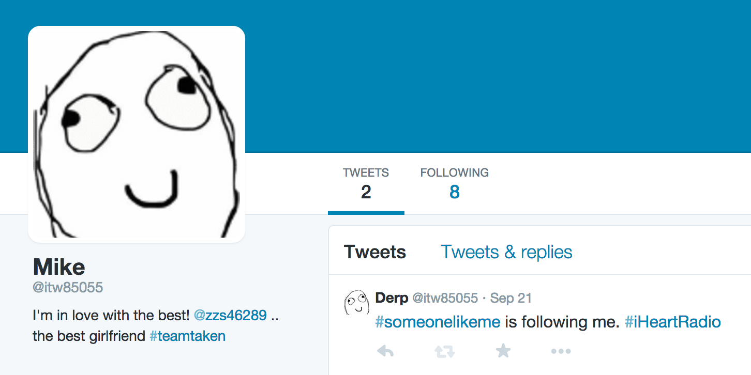
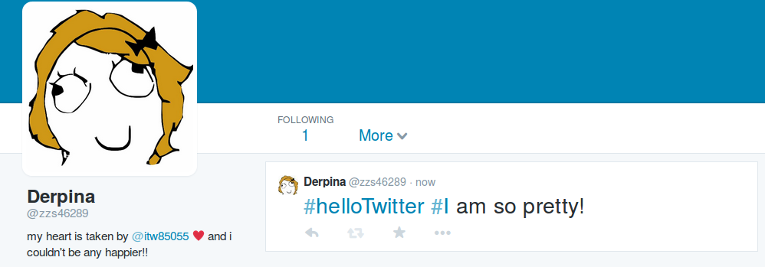
Data collection
28 hour snapshot of Twitter from July 2013.
* Fake profiles

Slide 8
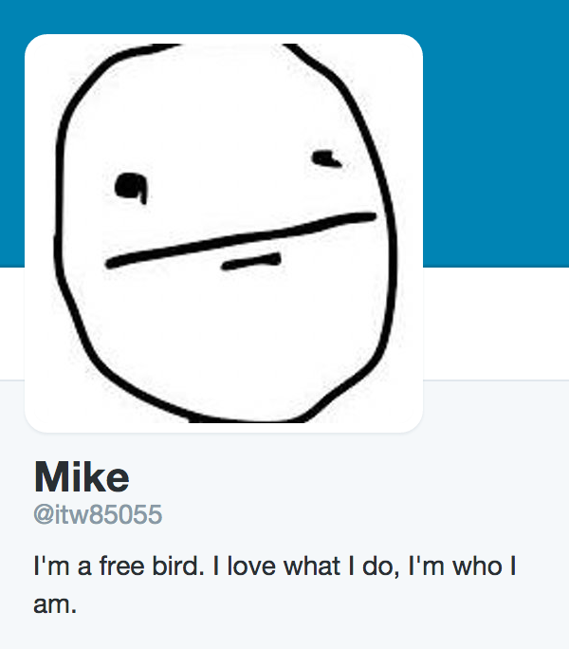
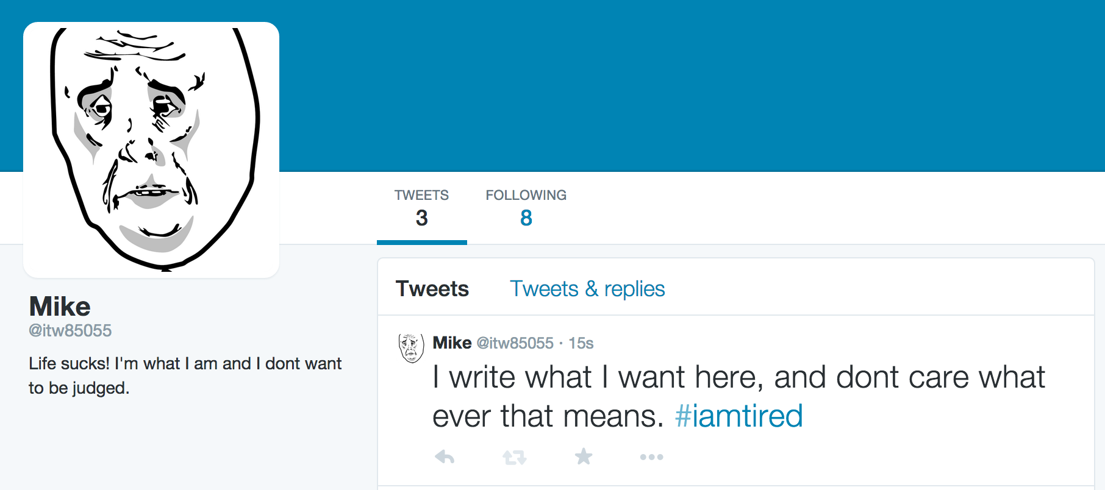
Data collection
Nov 4, 2013
Nov 11, 2013
Nov 25, 2013
…
Feb 23, 2014
(BREAKUP)
…
Apr 24, 2014
Data collected for 24 weeks.
Tweets, mutual friendships and profile information collected every week.

Slide 9
Data cleaning
Using crowdsourcing:
Asked 3 human judges if two users were in a relationship.
Labels for gender.
Limited to English speaking users (US, UK, Canada).
Got 661 couples, with high confidence.
Paired each breaking up couple (BR) with a random couple who didn’t breakup (NBR).

Slide 10
Results

Slide 11
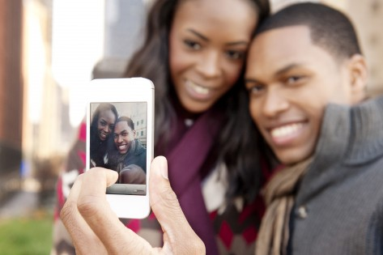
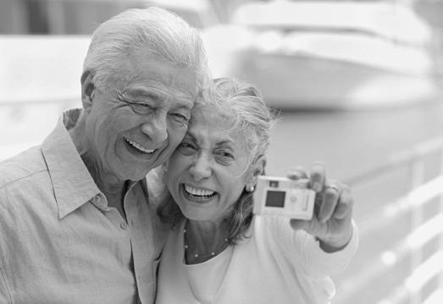
Length of the relationship
VS.
Are couples who have been longer in a relationship less likely to breakup?
Source: http://www.citynews.ca/files/2013/11/webselfieiphonesmartphonetwitterfacebook-473x315.jpg, http://cdn.comluv.com/wp-content/uploads/2014/02/old-couple-2.jpg

Slide 12
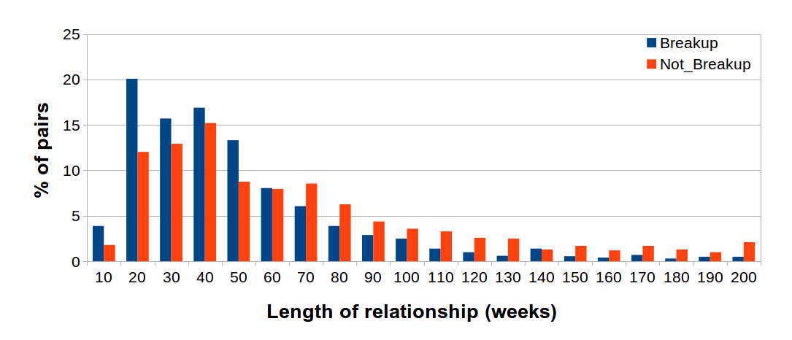
Length of the relationship
The longer you’ve been in a relationship, the lesser is the chance of a breakup.

Slide 13
Changes in profile

Slide 14
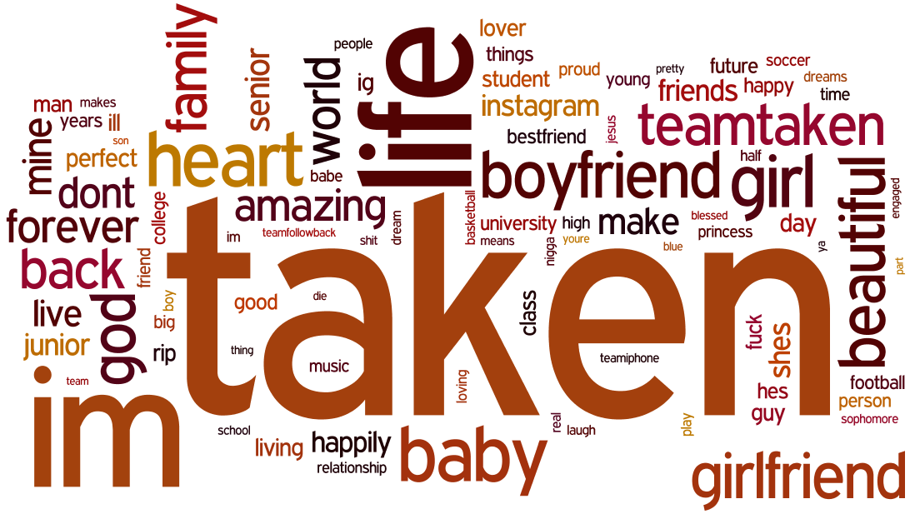
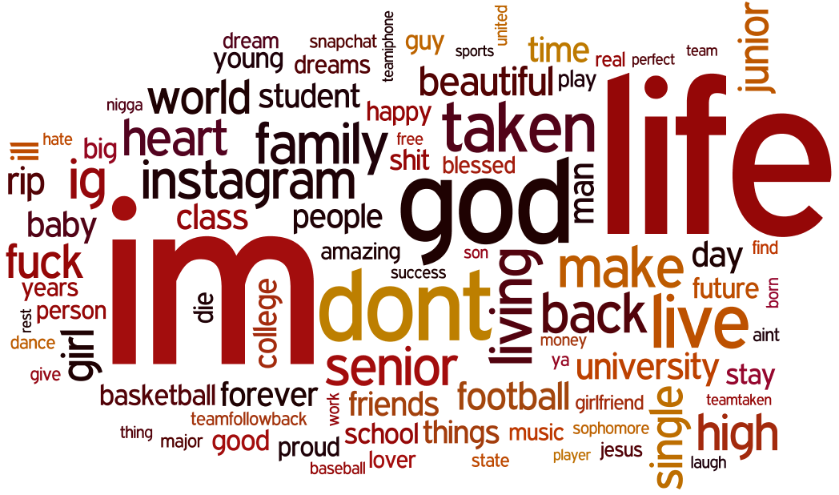
Changes in the profile
Before breakup
After breakup

Slide 15
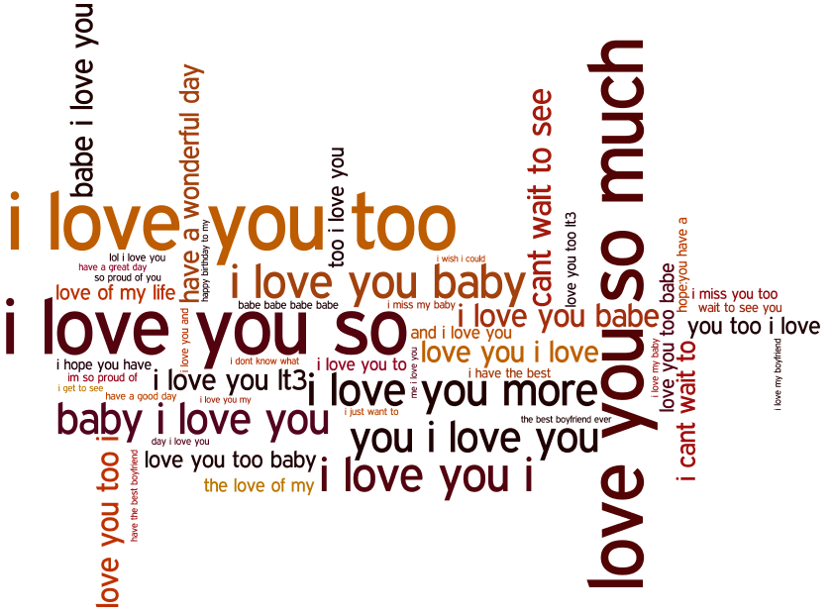

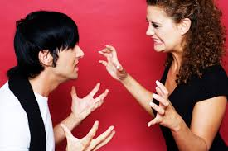
Changes in communication style
After?
Source: http://cdn.sheknows.com/articles/young-couple-fighting-against-red-background.jpg , http://myjoyofliving.com/wp-content/uploads/2013/02/couple-fighting.jpg

Slide 16
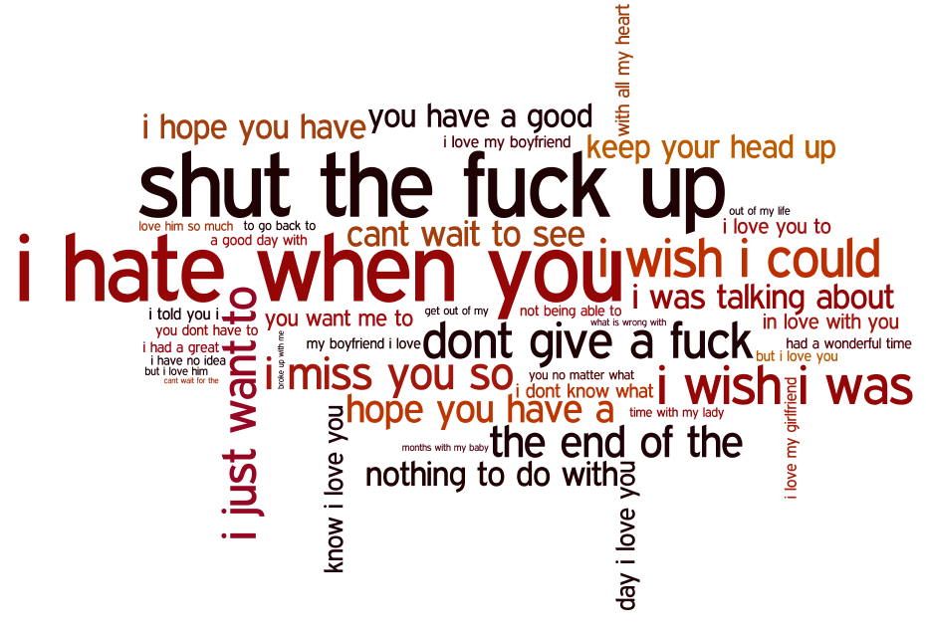
Changes in communication style
Before breakup
After breakup

Slide 17
Changes in communication patterns
How does the communication change compared to users who don’t breakup?

Slide 18
Partner Messages

Slide 19
Non-Partner Messages

Slide 20
Num. Original Tweets

Slide 21
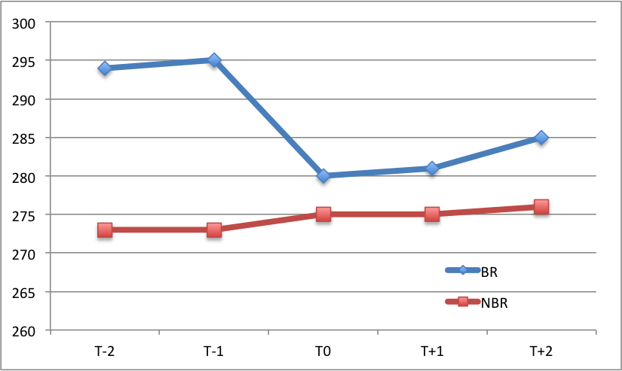
Changes in the social network
Significant losses in friends.
Median Friends

Slide 22
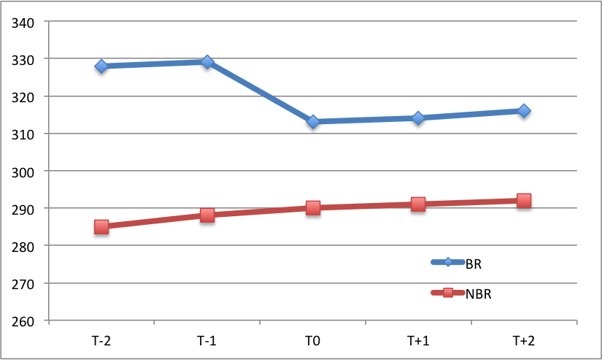
Changes in the social network
.. and followers.
Median Followers

Slide 23
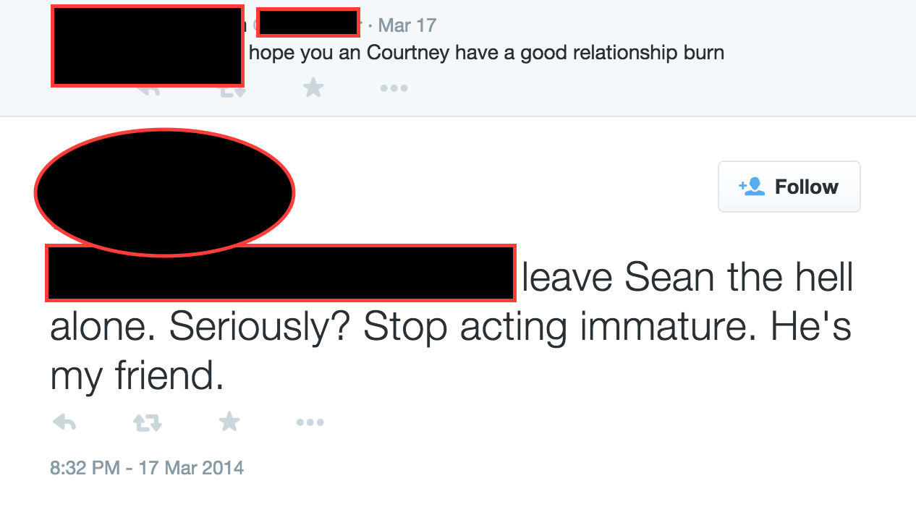
Example

Slide 24

Post breakup depression

Slide 25
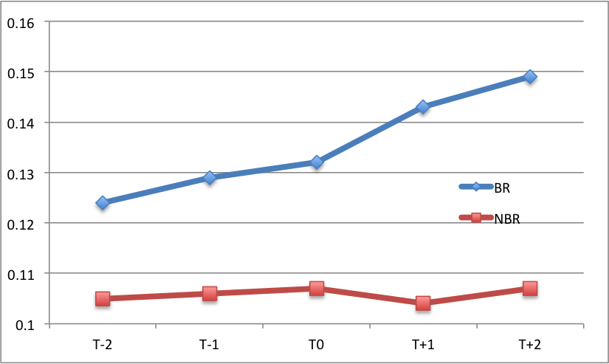
Post breakup depression
Couples breaking up post more depressed tweets.

Slide 26
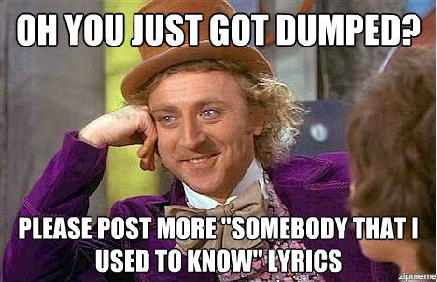
Got dumped?

Slide 27
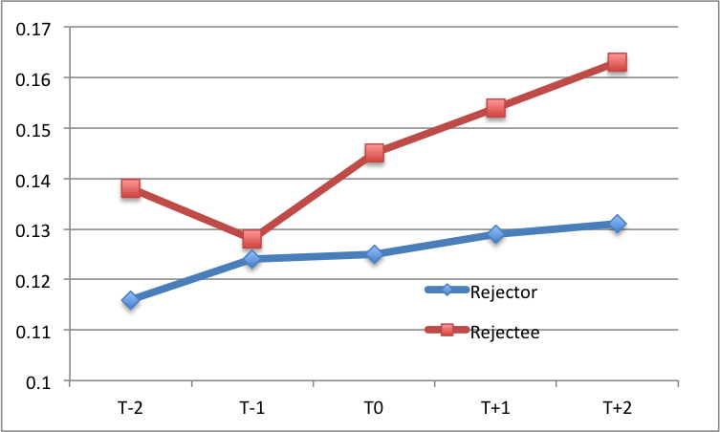
Rejector vs. Rejectee
Being dumped hurts more.

Slide 28
Post breakup closeness
Will couples with more pre-breakup closeness also be close post breakup?
Yes!

Slide 29
Stonewalling
Is only one side “doing all the talking”, before the breakup?
Yes!

Slide 30
You just told us what we already knew!
(Almost) True, but ..
Validates existing models
Also validates our data: despite various limitations, it shows expected characteristics.
More exhaustive psychological studies possible!
Don’t breakup and fight publicly.

Slide 31
More cool stuff possible!
Users moving on
Same sex/married couples
Analysis based on gender
Predicting breakups?
Want to collaborate?

Slide 32









Media coverage

Slide 33
Thank you!

