Slide 1
Quote RTs on Twitter: Usage of the New Feature for Political Discourse
Kiran Garimella (Aalto Univeristy)
Ingmar Weber (QCRI)
Munmun De Choudhury (Georgia Tech)
Presented by Yelena Mejova

Slide 2
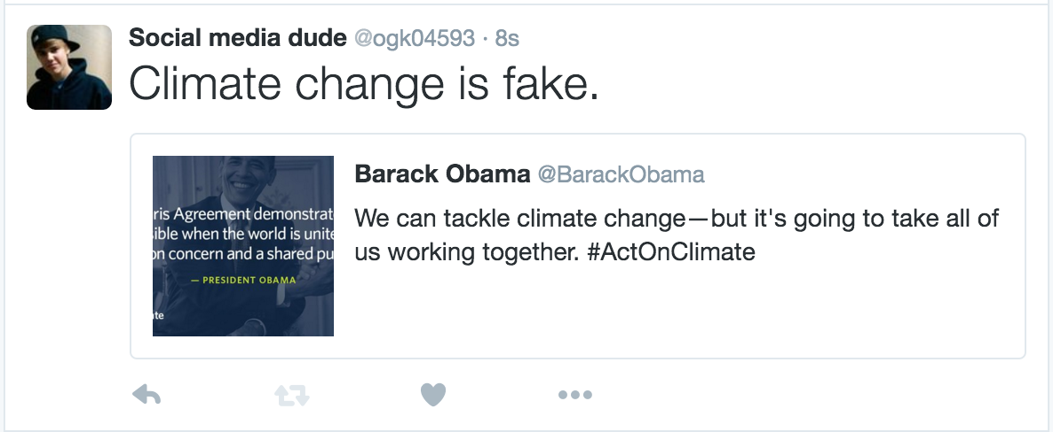
Quote Retweet on Twitter
New feature since April 2015

Slide 3
Terminology
User
Comment
Seed user
Quoted original tweet

Slide 4
Why are Quote RTs Interesting?
Change in dynamics of retweet
Previously, retweet => endorsement
Quote RTs need not be endorsements
Notes:
Two reasons: First is that the dynamics of a retweet will change with the introduction of quote RTs

Slide 5
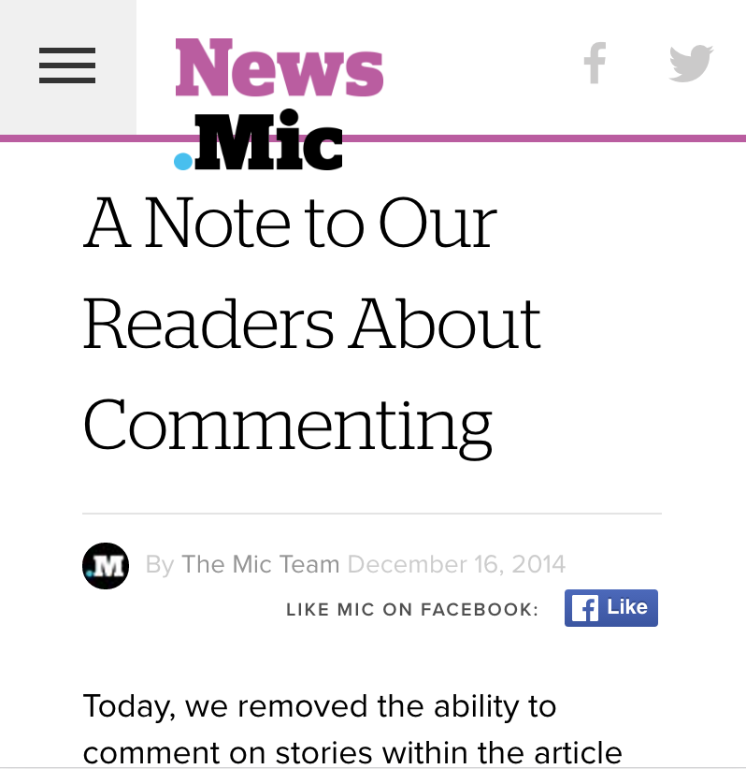
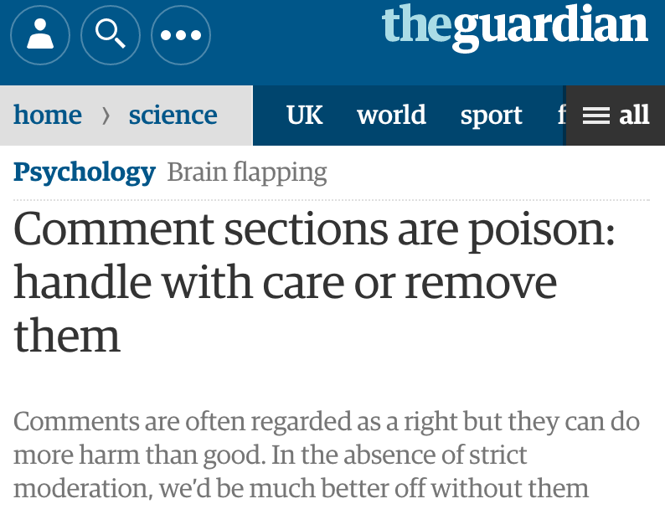
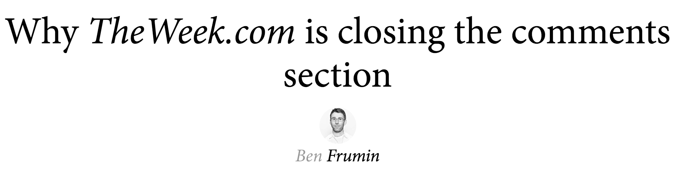
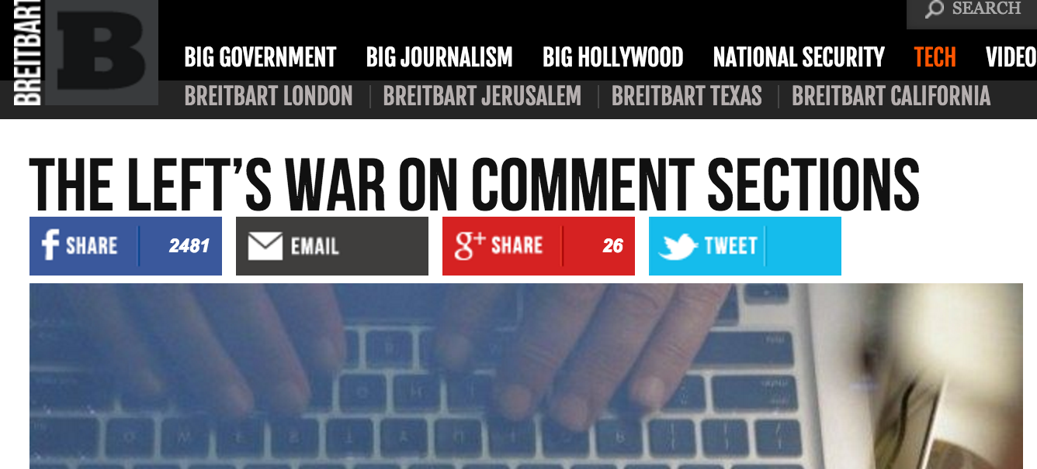
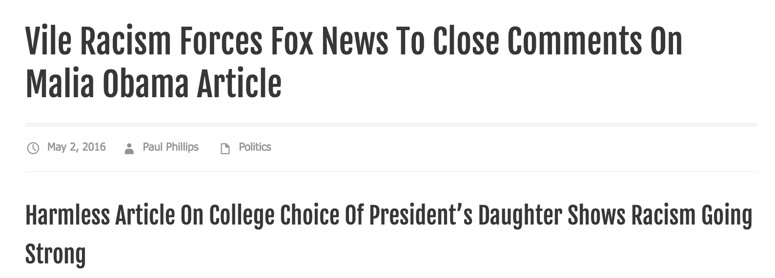
Comments on political news -> disaster!
Notes:
The second is reason
During a time when political news websites are complaining about user comments on news articles (because of a lot of abuse and spam), we were interested to see if giving this new power to users on twitter was a good idea..

Slide 6
Research Question
Does the introduction of a new feature (Quote RT) impact political discourse?

Slide 7
Data
192 US political accounts from followerwonk.com
Collected all their retweets, replies, mentions (from Jan-Sept 2015) and quote retweets (from Apr-Sept 2015)

Slide 8
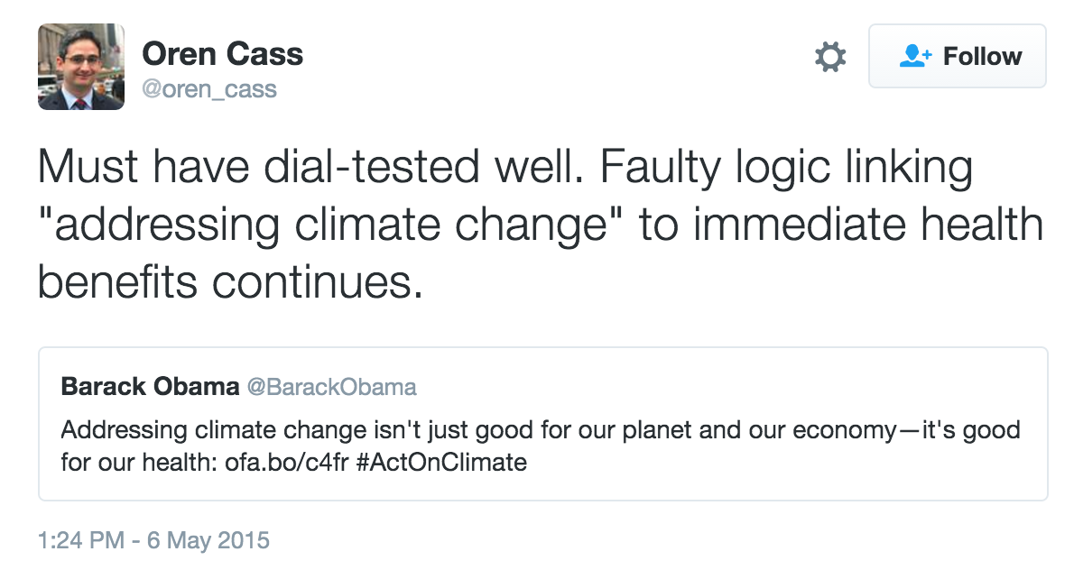
Some Use Cases
Opinion/Comment

Slide 9
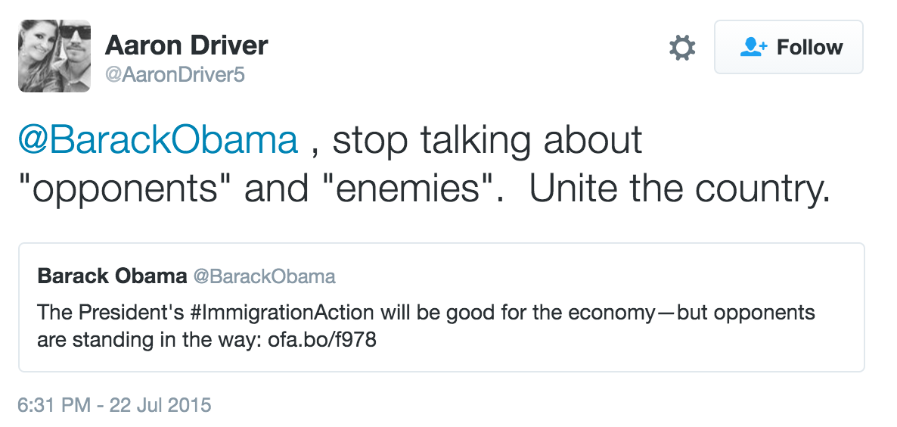
Some Use Cases
Public Reply

Slide 10
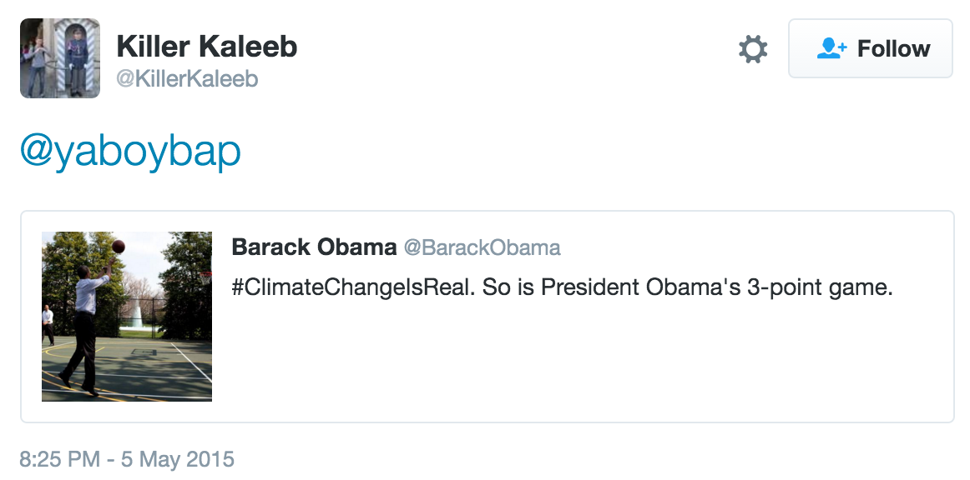
Some Use Cases
Forwarding

Slide 11
Who’s using Quote RTs?
Users who are more social
More Friends
More Followers
More Tweets
Been on Twitter longer

Slide 12
Mutual Following Patterns
@mentions between two users: [Liu and Weber’12]
Following each other => agreement
Not following each other => disagreement
Does this hold for Quote RT?
Notes:
Liu and Weber [12] show that if two users follow each other and mention each other, it is most likely to be a tweet containing political alignment. On the other hand, for users who do not follow each other, a mention is most likely going to indicate political disalignment.

Slide 13
Mutual Following Patterns
 | Retweet | Mention | Reply | Quote RT
Seed follows user | 0.6 | 0.9 | 0.6 | 0.4
User follows seed | 52.9 | 42 | 63.5 | 60
Both follow each other | 9.1 | 8.6 | 7.8 | 11.8
No follow in either direction | 37.4 | 48.5 | 28.1 | 27.8
Similar to reply

Slide 14
Does Information Spread Further?
Fraction of a user’s followers who also follow the seed user.
Seed User
User
User’s followers

Slide 15
Does Information Spread Further?
Fraction of a user’s followers who also follow the seed user.
Seed User
Fraction high -> Information reaches directly from the seed users, spreads only 1 level
Fraction low -> Information from the seed users spreads further than 1 level
User
User’s followers

Slide 16
Does Information Spread Further?
Quote retweets have the lowest fraction among retweets, replies, mentions.
Quote RTs help spread information further!

Slide 17
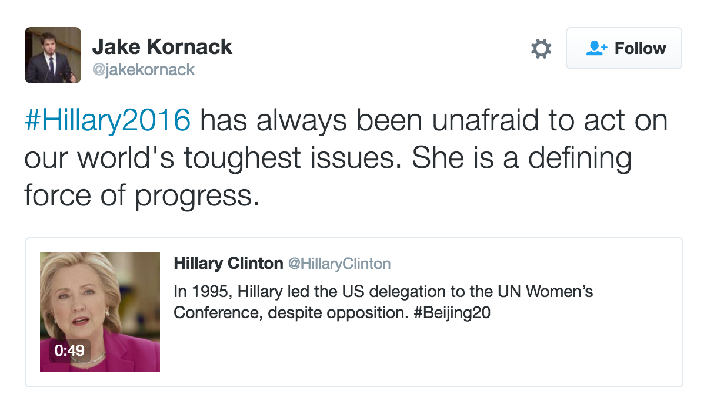
Civility of Discourse?
Notes:
Example of polite agreement

Slide 18
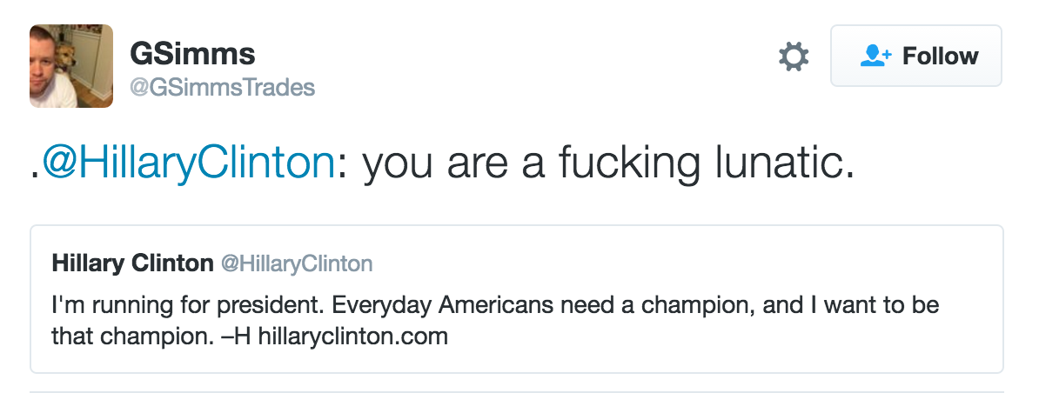
Civility of Discourse?
Notes:
Example of rude, disagreement

Slide 19
Civility of Discourse?
Used crowd labeling to get:
Use of hate words in replies and quotes
Measures of agreement/disagreement between original tweet and quote/reply.

Slide 20
Civility of Discourse - Findings
Lesser hate/insults compared to replies
More agreement, lesser disagreement, more neutral conversations

Slide 21
Summary
Quote RT still in its infancy
More similar in their usage to reply to an original tweet than to retweet
Currently still being used by niche users
Notes:
Can not make causal conclusions

Slide 22
Summary
Helps spread information further
Less hate and more discussion with Quote RTs
Might be leading to an improved political discourse
Notes:
Can not make causal conclusions

Slide 23

Thank you
@gvrkiran
@ingmarweber
@munmun10

