Slide 1

CONTROL STRUCTURES-2

Slide 2
AFTER THIS LESSON, LEARNERS
WILL BE ABLE TO:
Understand the concept and usage of selection and iteration statements.
Know various types of control structures available in C++.
Analyze the problem, decide and evaluate conditions.
To analyze and choose an appropriate combination of constructs to solve a
particular problem
Write code that employ decision structures, including those that employ sequences of decision and nested decisions.
Design simple applications having iterative nature.

Slide 3
FLOW OF CONTROL
AND CONTROL STRUCTURES
The order in which a set of statements are executed in a program is
known as its flow of control
Generally the flow of control is sequential.
However at times it is required to change this sequential flow so
that only a particular statement or group of statements are executed.
This is achieved by control structures
Control structures are statements that upon execution
alter or control the sequence of execution of statements in
a program.

Slide 4
TYPES OF CONTROL STRUCTURES
These can be categorized into the following categories:
Selection Control
Statements
Iterative Control
Structures
Jump Statements
if
if.....else
switch.....case
for loop
while loop
do.....while loop
break
continue
go to

Slide 5
REPETITIVE( ITERATIVE) CONTROL
STRUCTURES OR LOOP
A loop is a control structure that causes a statement or a set of statements (or code ) to be repeated again and again while a condition is true.
The piece of code or set of statements is repeated a certain no. of times till the condition becomes false, following which control is transferred to the statements following the loops.
In C++, there are three loop structures:-
For loop
While loop
Do loop ( do..while loop)

Slide 6
PARTS OF A LOOP
Each loop consists of 3 expressions, the initialization expression, the test expression and the update expression , and a Loop Control Variable ( or expression
)
The value of the loop control variable determines the number of times a loop is
executed.
The three expressions are formed using the loop control variable.
Examples of the expressions:
Initialization
Test
Update
int i=0;
int x=2;
i < 9;
x < 4;
i ++;
x--;

Slide 7
The for loop is the easiest to understa^{T}nd^{H}an^{E}d i^{F}s ^{O}the^{R}mo^{L}st^{O}co^{O}mm^{P}only used loop structure
in C++. The structure of the loop is as follows:
for( initialization expression; test expression; update expression)
{
Statement 1;
Statement 2;
Loop body
Statement n;
}

Slide 8

THE FOR LOOP –
STRUCTURE DEFINED
for( initialization expression; test expression; update expression) The three expressions usually involve the loop control variable.
The initialization expression initializes the loop variable with some legal
value.
Test expression determines whether the loop will be continued or not
The update expression is used to change the value of the loop variable for iteration purpose.

Slide 9
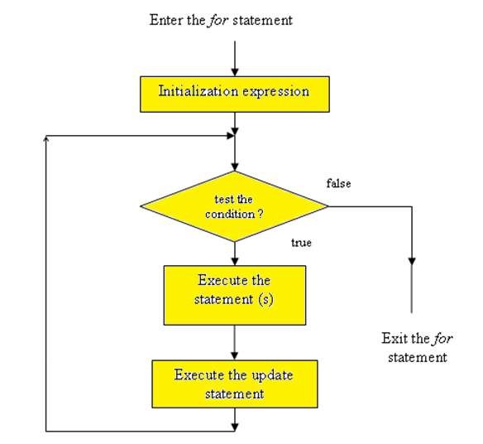
FLOWCHART : THE FOR LOOP

Slide 10
EXAMPLE :
PROGRAM TO PRINT NUMBERS FROM 1 TO 5
#include <iostream.h> void main()
{
Initialization conditional Expression expression
Output:
1
2
3
update expression
4
5
for ( int i=1 ; i<=5
cout<< i <<”\n”;
}
;
i++)
loop body
The loop control variable is i . The loop given above will execute five times. This can be verified by the number of times the value of i is displayed.

Slide 11
WORKING OF FOR LOOP:
STEP 1
#include <iostream.h> void main()
{ ₁
for ( int i=1 ; i<=5
cout<< i <<”\n”;
}
;
i++)

Slide 12

WORKING OF FOR LOOP:
STEP 2
#include <iostream.h> void main()
{
for ( int i=1
2
; i<=5
;
i++)
cout<< i <<”\n”;
}

Slide 13

WORKING OF FOR LOOP:
STEP 3
#include <iostream.h> void main()
{
for ( int i=1 ; i<=5
;
i++)
3
cout<< i <<”\n”;
}

Slide 14

WORKING OF FOR LOOP:
STEP 4
#include <iostream.h> void main()
{
for ( int i=1 ; i<=5
cout<< i <<”\n”;
}
;
i++)
4

Slide 15

WORKING OF FOR LOOP:
BACK TO STEP 2
#include <iostream.h>
void main()
2
{
for ( int i=1 ; i<=5
;
i++)
cout<< i <<”\n”;
}

Slide 16

WORKING OF FOR LOOP :
THE LOOP FORMATION
#include <iostream.h>
void main()
2
{ ₁
for ( int i=1 ; i<=5
;
i++)
3
cout<< i <<”\n”;
}
4

Slide 17
WORKING OF FOR LOOP :
THE LOOP FORMATION
#include <iostream.h> void main()
{
2
4
; i<=5 ; i++)
cout<< i <<”\n”;
3
Step 2 : Test statement
1
for ( int i=1
Step 4 : Update statement
Step 3 : Loop body
}

Slide 18
EXPLANATION
In the above program, we use a for loop to print numbers from 1 to 5. Let us see how this works:
WORKING OF FOR LOOP
First, the variable I is initialized with value 1. This happens only once.
Next the value of the variable is checked. If it is less than or equal to 5, the control
_{out of t} is passed to the body of the loop. If the condition is not satisfied, the control comes he loop.
The body of the loop which contains a cout statement is executed. The value of I is
displayed along with a new line character.
Next, the value of i (loop variable) is incremented.
Now, control comes back to the step 2, where again the value of i is checked. If it is less than or equal to 5, the body of the loop ( step 3) is executed, which prints the value of i. Now, step 4 is carried out, which increments i and so on.
The process continues till the value of i becomes 6. When I becomes 6 at step 4, control is transferred to step 2. Here the value of i is tested, the condition yields false and so the loop is terminated

Slide 19



MORE EXAMPLES TO DEMONSTRATE
WORKING OF FOR LOOP
for ( int k = 6; x > 0; k -- )
for ( int x = 1; x <= 9; x ++)
cout << k << “\t”;
cout<< 5*x<<“ ” ;
6 5 4 3 2 1
5 10 15 20 25 30 35 40 45
The variable k(loop control variable) is first
initialized with 6. It is then tested for k > 0,
then the body of the loop is executed which
The above code fragment displays
displays the value of k. Next the value of k is
the first nine multiples of 5.
decremented. Thus numbers in reverse order from 6 to 1.

Slide 20


MORE EXAMPLES TO DEMONSTRATE
WORKING OF FOR LOOP
int k = 15;
for ( int i = 2; i <= 20; i += 2 )
for ( int p = 1; p <= 5; p++ )
cout << i << “ ”;
{cout<<
k<<“x”<<p<<”=”<<k*p;cout<<
4 6 8 10 12 14 16 18 20
15 X 1 = 15
15 X 2 = 30
15 X 3 = 45
15 X 4 = 60
This code displays all the even numbers from 2 to 20. Note the expression i+=2. This increments the value of i by 2
15 X 5 = 75
The above code fragment displays the first nine multiples of 5.

Slide 21
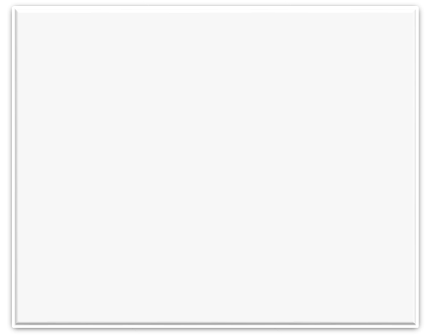
EXAMPLE PROGRAM:
WAP TO DISPLAY MULTIPLICATION TABLE
OF A NUMBER
S
#include<iostream.h> void main()
{int x, n;
cout<<“\nEnter the number “;
cin>>x;
cout<<“\nEnter the limit ”; cin>>n;
for(int i=1; i<=n; i++)
cout<<x<<“ X ”<<i<<“ = “<<x* i<<“\n”;
}
Declare x,n
Enter x, n
Y
Display x*i
Increment i
i<n ?
S

Slide 22
EXPLANATION
Two variables are declared to store the number whose multiplication table is to be
displayed and to store the limit.
int x, n : x for number, n for limit
The for loop is formed with 1 as the initial value and n as the last. for(int i=1; i<=n; i++)
The cout statement displays the number , x, then the multiplication symbol (X), the
value of i (varies from 1 to n), the = sign and then the product of multiplication (x*i) cout<<x<<“ X ”<<i<<“ = “<<x* i<<“\n”;

Slide 23
memory diagram of variables x n
Output
4 X 1 = 4
working
4
5
•
4 X 1 = 4
i
x * i
1
4

Slide 24
DRY RUN
memory diagram of variables x n
Output
working
4 X 1 = 4
4
5
4 X 2 = 8
•
4 X 2 = 8
i
x * i
2
8

Slide 25
DRY RUN
memory diagram of variables x n
Output
working
4 X 1 = 4
4
5
4 X 2 = 8
•
4 X 3 = 12
4 X 3 = 12
i
x * i
3
12

Slide 26
DRY RUN
memory diagram of variables x n
Output
working
4
5
4 X 1 = 4
4 X 2 = 8
•
4 X 4 = 16
4 X 3 = 12
4 X 4 = 16
i
x * i
4
16

Slide 27
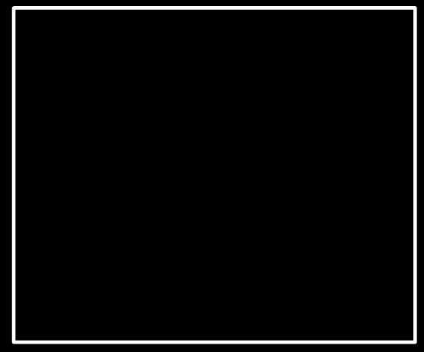
EXAMPLE PROGRAM:
DISPLAY THE SUM OF T₂HE ₃SERIES_{N}
1+X+X +X +….X
#include<iostream.h> void main()
{int x, n, sum=0;
cout<<“\nenter the value of x “;
cin>>x;
cout<<“\n enter the value of n”; cin>>n;
for(int i=1; i<=n; i++)
sum+=pow(x,i);
cout << “\nsum of series is ”<<1+sum;
}
S
Declare x,n,sum
Sum=0
Enter x, n
Y
Sum=sum +i
Increment i
i<n ?
Here sum is an accumulator variable. It accumulates
N
and stores the numbers from 1 to the value of n
S

Slide 28
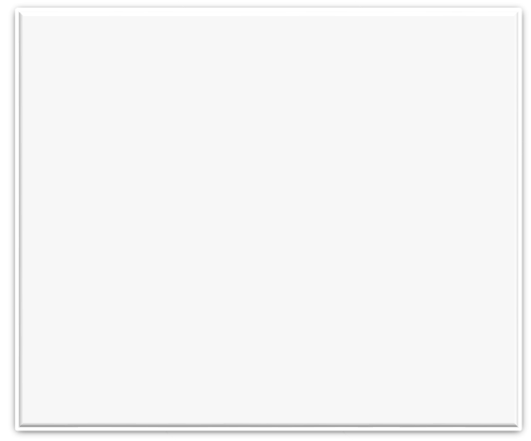
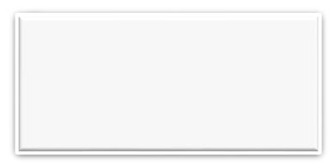
PROGRAM TO CALCULATE
FACTORIAL OF A NUMBER
Output
Enter the number : 4 Factorial is:24
#include<iostream.h> void main()
{int x, fact=1;
cout<<“\nEnter the number :“; cin>>x;
for(int i=x; i>0; i- -)
fact= fact * I;;
cout << “\nFactorial is:”<< fact;
”<<1+sum;
}

Slide 29
VARIATIONS IN FOR LOOP
Variation
Loop example
Output Explanation
Multiple initialization,
for( int i=0, j=2 ; i< j ; i++ , j- -) 0
1
There are two initializations and updates here.
update, test
The loop runs till i<j. when I becomes 2 and j
expressions
cout<<i*j<<“\ n”;
becomes 0 loop breaks.
Placement of
int i=0; 0 1 2 3 4
The initialization statement is above the loop
Expressions
for( ; i<5; )
initialization
update
and update inside the loop. This is allowed but
{cout<<i++;
we must write the semicolon in the respective
cout<<“ “;
places.
}
Empty loop
for(int x=0; x<9;x++) ;
9
This loop will execute till the value of x becomes
cout<<x<<“ ”;
9. The semicolon prevents control from entering
loop body. Thus the cout is executed only after loop terminates which displays the final value of x(9).
Infinite loop
int a = 0;
0 1 2 3 4
The above for loop does not have a test
for( ; ; )
….
expression, therefore the value of a keeps on
cout<< a ++<<” ” ;
incrementing which is displayed after each pass .
As there is no test expression the loop never
breaks.

Slide 30
WHILE LOOP
While loop is usually used when we do not know how many times we need to
execute the loop.
It repeats a statement or a set of statements on the basis of a condition.
If the condition is true, the statements in the loop are repeated again.
If the condition is false, the loop is terminated.
unlike the for loop the syntax of while loop does not require to place the initialization, test and update expressions in any order.
The syntax requires a condition or test expression as a part of it. The other two statements can be placed according to logic.

Slide 31
SYNTAX OF WHILE LOOP
while having one statement in loop body | while having multiple statements in loop body
while(condition) Statement; | while ( condition ) { statement block; }

Slide 32
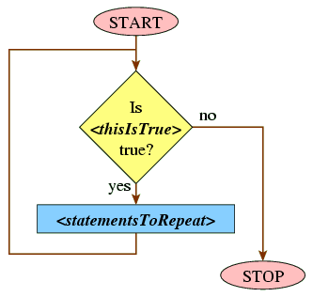


FLOWCHART: WHILE LOOP
false
condition
true

Slide 33

WORKING OF WHILE LOOP
while ( i< 9 )
{
statement(s);
}

Slide 34
WHILE LOOP DETAILED SYNTAX
Test expression/ condition
The test expression is any valid conditional
while ( i<9 )
{
statement 1;
statement 2;
…..
….
statement formed by using variables,
No semicolon
constants and operators including arithmetic
and relational operators.
We can also combine two conditions using
logical operators.
Loop body
There can be single or multiple statements in
Loop body.
These can be any valid c++ statement.
}
No semicolon

Slide 35


WORKING OF WHILE LOOP
When condition
is false
{ while ( i< 9 )
statement(s);
}

Slide 36
WHILE LOOP EXAMPLE
In order to be able to run the
loop properly we need the
Initialization expression
output
initialization as well as an update
2
statement also.
int i= 2;
3
while( i< 9 )
4
So we place the initialization
{
5
statement before the loop and
cout<< i<<“\n”;
6
the update statement inside the
i++;
}update expression
7
loop.
8

Slide 37
WORKING OF WHILE LOOP
1
int i= 2;
while( i< 9 )
{
cout<< i<<“\n”;
i++;
}
Initialization

Slide 38
WORKING OF WHILE LOOP
int i= 2;
2
while( i< 9 )
Test Expression
{
cout<< i<<“\n”;
i++;
}

Slide 39
WORKING OF WHILE LOOP
int i= 2;
while( i< 9 )
{
cout<< i<<“\n”;
i++;
}
Loop body
3

Slide 40
WORKING OF WHILE LOOP
int i= 2;
while( i< 9 )
{
cout<< i<<“\n”;
i++;
Update
4
}

Slide 41
WORKING OF WHILE LOOP
int i= 2;
while( i< 9 )
{
cout<< i<<“\n”;
i++;
}
Control transferred
to test expression

Slide 42
WORKING OF WHILE LOOP
1. Loop control variable(i) is initialized
1
2. The test expression is evaluated
int i= 2; ₂
while( i< 9 )
3. Loop body is executed if it is true
4. Loop control variable is updated
{
and control is transferred back to
cout<< i<<“\n”;
3
test expression.
If test expression evaluates to true
i++;
}
loop is executed otherwise control
4
is transferred to statement following
the loop

Slide 43
SOME POINTS TO NOTE
While loop is usually used when we do not know how many times we need to execute it. Such loops are known as sentinel controlled loops and do not require a counter.
The loop control variable acquires its value from user input and not by assignment/
initialization.
The updating takes place within the loop and depends on user input .
The number of times the loop executes also depends on the user input

Slide 44

A PROGRAM TO COUNT THE
NUMBER OF DIGITS IN A NUMBER
#include <iostream.h>
void main()
{ int no, count=0;
cout<<“\n Enter the number :”;
cin>>no; // user input : loop control variable (LCV)
Output
Enter the number :
4578
Number of digits is : 4
while(no!=0) // condition is formed using the LCV
{ count ++; no/=10;
// counter
// the update statement , changing value of LCV
}
cout<<“\ n Number of digits is:”<<count;
}

Slide 45
DRY RUN
•
memory diagram of variables
count 1
no
working
count ++
no=no/10
2
Pass 1
Pass 2
Pass 3
Pass 4
Loop terminates
1
4578
2
457
3
45
4
4
0

Slide 46
WORKING
Pass | no | Condition (no!=0) | Count ++ | Update (no/=10) | Output
1 | 4568 | 4568 != 0 True | 1 | no=4568/10 → no=456 | Number of digits is : 4
2 | 456 | 456 != 0 True | 2 | no=456/10 →no=45
3 | 45 | 45 != 0 True | 3 | no=45/10 →no=4
4 | 4 | 4 != 0 True | 4 | no=4/10 N0
0 != 0 False→ loop terminates

Slide 47
DO WHILE LOOP
The do….. while loop is a control structure in which the loop is first executed and then the test expression is evaluated.
This loop is also known as an exit controlled loop as the test expression/condition is
checked at the end of the loop i.e. after the loop body is executed.
This ensures that the loop executes at least once even if the condition is false.

Slide 48
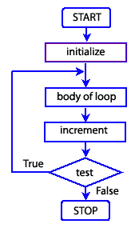
SYNTAX AND FLOWCHART OF
DO WHILE LOOP
do
{
statement;
}

Slide 49
WORKING OF DO WHILE LOOP
int x = 0;
initialization of loop control variable
The loop control variable is x, which is initialized
to 0.
The loop body is then executed which displays
and then increments the value of x.
do
{
After this the loop condition is tested.
If the condition is false, the loop is terminated,
cout << x++;
loop body
otherwise loop continues.
cout << “\n”;
}while (x < 6);
Loop condition
When the value of x becomes 6, the condition
becomes false and the loop is terminated

Slide 50
WORKING OF DO WHILE LOOP
In a do loop the loop will execute at least once even if the condition is false.
int x = 8;
The value of x is 8 which contradicts the
do
condition ( x < 8 ).
But since there is no check the loop body is
{
executed, which displays the value of x and
cout << x++;
increments it.
cout <<”\n”;
After the increment x becomes 9; the condition is
}while(x < 8);
checked in the end which is false and the loop is
terminated.
Output
Thus we can see that the loop executes at least
8
once even if the condition is false.

Slide 51
DO LOOP: WORKING
int x = 8; ¹
do
{
cout << x<<“\n”;
x++;
} while(x < 8);
Initialization

Slide 52
WORKING OF DO LOOP
int x = 8; do
{
cout << x<<“\n”;
x++;
} while(x < 8);
Loop Body
2

Slide 53
WORKING OF DO LOOP
int x = 8; do
{
Update
cout << x<<“\n”;
3
x++;
} while(x < 8);

Slide 54
WORKING OF DO LOOP
int x = 8; do
{
cout << x<<“\n”;
x++;
Test Expression
} while(x < 8);
4

Slide 55
WORKING OF DO LOOP
int x = 8; do
{
cout << x<<“\n”;
x++;
} while(x < 8);
Control transferred
to loop body if condition
is true

Slide 56
WORKING OF DO LOOP
1
int x = 8; do
{
1. Loop control variable(x) is initialized
2. Loop body is executed
3. Loop control variable is updated
4. The test expression is evaluated
cout << x<<“\n”;
3
x++;
2
} while(x < 8);
If test expression evaluates to true
loop is executed otherwise control
is transferred to statement following
the loop
4

Slide 57
PROGRAM TO CHECK WHETHER A
NUMBER IS A PALINDROME
#include <iostream.h> void main()
{
long int number, d, numrev, storednum;
numrev=0;
// declare a variable to accumulate reversed number
cout<<”Enter the number”;
cin>>number;
// Enter number to check (LCV)
storednum=number;
// store a copy of the original number as the value will change in the
loop do
{
d= number % 2;
// extract the last digit
numrev=numrev*10 + d;
// accumulate the digit in reverse
number=number/10;
// shorten the number (update LCV)
}while(number !=0);
if(numrev=storednum)
// numrev will contain the reversed number, compare with
cout<<”\n It is a Palindrome”;
// original number, if they are equal, it is a palindrome
else
cout<< “\n It is not a Palindrome”;
}

Slide 58
SAMPLE RUNS OF THE PROGRAM
Sample run 1 :
Enter the number : 99099
It is a palindrome
Sample run 2:
Enter the number : 1818 It is not a palindrome

Slide 59
ENTRY CONTROLLED AND EXIT
CONTROLLED LOOPS
The for and while loop are entry controlled loops whereas the do while is an exit controlled loop.
Entry Controlled Loop | Exit Controlled Loop
Condition is checked before the loop body. | Condition is checked after the loop body.
If the condition is false, loop will not be executed at all | If the condition is false, even then the loop is executed at least once
while(condition) Loop Entry point Loop body | do ^{loop body} ition); Loop Exit point while(cond

Slide 60
EXAMPLE OF ENTRY CONTROLLED LOOP VS EXIT CONTROLLED LOOP
While loop | Do while loop
int i = 15; while ( i < 6 ) { cout<< i--<<”\n”; } | int i = 15; do { cout<< i--<<”\n”; } while ( i < 6 );
^{Output}No output | Output ₁₅
Explanation | Explanation
The loop body will not be entered(executed) since condition is false and checked before the body. | The loop body will be entered(executed) and then the condition will be checked. Since it is false, loop will terminate.
loop will not be executed even once as the condition is false | loop will be executed at least once even if the condition is false

Slide 61
JUMP STATEMENTS
C++ provides us with some jump statements that forcibly transfer flow of control
according to a given condition.
There are three jump statements and a function which we shall study
break
continue
goto
exit()

Slide 62
THE BREAK STATEMENT
The break statement causes a loop to exit ie, it terminates the loop as soon
as it is encountered. The control is transferred outside the loop.
The break statement can be used with any of the loops- for loop, while loop or do….. while loop.
Syntax:
break;
Usage :
for(int i=0; i<15; i++)
{ if ( i % 11 ==0)
break;
} cout<<i<<“\n”;

Slide 63
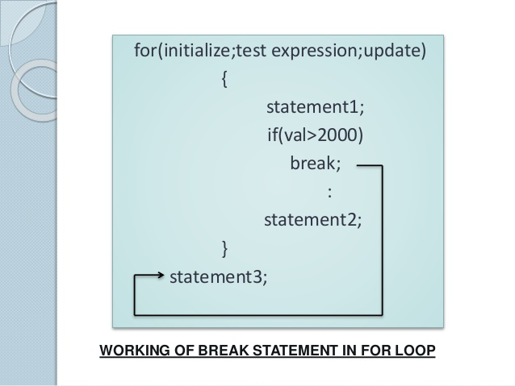

Slide 64
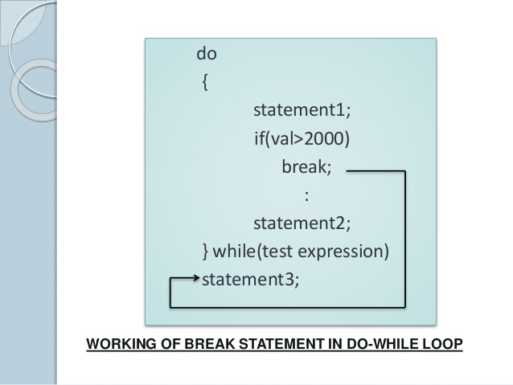

Slide 65
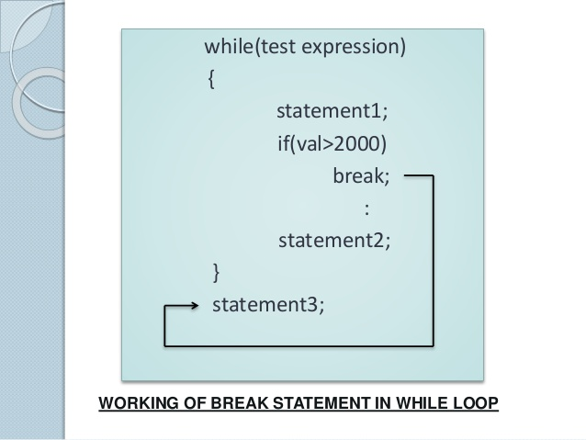

Slide 66
EXAMPLE AND FLOWCHART
S
Code | Output & Explanation
int i = 0; while( i < 15 ) { if( i = = 6 ) break; cout << i << “\n”; i = i + 2; } cout << “outside of loop”; } | Output 0 2 4 Outside of loop Explanation The loop runs only till the values of I becomes 6. When I is 6 the loop terminates and control is transferred to the statement outside the loop.
Initialize i
F
i<15 ?
T
i= =
Display i
6 ?
Increment i
T
F
S

Slide 67
THE CONTINUE STATEMENT
The continue statement is used to skip the current iteration (or pass ) of a loop.
This statement is valid only in loops.
When it is encountered it skips the rest of the statements in the loop body and causes the next iteration of the loop.
Syntax:
continue;
Usage
for(int i=0; i<15; i++)
{ if ( i % 11 ==0)
continue;
} cout<<i<<“\n”;

Slide 68
EXAMPLE AND FLOWCHART
S
code | Output and explanation
int i=1; while(i<6) { if(i%2= =0) continue; cout<<i++<<”\n”; } cout<<”\n out of loop”; | 1 3 5 out of loop Explanation The loop will not display any even numbers as whenever the value of i is even, the continue is executed and control is transferred to the update statement.
Initialize i
i< 6
?
T
i %
T
2==0
Increment i
F
?
F
Display i
S

Slide 69
THE GOTO STATEMENT
The goto statement is used to transfer control from one part of the program
to some other part.
The syntax of goto is: goto label;
Where label is any valid C++ identifier which is used to label the part of the program where the control is to be transferred

Slide 70
EXAMPLE AND EXPLANATION
#include<iostream.h>
void main()
We can see from the code that the
{ int n = 6;
int k;
goto statement simply transfer
cout<< “ Enter a number”;
control to some other part of the
program.
Here n is 6.
cin>> k;
if(n > k)
goto path1;
cout<<n<<”is not more than”<< k;
else
Suppose we enter 3 into k, then the
if condition (n > k) becomes true
path1:
and the goto is executed which is
cout<<”The larger number is”<< n;
goto path1
}
Control is transferred to the
statement labelled path1 where
Output
Enter a number 3
The larger number is 6
cout is executed

Slide 71
WHY WE SHOULD NOT USE GOTO?
It is best to avoid using goto as it leads to the program complexity. Programs
having goto are hard to debug and follow.
It is bad programming practice to use goto as it may lead to system failure.

