Slide 1
POINTERS IN C++

Slide 2
WHAT IS A POINTER?
A pointer is a variable that holds the memory address of another variable of same type.
This memory address is the location of another variable where it has been stored in the memory.

Slide 3
DECLARATION AND INITIALIZATION OF POINTERS
Syntax : Datatype *variable_name; eg. int *x; float *y; char *z;
Address of operator(&)- it is a unary operator that returns the memory address of its operand. Here the operand is a normal variable.
* is a dereferencing operator that return the value at address.
x
10
0x5f0fff2
eg. int x = 10;
int *ptr = &x;
Now ptr will contain address where the variable x is stored in memory.
ptr
Address of x

Slide 4
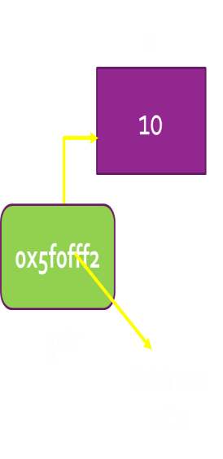
DEREFERENCE OPERATOR (*)
It is a unary operator that returns the value stored at the address pointed to by the pointer.
Here the operand is a pointer variable. eg.
int x = 10;
int *ptr = &x;
cout<< ptr;// address stored at ptr will be displayed
cout<<*ptr;// value pointed to by ptr will be displayed
OUTPUT
0x5f0fff2
10
Now ptr can also be used to change/display the value of x.

Slide 5
POINTER ARITHMETIC
Two arithmetic operations, addition and subtraction, may be performed on pointers. When we add 1 to a pointer, we are actually adding the size of data type in bytes, the pointer is pointing at.
For e.g. int *x; x++;
.If current address of x is 1000, then x++ statement will increase x by 2(size of int data type) and makes it 1002, not 1001.
.An integer value may be added or subtracted from a pointer variable.
.When two pointers are points to the same array one pointer can be subtracted from another.
.A pointer variable can not be multiplied by a constant.
.Two pointer variables can not be added.
.

Slide 6
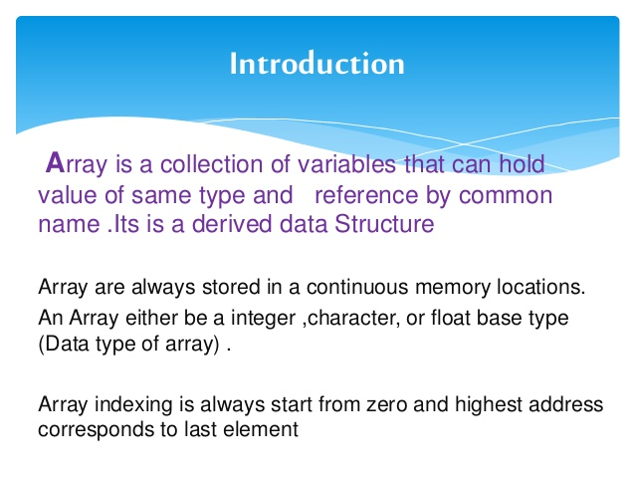
Arrays

Slide 7
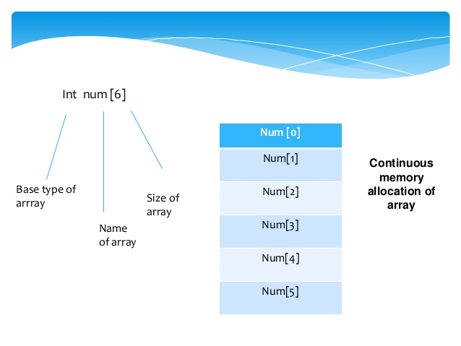

Slide 8
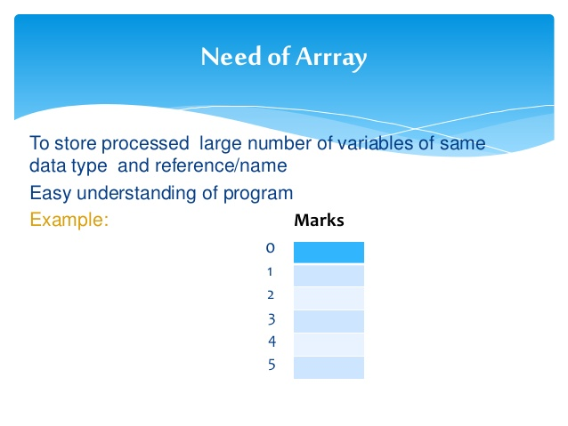

Slide 9
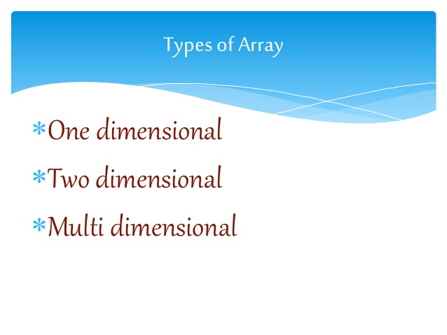

Slide 10
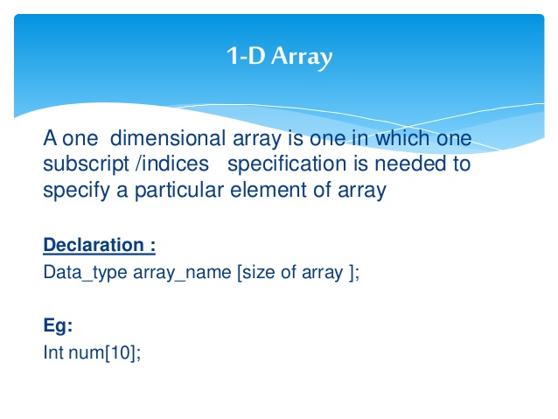

Slide 11
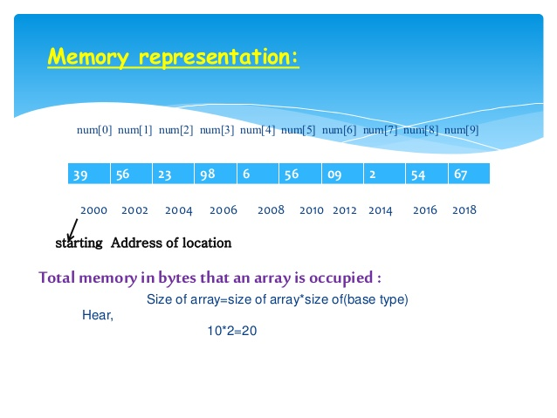

Slide 12
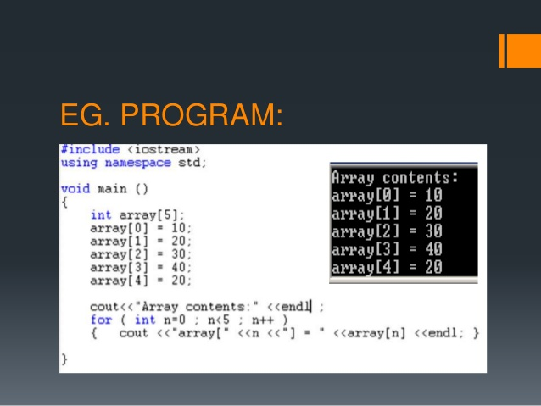

Slide 13
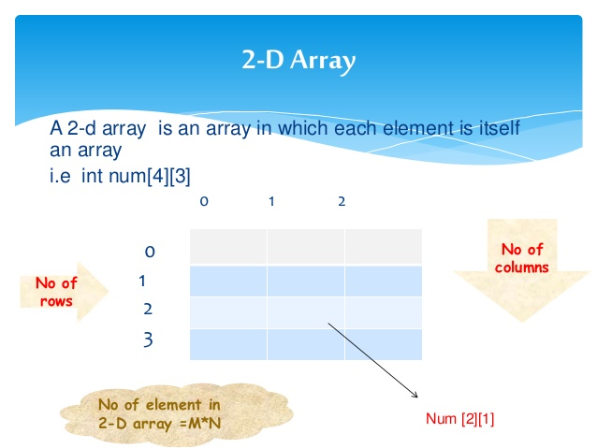

Slide 14
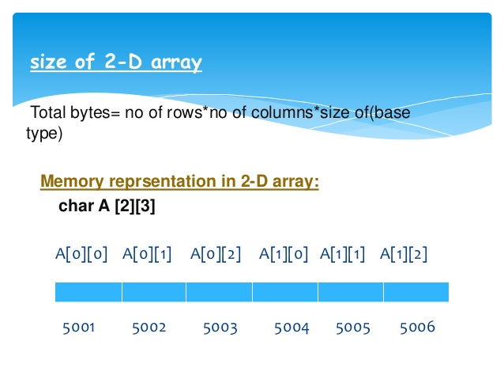

Slide 15
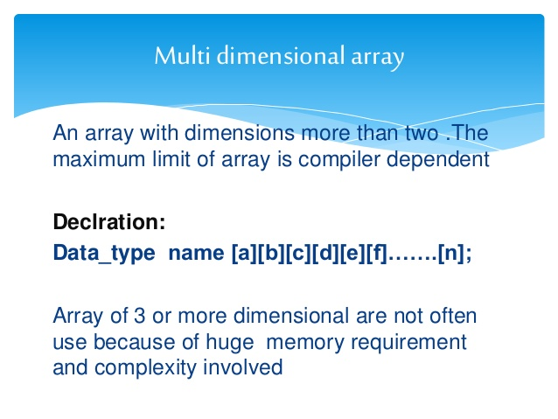

Slide 16
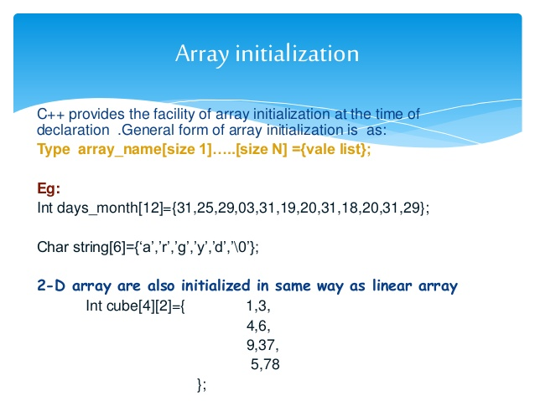

Slide 17
POINTERS AND ARRAYS
We can also store the base address of the array in a pointer variable. It can be used to access elements of array, because array is a continuous block of same memory locations.
x
0
For eg.
int x[5];
int * ptr=x; // ptr will contain the base address of x
1
ptr
2
3
we can also write
int * ptr= &x[0]; //ptr will contain the base address of x
4

Slide 18
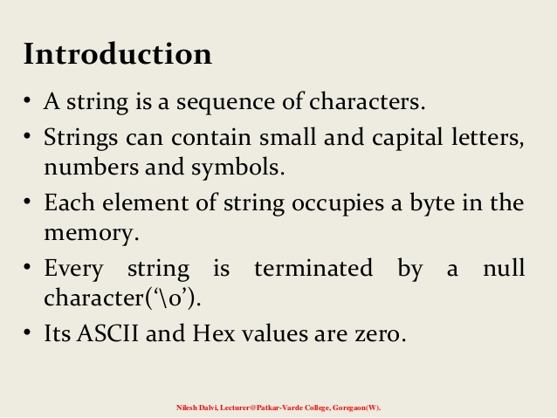
Sssr

Slide 19
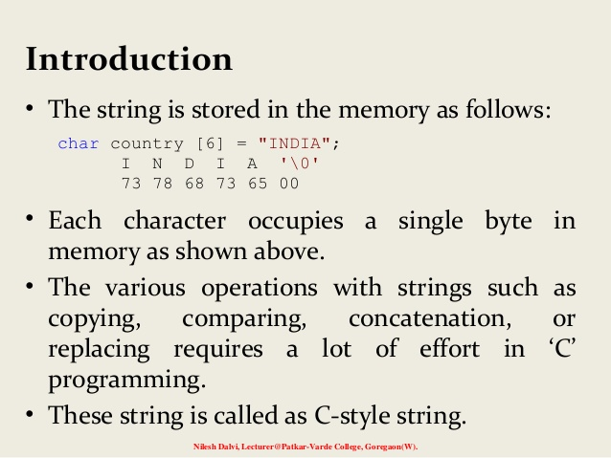

Slide 20
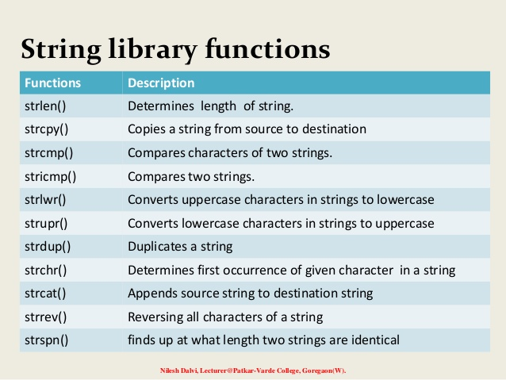

Slide 21
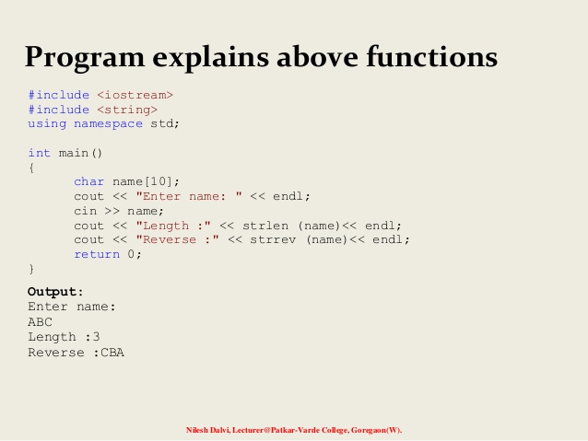

Slide 22
STRUCTURES
STRUCTURES

Slide 23
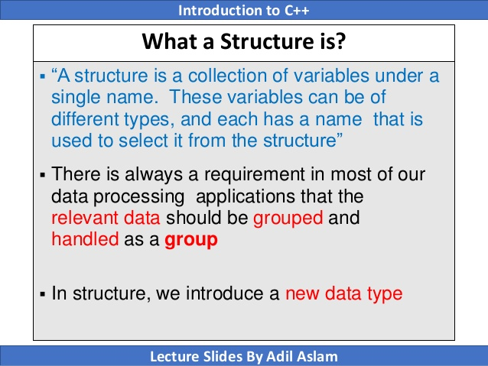
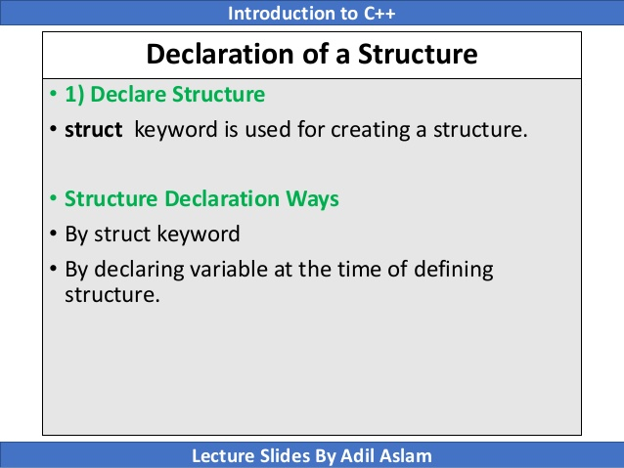
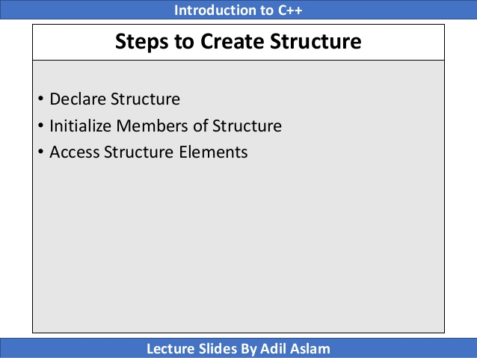
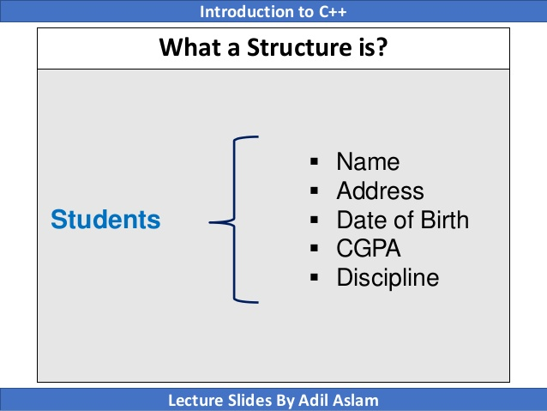
Srstr

Slide 24
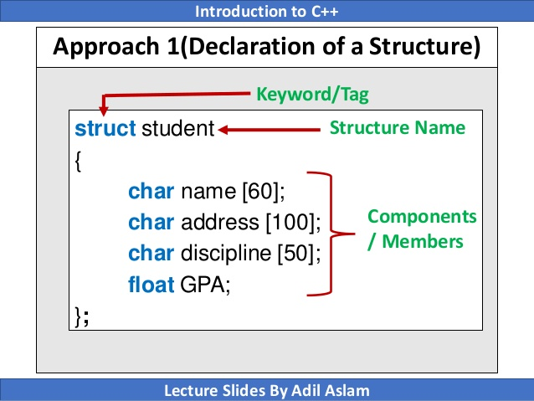
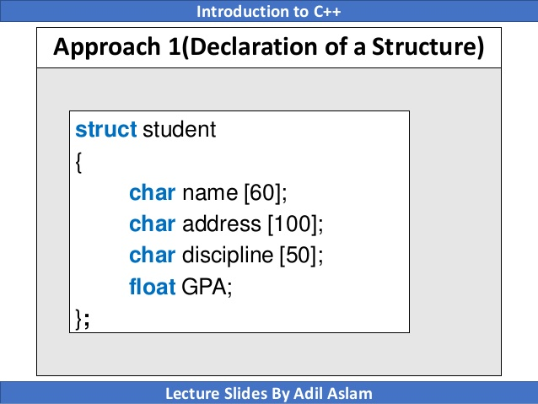

Slide 25
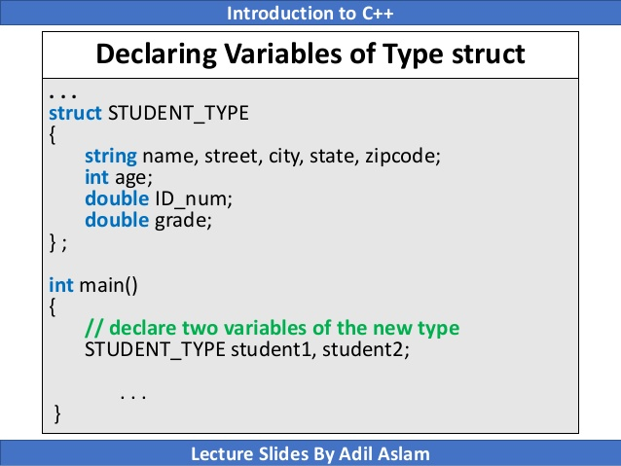
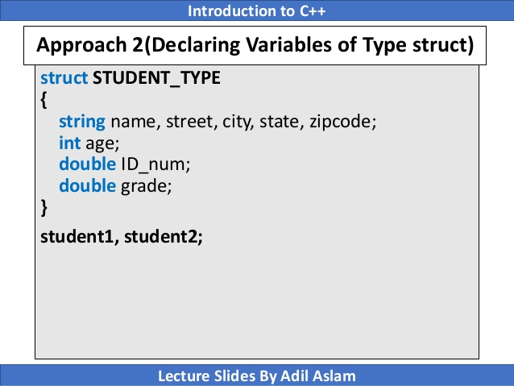
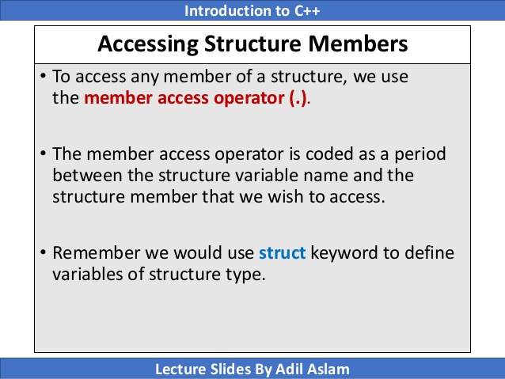
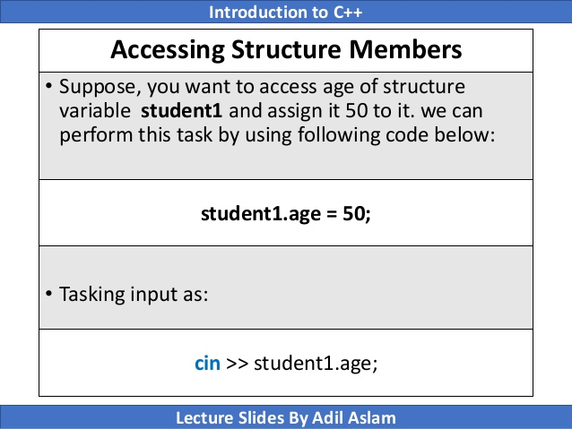

Slide 26
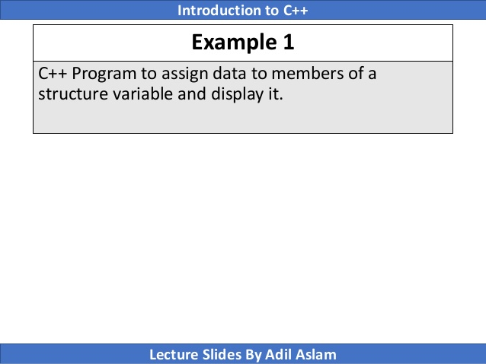
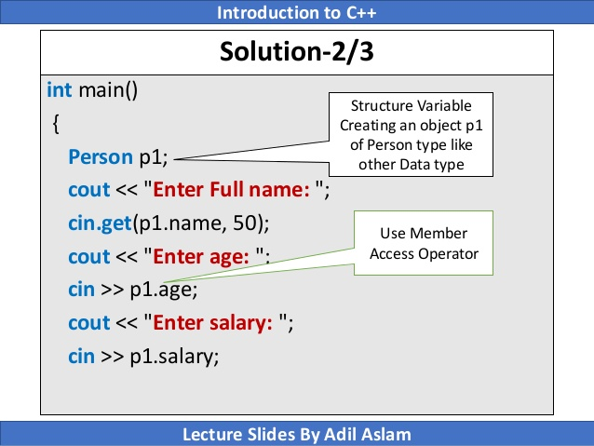
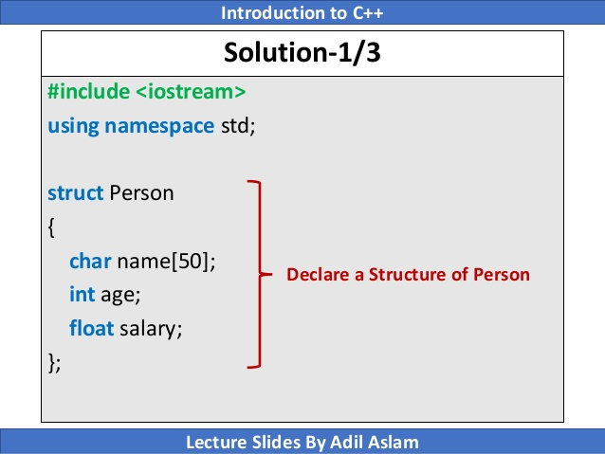
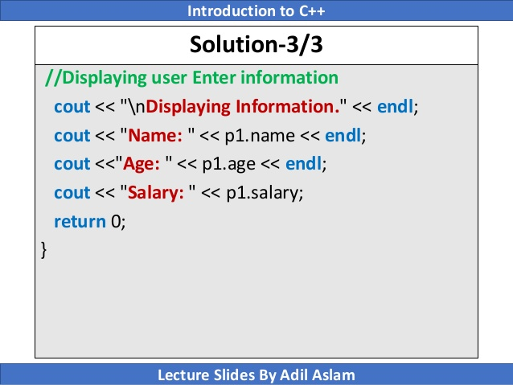

Slide 27
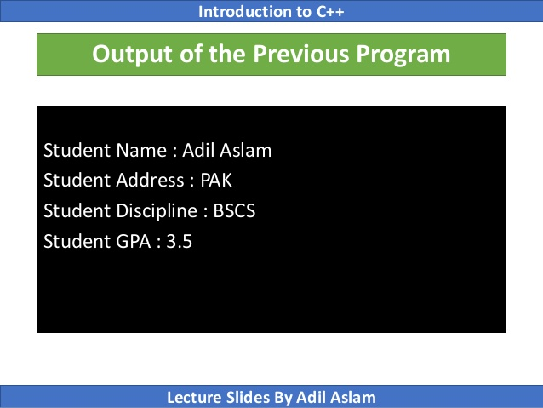
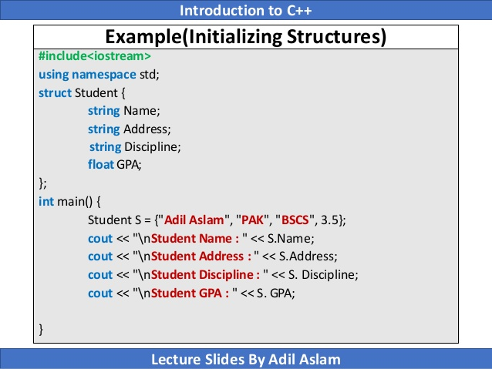

Slide 28
POINTERS TO STRUCTURES
The general syntax for creating pointers to structures is:
struct-name * struct-pointer;
For eg.
struct student
{ int rollno;
char name[20];}; void main()
{students s1;
cin>> s1.rollno;gets(s1.name); student *stu;
stu=&s1; //now stu points to s1 i.e. the address of
// s1 is stored in stu
cout<<stu->rollno<<stu->name;}
NOTE:
Here s1 is a variable to the structure student and stu is a pointer variable to the structure student.
The data members of structure can be accessed by pointer to structure using the symbol -> .

Slide 29
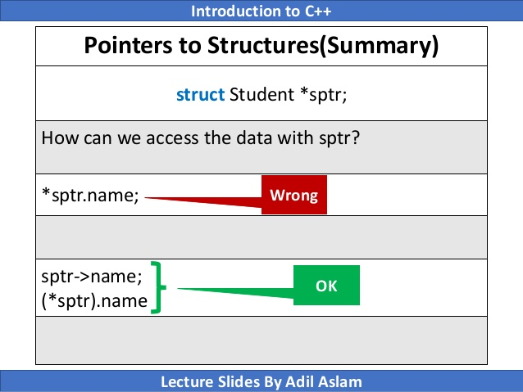
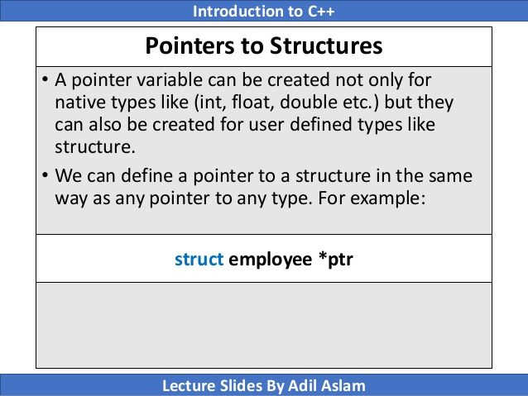

Slide 30
SELF REFERENTIAL STRUCTURES
A self referential structure is a structure which contains an element that points/refers to the structure itself.
For eg.
struct student
{ int rollno; char name[20];
student * link}; //pointer of type structure itself
The self referential structures are used for creating a node in a linked list.

Slide 31
REFERENCE VARIABLE
A reference variable is a name that acts as an alias or an alternative name, for an already existing variable.
sum
SYNTAX:
Data type & variable name = already existing variable;
10
EXAMPLE:
int num=10;
num
int & sum = num; // sum is a reference variable or alias name for num
NOTE: Both num and sum refer to the same memory location. Any changes made to the sum will also be reflected in num.

Slide 32
USAGE OF REFERENCE VARIABLES
This method helps in returning more than one value from the function back to the calling program.
When dealing with large objects reference arguments speed up a program because instead of passing an entire large object, only reference needs to be passed.

Slide 33
REFERENCE AS FUNCTION ARGUMENTS
Consider a program:
void cube(int &x)
{ x= x*x*x; }
void main()
{int y=10; cout<<y<<endl; cube(y); cout<<y<<endl;}
1000
10
y
x
No separate memory allocated to x.
OUTPUT:
10
1000
In the above program reference of y is passed. No separate memory is allocated to x and it will share the same memory as y. Thus changes made to x will also be reflected in y.

Slide 34
RETURN BY REFERENCE
A function can also return a reference. In this case function call can appear on the left hand side of an assignment statement. Consider a program:
void &cube(int &x)
{ x= x*x*x; return x;
}
void main()
5
1000
10
y
5
num
x
{ int y=10, num=5; cube(y) =num; cout<<y<<endl; cout<<num<<endl;}
OUTPUT: 5
5
No separate memory allocated to x.
In the function call statement firstly the function call is evaluated and value of x is changed to 1000. Then the function returns the reference of x which is nothing but y. Thus function call becomes equivalent to y=num; . As a result value of y becomes equal to 5.

Slide 35
INVOKING FUNCTION BY PASSING THE POINTERS
When the pointers are passed to the function, the addresses of actual arguments in the calling function are copied into formal arguments of the called function.
That means, in the called function whatever changes we make in the formal arguments, the actual arguments also get changed.
This is because formal arguments contain the address of actual arguments and point to the memory location where actual arguments are stored.

Slide 36
PASS BY POINTERS
Consider the program of swapping two variables with the help of pointers:
#include<iostream.h> void swap(int *m, int *n)
{ int temp; temp = *m; *m = *n; *n = temp; } void main()
{ int a = 5, b = 6;
cout << “\n Value of a :” << a << “ and b :” << b; swap(&a, &b); //we are passing address of a and b cout << “\n After swapping value of a :” << a << “and b :” << b;
}
OUTPUT :
Value of a : 5 and b : 6 After swapping value of a : 6 and b : 5

Slide 37
COMPARING PASS BY VALUE, PASS BY REFERENCE AND PASS BY POINTER
PASS BY VALUE | PASS BY REFERENCE | PASS BY POINTER
Separate memory is allocated to formal parameters. | Formal and actual parameters share the same memory space. | Formal parameters contain the address of actual parameters.
Changes done in formal parameters are not reflected in actual parameters. | Changes done in formal parameters are reflected in actual parameters. | Changes done in formal parameters are reflected in actual parameters.
For eg. | For eg. | For eg.
void cube(int x) { x= x*x*x; } void main() {int y=10; cout<<y<<endl; cube(y); cout<<y<<endl;} output: | void cube(int &x) { x= x*x*x; } void main() {int y=10; cout<<y<<endl; cube(y); cout<<y<<endl;} output: | void cube(int *x) { *x= (*x)*(*x)*(*x); } void main() {int y=10; cout<<y<<endl; cube(&y); cout<<y<<endl;} output:
1010 | 101000 | 101000

Slide 38
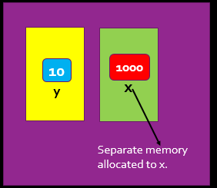
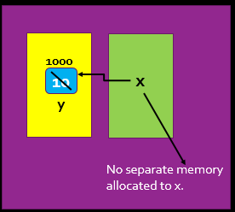
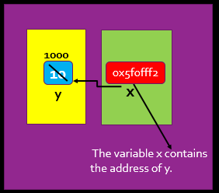
COMPARING PASS BY VALUE, PASS BY REFERENCE AND PASS BY POINTER Contd…
MEMORY DIAGRAM
PASS BY VALUE
PASS BY REFRENCE
PASS BY POINTER

Slide 39
FUNCTION RETURNING POINTERS
The general form of prototype of a function returning a pointer is:
Data Type * function-name (argument list);
Q WAP to find the minimum of two numbers using the pointers concept.
#include<iostream.h> int *min(int &, int &)
{ if (x < y ) return (&x); else return (&y); } void main()
{ int a, b, *c;
cout << “\nEnter a :”; cin >> a; cout << “\nEnter b :”; cint >> b; c = min(a, b);
cout << “\n The minimum no is :” << *c; }

Slide 40
DYNAMIC MEMORY ALLOCATION OPERATORS
C++ dynamically allocates memory from the free store/heap/pool, the pool of unallocated heap memory provided to the program.
There are two unary operators new and delete that perform the task of allocating and deallocating memory during runtime.

Slide 41
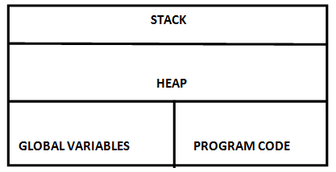
C++ MEMORY MAP
C++ memory is divided into four parts which are listed as follows:
Program Code: It holds the compiled code of the program.
Global Variables: They remain in the as long as program continues.
Stack: It is used for holding return addresses at function calls, arguments passed to the functions, local variables for functions. It also stores the current state of the CPU.
Heap: It is a region of free memory from which chunks of memory are allocated via dynamic memory allocation functions.
memory

Slide 42
NEW OPERATOR
New operator is used to allocate memory of size equal to its operand and returns the address to the beginning of the new block of memory allocated. For eg.
int * I =new int;
In the above example new operator allocates memory of size two bytes(size of int) at run time and returns the address to the beginning of the new block of memory allocated. This address is stored in the pointer variable I.
The memory allocated using new operator can also be initialized at the time of allocation itself. This can be done as follows:
char * ptr=new char(‘A’);
This statement will allocate one byte of memory from free store, stores the value ‘A’ in it and makes the pointer ptr points to it.

Slide 43
DELETE OPERATOR
Delete operator is used to deallocate memory which was allocated using new. For eg.
delete I;
The above command will deallocate the memory pointed to by the pointer variable I.

Slide 44
STATIC MEMORY ALLOCATION vs DYNAMIC MEMORY ALLOCATION
STATIC MEMORY ALLOCATION | DYNAMIC MEMORY ALLOCATION
The amount of memory to be allocated is known before hand. | The amount of memory to be allocated is not known before hand. It is allocated depending upon the requirements.
Memory allocation is done during compilation. | Memory allocation is done during run time.
For eg. int i; This command will allocate two bytes of memory and name it ‘I’. | Dynamic memory is allocated using the new operator. For eg. int*k=new int; In the above command new will allocate two bytes of memory and return the beginning address of it which is stored in the pointer variable k.
The memory is deallocated automatically as soon as the variable goes out of scope. | To deallocate this type of memory delete operator is used. For eg. delete k;

Slide 45
DYNAMIC STRUCTURES
The new operator can be used to create dynamic structures. The syntax is:
struct-pointer = new struct-type;
For eg.
struct student
{ int rollno;
char name[20];};
void main()
{ student *stu;
stu = new student; stu->rollno=1;
strcpy(stu->name,”Ramesh”);
cout<<stu->roll<<stu->name;}
A dynamic structure can be released using the deallocation operator delete as shown below :
delete stu;

Slide 46
DYNAMIC ARRAY
The new operator can be used to create dynamic arrays. The syntax is:
pointer-variable = new data-type [size];
For e.g.
int * array = new int[10];
Now array[0] will refer to the first element of array, array[1] will refer to the second element.
Similarly we can create a one dimensional dynamic character array using pointers
For e.g.
char * name=new char[20];

Slide 47
STATIC ARRAY vs DYNAMIC ARRAY
Static Array | Dynamic Array
It is created in stack area of memory | It is created in heap area of memory
The size of the array is fixed. | The size of the array is decided during run time.
Memory allocation is done during compilation time. | Memory allocation is done during run time.
They remain in the memory as long as their scope is not over. | They need to be deallocated using delete operator.

