Slide 1
Control Structures
•
Programs are written using three basic structures
Sequence
a sequence is a series of statements that execute one after another
Repetition(loop or iteration)
repetition (looping) is used to repeat statements while certain conditions are met.
Selection(branching)
selection (branch) is used to execute different statements depending on certain conditions
Called control structures or logic structures
•

Slide 2
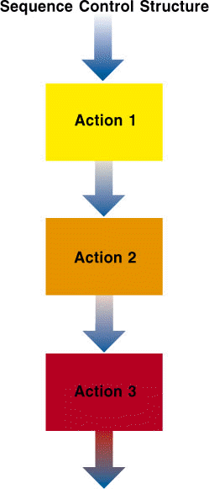
Sequence
The sequence structure directs the computer to process the program instructions, one after another, in the order listed in the program

Slide 3
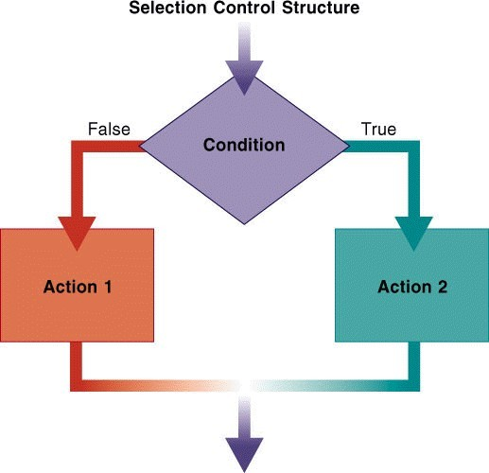
Selection (Branch)
Selection structure: makes a decision and then takes an appropriate action based on that decision
– Also called the
decision structure

Slide 4
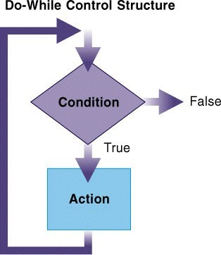
Repetition (Loop)
Repetition structure: directs computer to repeat one or more instructions until some condition is met
– Also called a loop or
iteration

Slide 5
Flow Control
How the computer moves through the program
Many keywords are for "flow control"
break, case, continue, default, do, else, for, goto, if, return, switch, while
https://www.facebook.com/AniLK0221

Slide 6
Normal flow
Statement 1;
Statement 2;
Statement 3;
Statement 4;

Slide 7
Flow control
Selection (Branch)
if
if-else
nested if
(goto)
switch
Repetition (Loop)
while
do-while
For
nesting

Slide 8
Conditional Statements
if
if else
nested if (if – else if – else if – else)
statement blocks ({…})
(goto)
switch (case, default, break)

Slide 9
if
if(condition)statement
if (x==100)
cout<<“x is 100”;
If the condition is true, statement is executed.
If the condition is false, statement is not executed.

Slide 10
if flow
if(…)
Condititional Statement
true
false

Slide 11
if else
 if (condition)statement1 else statement2
if (x==100)
cout<<“x is 100”; else
cout<<“x is not 100”;
If the statement1 is true, then print out on the screen x is 100
If the statement2 is true, then print out on the screen x is not 100

Slide 12
if else flow
if(…)
Condititional Statement
true
false
else Statement

Slide 13
Statement Blocks

If we want more than a single instruction is executed, we must group them in a in a block of statements by using curly brackets ({…})
if (x>0)
{
cout<<“x is positive”;
}
else
{
cout<<“x is negative”;
}

Slide 14
Nested if statements


When if statement occurs with in another if statement, then such type of if statement is called nested if statement. if (condition1)
if (condition2)
statement-1; else
statement-2; else statement-3;
https://www.facebook.com/AniLK0221

Slide 15
^{Nested if s} if(a>=b && a>=c)
tatements

In this program the
statement if(a>c) is nested with in the if(a>b).
if (a>b) is true only then the second if statement if(a>c) is executed.
If the first if condition is false then program control shifts to the statement after corresponding else statement.
cout<<“a is biggest”;
elseif(b>=a && b>=c)
cout<<“b is biggest”;
Else cout<<“c is
biggest”;


https://www.facebook.com/AniLK0221

Slide 16
Nested if flow
if
Condititional Statement 1
true
false
else if
Condititional Statement 2
true
false
else if
Condititional Statement 3
true
false
Else Statement

Slide 17
goto
•
It allows making an absolute jump to another point in the program.
"Go to" part of a program
•
#include<iostream.h>
int main()
{
int n=10; loop: cout<<n<<“,”;
n--;
if(n>0) goto loop; cout << “FIRE!“;
return 0;
}

Slide 18
Switch Statement
Like the goto statement but more structured
Structure is good - less confusing
Its objective is to check several possible constant values for an expression and Similar to if-elseif- elseif-else but a little simpler.
So the switch statement is better than goto !

Slide 19
Switch flow
switch
case 1
Condititional Statement 1
case 2
Condititional Statement 2
case 3
Condititional Statement 3

Slide 20
Switch statement
switch(expression) { case constant1:
block of instructions 1
break;
case constant2:
block of instructions 2 break;
default:
default block of instructions
}

Slide 21
Switch statement
◻
Switch evaluates expression and checks if it is equivalent to constant1, if it is, it executes block of instructions 1 until it finds the break keyword, then the program will jump to the end of the switch selective structure.
If expression was not equivalent to constant1, it will check if expression is equivalent to constant2. if it is, it executes block of instructions 2 until it finds the break keyword.
Finally if the value of expression has not matched any of the specified constants, the program will execute the instructions included in the default: section, if this one exists, since it is optional.
◻
◻
https://www.facebook.com/AniLK0221

Slide 22
Switch statement
switch(x) {
case | 1:
cout<<“x |  | is | 1”;
break;
case 2:
cout<<“x |  | is | 2”;
break;
default:
cout<<“value |  |  | of | x | is | unknown”;
}
https://www.facebook.com/AniLK0221

Slide 23
Loops and iterations
•
Loops have as objective to repeat a certain number of times or while a condition is fulfilled. When a single statement or a group of statements will be executed again and again in the program then such type of processing is called loop. Loop is divided into two parts
Body of loop
Control of loop
https://www.facebook.com/AniLK0221

Slide 24
Loops and iterations
◻
Control of loop is divided into two parts:
Entry control loop- in this first of all condition is checked if it is true then body of the loop is executed. Otherwise we can exit from the loop when the condition becomes false. Entry control loop is also called base loop. Example- While loop and for loop
Exit control loop- in this first body is executed and then condition is checked. If condition is true, then again body of loop is executed. If condition is false, then control will move out from the loop. Exit control loop is also called Derived loop. Example- Do-while
https://www.facebook.com/AniLK0221

Slide 25
Loops and iterations
The loops in statements in C++ language are-
While loop
Do loop/Do-while loop
For loop
Nested for loop

Slide 26
While Loop
◻
◻
◻
while (expression) statement While loop is an Entry control loop
And its function is simply to repeat statement while expression is true.
while(…)
Condititional Statements
true
false

Slide 27
While loop
#include<iostream.h> int main()
{
int n;
cout<<“Enter the starting number”; cin>>n;
while(n>0){ cout<<n<<“,”;
n--;
}
cout << “HEllo“;
return 0;
}

Slide 28
For loop
•
For loop is an Entry control loop when action is to be repeated for a predetermined number of times.
Most used – most complicated Normally used for counting Four parts
Initialise expression
Test expression
Body
•
•
•
–
Increment expression
for(initialization;condition;increment)

Slide 29
for loop
initialisation
increment
continuation test
body statements
true
false

Slide 30
For loop
int main()
{
int count;
for (count=1; count<=10; count++)
{
cout <<count<<“,”;
}
cout<<“HELL;
Return 0;
}

Slide 31
Do-While Loop
•
•
do statement while (expression)
Do-while is an exit control loop. Based on a condition, the control is transferred back to a particular point in the program.
– Similar to the while loop except that condition in
the do while is check is at end of loop not the start
do {
action1;
}
while (condition is true); action2;

Slide 32
Do Flow
do
condititional statements
while(…)
true
false

Slide 33
Nesting of Loops
A loop can be inside another loop. C++ can have at least 256 levels of nesting.
for(init;condition;increment)
{
for(init;condition;increment)
}
statement(s);
}
statement(s);
}
https://www.facebook.com/AniLK0221

Slide 34
Break Statement

Goes straight to the end of a do, while or for loop or a switch statement block,
#include<iostream.h> int main(){
int n; for(n=10;n>0;n--){ cout<<n<<“,”;
if(n==5){
cout<<“count down aborted!”; break;}}
return 0;}
^{O/P: 10,9,8,}h⁷ttp,s://⁶ww,w.⁵fac,ebo^{c}okº.co^{u}m/^{n}An^{t}iLK02^{d}21 ^{own} aborted!

Slide 35
Continue Statement

Goes straight back to the start of a do, while or for loop,
#include<iostream.h> int main()
{
int n; for(n=10;n>0;n--){ if(n==5)continue; cout<<n<<“,”;} cout << “FIRE!“;
return 0;}
O/P: 10,9,8,7,6,4,3,2,1,FIRE!

Slide 36
Summary

Programs: step-by-step instructions that tell a computer how to perform a task
Programmers use programming languages to communicate with the computer
First programming languages were machine languages
High-level languages can be used to create procedure- oriented programs or object-oriented programs
Algorithm: step-by-step instructions that accomplish a task (not written in a programming language)
Algorithms contain one or more of the following control structures: sequence, selection, and repetition



Slide 37
Summary (continued)
Sequence structure: process the instructions, one after another, in the order listed
Repetition structure: repeat one or more instructions until some condition is met
Selection structure: directs the computer to make a decision, and then to select an appropriate action based on that decision

