Slide 1
Stock Price Prediction using DEEP LEARNING
Team members
E . Gowthami (21P31A0512) MENTOR : S.V.V.s.n.RAMESH SRIPADA
G.V.SAI SURYA(21P31A0554) (Assistant professor,m.tech,ph.d)
B.L. JUHITHA (21P31A0550)
J. Harsha VARDHAN (21P31A0555)
P.D. RAMA KRISHNA(21P31A0560)

Slide 2
AGENDA
PROBLEM STATEMENT
EXSITING SYSTEM & DRAWBACKS
FLOW OF PROPOSED MODEL
TECHNOLOGIES & TOOLS USED
FEASIBILITY OF PROPOSED SYSTEM
Flow of the Proposed System
Functional Requirements
Non-Functional Requirements
Data Flow Diagram
Expected Outcomes

Slide 3
MOTIVATION
There is increased in stock market investors in present days.
Due to lack of knowledge on stock investment many people are tends to loss of money and valuable time.
So, Our project is mainy used to those people to analyze in a technical way by making use of Deep learning.

Slide 4

PROBLEM STATEMENT
Prediction of a particular stock price using Deep Learning techniques.
Data Fetching using yfinance API
Visualizing the result obtained by the trained model.

Slide 5
EXSITING SYSTEM & Drawbacks
-> Prediction of a particular stock price on a specific day using regression algorithms.
->Low Accuracy.
->Risk of money loss.
->Shows different behavior when dealing with unseen data.
->Manual data adding to the model.

Slide 6
FLOW OF PROPOSED MODEL
1
Data loading using an API in to SQLite DB
3
Data Preprocessing
4
Model Training
6
Prediction
5
Testing the model
2
Data loading into the CSV file.

Slide 7
TECH STACK
Deep Learning Using Python
Python IDLE
SQLite DB
yFinance API

Slide 8
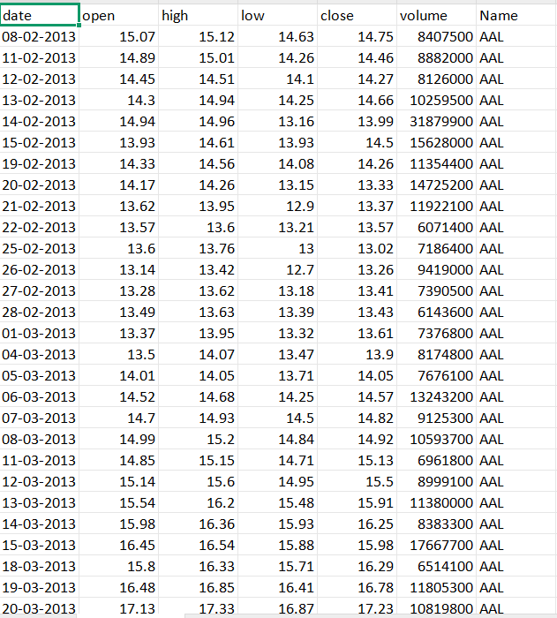
SAMPLE DATA SET

Slide 9
>> This presentation outlines the development of a stock price prediction system using TensorFlow.
>> We will cover the functional and non-functional requirements, system design, key components, and expected outcomes.
>> Our goal is to build a robust and accurate prediction model.

Slide 10
Functional Requirements
Data Acquisition
Data Preprocessing
Model Training
Visualization
Real time Analysis
User friendly interface
Performance monitoring

Slide 11
Non-Functional Requirements
Software Requirements
Python 3.12+
Required libraries: tkinter, tkcalendar, matplotlib, yfinance, tensorflow, pandas, numpy, sqlite3
Usability
The application should be usable by non-technical users with minimal instructions.
It must offer clear error messages, tooltips, and logs to guide the user throughout the process.
Performance
The GUI should remain responsive during background tasks like model training or data fetching.
The system should handle at least 1 year of stock data efficiently with minimal lag.
Model training time should remain reasonable (under 1 minute for most datasets).
Supportability
The application should be easy to maintain and update with new tickers or deep learning algorithms.
Code should be modular to facilitate debugging and future enhancements.

Slide 12
Security Requirements
Since the system uses third-party APIs, ensure secure data retrieval using HTTPS.
Sensitive user data (if any) should not be stored permanently.
The application must handle invalid or malicious inputs gracefully.
Resource Requirements
Disk Space: At least 200 MB for storing SQLite DB and logs
No internet is needed after initial data retrieval, making it partially offline-compatible.

Slide 13
Data Flow Diagram
Data Acquistion
Preprocessing
Model Training
Prediction
Reporting

Slide 14
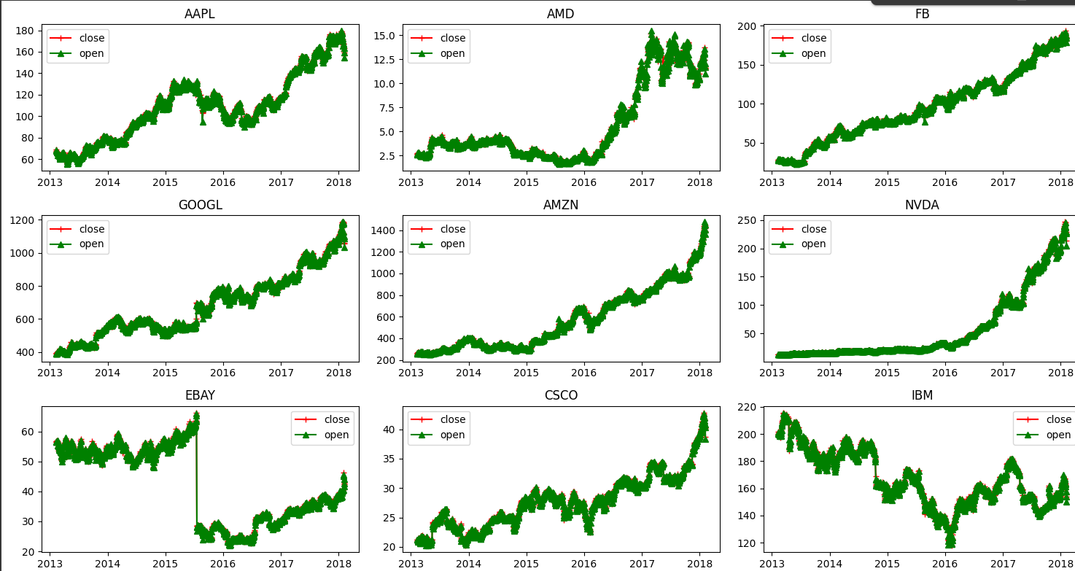

Open & close prices visualizations

Slide 15
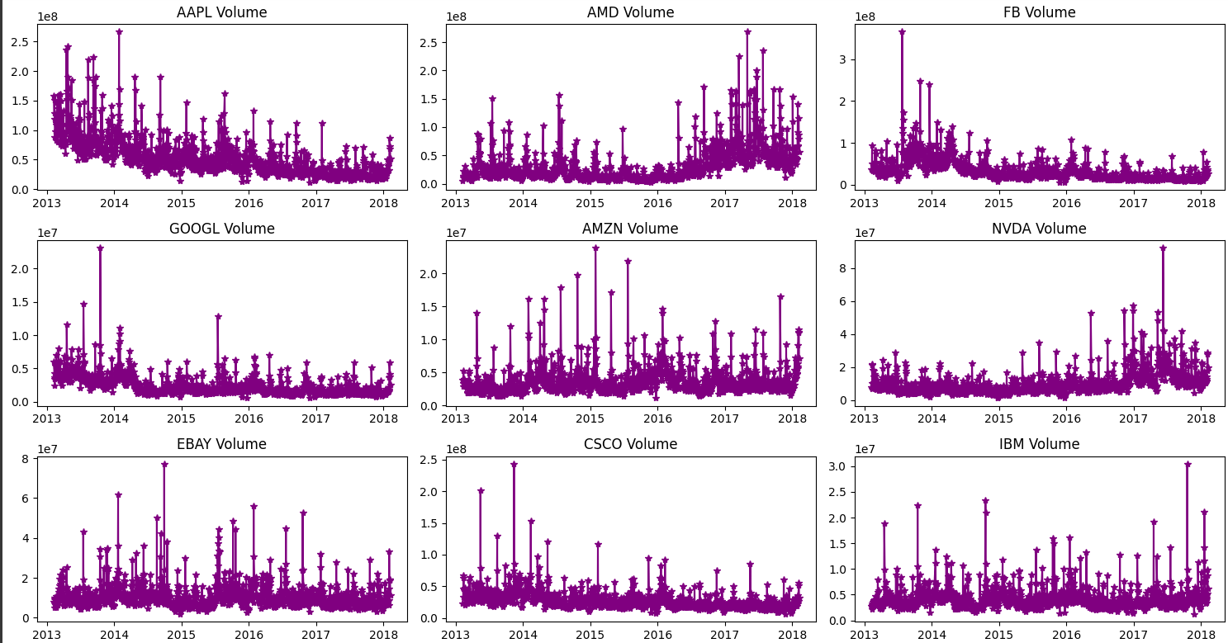
Volume of stocks

Slide 16
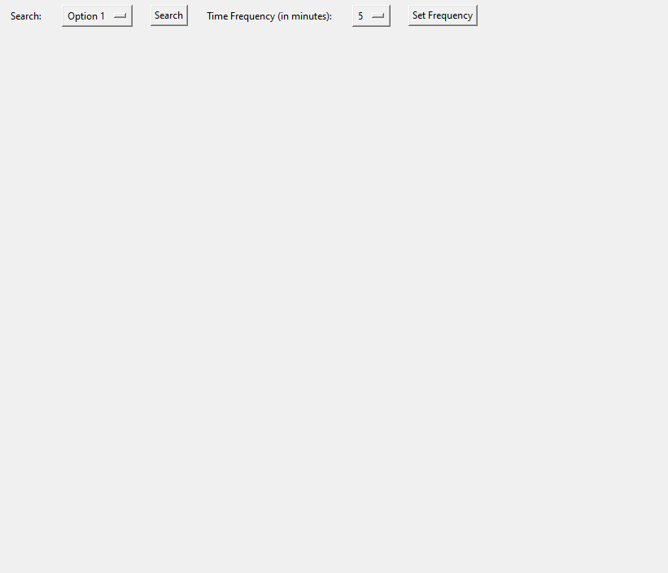
SAMPLE INTERFACE

Slide 17
FLOW OF THE prediction
Data fetching using API
Storing the fetched data in SQLite DB
Converting the fetched data to a csv file
Applying model to the dataset
Prediction (OUTPUT)
Specifying the stock name & period

Slide 18
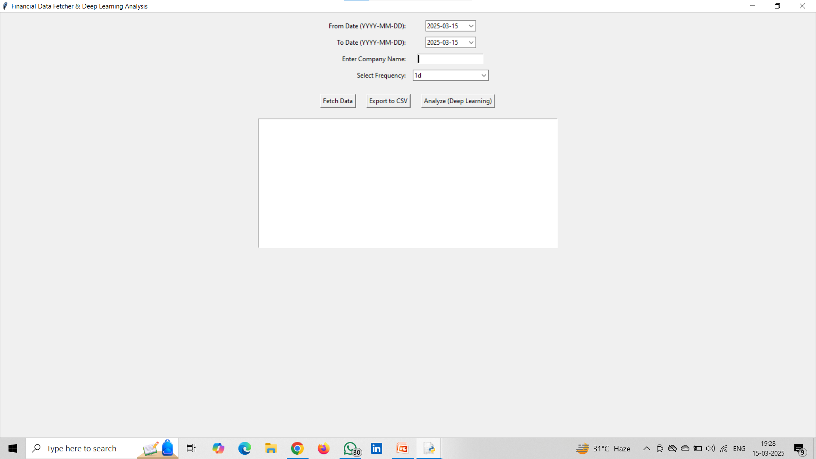
Actual interface

Slide 19
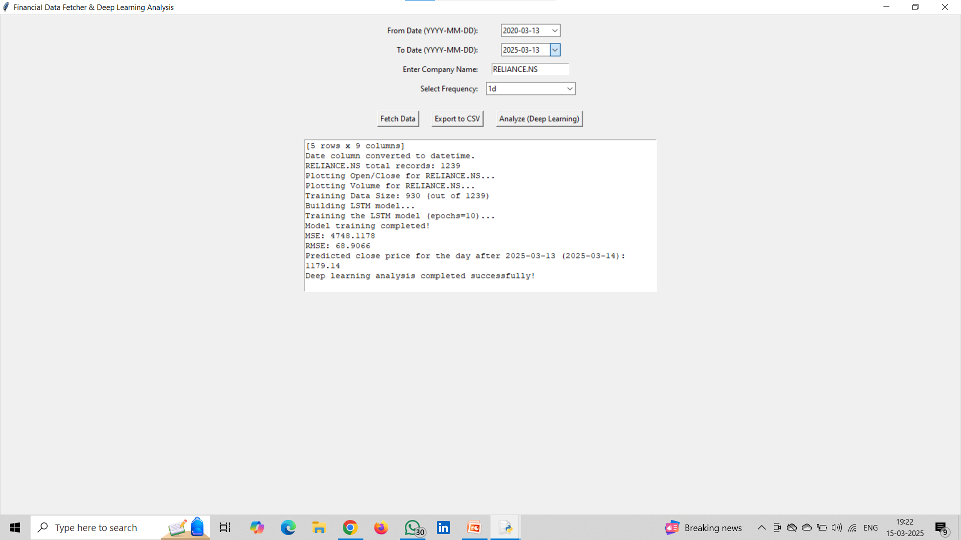
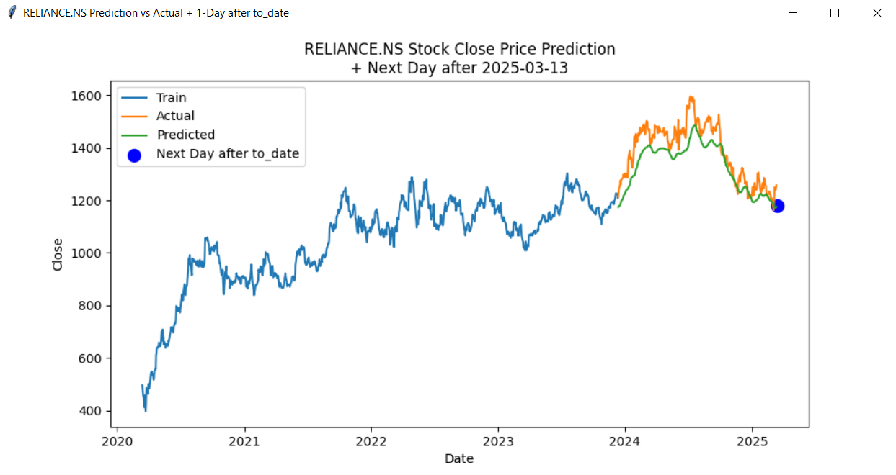
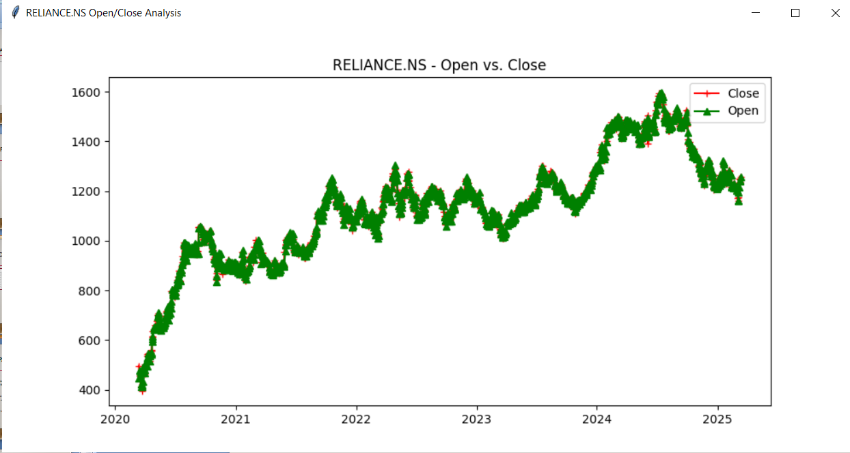
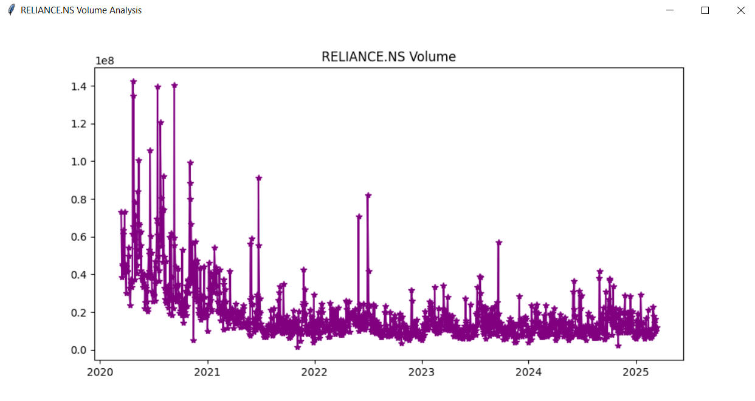
SAMPLE OUTPUT FOR RELAINCE STOCK

Slide 20
Data Acquisition & Preparation
yfinance API
Historical stock data is fetched using the yfinance API. This includes Open, High, Low, Close, and Volume data points. For example, we download 5 years of daily data for AAPL.
Database Integration
The fetched data is stored in a SQLite database named `stock_data`. The schema includes `stock_symbol`, `date`, `open`, `high`, `low`, `close`, and `volume`.
CSV Export
The database data is transformed into CSV format for model input. For example, we create a file named `stock_data.csv`.

Slide 21
Future WORK
Enhanced User Personalization
Adding user authentication, personalized dashboards, and alert systems (via email or SMS) based on user preferences can improve the overall user experience.
Sentiment Analysis
Implement real-time sentiment tracking for specific tickers.
Develop dashboards showing sentiment trends alongside price charts.
Automate model training with newly fetched sentiment data.
Multi-stock Portfolio Forecasting
Enable support for analyzing and predicting multiple stocks at once, allowing users to
track a full portfolio and get comparative visualizations.

Slide 22
Thank You
TEAM-16

