Slide 1
QuantSparse 3D Biweekly 2025-03-04
Integrated Systems Laboratory (ETH Zürich)
Bowen Wang bowwang@iis.ee.ethz.ch Paul Scheffler paulsc@iis.ee.ethz.ch
Luca Benini lbenini@iis.ee.ethz.ch

Slide 2
Agenda: Literature Review on Sparsity
Overview and Definitions
Literature Findings
Coarse-Grain Sparsity
Medium-Grain Sparsity
Fine-Grain Sparsity
Discussion

Slide 3
Sparse LLMs: Definitions and Overview
Two orthogonal kinds of sparsity
Activation sparsity: activate only subset of parameters for each token ➜ Scale up params without proportional scaling in compute & memory
Weight sparsity: introduce zeros in weights using pruning or (re)training ➜ Reduce compute & memory by not storing zeros, skipping ineffectual comp.
Granularity is critical for HW
Coarse-grain solutions are portable
Fine-grain solutions need HW support!
Granularity | Sp. Type | Techniques | Location
Coarse (Networks) | Activation | Sparse MoE | FFN
 | Activation | Head Selection | Attention
Medium (Vectors) | Activation | Sparse Attention | Attention
 | Activation | Product-Key Mem. | FFN / Skip.
Fine (Scalars) | Weights | (One-shot) Pruning | Anywhere
 | Weights | Sparse (Re)training | Anywhere

Slide 4
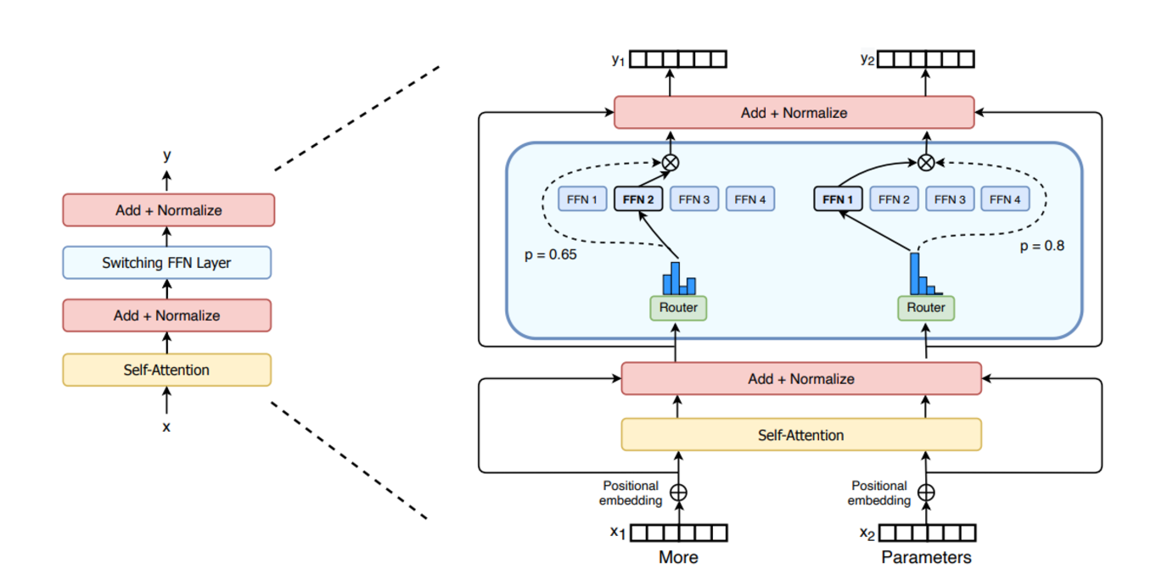
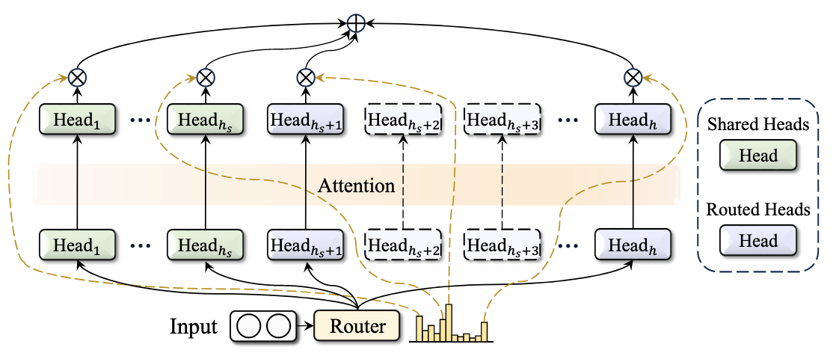
Coarse-Grain Approaches
Target
Layers, Attention heads, blocks of weights
Activation sparsity
DeepSpeed-MoE^{[1]}, DeepSeekMoE^{[2]}: selectively activates only a small subset of expert networks
IST^{[3]}: most important subset of full layers with effective layer-wise importance scoring
MoH^{[4]}: treats attention heads as experts in the MoE mechanism

Slide 5
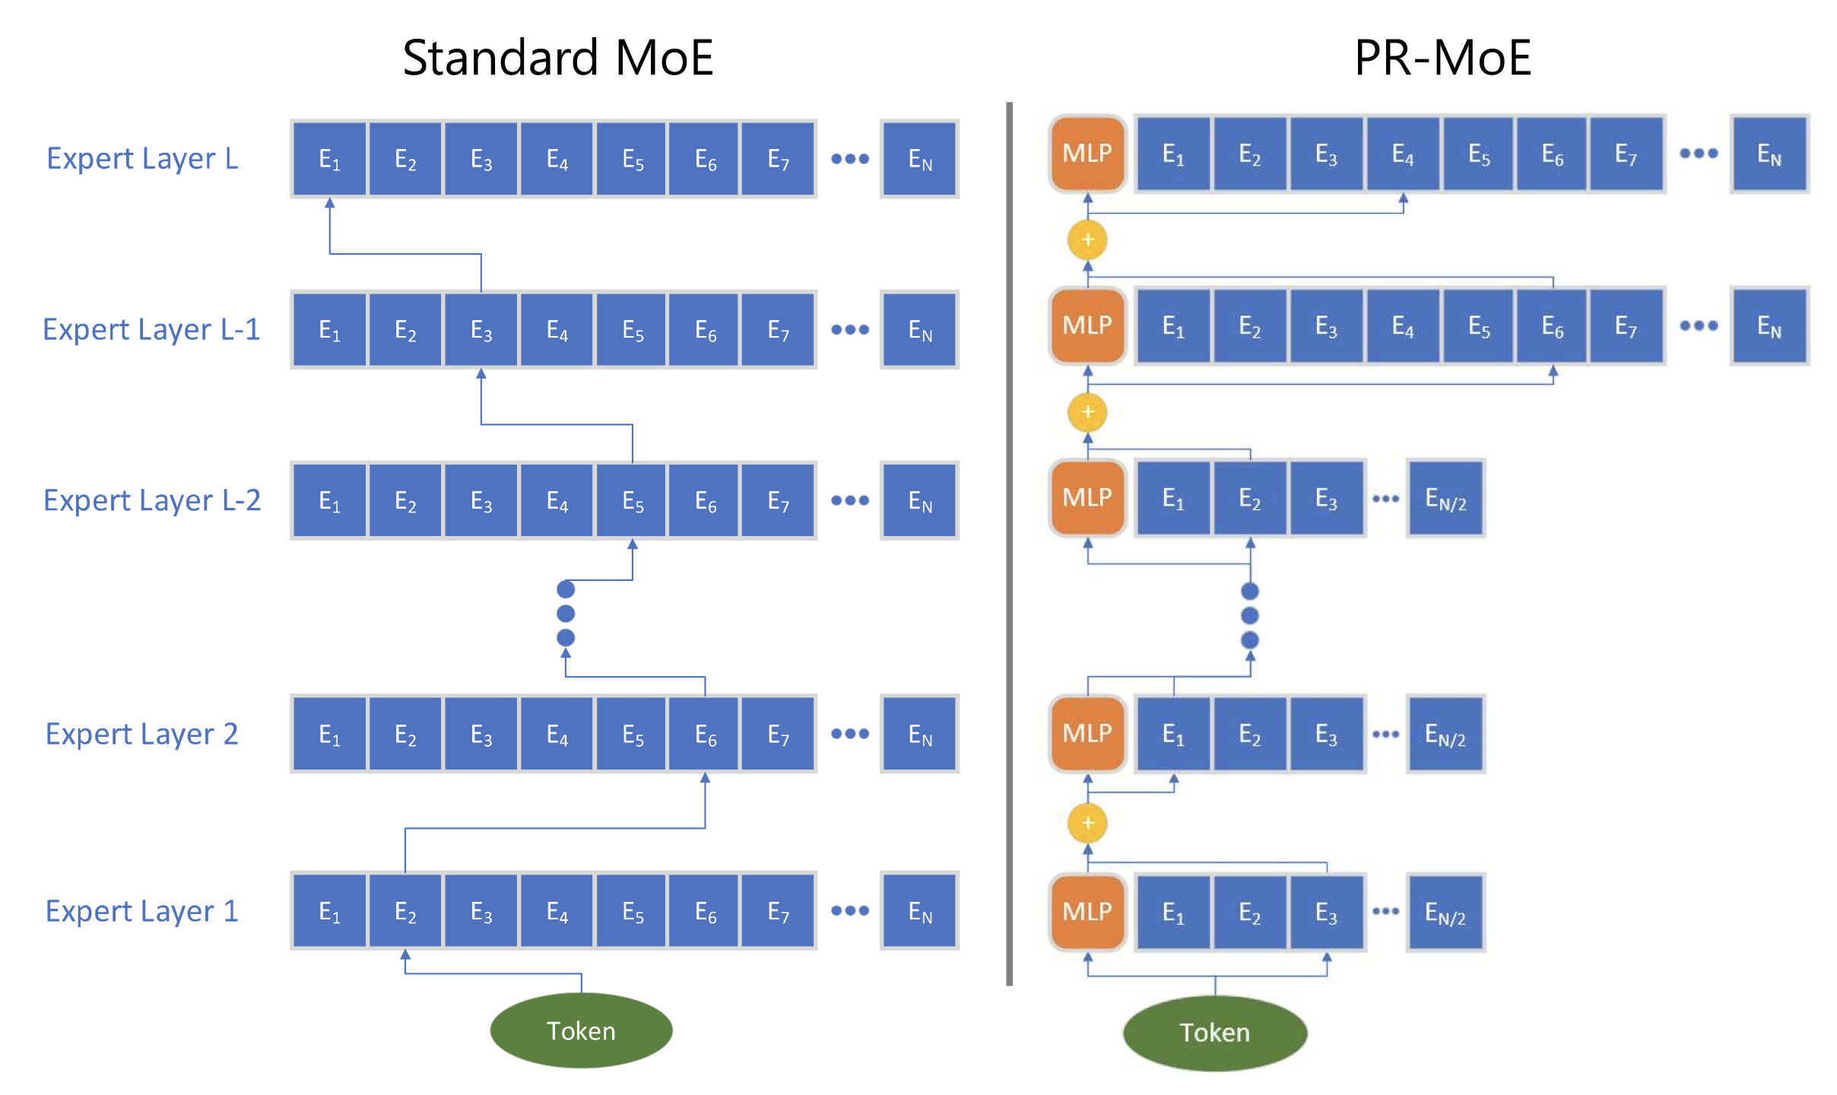
DeepSpeed-MoE in Depth
Key observations
Not all MoE layers learn the same representation → Deeper layers benefit more from a large number of experts.
Residual-MoE: Fixing one expert and varying the second → an error correction term
Combine expert, tensor, and data parallelism
Tensor slicing for non-expert parameters
Expert slicing to allocate one expert per GPU
Data parallelism to reduce communication overhead

Slide 6
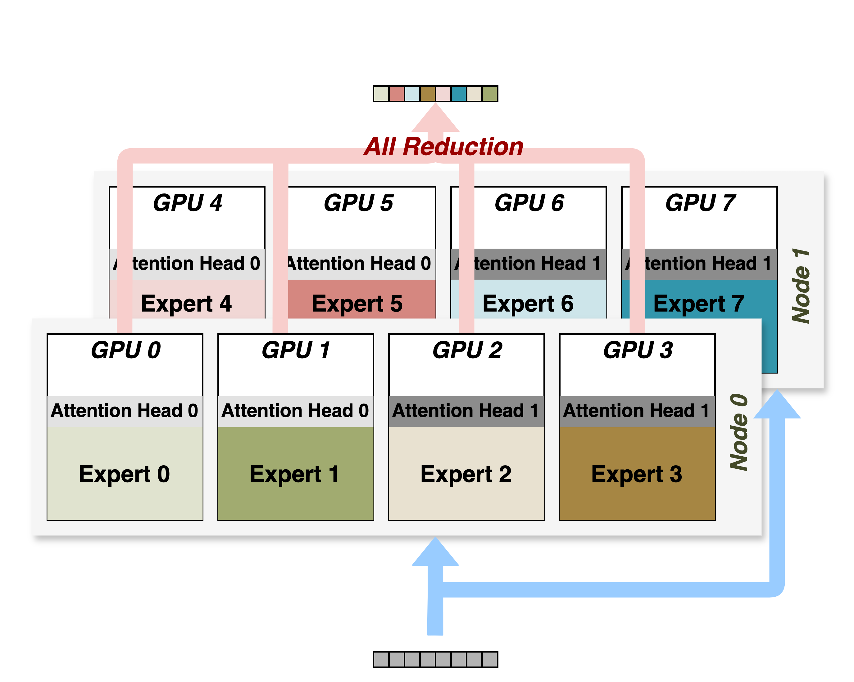
DeepSpeed-MoE in Depth
Achievements
Same quality with 5x less training cost
1.3B+MoE-128 vs. 6.7B dense baseline
Optimized inference system
Communication Optimization
Tensor slicing splits individual operations across GPUs → requires all-reduction between GPUs per Node

Slide 7
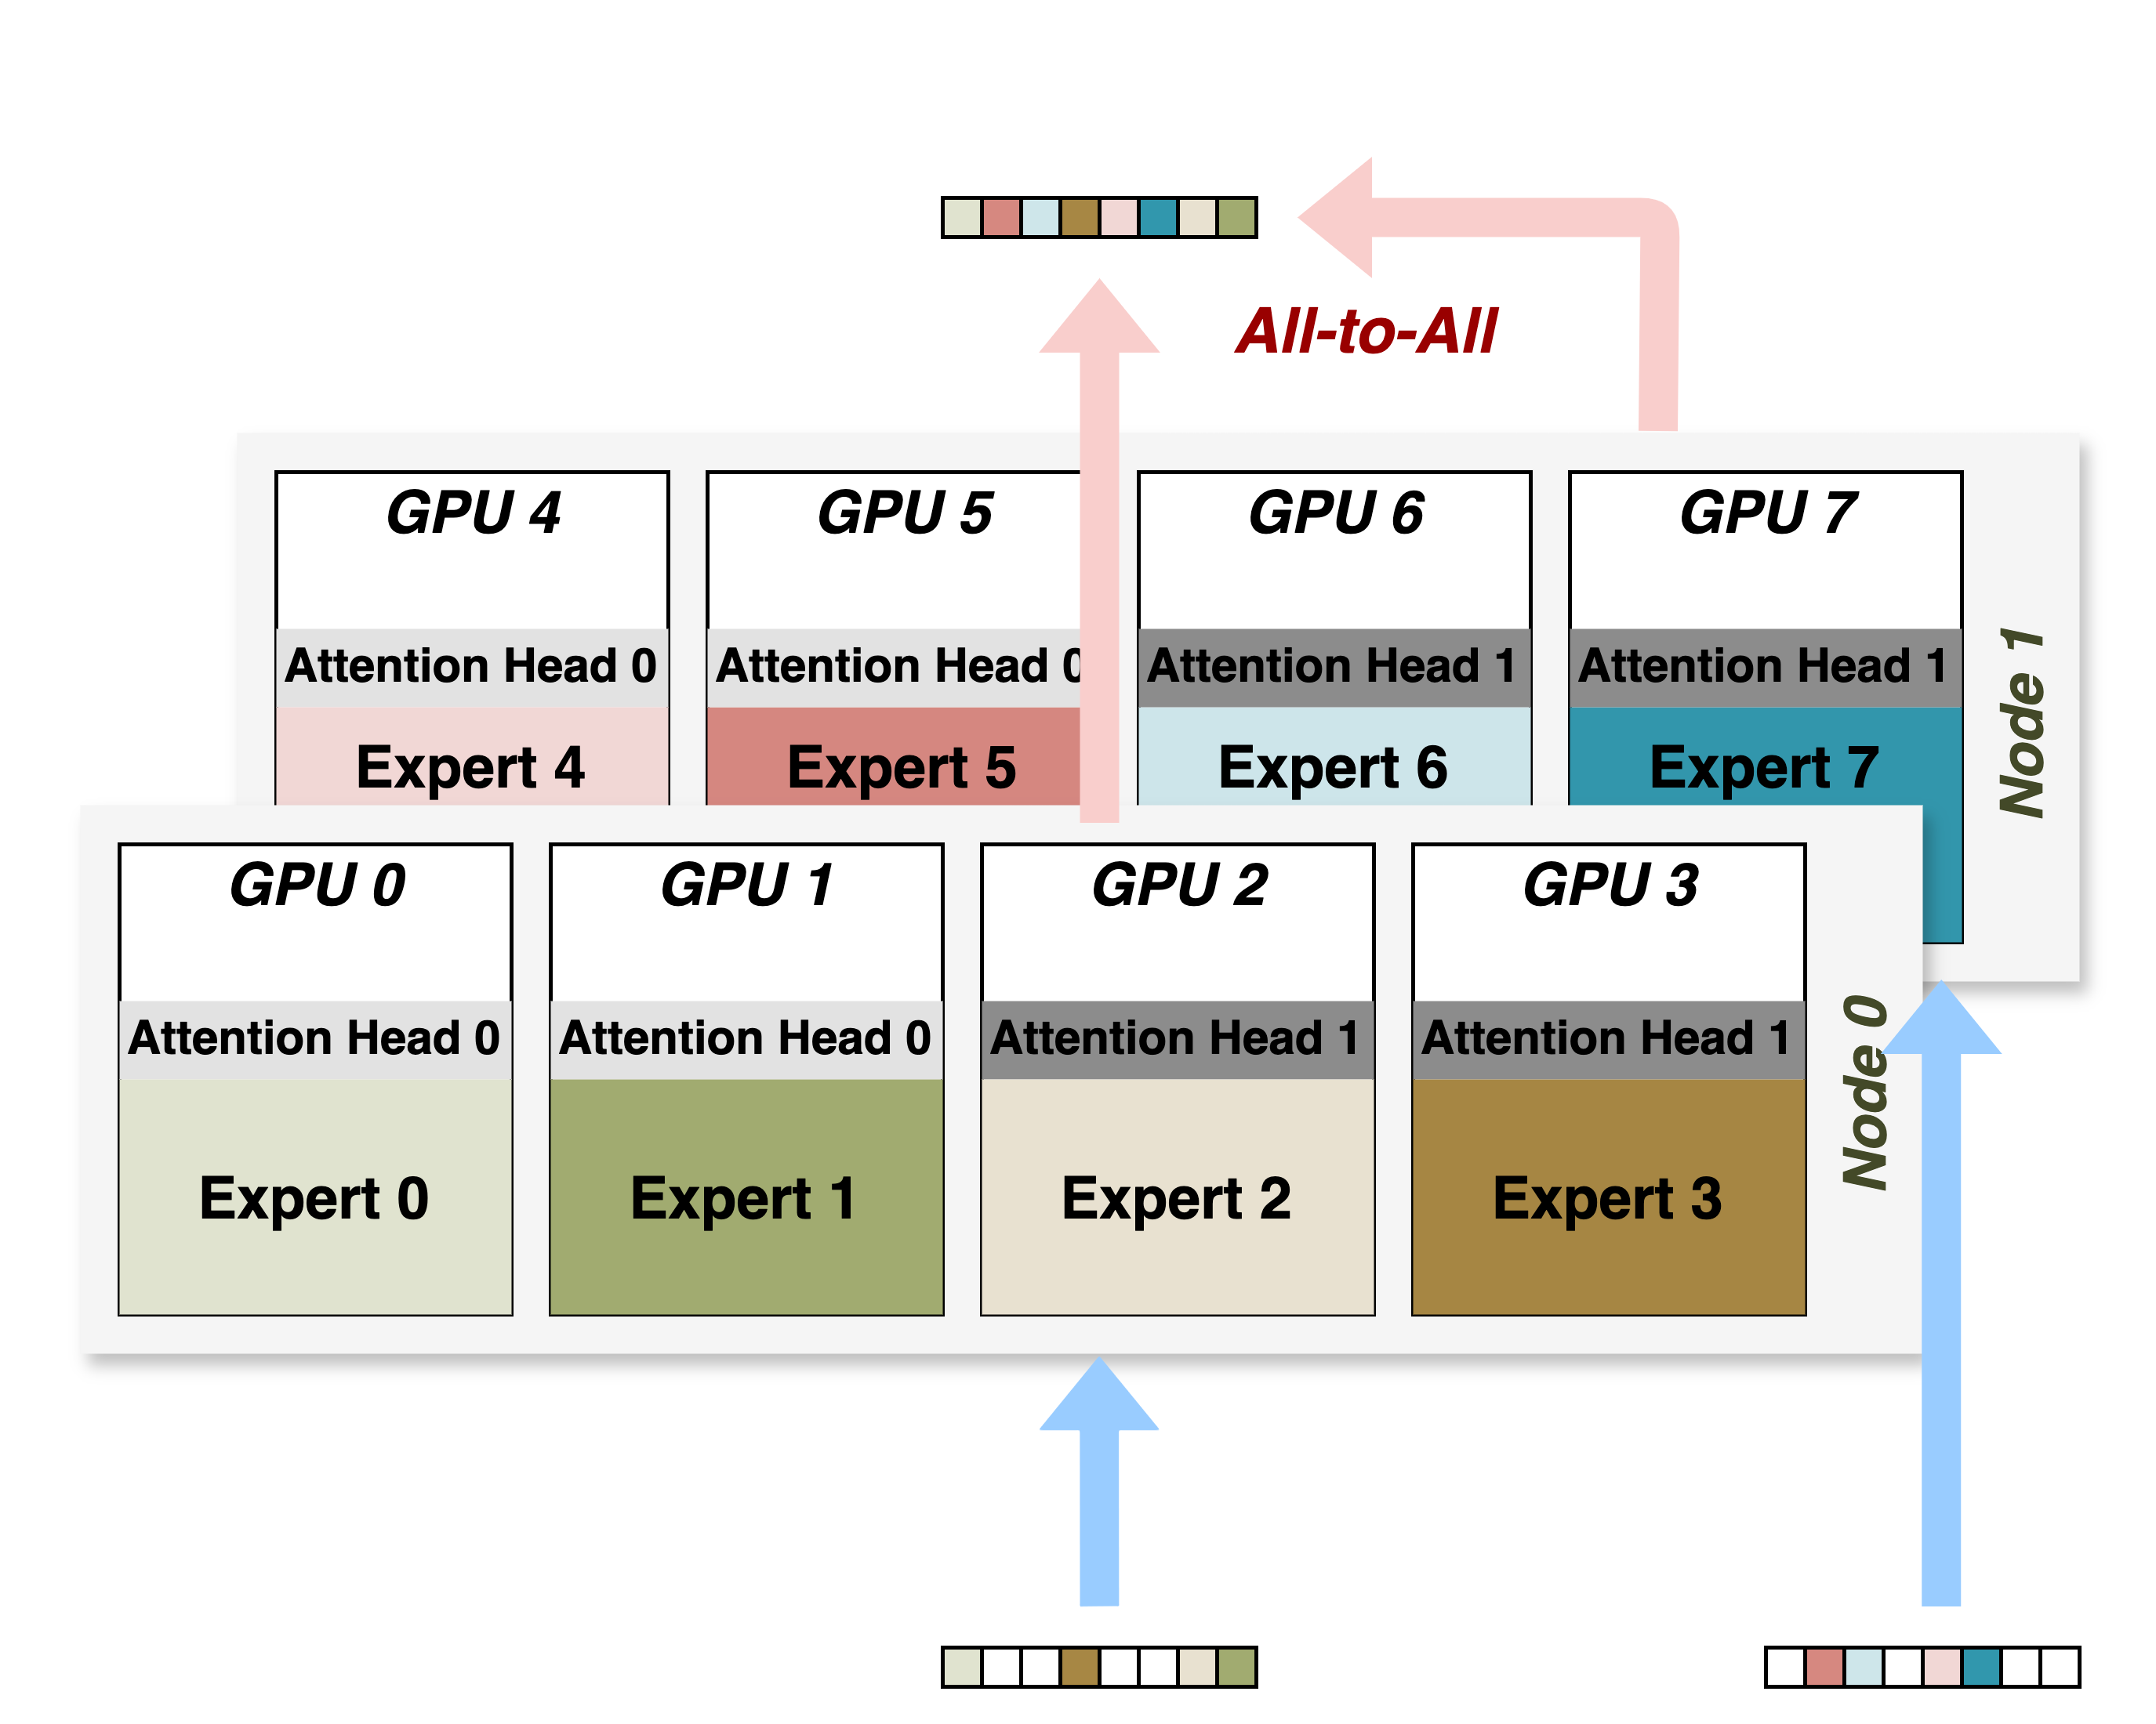
DeepSpeed-MoE in Depth
Achievements
Same quality with 5x less training cost
1.3B+MoE-128 vs. 6.7B dense baseline
Optimized inference system
Communication Optimization
Tensor slicing splits individual operations across GPUs → requires all-reduction between GPUs per Node
Experts distributed across GPUs without splitting → requires all-to-all communication
Challenges in Workload Mapping
Hardware Opportunities in Data Movement

Slide 8
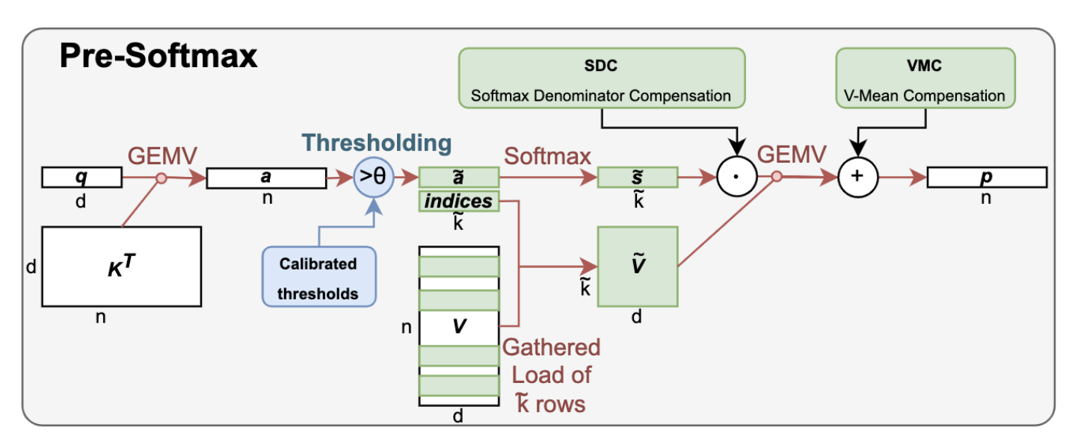
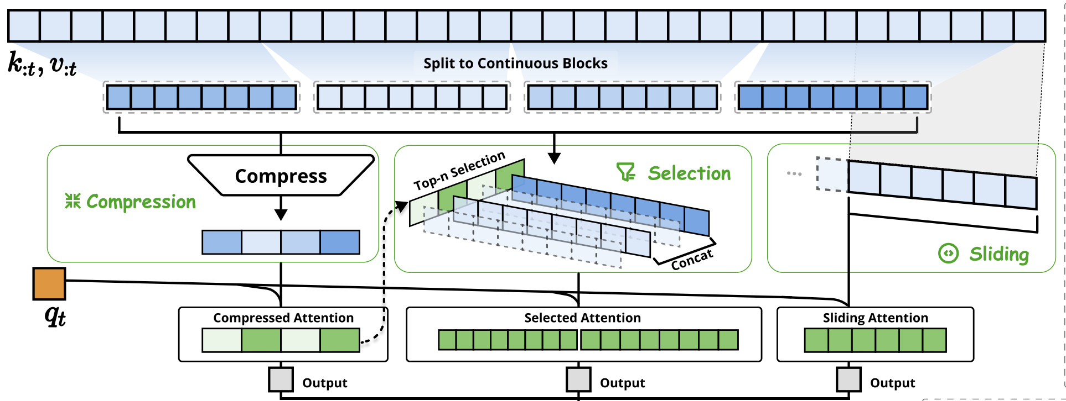
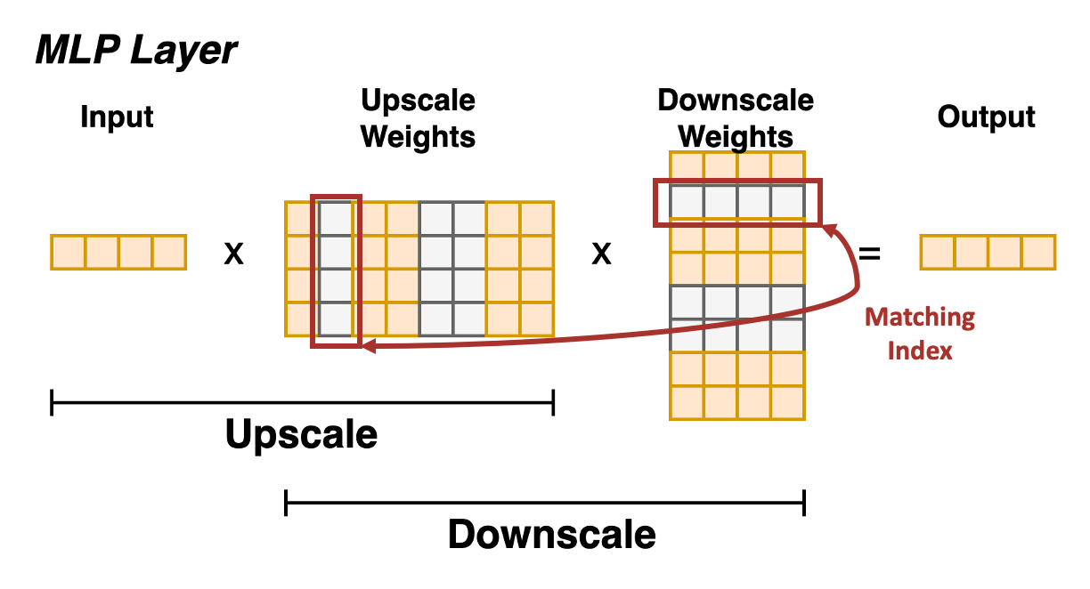
Medium-Grain Approaches
Target
Rows in weight/cache matrices
Activation sparsity
Top-k^{[5]}, Top-Theta^{[6]}: selectively activates rows in V matrix with highest Attention scores
Quest^{[7]}: activates predicted important tokens K, V based on input token’s Q
Native Sparse Attention^{[8]}: activates K, V based on compressed attention
Deja Vu^{[9]}: contextual sparsity in MLP blocks
Hardware to be flexible enough for vector-level operations
Notes:
Mention Blackwell

Slide 9
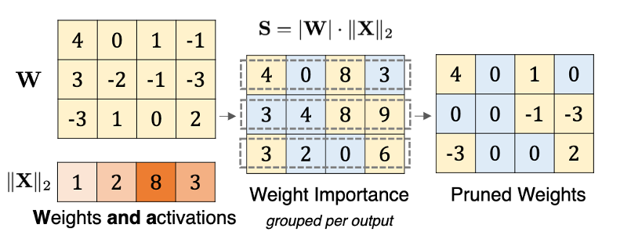
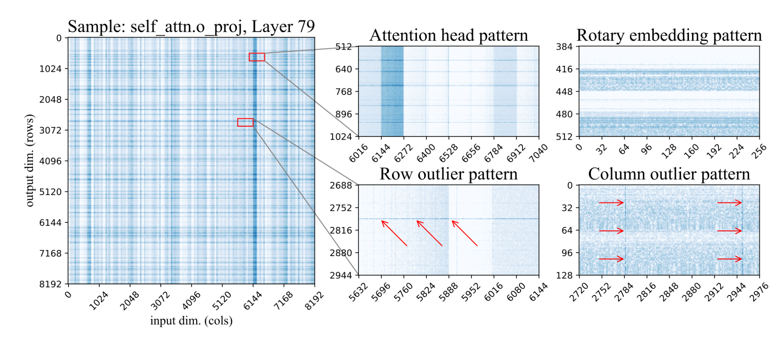
Fine-Grain Approaches
Target
Individual elements in weight matrices
Weight sparsity
Wanda^{[10]}: per-output pruned by magnitude and input activation
SparseGPT^{[11]}: one-shot pruning leverages second-order Hessian approximations
SuPar^{[12]}: stabilized static sparse training method achieves 70% sparsity with full accuracy recovery
SpQR^{[13]}: Sparse-Quantized Representation for Near-Lossless LLM Weight Compression➜1% outliers across the whole model

Slide 10
Fine-Grain Approaches
Observations
Wanda ^{[10]} and SparseGPT ^{[11]} are trained for unstructured sparsity format but adapted to 2:4 structured format for GPU acceleration
Adaptation incurs accuracy loss
SuPar ^{[12]} and SpQR ^{[13]}: highly sparse models
Unable to adapt structured sparsity format
Supported SoA commercial platforms:
Groq Groqchip
Tenstorrent Blackhole
SambaNova SN40L
Cerebras WSE-3
Hardware Support for Unstructured Sparse Weight Streaming

Slide 11
Takeaways
 | Activation Sparsity | Weight Sparsity
Coarse-Grain | SparseMoE DeepSeekMoE IST MoH | ShortGPT Attention head pruning
Medium-Grain | Deja Vu Top-k/Top-Theta Native Sparse Attention Quest
Fine-Grain |  | Wanda SuPar SparseGPT SpQR
MoE Pruner
STUN
MoE-Compression

Slide 12
Takeaways
 | Activation Sparsity | Weight Sparsity
Coarse-Grain | SparseMoE DeepSeekMoE IST MoH | ShortGPT Attention head pruning
Medium-Grain | Deja Vu Top-k/Top-Theta Native Sparse Attention Quest
Fine-Grain |  | Wanda SuPar SparseGPT SpQR
Dense Matrix/Vector Ops Workload Mapping
HW-opt Data Movement
Limited Downstream Scenarios
Flexible Hardware for Vector-level Operation
Global Information Loss
➜Low-precision Quantization
High Prediction Overhead
Unstructured Sparsity Support

Slide 13
Reference
[1] R, Samyam, et al. "Deepspeed-moe: Advancing mixture-of-experts inference and training to power next-generation ai scale." ICML. PMLR, 2022.
[2] D, Damai, et al. "Deepseekmoe: Towards ultimate expert specialization in mixture-of-experts models." arXiv preprint arXiv:2401.06066 (2024).
[3] Y, Kai, et al. "Layer-wise Importance Matters: Less Memory for Better Performance in Parameter-efficient Fine-tuning of Large Language Models." arXiv preprint arXiv:2410.11772 (2024).
[4] J, Peng, et al. "Moh: Multi-head attention as mixture-of-head attention." arXiv preprint arXiv:2410.11842 (2024).
[5] G, Ankit, et al. "Memory-efficient Transformers via Top-$ k $ Attention." arXiv preprint arXiv:2106.06899 (2021).
[6] B, Konstantin, et al. "Top-Theta Attention: Sparsifying Transformers by Compensated Thresholding." arXiv preprint arXiv:2502.08363 (2025).
[7] T, Jiaming, et al. "Quest: Query-aware sparsity for efficient long-context llm inference." arXiv preprint arXiv:2406.10774 (2024).
[8] Y, Jingyang, et al. "Native Sparse Attention: Hardware-Aligned and Natively Trainable Sparse Attention." arXiv preprint arXiv:2502.11089 (2025).
[9] L, Zichang, et al. "Deja vu: Contextual sparsity for efficient llms at inference time." International Conference on Machine Learning. PMLR, 2023.
[10] S, Mingjie, et al. "A simple and effective pruning approach for large language models." arXiv preprint arXiv:2306.11695 (2023).
[11] F, Elias et al.. "Sparsegpt: Massive language models can be accurately pruned in one-shot." ICML. PMLR, 2023.
[12] D, Nolan. "Sparse maximal update parameterization: A holistic approach to sparse training dynamics." arXiv preprint arXiv:2405.15743 (2024).
[13] D, Tim, et al. "Spqr: A sparse-quantized representation for near-lossless llm weight compression." arXiv preprint arXiv:2306.03078 (2023).

