Slide 1
QuantSparse 3D Biweekly 2025-05-06
Integrated Systems Laboratory (ETH Zürich)
Bowen Wang bowwang@iis.ee.ethz.ch Paul Scheffler paulsc@iis.ee.ethz.ch
Luca Benini lbenini@iis.ee.ethz.ch

Slide 2
Agenda
Progress Update
Spatz: Multi-level N:M sparsity handling, RTL
Deployment: SoftHier Runtime Memory Allocation Support
3D Chiplet Interconnection: Literature Review
Timeline
Discussion

Slide 3
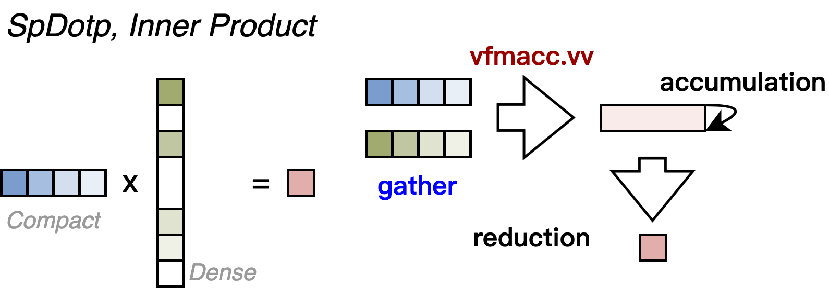
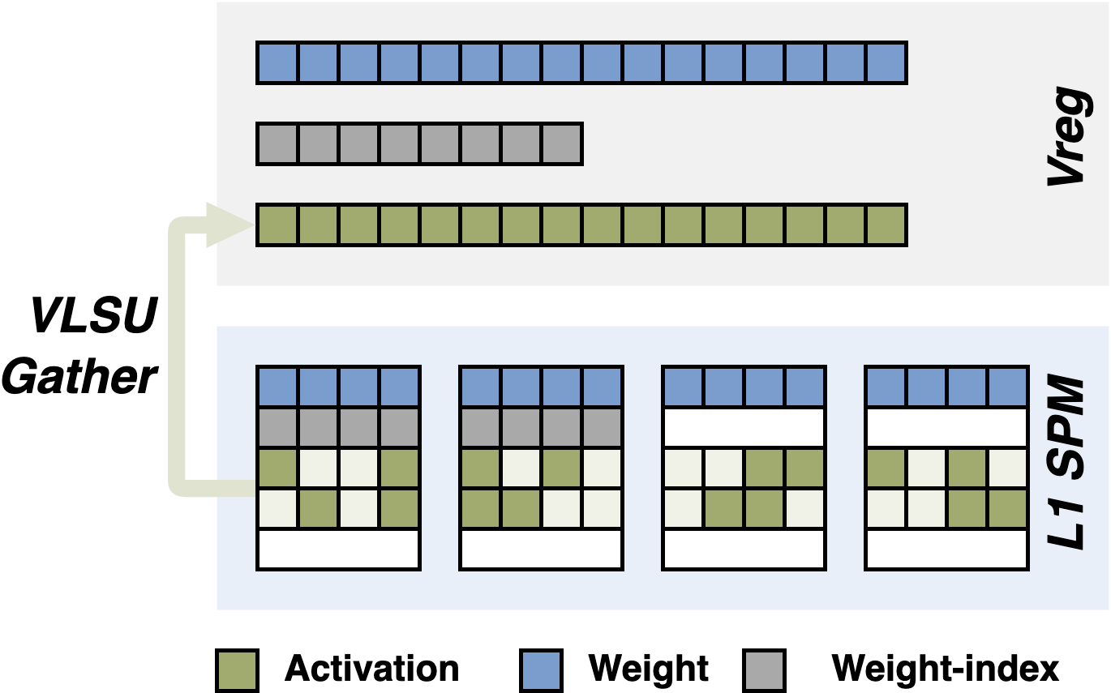
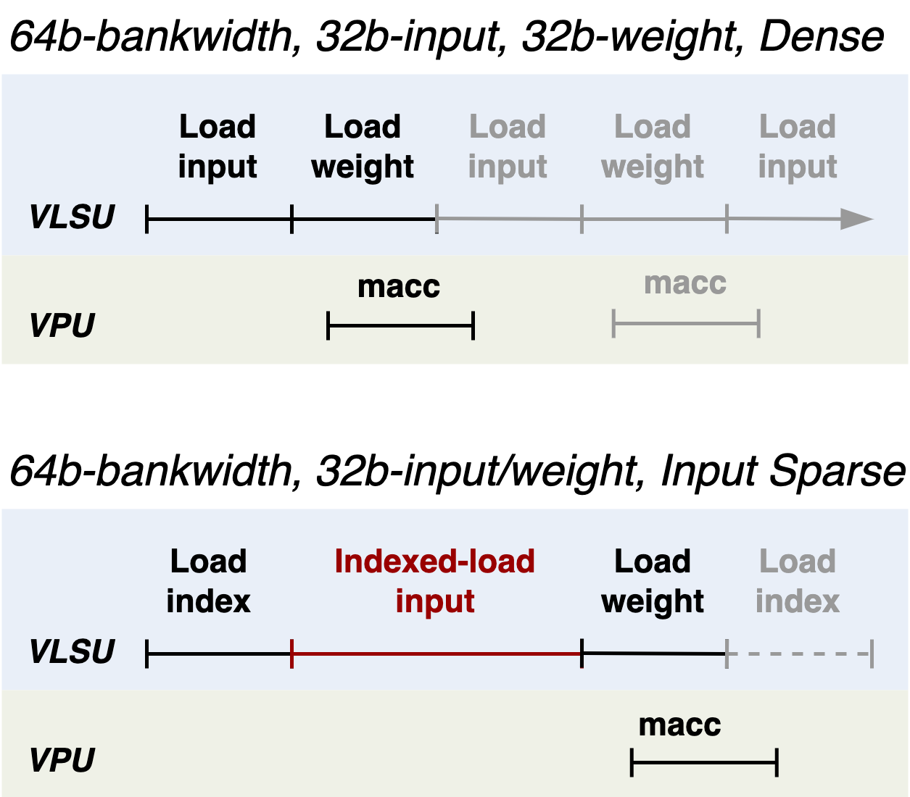
Spatz N:M Sparsity Handling - VLSU
SpDotp
No data reuse in dense activation vector → Effective activation elements are gathered at VLSU level
Standard RVV instruction support (vloxei.v)
No Vreg overhead to store ineffective activation elements
Theoretical max. VPU utilization: ~50%
The effective VLSU-to-L1 bandwidth is halved when loading activation
RTL update
Completed coalescing strides in the commit stage and ongoing functional verification

Slide 4
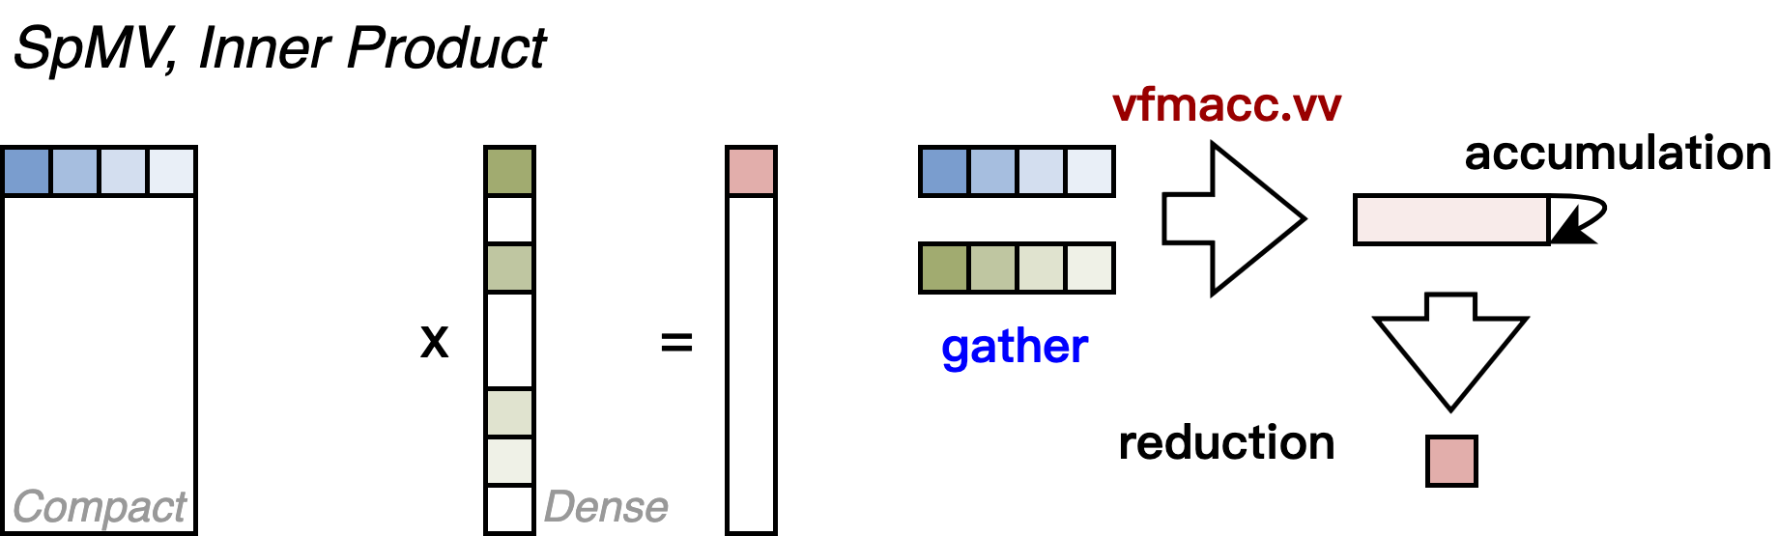
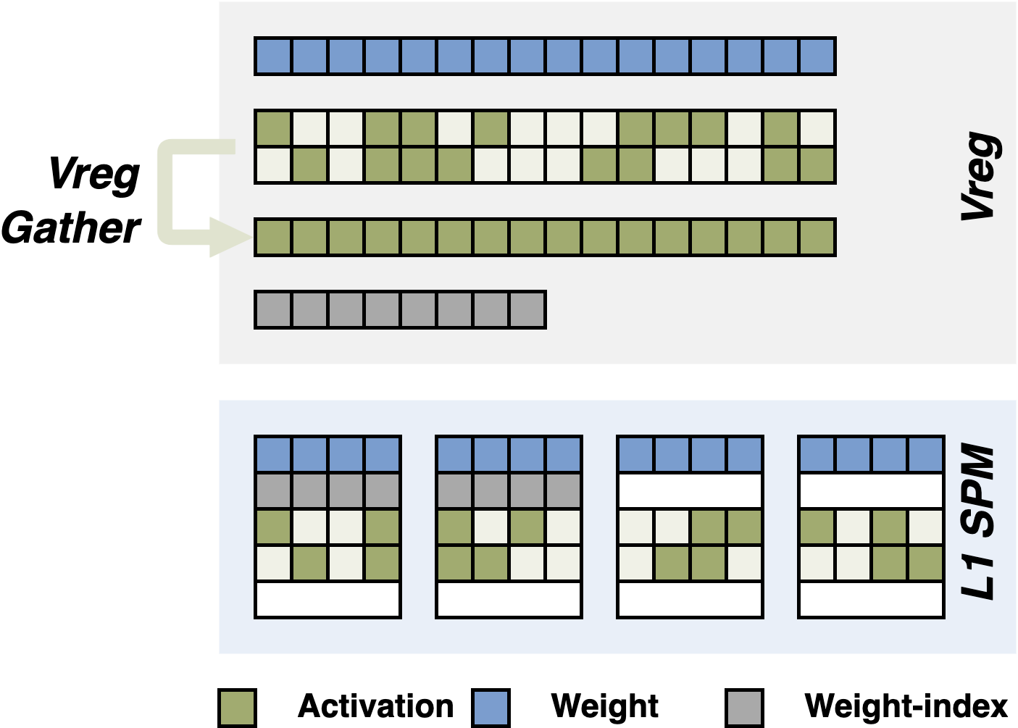
Spatz N:M Sparsity Handling - Vreg
SpMV
Reuses the dense activation vector across multiple weight matrix rows
Gathering at VLSU is inefficient
Entire input vector is loaded into Vregs → Effective activation elements are gathered within Vreg using vrgather.vv
Additional VReg storage is required
Theoretical VPU utilization 75%~90%
Efficient gather operation
Applicable for SpMM
RTL Update
Finished first-version implementation, functional verification ongoing

Slide 5
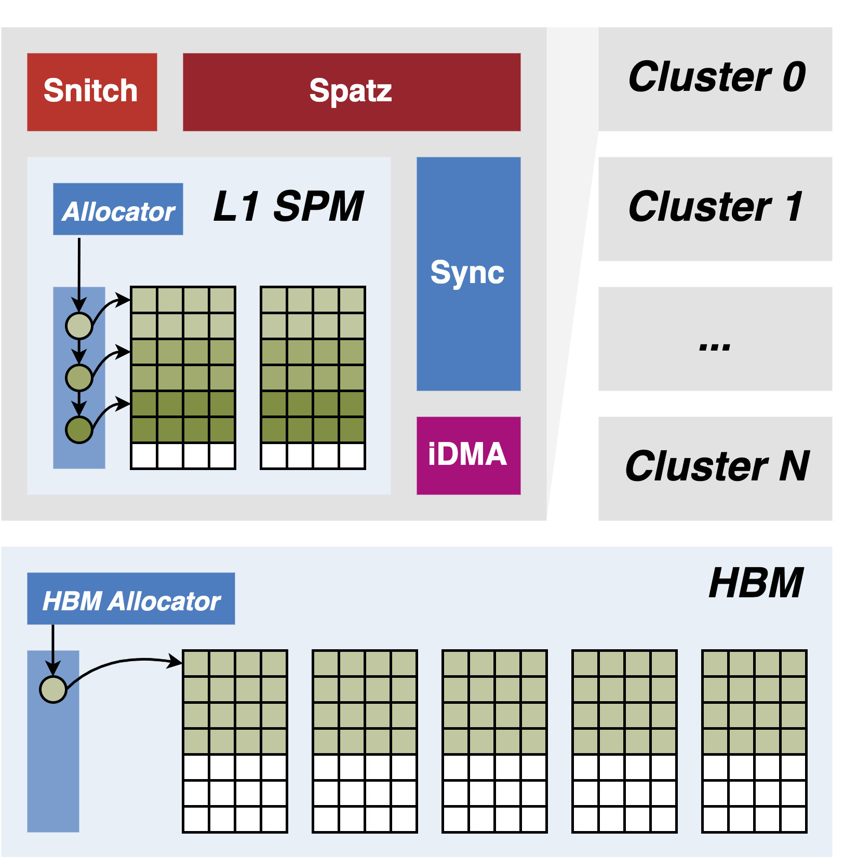

Memory Allocation Runtime in SoftHier
Original memory management in SoftHier
Static memory allocation for both HBM and L1
Assume input/output addresses are unchanged throughout the program → Unsustainable when deploying networks beyond multiple layers
Added runtime libraries
Dynamic memory allocation for HBM and L1
Per-cluster, privately accessed L1 allocator
Per-system, shared HBM allocator
Ongoing extensions
Globally accessed allocation data structure → inter-cluster block DMA operations
https://github.com/gvsoc/gvsoc/tree/soft_hier_release(#91)

Slide 6
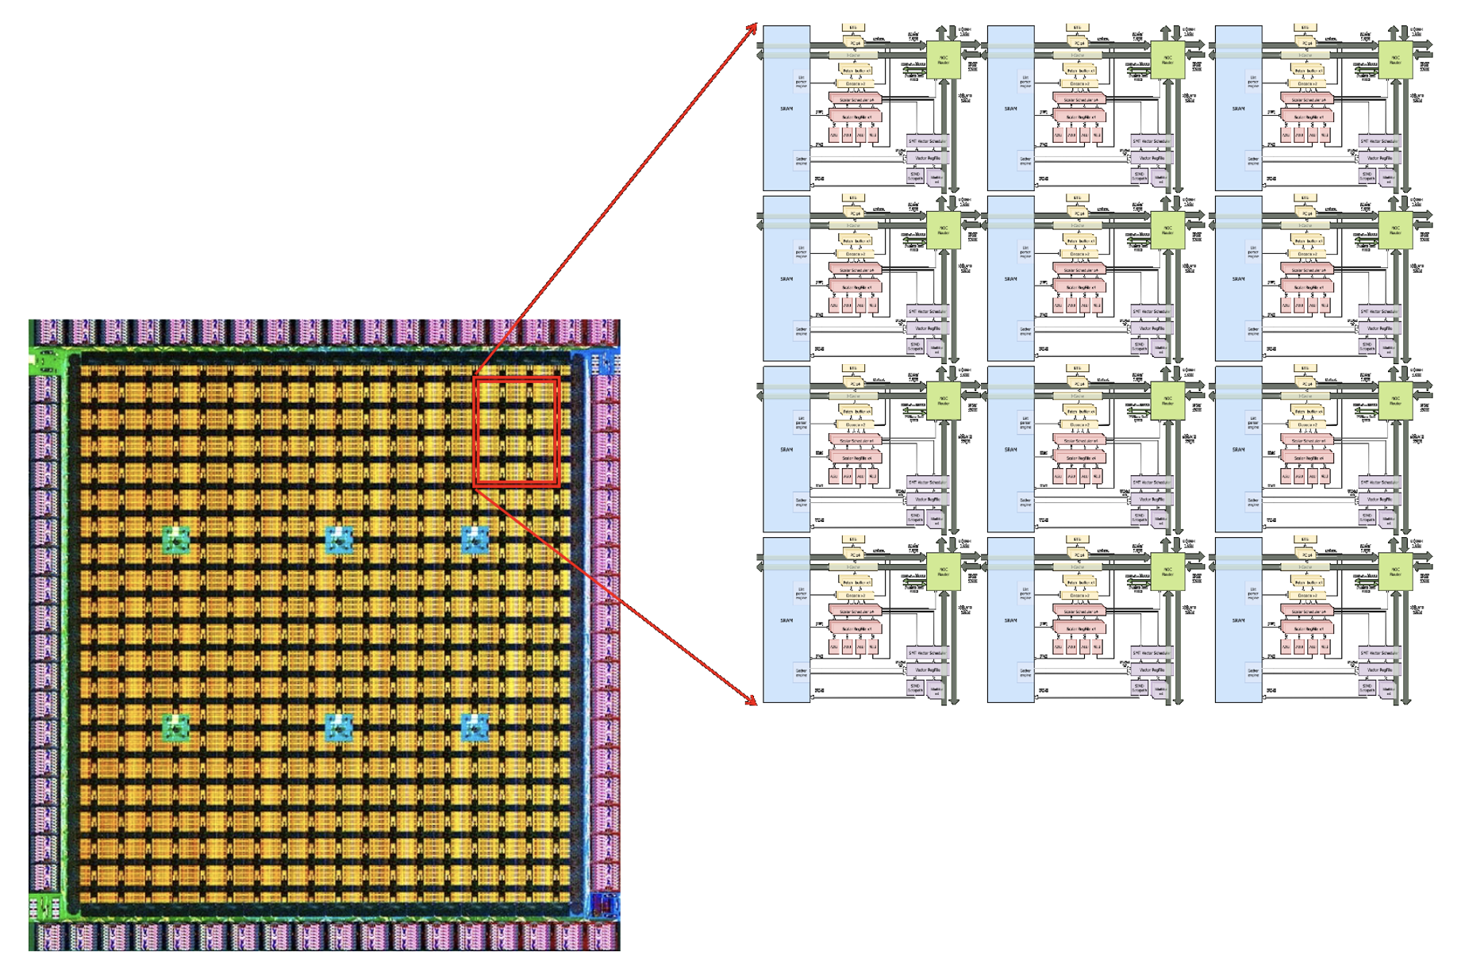
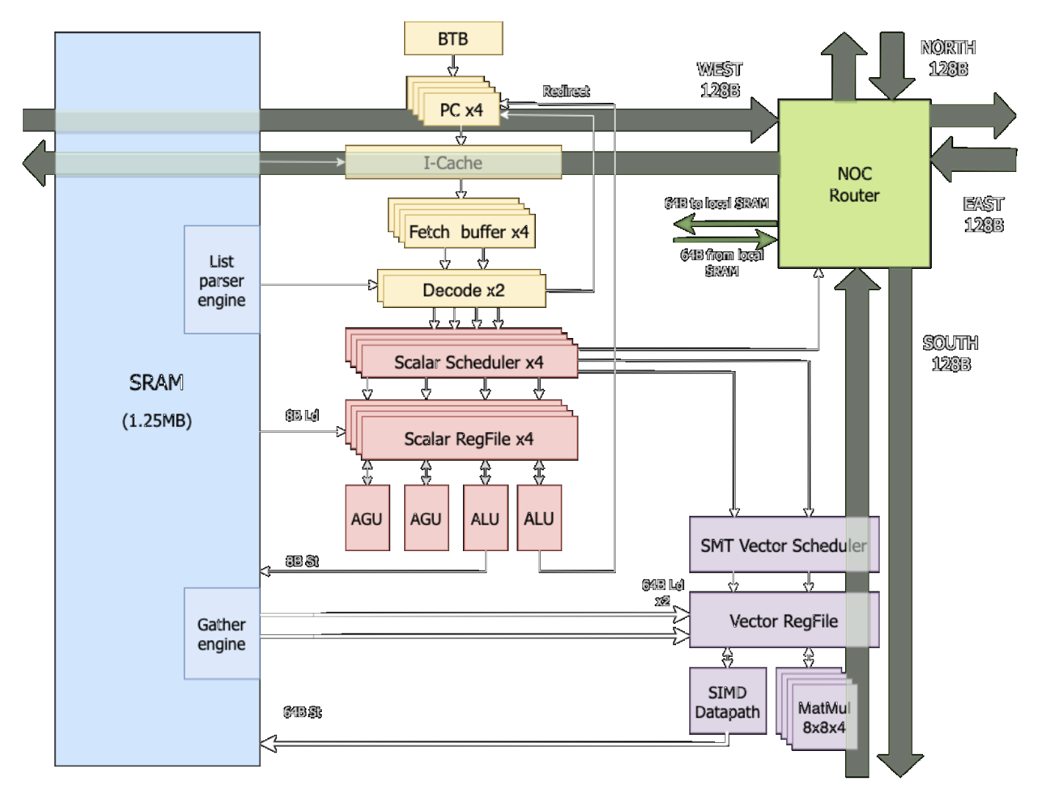
TSMC InFO_SoW^{[1]} Example: Tesla Dojo D1^{[2]}
A mesh of individual units connected by a high-speed 2D fabric
Each individual unit has:
1.25MB SRAM scratchpad
Gather engine at 8B and 16B granularity
4 superscalar CPU cores with 64B SIMD unit and 8x8x4 matrix multiply units
Customized ML formats (CPF8/16)
Customized ML instructions (gather operands, tensor transpose, compressed operands expansion)
Independent NoC router
Direct SRAM connection, one read and one write packet per cycle
Block level DMA operations

Slide 7
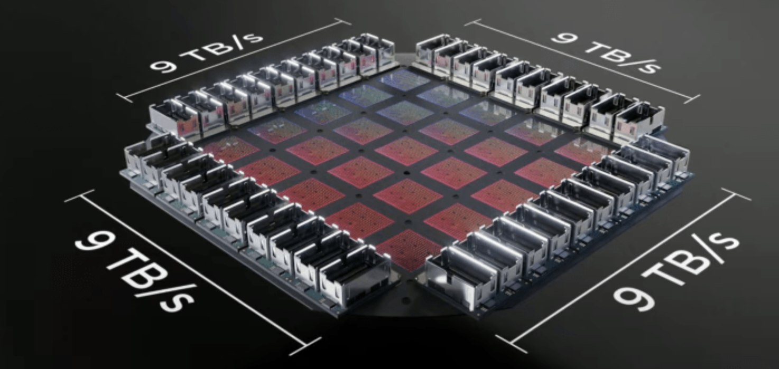
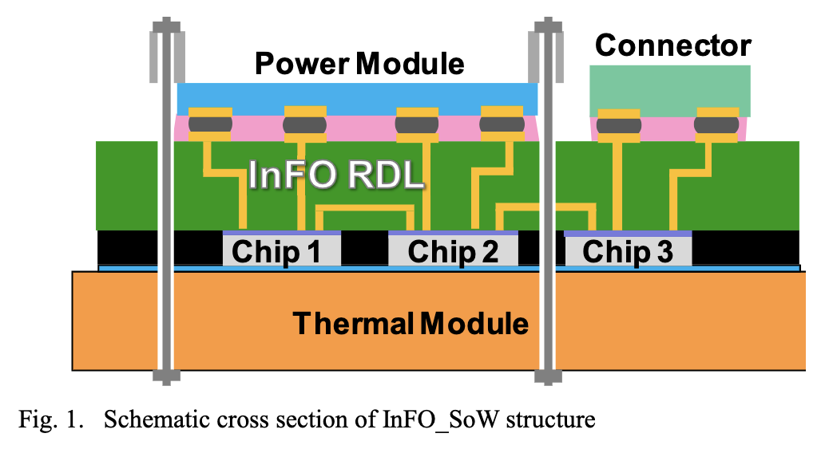
TSMC InFO_SoW^{[1]} Example: Tesla Dojo D1^{[2]}
Dojo D1 die manufactured in TSMC 7nm
354 Dojo processing nodes per die
440 MB on-chip SRAM
362 TFlops BF16/CFP8, 22 TFlops FP32 @2GHz
5x5 array of D1 chips per training tile
Packaged with TSMC InFO_SoW
low latency chip-to-chip communication, high bandwidth density
enabled chiplet-based design for greater cost saving and design flexibility
Potential wafer-scale integration with TSMC-CoSoW^{[3]} by 2027

Slide 8
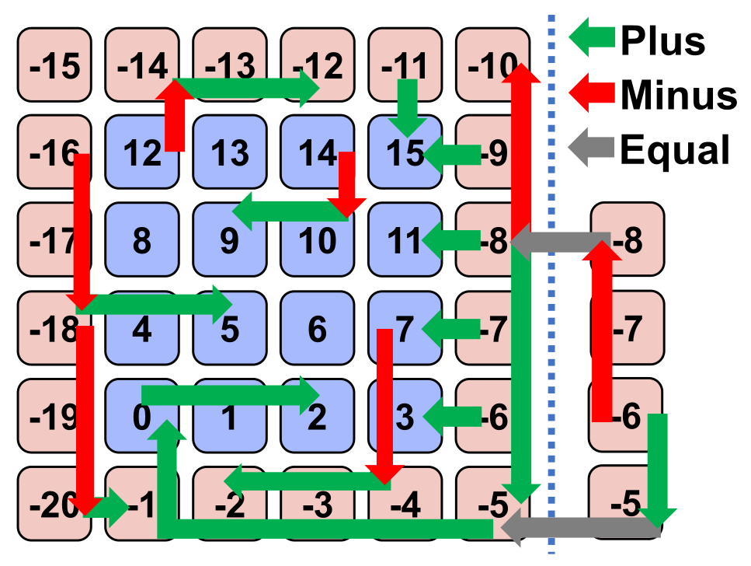
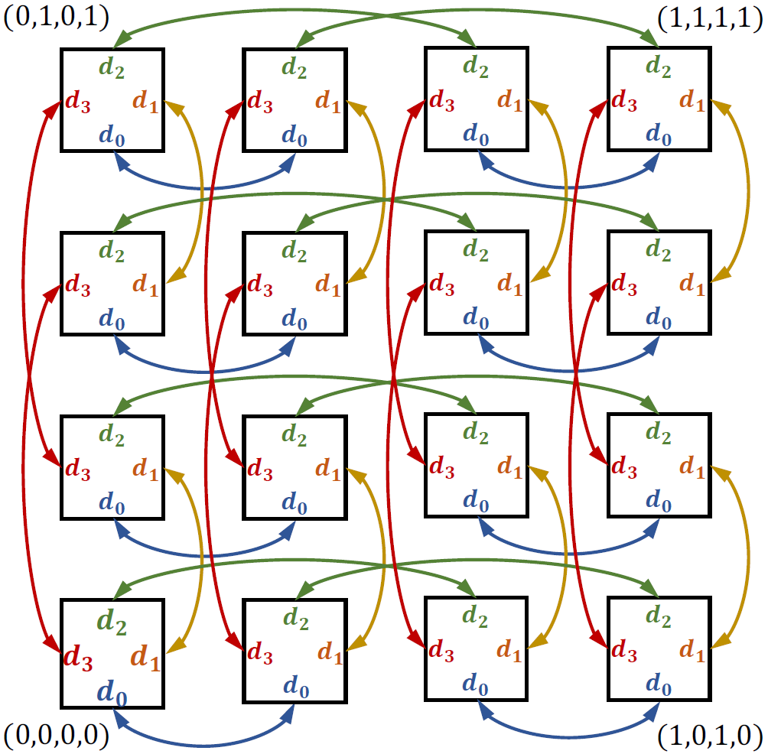
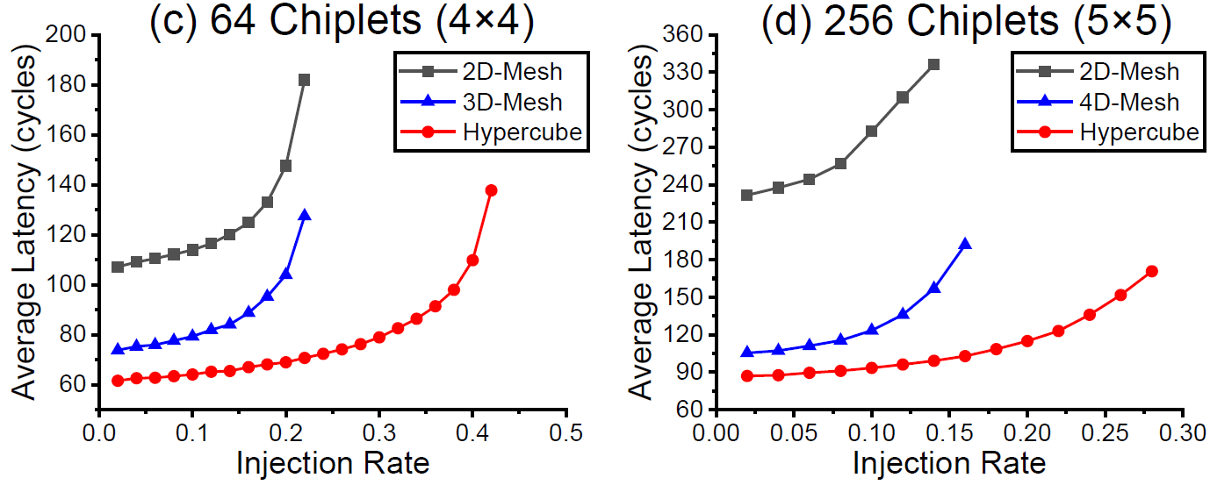
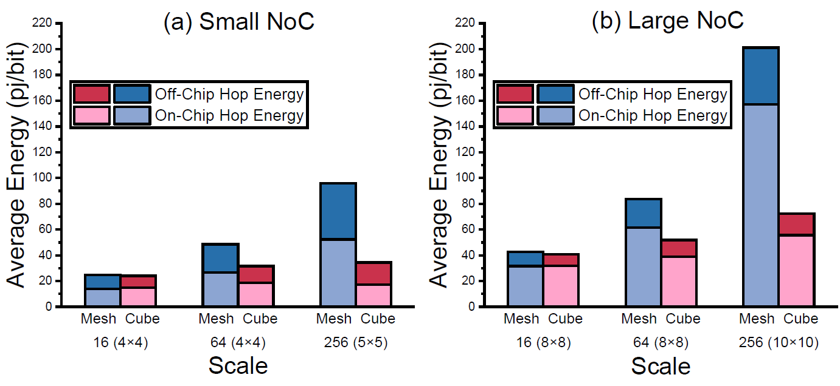
3D-Chiplet Interconnection: Literature Review
How do we best interconnect stacks through the interposer?
Feng et al^{[4]} enable high-radix interconnect between chiplets:
Based on minus-first routing (MFR)^{[5]} with multiple improvements
Groups, interleaves interface nodes
Supports nD mesh, dragonfly, hypercube
Notably better latency, throughput
High radices scale better with #chiplets
Notable reduction in energy, esp. off-chip
Interleaved interface nodes help

Slide 9
Timeline
Project Start 2025-02
Literature review on sparsity and quantization format supported on SoA platforms
Multi-granularity sparsity handling
Proposed Spatz-based multi-cluster architecture; Literature review on quantization handling
Spatz GVSoC model VLSU port extension; Start NoC packing scheme; Initial discussion on 3D chiplet integration
Literature Review 2025-04
Spatz multi-level N:M sparsity handling; SoftHier memory allocation runtime; Discussion on 3D integration
Next step:
Customized data format for MX-like quantization and N:M structured sparsity
Customized ISA support in Spatz GVSoC model
Year 1 2026-02

Slide 10
References
[1] C. Shu-Rong, et al. "InFO_SoW (system-on-wafer) for high performance computing." IEEE ECTC, 2020.
[2] T. Emil, et al. "Dojo: The microarchitecture of tesla’s exa-scale computer." IEEE HSC, 2022.
[3] H. Yu-Chen, et al. "CoWoS architecture evolution for next generation HPC on 2.5 D system in package." IEEE ECTC, 2023.
[4] Y. Feng et al., “A Scalable Methodology for Designing Efficient Interconnection Network of Chiplets,” IEEE HPCA, 2023
[5] D. Xiang et al., “Deadlock-Free Broadcast Routing in Dragonfly Networks without Virtual Channels,” IEEE TPDS, 2023

Slide 11
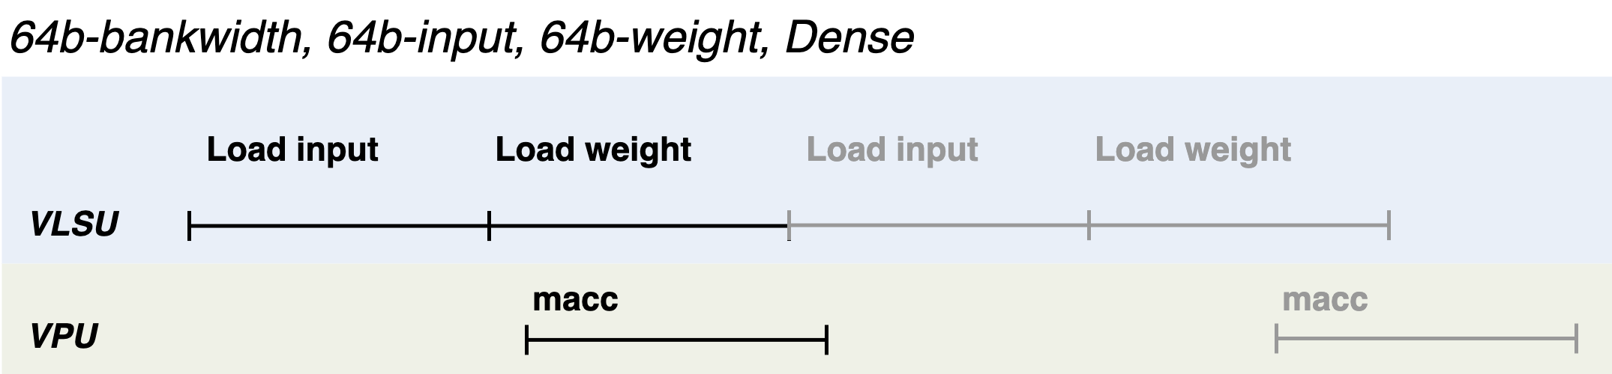
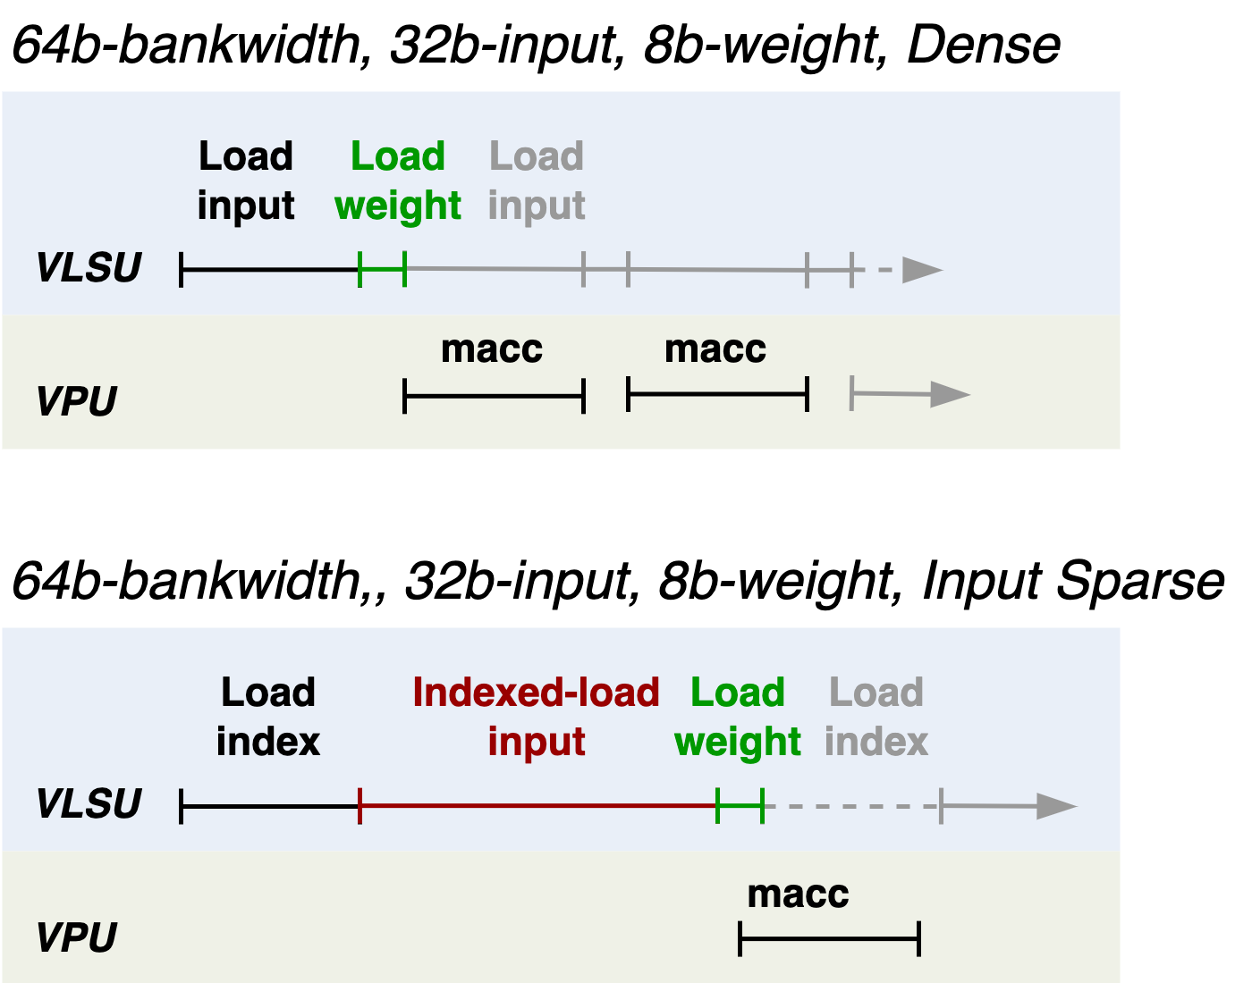
Backup: Handle at VLSU
Theoretical max. VPU utilization: 50%
Theoretical max. VPU utilization: 50%
Lower precision weights →
Theoretical max. VPU utilization: ~75-100%
Granularity mismatch →
Theoretical max. VPU utilization: 33%
Lower precision weights →
Theoretical max. VPU utilization: ~50%
~50% upper-bound VPU utilization limited by VLSU-to-L1 effective bandwidth
Design trade-off at L1 memory bankwidth

Slide 12
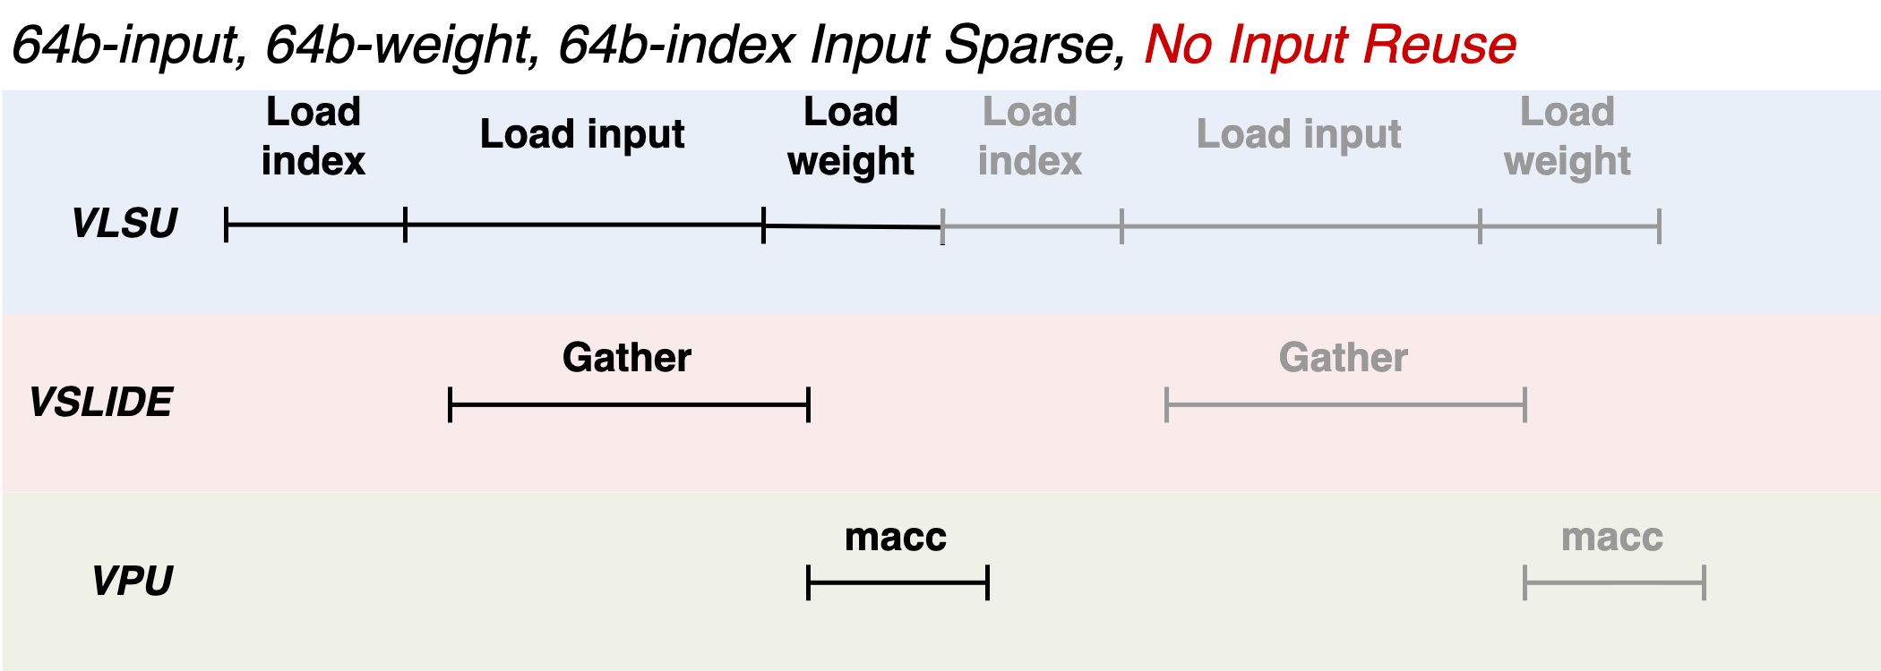
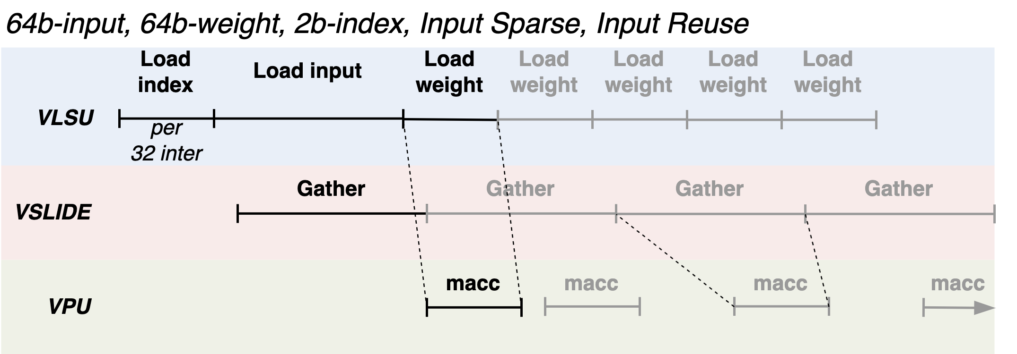
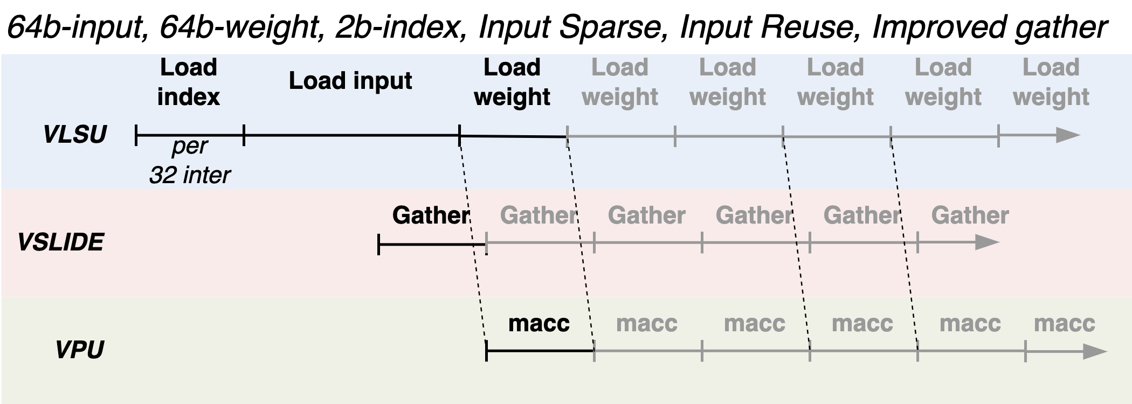
Backup: Handle at VReg
Inefficient if no reuse in the dense input tensor
VReg overhead to store the gathered input elements
Max. VPU utilization: ~33%
Input tensor is reused over multiple iterations
The gathering operation becomes the bottleneck
Max. VPU utilization: ~50%
The gathering operation’s efficiency
depends on the VSLIDE unit implementation (e.g. port reuse)
Max. VPU utilization: ~75-100%

