Slide 1
QuantSparse 3D Biweekly 2025-07-01
Integrated Systems Laboratory (ETH Zürich)
Bowen Wang bowwang@iis.ee.ethz.ch Paul Scheffler paulsc@iis.ee.ethz.ch
Luca Benini lbenini@iis.ee.ethz.ch

Slide 2
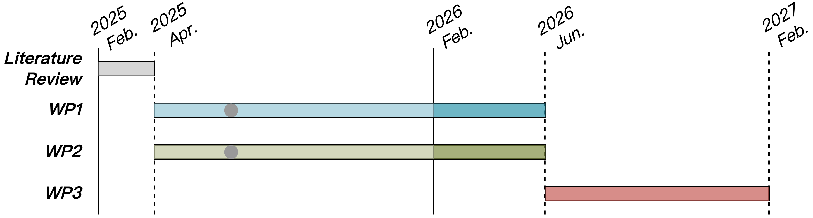
Progress Recap
WP1
Gustavson’s algorithm-based activation and weight sparsity handling
Spatz GVSoC model with FP8 datapath, instruction tests, and Gustav MatMul baseline implementation
Spatz MX format ISA extension initial discussion

Slide 3
Agenda
Progress Update
Spatz N:M sparsity format
Gustavson’s dense FP8 MatMul kernels
Software emulation: 2:4 FP8 SpMM kernel, overhead analysis
Custom instruction vfwxmacc.vf: widening indexed macc operation
Gustavson’s SpMM FP8 MatMul kernel with vfwxmacc.vf
Timeline
Discussion

Slide 4
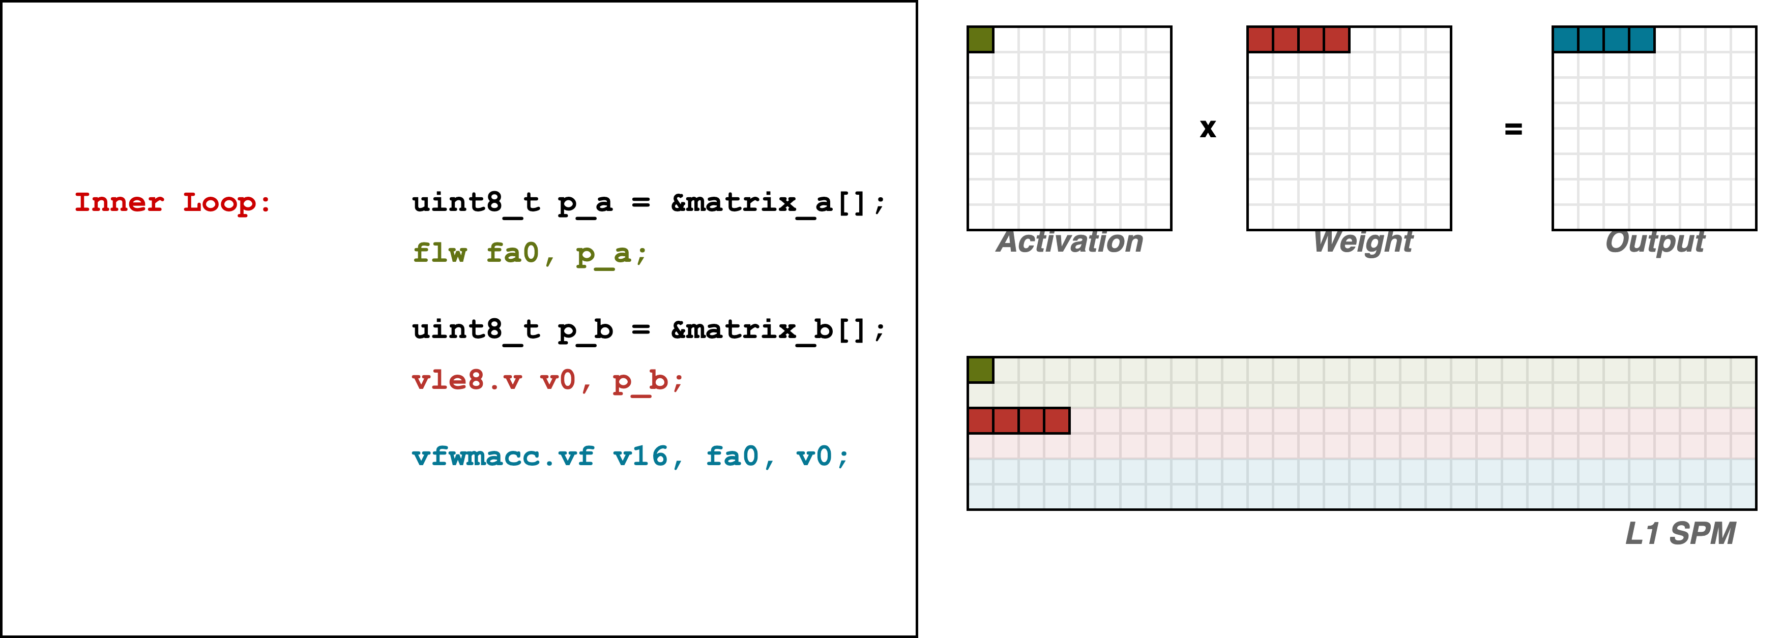
Dense MatMul (Gustav)
1
2
3
1
2
3

Slide 5
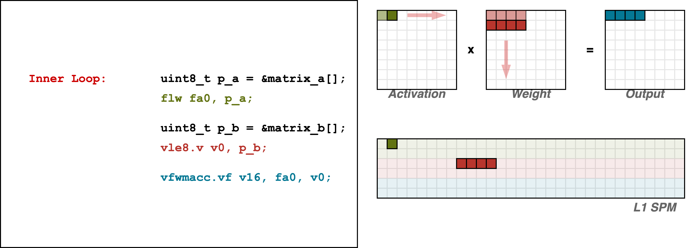
Dense MatMul (Gustav)
Accumulate in VRF

Slide 6
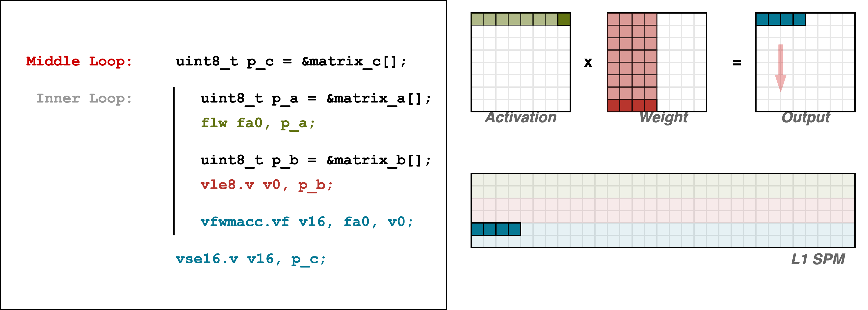
Dense MatMul (Gustav)
4
4

Slide 7
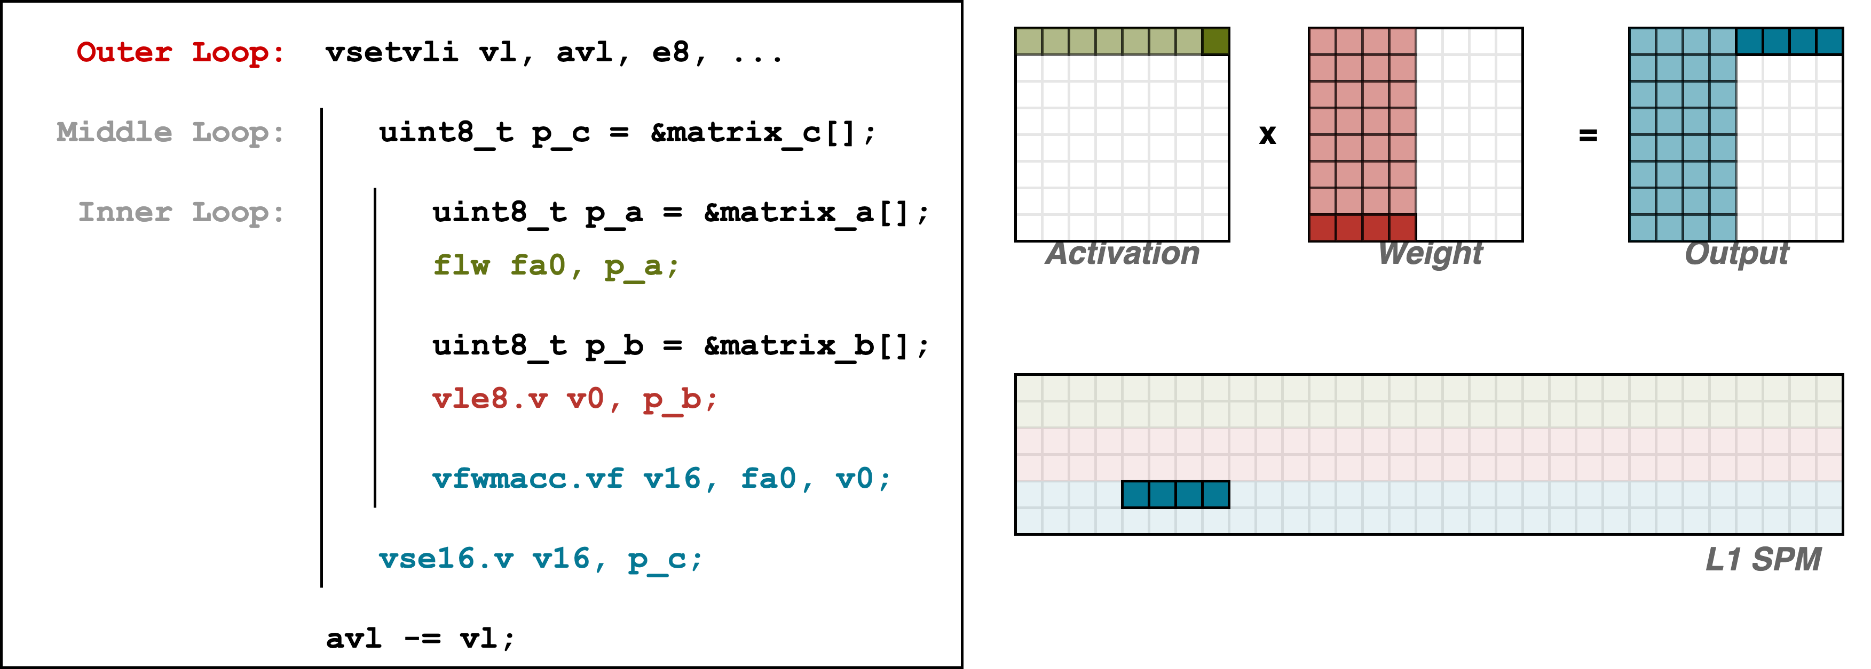
Dense MatMul (Gustav)
Outer Loop
Middle Loop

Slide 8
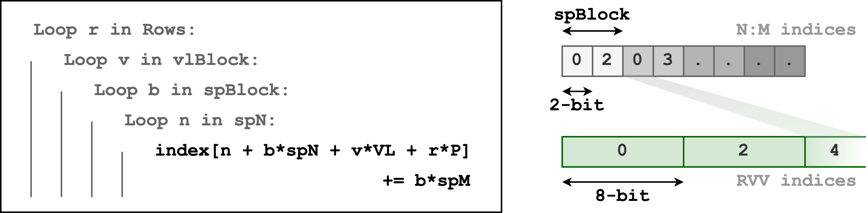
SpMM Software Emulation (Gustav)
Index generation is required to bridge the discrepancy between the two index formats

Slide 9
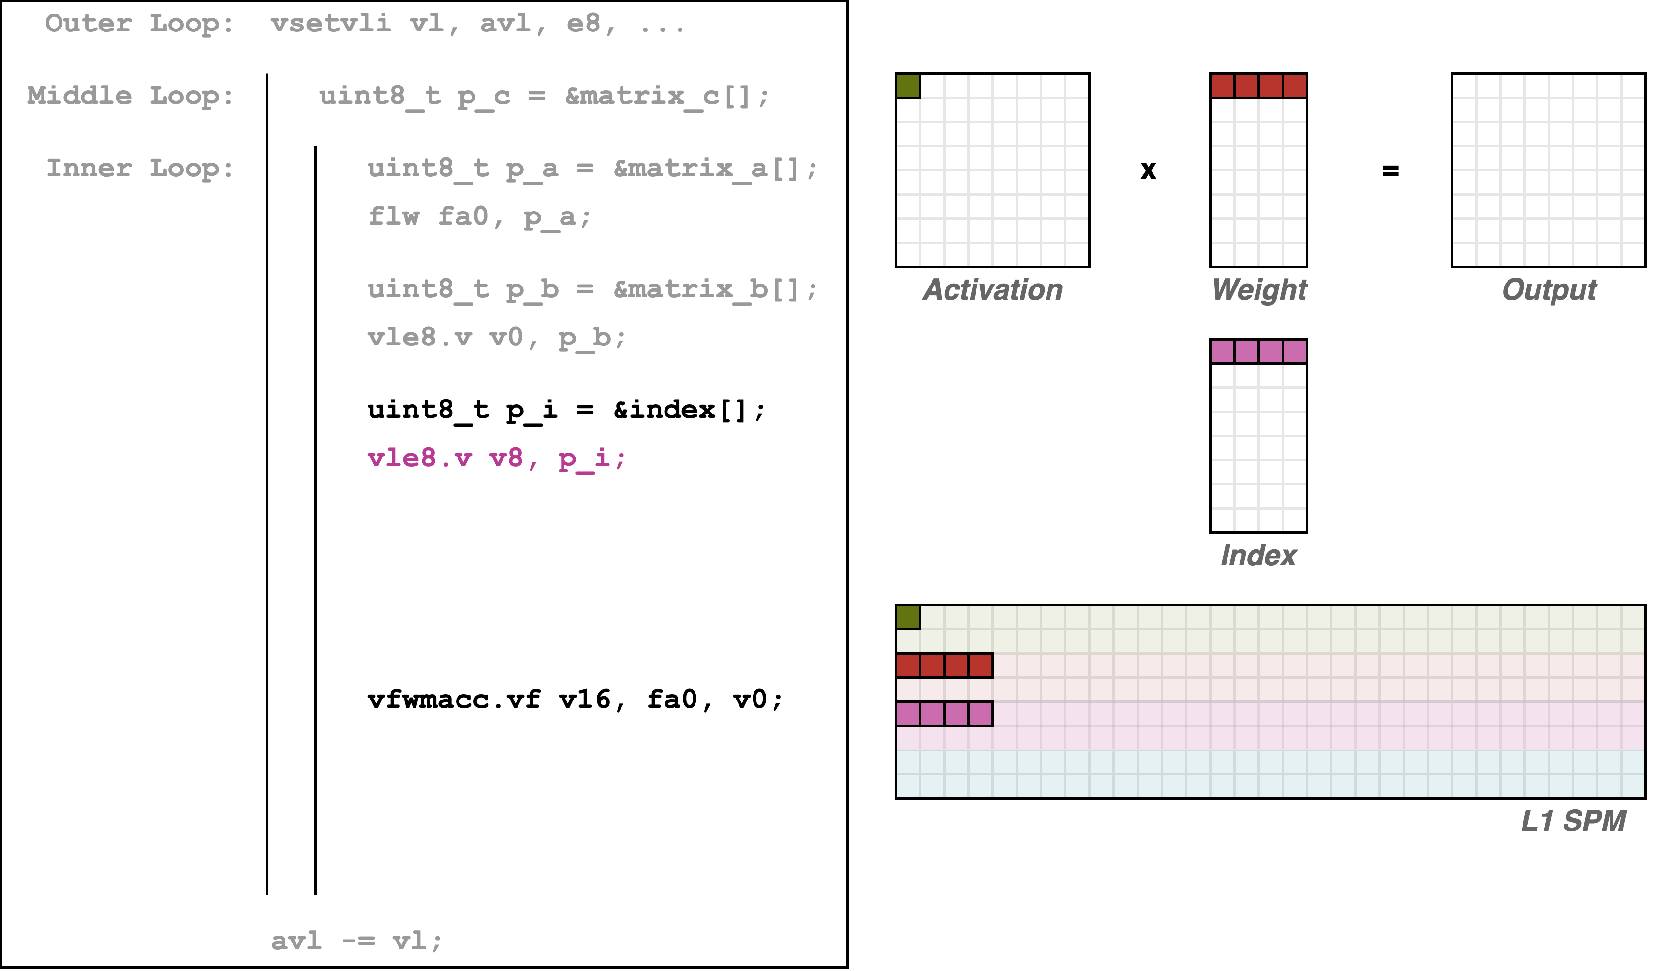
SpMM Software Emulation (Gustav)
1
2
3
3
No VRF scatter RVV instruction support
→ Use L1 to accumulate

Slide 10
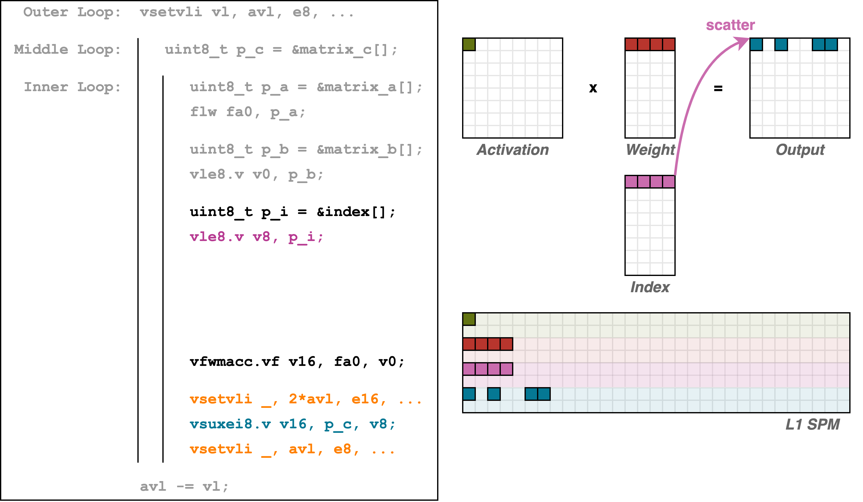
SpMM Software Emulation (Gustav)
4
1
2
3
SEW = 8
4
8 denotes the index bit-width
SEW = 16

Slide 11
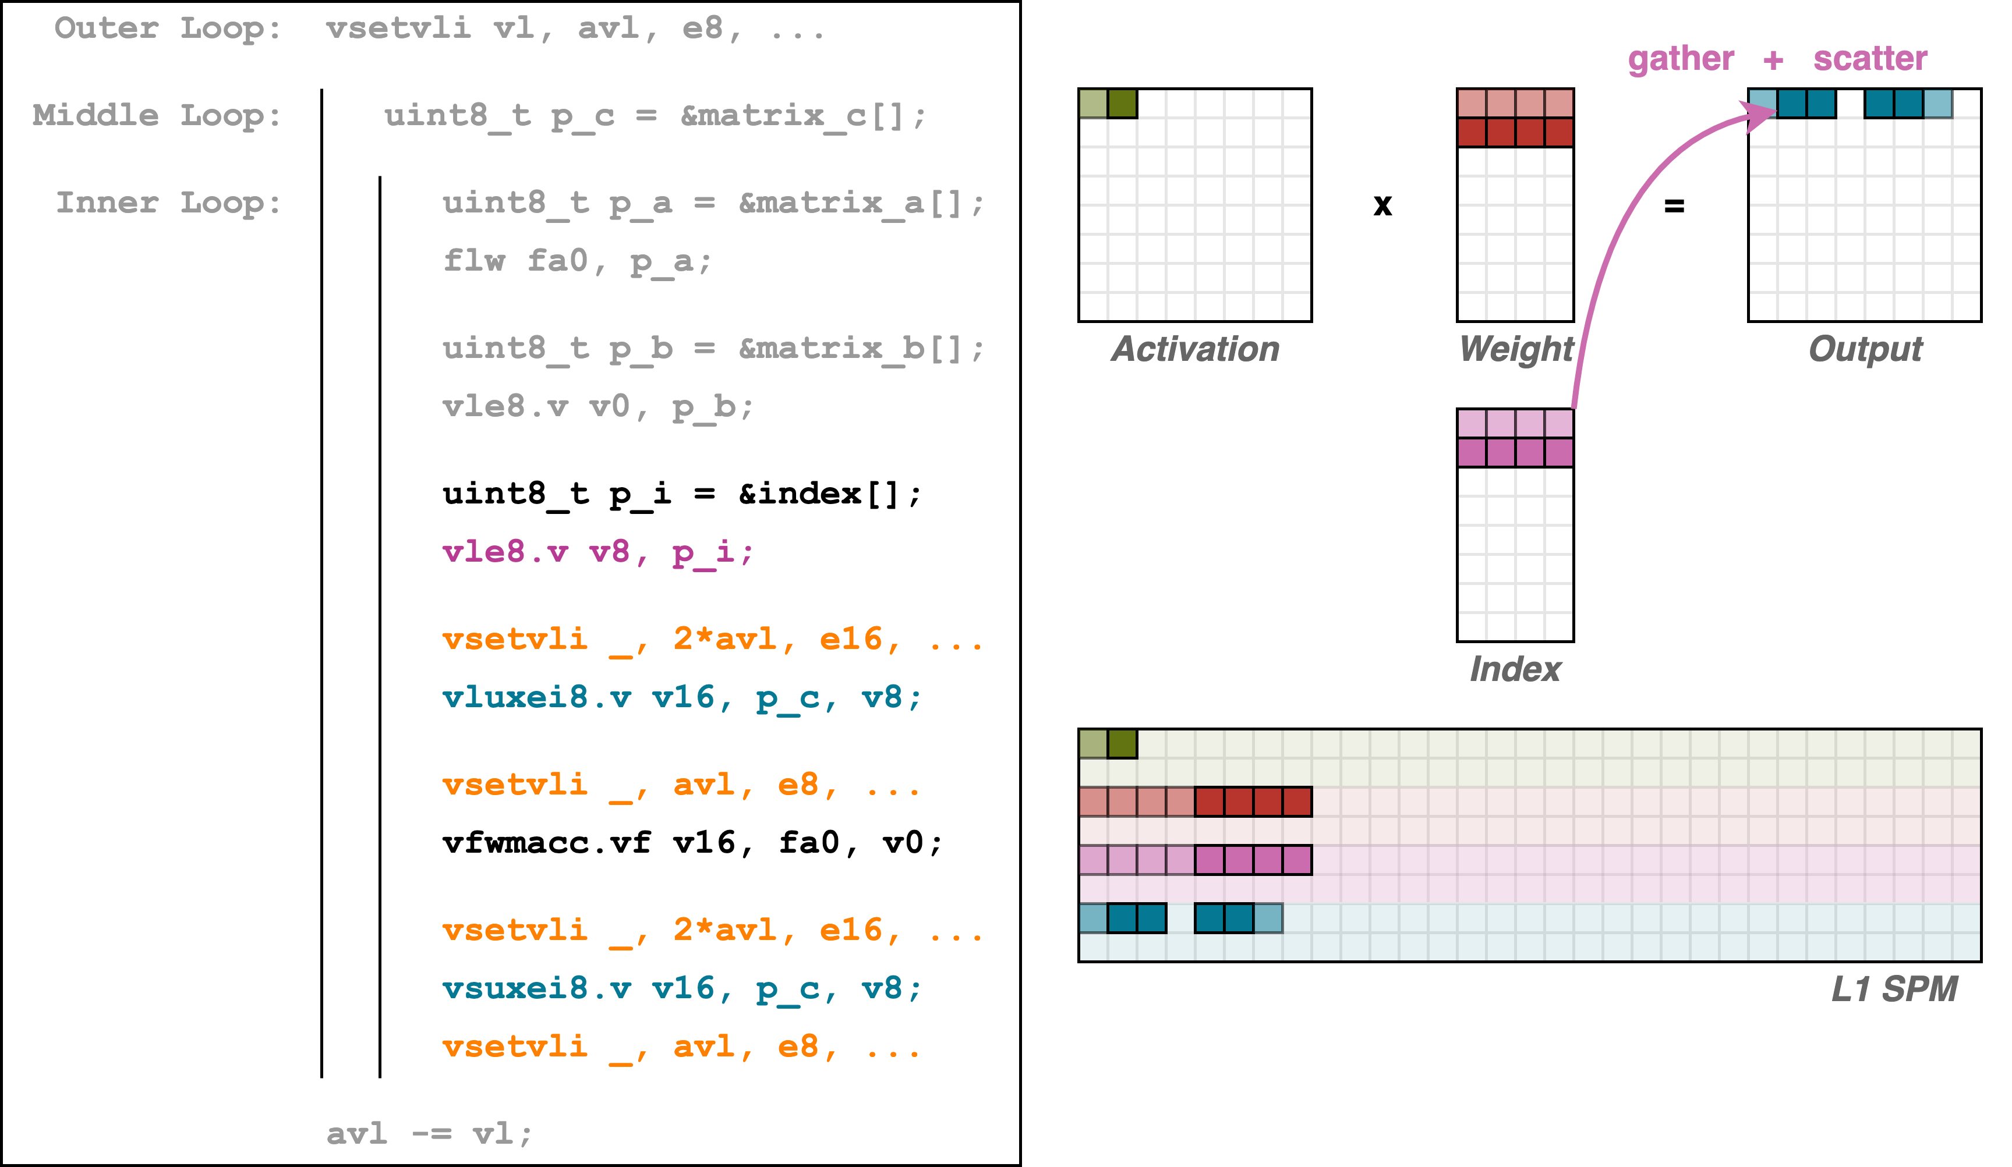
SpMM Software Emulation (Gustav)
5
Gather effective elements for accumulation
5
~50% instructions are used for config + scatter/gather

Slide 12
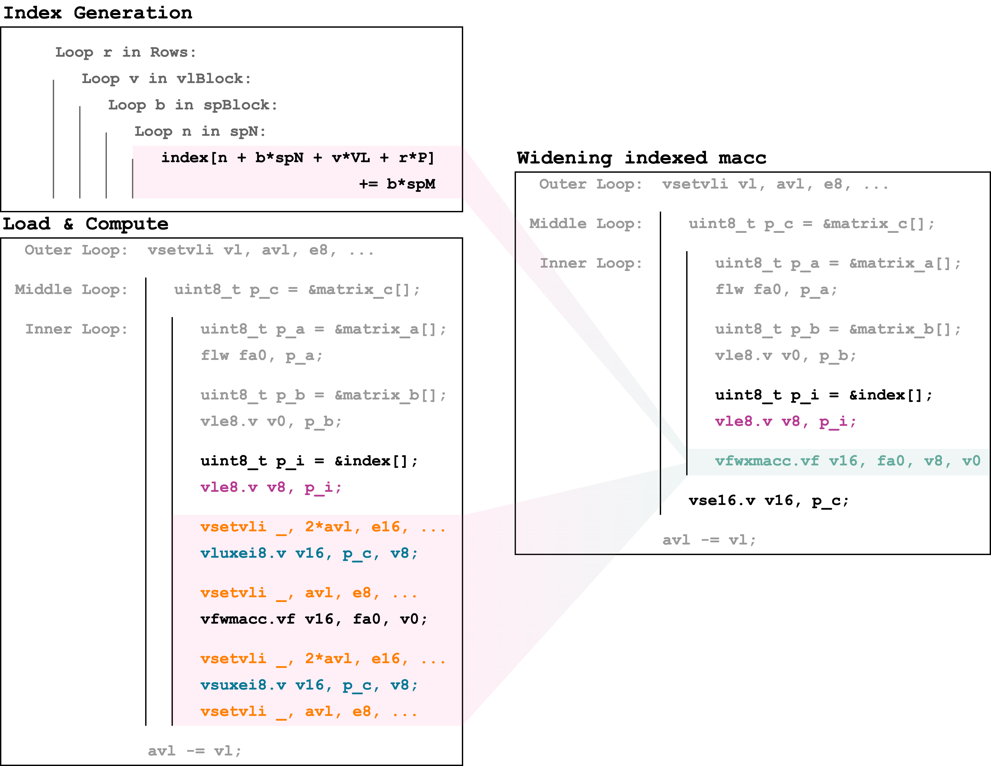
SpMM Custom Instruction (Gustav)
Merged index generation
Accumulating in SPM is inefficient
Config instructions overhead is for SEW discrepancy between index load/store and widening accumulation

Slide 13
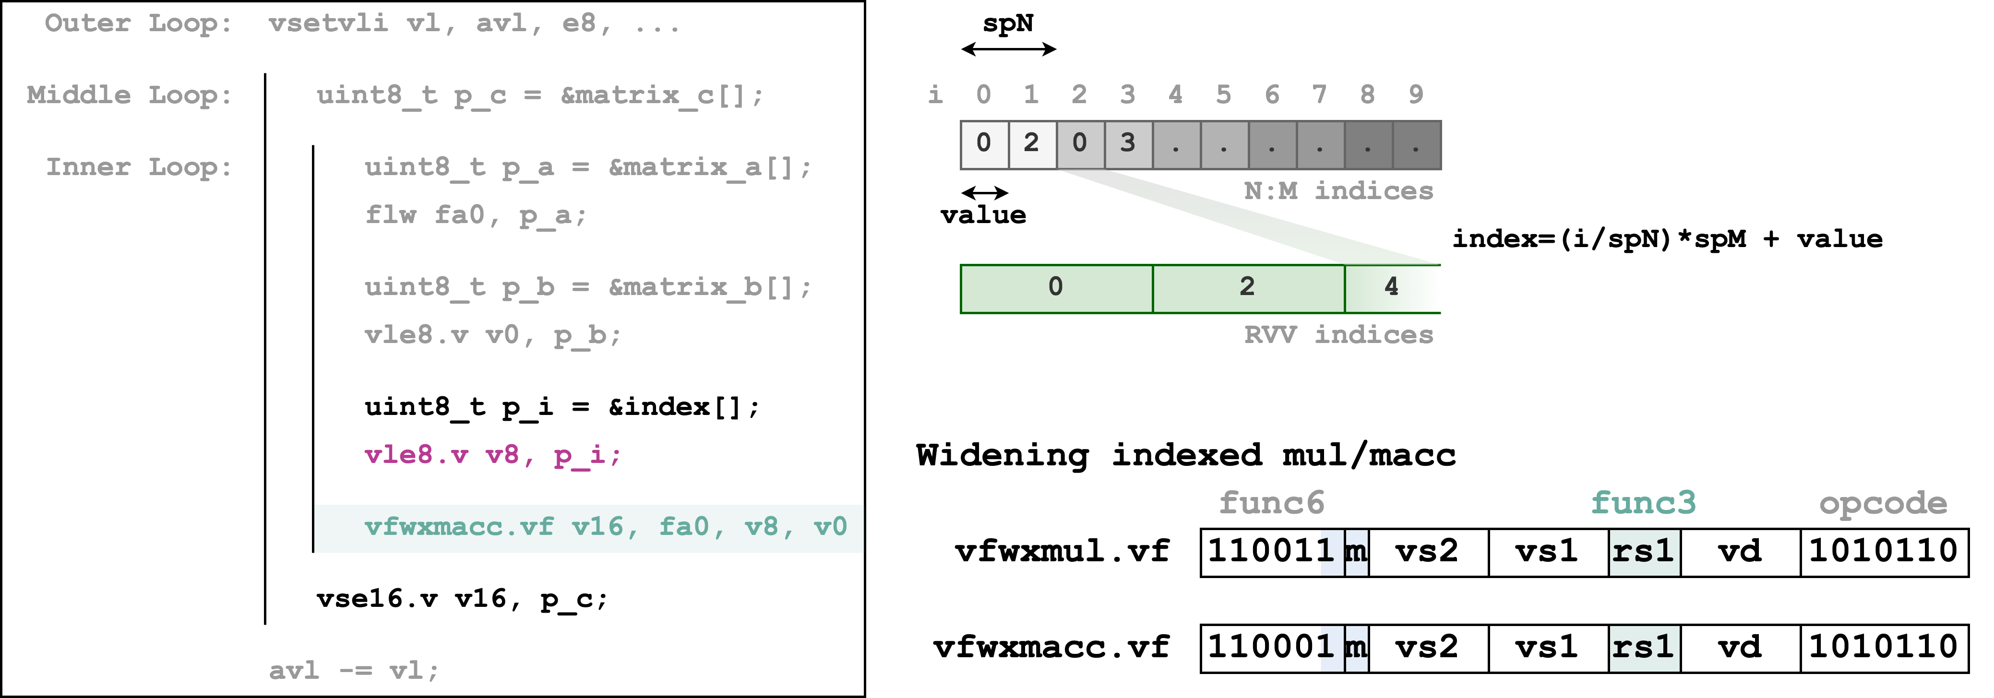
SpMM Custom Instruction (Gustav)
Only requires N:M format to config

Slide 14

vfwx_.vf in Spatz GVSoC Model
Modeled widening indexed instructions
SpMM kernel implementation with software emulation and vfwx_.vf instructions
Passed functional verification
Added instruction timing models and started performance benchmark
Work in progress
Kernel optimization on index handling
Support more N:M formats, currently only on 2:4
Continue performance benchmark
Add kernel for activation sparsity handling
https://github.com/gvsoc/gvsoc/tree/soft_hier_release(#131)

Slide 15
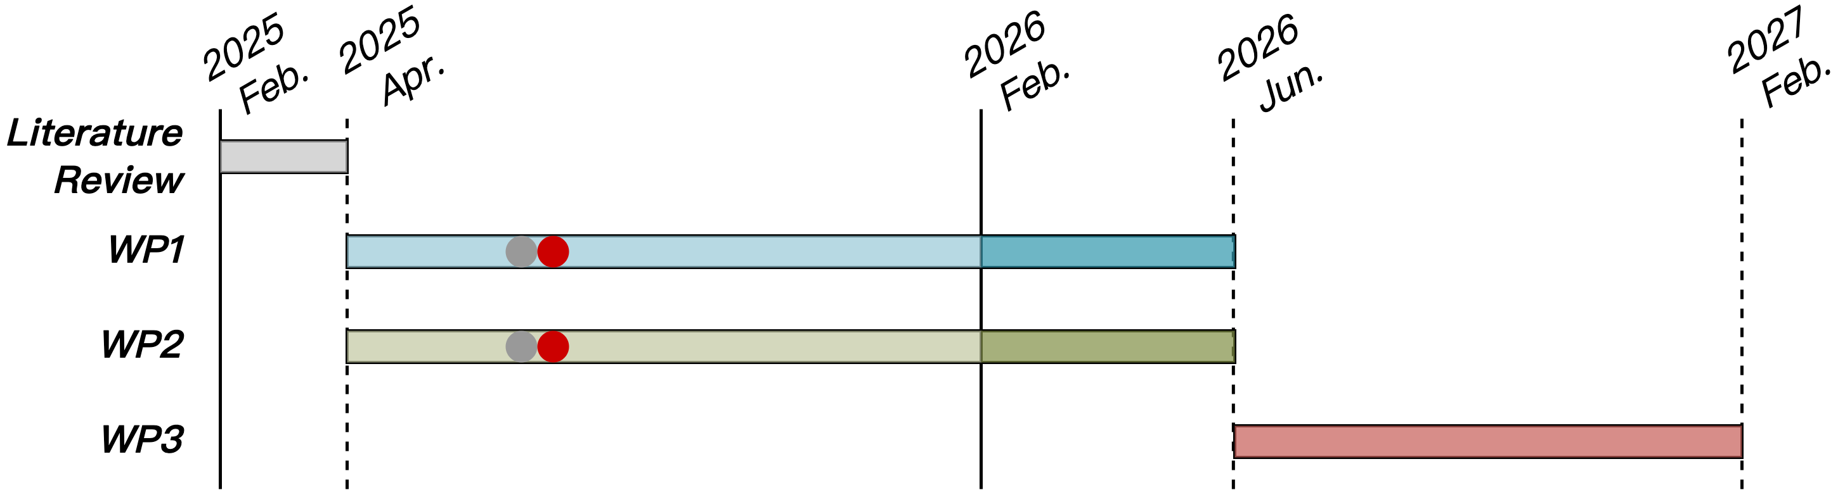
Progress Update
WP1
Software emulation on SpMM with RVV instructions
Custom widening index instructions in Spatz GVSoC model
SpMM kernel implementation with vfwx_.vf instructions

