Slide 1
QuantSparse 3D Biweekly 2025-07-22
Integrated Systems Laboratory (ETH Zürich)
Bowen Wang bowwang@iis.ee.ethz.ch Paul Scheffler paulsc@iis.ee.ethz.ch
Luca Benini lbenini@iis.ee.ethz.ch

Slide 2
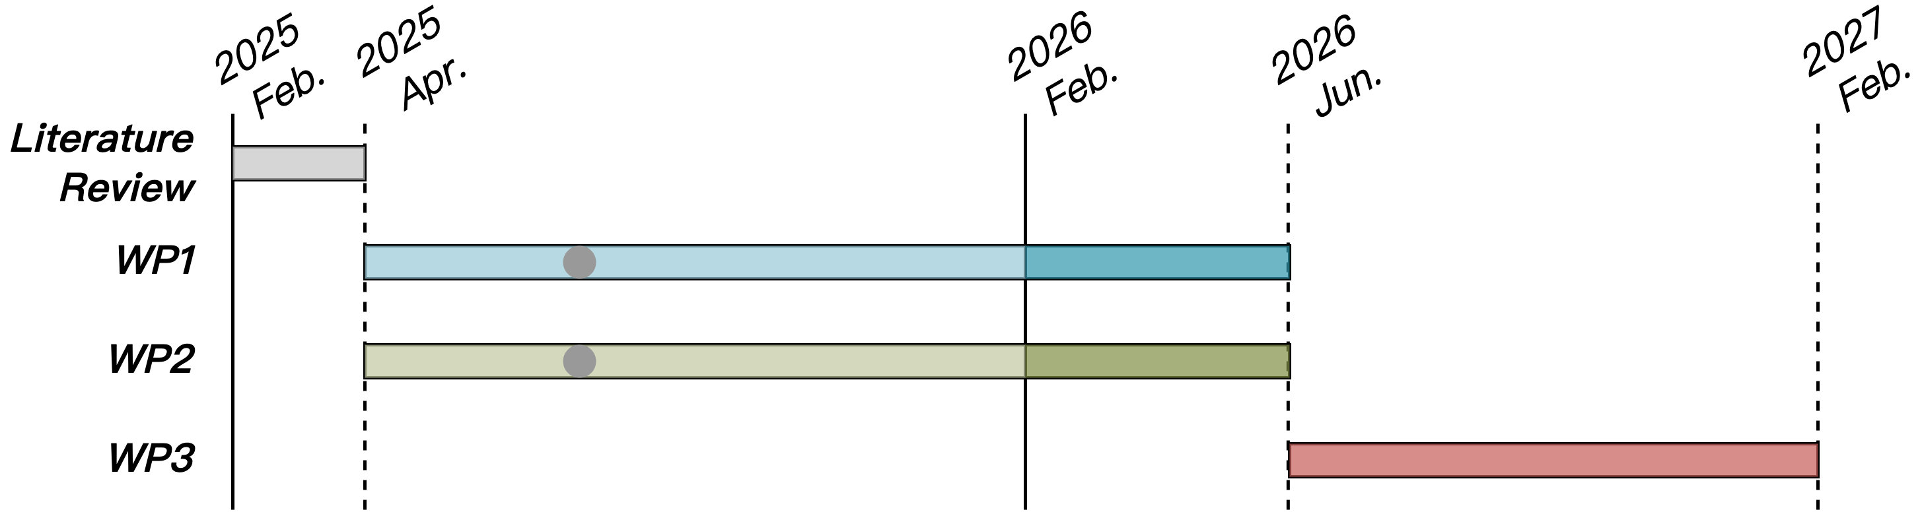
Progress Recap
WP1
Software emulation on SpMM with RVV instructions
Custom widening index instructions in Spatz GVSoC model
SpMM kernel implementation with vfwx_.vf instructions

Slide 3
Agenda
Progress Update
Spatz N:M sparsity format
Baseline: Dense vs. sparse (2:4) FP8 MatMul
Optimization: Loop unroll, VRF prefill
Performance benchmark, insights
Timeline
Discussion

Slide 4
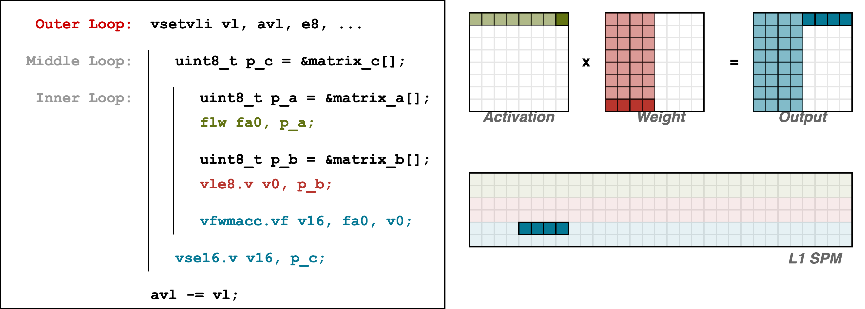
Recap: Dense MatMul (Gustav)
Outer Loop
Inner Loop
Middle Loop

Slide 5
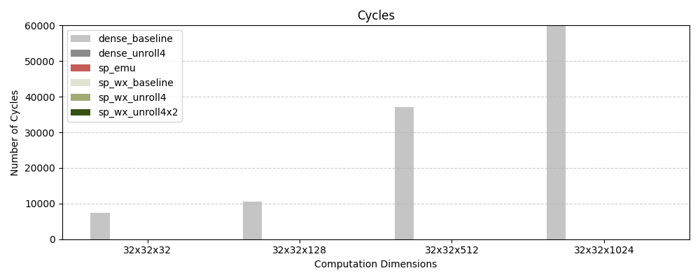
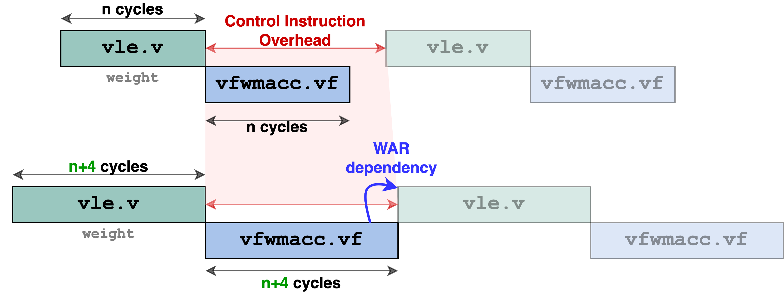
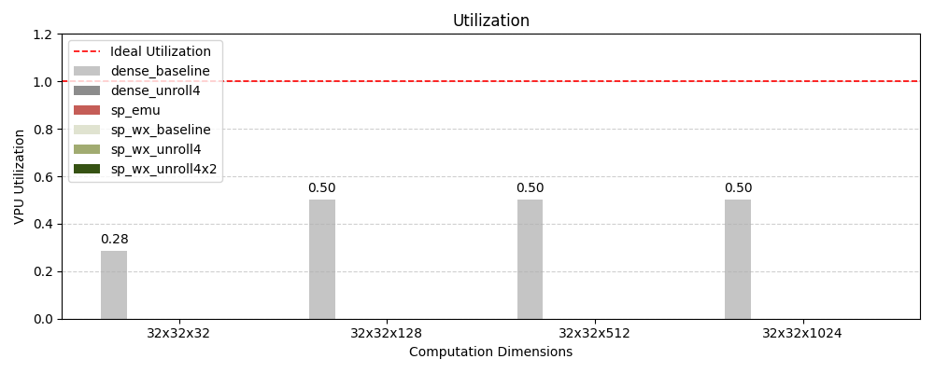
Baseline Benchmark: Dense MatMul
VPU utilization increases with larger P dimension due to longer Vl
VPU utilization is constrained by WAR dependency

Slide 6
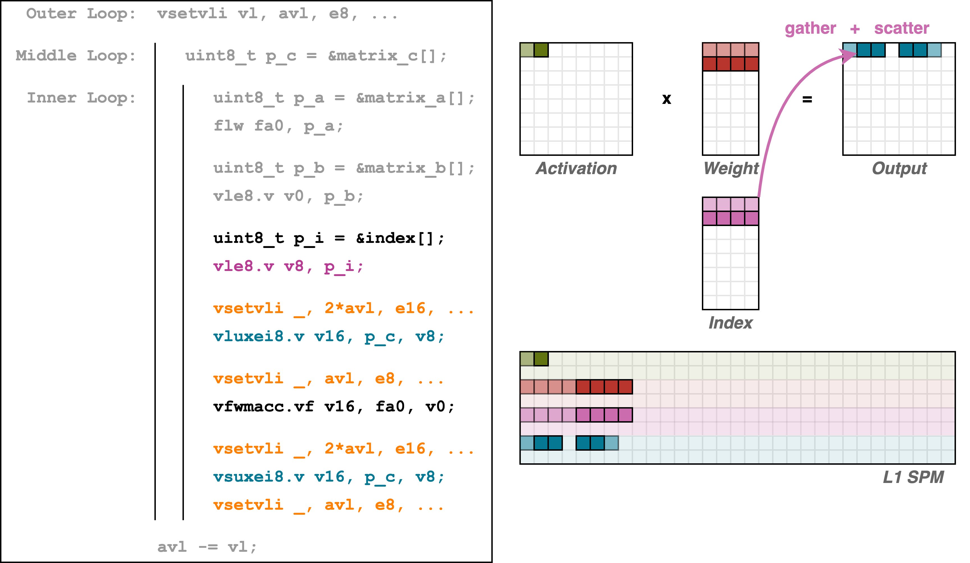
Recap: SpMM Software Emulation (Gustav)
Inner Loop
Index generation is required
~50% instructions are used for config + scatter/gather

Slide 7
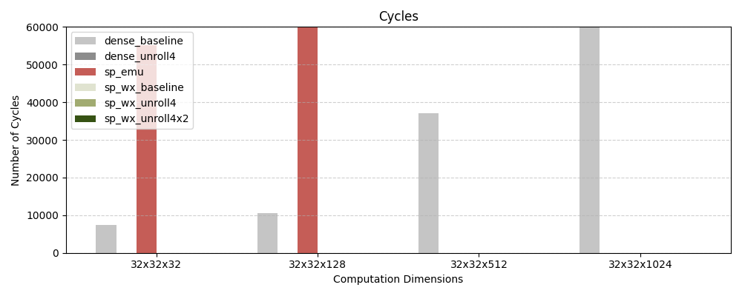
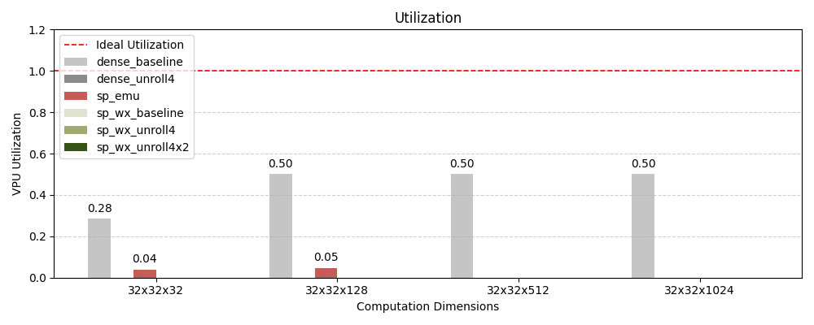
Baseline Benchmark: SpMM Software Emulation
Vectors with >256 elements cannot be processed in one iteration, due to the 8-bit index constraint
Performs poorly due to software index translation and reliance on VLSU for scatter/gather

Slide 8
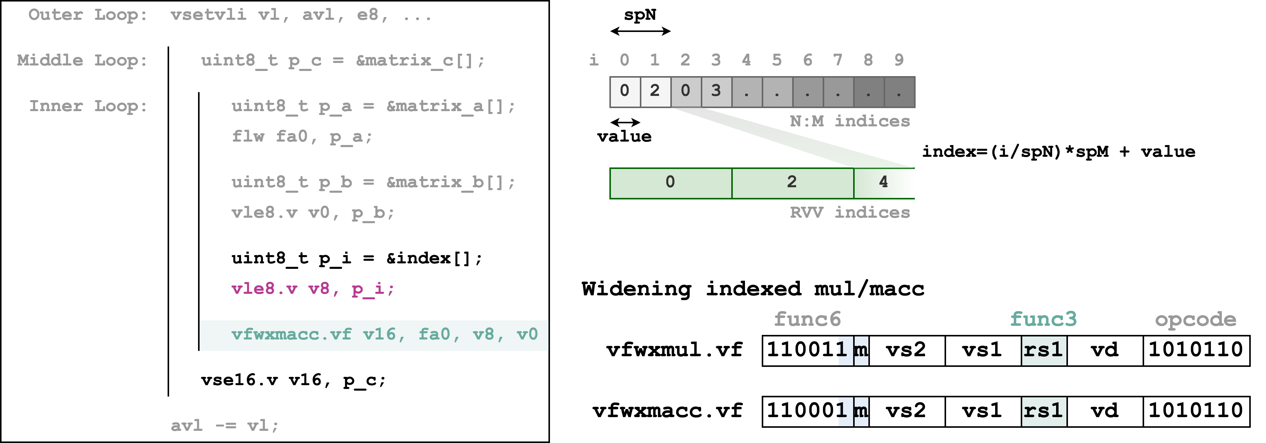
Recap: SpMM Custom Instruction (Gustav)
Merged index translation
Scatter/Gather in VRF
No configuration overhead

Slide 9
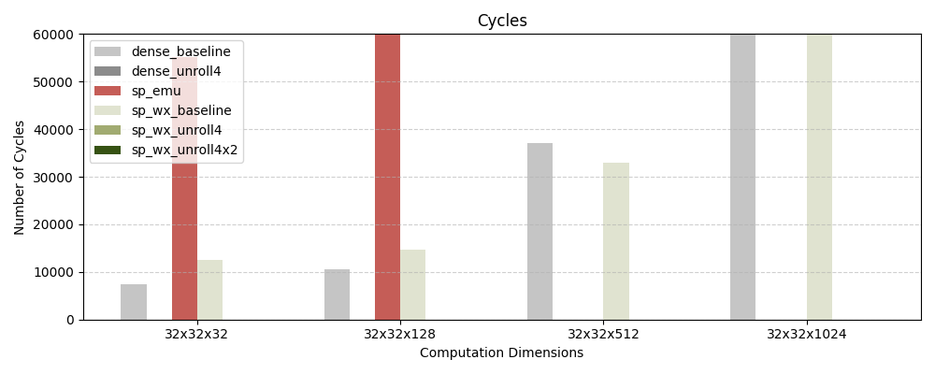
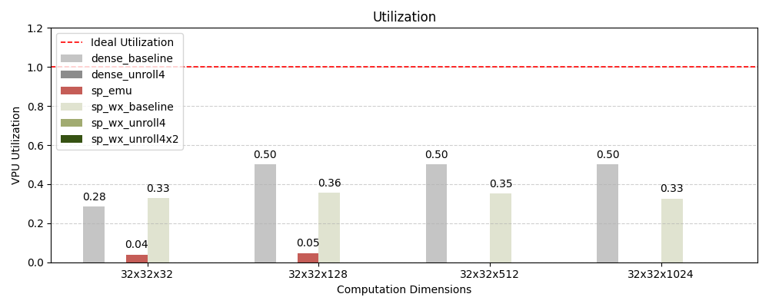
Baseline Benchmark: SpMM Custom Instructions
Timing model:
vfw_.vf instructions are aligned with RTL implementation. For FP8 inputs, 1 cycle latency
vfwx_.vf instructions are estimated.
VREG-based scatter/gather, which effectively halves the VREG-to-VPU bandwidth under 2:4 sparsity → Latency is modeled as double that of regular vfw_.vf instructions

Slide 10
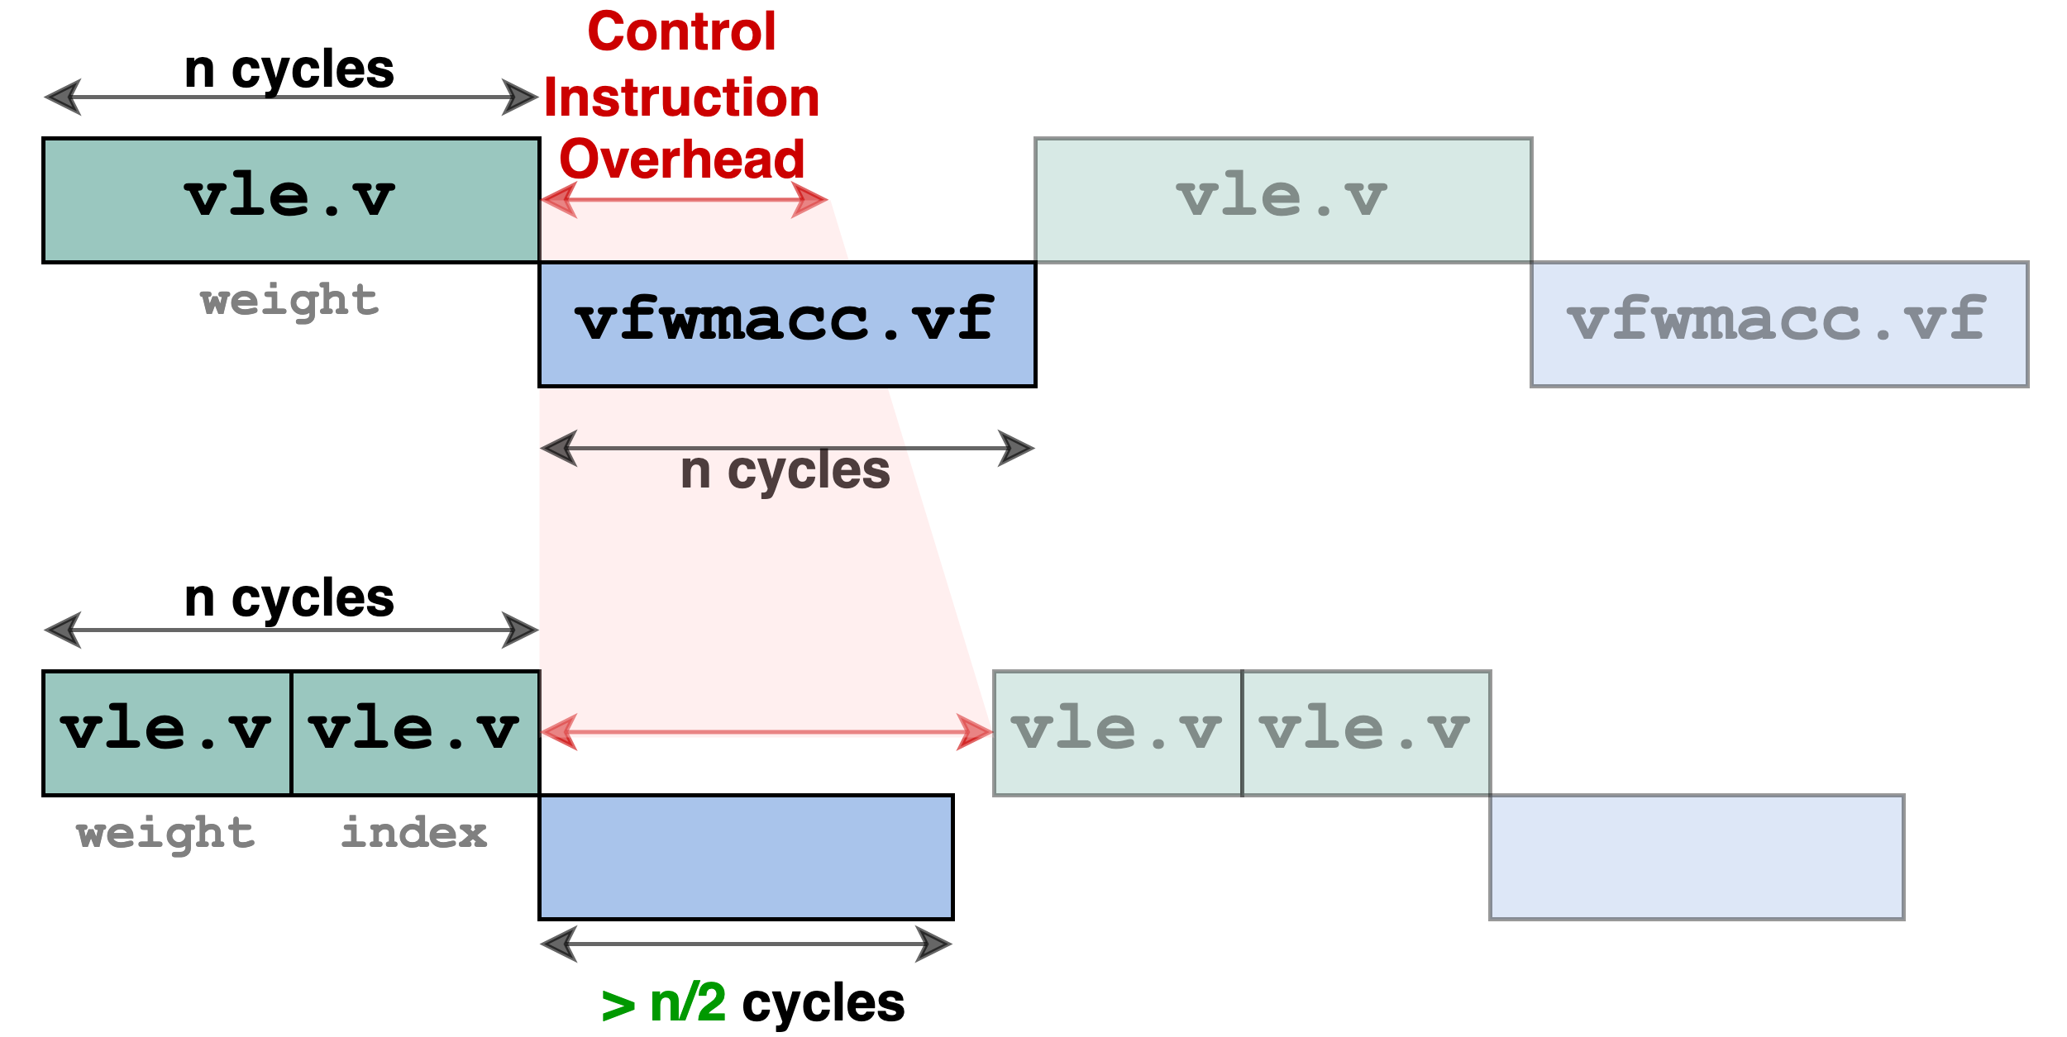
Baseline Benchmark: SpMM Custom Instructions
Larger control instruction overhead for indices
Additional runtime for loading index vector
Reduced runtime for computation

Slide 11
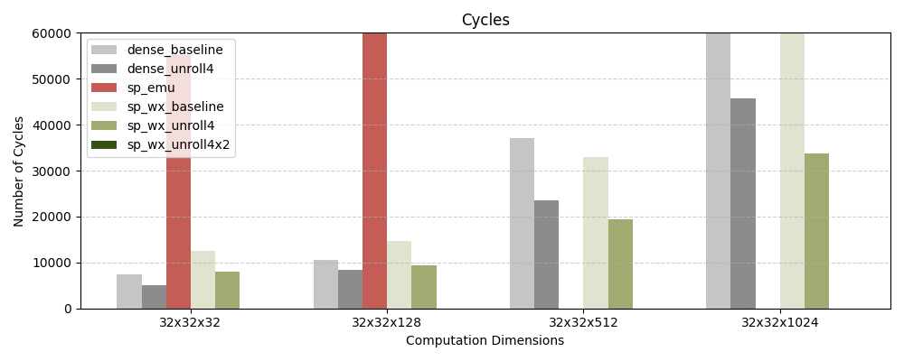
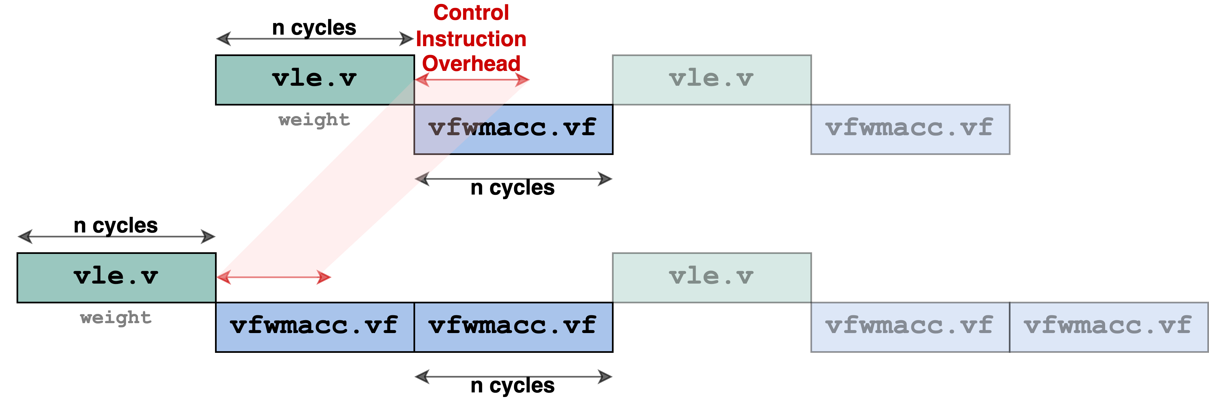
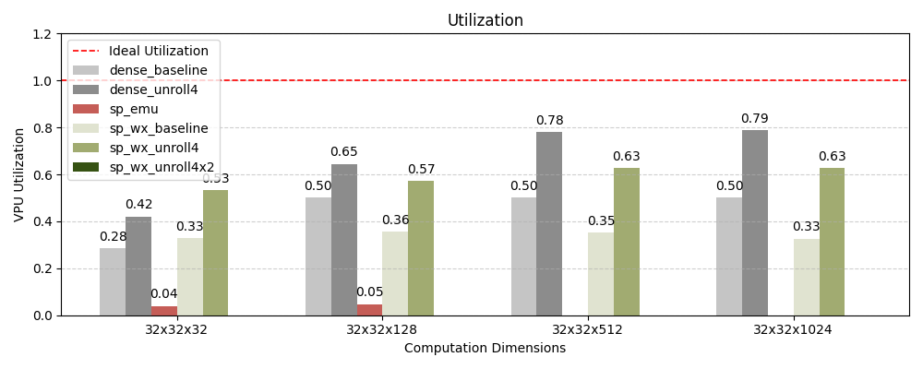
Optimization: Loop Unroll
Mitigate control instruction overhead impacts
Increased data reuse

Slide 12
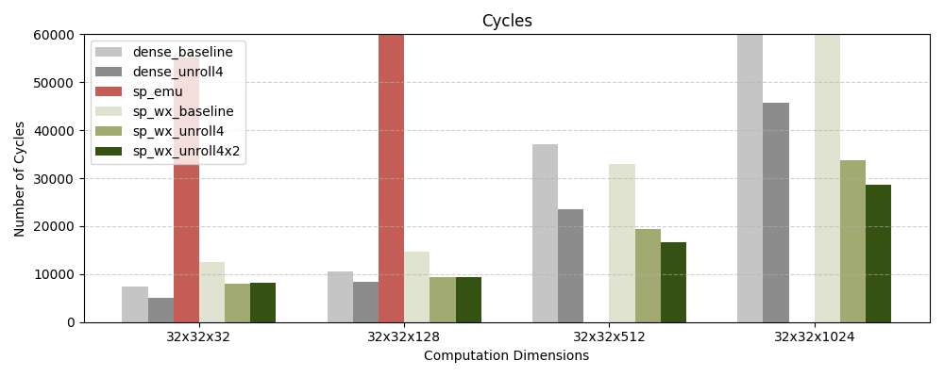
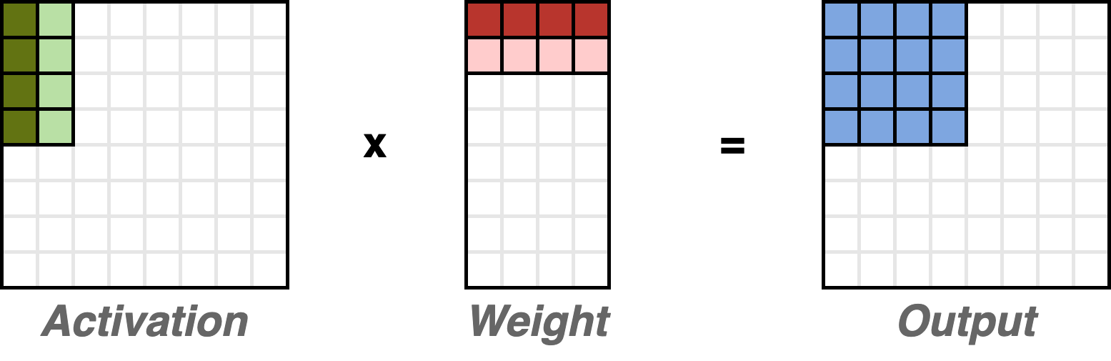
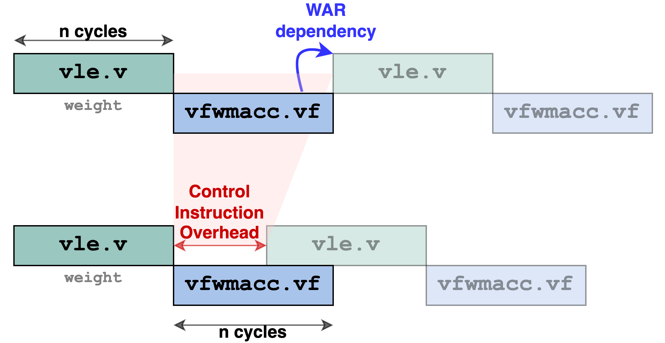
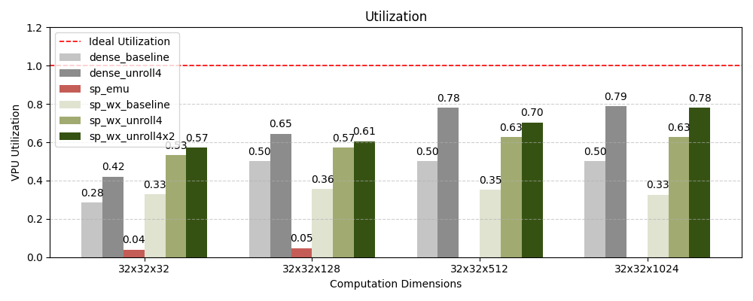
Optimization: VREG Preload
Unroll
Preload
Removed data compute-load dependency

Slide 13
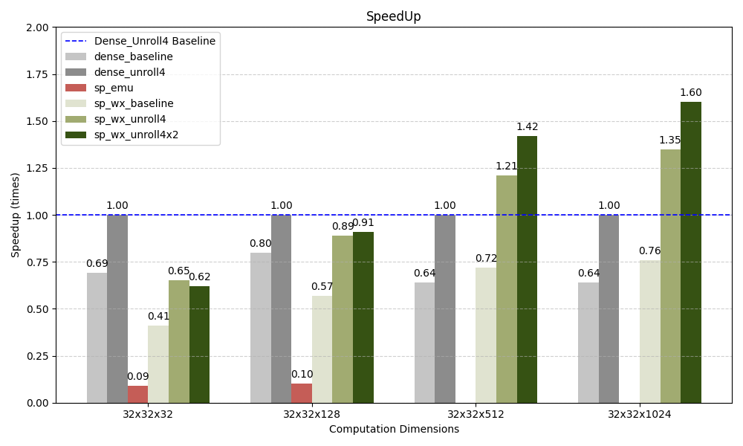

Speed Up
Results:
Up to 1.60x speedup with long vl
Lower performance with shorter vl, as a result of higher control overhead (address calculation) → Post-Incrementing vector Load & Store Instructions
Limitations
No vector chaining support in the current Spatz GVSoC model
Work in progress
Add kernel for activation sparsity handling
MX-format combined handling
https://github.com/gvsoc/gvsoc/tree/soft_hier_release(#137)

Slide 14
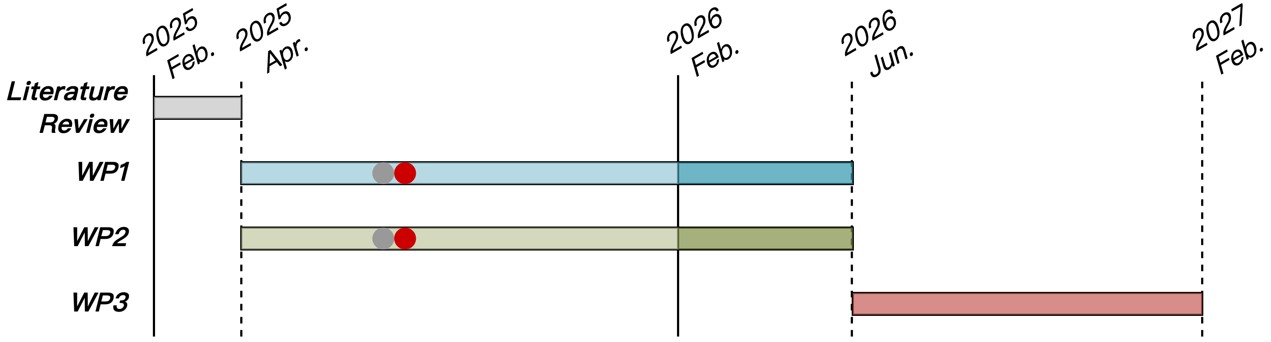
Progress Update
WP1
SpMM kernel implementation, optimization, and benchmark with vfwx_.vf instructions

