Slide 1
QuantSparse 3D Biweekly 2025-08-19
Integrated Systems Laboratory (ETH Zürich)
Bowen Wang bowwang@iis.ee.ethz.ch Paul Scheffler paulsc@iis.ee.ethz.ch
Luca Benini lbenini@iis.ee.ethz.ch

Slide 2
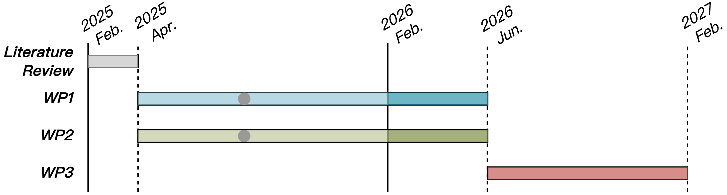
Progress Recap
WP1
SpMM kernel implementation, optimization, and benchmark with vfwx_.vf instructions

Slide 3
Agenda
Progress Update
Spatz N:M sparsity format
Extending vfwx_.vf instruction with multi-format support
Performance benchmark, roofline model analysis
N:M format wrap-up
Timeline
Discussion

Slide 4
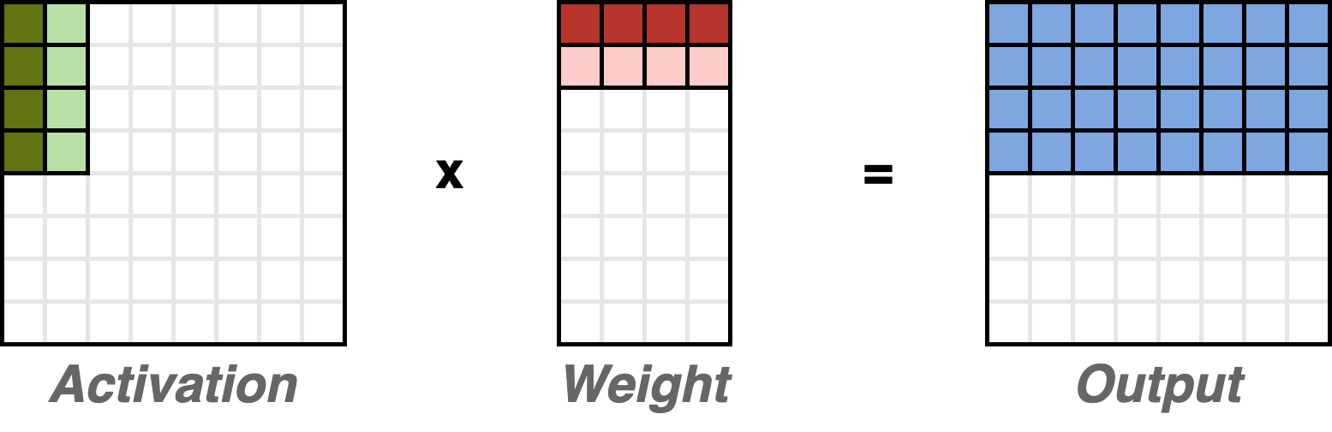
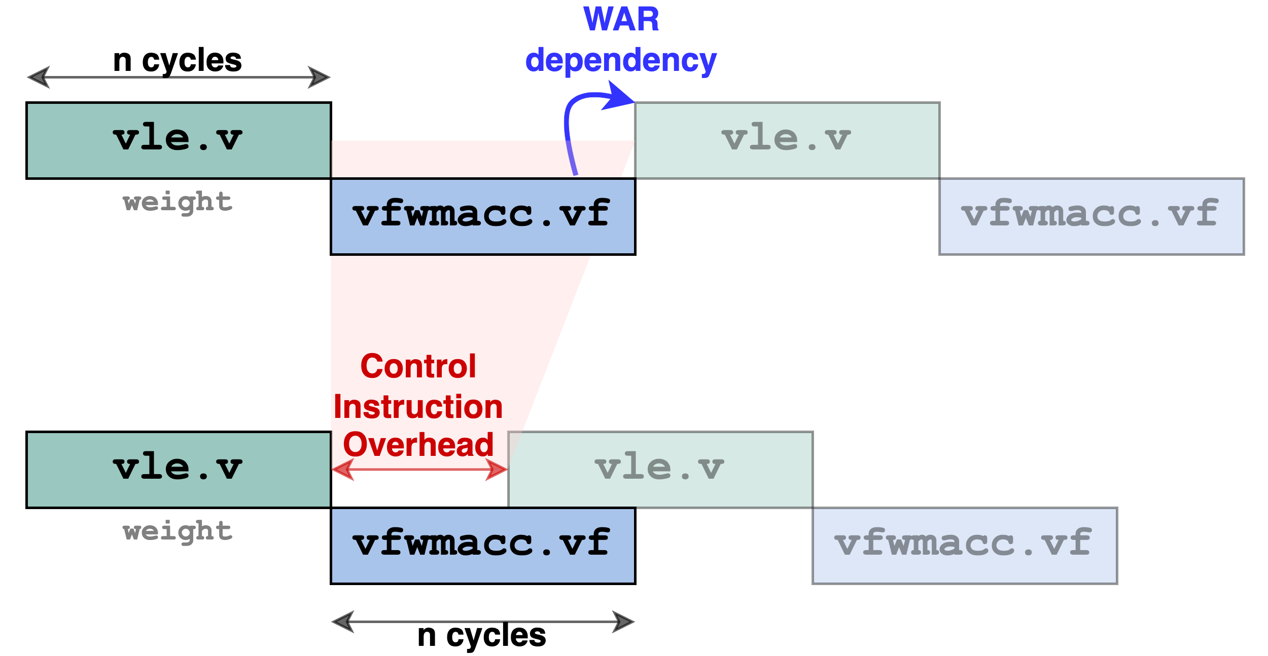
Recap: SpMM kernel imple. with vfwx_.vf instructions
Activation elements are passed through FP registers
Unrolled 4x to increase the data reuse of the weight vectors
Weight elements are loaded as vectors
Preload 2x to remove the WAR dependency
Control overheads:
Address incremental calculation for loading elements
Explicit scalar load instructions for activation
Unroll
Preload
Scatter / Gather

Slide 5
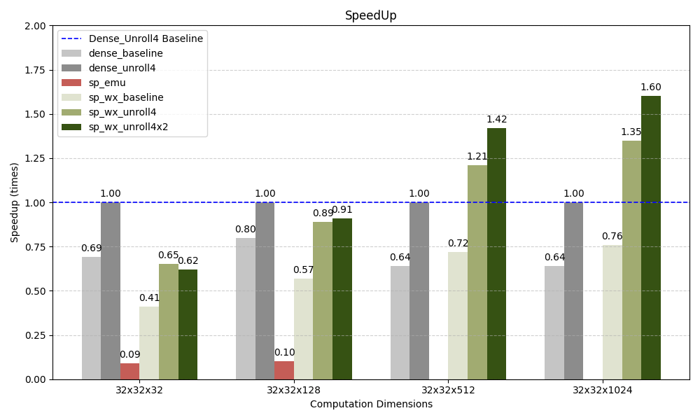
Recap: Speed Up Results
Results:
Up to 1.60x speedup with long vl
Lower performance with shorter vl, as a result of higher control overhead (address calculation) → Post-Incrementing vector Load & Store Instructions

Slide 6
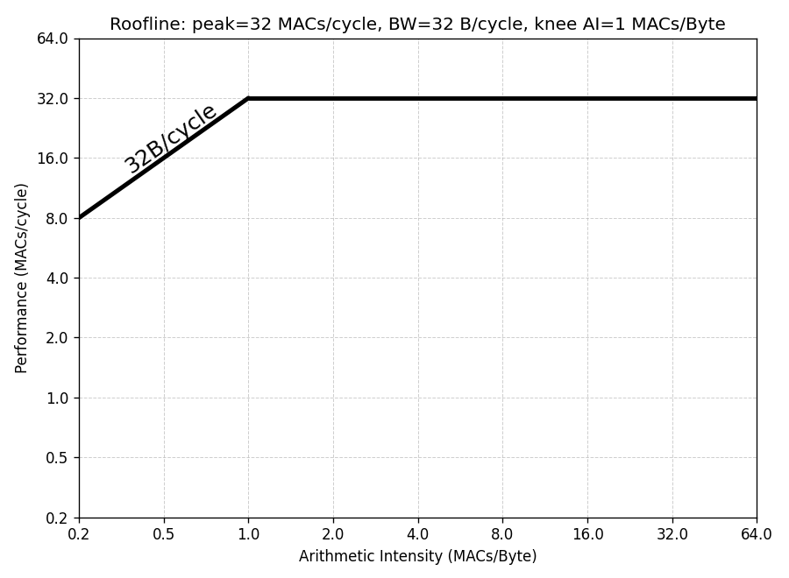
Roofline Analysis
System configurations
1x Spatz₄ per SoftHier Cluster
4x 64-bit PEs per Spatz₄
→ Peak performance 32 MACs/cycle (FP8)
4x 64-bit LSUs per Spatz₄
→ L1-to-PE bandwidth 32B/cycle

Slide 7
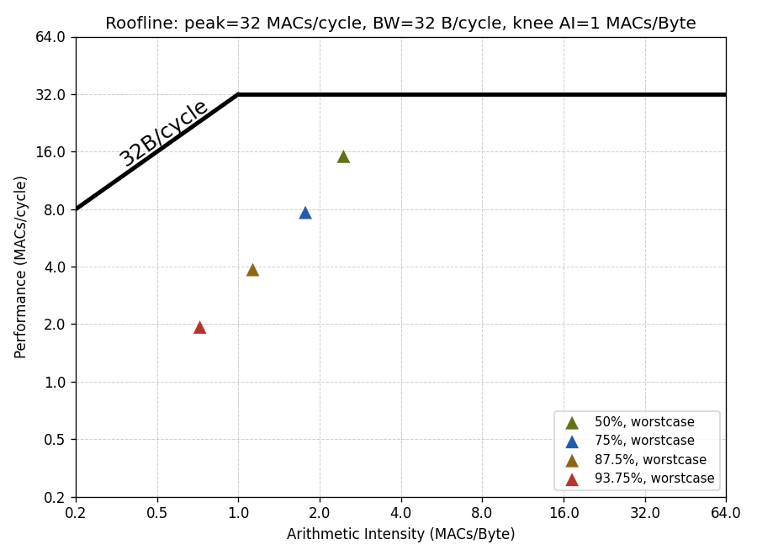
Roofline Analysis: Impact of Efficient VReg Gather OPs
No special handling for output accumulations
Benchmarked with 32x32x1024 SpMM

Slide 8
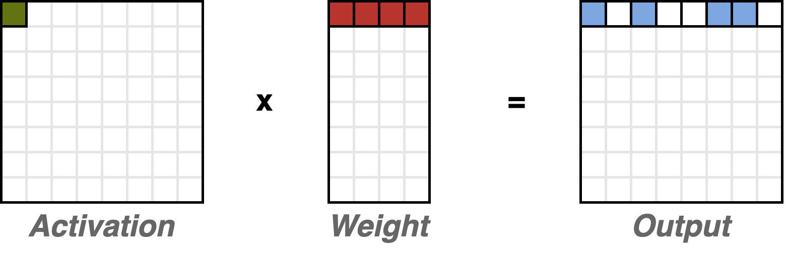
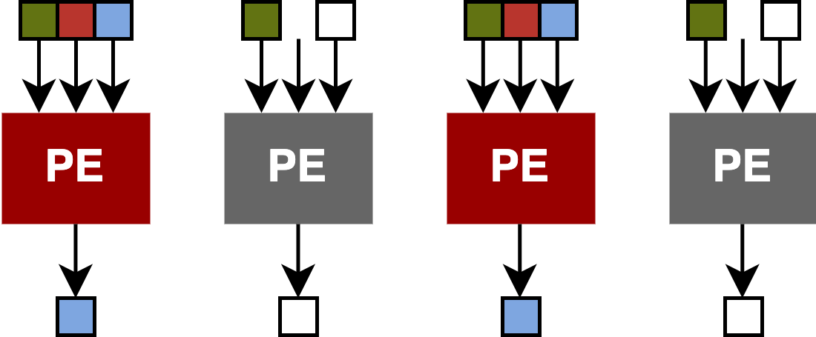
Roofline Analysis: Impact of Efficient VReg Gather OPs
No special handling for output accumulations
For a 50% sparsity rate (e.g. 1:2), only half of the output accumulations are effective
→ Effective VPU throughput is halved
Effective
Effective

Slide 9
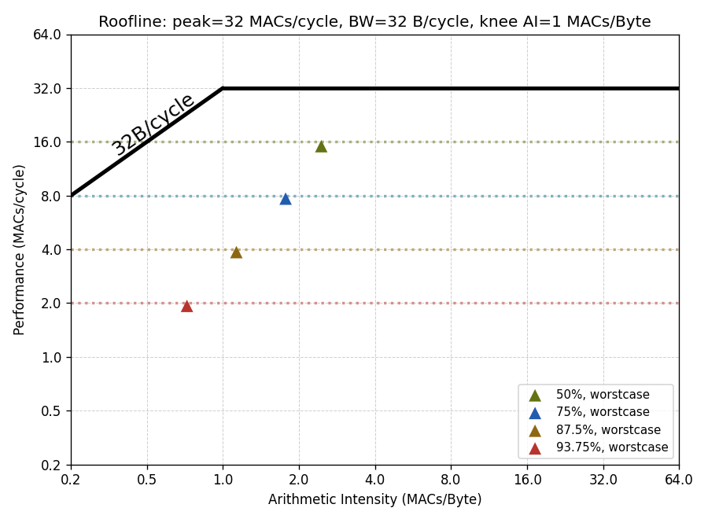
Roofline Analysis: Impact of Efficient VReg Gather OPs
No special handling for output accumulations
For a 50% sparsity rate (e.g. 1:2), only half of the output accumulations are effective
→ Effective VPU throughput is halved
Worsened for a higher sparsity rate
Performance is constrained by the effective VPU throughput
32 MACs/cycle
16 MACs/cycle
1:2
8 MACs/cycle
1:4
4 MACs/cycle
1:8
2 MACs/cycle
1:16
Benchmarked with 32x32x1024 SpMM

Slide 10
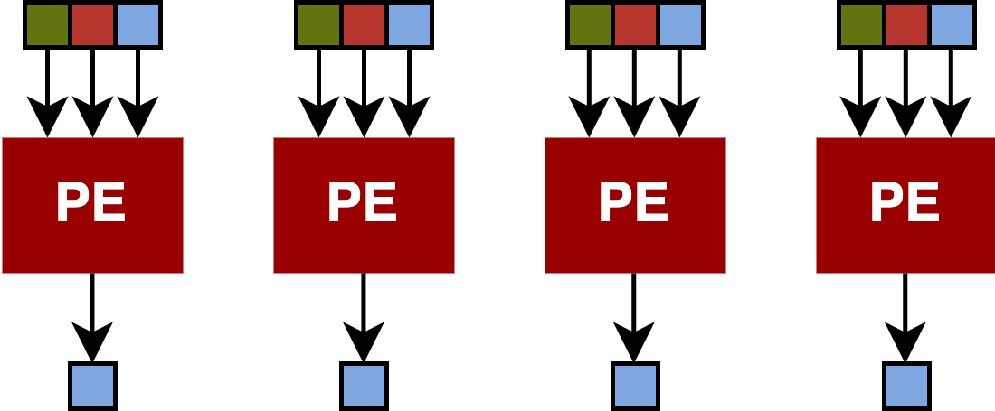
Roofline Analysis: Impact of Efficient VReg Gather OPs
Gather
Gathering effective output accumulations
With VSLIDE unit, within VRegs, adding buffers. Or combined.
For a higher sparsity rate, multiple combined methods are required → larger hardware overhead should be expected

Slide 11
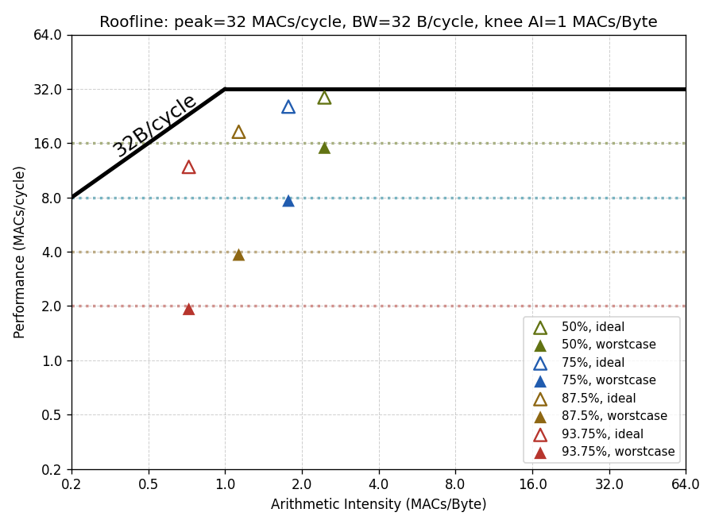
Roofline Analysis: Impact of Efficient VReg Gather OPs
Gathering effective output accumulations
With VSLIDE unit, within VRegs, adding buffers. Or combined.
For a higher sparsity rate, larger hardware overhead should be expected
Performance improvement is promising
Highly depends on the gathering strategies and hardware implementation
32 MACs/cycle
1.9x
16 MACs/cycle
1:2
8 MACs/cycle
1:4
6.1x
4 MACs/cycle
1:8
2 MACs/cycle
1:16
Benchmarked with 32x32x1024 SpMM

Slide 12
Roofline Analysis: Impact of Control Instructions
Performance is still detached from the roofline
Impacts from: Control instructions for address calculation and, explicit scalar activation elements loading
32 MACs/cycle
16 MACs/cycle
8 MACs/cycle
4 MACs/cycle
2 MACs/cycle
Benchmarked with 32x32x1024 SpMM

Slide 13
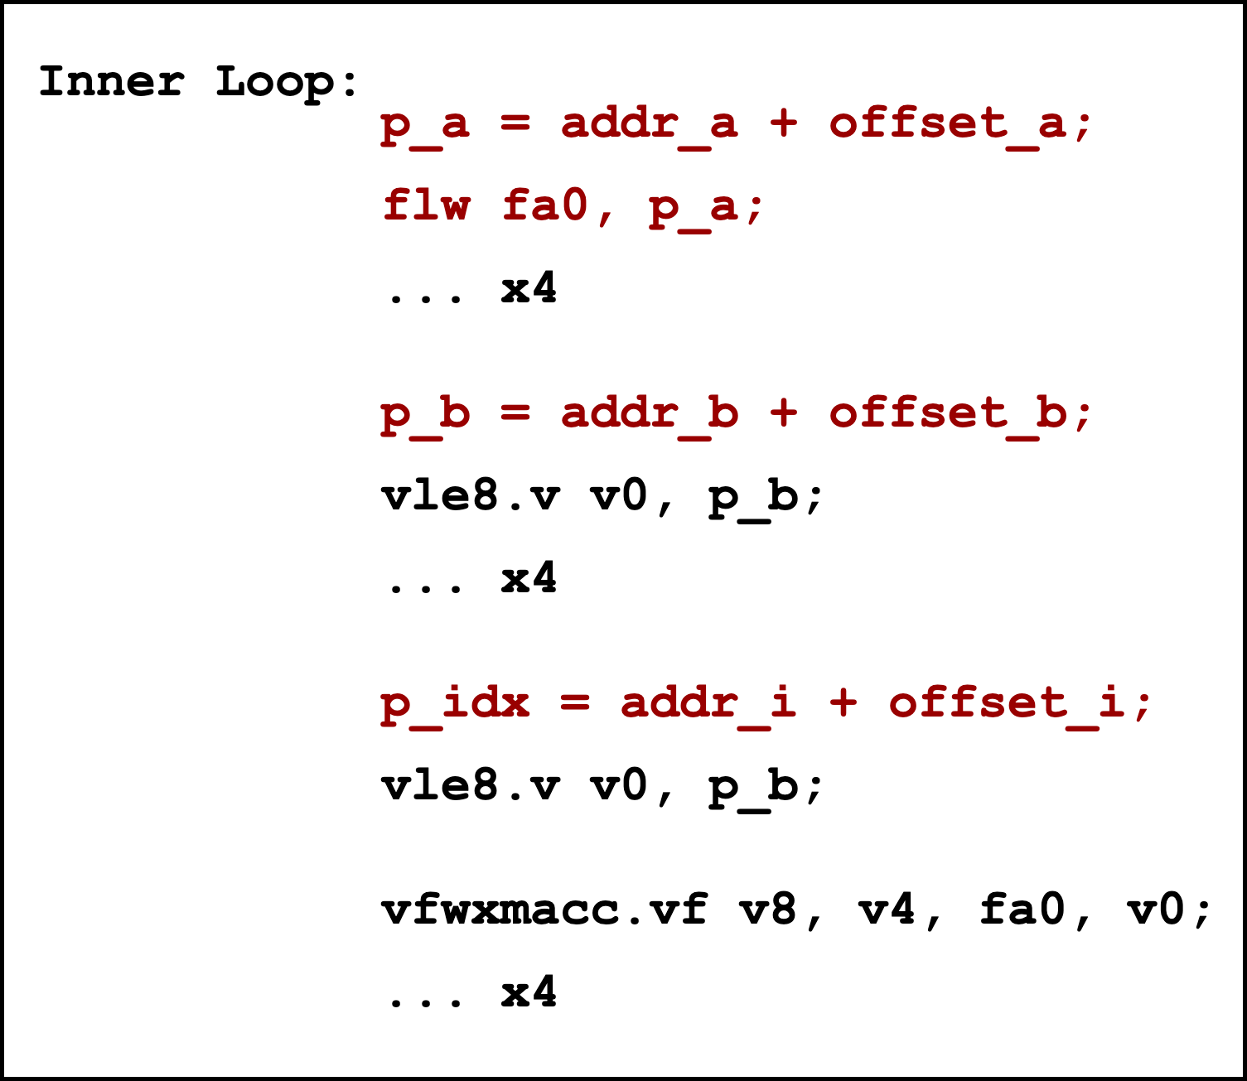
Roofline Analysis: Impact of Control Instructions
Performance is still detached from the roofline
Impacts from: Control instructions for address calculation and, explicit scalar activation elements loading
More prominent with a higher sparsity rate. For the vfwxmacc.vf instruction: 16 cycles for 1:2 format 2 cycles for 1:16 format @ Spatz₄ FP8 inputs

Slide 14
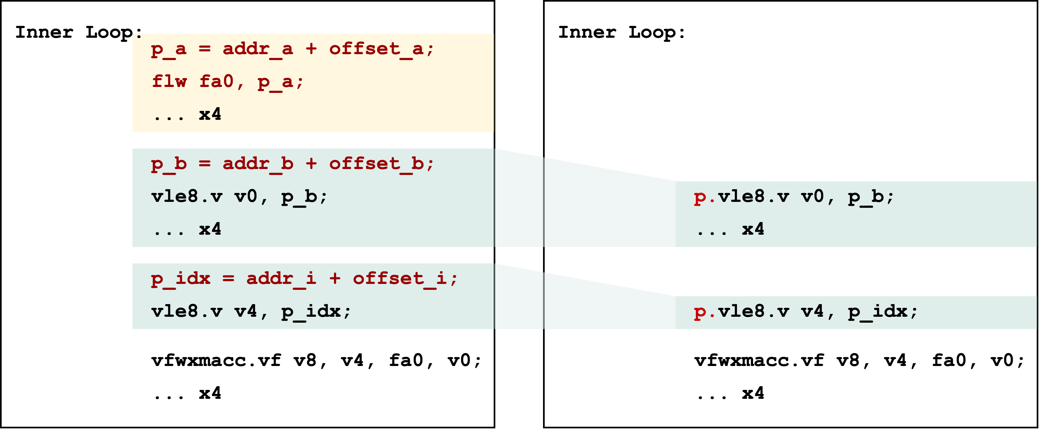
Roofline Analysis: Impact of Control Instructions
Scalar activation streaming
Address post increment

Slide 15
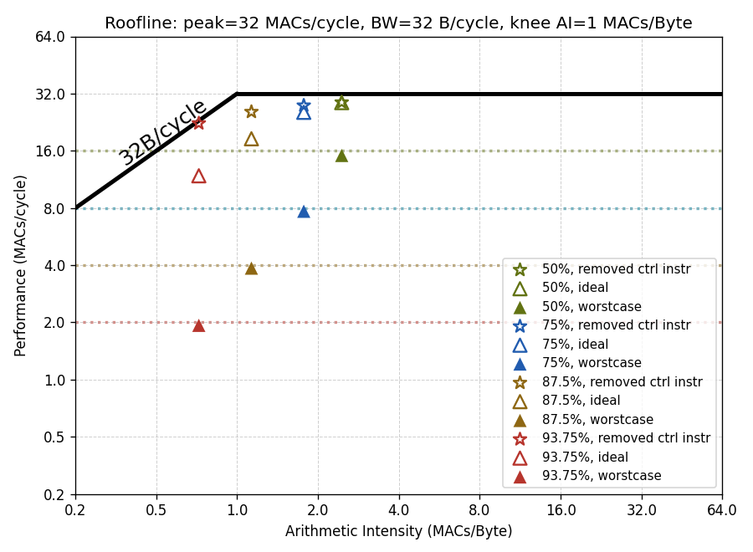
Roofline Analysis: Impact of Control Instructions
Removing the control instructions pushes the performance to the roofline
Additional hardware overhead required
32 MACs/cycle
16 MACs/cycle
8 MACs/cycle
Benchmarked with 32x32x1024 SpMM

Slide 16


Roofline Analysis: Impact of Higher Sparsity Rate
$$\#Bytes=\frac{M}{4}×(4N+\frac{N×P}{SR}×δ+8P)$$
32 MACs/cycle
16 MACs/cycle
$$\#MACs=\frac{M×N×P}{SR}$$
8 MACs/cycle
Lower AI
1:2 → 1:4: doubled sparsity rate (2xSR): → Halved #MACs, less impact on #Bytes
Lower performance
More prominent control overheads
Benchmarked with 32x32x1024 SpMM

Slide 17
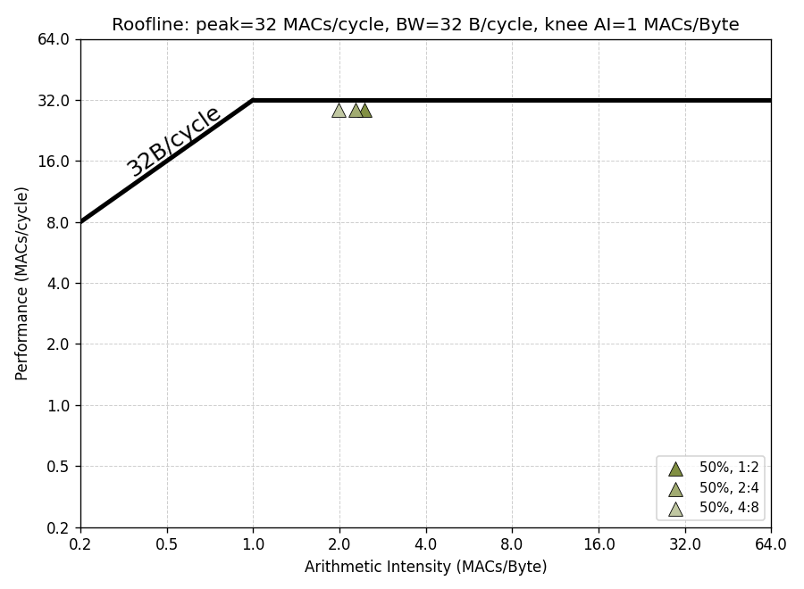


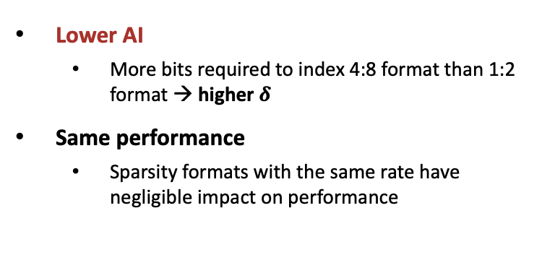
Roofline Analysis: Impact of Sparsity formats
$$\#Bytes=\frac{M}{4}×(4N+\frac{N×P}{SR}×δ+8P)$$
4:8
1:2
32 MACs/cycle
$$\#MACs=\frac{M×N×P}{SR}$$
Lower AI
More bits required to index 4:8 format than 1:2 format → higher $δ$
Same performance
Sparsity formats with the same rate have negligible impact on performance
Benchmarked with 32x32x1024 SpMM

Slide 18


Roofline Analysis: Impact of Comp. Dimensions (M)
$$\#Bytes=\frac{M}{4}×(4N+\frac{N×P}{SR}×δ+8P)$$
$$\#MACs=\frac{M×N×P}{SR}$$
Same AI
M scales #Bytes and #MACs with the same ratio
Same performance
M only determines the number of middle loops

Slide 19
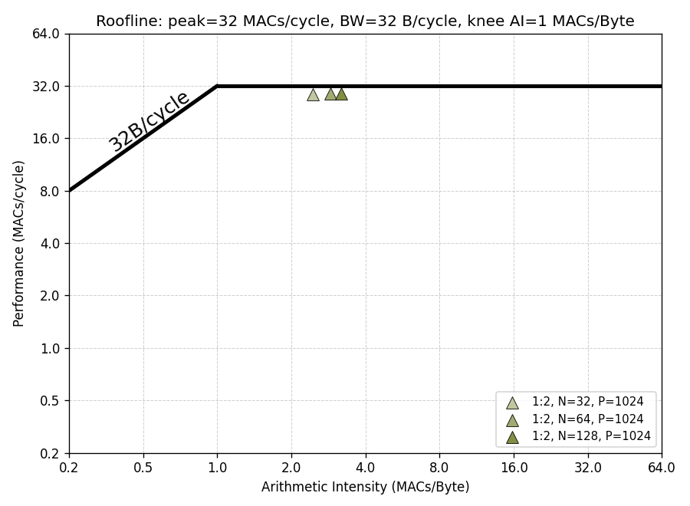


Roofline Analysis: Impact of Comp. Dimensions (N↑)
$$\#Bytes=\frac{M}{4}×(4N+\frac{N×P}{SR}×δ+8P)$$
N=32
N=128
32 MACs/cycle
$$\#MACs=\frac{M×N×P}{SR}$$
Higher AI
N scales #MACs with a higher ratio compared to #Bytes
Same performance
N only determines the number of inner loops
Benchmarked with M=32, 1:2 format

Slide 20
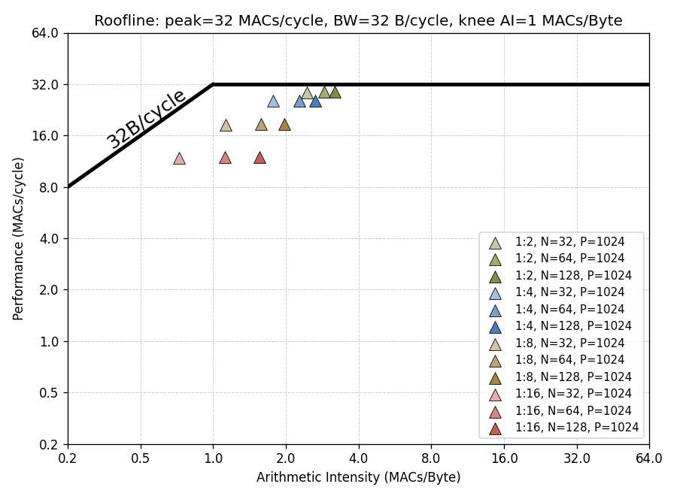
Roofline Analysis: Impact of Comp. Dimensions (N↑)
$$\#Bytes=\frac{M}{4}×(4N+\frac{N×P}{SR}×δ+8P)$$
32 MACs/cycle
1:2
$$\#MACs=\frac{M×N×P}{SR}$$
1:4
1:8
1:16
Higher AI
N scales #MACs with a higher ratio compared to #Bytes
Same performance
N only determines the number of inner loops
Benchmarked with M=32, P=1024

Slide 21
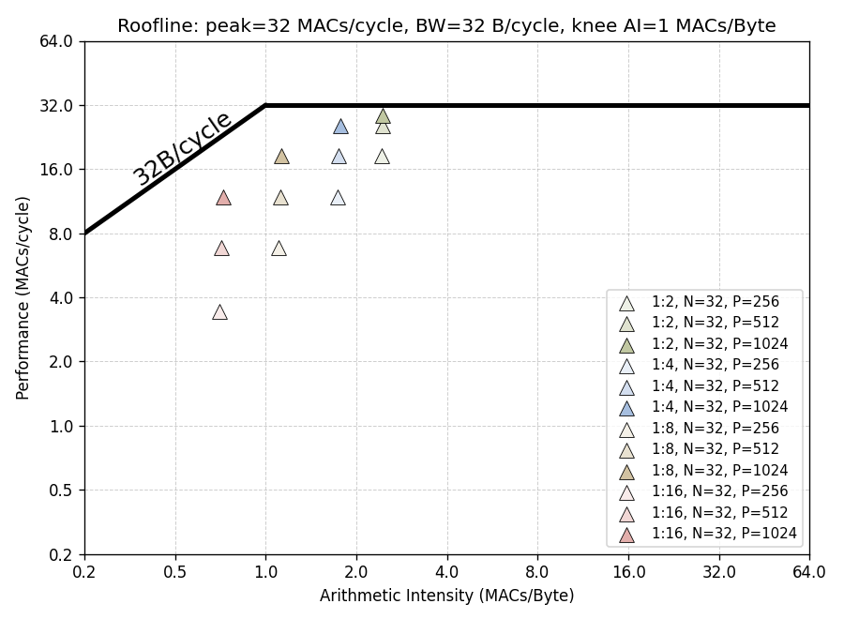


Roofline Analysis: Impact of Comp. Dimensions (P↑)
$$\#Bytes=\frac{M}{4}×(4N+\frac{N×P}{SR}×δ+8P)$$
32 MACs/cycle
$$\#MACs=\frac{M×N×P}{SR}$$
1:2
1:4
Higher AI
P scales #MACs with a higher ratio compared to #Bytes
Higher performance
More tolerant to the control overhead
Confined by VLEN and VReg grouping
1:8
1:16
Benchmarked with M=N=32

Slide 22
Conclusion: Structure Sparsity Handling
Effective gathering operation for output accumulation is essential
Combined strategies from the VSLIDE unit, VReg, and buffers
Higher hardware overhead for formats with higher sparsity rates
Removing control instruction overhead improves the performance
With activation streaming and address post increment
Additional hardware overhead
Higher sparsity rate → Lower AI
Moving towards the memory-bound region
Workload tiling strategy
Tiling on the M dimension has a negligible impact on performance, weight duplication across clusters
Tiling on the N dimension requires inter-cluster reduction
Keep the P dimension as large as possible → Higher performance

Slide 23
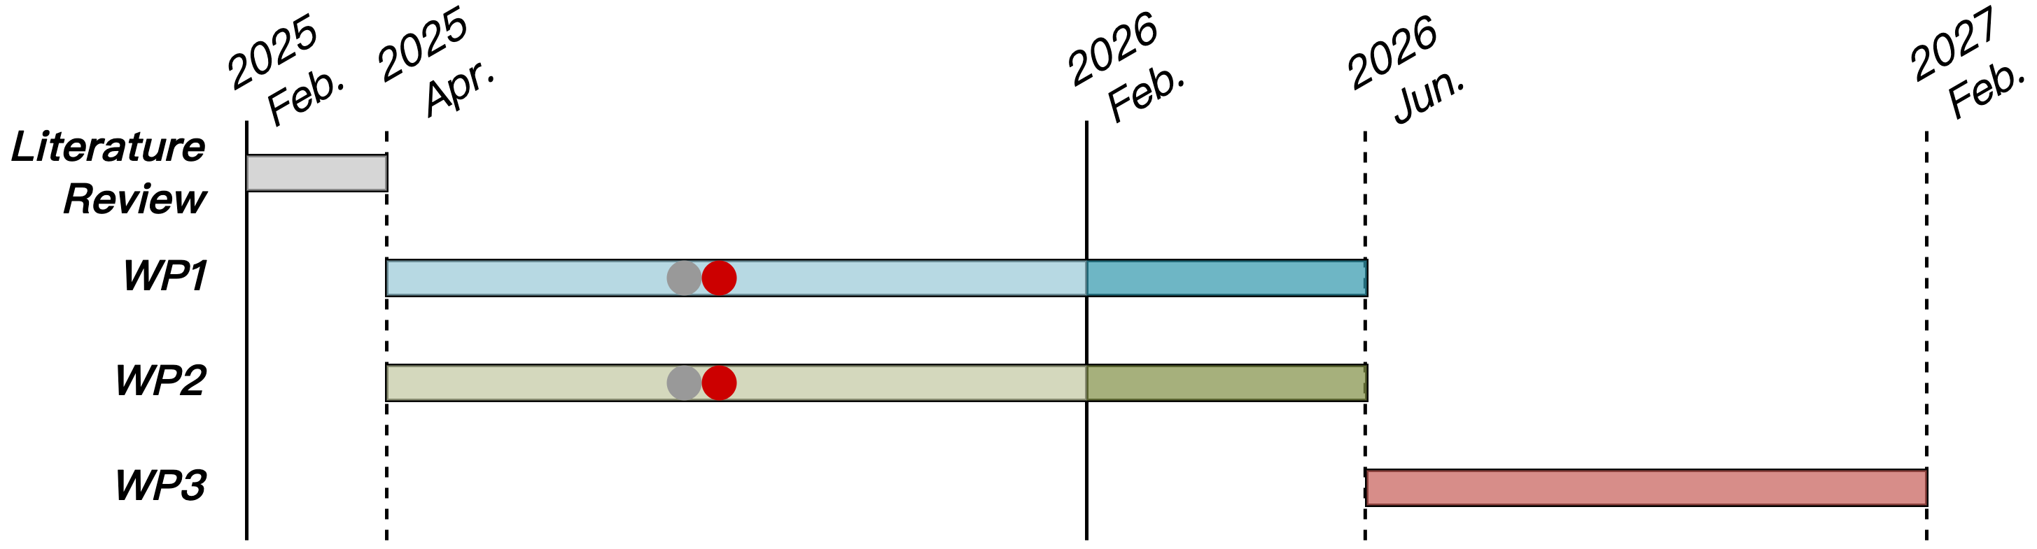
Progress Update
WP1
Structure sparsity format handling wrap-up

