Slide 1
QuantSparse 3D Biweekly 2025-09-10
Integrated Systems Laboratory (ETH Zürich)
Bowen Wang bowwang@iis.ee.ethz.ch Paul Scheffler paulsc@iis.ee.ethz.ch
Luca Benini lbenini@iis.ee.ethz.ch

Slide 2
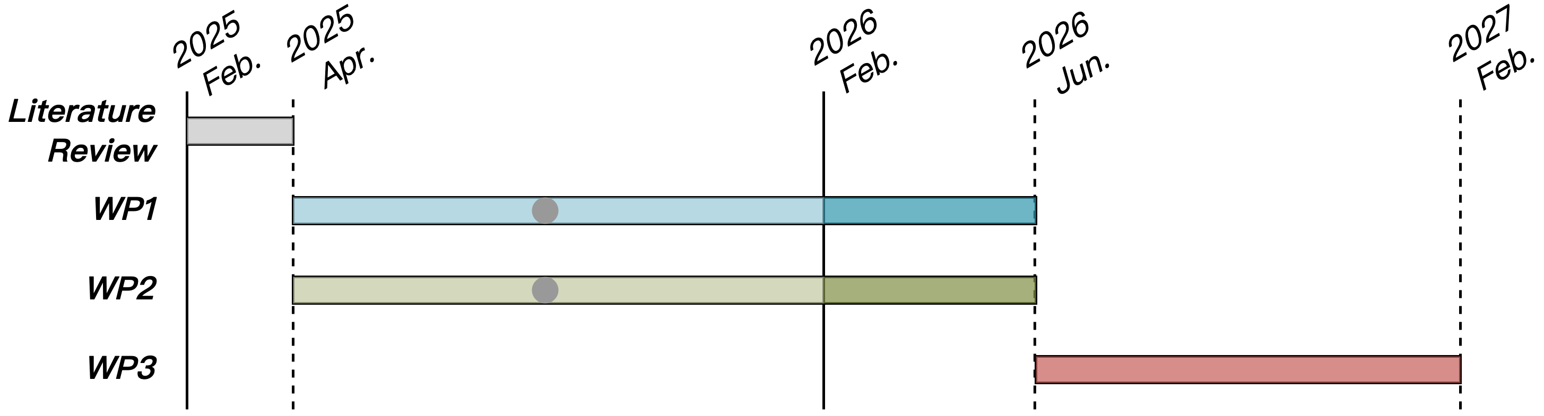
Progress Recap
WP1
Structured sparsity handling wrap-up

Slide 3
Agenda
Progress Update
Block quantization: Microscaling (MX) format
OCP Microscaling Formats (MX) Specification
FPU DOTP datapath
MX format handling
FPU MXDOTP datapath
Quantization-axis consideration
Joint Handling of MX and N:M Structured Sparsity
Sparsification, quantization-axis joint consideration
Timeline
Discussion

Slide 4
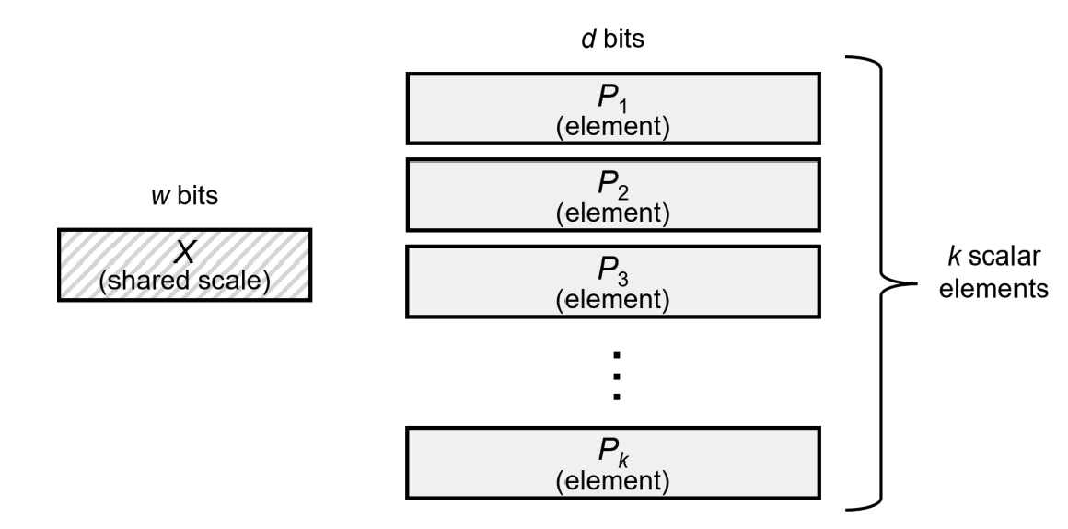
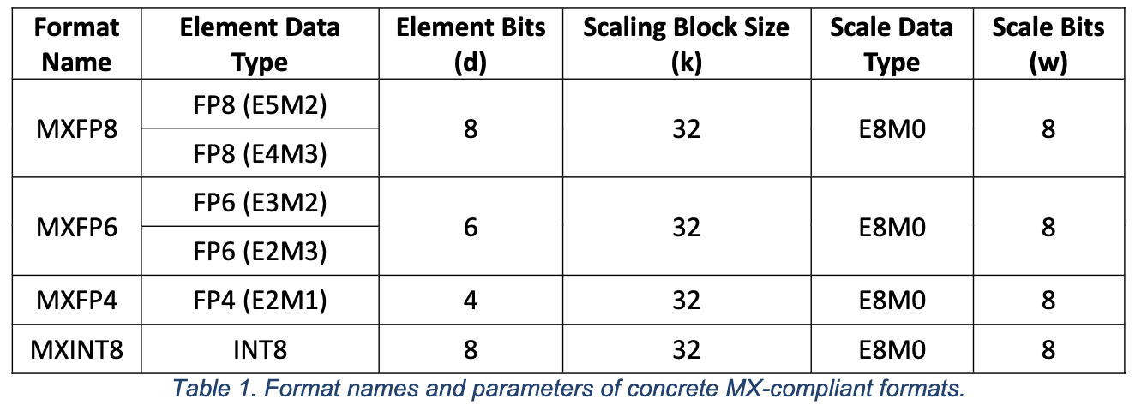
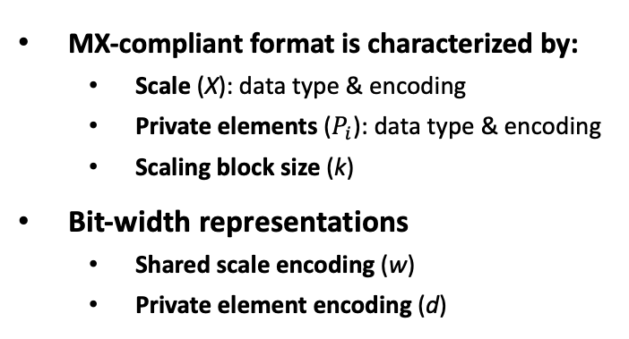
OCP Microscaling Format (MX) Specification^{[1]}
MX-compliant format is characterized by:
Scale (X): data type & encoding
Private elements ($P_{i}$): data type & encoding
Scaling block size (k)
Bit-width representations
Shared scale encoding (w)
Private element encoding (d)
32
8-bit (E8M0)
8-bit (E5M2 or E4M3)

Slide 5
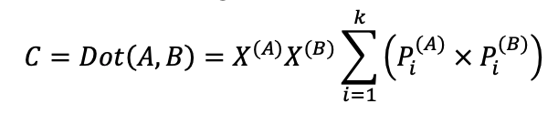
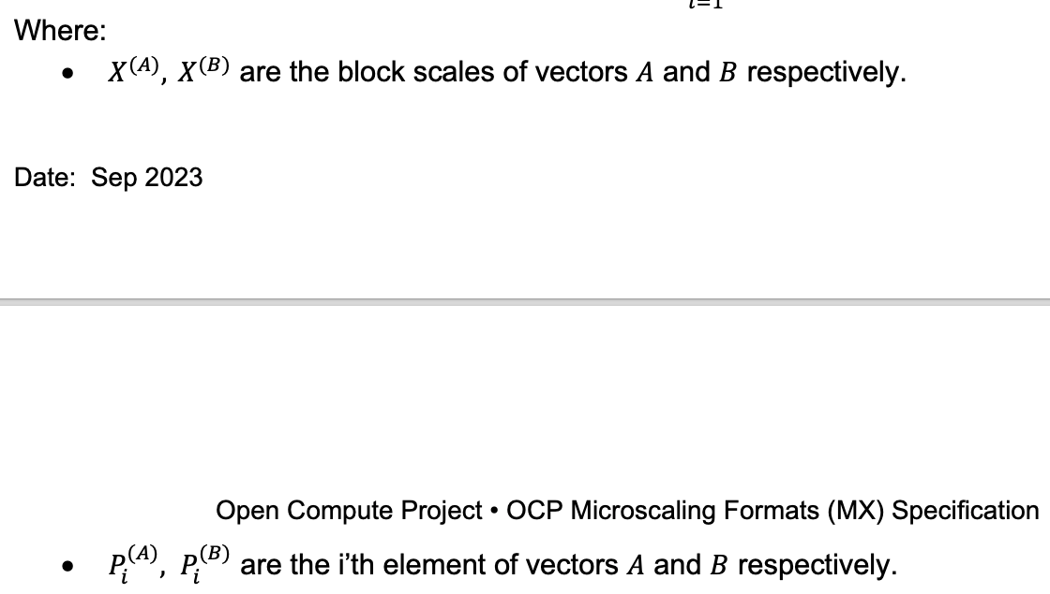
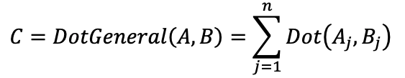
OCP Microscaling Format (MX) Specification^{[1]}
Basic operations
Dot product of two MX-blocks
A and B may use different data types
The internal precision is implementation-defined
General dot product of two MX-vectors
Accumulator (C) should be Float32
Dot Product
General Dot Product

Slide 6
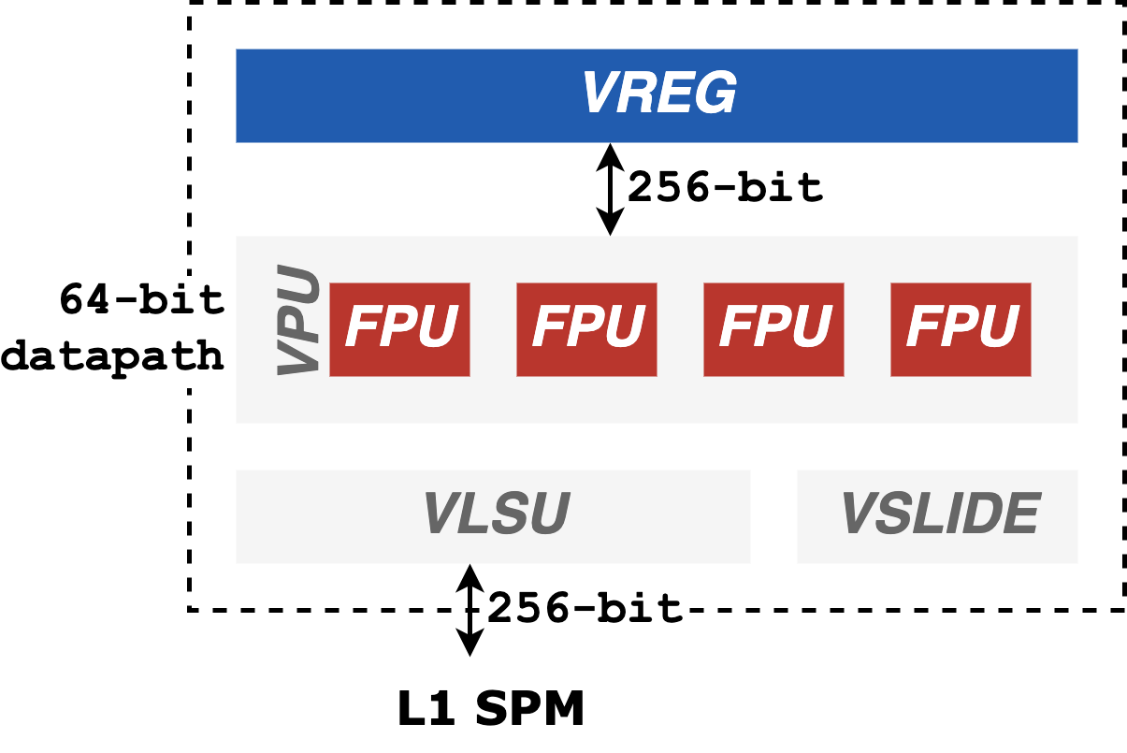
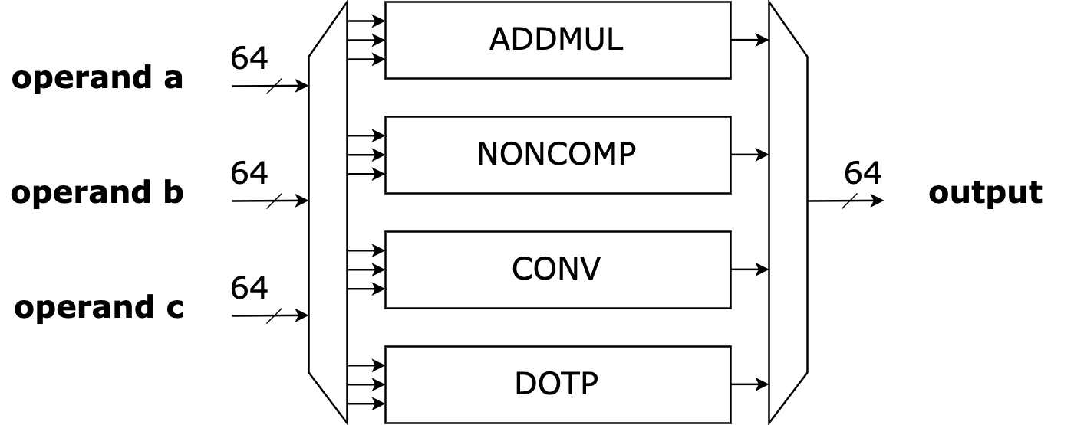
Spatz₄ Datapath
Vector processing unit (VPU)
Comprises four 64-bit FPUs operating in parallel
Connected via a 256-bit interconnect to VREG
FPU datapath comprises operations groups
N:M format handling leverages the ADDMUL operation group

Slide 7
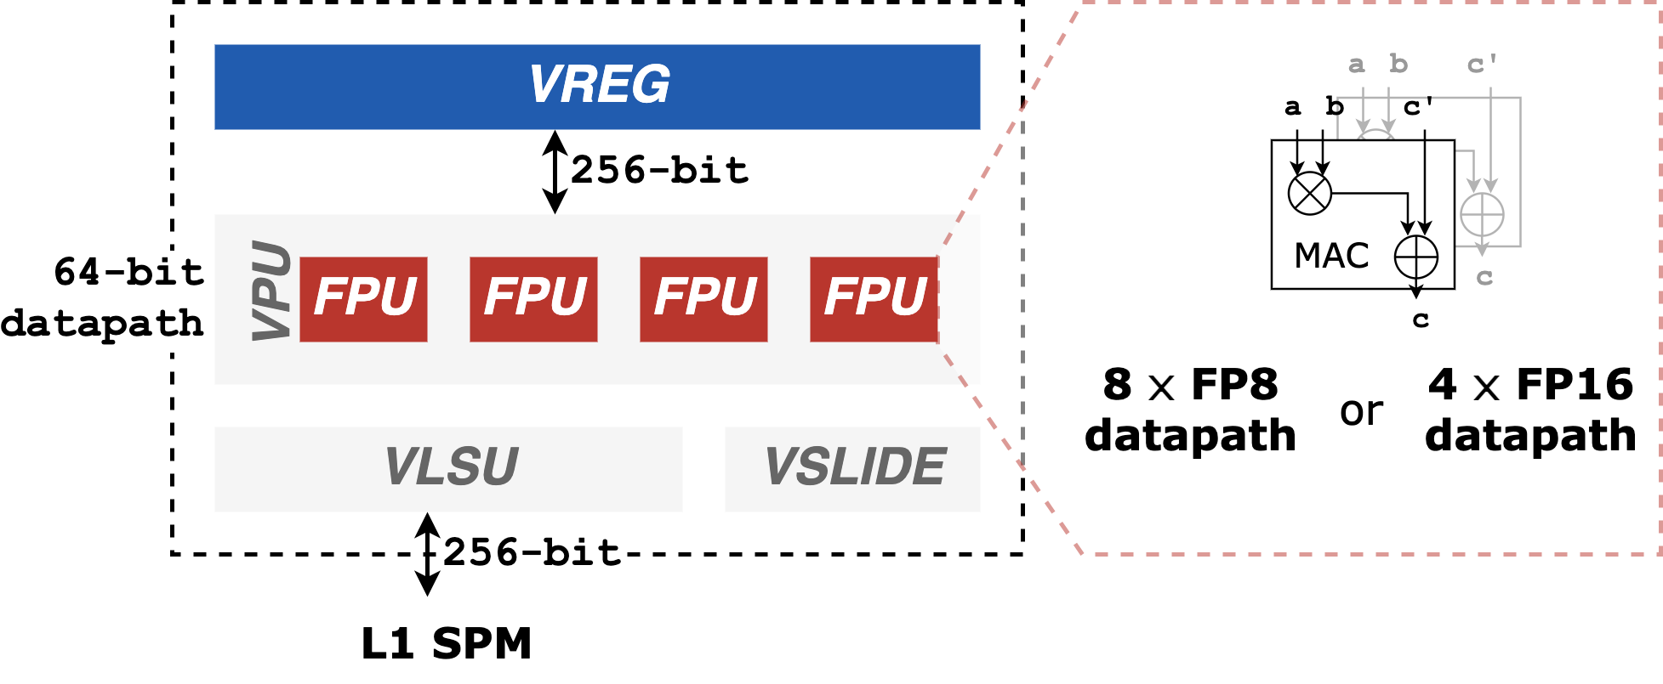
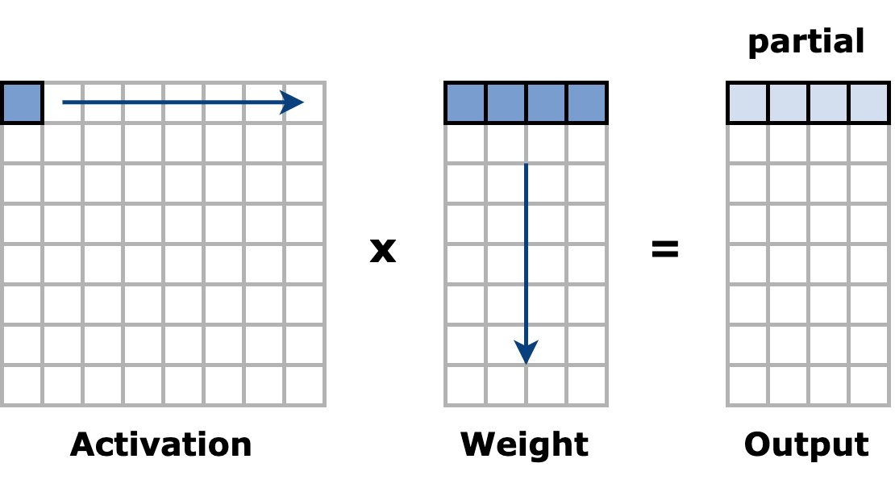
Spatz₄ Datapath
Vector processing unit (VPU)
Comprises four 64-bit FPUs operating in parallel
Connected via a 256-bit interconnect to VREG
FPU datapath comprises operations groups
N:M format handling leverages the ADDMUL operation group
MX specification: FP8 input elements, FP32 accumulator → widening instruction required
Effective throughput is halved (4x FP8 inputs per cycle)
Per FPU workload

Slide 8
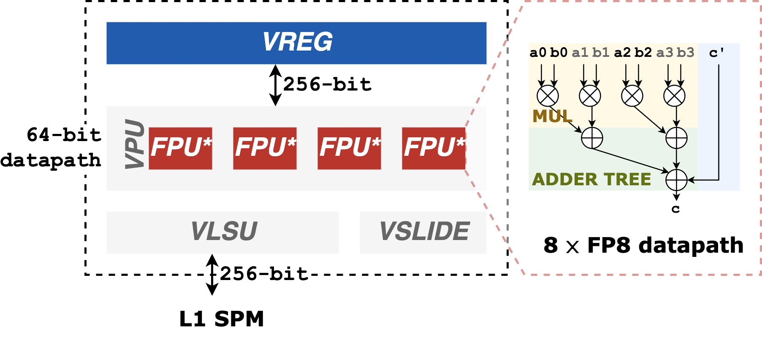
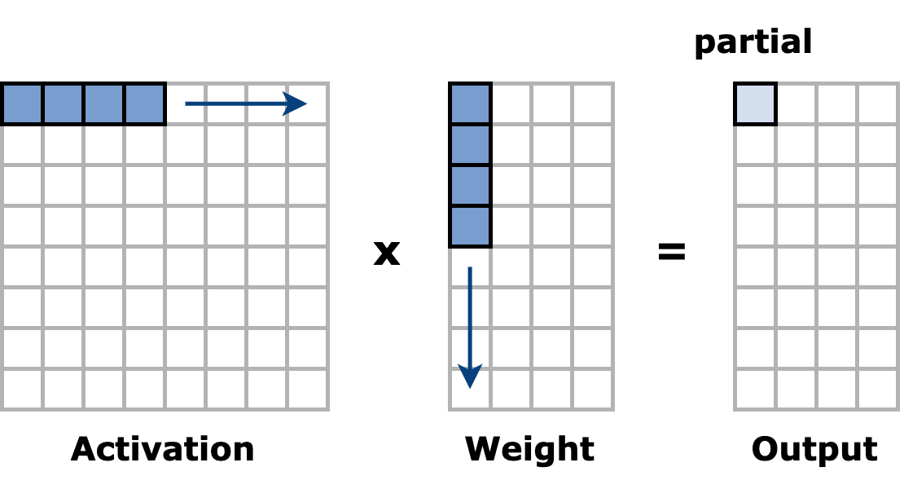
Spatz₄ Datapath
DOTP operation group
2x throughput compared with ADDMUL
Low latency depends on the number of pipeline stages
Per FPU operates on an inner-product dataflow
Per FPU workload

Slide 9
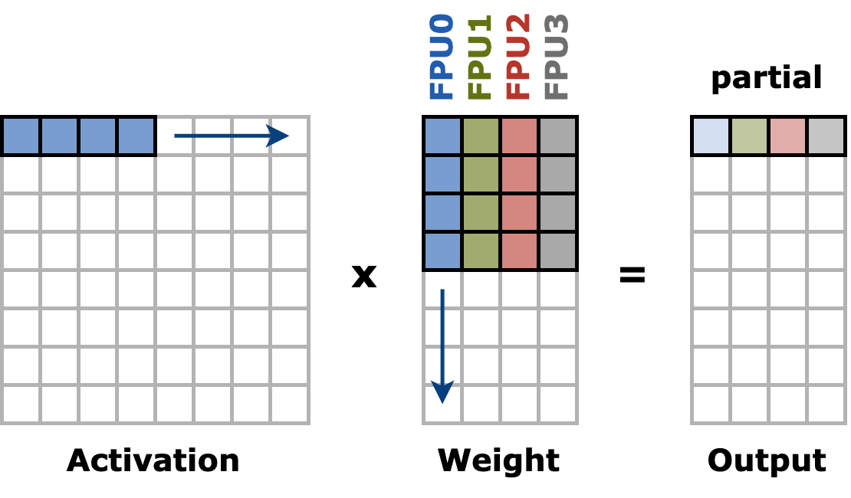
Spatz₄ Datapath
DOTP operation group
2x throughput compared with ADDMUL
Low latency depends on the number of pipeline stages
Per FPU operates on an inner-product dataflow
Per Spatz operates on a mixture of inner-product/Gustav dataflow
Per Spatz workload

Slide 10
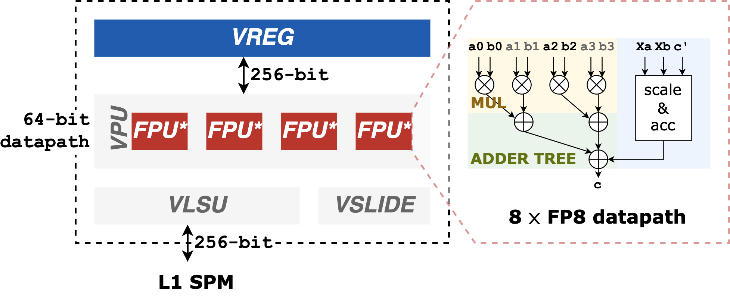
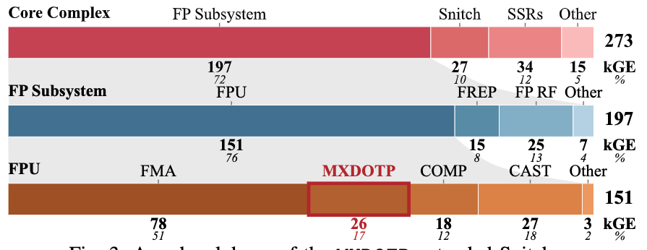
MXDOTP^{[2]}: RV ISA Extension for MX Dot Products
MXDOTP operation group
Datapath is integrated into the FPU of the Snitch Cluster as an additional operation group
Computes the dot product between vectors of eight FP8 elements
Throughput: one FP32 result per cycle
Implementation and area analysis
Synthesize, PnR with GF 12nm FinFET
1.09GHz @ TT/0.8V/25°C, with three pipeline stages, without introducing new critical paths
26 kGE per MXDOTP datapath, 17% of FPU area

Slide 11
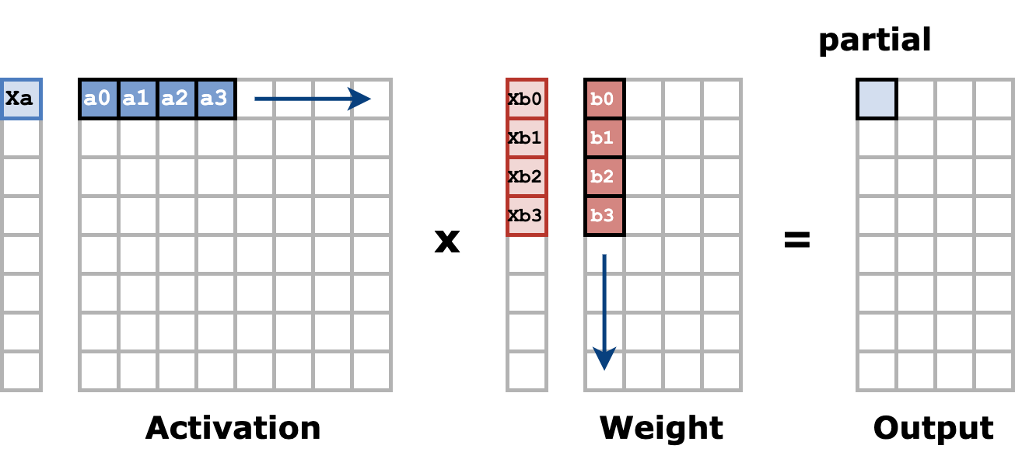
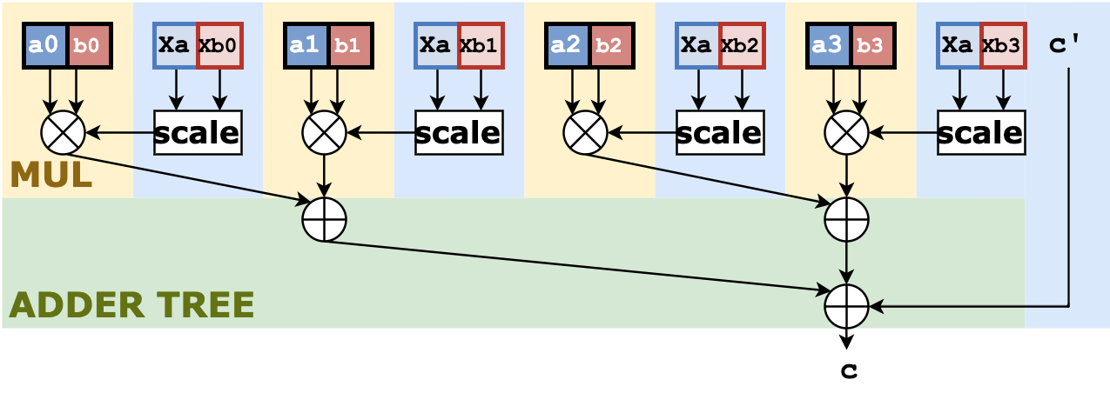
GEMM Quantization-axis Consideration
Rows of the weight matrix
Scales need to be applied directly after MUL → duplicated logic
High bit-count (FP32) adder tree → large area footprint

Slide 12
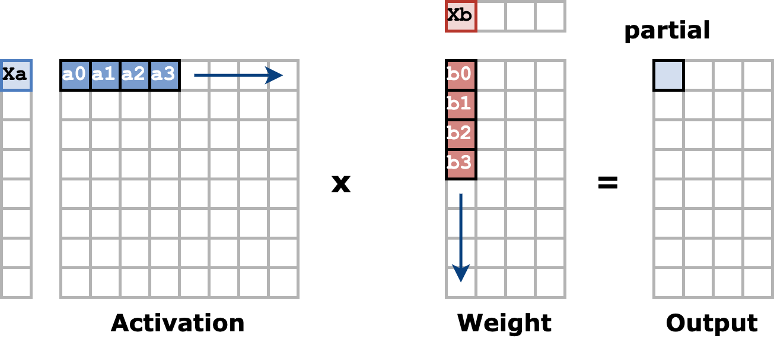
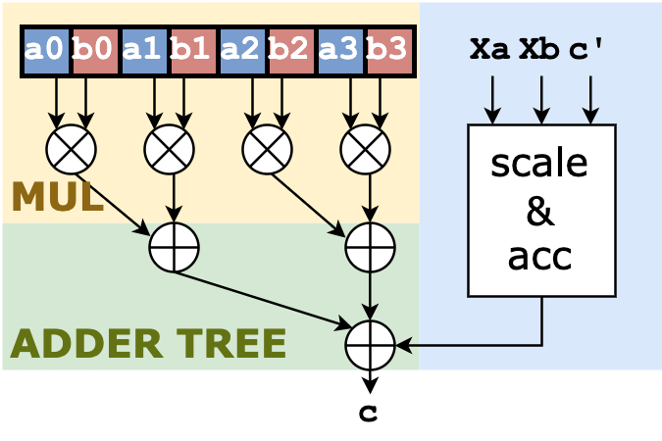
GEMM Quantization-axis Consideration
Columns of the weight matrix
Low-precision adder tree → area efficiency
The scales only need to be calculated and applied at the final stage

Slide 13
VMXDOTP

Slide 14
VMXDOTP

Slide 15
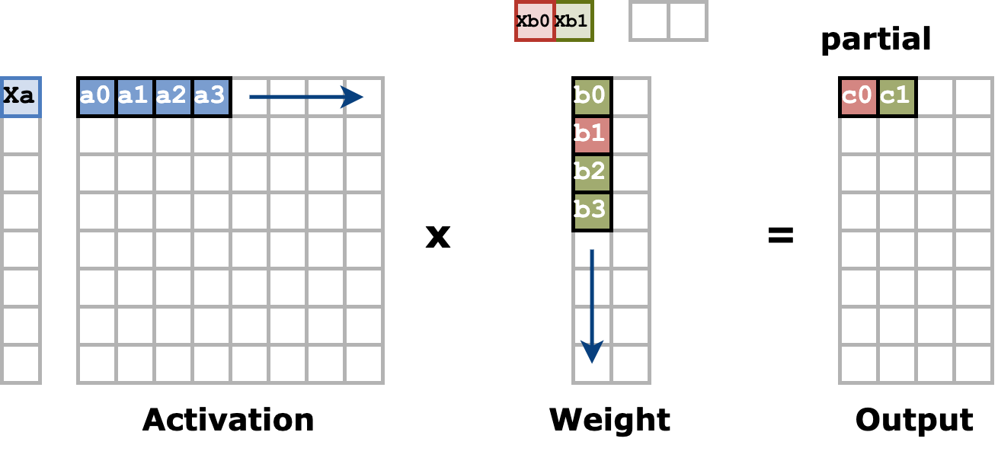
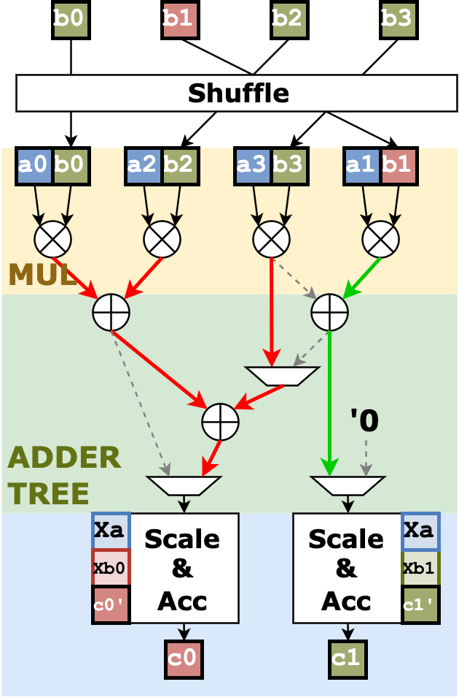
GEMM Sparsification-axis Consideration
2:4 format as an example
Orthogonal to the MX blocks
Columns of weight elements utilize distinct shared scales
An additional shuffling stage to group elements with the same scales together
Dynamic MAC unit linkage relies on N:M indices
Separate logic blocks for applying scales and accumulation
→ Difficult to scale for various N:M format and MX precisions

Slide 16
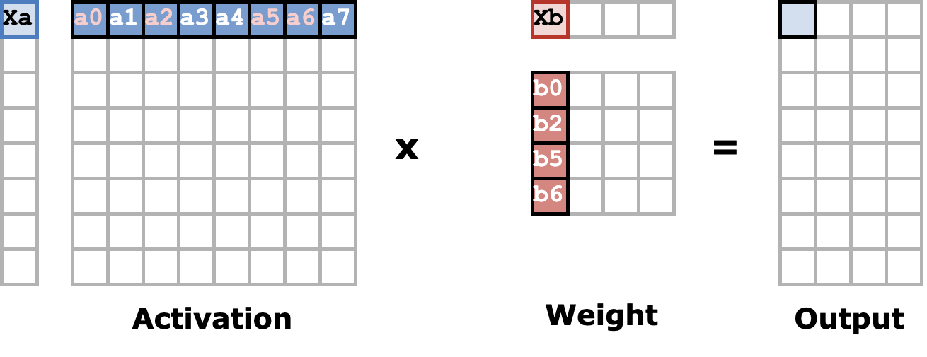
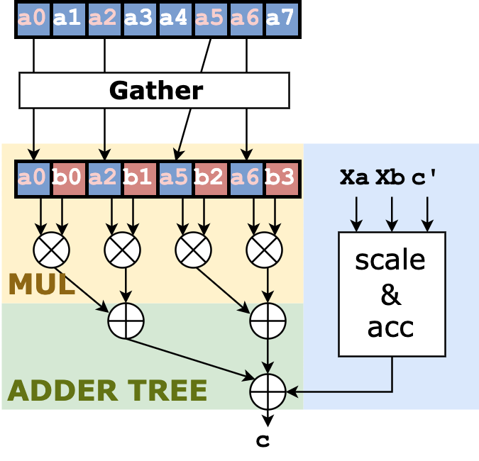
GEMM Sparsification-axis Consideration
2:4 format as an example
Aligned to the MX blocks
Columns of weight elements share the same MX scales
An additional gathering stage to group effective activation elements (same as the discussion in the N:M format handling)
MXDOTP datapath remains unchanged
Compatible with both N:M and MX formarts

Slide 17
Takeaways
Gustavson-based dataflow with ADDMUL operation group
Lower throughput with widening instructions
An additional conversion step (FP8→FP16) is required to align with the OCP MX specification
Compatible with high-sparse activation tensors (i.e., top-k, top-theta)
Mixed-type dataflow with MXDOTP operation group
Inner product per FPU
2x throughput increment compared with ADDMUL options
Weight matrix column-wise quantization is required for area and energy efficiency
Sparsification is aligned with the quantization direction for scalability

Slide 18
Roadmap
Model compression techniques revisit
Pruning
Weight structured/unstructured pruning
Activation (token) unstructured pruning
Attention (KV pruning)
Low-precision quantization
Block quantization with MX format – Outlier handling
Vector quantization*
Proposed handling mechanism
Discussion

Slide 19
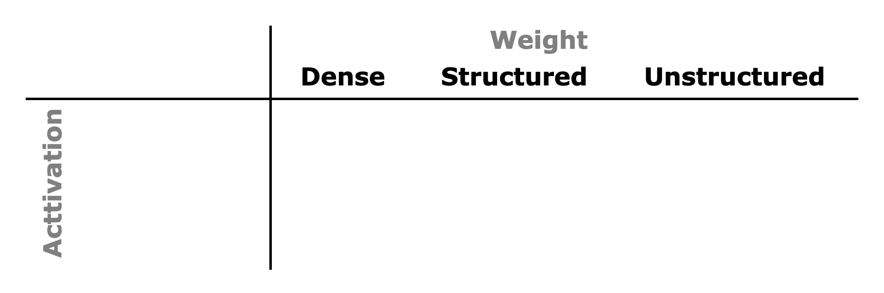
Weight Pruning
Structured pruning
Strictly removing structured sets of parameters
SoA methods^{[1][2]}: 50%-75% sparsity rate
Unstructured pruning
Arbitrary patterns of sparsification for parameters
SoA methods^{[3]}: 90% sparsity rate without performance drop

Slide 20
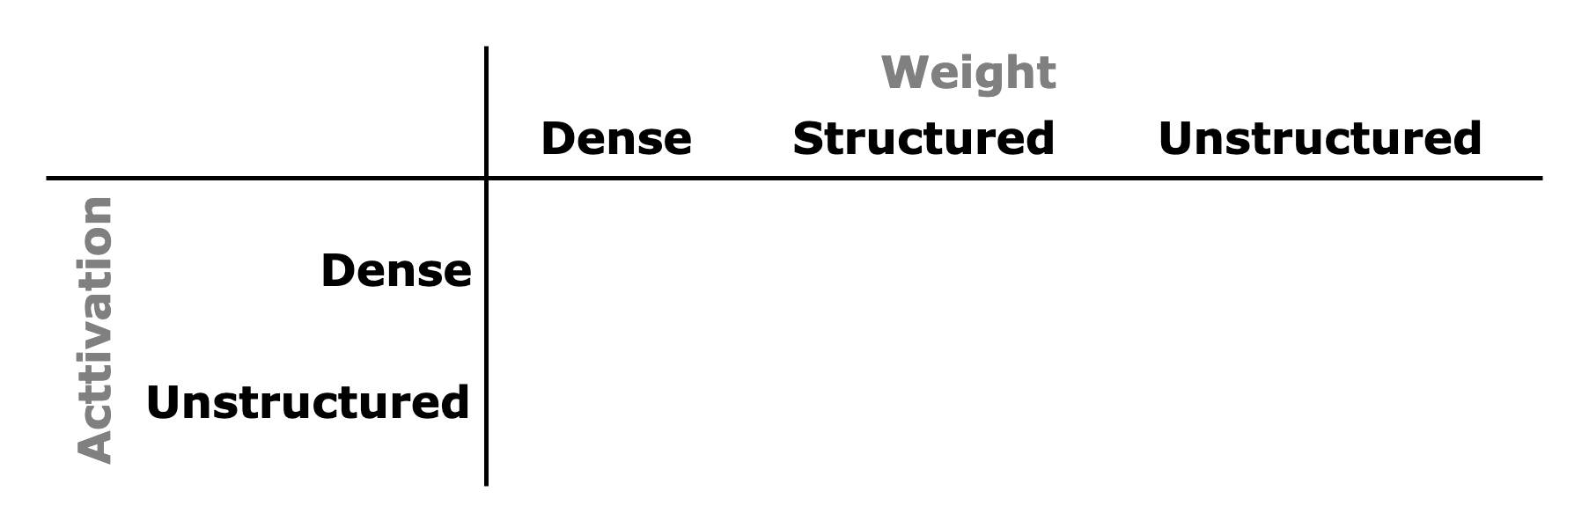
Activation Pruning
Unstructured pruning
Dynamically detect and zero out unimportant activations at run-time
In Transformer inference, the mainstream branch of activation pruning is token pruning^{[4][5]}
Detects and drops less important tokens in each Transformer layer from the rest of the inference
Result: Reduced sequence length → No impact on PE handling with inner-product or Gustav-based dataflow

Slide 21
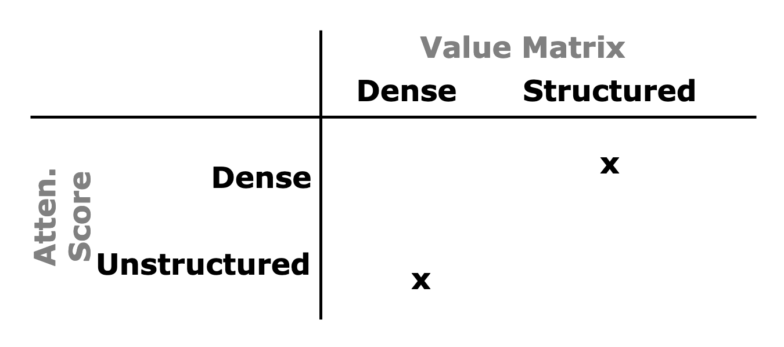
Attention Pruning (Sparse Attention)
Unstructured pruning
Leverage the dynamic sparsity patterns of the attention score activations
Many combinations of query and key tokens are not semantically meaningful^{[6][7]}
Keep the Top-k largest attention score activations (unstructured attention score)
Keep the corresponding rows of the Value matrix (row-wise structured sparsity)

Slide 22
Low-precision quantization
Block quantization with MX formats
Uniform quantization: splits the floating-point domain into evenly spaced intervals and maps each interval into a single value → activation outliers^{[8]}
Non-uniform quantization: no requirement for the intervals to be evenly spaced → circumvent the activation outlier issue^{[9]}
MX format is block-level uniform, global non-uniform quantization
Vector quantization(VQ) is non-uniform quantization
Weight outliers still need to be handled
The majority of the weight elements can be compressed to 3-4 bits, while less than 1% outliers (unstructured sparse) are stored in FP16^{[10]}

Slide 23
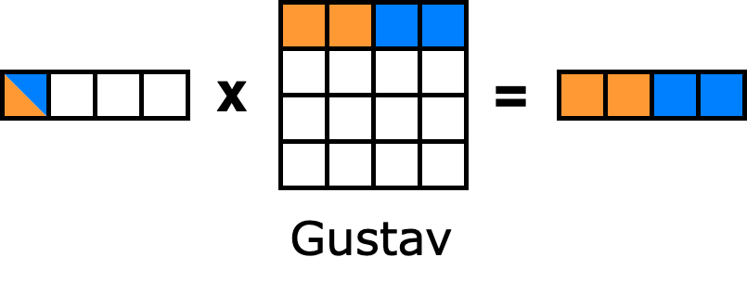
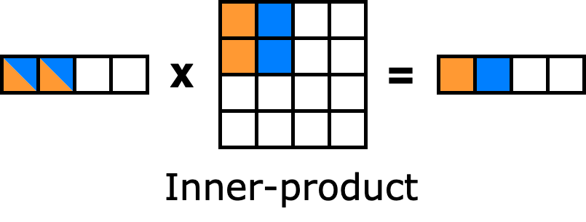
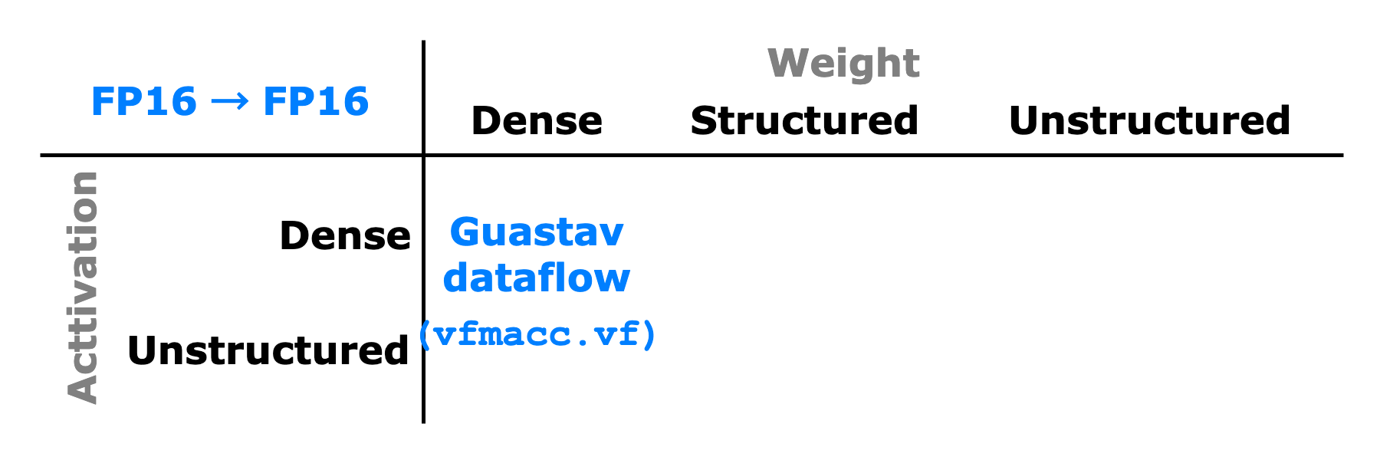
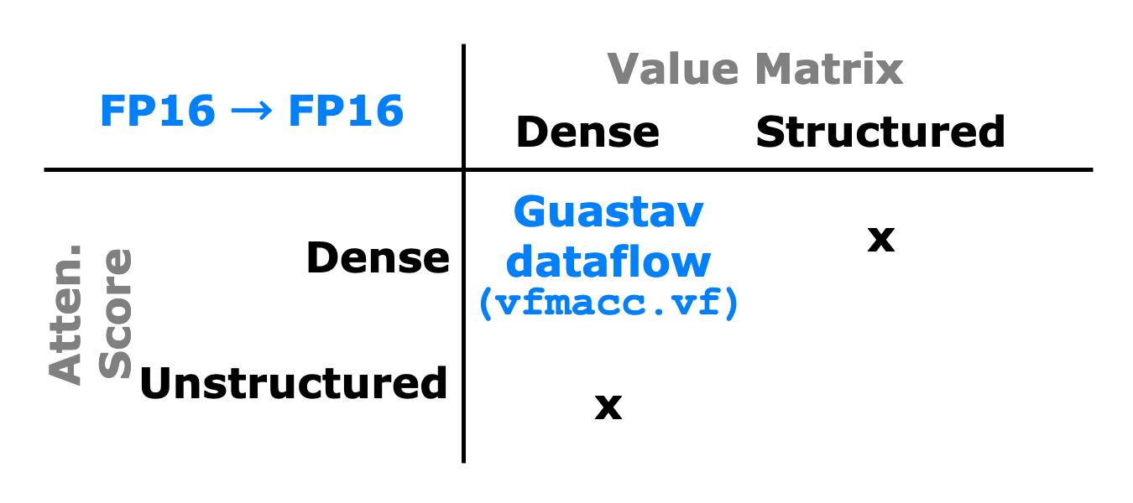
Proposed Solution: Sparsity Handling
Dense-Dense
Gustav-based dataflow with ADDMUL operation group
Inner-product dataflow with ADDMUL operation group requires a reduction stage

Slide 24
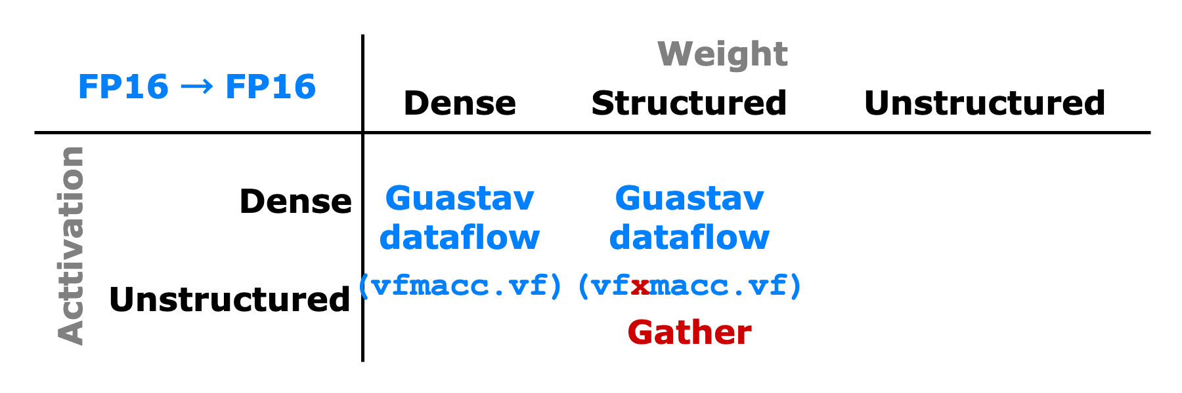
Proposed Solution: Sparsity Handling
Dense-Structured
Gustav-based dataflow with ADDMUL operation group
Utilize the indexed-macc operation
Remove the index translation between the N:M format and RVV spec
Modeled in GVSoC, with one important insight → Efficient VRF gather operation required

Slide 25
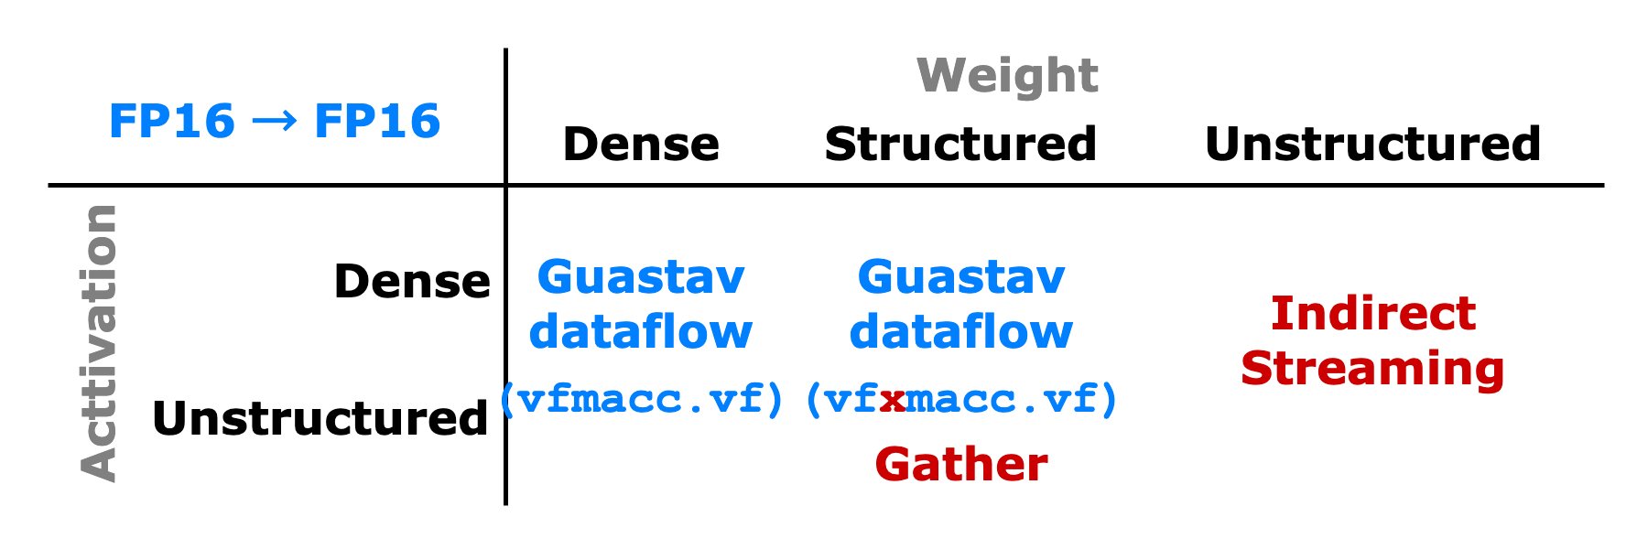
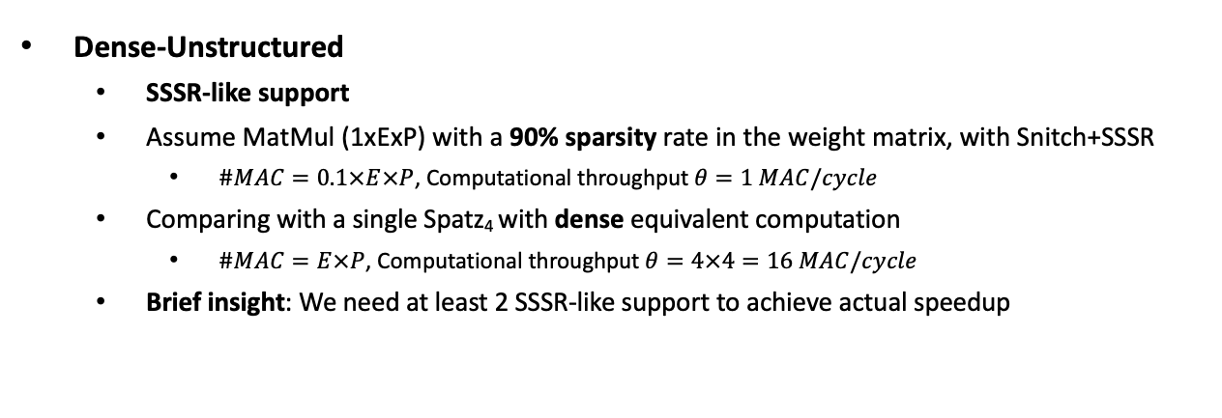
Proposed Solution: Sparsity Handling
Dense-Unstructured
SSSR-like support
Assume MatMul (1xExP) with a 90% sparsity rate in the weight matrix, with Snitch+SSSR
$\#MAC=0.1×E×P$, Computational throughput $θ=1 MAC/cycle$
Comparing with a single Spatz₄ with dense equivalent computation
$\#MAC=E×P$, Computational throughput $θ=4×4=16 MAC/cycle$
Brief insight: We need at least 2 SSSR-like support to achieve actual speedup

Slide 26
Proposed Solution: Sparsity Handling
Current SSSR streaming limitation
The streaming units work on L1 bank-width granularity → underutilized bandwidth
Extend streaming units with lower control granularity, L1-to-SSSR gather operation
Potential SSSR integration
(P1) Heterogeneous cluster: Spatz and Snitch + SSSR, unstructured workload map to SSSR
(P2) Vector streaming processor: reformulate Spatz VLSU and VRF
Notes:
address generate replication + chaining, bypass the VRF

Slide 27
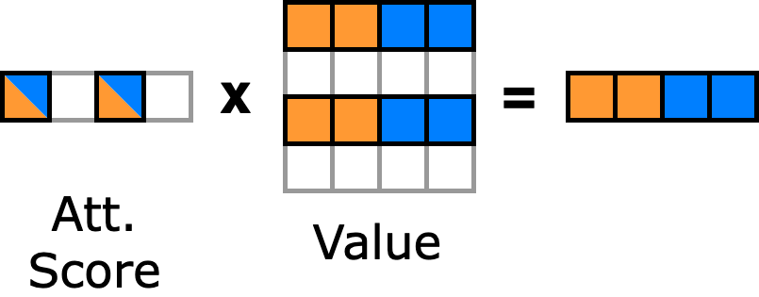
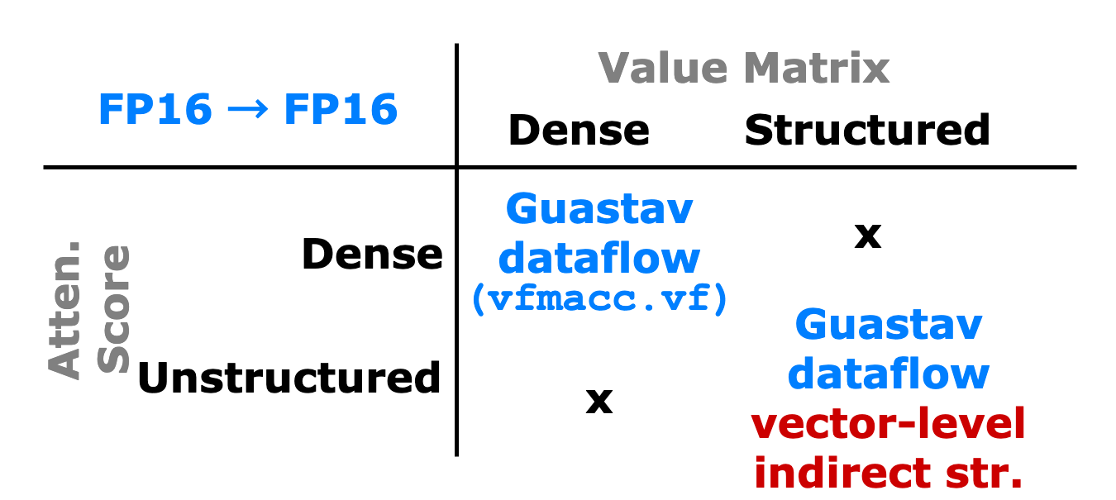
Proposed Solution: Sparsity Handling
Sparse attention
Fundamentally, still a ‘dense’ GEMV
PE level, still handled by scalar-vector multiplication, with Gustav-based dataflow
The vectors of Value matrix should be loaded according to the top-k attention score indices → Vector-level loading/indirect streaming

Slide 28
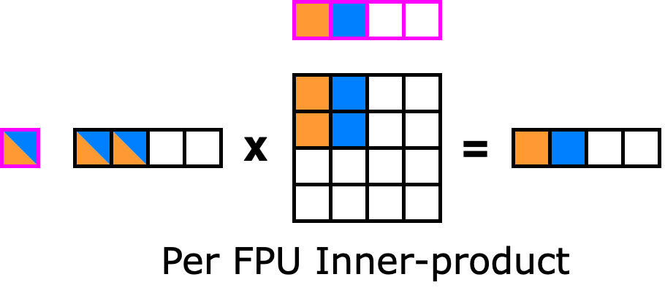
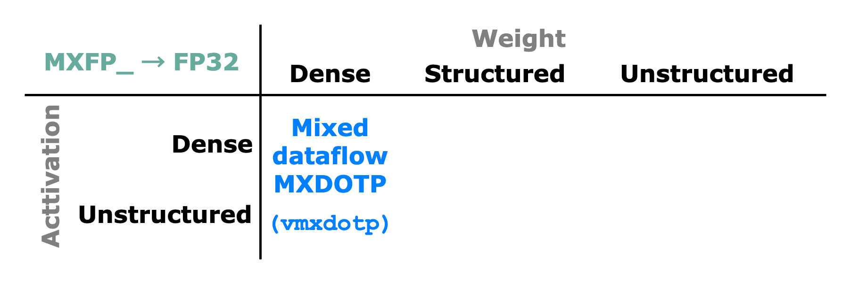
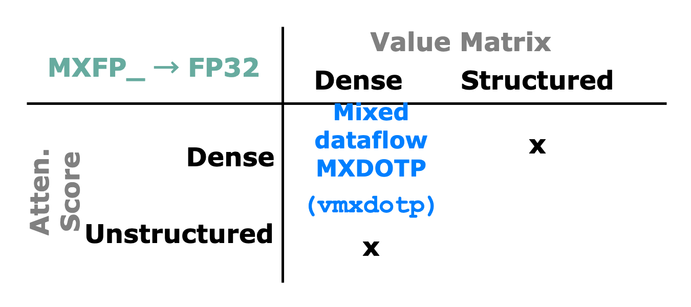
Proposed Solution: Sparsity + Block Quantization
MX Dense-Dense (ignoring the outliers)
Per FPU inner-product dataflow, per Spatz mixed (inner+Gustav) dataflow
Row-wise quantized activation, column-wise quantized weight
Highlight the requirement for online MX quantization (FP32 → MXFP8)
Notes:
memory load section speed up
not focus to much the computation speed up from MX

Slide 29
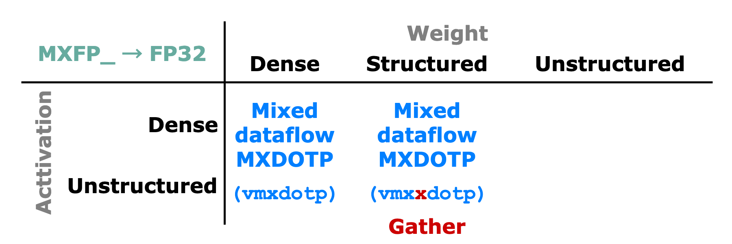
Proposed Solution: Sparsity + Block Quantization
MX Dense-Structured (ignoring the outliers)
The pruning direction needs to align with the quantization direction
MXDOTP operation group can be reused without modification
Gather operation support in VRF

Slide 30
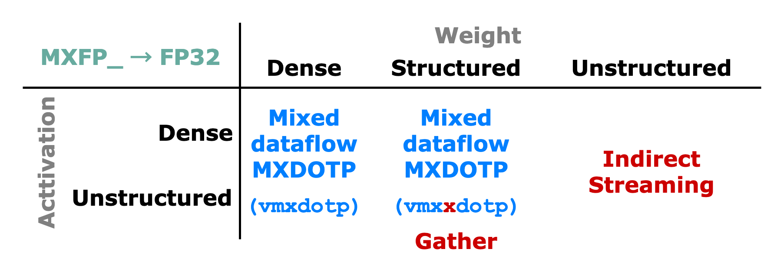
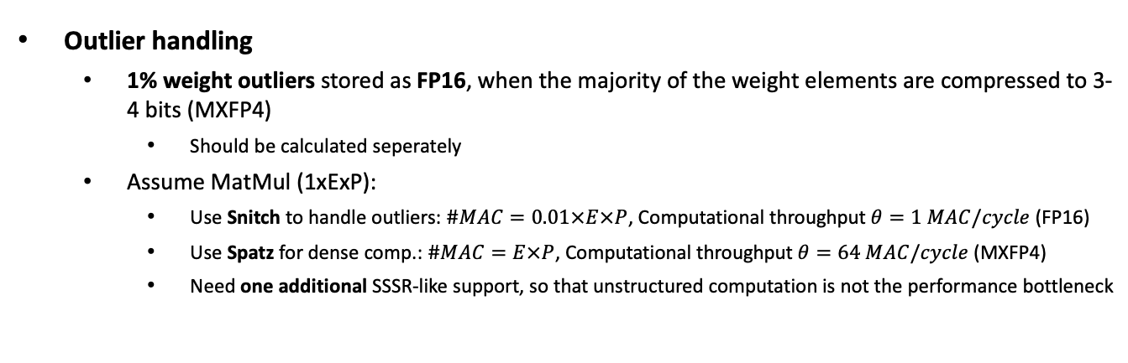
Proposed Solution: Sparsity + Block Quantization
Outlier handling
1% weight outliers stored as FP16, when the majority of the weight elements are compressed to 3-4 bits (MXFP4)
Should be calculated seperately
Assume MatMul (1xExP):
Use Snitch to handle outliers: $\#MAC=0.01×E×P$, Computational throughput $θ=1 MAC/cycle$ (FP16)
Use Spatz for dense comp.: $\#MAC=E×P$, Computational throughput $θ=64 MAC/cycle$ (MXFP4)
Need one additional SSSR-like support, so that unstructured computation is not the performance bottleneck

Slide 31
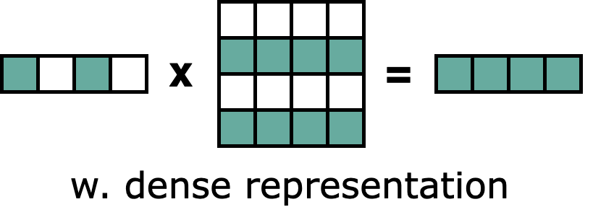
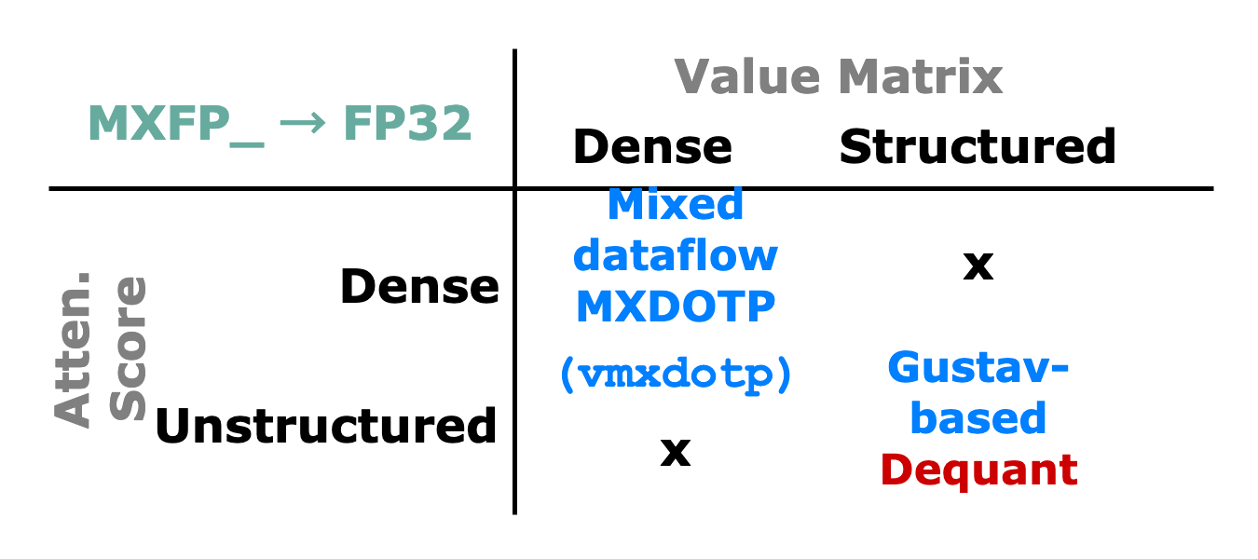
Proposed Solution: Sparsity + Block Quantization
Sparse Attention + MX
Value matrix is MX-quantized after the KQV Gen stage, stored back in HBM
Top-k selection determines rows of the Value matrix load back to L1 → Dequantize
Computation with FP16, much less data movement overhead
Notes:
quantizagtion after transaction does not make sense
dont bring in the unnecessary data (latency - throughput tradeoff)
we drop the
We just quantized value matrix for transfer, load back and dequantized it (good idea)
memory save is the key!!!

Slide 32
Roadmap

Slide 33
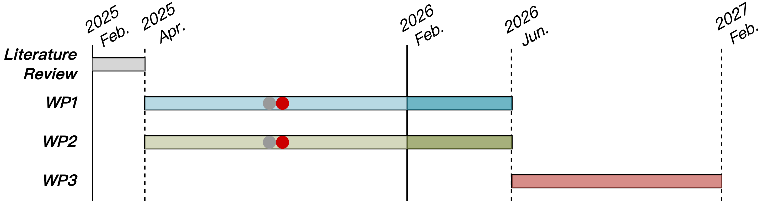
Progress Update
WP1
MX, N:M format co-consideration

Slide 34
References
[1] Bita, Rouhani, et. al., “OCP Microscaling Formats (MX) Specification, Version 1.0.” [Online]. Available: https://www.opencompute.org/documents/ocp-microscaling-formats-mx-v1-0-spec-final-pdf
[2] İslamoğlu, Gamze, et al. "MXDOTP: A RISC-V ISA Extension for Enabling Microscaling (MX) Floating-Point Dot Products." arXiv preprint arXiv:2505.13159 (2025).

Slide 35
References
[1] Xia, M, et al. "Structured pruning learns compact and accurate models." arXiv preprint arXiv:2204.00408 (2022).
[2] Sun, Mingjie, et al. "A simple and effective pruning approach for large language models." arXiv preprint arXiv:2306.11695 (2023).
[3] Kurtic, Eldar, et al. "The optimal bert surgeon: Scalable and accurate second-order pruning for large language models." arXiv preprint arXiv:2203.07259 (2022).
[4] Goyal, Saurabh, et al. "Power-bert: Accelerating bert inference via progressive word-vector elimination." International Conference on Machine Learning. PMLR, 2020.
[5] Kim, Gyuwan, and Kyunghyun Cho. "Length-adaptive transformer: Train once with length drop, use anytime with search." arXiv preprint arXiv:2010.07003 (2020).
[6] Gupta, Ankit, et al. "Memory-efficient Transformers via Top-$ k $ Attention." arXiv preprint arXiv:2106.06899 (2021).
[7] Berestizshevsky, Konstantin, et al. "Top-theta attention: Sparsifying transformers by compensated thresholding." arXiv preprint arXiv:2502.08363 (2025).
[8] Kovaleva, Olga, et al. "BERT busters: Outlier dimensions that disrupt transformers." arXiv preprint arXiv:2105.06990 (2021).
[9] Zadeh, Ali Hadi, et al. "Gobo: Quantizing attention-based nlp models for low latency and energy efficient inference." 2020 53rd Annual IEEE/ACM International Symposium on Microarchitecture (MICRO). IEEE, 2020.
[10] Dettmers, Tim, et al. "Spqr: A sparse-quantized representation for near-lossless llm weight compression." arXiv preprint arXiv:2306.03078 (2023).

