Slide 1
QuantSparse 3D Biweekly 2025-09-24
Integrated Systems Laboratory (ETH Zürich)
Bowen Wang bowwang@iis.ee.ethz.ch Paul Scheffler paulsc@iis.ee.ethz.ch
Luca Benini lbenini@iis.ee.ethz.ch

Slide 2
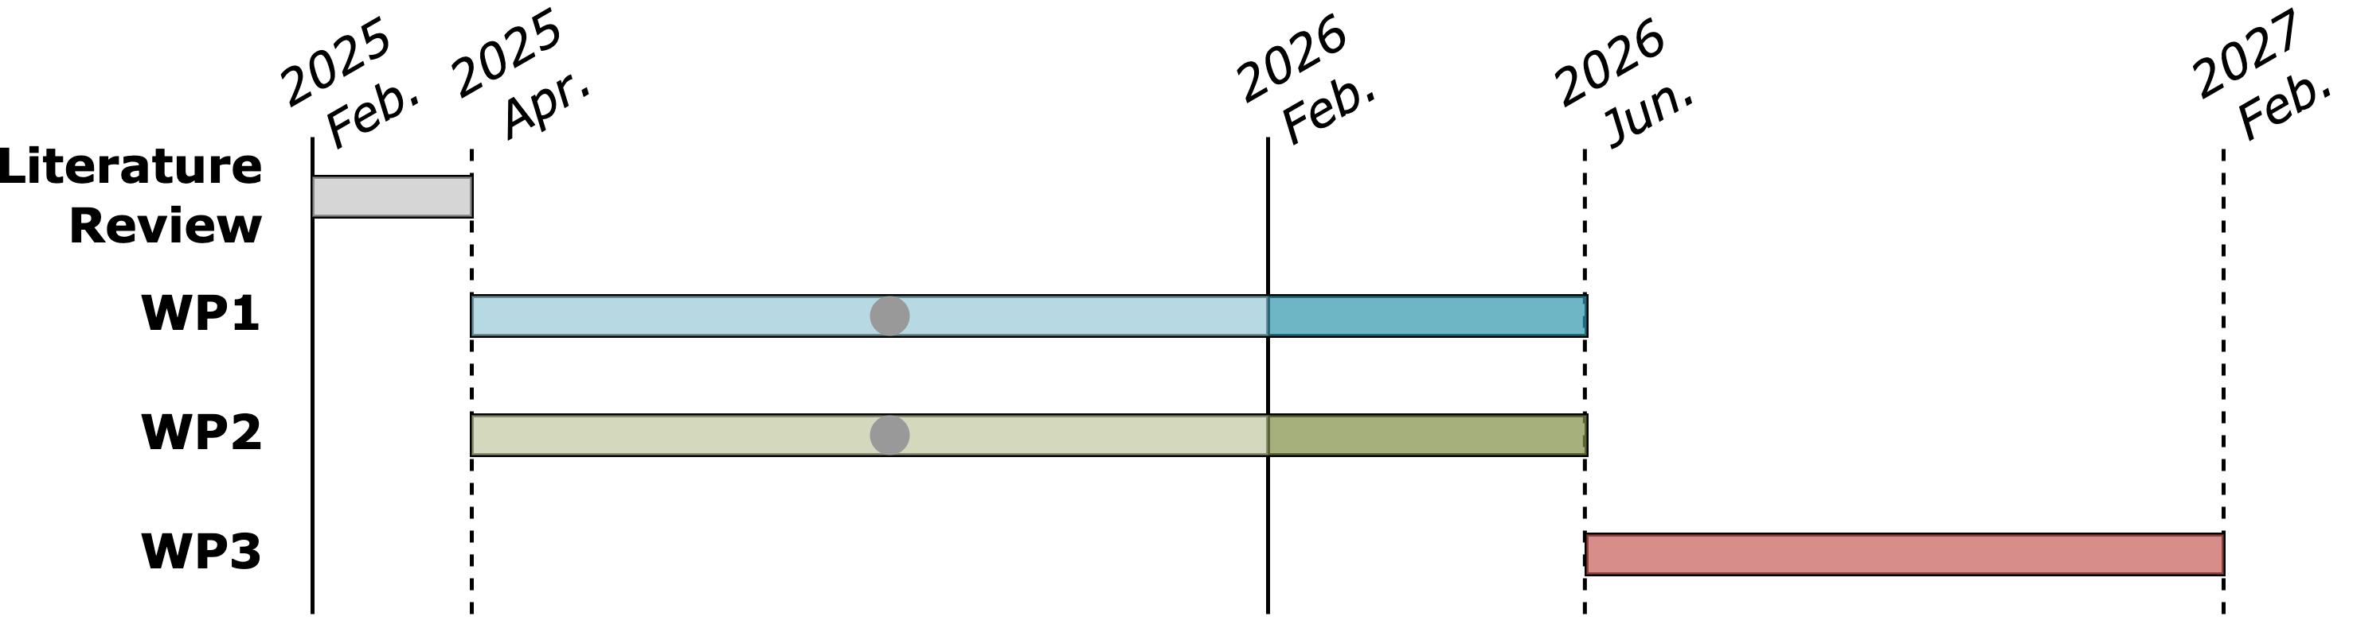
Progress Recap
WP1
Roadmap on efficient scatter/gather operation and unstructured data structure streaming

Slide 3
Agenda
Progress Update
Spatz VRF architecture
Efficient scatter/gather operation
Existing VSLDU-based design and limitations
Proposal 1: VRF reformulation
Proposal 2: Buffer-based design
Overhead analysis
Timeline
Discussion

Slide 4
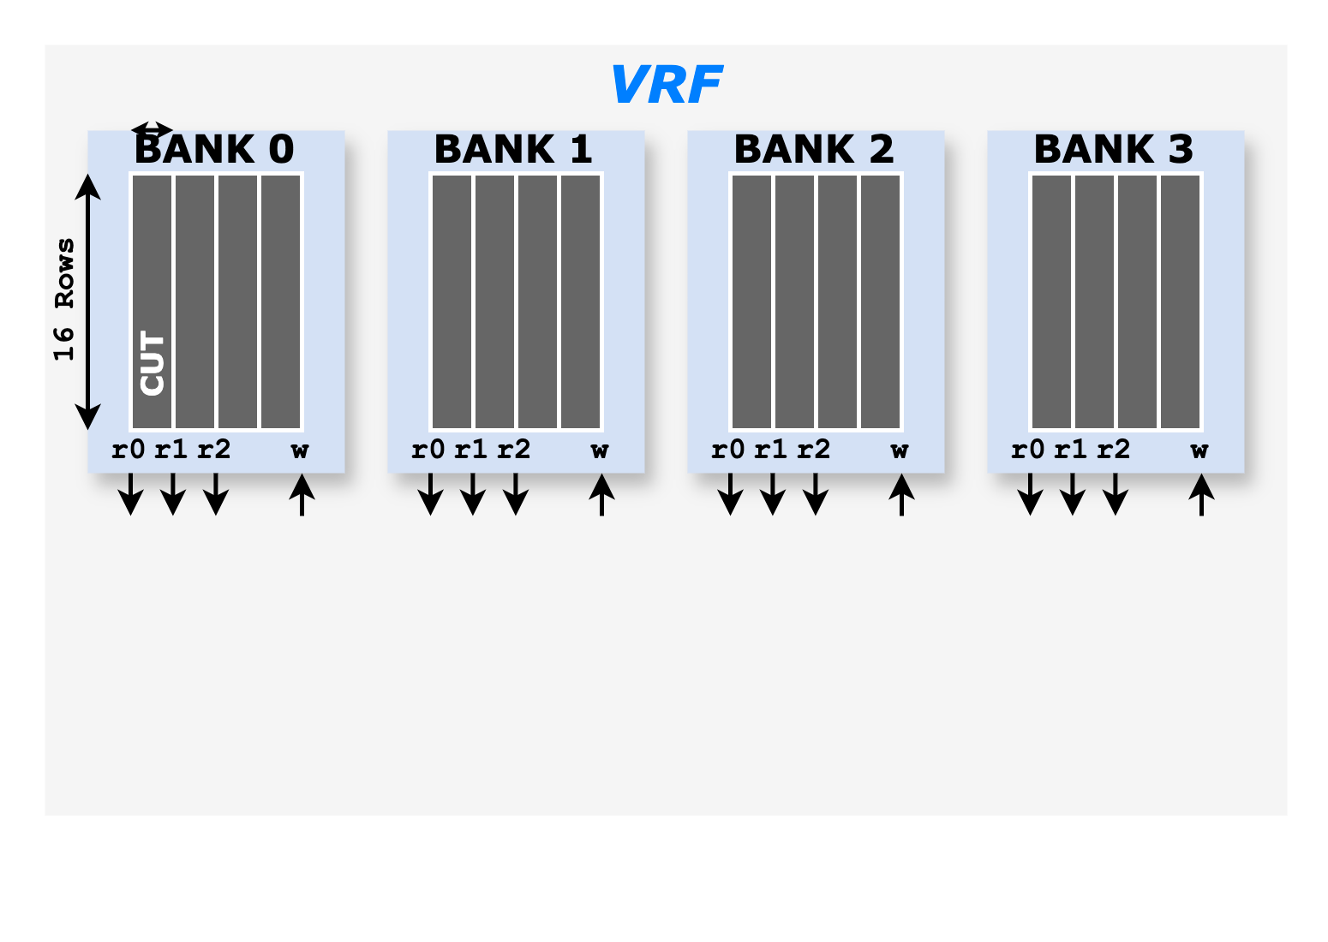
Spatz VRF Architecture
Spatz VRF is implemented as a multi-banked, multi-ported, latch-based standard cell memory SCM
32 VLENB bytes of the VRF are divided into four banks
three read ports and one write port (3R1W) → Provides enough bandwidth for executing vfmacc.vv instruction

Slide 5
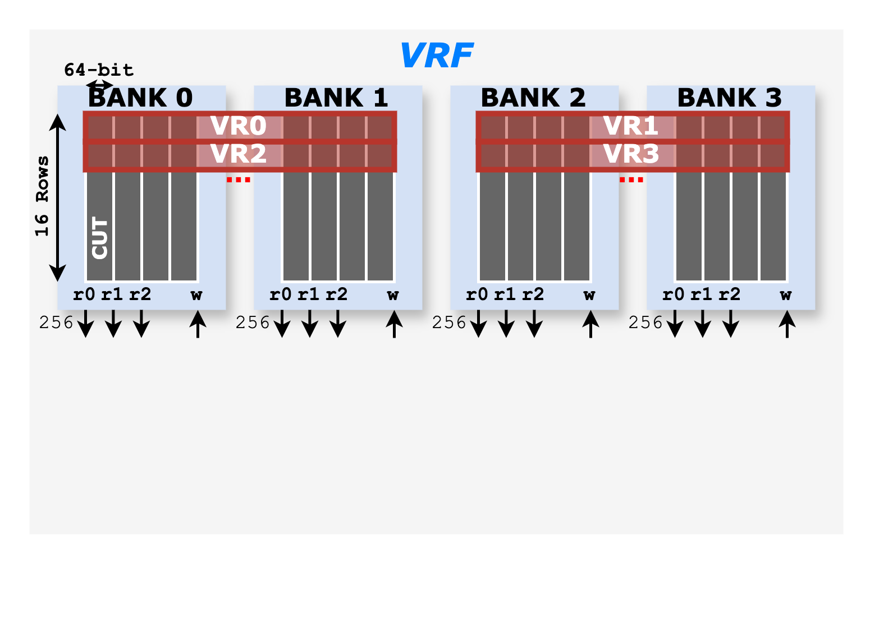
Spatz VRF Architecture
Spatz VRF is implemented as a multi-banked, multi-ported, latch-based standard cell memory (SCM)
32 VLENB bytes of the VRF are divided into four banks
three read ports and one write port (3R1W) → Provides enough bandwidth for executing vfmacc.vv instruction
Each with VLENB/2 byte width
In SoftHier, Spatz VLENB = 512 (i.e., 16 KiB VRF)

Slide 6
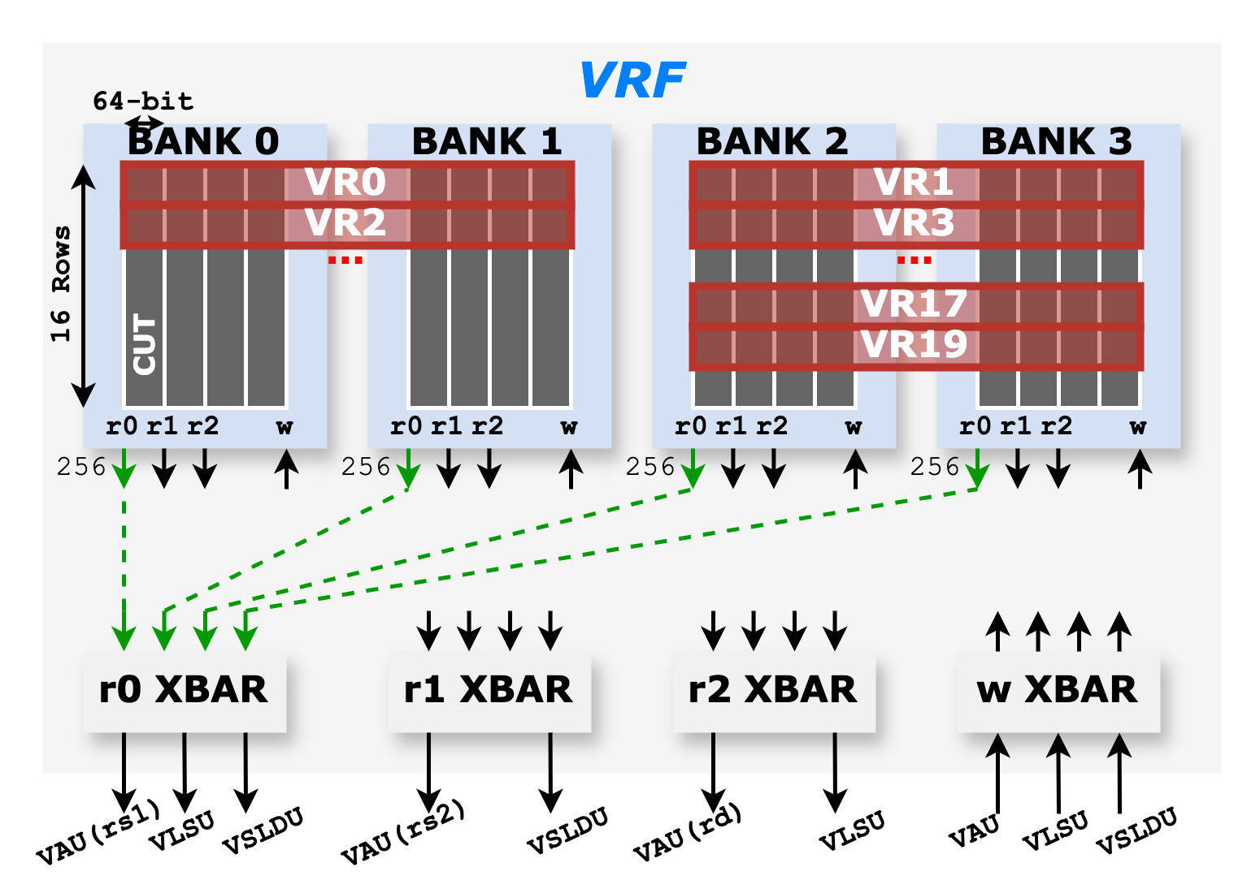
Spatz VRF Architecture
Spatz VRF is implemented as a multi-banked, multi-ported, latch-based standard cell memory (SCM)
32 VLENB bytes of the VRF are divided into four banks
three read ports and one write port (3R1W) → Provides enough bandwidth for executing vfmacc.vv instruction
Each with VLENB/2 byte width
In SoftHier, Spatz VLENB = 512 (i.e., 16 KiB VRF)
Spatz has three function units:
VAU: Vector Arithmetic Unit
VLSU: Vector Load/Store Unit
VSLDU: Vector Slides Unit

Slide 7
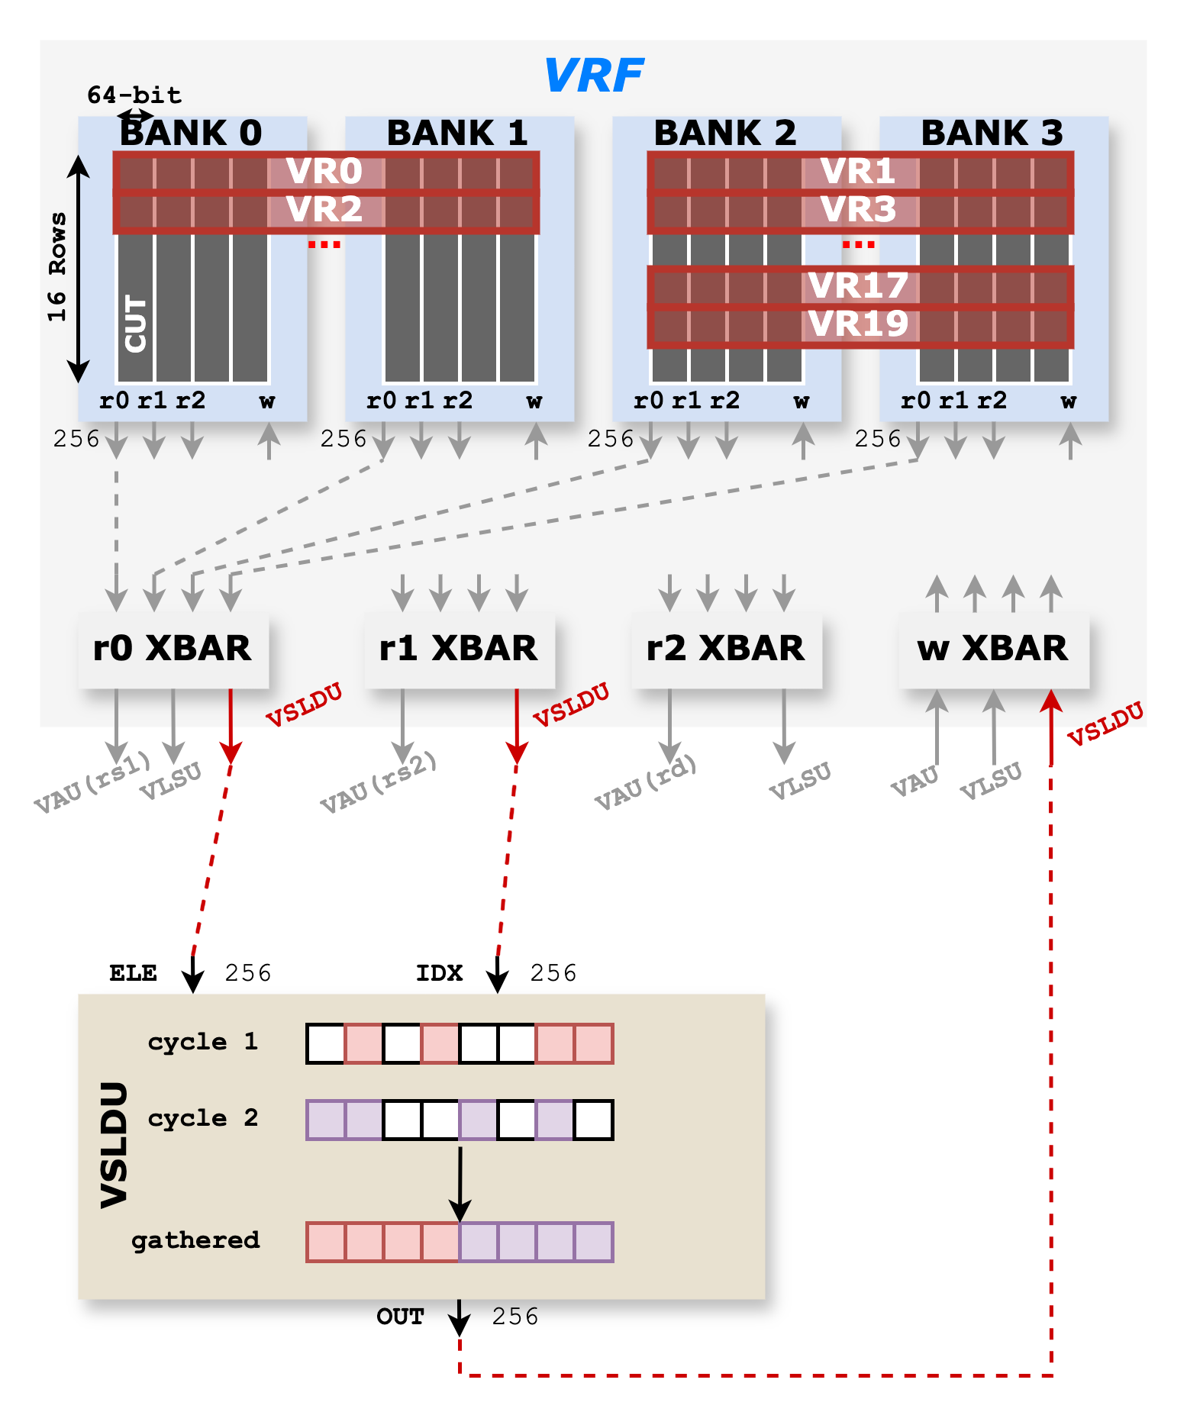
Sc/Ga Operation: Existing VSLDU-based design
Extended VSLDU with an additional port for indices
Support native N:M formats
Limitations:
Throughput bottleneck: With a 50% sparsity rate, Cycle 1 produces the upper-half gathered output, and Cycle 2 produces the lower-half
Lack of streaming: VSLDU gathers a vector from VRF, writes it back, and requires an additional read for arithmetic.
Insights:
Asymmetrical bandwidth required to feed VAU at full utilization
Streamlined Sc/Ga operation with arithmetic

Slide 8
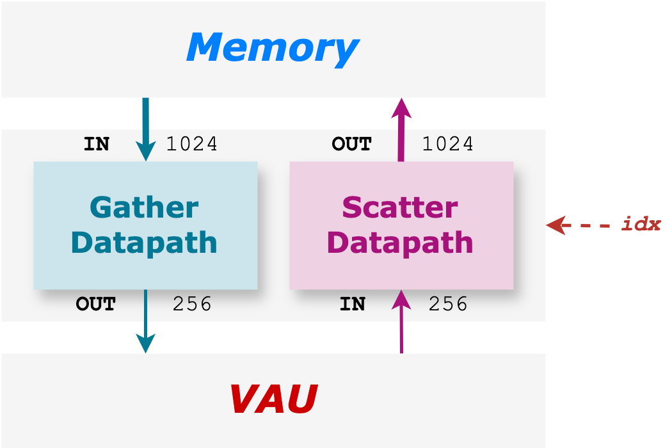
Design Requirements
Based on Spatz:
Asymmetrical bandwidth required to feed VAU at full utilization
Streamlined Sc/Ga operation with arithmetic
Support up to 75% sparsity ratio (e.g., 1:4), aligned with SoA studies → Gather: input bandwidth 4× the output port Scatter: output bandwidth 4× the input port

Slide 9
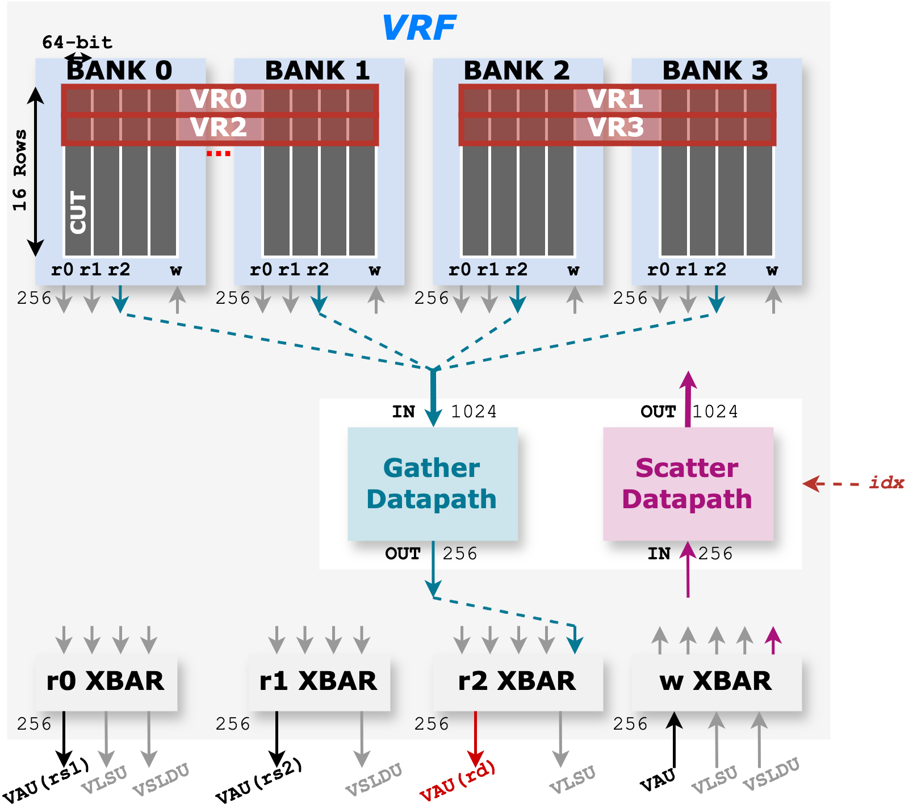
Inserting Sc/Ga Datapath into VRF
Gather effective elements from VRF
1024-bit input, 256-bit output datapath
r2 port of all banks will be occupied @ 75% sparsity rate → VLSU port can be re-routed to r1 XBar

Slide 10

Inserting Sc/Ga Datapath into VRF
Gather effective elements from VRF
1024-bit input, 256-bit output datapath
r2 port of all banks will be occupied @ 75% sparsity rate → VLSU port can be re-routed to r1 XBar
Scatter effective elements to VRF
256-bit input, 1024-bit output datapath
w port of all banks will be occupied @ 75% sparsity rate → VLSU and VSLDU cannot write back to VRF (port conflict)

Slide 11
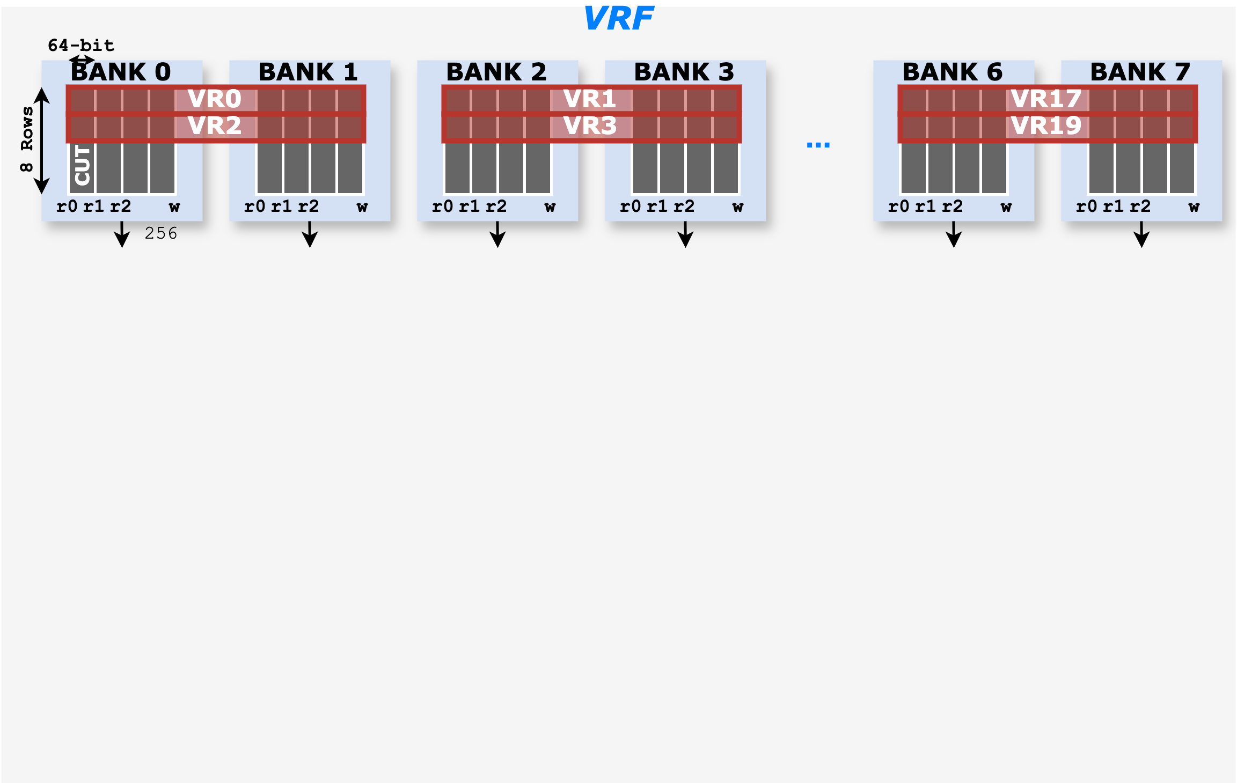
Proposal 1: VRF Reformulation
To resolve the scattered-write port conflict
Double the number of banks 4 → 8

Slide 12
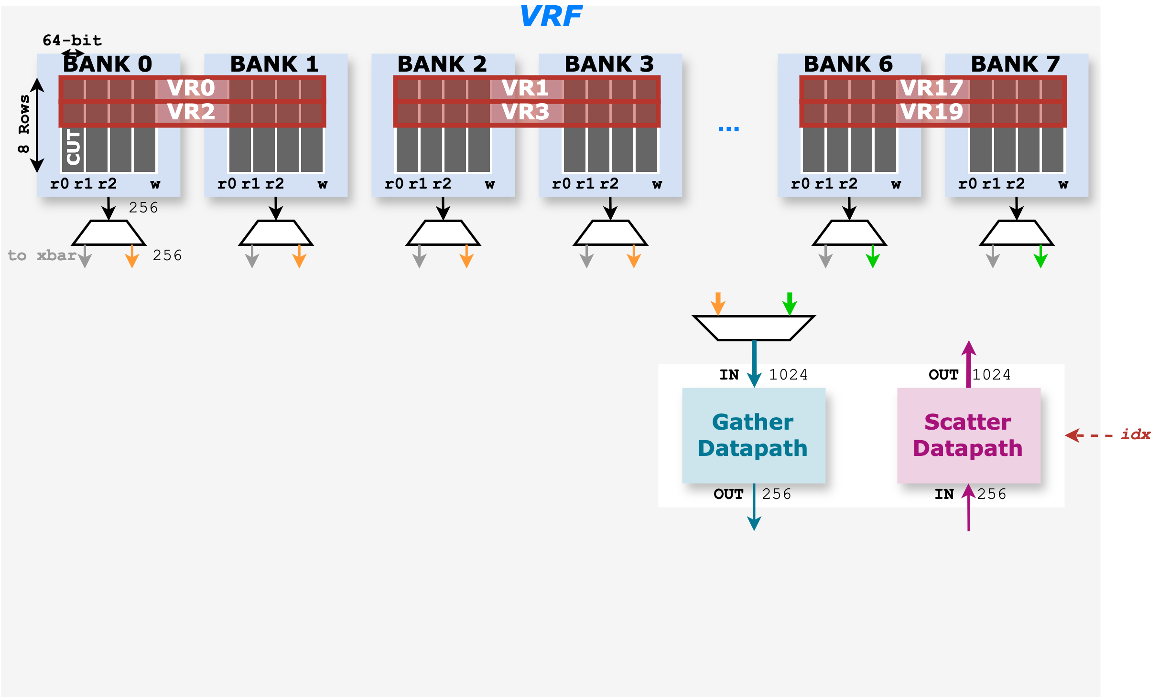
Proposal 1: VRF Reformulation
To resolve the scattered-write port conflict
Double the number of banks 4 → 8
The gather datapath steers to the upper or lower four banks
Depends on VRF mapping

Slide 13
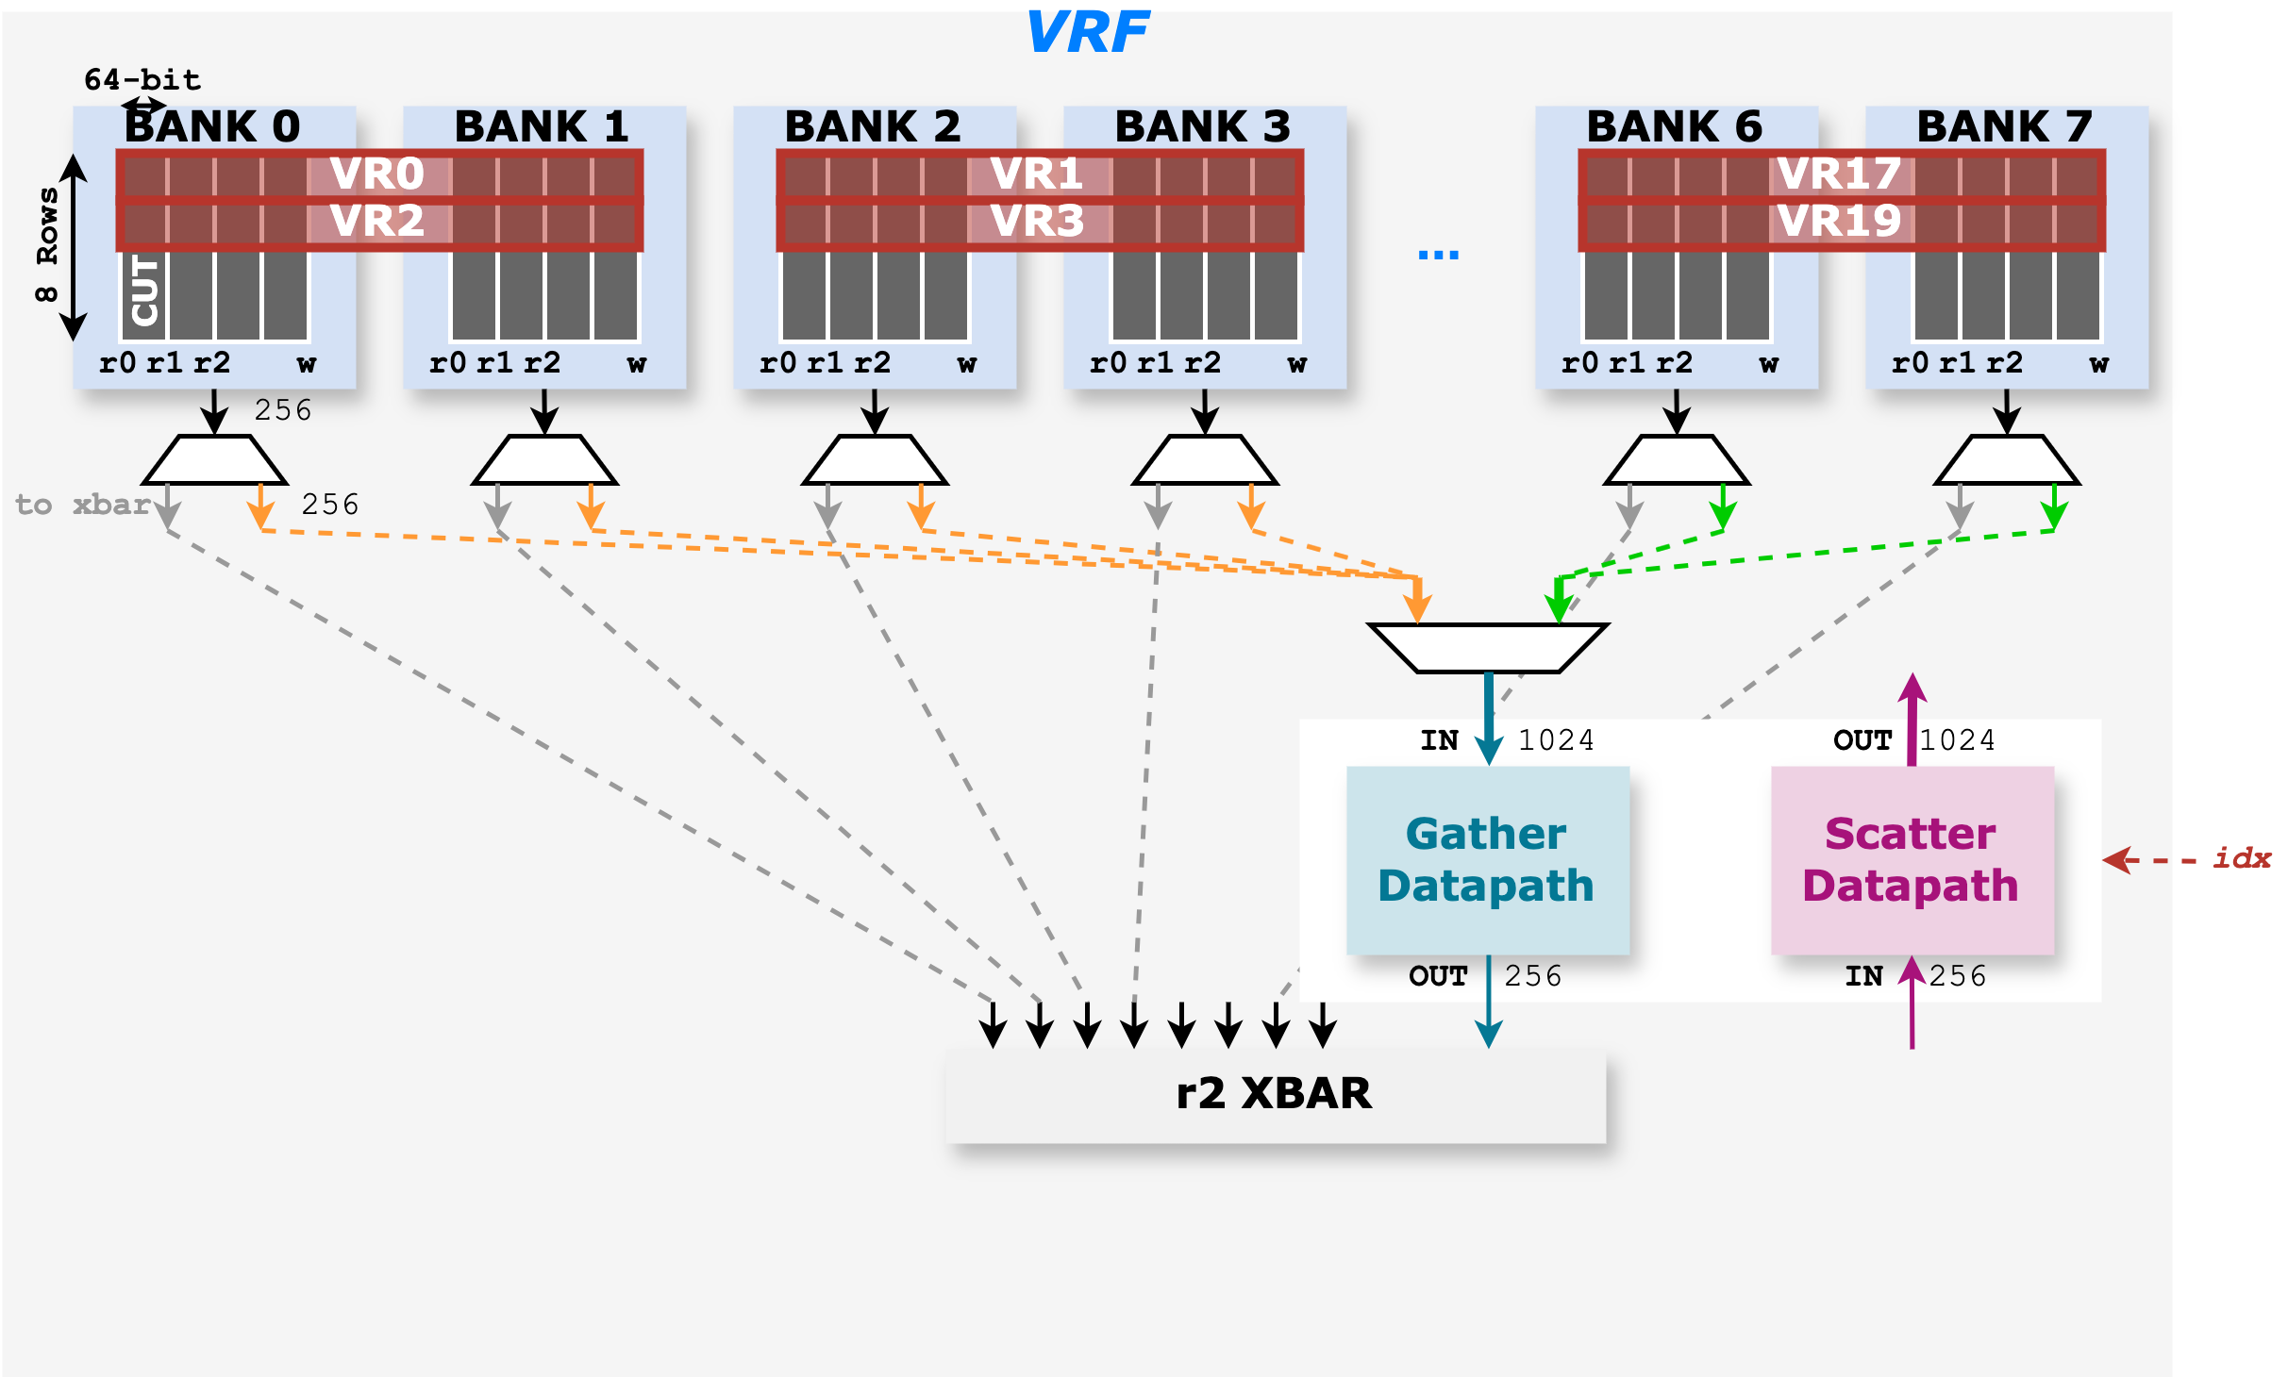
Proposal 1: VRF Reformulation
To resolve the scattered-write port conflict
Double the number of banks 4 → 8
The gather datapath steers to the upper or lower four banks
Depends on VRF mapping
Expanded crossbar
For doubled memory banks and the additional gather datapath

Slide 14
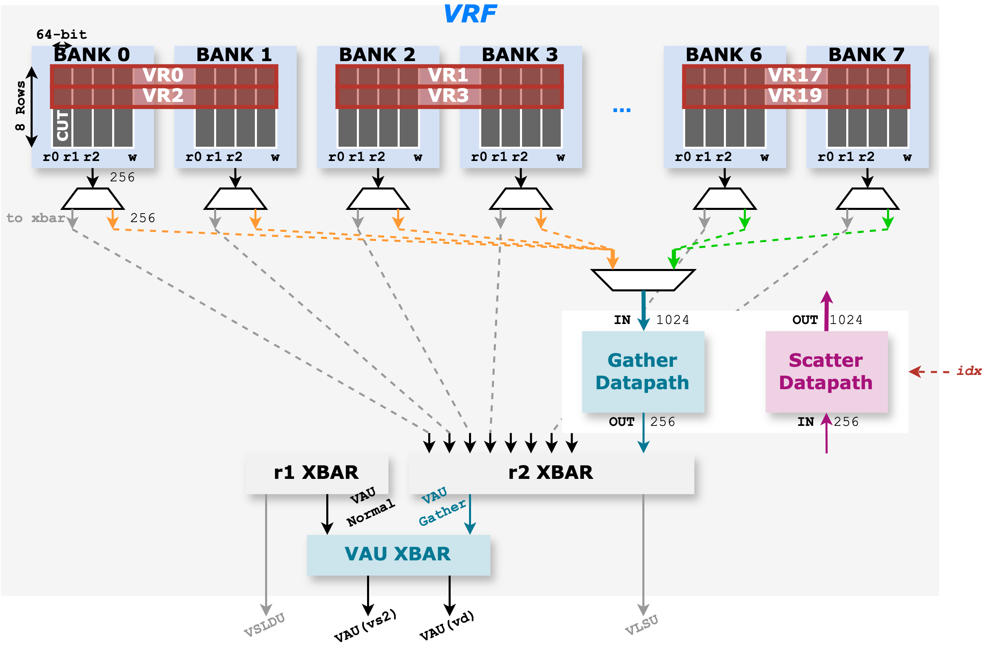
Proposal 1: VRF Reformulation
To resolve the scattered-write port conflict
Double the number of banks 4 → 8
The gather datapath steers to the upper or lower four banks
Depends on VRF mapping
Expanded crossbar
For doubled memory banks and the additional gather datapath
Additional crossbar for VAU routing
Gustav: gather for accumulated outputs (vd)
Inner-product: gather for input activations (vs2)

Slide 15
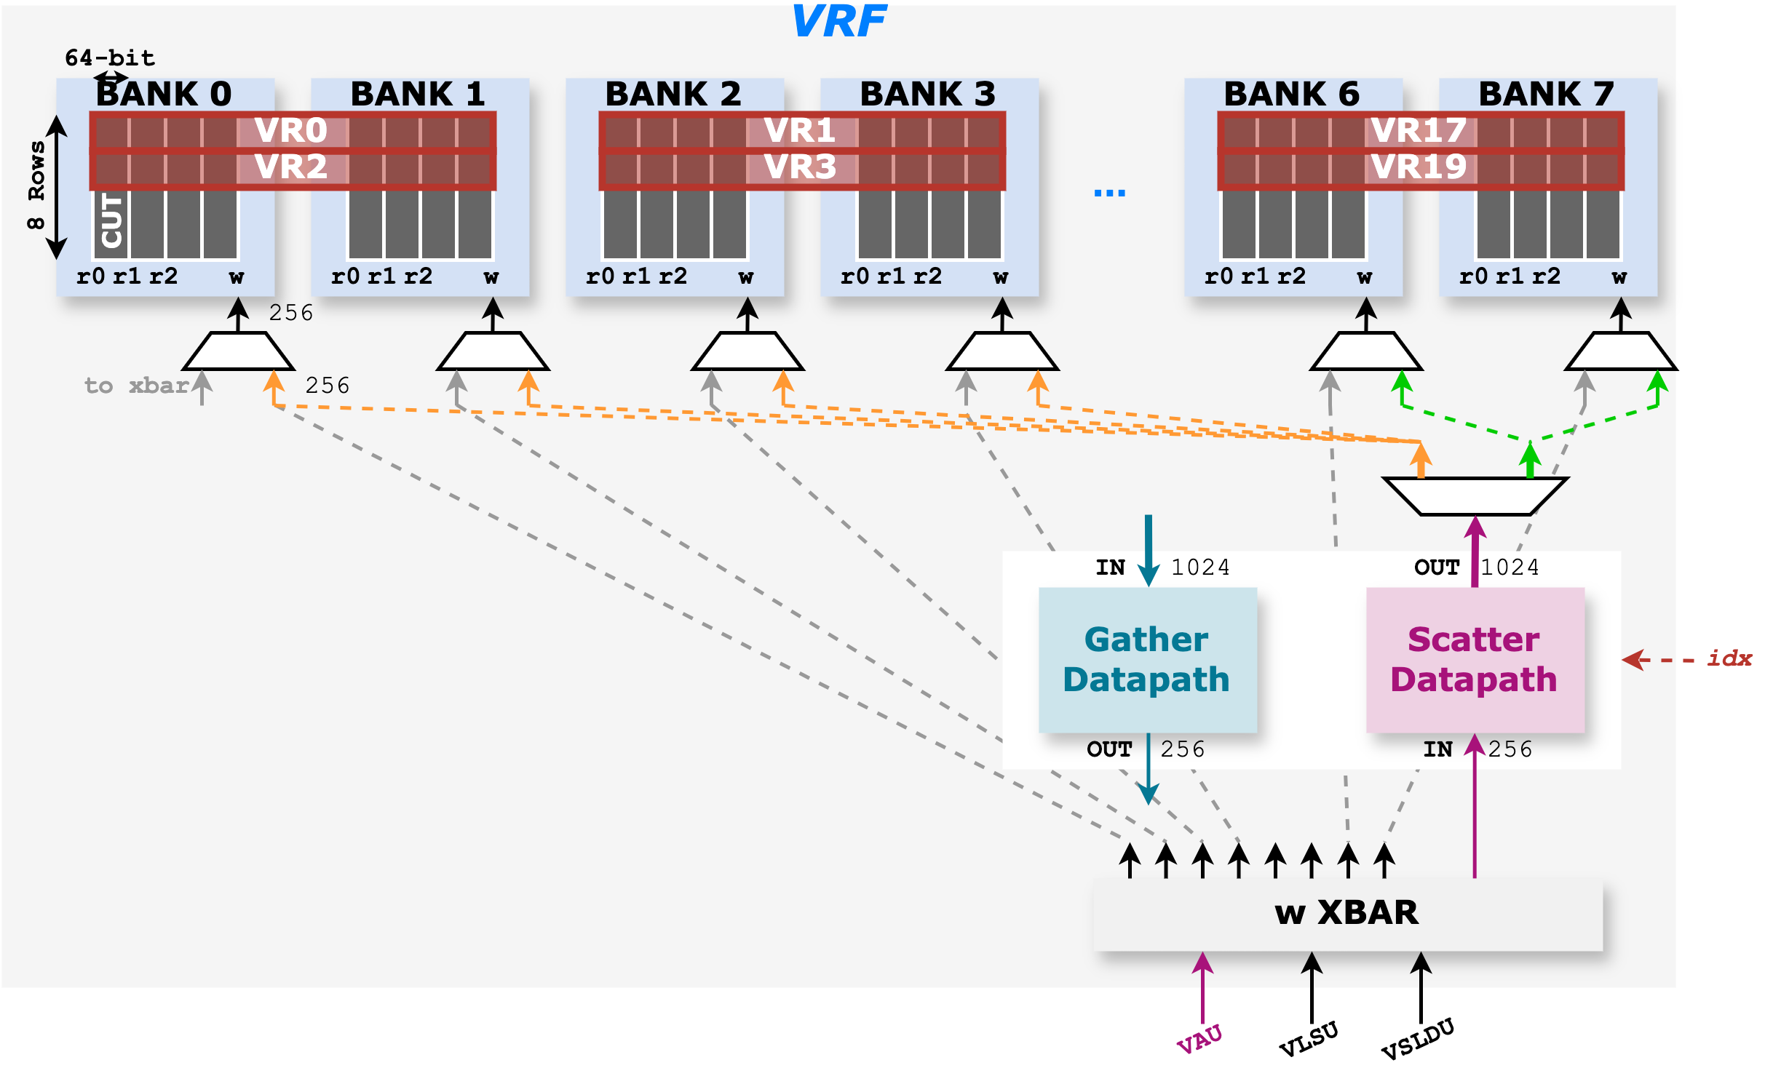
Proposal 1: VRF Reformulation
To resolve the scattered-write port conflict
Double the number of banks 4 → 8
The gather datapath steers to the upper or lower four banks
Depends on VRF mapping
Expanded crossbar
For doubled memory banks and the additional gather datapath
Additional crossbar for VAU routing
Gustav: gather for accumulated outputs (vd)
Inner-product: gather for input activations (vs2)
Similar architecture for the w datapath

Slide 16
Proposal 1: VRF Reformulation
Hardware overhead analysis
Sixteen 256-bit (1x2) and two 1024-bit (1x2) MUX/DEMUX from banks to the Sc/Ga datapath
r0/r1 crossbar: 256-bit (4x2) →256-bit (8x2); r2 crossbar: 256-bit (4x2) →256-bit (9x2); w crossbar: .256-bit (3x4) → 256-bit (3x9)
VAU routing: 256-bit (2x2) crossbar
Scatter/Gather datapath

Slide 17
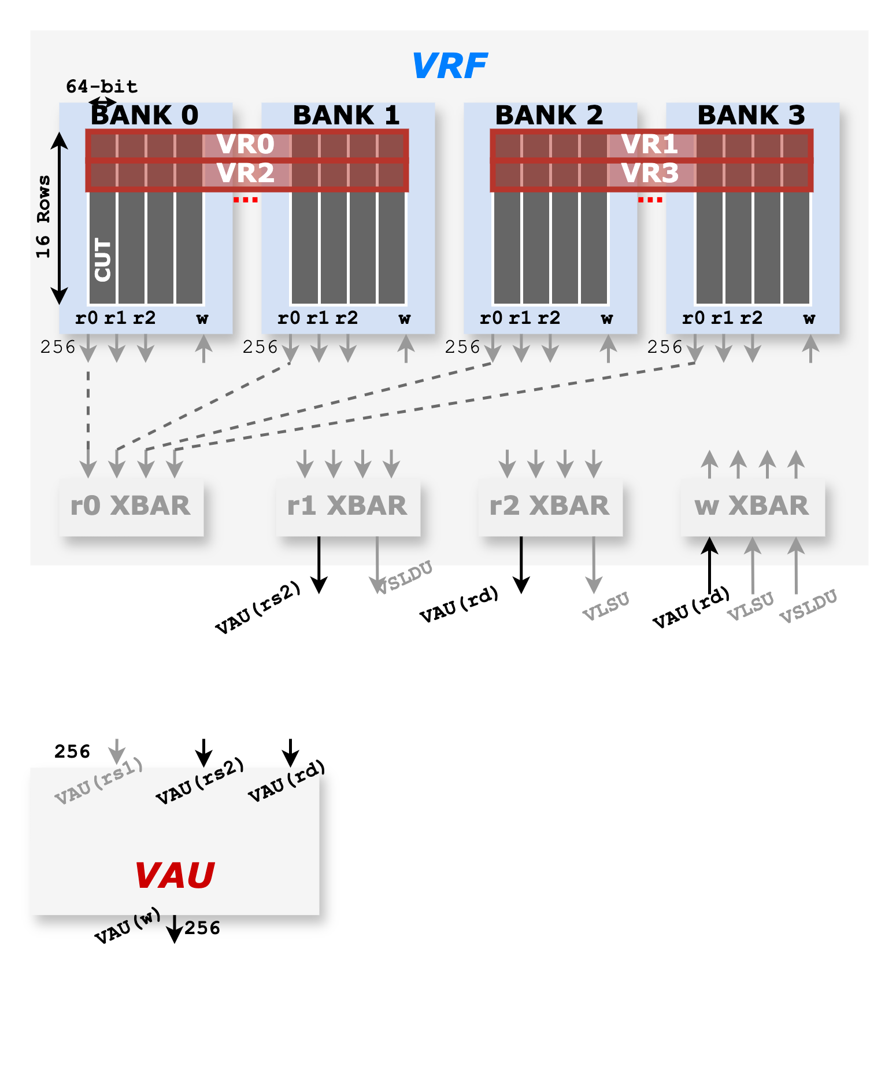
Proposal 2: Buffer-based Design
VRF remains unchanged

Slide 18
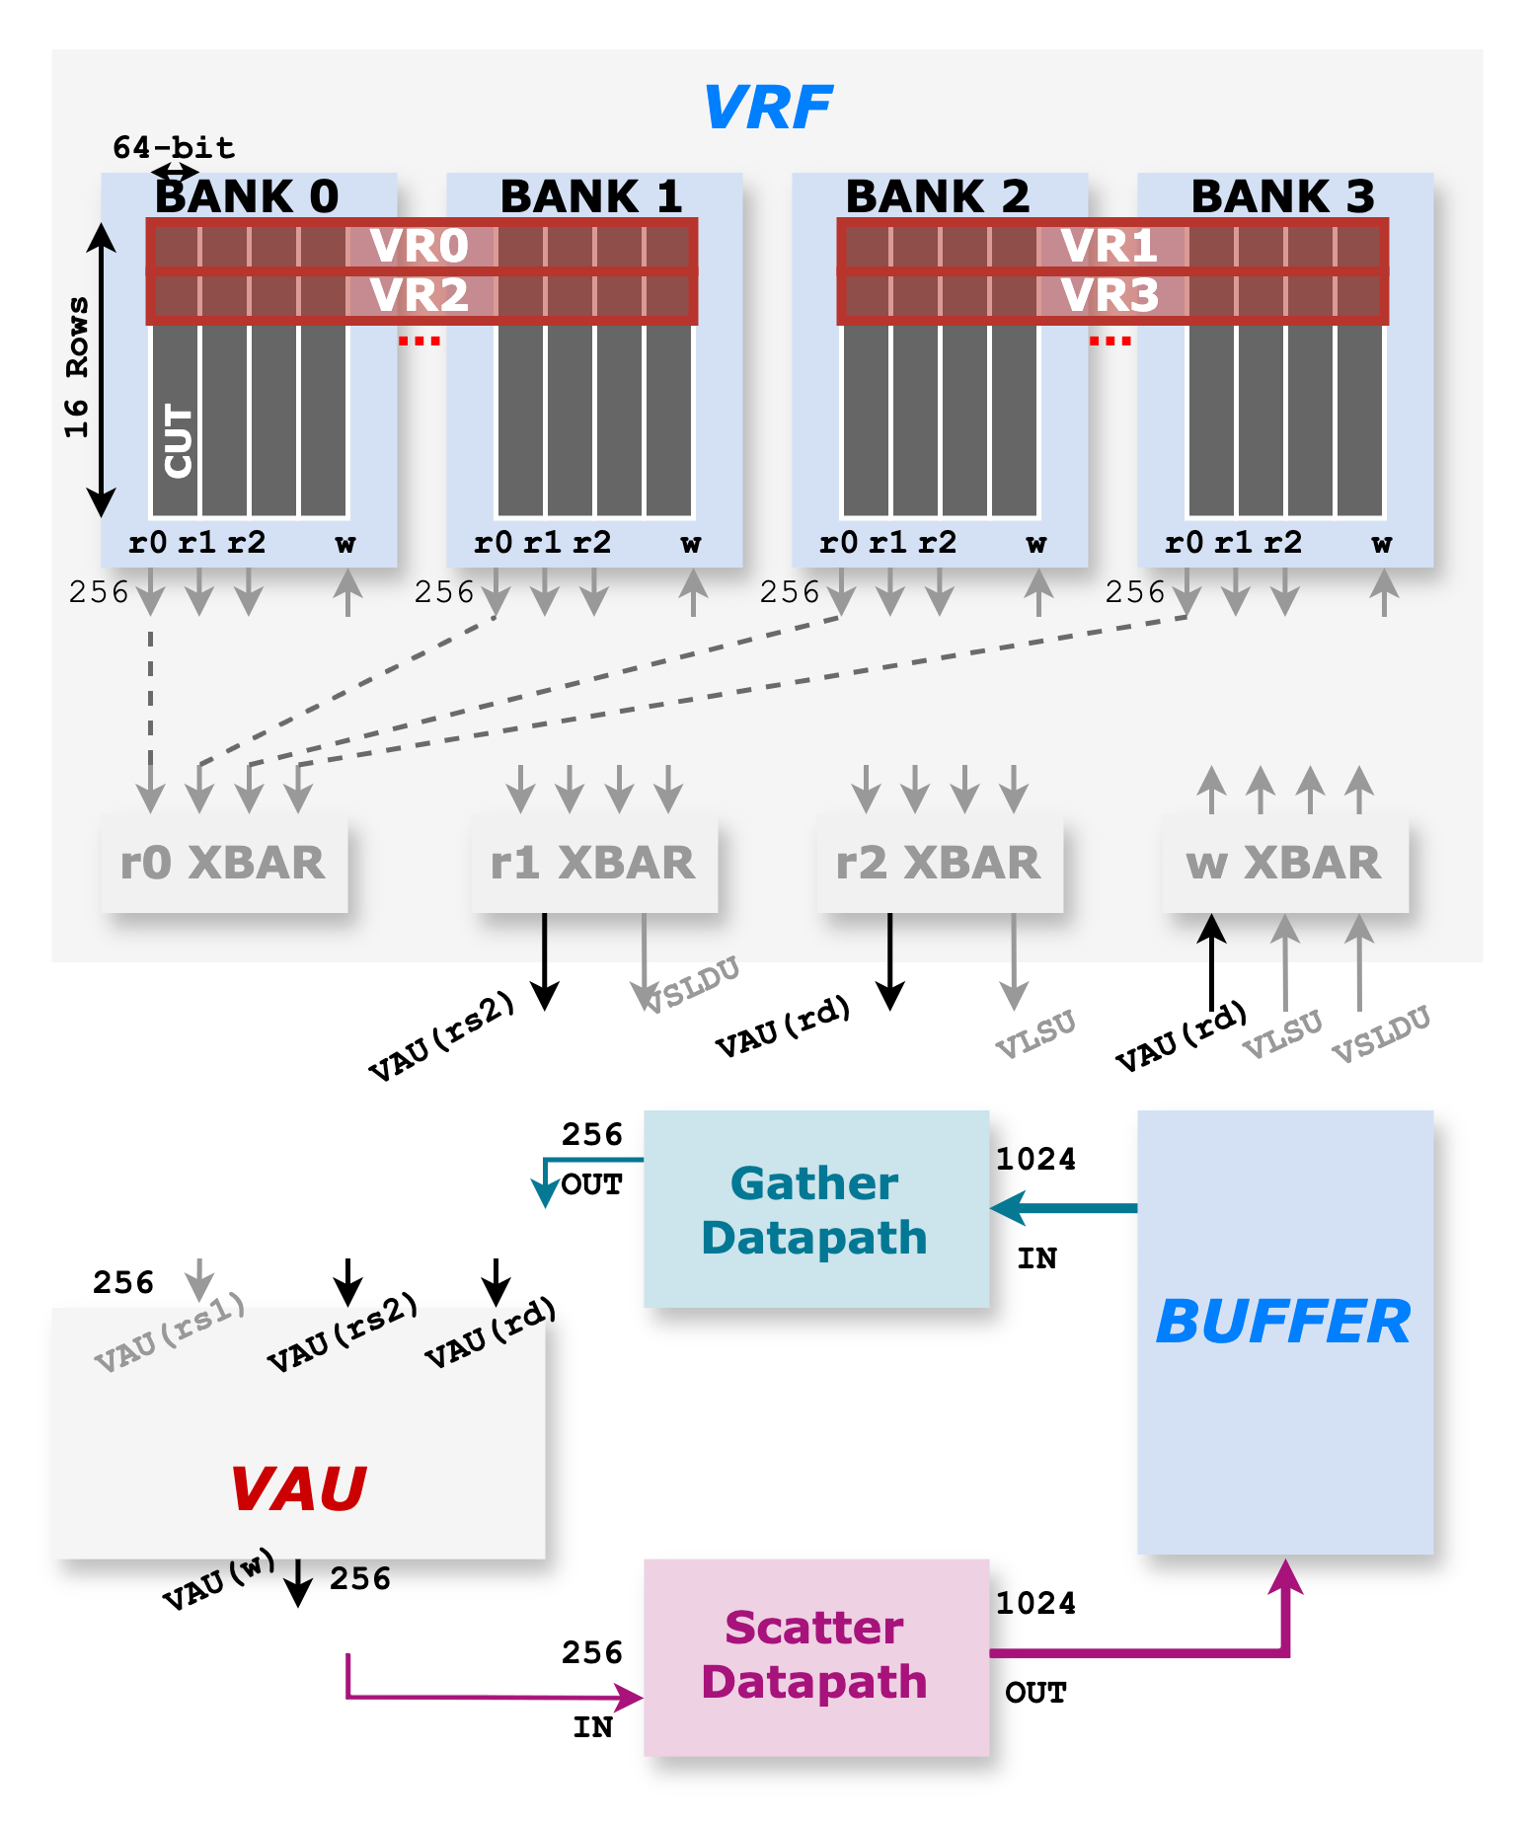
Proposal 2: Buffer-based Design
VRF remains unchanged
The scatter/gather datapath and buffer are implemented along the VAU
A 1024-bit 1R1W interface is required for the buffer

Slide 19
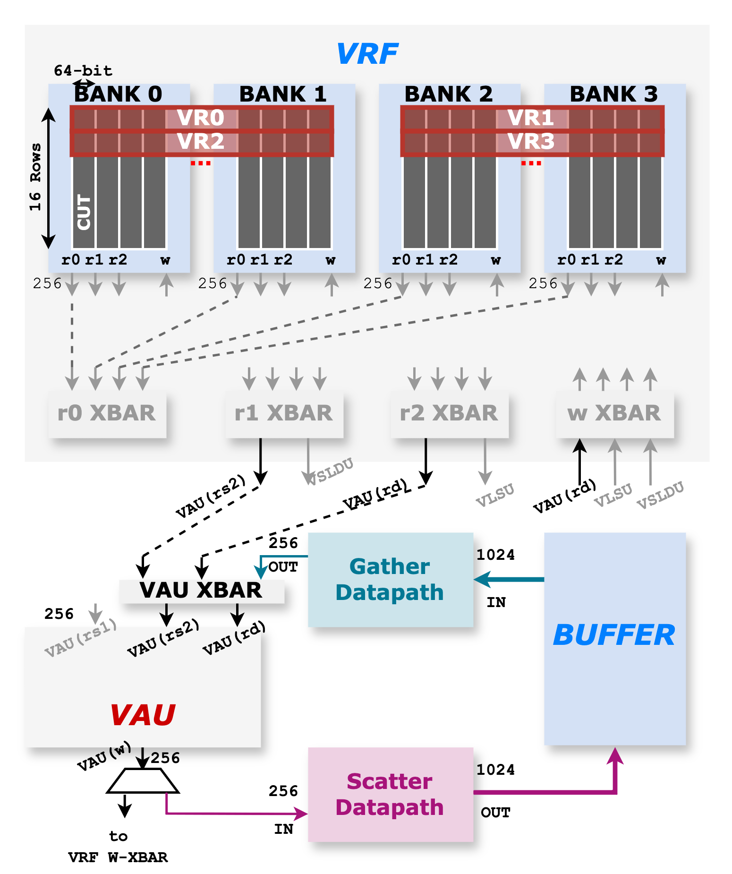
Proposal 2: Buffer-based Design
VRF remains unchanged
The scatter/gather datapath and buffer are implemented along the VAU
A 1024-bit 1R1W interface is required for the buffer
Similar crossbar structure for VAU routing

Slide 20
Proposal 2: Buffer-based Design
Hardware overhead analysis
One 4KiB buffer, assuming to support LMUL=8 accumulation
One 256-bit (3x2) crossbar and one 256-bit (1x2) MUX
Scatter/Gather datapath
Energy efficiency consideration
Avoids the need to activate 4x the banks every cycle into the VRF → saves energy since it does not activate a large VRF
Buffer reuse
The inserted buffer could be repurposed for no-reuse vector streaming

Slide 21
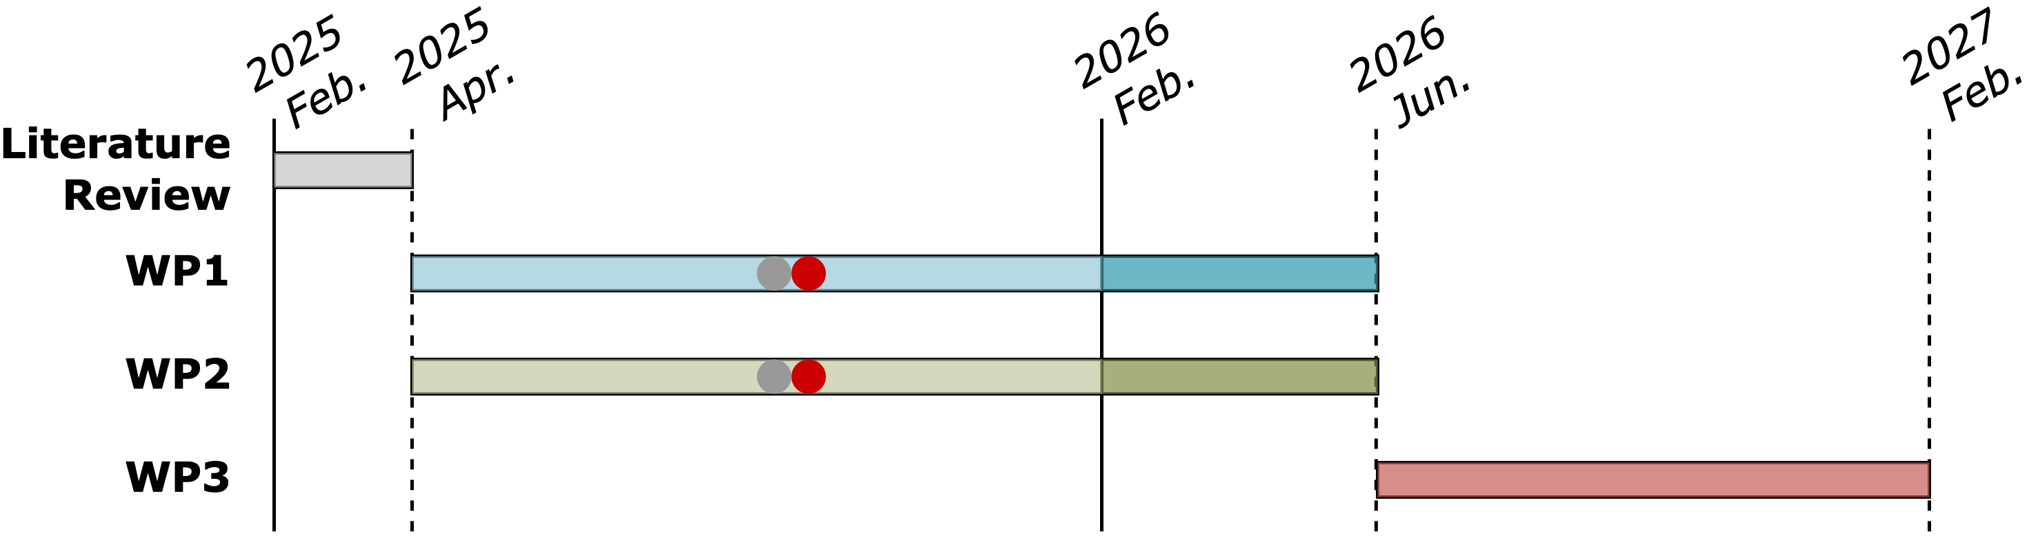
Progress Update
WP1
Proposal for the efficient scatter/gather operation
Backend exploration for Proposal 1

