Slide 1
QuantSparse 3D Biweekly 2025-10-30 Pre-Discussion on Stage Report
Integrated Systems Laboratory (ETH Zürich)
Bowen Wang bowwang@iis.ee.ethz.ch Paul Scheffler paulsc@iis.ee.ethz.ch
Luca Benini lbenini@iis.ee.ethz.ch

Slide 2
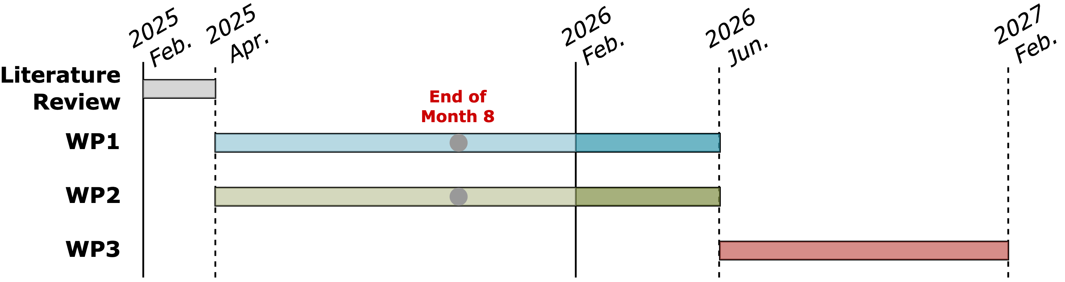
Progress Recap
WP1
Proposal for the unstructured SpMV dataflow and custom ELLPACK data format

Slide 3
Agenda
Progress Update
Ventaglio – Scatter and gather datapath
Pre-discussion on the stage report
Work package revisit
Proposed structure of stage report
Timeline
Discussion

Slide 4
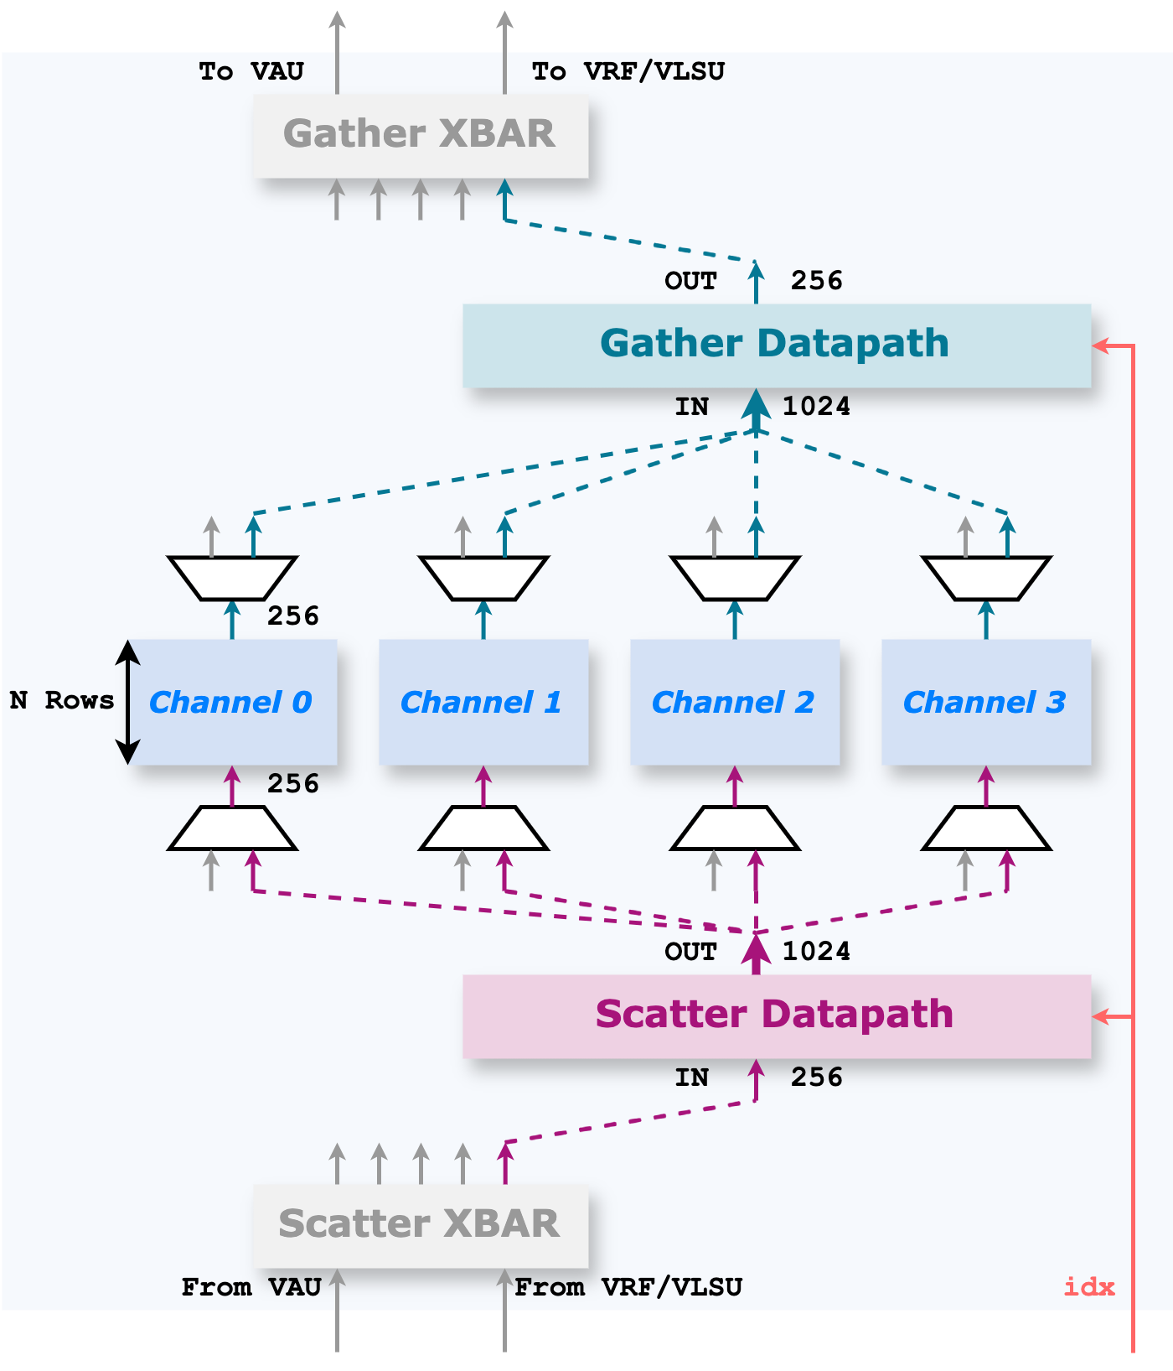
Ventaglio – Scatter/Gather Datapath
Memory unit
Configurable number of rows, currently 4 rows per channel to support LMUL=8
Currently implemented with arrays of clock-gated flip-flops
Scatter/Gather datapath
To select the effective elements based on the index vector
Provides symmetrical interfaces

Slide 5
Ventaglio – Scatter/Gather Datapath
Gather/Scatter crossbars
Actively switching connections → (Load/Store phase) Route the data stream from VLSU directly into the memory units (Compute phase) Route the data stream through the scatter/gather datapath

Slide 6
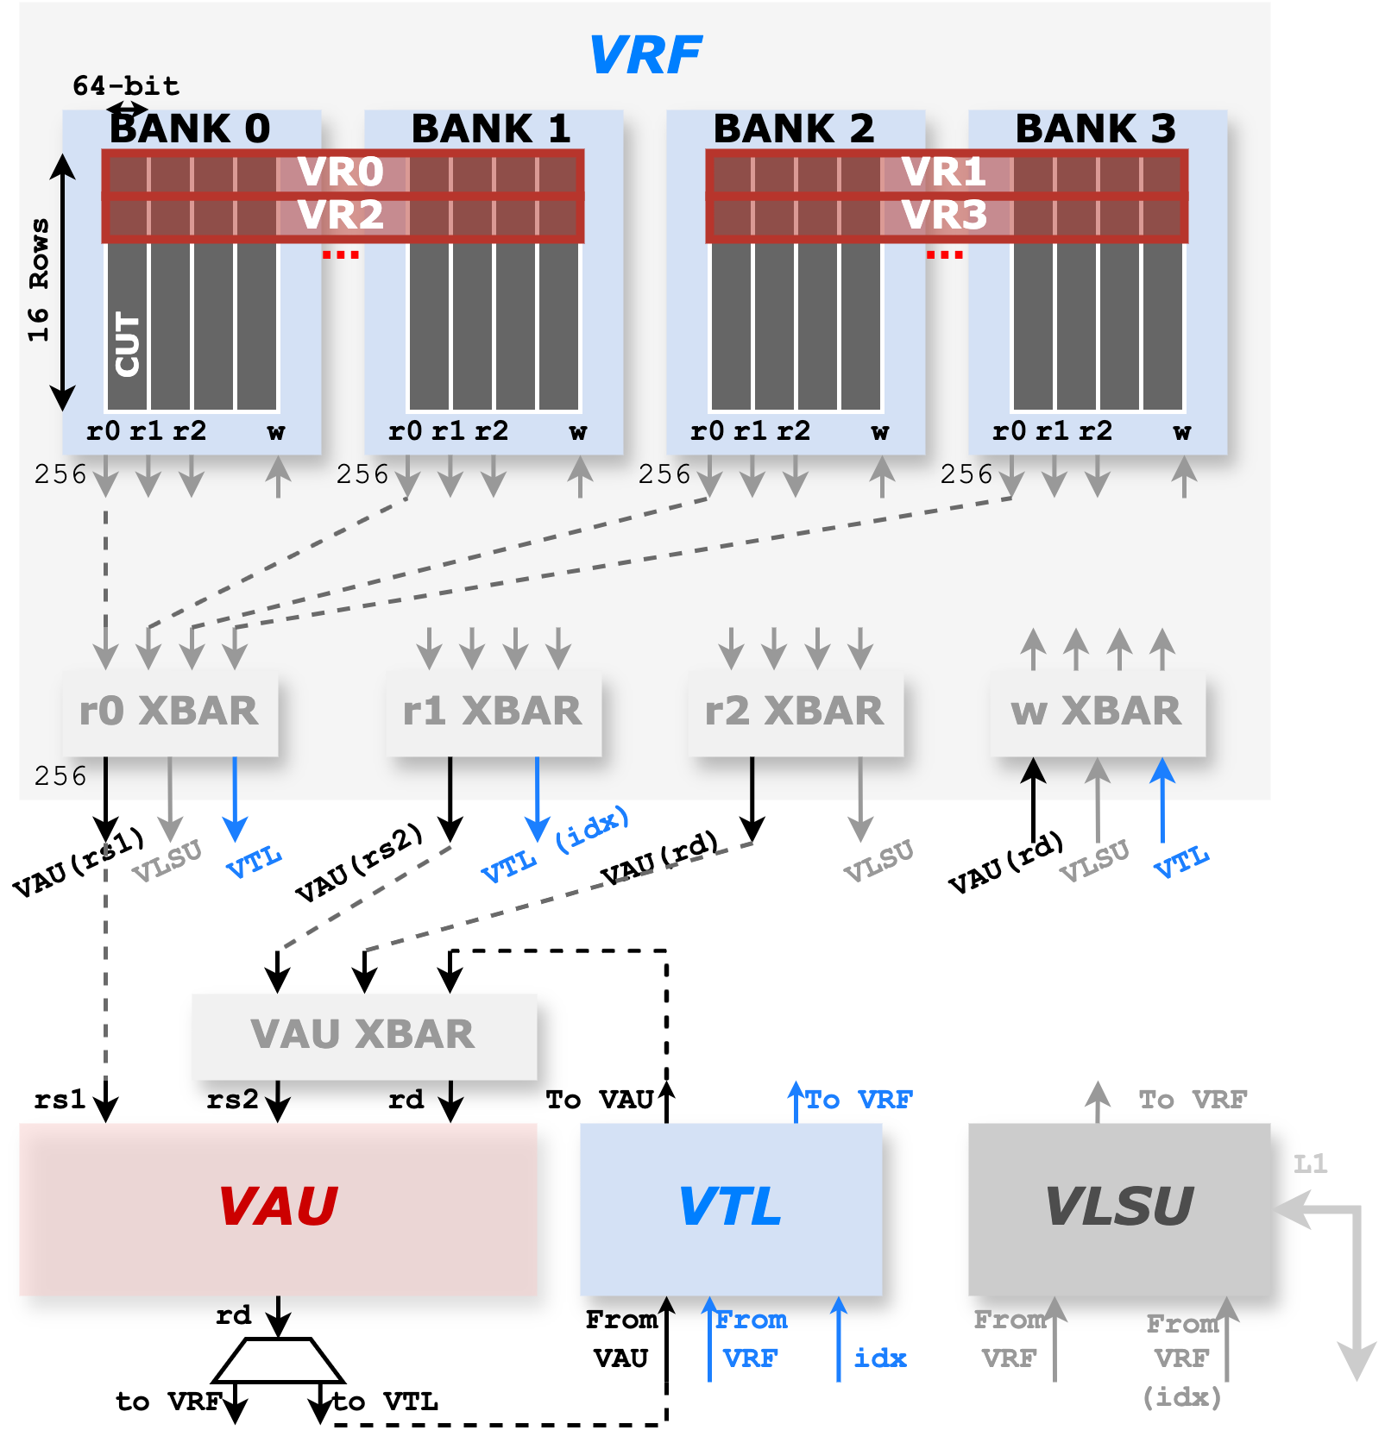
Ventaglio – Spatz Integration
VSLDU substitution
VTL is capable of all the functions of VSLDU, exposing the same interface towards VRF
VAU Crossbar
The gather operation can be applied to both activation and accumulation tensors
If gather and scatter are applied to the accumulation (i.e., with Gustavson’s dataflow), it is written back to the VTL memory units
With mixed, Inner-product-based dataflow, the gather operation is only applied to the activation tensor → accumulations are stored back in the VRF

Slide 7
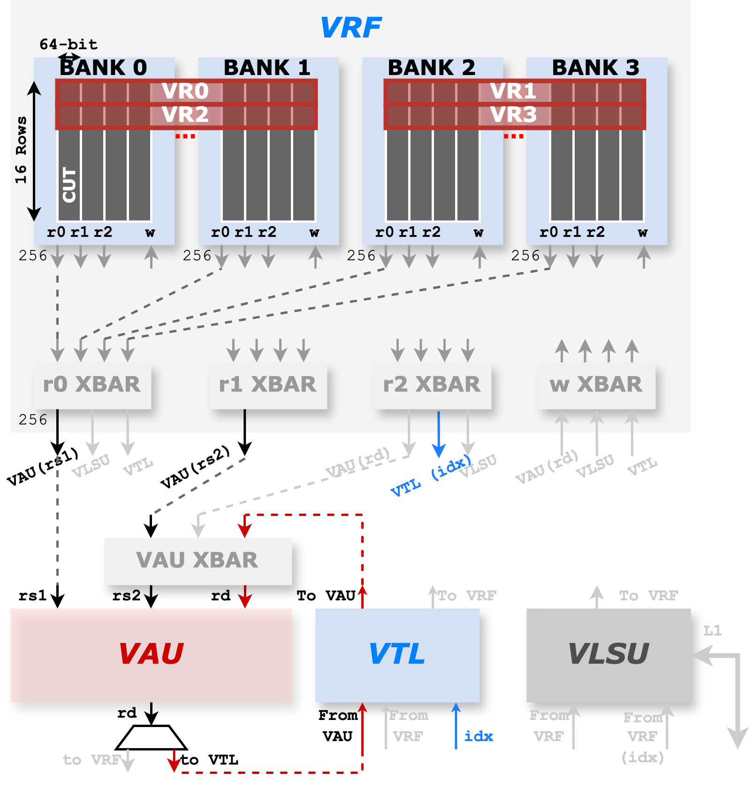
Ventaglio – Spatz Integration
Gustavson’s dataflow example
Vector of weight elements is streamed from VRF (rs1)
Scalar activation elements are read from scalar registers
Vector of output accumulations is gathered-read from VTL, and scattered-write back to VTL
Indices are read from the VRF

Slide 8
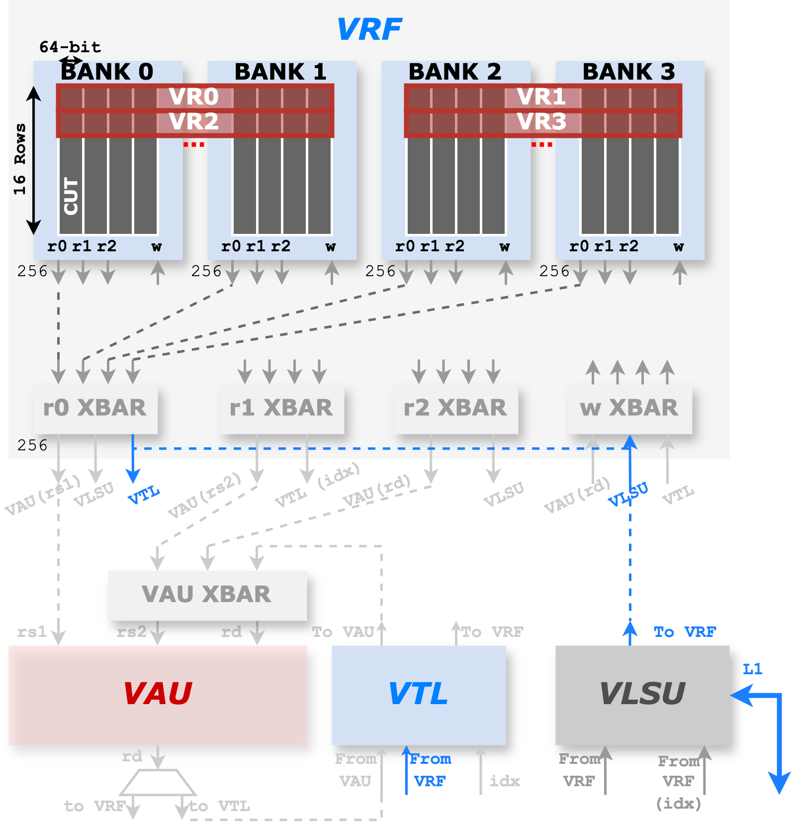
Ventaglio – Spatz Integration
Mixed- inner-product dataflow example
Vector of activation elements is loaded from L1 through VLSU, and written to the memory units in VTL → bypassing VRF

Slide 9
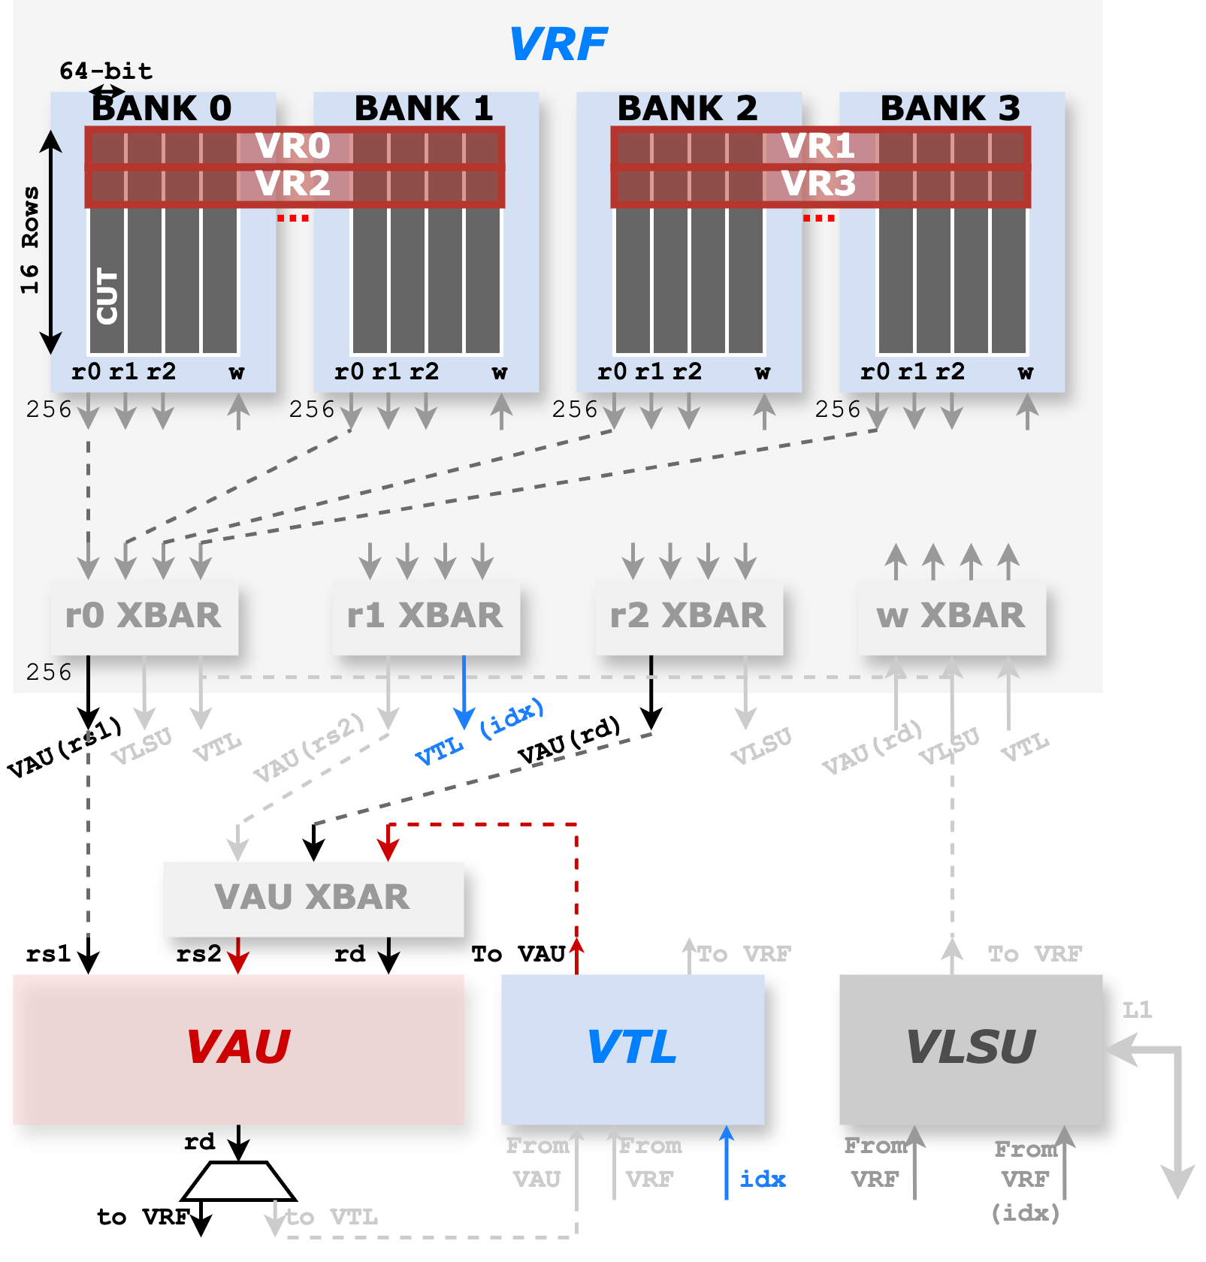
Ventaglio – Spatz Integration
Mixed- inner-product dataflow example
Vector of activation elements is loaded from L1 through VLSU, and written to the memory units in VTL → bypassing VRF
Compute stage
Effective activation elements are gathered with indices
The vector of weight elements and output accumulations are streamed from VRF

Slide 10
Review of First-Year Work Package
(WP1) Chiplet architecture and building blocks
Architectural modeling, simulation, and design of the chiplet architecture, including processing engines, on-chip interconnect, memories, and main memory endpoints (controllers and near/in memory compute units).
Parameterized RTL models will be built and synthesized on advanced technology models representative of state-of-the-art technologies to assess PPA.
(WP2) System and software design
Architectural modeling of multi-chiplet fabrics and 3D-stacked memories.
Software environment for mapping LLM models to the hardware architecture, leveraging open-source environments (PyTorch, TVM, LLVM) and open specifications (ONNX).
Design space exploration of system configurations using a set of simplified end-to-end models and microkernels, such as autoregressive inference using a KV-cache for long input sequences, also using micro-scaling formats to reduce memory and energy footprints.

Slide 11
Review of First-Year Work Package
(WP1.1) Architectural modeling, simulation, and design of the chiplet architecture
[Done] Modeled (widened) indexed-macc in the vector processor Spatz for sparsity handling
[Done] Modeled vmxdotp instructions in Spatz for block quantization data format handling
[Done] Modeled on-chip interconnect, memories, and main memory endpoints.
[Finishing] Modeled controller and coalescer in main memory endpoint
(WP1.2) Parameterized RTL models
[Done] MXDOTP operation group has been integrated into Spatz. It is synthesized with the GF12 technology node and performs PPA analysis.
[Done] RTL implementation of controller and coalescer in main memory endpoint
[Ongoing] The Ventaglio gather and scatter datapath is being integrated into Spatz. – Expect to finish in November (M9)

Slide 12
Review of First-Year Work Package
(WP2.1) Architectural modeling of 3D-stacked memories
[Ongoing] Extend the router model with optional 3D (z-up and z-down) routing – Expect to finish in December (M10)
(WP2.2) Software environment for LLM Deployment
[Done] Extended SoftHier runtime with dynamic memory allocation in both L1 SPM and HBM.
[Done] Integrated the SoftHier runtime and basic kernel templates into the Deeploy framework. Achieved single-cluster microkernel deployment.
[Ongoing] Extending the deployment framework to support multi-node architectures. – Expect to finish in January (M11)
(WP2.3) DSE for simplified end-to-end models and microkernels
[Done] Implemented microkernels for SpMM and SpMV kernels with structured sparse weight matrix and unstructured activations. GEMM and GEMV kernels with MX block quantization format.
[Ongoing] Proposed multi-level ELLPACK format for SpMV kernel with unstructured sparse weight matrix. HW-SW co-design with Ventaglio scatter/gather datapath. – Expect to finish in December (M10)
[Pending] Implementation of end-to-end model deployment. – Expect to finish in February (M12)

Slide 13
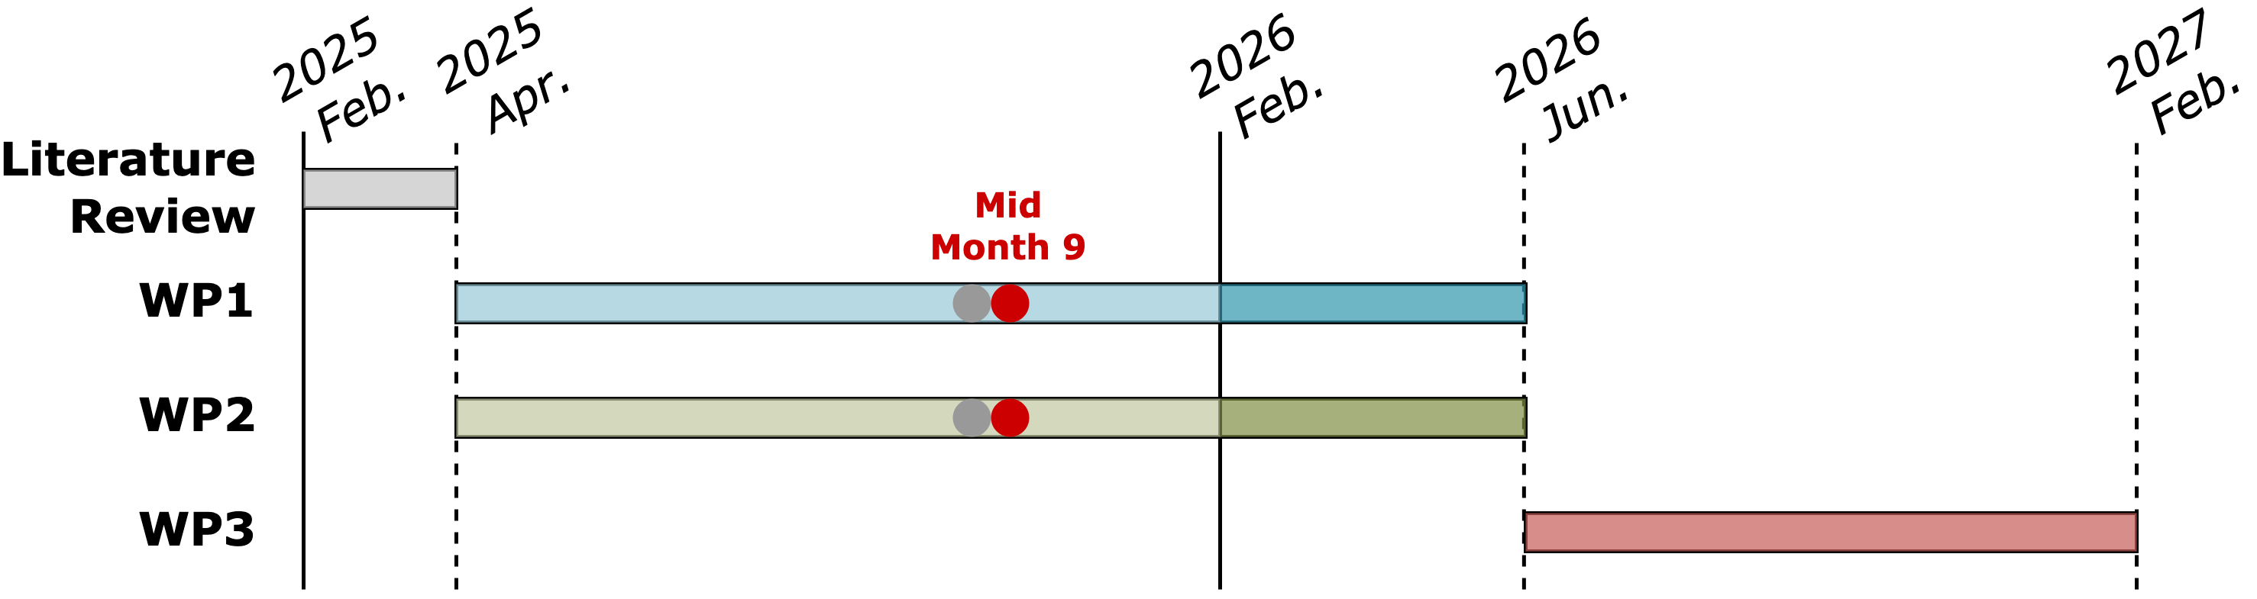
Progress Update
WP1
Pre-discussion for Stage Report

