Slide 1
QuantSparse 3D Biweekly 2025-12-18
Integrated Systems Laboratory (ETH Zürich)
Bowen Wang bowwang@iis.ee.ethz.ch Paul Scheffler paulsc@iis.ee.ethz.ch
Luca Benini lbenini@iis.ee.ethz.ch

Slide 2
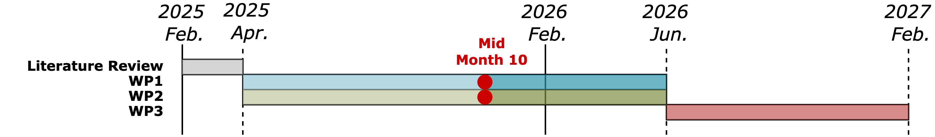
Agenda
Progress Update
Ventaglio – Scatter and gather datapath
3D architectural modeling
Timeline
Discussion

Slide 3
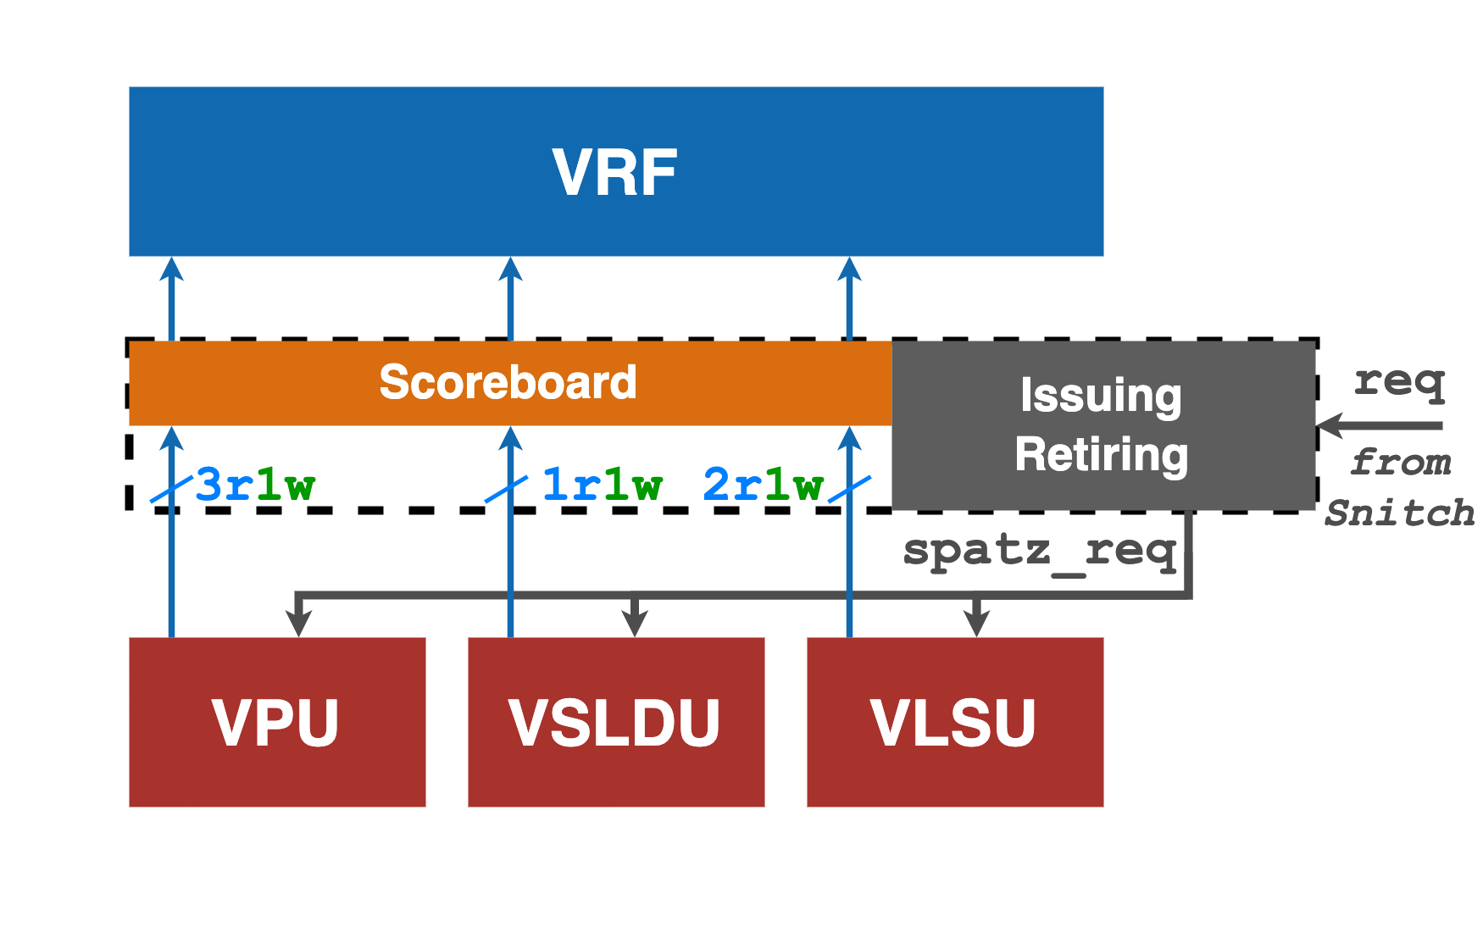
Spatz Requests Processing
Spatz controller
Maintains a scoreboard to track instruction dependencies
Resolves dependencies between Spatz instructions
Manages instruction issuing and retirement
Upon receiving an offload request from Snitch: Decode the request; Enrich it with additional metadata to form a Spatz request
Check the scoreboard: Register the instruction as in-flight; Update dependency state
Broadcast the Spatz request to all downstream units
Spatz function units
Filter incoming Spatz requests based on matching ex_unit
Process eligible requests
Each function unit exposes multiple memory master ports to the VRF

Slide 4
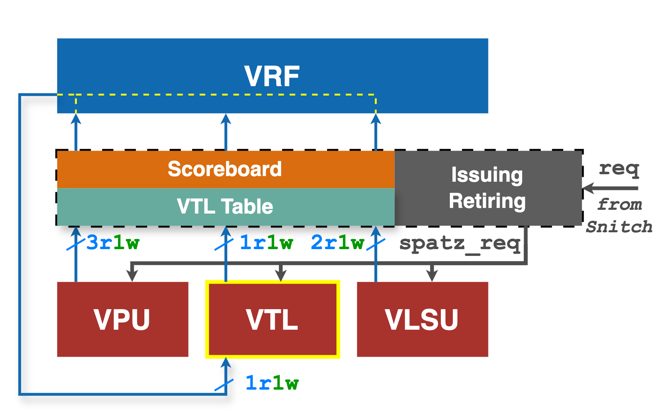
Streamline Scatter/Gather Operations
Bypassing VRF
Operands involved in scatter/gather operations should be accessed directly by the VPU, bypassing the VRF
High-level architectural changes
VTL: 1. Add an additional memory slave port (1R/1W)
Controller: 1. Introduce a VTL table to decide whether a memory request should bypass the VRF. (We configure a vector register that is mapped to the VTL memory unit) 2. Attach VTL metadata to the Spatz request when bypassing is enabled
VRF: 1. Add one memory master port (1R/1W) 2. Forward selected memory requests to VTL 3. Enable VLSU-generated memory requests to bypass the VRF →Vector load/store instructions can access VTL memory units directly

Slide 5
Custom Instructions
Vector load index (vlx.v vd)
Reuse a vacant VRF slot to store index vectors
Index element bitwidth is configured ahead of execution → No need to specify SEW in the instruction
Vector length vl for the load/store is inferred by the controller
The VTL table always maps vd to the VRF
Indexed MACC operation (vfxmacc.vf vd, rs1, vs2)
The index vector implicitly shares the same VID as the vector register mapped to VTL → Enables non-intrusive instruction encoding
The controller attaches VTL metadata to enable bypass, gather, and scatter logic
The generated Spatz request is also captured by VTL
No changes required in the VPU. Still executes standard vfmacc operations.

Slide 6
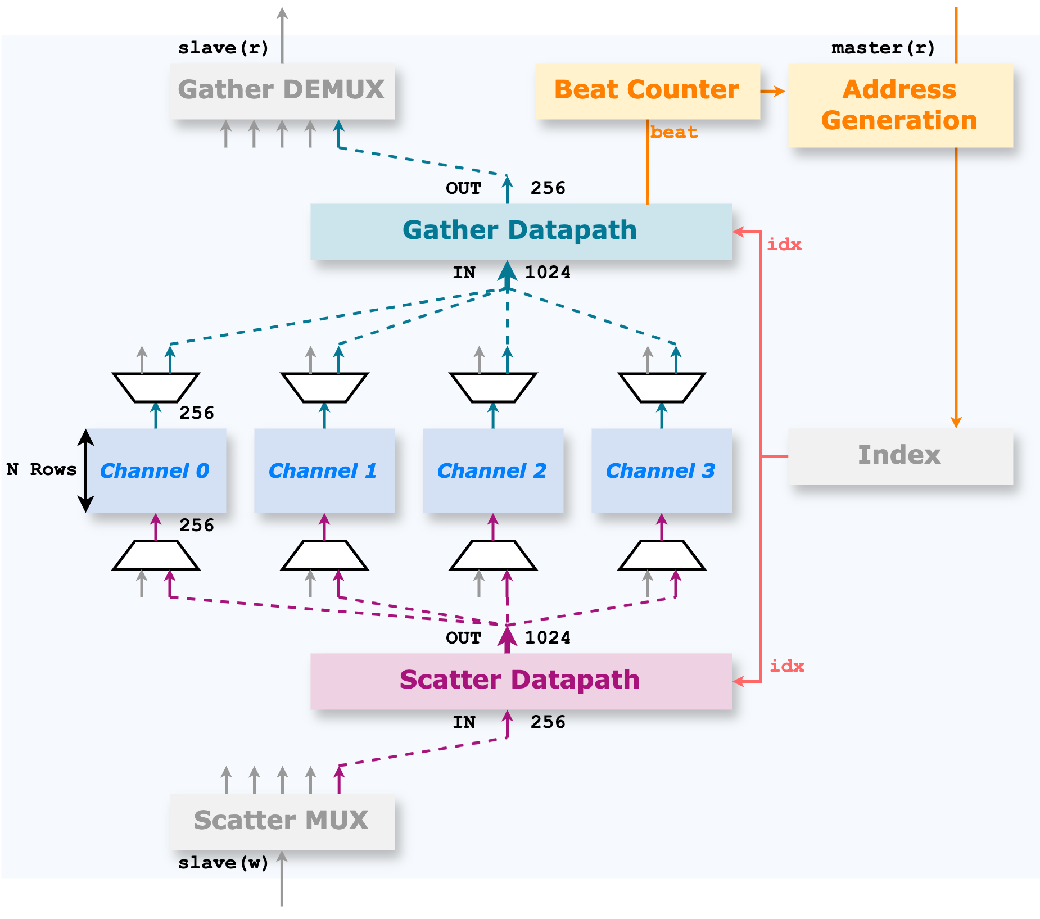
VTL Implementation
Memory Slave Port (Data Side)
Vector load/store instructions bypass the scatter/gather datapath → Access memory units directly
vfxmacc instruction enables the scatter/gather datapath → Supplies effective elements to the VPU
Memory Master Port (Index Side)
Read index vectors from the corresponding VRF slots
Due to bitwidth mismatch, the master read port operates at a much lower frequency
Index readback is buffered in a VLEN-bit index buffer
Address Generation & Scheduling
Coupled with a beat counter. Prefetches indices ahead of data consumption

Slide 7
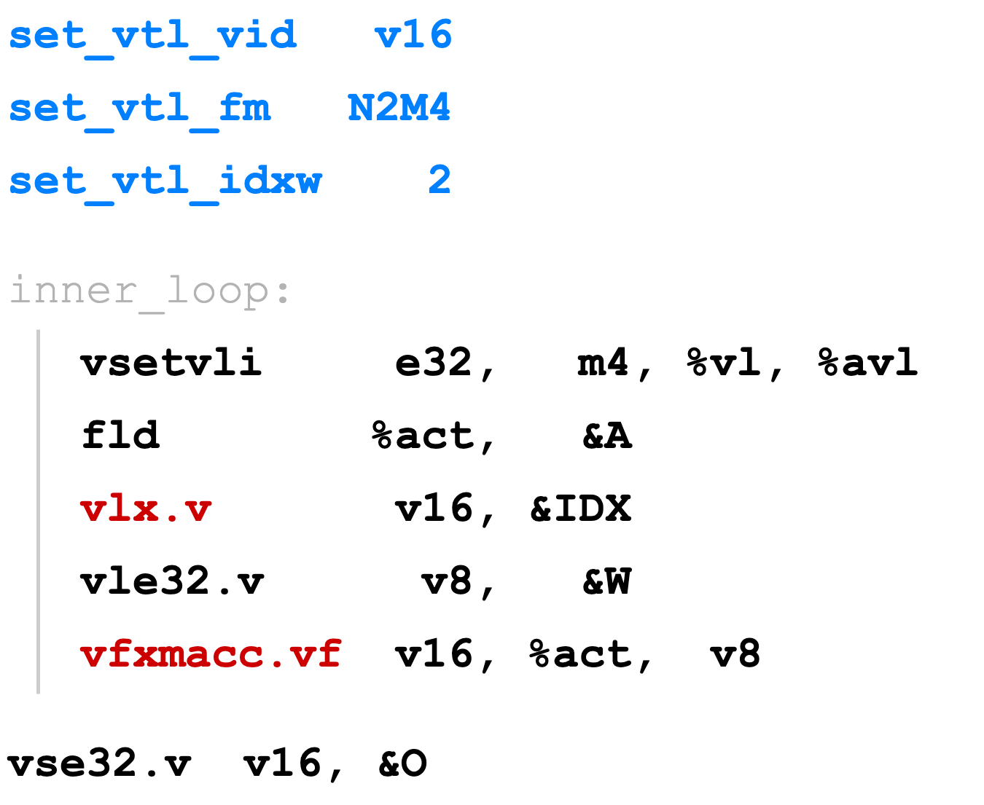
Example Walk Through
set_vtl
vlx.v
vle.v
vfxmacc
w
idx
vse.v

Slide 8
Example Walk Through
w
idx
acc
vse.v
acc
idx

Slide 9
Example Walk Through
acc
idx
vse.v
idx
acc

Slide 10
Example Walk Through
acc
idx
vse.v

Slide 11
Example Walk Through
acc
idx

Slide 12
Current Progress
First version RTL finished
Ventaglio is integrated in Spatz
Currently supports 2:4 format; more formats will be supported soon
Custom instructions functional verification done
Baseline SpMV kernel implementation done
Benchmark and performance analysis are ongoing

Slide 13
3D Architectural Modeling: NoC Extension
Extended FlooNoC model with z-axis routing
Fully parametric, backward-compatible
For axis-ordered routing: Z first
Verified in vanilla GVSoC
Currently: Implementing additional collectives features from SoftHier in 3D
Next: Explore heterogeneous 3D links, different inter-die topologies
Different Z throughput and bandwidth
Higher Z arity (more links)
Different Z connection topologies
R
R
R
R
...
logic die
R
logic die
...

