Slide 1
QuantSparse 3D Biweekly 2026-01-15
Integrated Systems Laboratory (ETH Zürich)
Bowen Wang bowwang@iis.ee.ethz.ch Paul Scheffler paulsc@iis.ee.ethz.ch
Luca Benini lbenini@iis.ee.ethz.ch

Slide 2
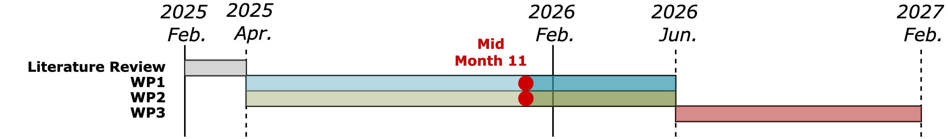
Agenda
Progress Update
Ventaglio – Fixes, performance analysis, and backend
3D System – Adapting SoftHier system & SW stack to 3D
Timeline
Discussion

Slide 3
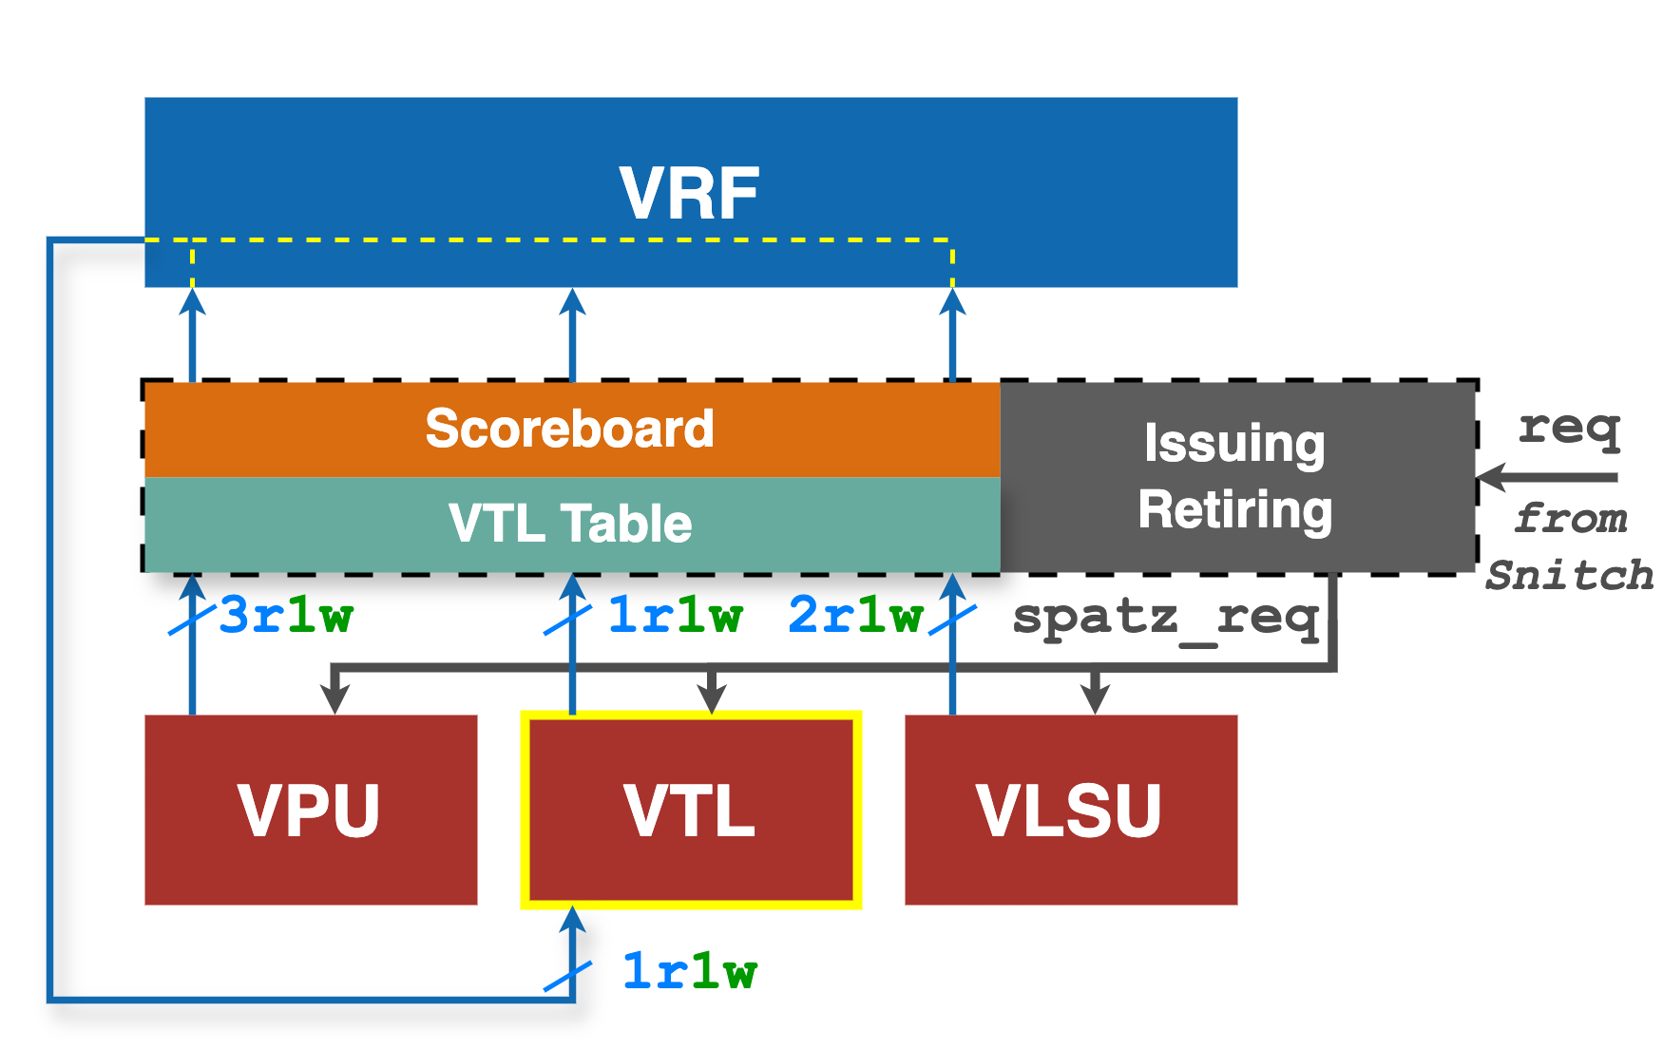
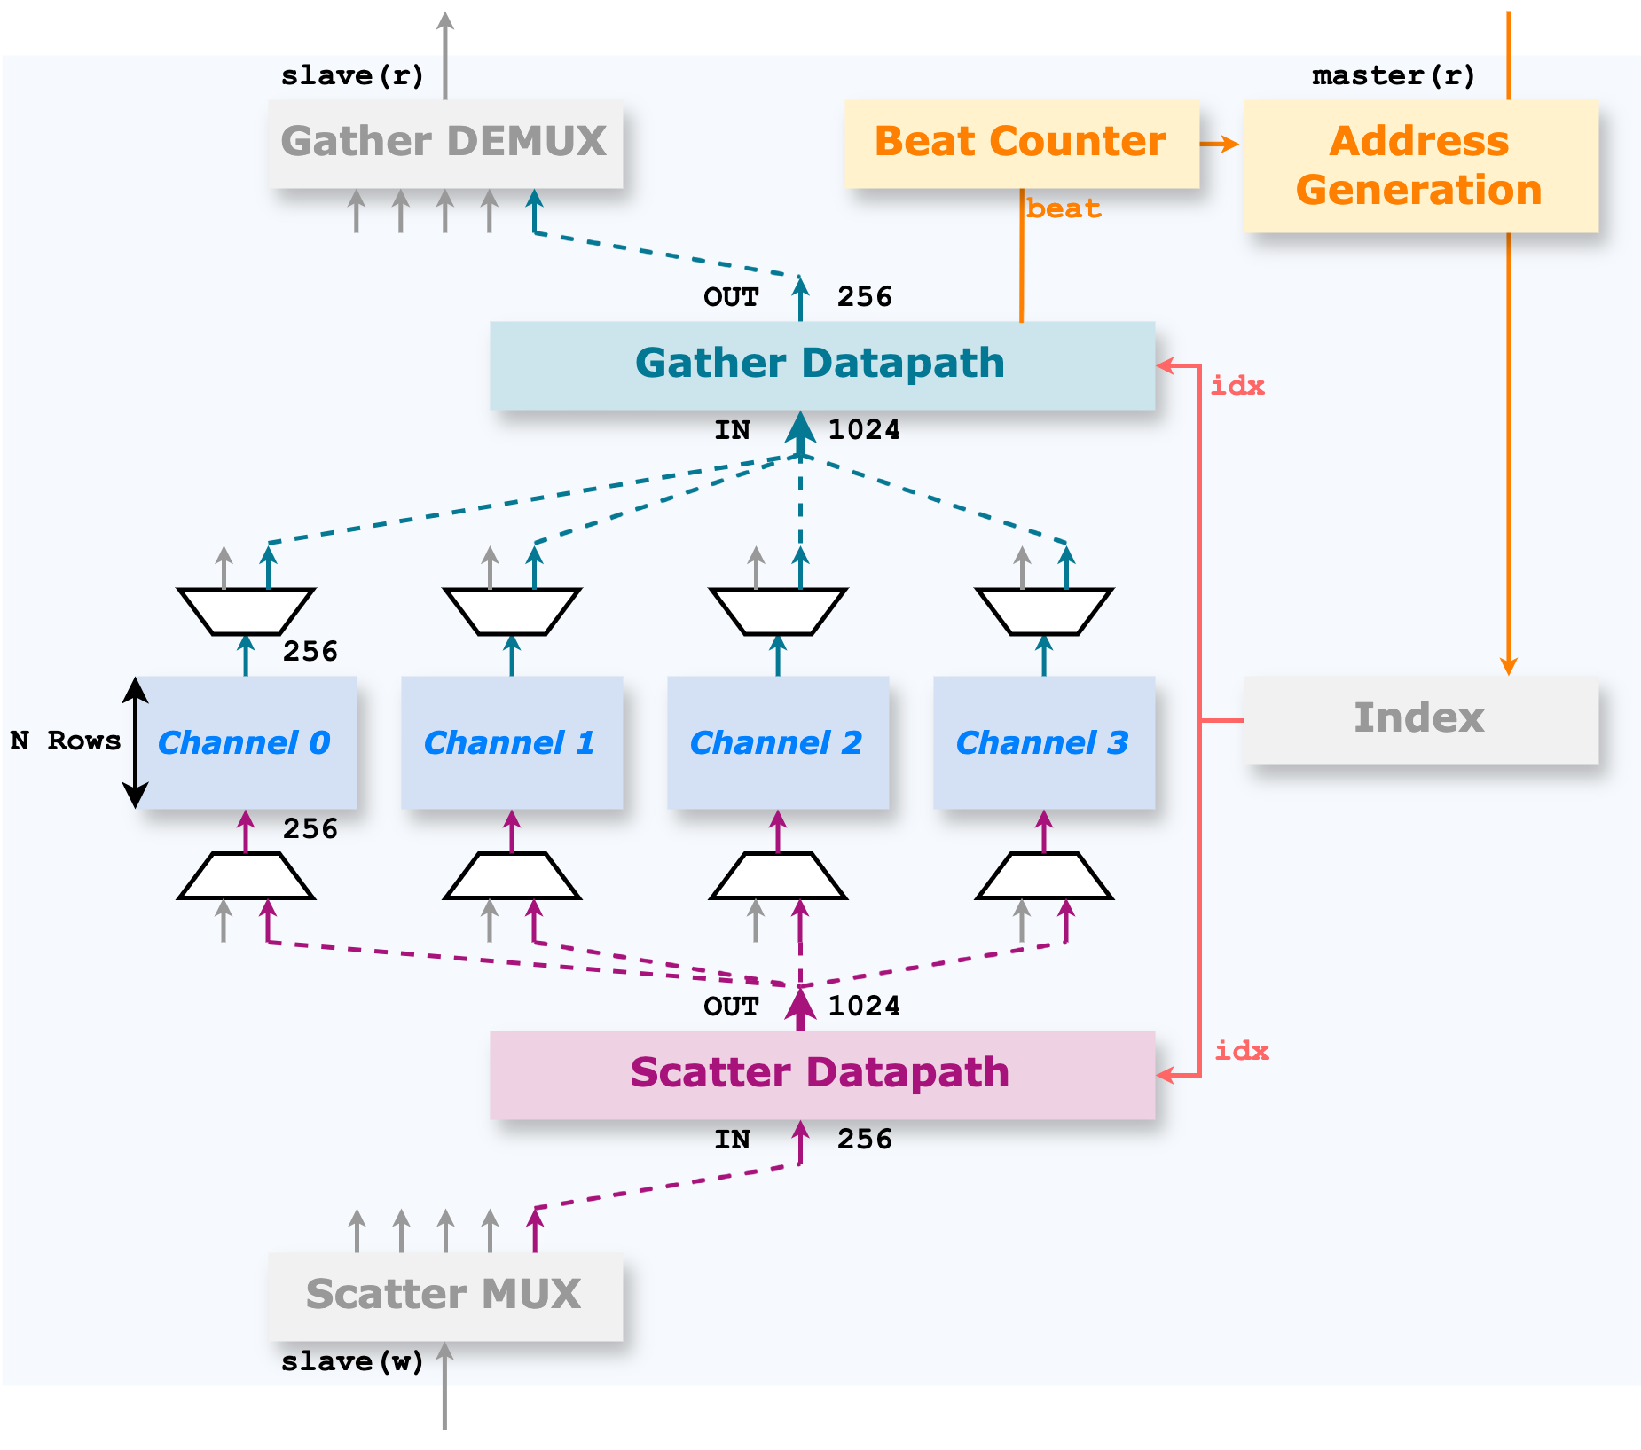
Ventaglio Backend Analysis
Performed the backend implementation with GF12 FinFET
VTL_v0.1 design
Introduced a new critical timing path, adding ~0.1 ns delay under the SS corner
Root cause: the index datapath → Upon receiving a new request, indices are loaded into VTL and used for the gather operation in the same cycle
Solution: Implemented an index preloading mechanism, triggered with two cases:
When an index is written to the VRF by a valid VLX instruction
When the current index stored in the VTL is depleted.
Indices are available ahead of gather/scatter operations, eliminating the extra delay

Slide 4
Ventaglio Backend Analysis
Performed the backend implementation with GF12 FinFET
VTL_v0.2 design
Timing issue is resolved, and Ventaglio no longer introduces a new critical timing path
Area impact:
Integrating Ventaglio increases the area by 55.9 kGE in GF12, ~5% at the Spatz core level. (4 channels, 4 rows)
~85% of the area increment is from memory units in VTL
Compared to the alternative approach of doubling VRF banks, Ventaglio
Incurs lower area overhead
Providing greater flexibility and programmability

Slide 5
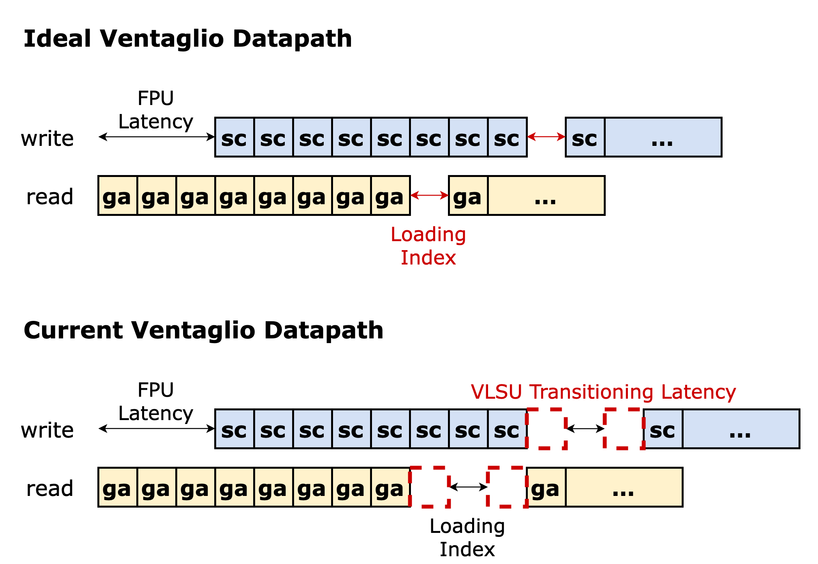
Ventaglio Performance Analysis
Datapath behavior under an SpMV workload (Gustavson’s dataflow).
Ideal waveform
Should be only one cycle latency between consecutive vfxmacc operation (unavoidable in current design)
Comes from loading indices from L1 into the VRF
Weight matrix is not reused under SpMV workload → VLSU bandwidth matches that of the VPU
Theoretical maximum VPU utilization is 94.1% (LMUL=8).
VTL_v0.2 design
Two additional stall cycles are observed
Root cause: VLSU behavior when two load instructions arrive back-to-back. VLSU requires a transition cycle to commit the previous instruction

Slide 6
Ventaglio Performance Analysis
Datapath behavior under an SpMV workload (Gustavson’s dataflow).
VTL_v0.3 design: Ongoing optimization
These two extra cycles can be removed by modifying the VLSU commit logic
Current progress: Additional cycles are removed while memory requests may commit improperly in some corner cases. Fix in progress

Slide 7
Ventaglio: Next Steps
Features:
[HW] Loop unrolling support
[HW] More N:M formats → cost estimation
[HW/SW] Duo-level ELLPACK format support
[SW] VTL GVSoC model
Upcoming projects:
Ventaglio + MX datapath in Spatz
Ventaglio + RVV matrix extension in Spatz

Slide 8
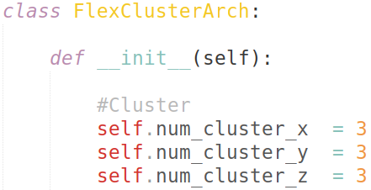
3D System: Extending SoftHier Model
Completed 3D NoC integration in SoftHier
Adapted GVSoC system model
Logic dies (clusters) stacked in 3D mesh
Adapted outstanding requests to account for higher distances (Nx + Ny → Nx + Ny + Nz)
HBM controllers remain in base die for now
Transparent HW extension through additional system parameter
Extended cluster registers
Provide Z coordinate and 3D cluster ID
Extend inter-cluster mesh barrier to 3D
HBM
HBM
HBM
HBM
HBM
HBM
HBM
HBM
HBM

Slide 9
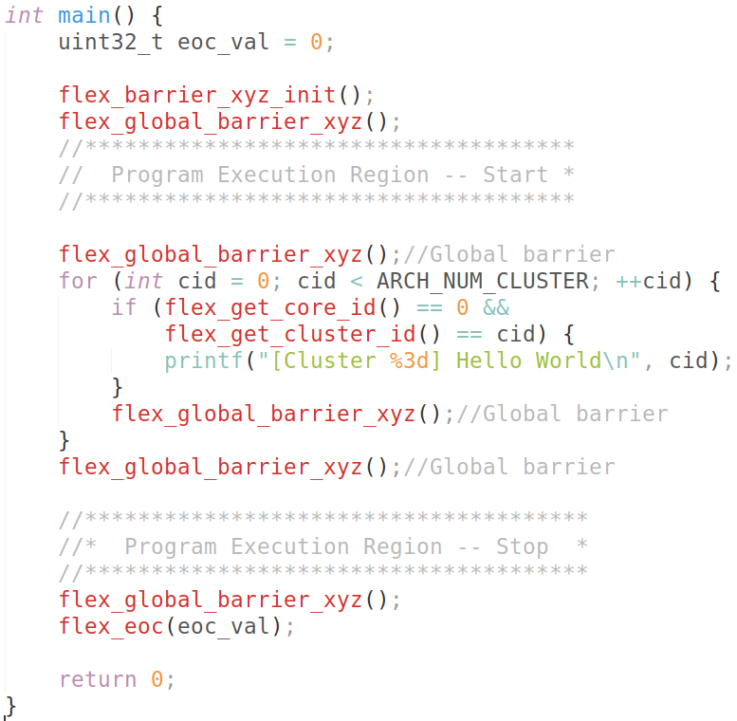
3D System: Extending SoftHier Runtime
Extended Runtime for 3D mesh
New methods for own ID & Z neighbors
Extended global & mesh barriers
Working on mesh DMA primitives
First debugging of 3D mesh execution
Upper clusters can fetch and run code from HBM
Currently: debugging 3D barriers for upper cores

Slide 10
3D System: Next Steps
Software:
Resolve barrier issues
Demonstrate DMA primitives in 3D
Demonstrate compute kernels on 3D mesh
Hardware:
Make Z links parametric (throughput, arity)
Explore different Z topologies

