Slide 1
QuantSparse 3D Biweekly 2026-01-29
Integrated Systems Laboratory (ETH Zürich)
Bowen Wang bowwang@iis.ee.ethz.ch Paul Scheffler paulsc@iis.ee.ethz.ch
Luca Benini lbenini@iis.ee.ethz.ch

Slide 2
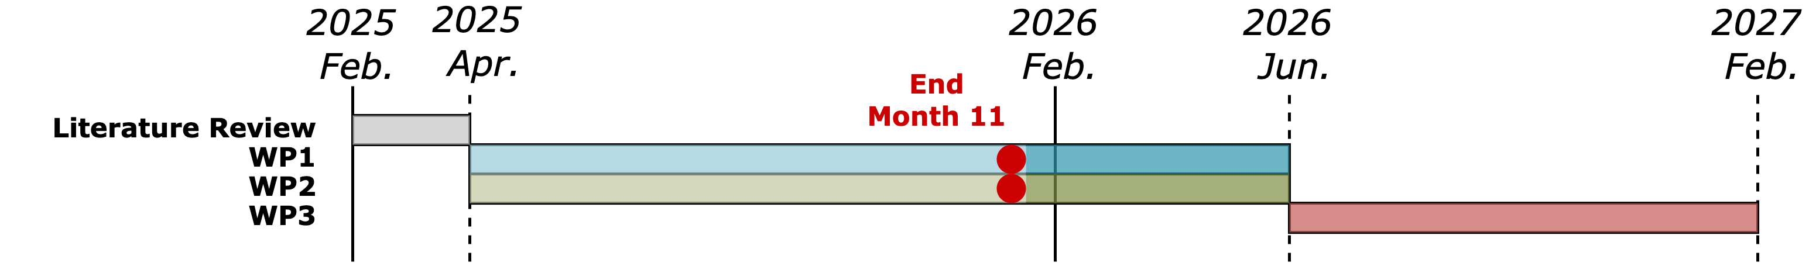
Agenda
Progress Update
Ventaglio – Performance improvement; instructions, semantic update
3D System – Fixes and progress update
Timeline
Discussion

Slide 3
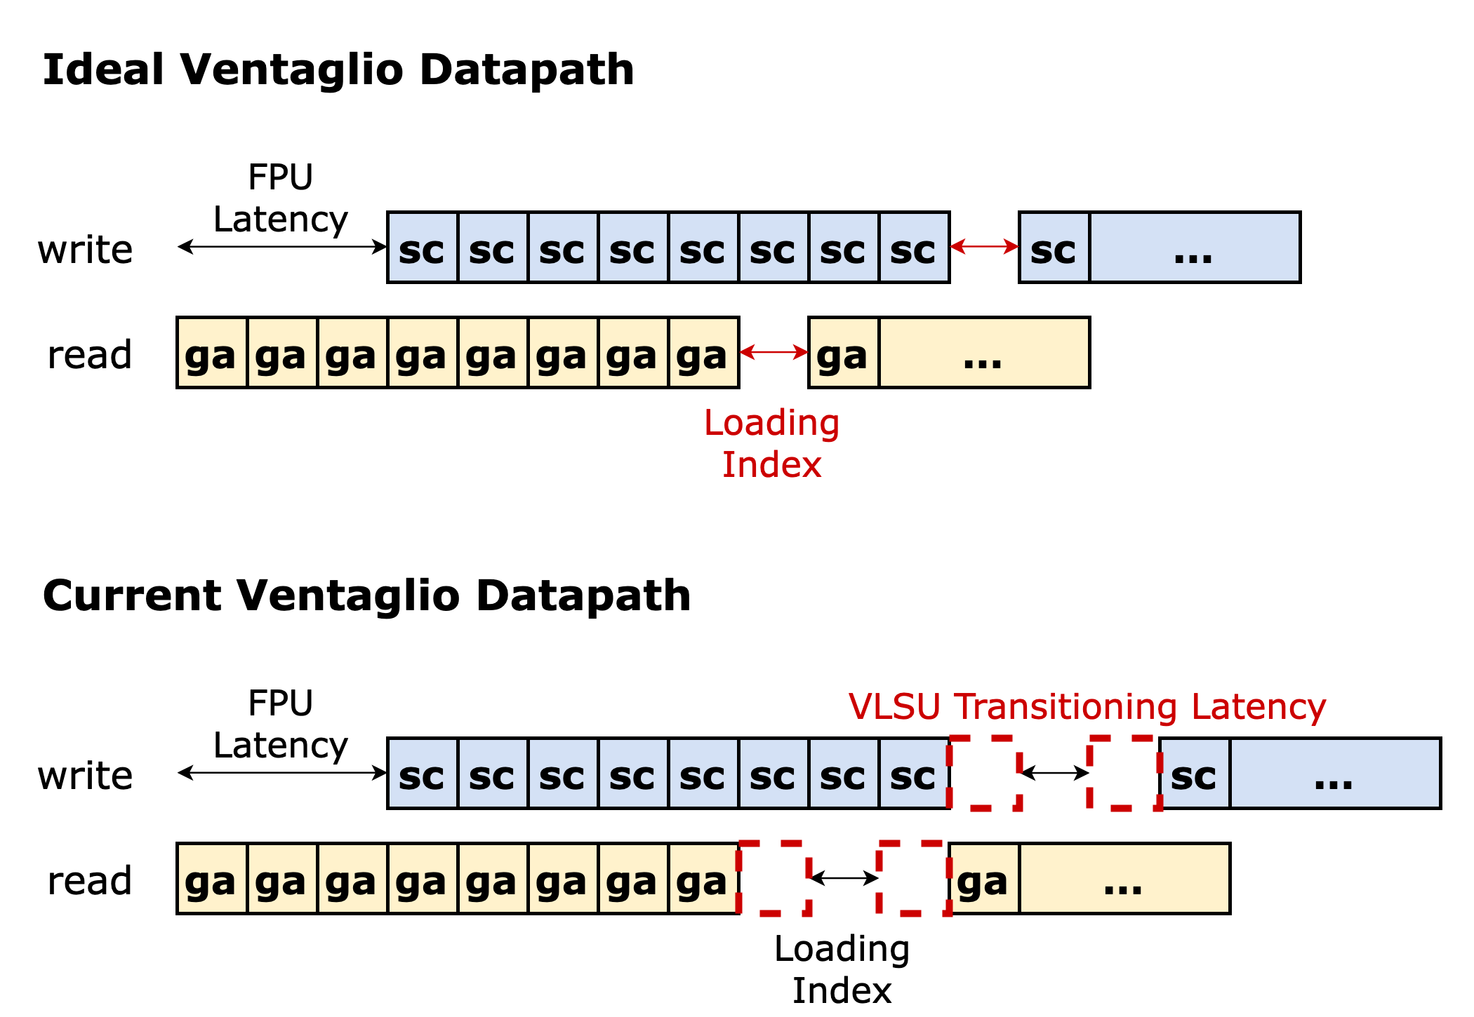
Recap: Ventaglio Performance Analysis
Datapath behavior under an SpMV workload (Gustavson’s dataflow).
Ideal waveform
Should be only one cycle latency between consecutive vfxmacc operation (unavoidable in current design)
Comes from loading indices from L1 into the VRF
Weight matrix is not reused under SpMV workload → VLSU bandwidth matches that of the VPU
Theoretical maximum VPU utilization is 94.1% (LMUL=8).
VTL_v0.2 design
Two additional stall cycles are observed
Root cause: VLSU behavior when two load instructions arrive back-to-back. VLSU requires a transition cycle to commit the previous instruction

Slide 4
Ventaglio Performance Analysis
Datapath behavior under an SpMV workload (Gustavson’s dataflow).
VTL_v0.3 design:
These two extra cycles can be removed by modifying the VLSU commit logic
Modifying VLSU commit logic: allowed early commit for consecutive vector load operations
Result: VPU utilization reaches 93.7% (LMUL=8) on SpMV (reaching the ideal case)
Observation: VPU utilization drops at smaller LMUL (LMUL=2/4)
Root cause: Shorter MACC compute phase, so loop-control overhead can't hide behind computation. → More prominent in sparse kernels.
Solution: Loop unrolling

Slide 5
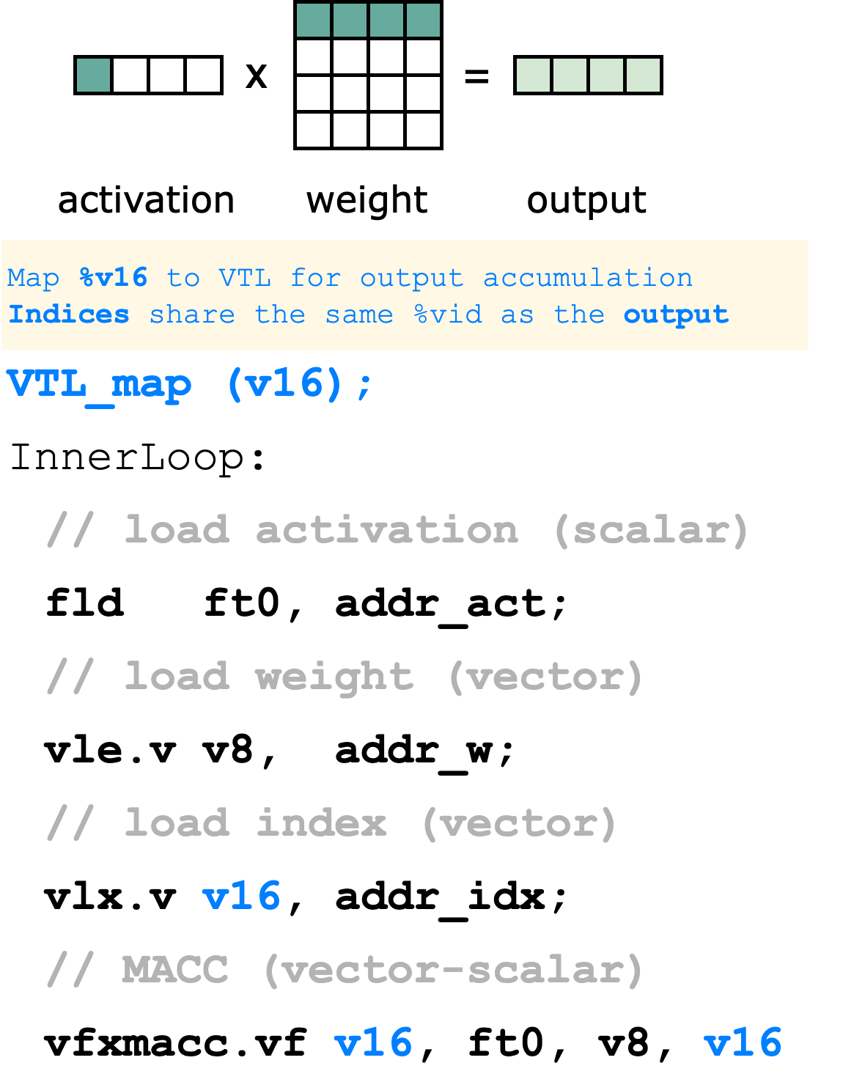
Existing Instructions Semantics
Vector load index (vlx.v vd)
Reuse a vacant VRF slot to store index vectors
Indexed MACC operation (vfxmacc.vf vd, rs1, vs2)
The index vector implicitly shares the same VID as the vector register mapped to VTL → Enables non-intrusive instruction encoding

Slide 6
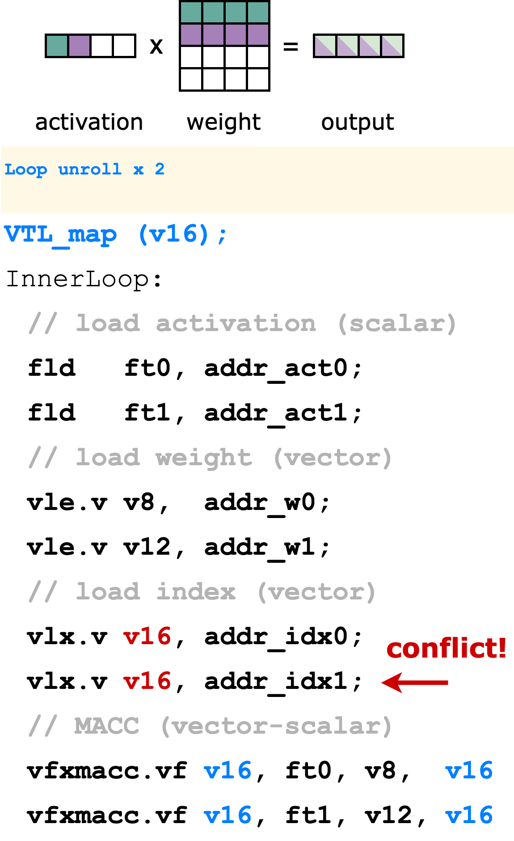
Issue with Loop Unrolling
Datapath behavior under an SpMV workload (Gustavson’s dataflow).
VTL_v0.3 design:
The accumulation/output vector is mapped to VTL
Issue: We can no longer distinguish index vectors across consecutive vfxmacc operations
Root cause: vlx and vfxmacc implicitly bind the index %vid to the accumulation tensor, not the corresponding weight tensor.
Insight: the instruction semantics needs to change so that the index %vid is bound to the tensor that is encoded with → cleaner semantics

Slide 7
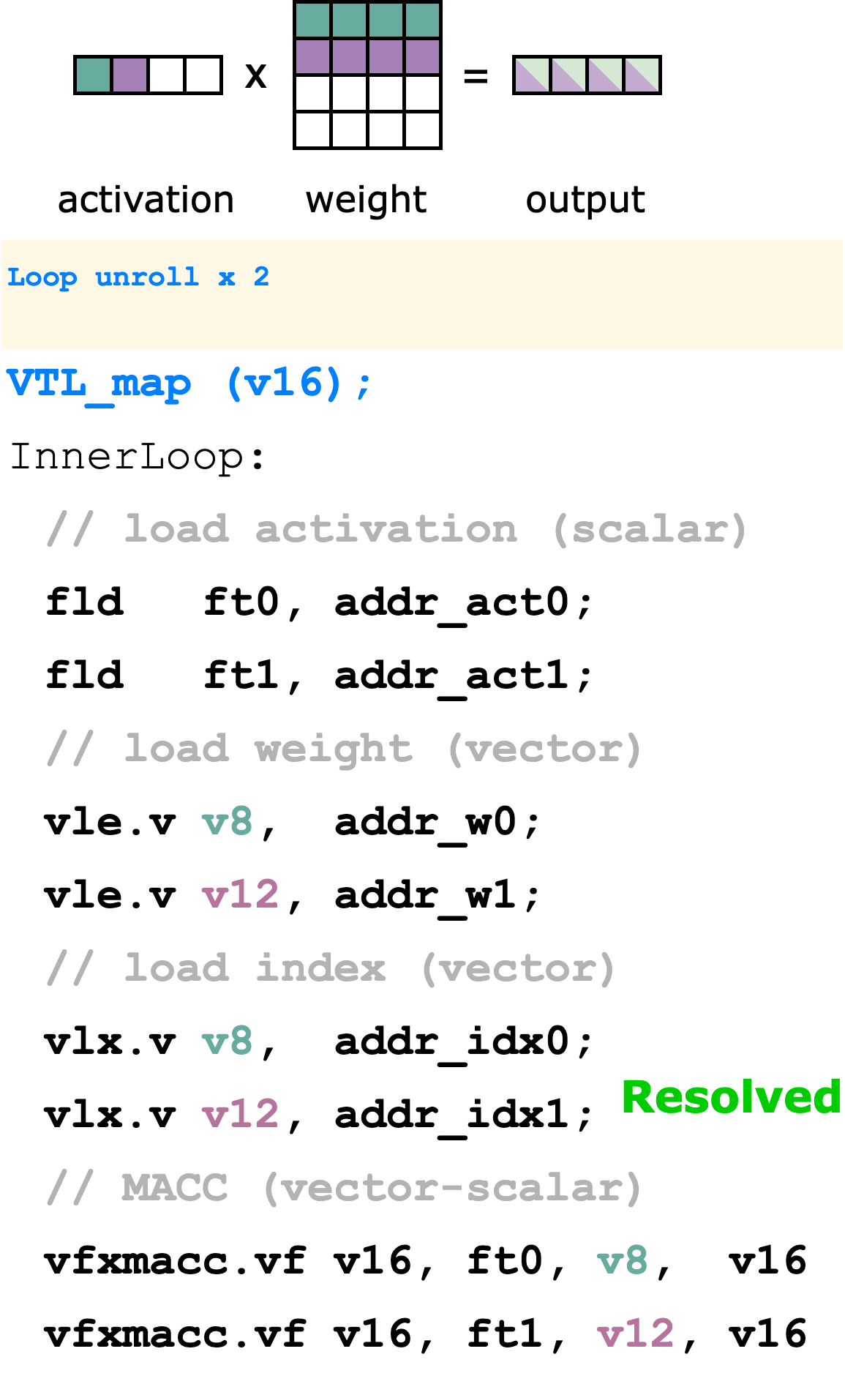
Instruction Semantics Update
Datapath behavior under an SpMV workload (Gustavson’s dataflow).
VTL_v0.4 design:
Key difficulty: Weights can be loaded into %v8 with: vle.v v8, addr_w Indices should conceptually bind to %v8 → ISA would express: vlx.v v8, addr_idx But indices cannot physically occupy the same VRF slot as the weights.
Solution: added a small %vid mapping table in the Spatz controller → map “encoded %vid” to the “vacant VRF slot”

Slide 8
Instruction Semantics Update
Datapath behavior under an SpMV workload (Gustavson’s dataflow).
VTL_v0.4 design:
On vlx.v %vid_encoded:
find a vacant VRF slot %vid_real,
record mapping %vid_encoded → %vid_real,
send the VLSU request using %vid_real
On vfxmacc.v issued to VTL:
VTL generates an index read using %vid_encoded,
mapping table translates it to %vid_real → VRF reads the correct index vector.

Slide 9
Ventaglio: Status and Next Steps
Status:
Ventaglio v0.4 RTL done; finished functional verification
VPU utilization returns to ideal under small LMUL + loop unrolling
Rerun the backend flow: negligible area overhead and no critical timing impact
Remaining tasks:
[HW] More N:M formats → cost estimation
[SW] SpMM kernel and collect performance benchmarks
Design cleanup, back to GVSoC

Slide 10
3D System: Status and Next Steps
Status:
Resolved 3D barrier issues
Extending the collective transfer primitive in the SoftHier runtime
Added support for layer-masked collectives in the iDMA GVSoC model
Start computing kernels implementation on 3D mesh (i.e. systolic GEMM)
Next step:
Porting other kernels available on 2.5D SoftHier (e.g. attention)
Performance comparison between 2.5D Softhier and 3.5D architecture
HBM
HBM
HBM
HBM
HBM
HBM
HBM
HBM
HBM

