Slide 1
QuantSparse 3D Biweekly 2026-02-12
Integrated Systems Laboratory (ETH Zürich)
Bowen Wang bowwang@iis.ee.ethz.ch Paul Scheffler paulsc@iis.ee.ethz.ch
Luca Benini lbenini@iis.ee.ethz.ch

Slide 2
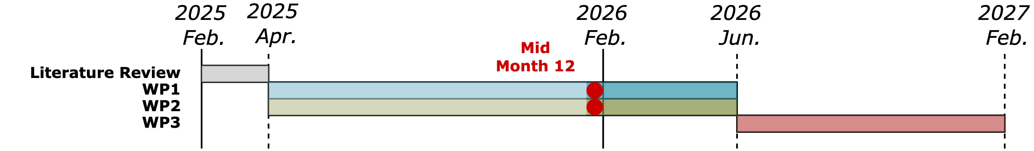
Agenda
Progress Update
Ventaglio – Format extensions, loop-unrolled SpMM kernel, perf. benchmark
3D System – 3D Systolic GEMM: dataflow and implementation
Timeline
Discussion

Slide 3
Status Recap
Status:
Ventaglio v0.4 RTL done; finished functional verification
VPU utilization returns to ideal under small LMUL + loop unrolling (VLSU commit)
Rerun the backend flow: negligible area overhead and no critical timing impact
Remaining tasks:
[HW] More N:M formats → cost estimation
[SW] SpMM kernel and collect performance benchmarks
Design cleanup, back to GVSoC

Slide 4
Extending Ventaglio Supported Format
Modular scatter/gather datapath in VTL
Main goal: keep the design maintainable
Approach: Refactored the datapath. New formats can be enabled by instantiating the additional datapaths with the proper N:M configuration.
The control logic (e.g., index preloading and buffered indices) shared across all datapaths to avoid duplication.
Results:
Extended with 1:4 format. Passed functional verification.
Adding one more format increases area by 12% (~6.9 kGE) @ VTL unit level → Matches expectations given the v0.4 area breakdown
Memory unit: 41.6 kGE
Datapath: 7.8 kGE
Control: 5.7 kGE

Slide 5
Loop-Unrolled SpMM Kernel
Implementation done and passed functional verification
Currently supported settings:
LMUL=4 @ 50% sparsity, LMUL=2 @ 25% sparsity (Constrained by the VTL Memory unit capacity)
Waveform inspection shows ideal (100%) FPU utilization in the inner loop (2:4 format)
Reason: With loop unrolling + Gustavson’s algorithm, the weight vector and its index vector are reused across multiple activation elements.

Slide 6
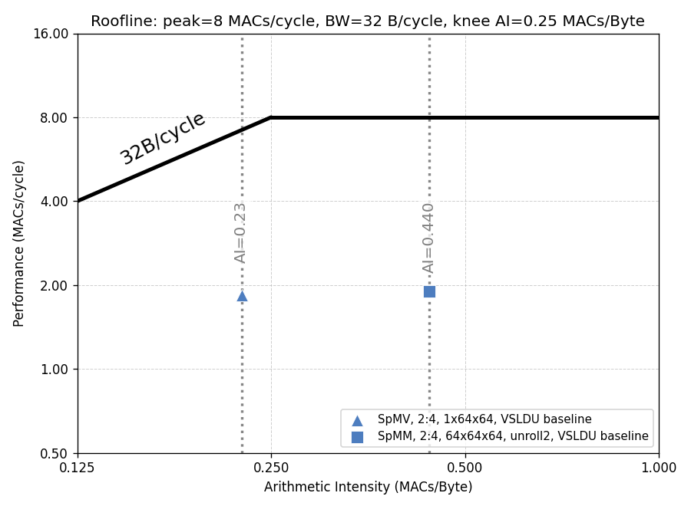
Performance Analysis
Baseline implementation
Scatter and gather using VSLDU
Theoretical VPU utilization is 40%, measured utilization is 23% considering control overheads
Unroll x2 SpMM kernel achieves ~2x AI comparing with SpMV
Performance is constrained by VSLDU-to-VRF halved throughput with inefficient scatter/gather

Slide 7
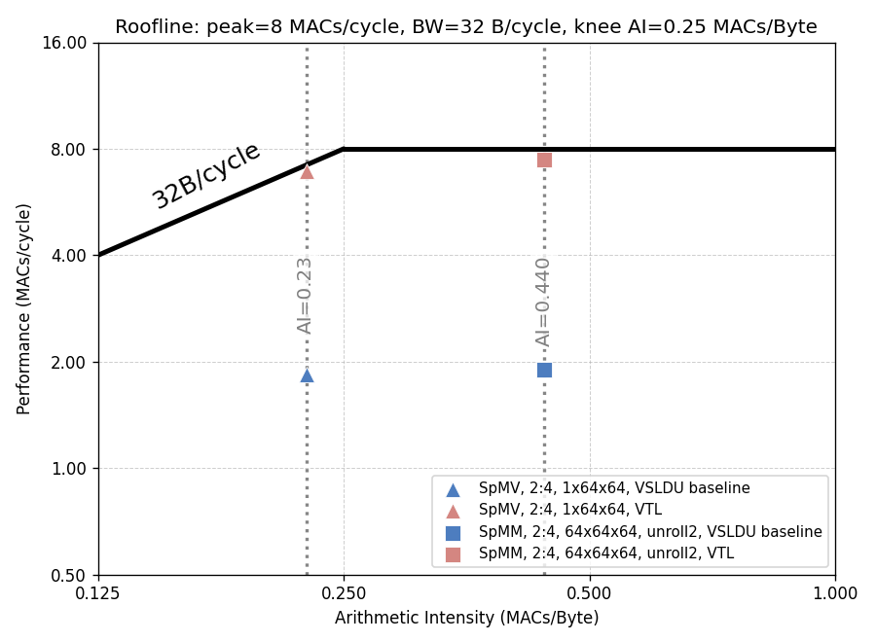
Performance Analysis
Scatter/Gather with Ventaglio
Pushed the VPU utilization to the roofline
With 2:4 format, N=64, P=64
86.3% VPU utilization under SpMV workload
93.1% VPU utilization under SpMM workload
Memory-bound SpMV workload
Cycles for loading indices cannot hide behind computaition
86.3%
93.1%
4.1x
3.7x

Slide 8
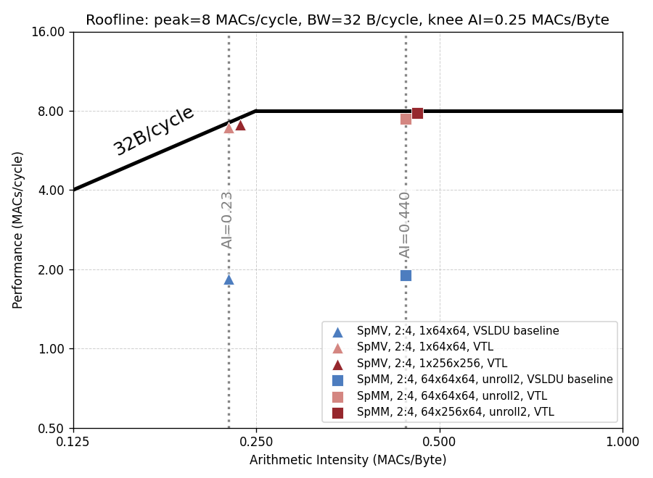
Performance Analysis
Scatter/Gather with Ventaglio
Pushed the VPU utilization to the roofline
With 2:4 format, N=64, P=64
86.3% VPU utilization under SpMV workload
93.1% VPU utilization under SpMM workload
Memory-bound SpMV workload
Cycles for loading indices cannot hide behind computaition
Utilization improves with larger N-dimension
Mid-/Outer-loop control overhead becomes easier to amortize.
Performance is comparable with the dense workload.
87.5%
97.9%

Slide 9
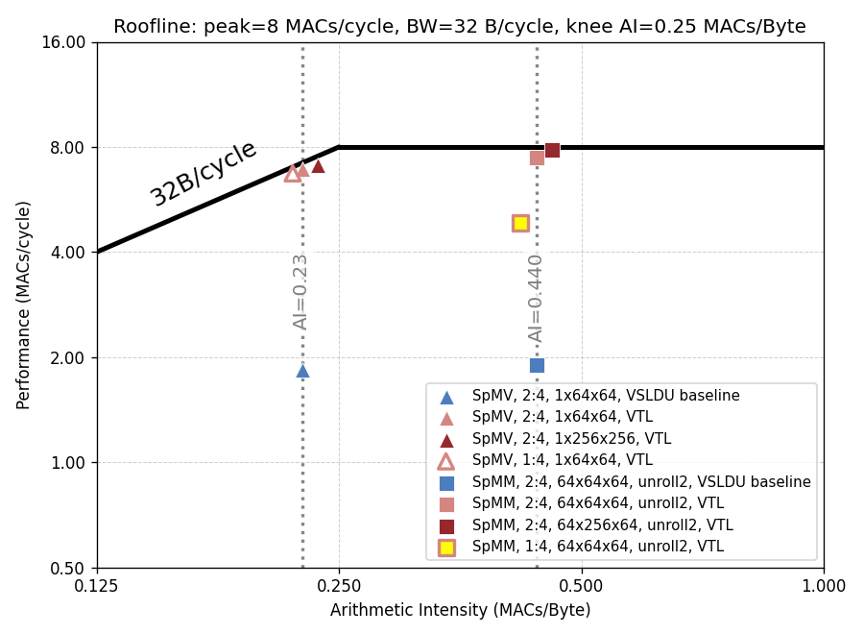
Performance Analysis
Scatter/Gather with Ventaglio
With 1:4 format, N=64, P=64
SpMV remains at the roofline. Index loading overhead is comparably larger than 2:4 format
SpMM performance drops
Reason: VTL memory-unit capacity + Unrolling
For dense GEMM, a common latency-hiding technique: more unrolling (e.g., 2× → 4×)
For Ventaglio + Gustavson, this becomes expensive → must hold temporal accumulations in the VTL memory unit
Unrolling along M-dimension requires multiple accumulation vectors resident simultaneously.
With sparsity, the accumulation vector can expand relative to the weight vector → Lower LMUL supported
84.1%
60.1%

Slide 10
Performance Analysis
Current supported settings (SEW=32, unroll=2×):
LMUL=2 @ 1:4 sparsity format
Memory unit capacity: 8192-bit, adding ~8% area @ Spatz core level.
Cannot fully hide control overhead
Solutions:
Increase memory-unit capacity, trading off area
Introduce ‘post-increment’ semantics into RVV
84.1%
60.1%

Slide 11
Ventaglio: Status and Next Step
Status:
Ventaglio RTL wrap-up;
Roofline model for performance analysis;
Backend results analysis, area breakdown.
Remaining tasks:
Design cleanup, back to GVSoC

Slide 12
3D Systolic GEMM on Cluster-Stacked System
Worked on 3D variant of systolic GEMM
Current assumptions:
HBM still planar (attached on two base edges)
Vertical links have same BW as planar ones
For now: use RedMulE as compute (comparable to 2D SoftHier baseline)
In-layer flow remains the same
Inputs (X) are streamed west to east, weights (W) south to north
Output (Y) tiles are stationary, stored in south HBM once complete
X, W are double-buffered in TCDM
HBM
HBM
HBM
HBM
HBM
HBM
HBM
HBM
HBM
z = 0 (base layer) view:
Like 2D systolic GEMM, but narrower W, Y tiles: distributed among stacked clusters. Output Y is stationary.
HBM
HBM
X
HBM
HBM
HBM
HBM
HBM
W
HBM

Slide 13
3D Systolic GEMM: Vertical Dataflow
Partition W tiles among layers
South-edge clusters “pull up” tiles fetched from HBM in base layer
Only used subtiles are moved / kept
Local subtile is streamed north
Full X tiles reused among layers
West edge “pulls up” full X tiles → reuse
Tiles then streamed west as in 2D
Finished Y tiles written back directly
As in 2D, clusters close to HBM start and finish first → low contention
z
w₃
y
w₂
w₃
w₁
w₂
w₃
HBM
w₀
w₁
w₂
w₃
z
x
y
x
x
HBM
x

Slide 14
3D Systolic GEMM: Status and Next Steps
Current status:
Implemented first version of 3D kernel
Debugging implementation in GVSoC
Next steps:
Measure performance benefits of 3D stacking vs. 2D SoftHier
Analyze layer scaling and optimize implementation
Implement further kernels (e.g. Attention)

