Slide 1
QuantSparse 3D Biweekly 2026-02-26
Integrated Systems Laboratory (ETH Zürich)
Bowen Wang bowwang@iis.ee.ethz.ch Paul Scheffler paulsc@iis.ee.ethz.ch
Chi Zhang chizhang@iis.ee.ethz.ch
Luca Benini lbenini@iis.ee.ethz.ch

Slide 2
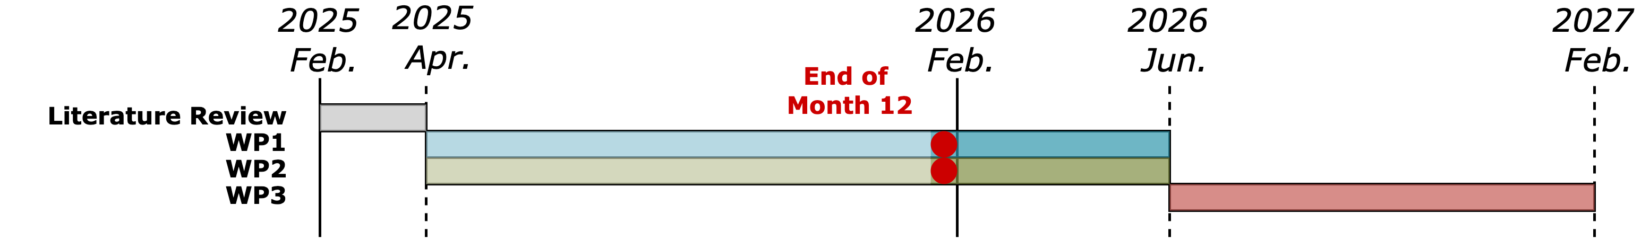
Agenda
Progress Update
Ventaglio – Post-increment semantics for RVV, perf. benchmark
3D System – First systolic 3D GEMM evaluation and analysis
Timeline
Discussion

Slide 3
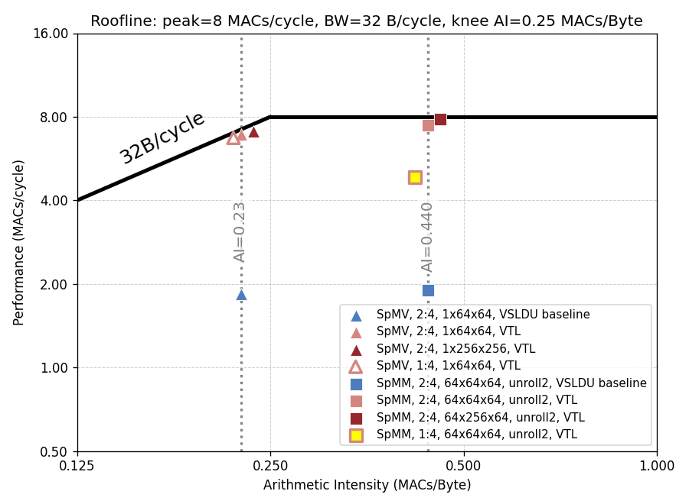
Recap: Performance Analysis
Ventaglio status:
Ventaglio RTL wrap-up;
Roofline model for performance analysis;
Backend results analysis, area breakdown.
Current supported settings (SEW=32, unroll=2×):
LMUL=2 @ 1:4 sparsity format
Memory unit capacity: 8192-bit, adding ~8% area @ Spatz core level.
Cannot fully hide control overhead
Solution:
Introduce ‘post-increment’ semantics into RVV
84.1%
60.1%

Slide 4
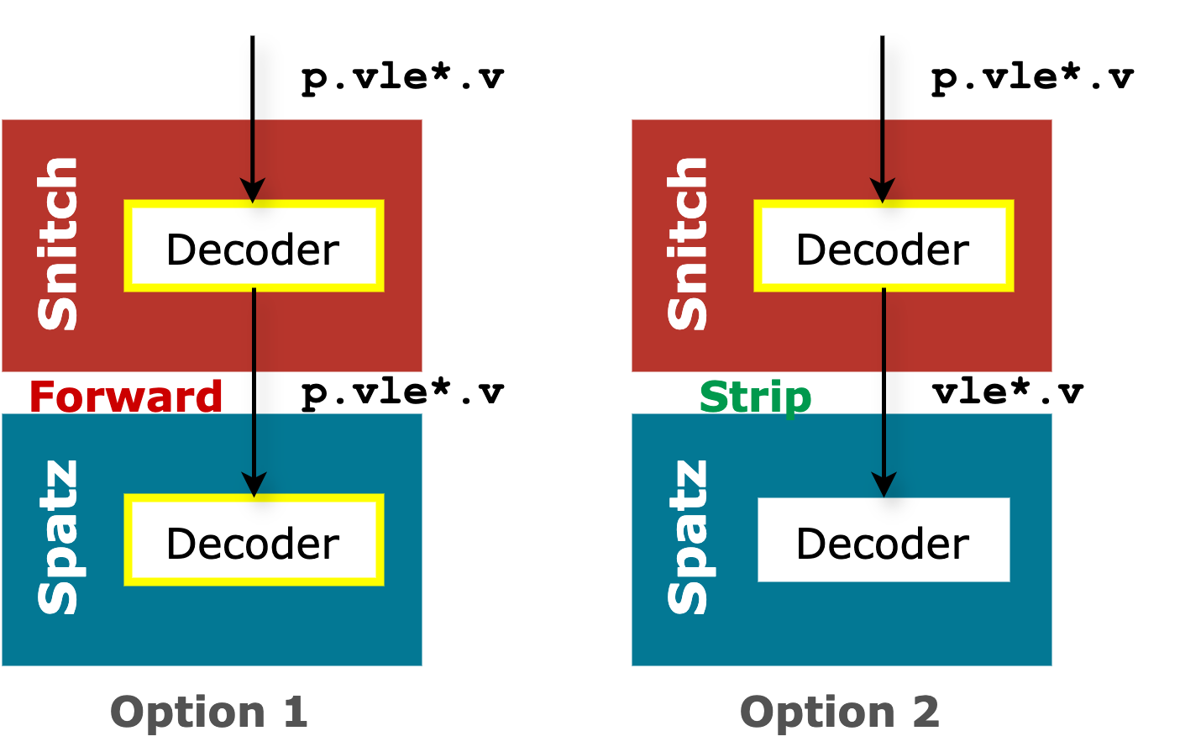
Post-increment instruction extension
Ventaglio for high sparse ratio MatMul
Objective: Eliminate explicit pointer updates → Improving VPU utilization when LMUL is small
The post-increment semantics should be added to
vle*.v: weight vectors
fl*: scalar activations
vlx*.v: index vectors
Two possible implementation approaches:
Option 1: Handle decoding in the Spatz controller → Need to add logics in both Snitch and Spatz decoder
Option 2: Strip the post-increment semantics in Snitch → Forward bare load requests to Spatz

Slide 5
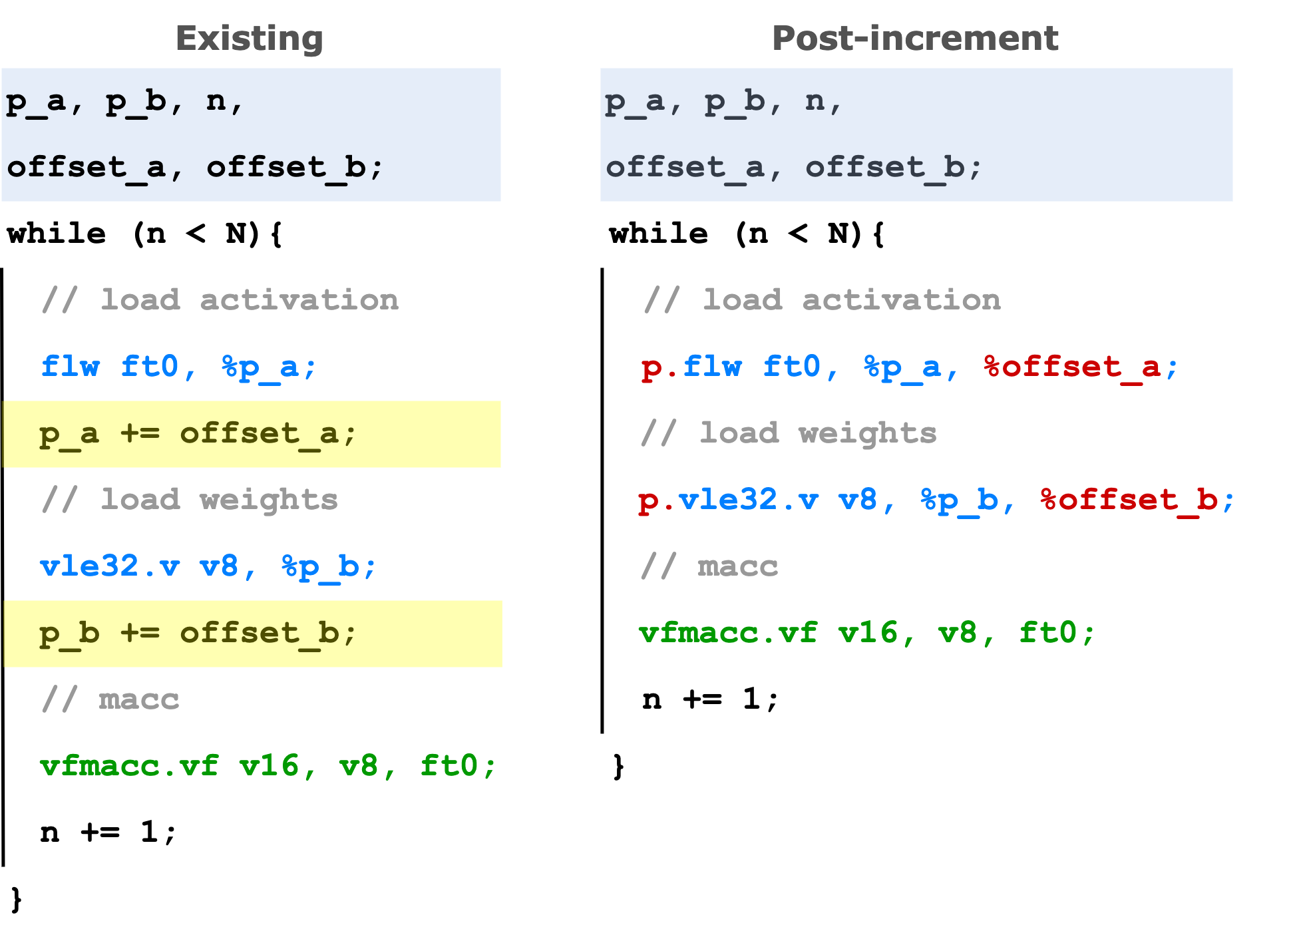
Post-increment instruction extension
Implementation status
Starting from the vanilla Spatz cluster, implemented the new instructions
vle*.v: weight vectors
fl*: scalar activations
Passed functional verification. Adapted the single-precision MatMul kernel that uses the new instructions.
Able to remove all pointer-update instructions. → The number of instructions in the inner loop is reduced by ~50%. (Consider loop unrolling.)

Slide 6
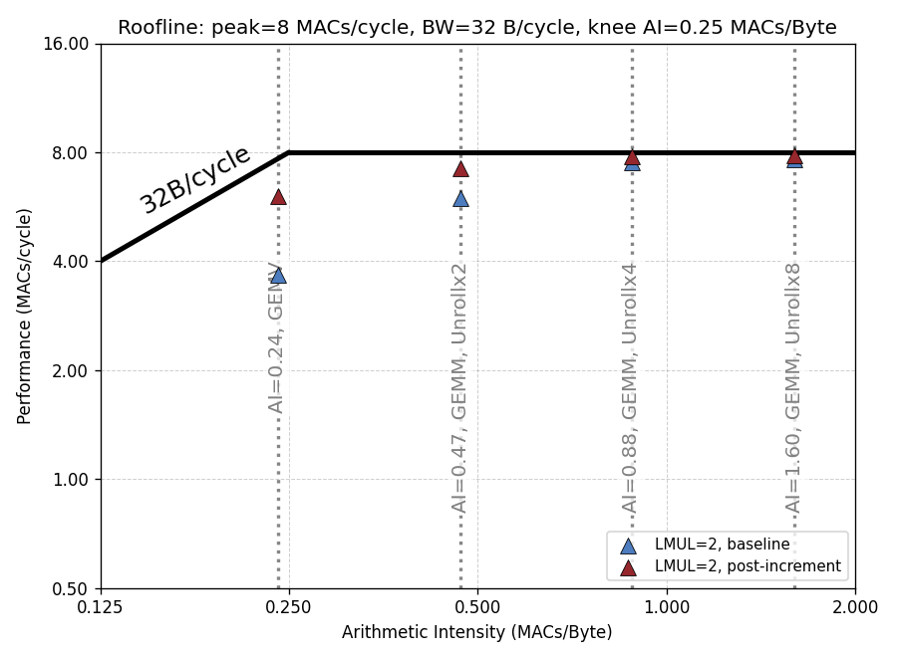
Post-increment instruction extension
64x64x64 GEMM workload with LMUL=2
With constrained LMUL settings, baseline VPU utilization is hindered by the overhead of control instructions.
Post-increment extension improves VPU utilization
With the VLSU commit logic optimization, the utilization is expected to be `at-the-roofline`.
Next step:
Merge the change with Ventaglio, benchmark
Work with Chi on Ventaglio modeling and calibration
75.7%
90.5%
97.4%
98.1%
1.2x
1.6x
74.4%
45.9%

Slide 7
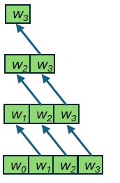
3D Systolic GEMM on Cluster-Stacked System
First measurements on systolic GEMM
Improved weight dataflow
What remains the same
Same in-layer dataflow: X east-west, W south-north, Y stored south
Same X tile, different W tiles per layer
What changed: W tile distribution
Before: partition W tiles, pass along sub-tiles
Now: each layer gets its own full W tile directly from HBM (no systolic Z movement)
No risk of underutilizing RedMulE
Better TCDM utilization & arith. intensity
HBM
HBM
X
HBM
HBM
HBM
HBM
HBM
HBM
HBM
W
z
w₃
z
y
w₂
y
w₁
HBM
HBM
w₀

Slide 8
3D Systolic GEMM: Performance Results
Good scaling for stacked layers
2 layers: 1.78× faster
4 layers: 2.98× faster
Scaling losses due to
Increased systolic delay
Longer writeback phase
At ≥4 layers: local link bottleneck
Limitation: local link at origin must move twice the HBM data
Must copy in weights (S) and inputs (W)
Limits sum of S and W HBM utils to 100%
Local link util saturates at 4 layers (86%)
Speedup
Local link utilization

Slide 9
3D Systolic GEMM: Status and Next Steps
Current status:
3D Systolic kernel running, demonstrating speedups until bound by local link
Next steps:
Investigate dataflows that avoid local link bottleneck (perhaps input/weight stationary)
Implement parametric 3D links (BW, arity)
Implement further kernels (e.g. Attention)

