Slide 1
QuantSparse 3D Biweekly 2026-03-12
Integrated Systems Laboratory (ETH Zürich)
Bowen Wang bowwang@iis.ee.ethz.ch
Chi Zhang chizhang@iis.ee.ethz.ch
Luca Benini lbenini@iis.ee.ethz.ch

Slide 2
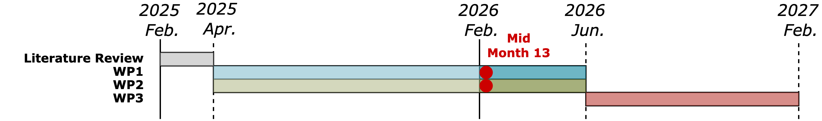
Agenda
Progress Update
Ventaglio – Integrated post-increment to Ventaglio, perf. benchmark
3D System – Discussion on architecture and dataflow exploration
Timeline
Discussion

Slide 3
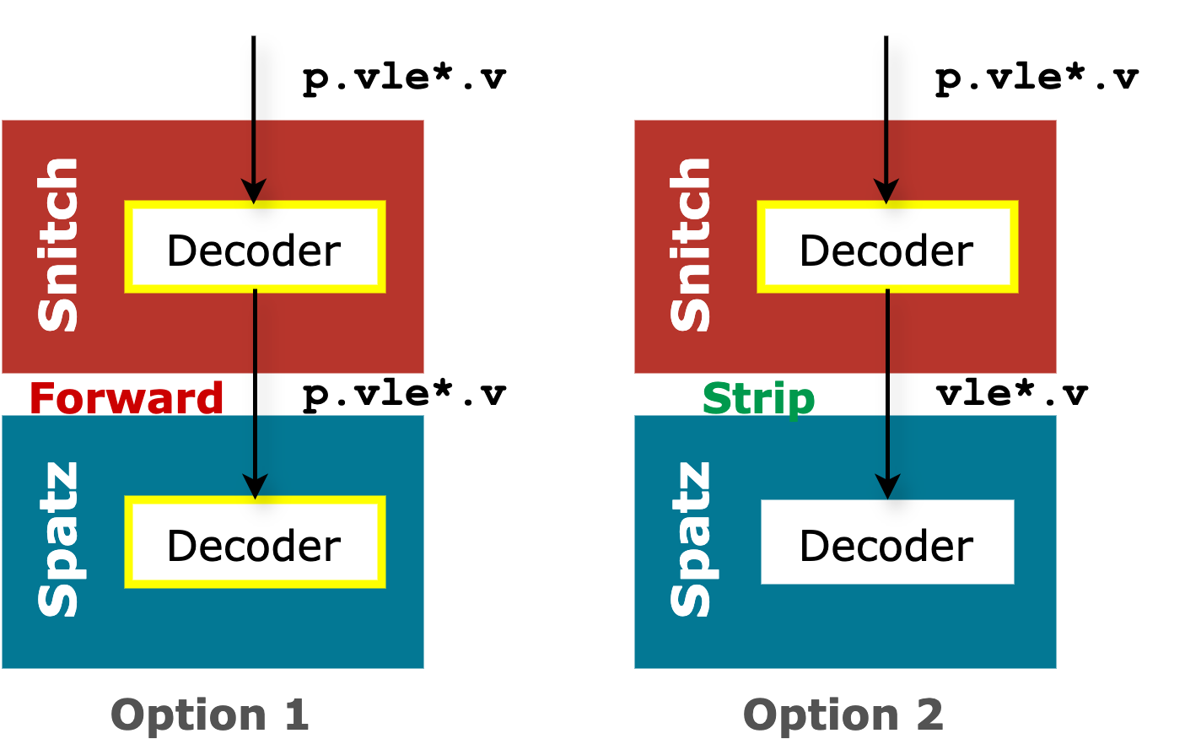
Recap: Post-increment instruction extension
Ventaglio for high sparse ratio MatMul
Objective: Eliminate explicit pointer updates → Improving VPU utilization when LMUL is small
The post-increment semantics should be added to
vle*.v: weight vectors
fl*: scalar activations
vlx*.v: index vectors
Strip the post-increment semantics in Snitch → Forward bare load requests to Spatz
In vanilla Spatz cluster:
vle*.v: weight vectors
fl*: scalar activations

Slide 4
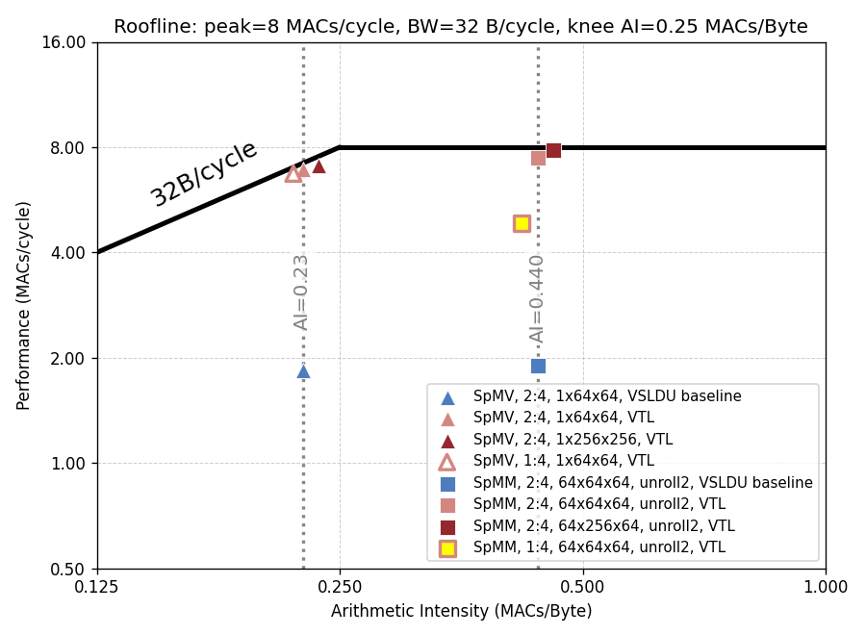
Post-increment instruction extension
Implementation finished
Integrated post-increment extension with Ventaglio
vle*.v: weight vectors
fl*: scalar activations
vlx*.v: index vectors
Passed functional verification. Adapted the single-precision SpMM, SpMV kernels that uses the new instructions.
60.1%

Slide 5
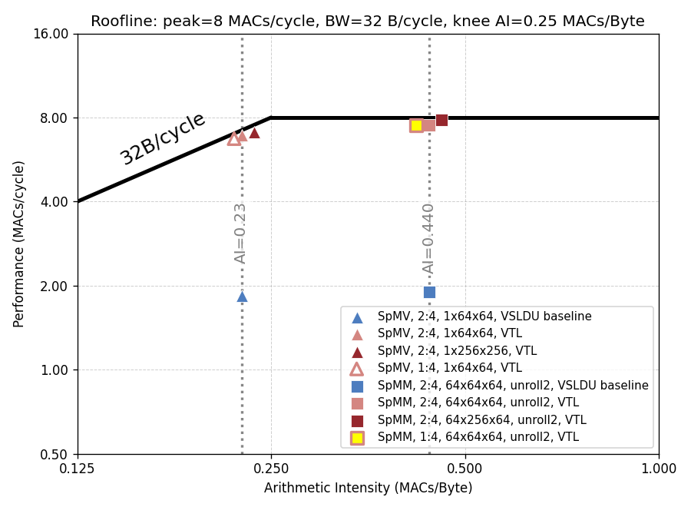
Post-increment instruction extension
Implementation status
Integrated post-increment extension with Ventaglio
vle*.v: weight vectors
fl*: scalar activations
vlx*.v: index vectors
Passed functional verification. Adapted the single-precision SpMM, SpMV kernels that uses the new instructions.
Removed explicit pointer updates
VPU achieves maximum utilization in each inner-loop, no gap between MACC operations.
Finished SpMM and SpMV HW-SW optimizations.
93.7%

Slide 6
Other Improvements and Next Steps
Completed custom instruction extensions
Added vfxmul.vf instruction, removed explicit Ventaglio memory unit reset;
All custom instructions have LLVM and RISC-V opcodes supports.
New features and fixed bugs
Simplified Ventaglio index-preload logic; removed complex preload FSM;
Improved Ventaglio memory unit to vid mapping under loop-unrolling with simple shift logics;
Fixed beat_counter in the scatter datapath for proper index refill.
New project launched
SA – Integrating Ventaglio with VMXDOTP
Inner-product dataflow; Bitmap indices for MX-blocks
Next step:
Started Ventaglio modeling and calibration → End-to-end benchmark

Slide 7
On 3D Architecture and Dataflow Exploration
Current status:
In previous discussions, we examined the 3D mesh topology for stacking compute clusters in SoftHier.
We also discussed the 3D systolic dataflow for GEMM operations.
Key questions need more discussion:
Network Topology:
Is a 3D mesh the optimal topology for this architecture?
Should we explore alternative topologies with lower network diameter?
What trade-offs arise in terms of latency, scalability, routing complexity, and physical layout?
Architecture Organization :
Is 3D stacking of compute tiles only the best architectural approach?
What is the optimal compute-to-memory ratio for this architecture?
How should memory and logic be organized to: Reduce thermal hotspots, Improve bandwidth and locality.
We Need a More Flexible and Extensible Architecture Description for 3D SoftHier !

