Slide 1
QuantSparse 3D Biweekly 2026-06-11
Integrated Systems Laboratory (ETH Zürich)
Bowen Wang bowwang@iis.ee.ethz.ch
Chi Zhang chizhang@iis.ee.ethz.ch
Luca Benini lbenini@iis.ee.ethz.ch

Slide 2
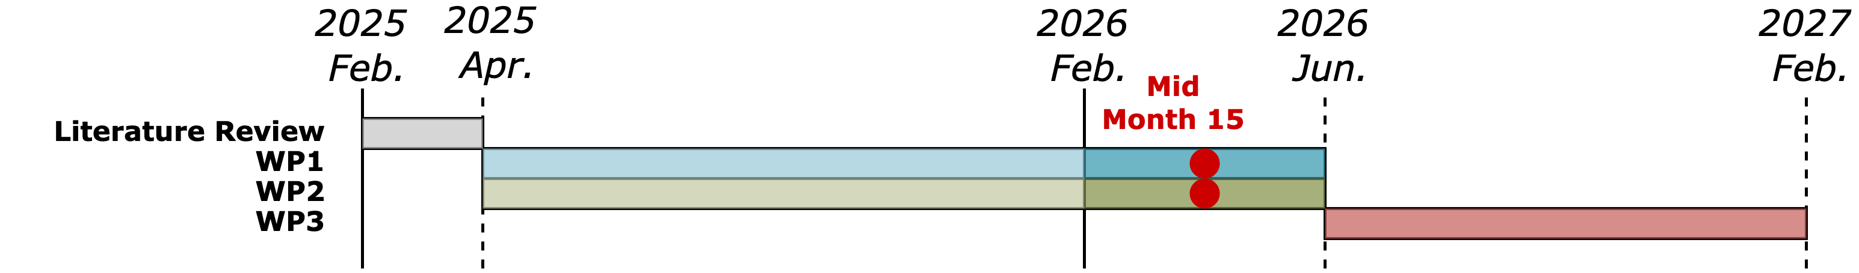
Agenda
Progress Update
3D System – 3D GEMV Benchmarks
TileLang – Methodology and progress update
Timeline
Discussion

Slide 3
3D stack DRAM-on-logic
We already modeled by extending SoftHier
For Each Cluster add arbiters to:
1. DRAM channels on top
2. NoC Routers in the logic die
To SYNC NoC Router
3D-stack DRAM
To DATA NoC Router
I $
Vector
Engine
Core 0
Matrix
Engine
DMA
NoC Router
Core 0
TSV
Cluster
Cluster
Cluster
Cluster
…
R
R
R
R
Cluster
Cluster
Cluster
Cluster
Core n
R
R
R
R
Cluster
Cluster
Cluster
Cluster
Interconnect
R
R
R
R
Cluster
Cluster
Cluster
Cluster
L1 local memory
DRAM.ch CTRL
R
R
R
R
logic
TE Cluster

Slide 4
Benchmark 3D GEMV
Simple GEMV dataflow for 3D-DRAM arch
x
=
cluster
cluster
cluster
cluster
cluster
cluster
cluster
cluster
cluster
cluster
cluster
cluster
M
M
M
M
cluster
cluster
cluster
cluster
cluster
cluster
cluster
cluster
cluster
cluster
cluster
cluster
M
M
M
M
cluster
cluster
cluster
cluster
cluster
cluster
cluster
cluster
cluster
cluster
cluster
cluster
M
M
M
M
cluster
cluster
cluster
cluster
cluster
cluster
cluster
cluster
cluster
cluster
cluster
cluster
M
M
M
M
1.Row-wise Multicast
2. Cluster-wise local GEMV
3. Col-wise Reduce

Slide 5
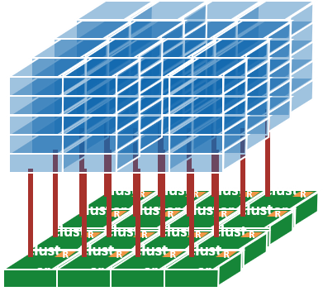
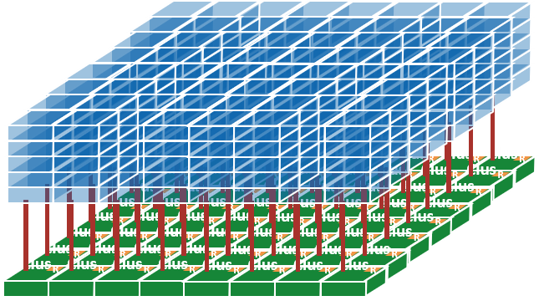
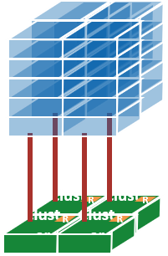
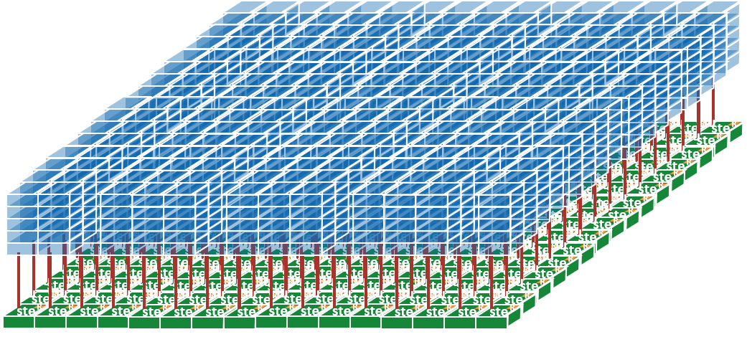
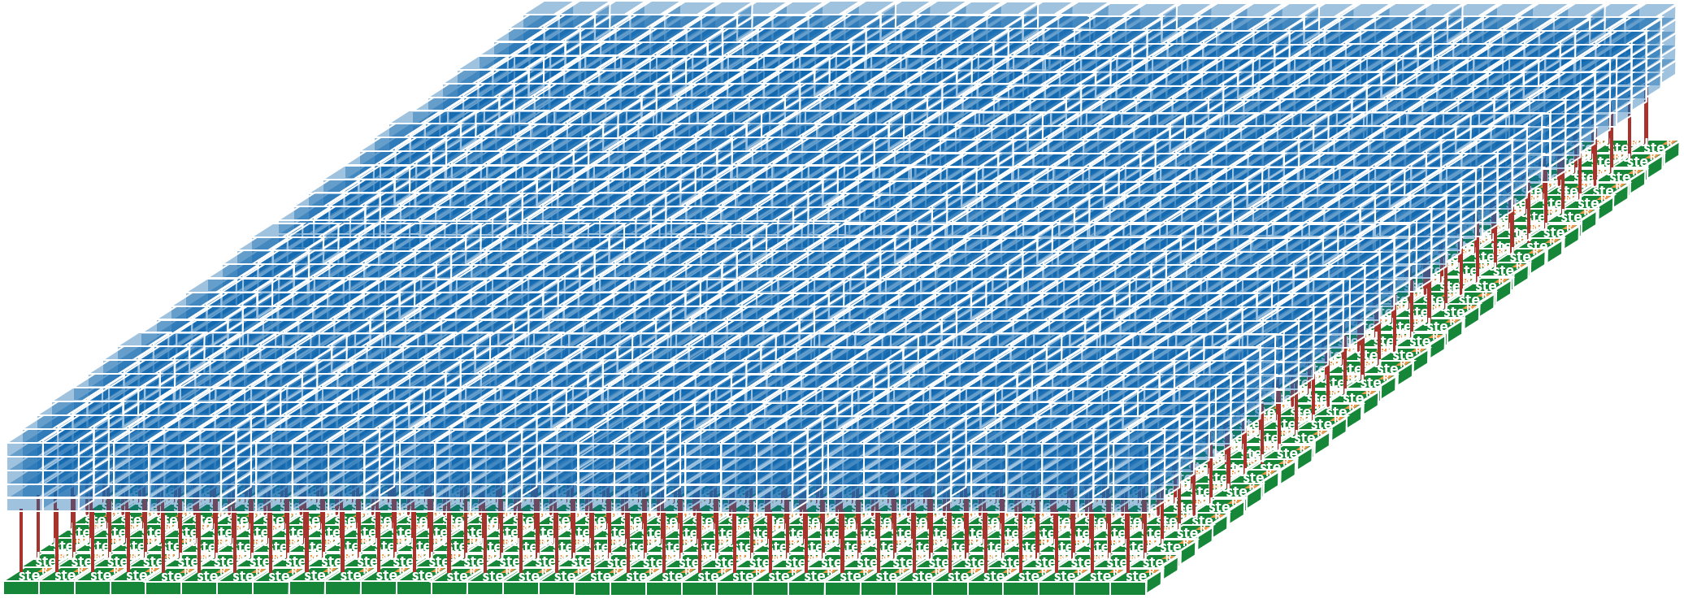
Benchmark 3D GEMV
Benchmark on different arch scales
3D_2x2
3D-DRAM BW = 0.25TB/s
3D_4x4
3D-DRAM BW = 1TB/s
3D_8x8
3D-DRAM BW = 4TB/s
3D_16x16
3D-DRAM BW = 16TB/s
3D_32x32
3D-DRAM BW = 64TB/s

Slide 6
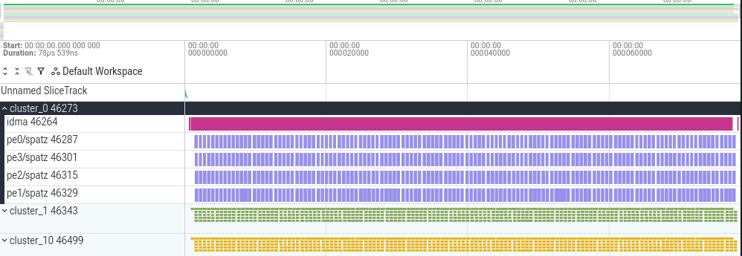
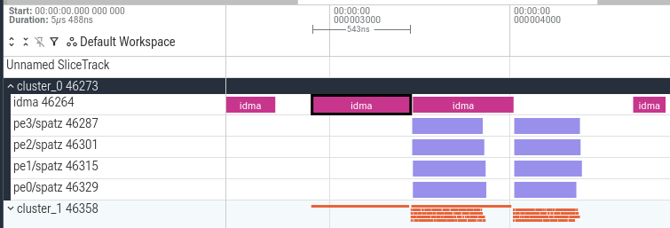
Benchmark 3D GEMV
Benchmark FP8 GEMV 4096x16384
Tile size = 128x256
Scale out -> Fewer data per channel -> hard to amortize double-buffer pipeline latency
We need smarter & fine-grain dataflow design

Slide 7
Motivation: Lifting the Programming Abstraction for Scalable Systems
Hardware scales for scaling of ML workloads
ML system scale-out with heterogeneity and additional hierarchy → scaling programming complexity
To program:
Threads as the abstraction unit for programming → Too many hardware details and primitives to consider
Do programmers have an easier-to-use abstraction that balances performance and productivity?

Slide 8
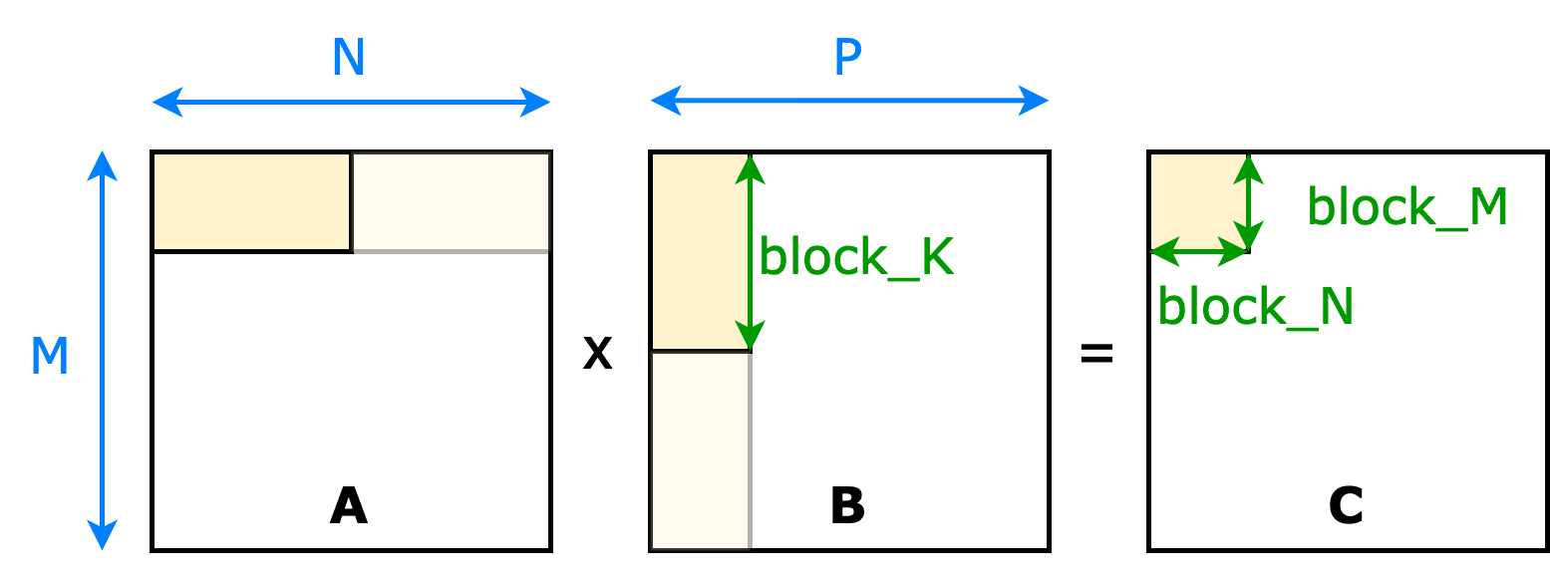
TileLang: Tile-based Domain-Specific Language
Tilelang programming example: GEMM
@tilelang.jit
def matmul(A, B, C, M, N, K, block_M, block_N, block_K):
Tile as an abstraction level
Designed for NVIDIA GPU
TVM as the backbone for code transformation and code generation
CONFIGURE PHYSICAL COMPUTE UNIT (grid, block config in GPU)
with T.Kernel(ceildiv(N,block_N), ceildiv(M,block_M)) as (bx, by):
DECLARE BUFFERS
A_shared = T.alloc_shared((block_M, block_K), dtype)
B_shared = T.alloc_shared((block_K, block_N), dtype)
C_local = T.alloc_fragment((block_M, block_N), dtype);
T.clear(C_local)
REDUCE OVER K — pipelining with double-buffering
for ko in T.Pipelined(ceildiv(K, block_K), num_stages=2):
TILE LOAD
T.copy(A[by*block_M, ko*block_K], A_shared)
T.copy(B[ko*block_K, bx*block_N], B_shared)
COMPUTE
T.gemm(A_shared, B_shared, C_local)
TILE STORE
T.copy(C_local, C[by*block_M, bx*block_N])
Introducing TileLang to SoftHier, two missing components:
Collective communication primitives
Explicit cluster-level execution bindings
Programmer hand-codes on tiles:
Dataflow
Memory management
programmer expresses where data lives and what to compute; compiler decides how and when
github: tile-ai/tilelang

Slide 9
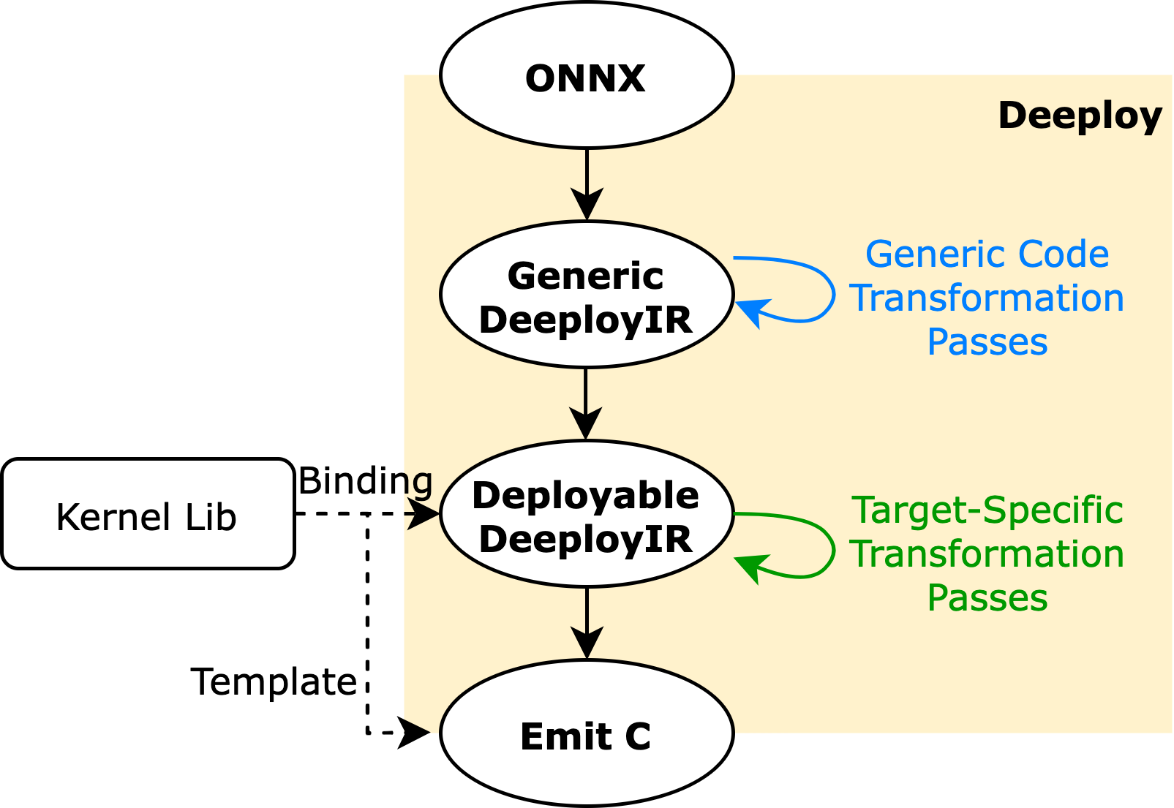
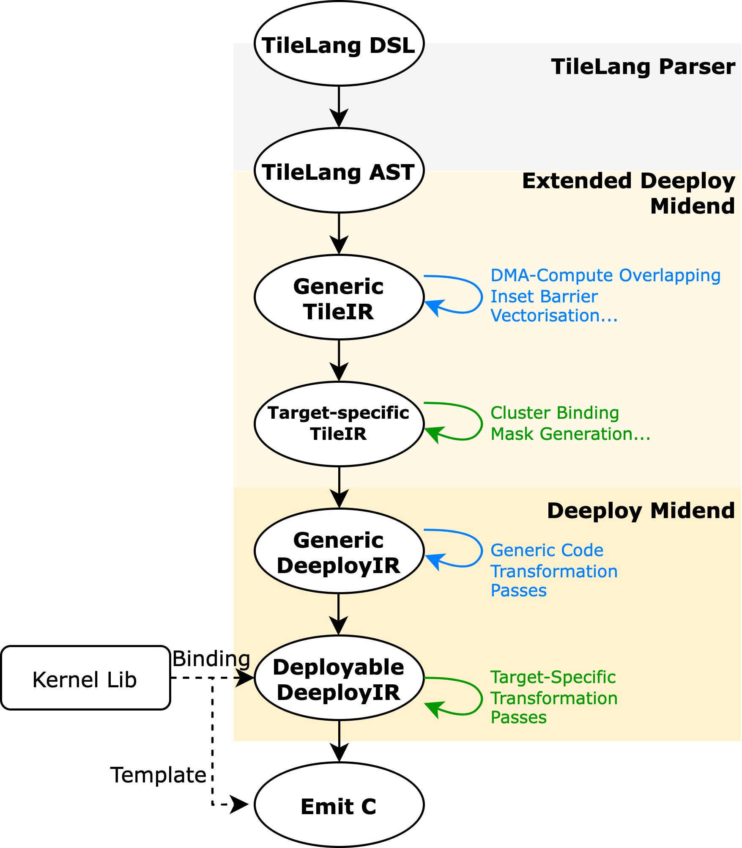
Deeploy: Bring Automation to Code Transformation
A Compiler for Code Generation
Deeploy
Lowers ONNX operator graphs to C
Allows customized optimization passes
Graph IR frontend
A Programming Model
Tilelang DSL
Tile-level abstraction for programmer
Allows customized dataflow definition
Targets GPU

Slide 10
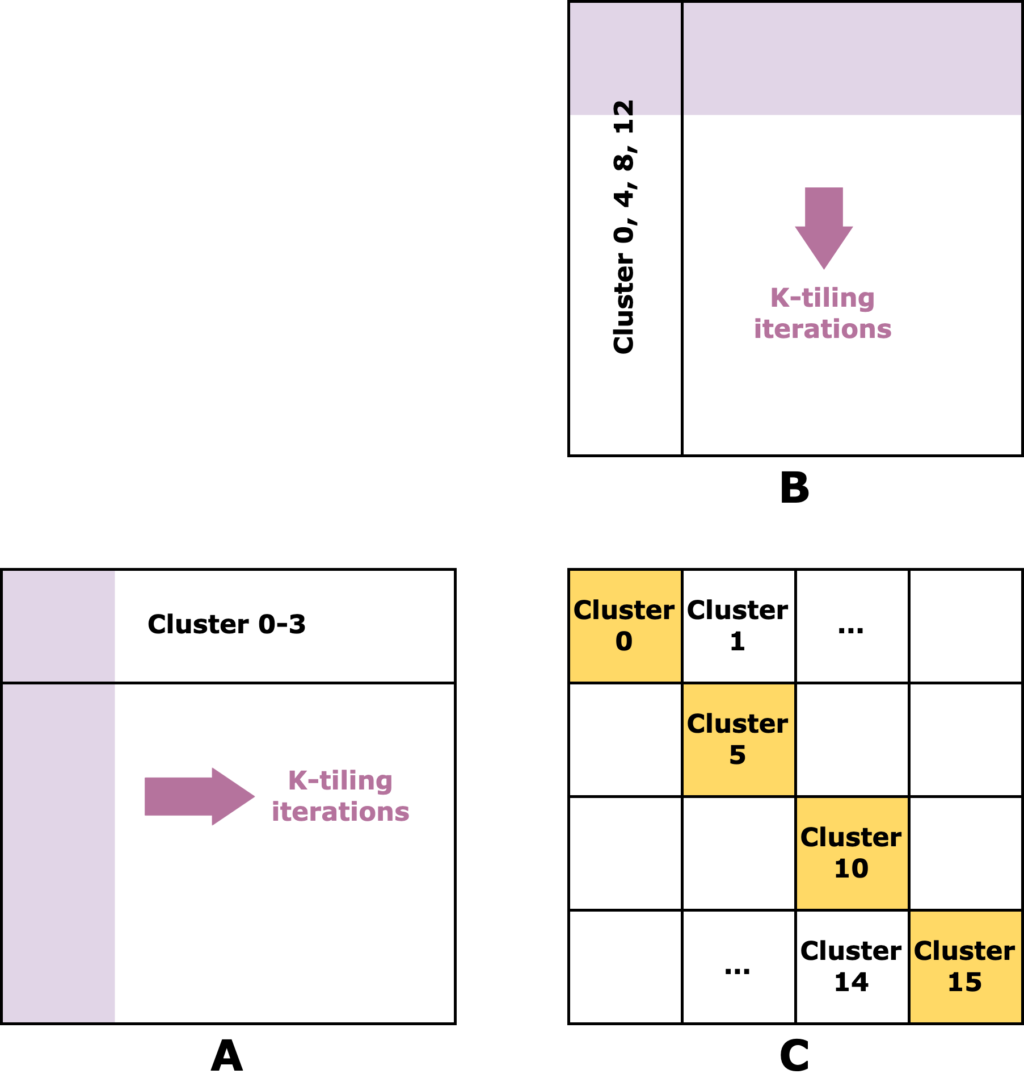
DSL: Extension on TileLang
To support tile-based many-PE architecture:
Explicit binding of work with physical cluster, accelerator units
Explicit memory allocation at local TCDM or HBM
Explicit communication between clusters
Explicit synchronization at different scopes
@tilelang.jit
def summa_gemm(A, B, C, M, K, N,
BM, BN, BK: int, SX, SY: int, GX, GY: int):
// In this example, SX=GX, SY=GY (1 Group per System)
with T.Kernel(T.ceildiv(M,GY*BM), T.ceildiv(N,GX*BN)) as (by, bx):
with T.cluster_group("summa", x=GX, y=GY, axes=("x", "y")) as (inst_id, local_x, local_y):
A_local = T.alloc_l1((BM, BK), dtype)
B_local = T.alloc_l1((BK, BN), dtype)
C_local = T.alloc_l1((BM, BN), dtype)
T.clear(C_local)
for bk in T.Pipelined(T.ceildiv(K, BK), num_stages=2):
if local_x == local_y:
T.copy(A[(by * GY + local_y) * BM, bk * BK], A_local)
T.copy(B[bk * BK, (bx * GX + local_x) * BN], B_local)
T.broadcast(A_local, level="intra_group", axis="x",
group="summa", root=local_y)
T.broadcast(B_local, level="intra_group", axis="y",
group="summa", root=local_x)
T.gemm(A_local, B_local, C_local, clear_accum=False)
T.copy(C_local, C[(by*GY+local_y)*BM, (bx*GX+local_x)*BN])

Slide 11
DSL: Extension on TileLang
To support tile-based many-PE architecture:
Explicit binding of work with physical cluster, accelerator units
Explicit memory allocation at local TCDM or HBM
Explicit communication between clusters
Explicit synchronization at different scopes
For simplicity, what are added and exposed to programmer:
Schedule:
Hierarchical schedule T.cluster_group
with axis annotation and spatial cluster id
A scheduling scope higher than single cluster tile, lower than entire chip
Communication:
Collective communication T.broadcast, T.reduce
Simplify communication patterns for programmers
Reuse Tilelang parser to generate Tilelang Abstract Syntax Tree (AST)
Others handled by compiler
@tilelang.jit
def summa_gemm(A, B, C, M, K, N,
BM, BN, BK: int, SX, SY: int, GX, GY: int):
// In this example, SX=GX, SY=GY (1 Group per System)
with T.Kernel(T.ceildiv(M,GY*BM), T.ceildiv(N,GX*BN)) as (by, bx):
with T.cluster_group("summa", x=GX, y=GY, axes=("x", "y")) as (inst_id, local_x, local_y):
A_local = T.alloc_l1((BM, BK), dtype)
B_local = T.alloc_l1((BK, BN), dtype)
C_local = T.alloc_l1((BM, BN), dtype)
T.clear(C_local)
for bk in T.Pipelined(T.ceildiv(K, BK), num_stages=2):
if local_x == local_y:
T.copy(A[(by * GY + local_y) * BM, bk * BK], A_local)
T.copy(B[bk * BK, (bx * GX + local_x) * BN], B_local)
T.broadcast(A_local, level="intra_group", axis="x",
group="summa", root=local_y)
T.broadcast(B_local, level="intra_group", axis="y",
group="summa", root=local_x)
T.gemm(A_local, B_local, C_local, clear_accum=False)
T.copy(C_local, C[(by*GY+local_y)*BM, (bx*GX+local_x)*BN])

Slide 12
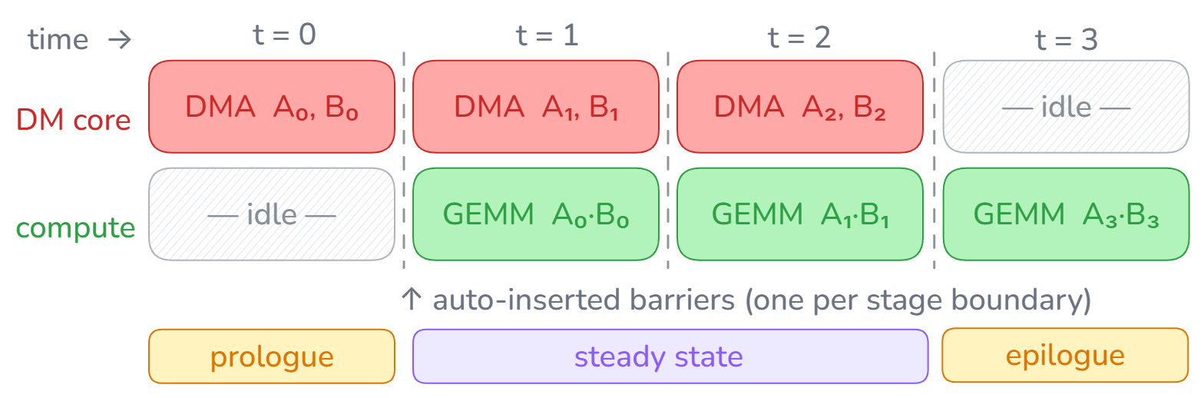
Compiler: what the compiler decides
User Writes
Compiler Decides
T.cluster_group("tp", x=4, y=1,num_groups=4,
axes=("x","y")) as (gid,local_x, local_y)
Logical cluster groups → physical clusters
[0,1,2,3] [4,5,6,7] [8,9,10,11] [12,13,14,15]
Logical axes, id recorded
Topology
with T.cluster_group(…) as (gid,local_x, local_y):
T.broadcast(A_local, axis="x", level=“intra_group", root=local_y)
row_mask = 0x3 col_mask = 0xF
If (cluster_id == local_y) {
flex_dma_async_broadcast(...,
row_mask, col_mask, ...);
}
Collectives
for bk in T.Pipelined(K//BK, num_stages=2):
T.copy(A → A_local)
T.gemm(A_local, B_local, C_local)
Pipelining
for i in T.Parallel(chunk):
x[i] = T.sigmoid(x[i])
work split: per-core SID, strided base addr stripmine: vsetvli loop over hardware VLEN op decomp: sigmoid → vfmul·vfexp·vfdiv·vfadd·vfdiv emission: inline RISC-V V asm for Spatz Engine
Vectorization

Slide 13
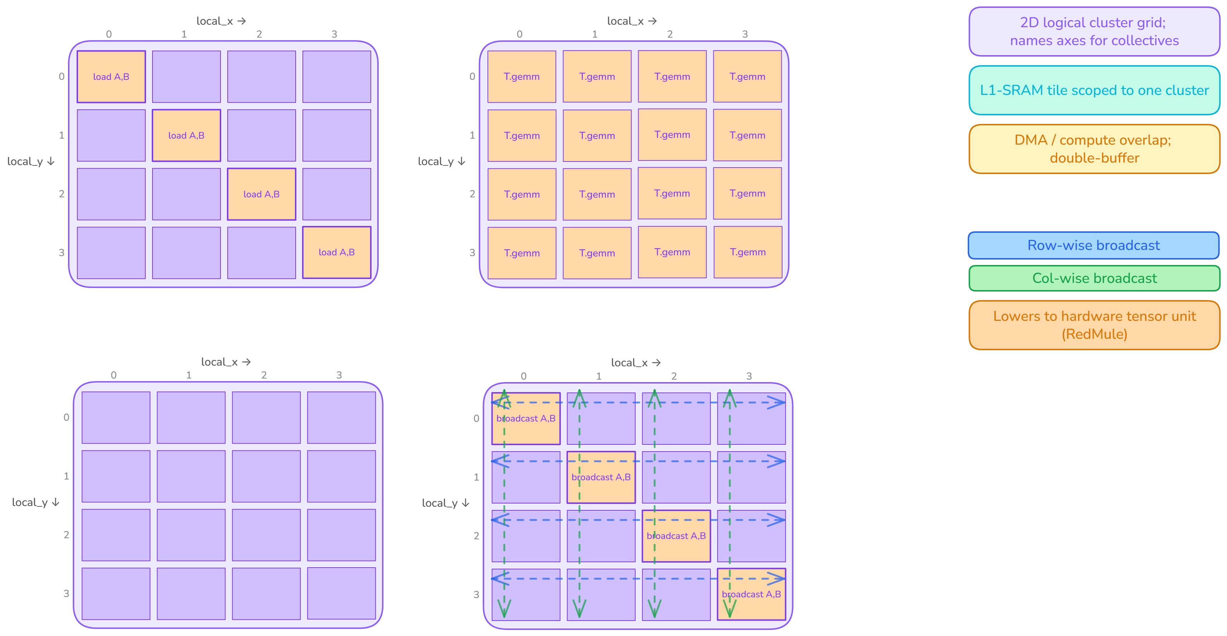
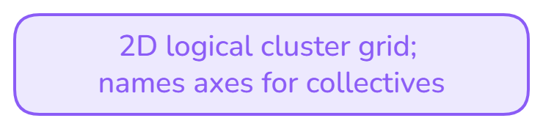
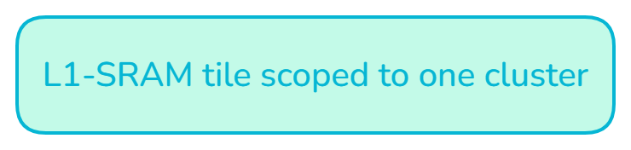
Kernel: 2D SUMMA GEMM
@tilelang.jit
def summa_gemm(A, B, C, M, K, N,
BM: int, BN: int, BK: int, GX: int, GY: int):
with T.Kernel(T.ceildiv(M,GY*BM), T.ceildiv(N,GX*BN)) as (by, bx):
with T.cluster_group("summa", x=GX, y=GY, num_groups=1,
axes=("x", "y")) as (inst_id, local_x, local_y):
A_local = T.alloc_fragment((BM, BK), dtype)
B_local = T.alloc_fragment((BK, BN), dtype)
C_local = T.alloc_fragment((BM, BN), dtype)
T.clear(C_local)
for bk in T.Pipelined(T.ceildiv(K, BK), num_stages=2):
if local_x == local_y:
T.copy(A[(by * GY + local_y) * BM, bk * BK], A_local)
T.copy(B[bk * BK, (bx * GX + local_x) * BN], B_local)
T.broadcast(A_local, level="intra_group", axis="x",
group="summa", root=local_y)
T.broadcast(B_local, level="intra_group", axis="y",
group="summa", root=local_x)
T.gemm(A_local, B_local, C_local, clear_accum=False)
T.copy(C_local, C[(by*GY+local_y)*BM, (bx*GX+local_x)*BN])
Numerical verification against a bit-true golden:
Reference: RedMule's exact FP16 FMA in software.
Verified with different input shapes.

Slide 14
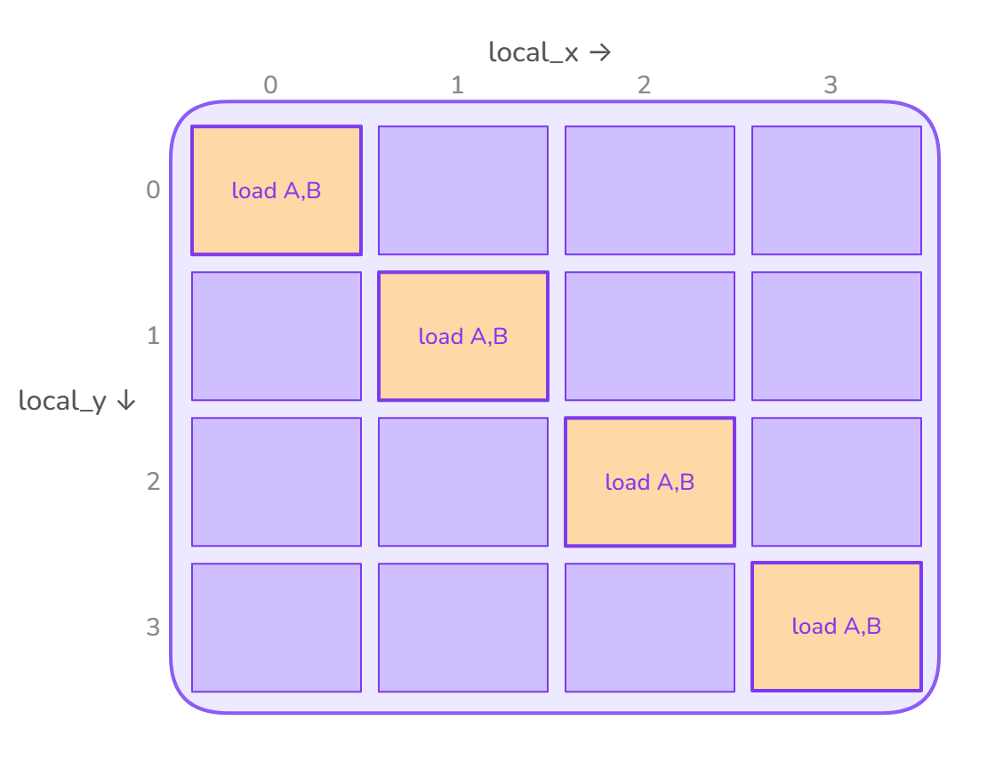
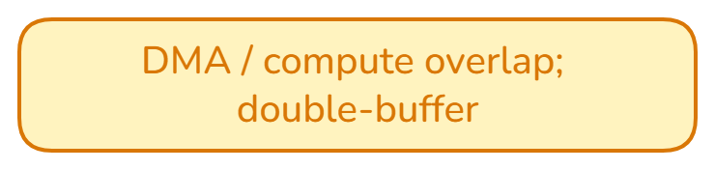
Kernel: 2D SUMMA GEMM
@tilelang.jit
def summa_gemm(A, B, C, M, K, N,
BM: int, BN: int, BK: int, GX: int, GY: int):
with T.Kernel(T.ceildiv(M,GY*BM), T.ceildiv(N,GX*BN)) as (by, bx):
with T.cluster_group("summa", x=GX, y=GY, num_groups=1,
axes=("x", "y")) as (inst_id, local_x, local_y):
A_local = T.alloc_fragment((BM, BK), dtype)
B_local = T.alloc_fragment((BK, BN), dtype)
C_local = T.alloc_fragment((BM, BN), dtype)
T.clear(C_local)
for bk in T.Pipelined(T.ceildiv(K, BK), num_stages=2):
if local_x == local_y:
T.copy(A[(by * GY + local_y) * BM, bk * BK], A_local)
T.copy(B[bk * BK, (bx * GX + local_x) * BN], B_local)
T.broadcast(A_local, level="intra_group", axis="x",
group="summa", root=local_y)
T.broadcast(B_local, level="intra_group", axis="y",
group="summa", root=local_x)
T.gemm(A_local, B_local, C_local, clear_accum=False)
T.copy(C_local, C[(by*GY+local_y)*BM, (bx*GX+local_x)*BN])
Numerical verification against a bit-true golden:
Reference: RedMule's exact FP16 FMA in software.
Verified with different input shapes.

Slide 15
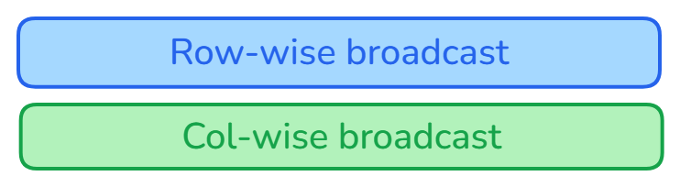
Kernel: 2D SUMMA GEMM
@tilelang.jit
def summa_gemm(A, B, C, M, K, N,
BM: int, BN: int, BK: int, GX: int, GY: int):
with T.Kernel(T.ceildiv(M,GY*BM), T.ceildiv(N,GX*BN)) as (by, bx):
with T.cluster_group("summa", x=GX, y=GY, num_groups=1,
axes=("x", "y")) as (inst_id, local_x, local_y):
A_local = T.alloc_fragment((BM, BK), dtype)
B_local = T.alloc_fragment((BK, BN), dtype)
C_local = T.alloc_fragment((BM, BN), dtype)
T.clear(C_local)
for bk in T.Pipelined(T.ceildiv(K, BK), num_stages=2):
if local_x == local_y:
T.copy(A[(by * GY + local_y) * BM, bk * BK], A_local)
T.copy(B[bk * BK, (bx * GX + local_x) * BN], B_local)
T.broadcast(A_local, level="intra_group", axis="x",
group="summa", root=local_y)
T.broadcast(B_local, level="intra_group", axis="y",
group="summa", root=local_x)
T.gemm(A_local, B_local, C_local, clear_accum=False)
T.copy(C_local, C[(by*GY+local_y)*BM, (bx*GX+local_x)*BN])
Numerical verification against a bit-true golden:
Reference: RedMule's exact FP16 FMA in software.
Verified with different input shapes.

Slide 16
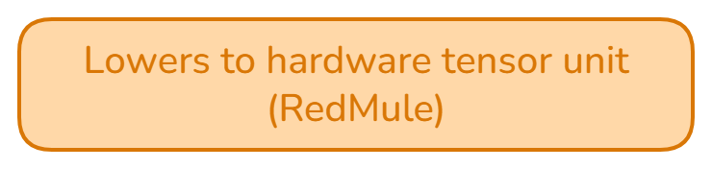
Kernel: 2D SUMMA GEMM
@tilelang.jit
def summa_gemm(A, B, C, M, K, N,
BM: int, BN: int, BK: int, GX: int, GY: int):
with T.Kernel(T.ceildiv(M,GY*BM), T.ceildiv(N,GX*BN)) as (by, bx):
with T.cluster_group("summa", x=GX, y=GY, num_groups=1,
axes=("x", "y")) as (inst_id, local_x, local_y):
A_local = T.alloc_fragment((BM, BK), dtype)
B_local = T.alloc_fragment((BK, BN), dtype)
C_local = T.alloc_fragment((BM, BN), dtype)
T.clear(C_local)
for bk in T.Pipelined(T.ceildiv(K, BK), num_stages=2):
if local_x == local_y:
T.copy(A[(by * GY + local_y) * BM, bk * BK], A_local)
T.copy(B[bk * BK, (bx * GX + local_x) * BN], B_local)
T.broadcast(A_local, level="intra_group", axis="x",
group="summa", root=local_y)
T.broadcast(B_local, level="intra_group", axis="y",
group="summa", root=local_x)
T.gemm(A_local, B_local, C_local, clear_accum=False)
T.copy(C_local, C[(by*GY+local_y)*BM, (bx*GX+local_x)*BN])
Numerical verification against a bit-true golden:
Reference: RedMule's exact FP16 FMA in software.
Verified with different input shapes.

Slide 17
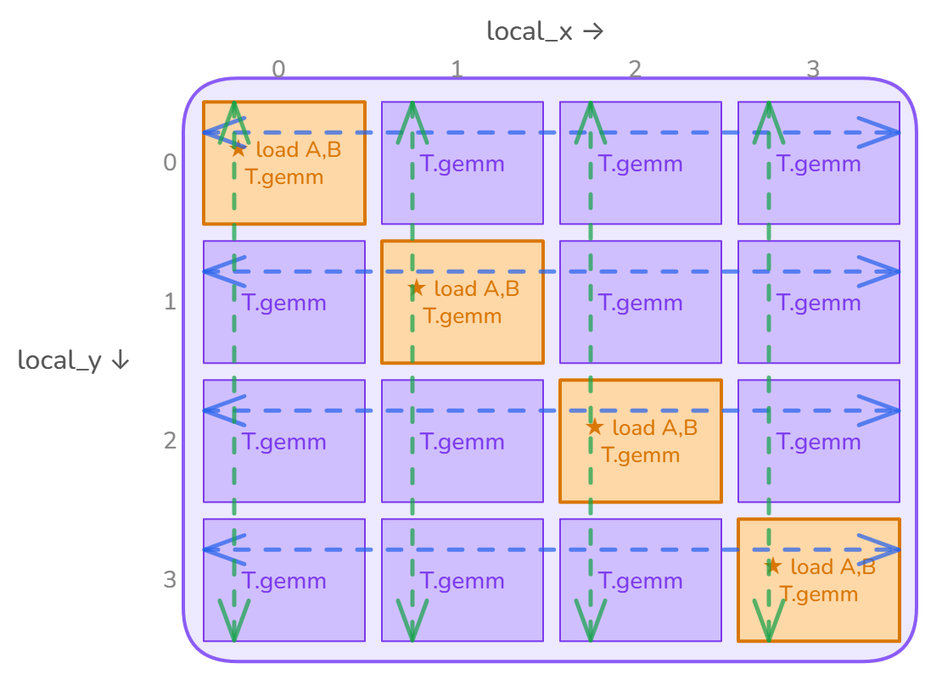
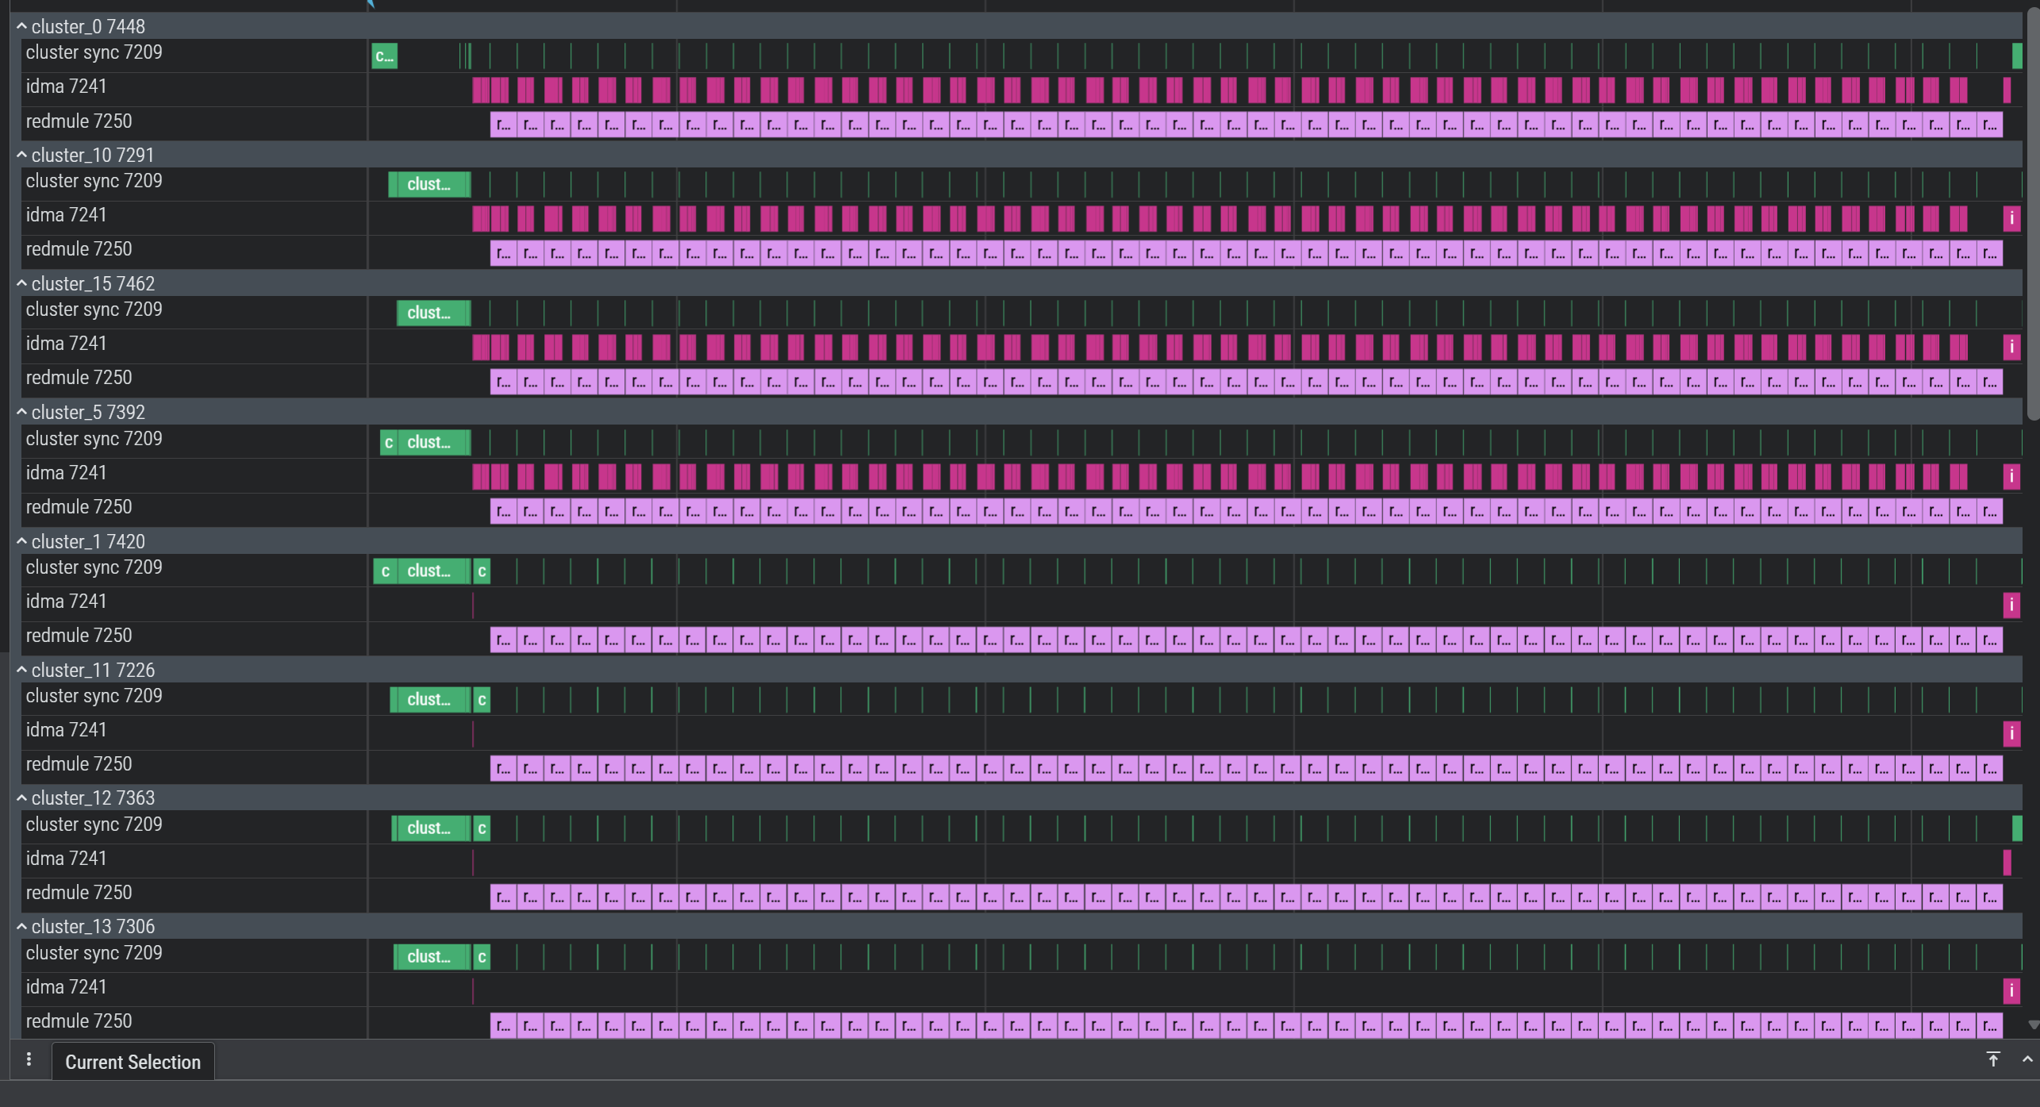
Kernel: 2D SUMMA GEMM
GVSOC TRACE — 16 CLUSTERS · M, K, N = 512, 7168, 512
iDMA Transfer
RedMule compute

Slide 18
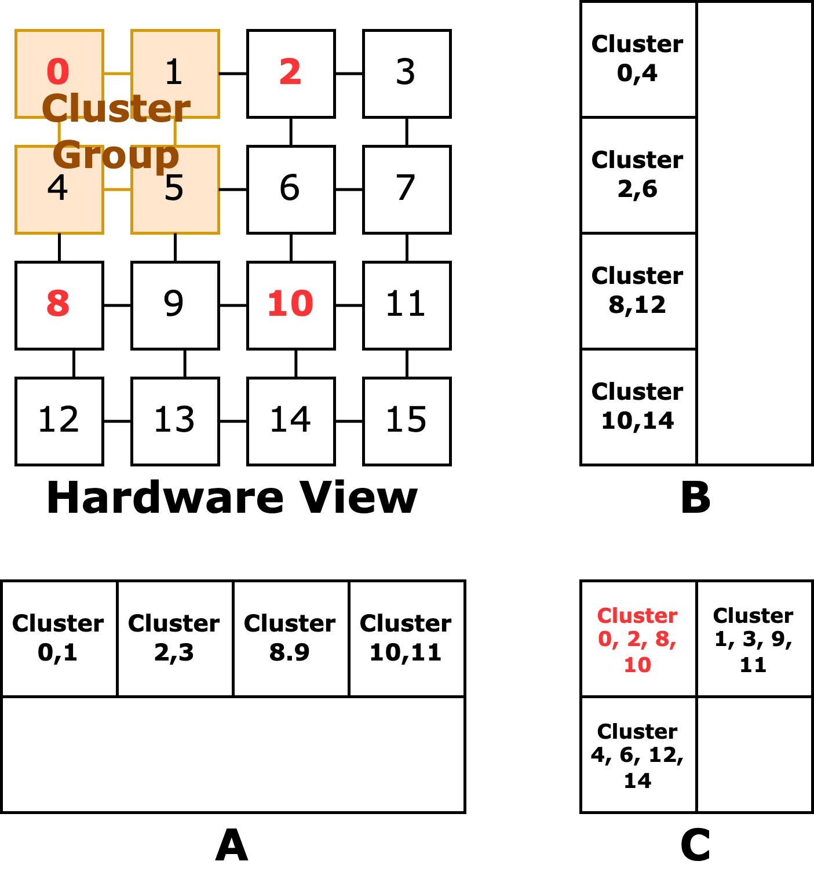
Kernel: SUMMA GEMM
with Split-K works easily
Partitioning K dimension into different cluster_group
Suitable for flat GEMM with small M dimension (e.g. 512x7168x2048)

Slide 19
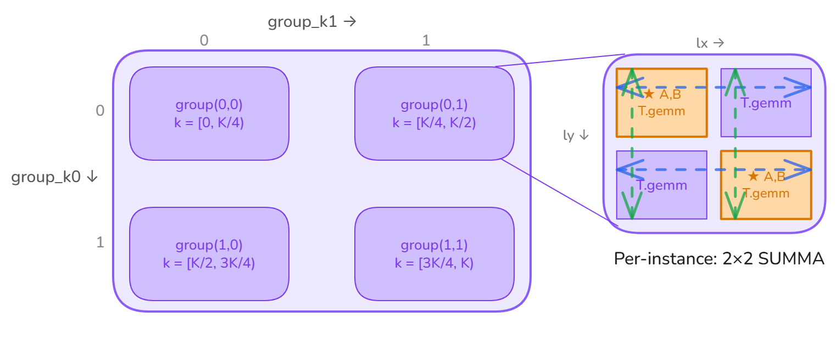
Kernel: SUMMA GEMM
with Split-K works easily
@tilelang.jit
def summa_gemm_split_k(A, B, C, M, K, N,
BM, BN, BK, SX, SY: int, GX, GY: int):
with T.Kernel(T.ceildiv(M,GY*BM), T.ceildiv(N,GX*BN)) as (by, bx):
with T.cluster_group("summa", x=GX, y=GY,
num_groups=(SX/GX)*(SY/GY),
axes=("x","y"), split_axes=("k0","k1"), split_shape=(GX, GY) ) as (inst_id, local_x, local_y, group_k0, group_k1):
# split K into different cluster groups
K_per_group = T.ceildiv(K, num_groups)
K_base = (group_k0*GX+group_GY)*K_per_group
for bk in T.Pipelined(T.ceildiv(K_per_group, BK), num_stages=2):
if local_x == local_y:
T.copy(A[(by * GY + local_y) * BM, K_base + bk * BK], A_local)
T.copy(B[K_base + bk * BK, (bx * GX + local_x) * BN], B_local)
T.broadcast(A_local, level="intra_group", axis="x",
group="summa", root=local_y)
T.broadcast(B_local, level="intra_group", axis="y",
group="summa", root=local_x)
T.gemm(A_local, B_local, C_local, clear_accum=False)
# reduce along k axis
T.reduce(C_local, op="sum", level="inter_group", axis="k0", group="summa")
T.reduce(C_local, op="sum", level="inter_group", axis="k1", group="summa")
# one cluster group copies back result
if inst_id == 0:
T.copy(C_local, C[(by*GY+local_y)*BM, (bx*GX+local_x)*BN])
Partitioning K dimension into different cluster_group
Suitable for flat GEMM with small M dimension (e.g. 512x7168x2048)

Slide 20
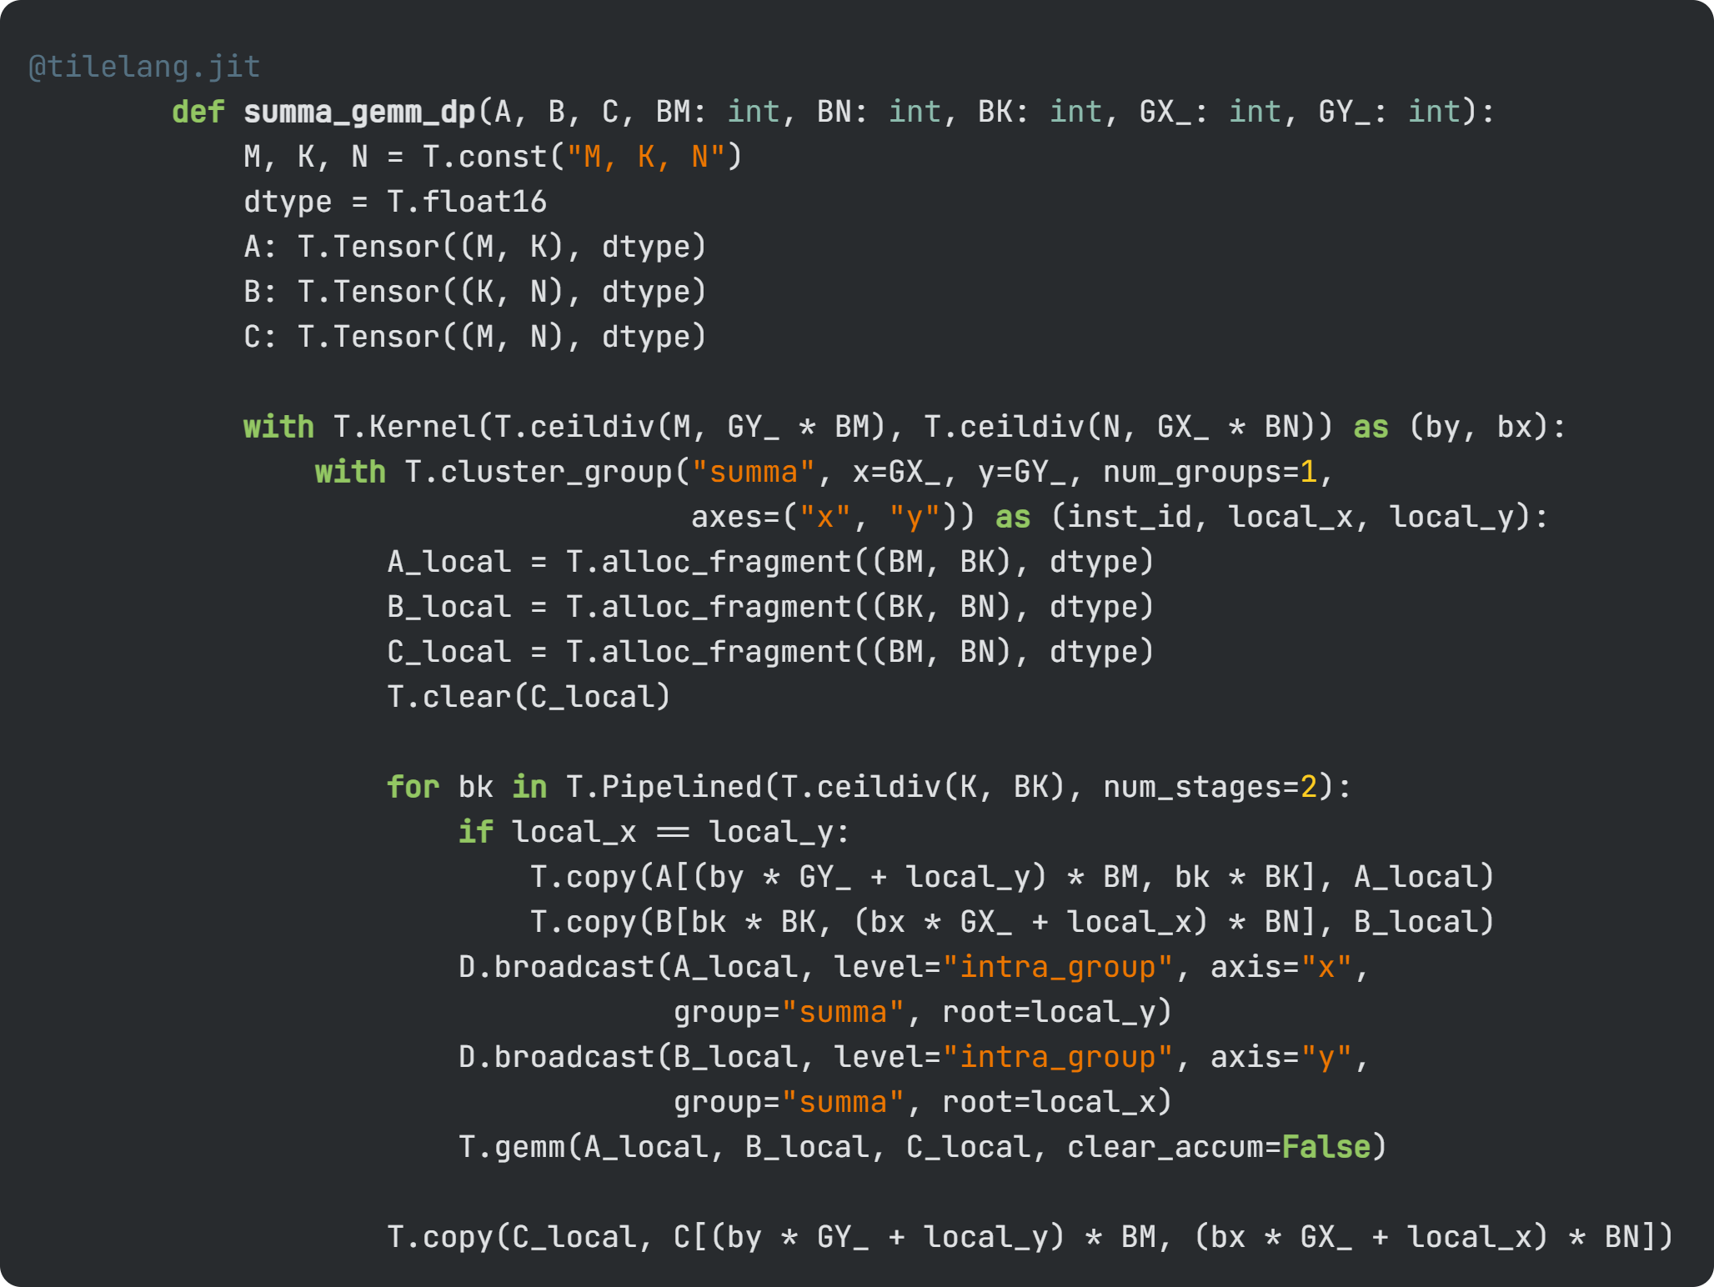
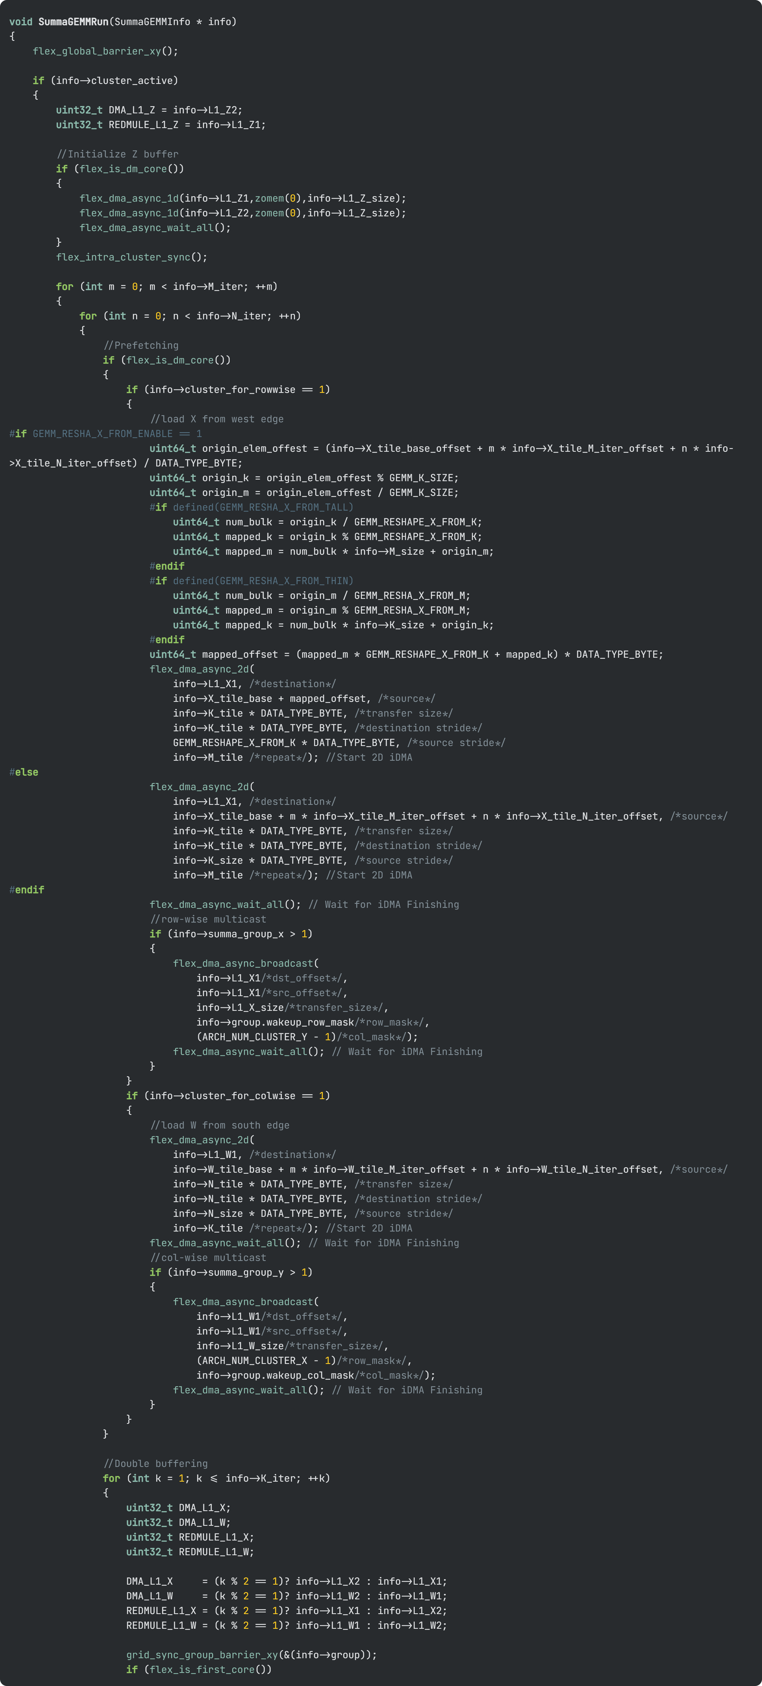
2D SUMMA GEMM: Tilelang DSL vs. Hand-Written C
TILELANG
HAND-WRITTEN C
20
523
lines of Tilelang code
lines of C
Both produce numerically correct C code
The 20 lines Tilelang code can control:
Tiling size, axis
Software pipeline
Collective communication strategy (axis, scope, root cluster)

Slide 21
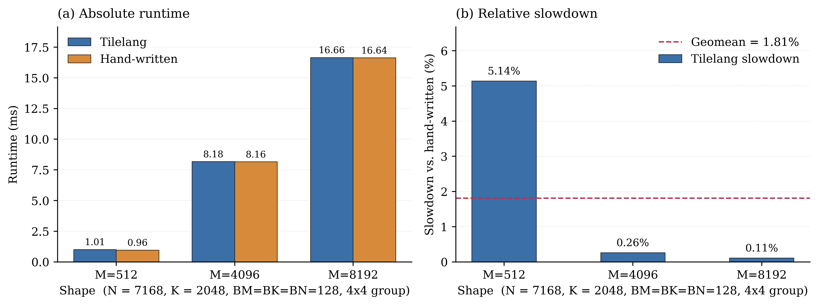
2D SUMMA GEMM: Tilelang DSL vs. Hand-Written C
Experimental variables:
Kernels produced by compiler
have performance close to hand-written C
Cluster Config: 4x4 clusters
Tile sizes: BM = BN = BK = 128

Slide 22
Summary
DSL: Extension on Tilelang targeting general tile-based many-PE hardware architecture
Utilization:
Macro kernels: simplified API, explicit dataflow control
Complex layers: Able to describe FlashAttention, easy adaptation from TileLang kernel libraries
Customized dataflow exploration: FlatAttention, 3D-FlatAttention
Current progress:
Semester project finished, code-cleanup and open-source in progress

