Slide 1
QuantSparse 3D Biweekly 2026-06-25
Integrated Systems Laboratory (ETH Zürich)
Bowen Wang bowwang@iis.ee.ethz.ch
Chi Zhang chizhang@iis.ee.ethz.ch
Luca Benini lbenini@iis.ee.ethz.ch

Slide 2
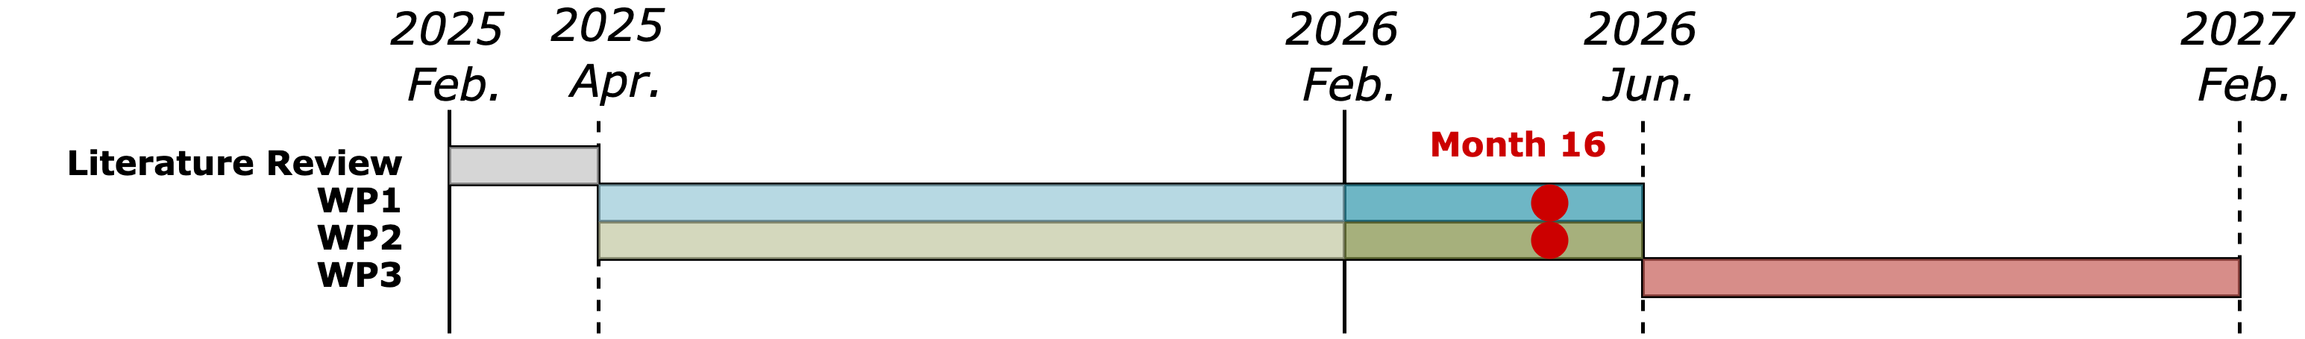
Agenda
Progress Update
Sparsity handling in memory endpoints
Ventaglio open-source release
Timeline
Discussion

Slide 3
Handling Sparsity Beyond Core-level
We handle fine-grained element-wise sparsity at core-level
Ventaglio for dual-sparsity at moderate-sparse regime
Unstructured extreme-sparse regime support under-developed
What is missing
In prefill stage:
matrix-matrix multiplication dominant
compute-bound, sparsity translate to end-to-end speedup
In auto-regressive decoding stage
vector-level tensor contraction
memory-bound, efficient sparsity handling in memory endpoints
Sparse attention, vector quantization induced codebook accesses
Vector-level gather from memory endpoint

Slide 4
Sparse Pattern Analysis
Sparse attention
What to gather: KV cache entries
How to gather: runtime generated indexing → core side generated
Access granularity: head dimension (128~512 elements) in multiple-GiB range
VQ codebook access
What to gather: codebook entries
How to gather: compile-time determined indexing → memory stored
Access granularity: 4-16 elements in multiple-MiB range

Slide 5
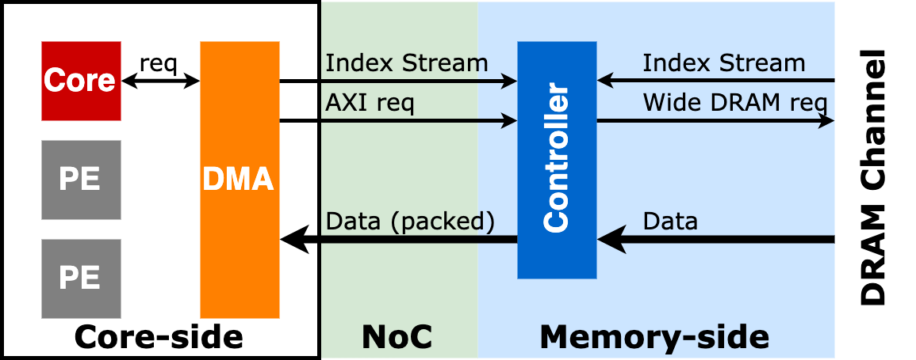
Memory-side Controller Extension for Sparsity Handling
Key features
Decoupled core request and data movement
Semantic extension for native index handling
Accept index streams from both core and memory side
Narrow access coalescing

Slide 6
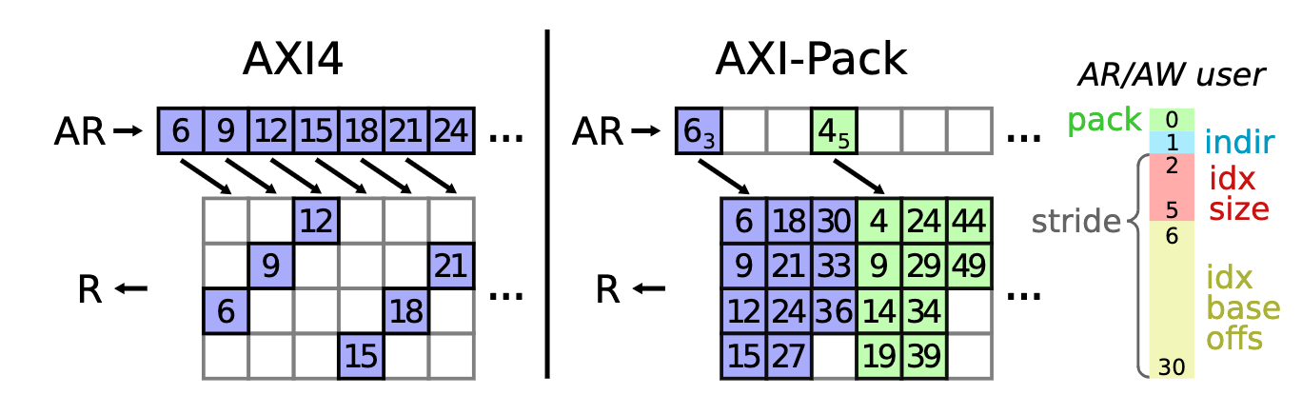
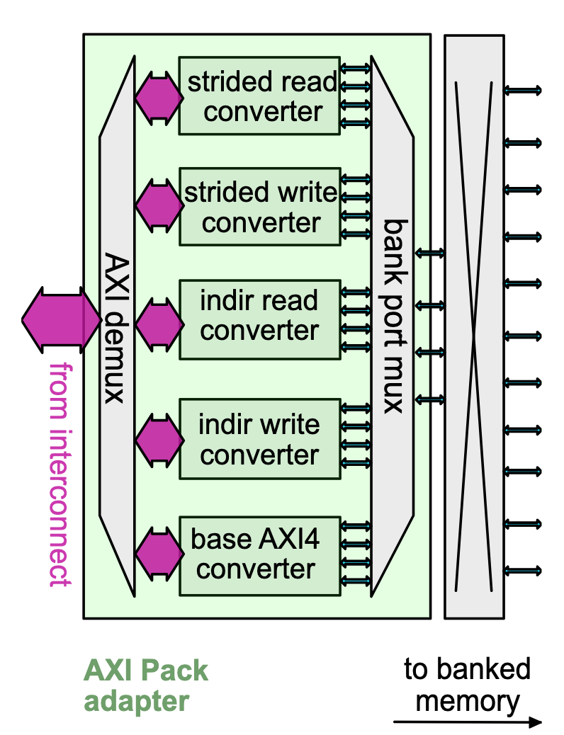
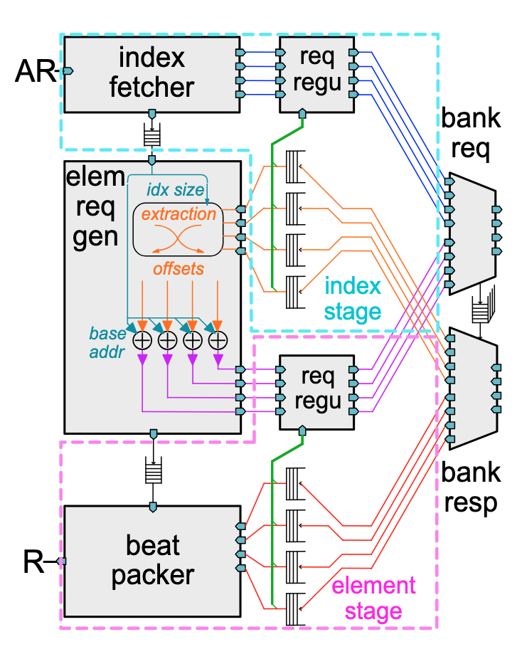
AXI-Pack: Bus Packing for AXI4 Indirect Accesses
Target: memory-side index streams
Extends the request channels AR and AW with user signals to support packed irregular burst
pack bit indicates whether extension is enabled
index size and base offset for indirect bursts
Controller architecture
Adapter translates both regular and irregular bursts to sequences of n parallel word accesses
Adapter forwards requests to converters for concurrent burst handling
index stage fetches indices from memory
element stage uses these indices to fetch indirect elements and pack them into R beats
requested elements packed by a beat packer as specified by metadata
Zhang, Chi, et al. "Axi-pack: Near-memory bus packing for bandwidth-efficient irregular workloads." 2023 Design, Automation & Test in Europe Conference & Exhibition (DATE). IEEE, 2023.

Slide 7
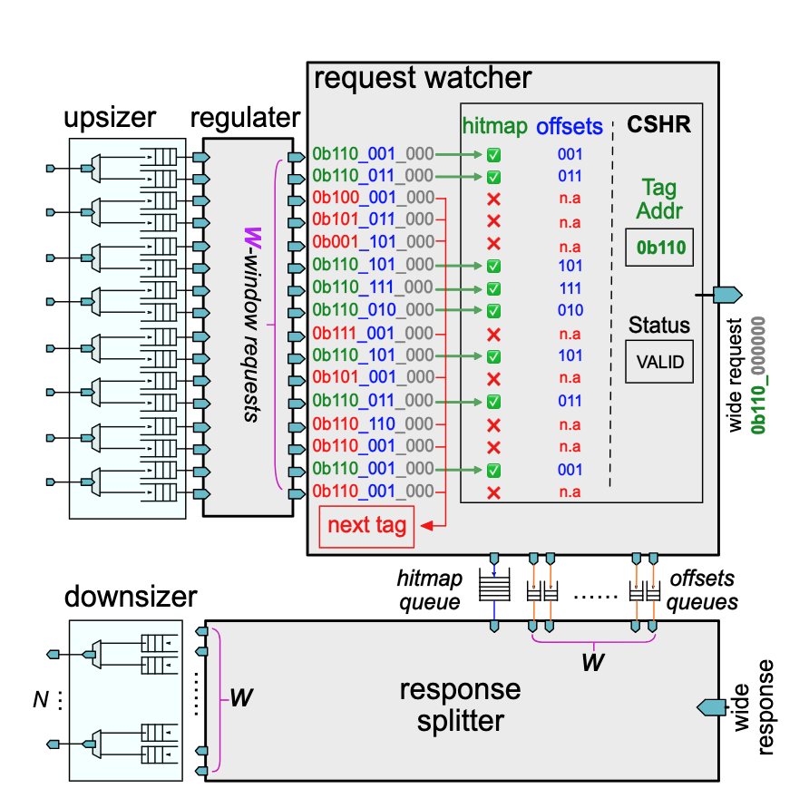
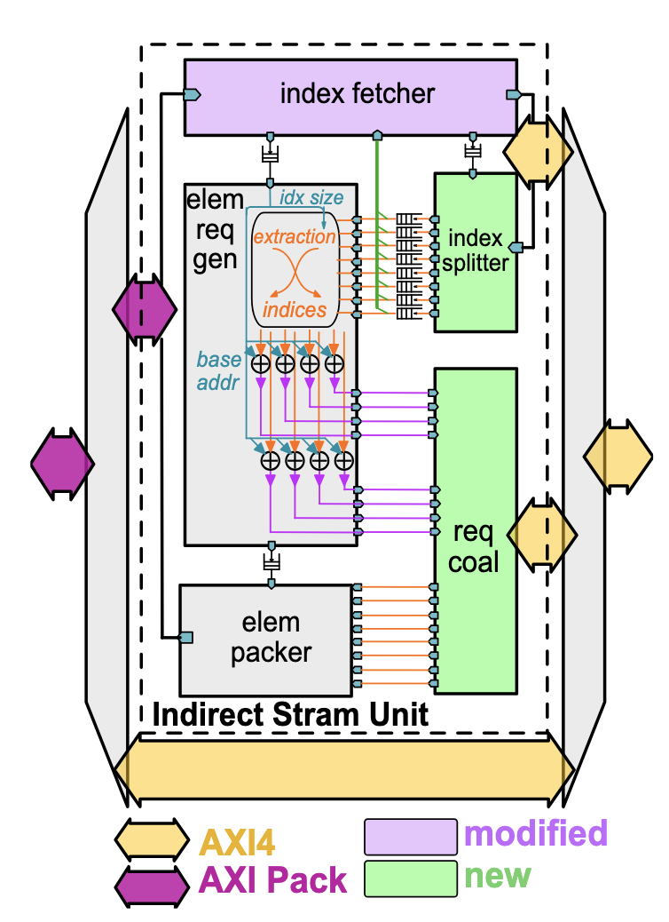
Near-Memory Parallel Indexing and Coalescing
Target: Index + DRAM access granularity
Push AXI-Pack to modern DRAM backend: backing narrow irregular stream elements onto wide memory buses
Controller architecture
element request generator produces N parallel narrow element requests based on the index stream
N parallel requests pass to coalescer to form wide DRAM access
Upsizer widen the request window
Request watcher identifies accesses targeting at the same wide DRAM block
Response splitter retrieves the parallel narrow elements from the wide downstream data response
Zhang, Chi, et al. "Near-memory parallel indexing and coalescing: Enabling highly efficient indirect access for SpMV." 2024 Design, Automation & Test in Europe Conference & Exhibition (DATE). IEEE, 2024.

Slide 8
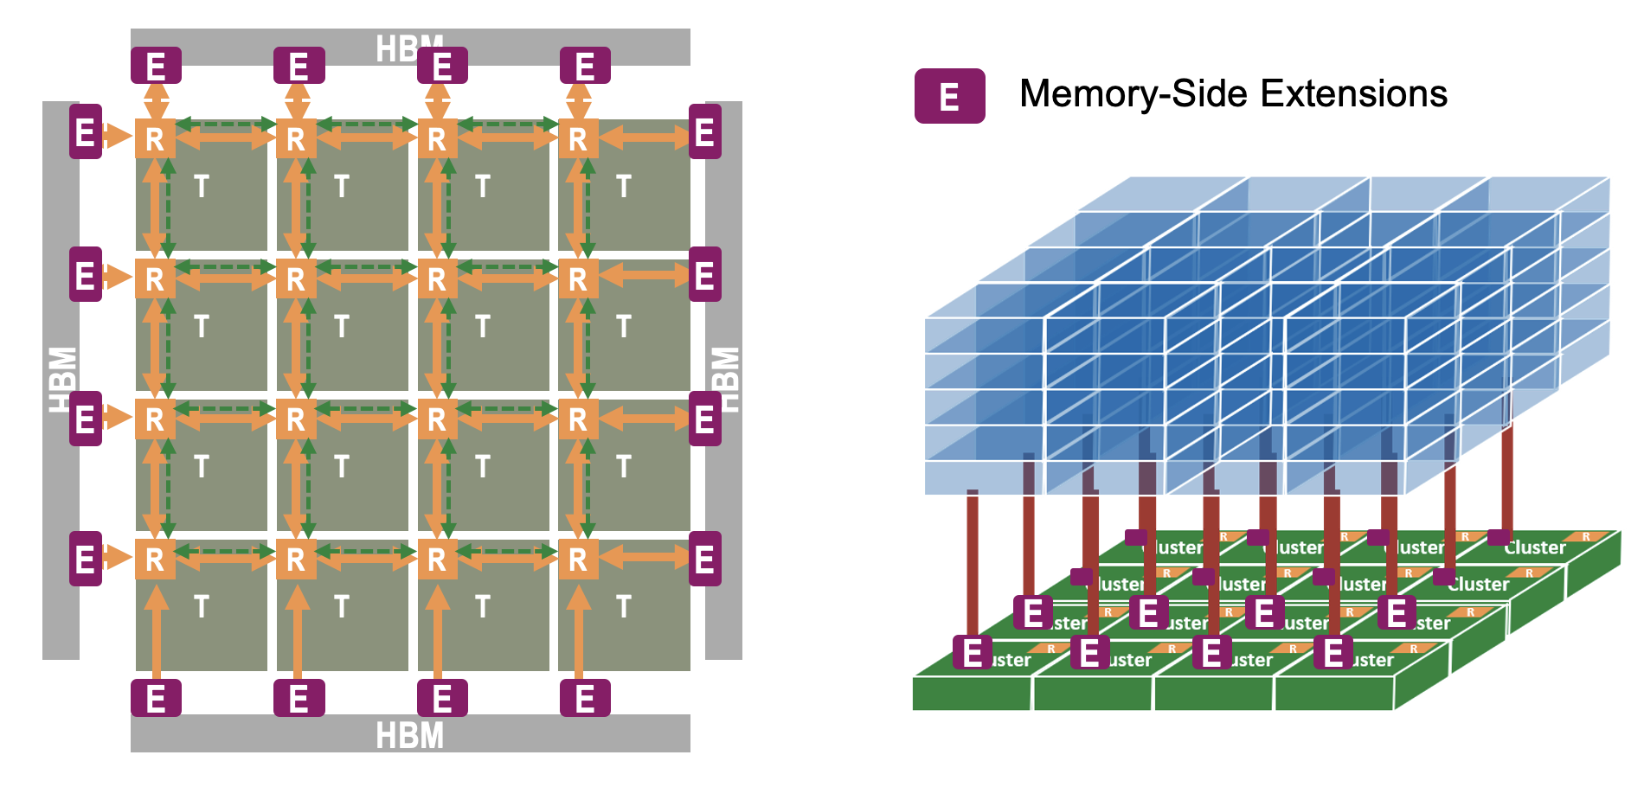
Extending Controller for LLM Sparse Workload
Missing features
Core-side index stream handling
Granularity alignment
Multi-node and memory endpoint exploration

