Slide 1
Sparsity Support in Memory Endpoints
Integrated Systems Laboratory (ETH Zürich)
Bowen Wang bowwang@iis.ee.ethz.ch
Chi Zhang chizhang@iis.ee.ethz.ch
Luca Benini lbenini@iis.ee.ethz.ch

Slide 2
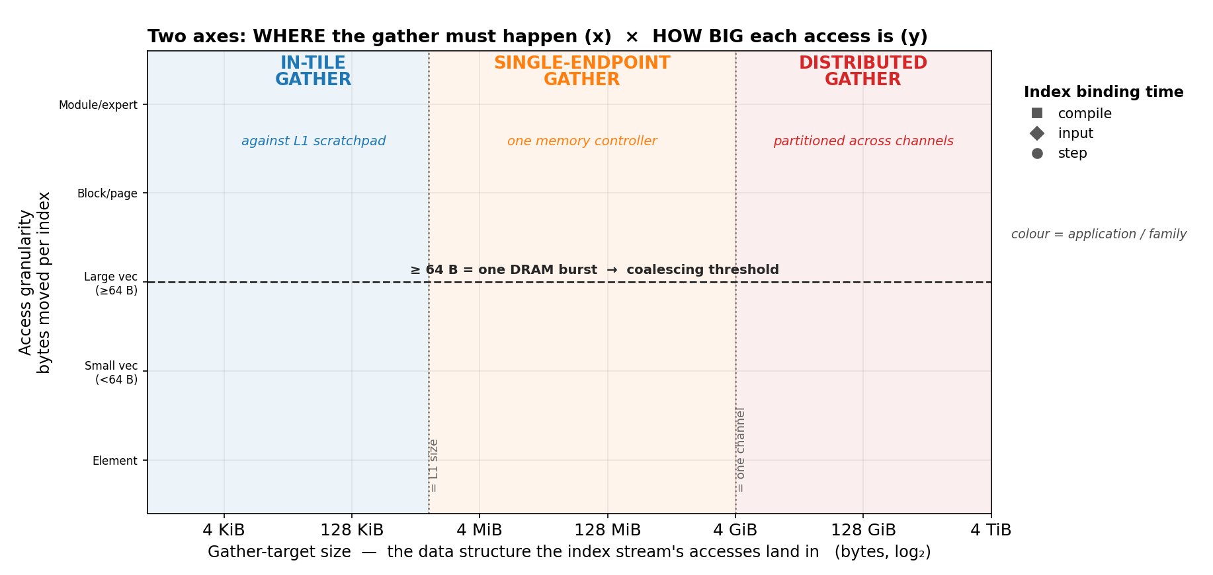
Sparse Pattern Analysis Framework
3
2
Index from cluster side
at runtime
Index reside in memory endpoint
Hardware-dependent placement
L1
Boundary
Single Channel
Boundary
1

Slide 3
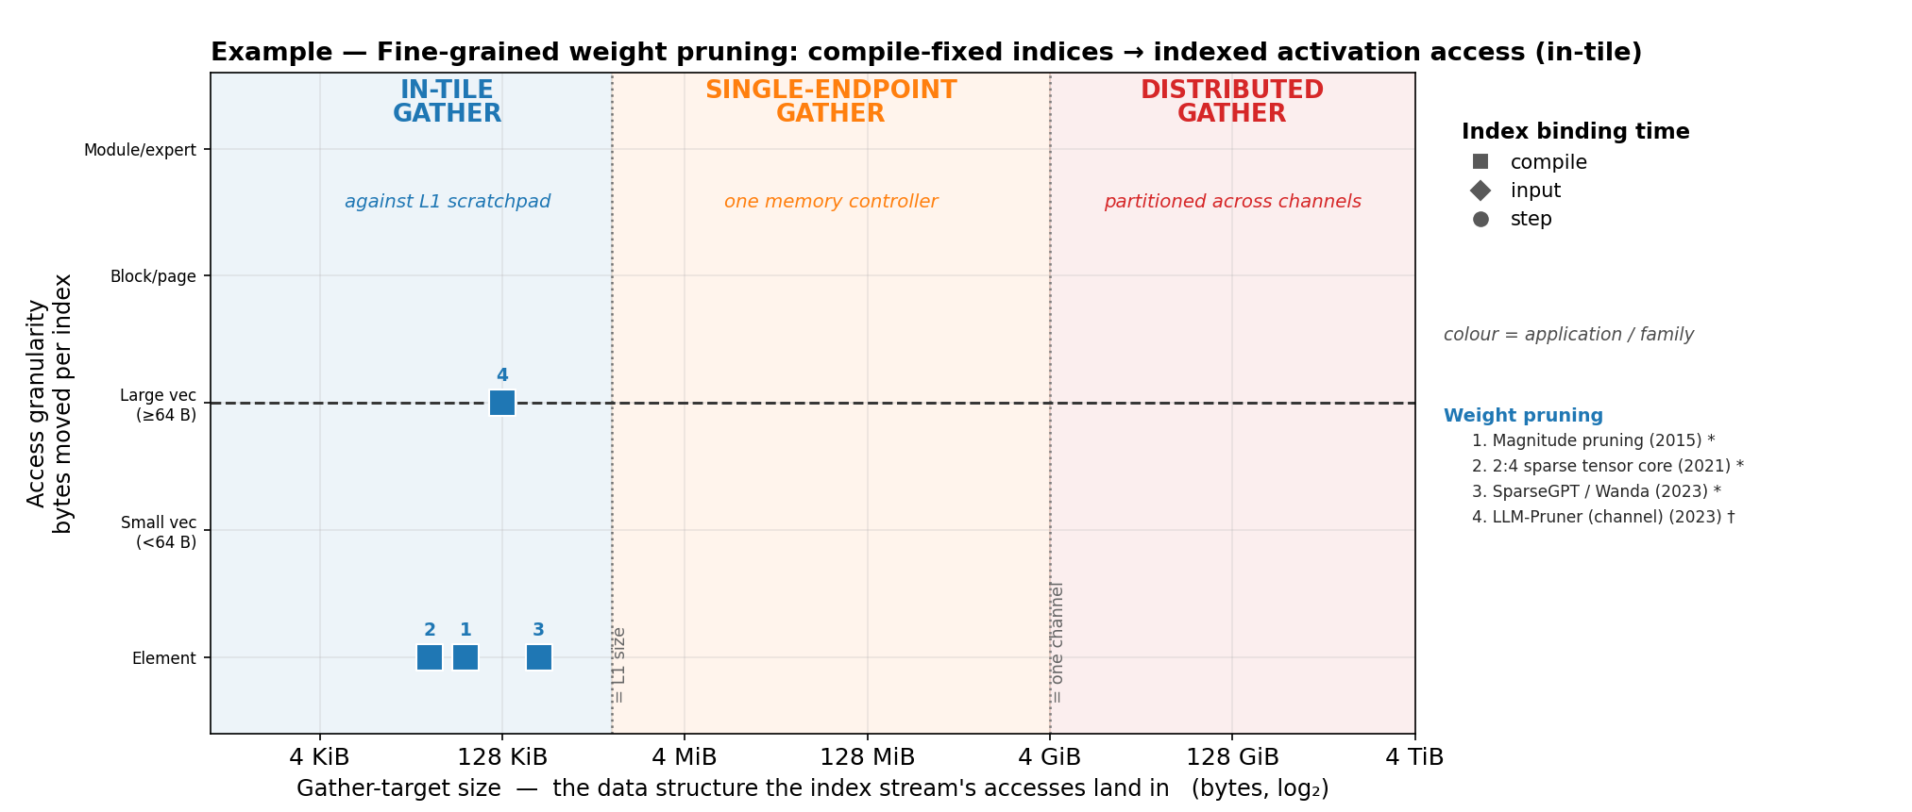
Example: Model Pruning
Index binding: fixed at compile time, streamed sequentially with the values
Gather target: the activation tile, L1 scratchpad-resident through tiling
Indexed load/store instructions
Ventaglio-like in-core scatter/gather

Slide 4
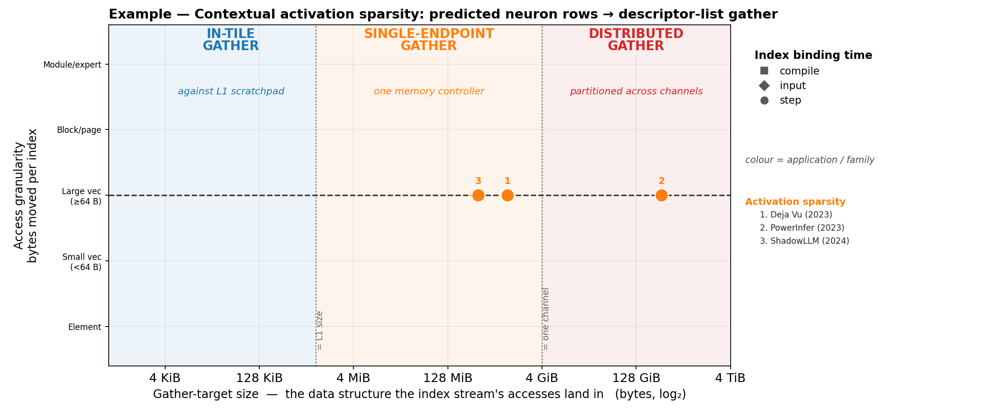
Example: Contextual Activation Sparsity
Per token a small predictor guesses which FFN neurons/layer to use; only those weight rows/blocks are fetched and computed
Index binding: fire for the current token — step-bound (index from the cluster side)
Gather target: per layer/model weight matrices
Smart DMA: index dispatch
Memory controller: index semantic, accept index from cluster side

Slide 5
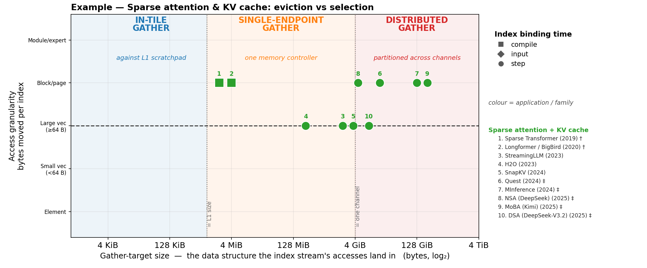
Example: Sparse Attention
Autoregressive attention touching only a subset of past tokens
Index binding: select per each input token — step-bound (index from the cluster side); early work with fixed gather window
Gather target: long context KV cache
Sparse 2D DMA with index semantic
2D DMA for fixed gather window, depreciated
Sparse 1D DMA + Memory controller with index semantic
Similar to contextual activation sparsity,
accept index from cluster side

Slide 6
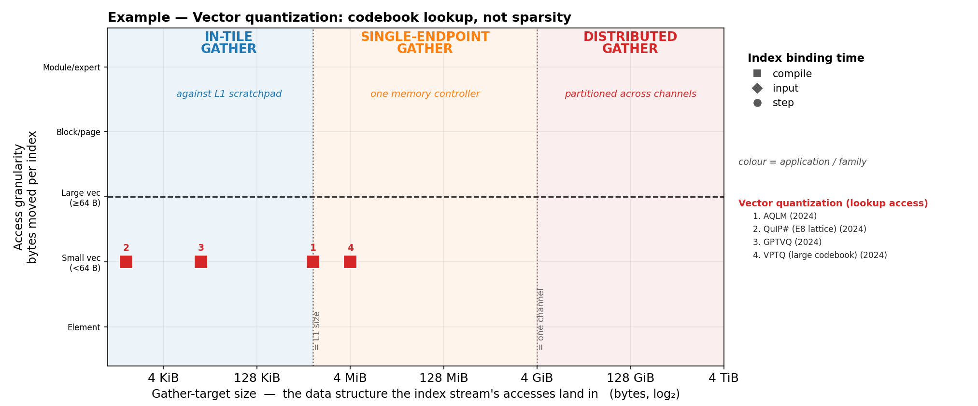
Example: Vector Quantization
Weight matrix codebook irregular lookup access
Index binding: compile time determined, stream with indices
Gather target: codebook
Blocked index load
Cluster side cache
Sparse 1D DMA + memory-side coalescing
With memory-side small cache

Slide 7
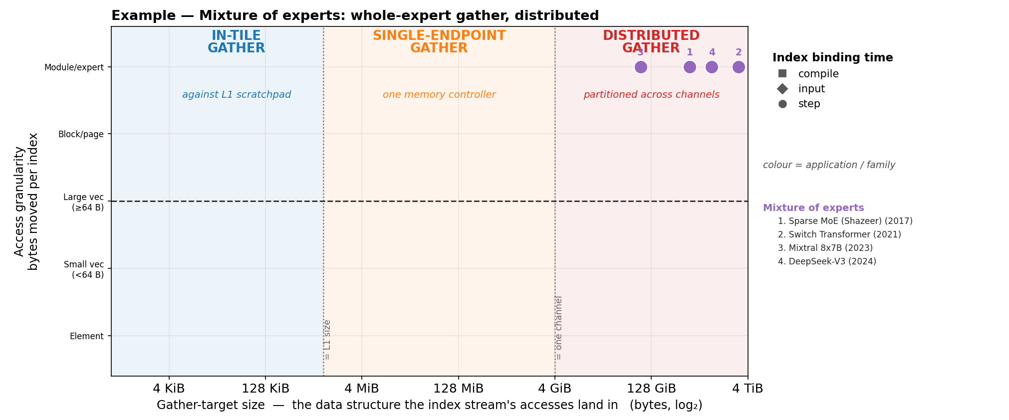
Example: MoE
FFN is served by k of N expert MLPs chosen by a router
Index binding: expert IDs from the cluster-side router, runtime determined
Gather target: expert pool
SW stack
Expert placement, duplication, split/merge

Slide 8
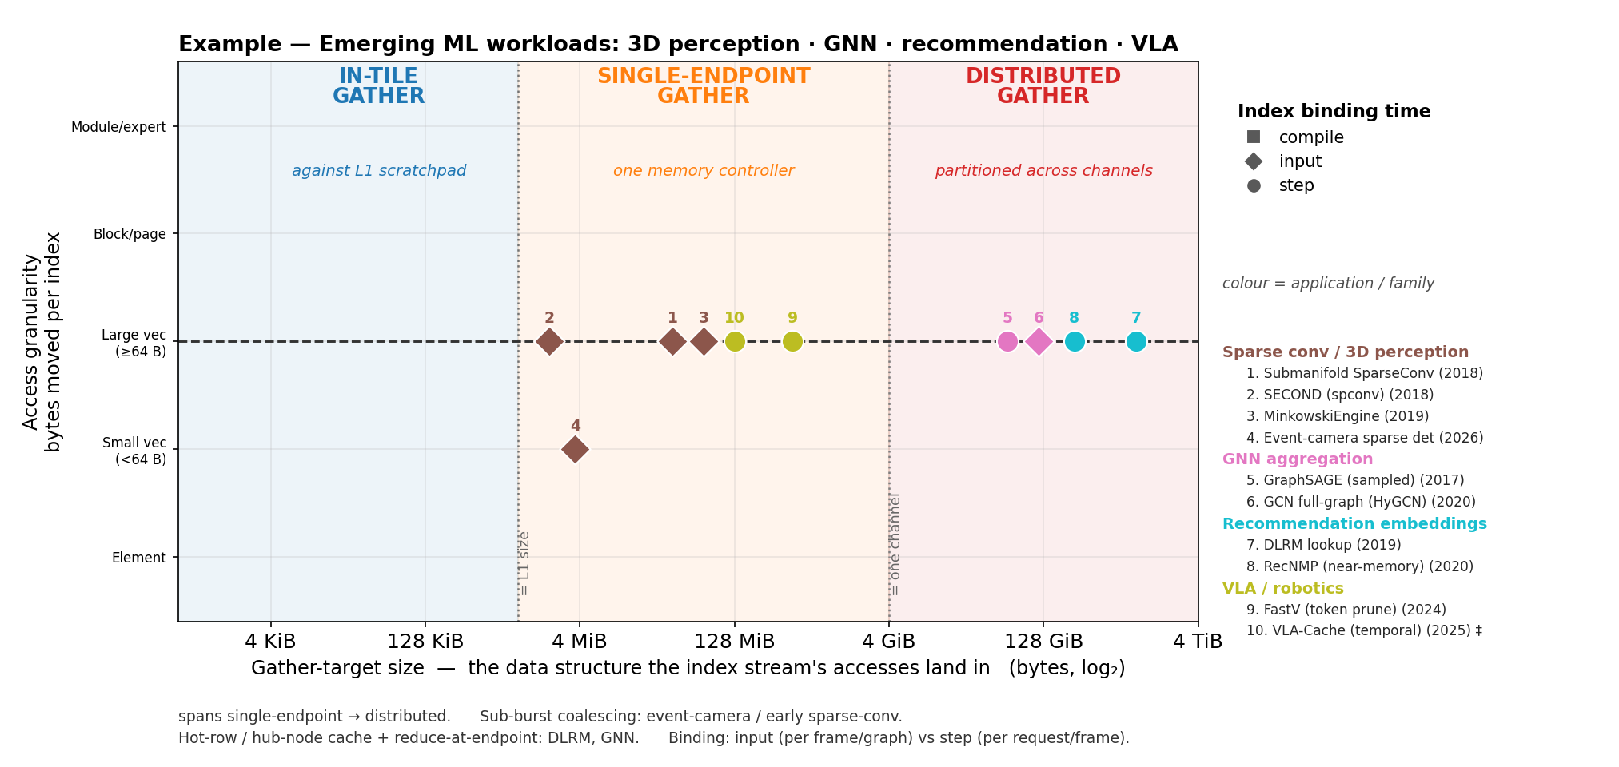
Example: Emerging ML Applications
Memory controller accepts
index stream from endpoint
Sparse 1D DMA
Cluster side loads distributed indices
+ DMA dispatch
Or
Specialized hardware for
index sharing between endpoints
(might be expensive)

Slide 9
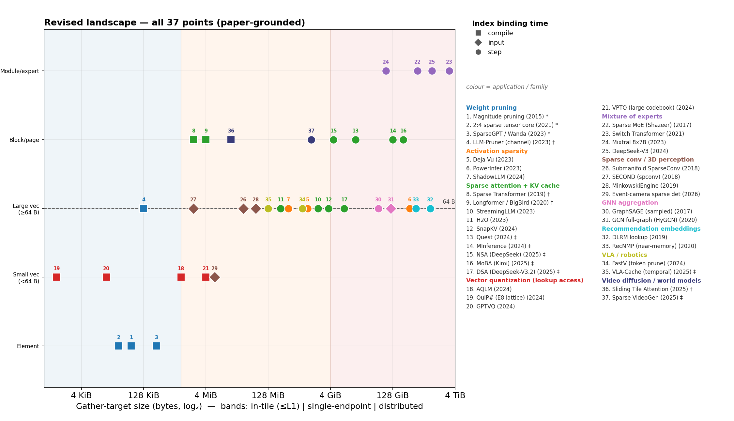
Overview Landscape
Sparse DMA + controller
(coalescing, cache, etc)
SW
Index load
Blocked index load
HPC application regime, EIADAS
Ventaglio

Slide 10
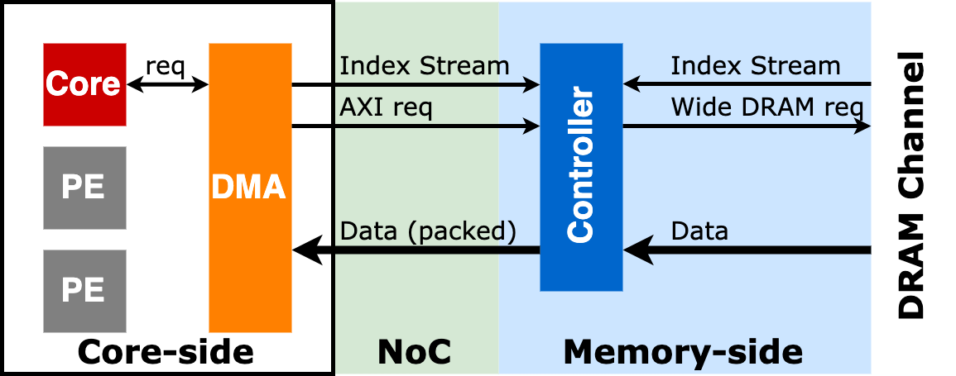
Memory-side Controller Extension for Sparsity Handling
Key features
Decoupled core request and data movement
Semantic extension for native index handling
Accept index streams from both core and memory side
Narrow access coalescing
Memory-side cache

