Slide 1
QuantSparse3D 2026-09-29 Bi-weekly
Integrated Systems Laboratory (ETH Zürich)
Bowen Wang bowwang@iis.ee.ethz.ch
Chi Zhang chizhang@iis.ee.ethz.ch
Luca Benini lbenini@iis.ee.ethz.ch

Slide 2
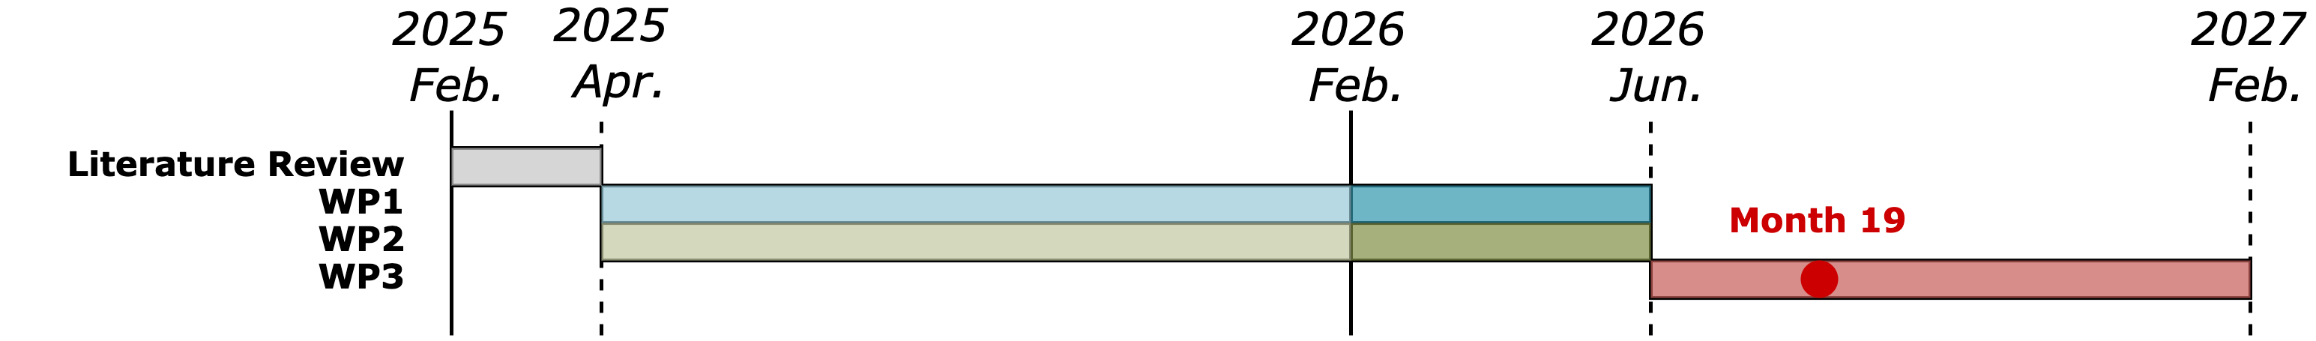
Agenda
Progress Update
  Sparsity handling in memory endpoints, multi-node GVSoC model
Timeline
Discussion

Slide 3
Recap: Sparse DMA in GVSoC
Implementation
Original gather experiment
Sparse gather added to the GVSoC iDMA model
RTL
GVSoC
Indices select scattered source rows
3099
3056
DMA gathers rows into local memory
3,000
1952
1914
Calibration against the RTL model
2,000
Cycle count deviation within 10%
1236
1159
Worst cycle deviation: 8.80%
1,000
Worst DMA-window deviation: 8.94%
0
Core
loop
Inlined
loop
HW
gather
Accuracy validated on the measured gather workloads.
Software-measured cycles • 128 gathered rows

Slide 4
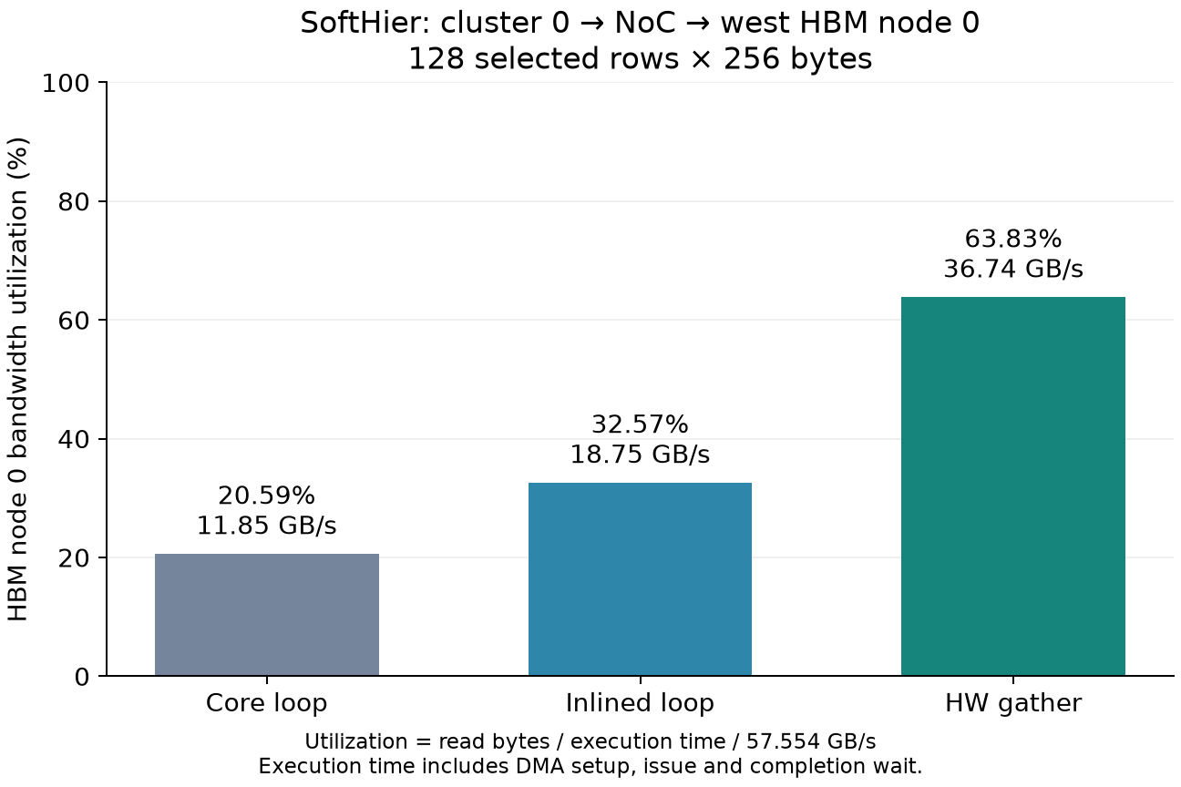
Extending Sparse DMA to Multi-node System
Implementation
  Extended the iDMA engine in SoftHier with updated gather support
  Same modeling methodology as standalone iDMA
  Instantiated 4x4 clusters, 16 HBM nodes on all 4 edges
Sanity test
  Cluster 0 issues gather requests to HBM node 0
  Same workload:
    Top-k sparse attention gather access patterns
    128 entries with 256-byte each in a 2k context
  Same performance gain comparing with standalone iDMA modeling
3.10x

Slide 5
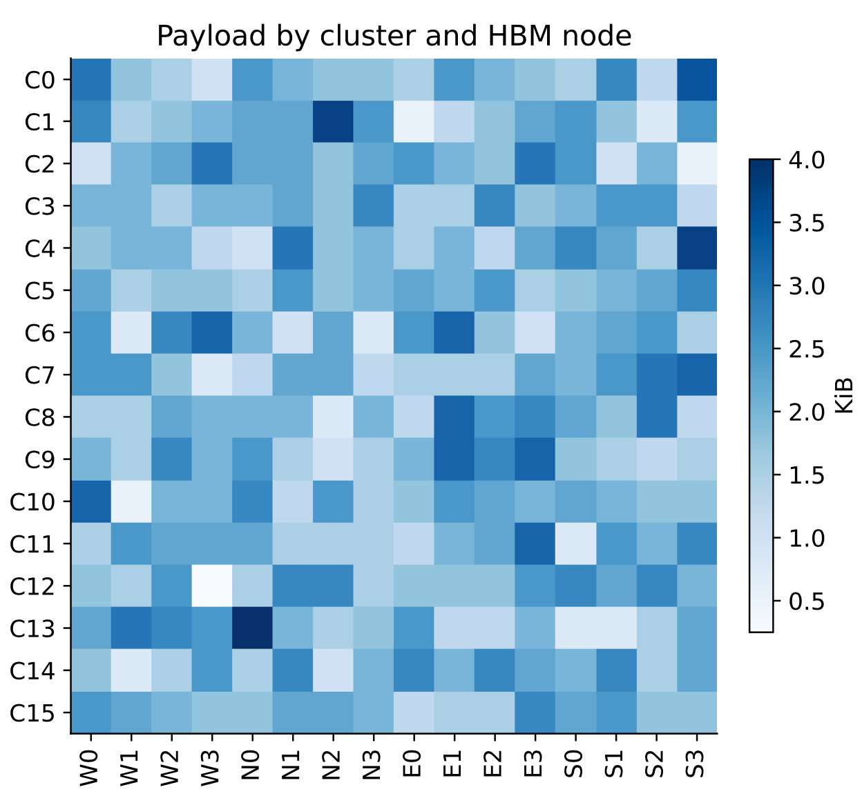
Extending Sparse DMA to Multi-node System
Multi-node test setup
  4 x 4 clusters, one independent user context per cluster; 16 HBM nodes on all four edges
  Each cluster workload:
    Gather 128 KV entries out of 2k context, each is 128 x FP16 (32 KiB payload in total)
    System-wise 0.5 MiB read payload, from 4 MiB of non-overlapping context address space, fully interleaved in 16 HBM nodes
Benchmark Settings
  3 software implementations:
    Core-loop
    Inline-loop
    HW-gather with sparse DMA

Slide 6
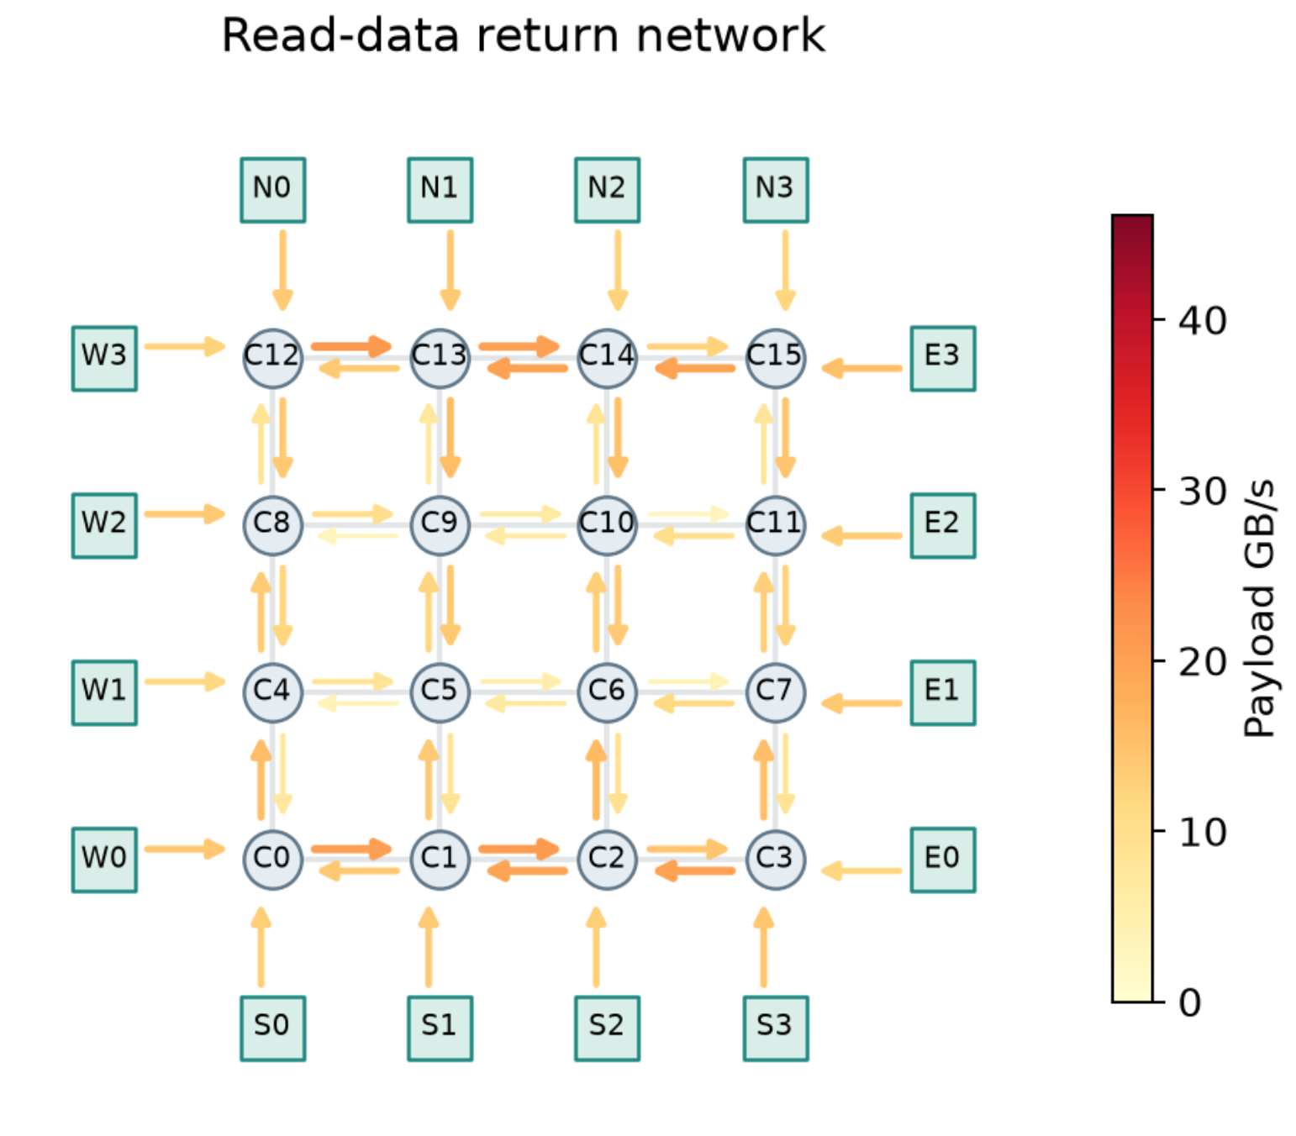
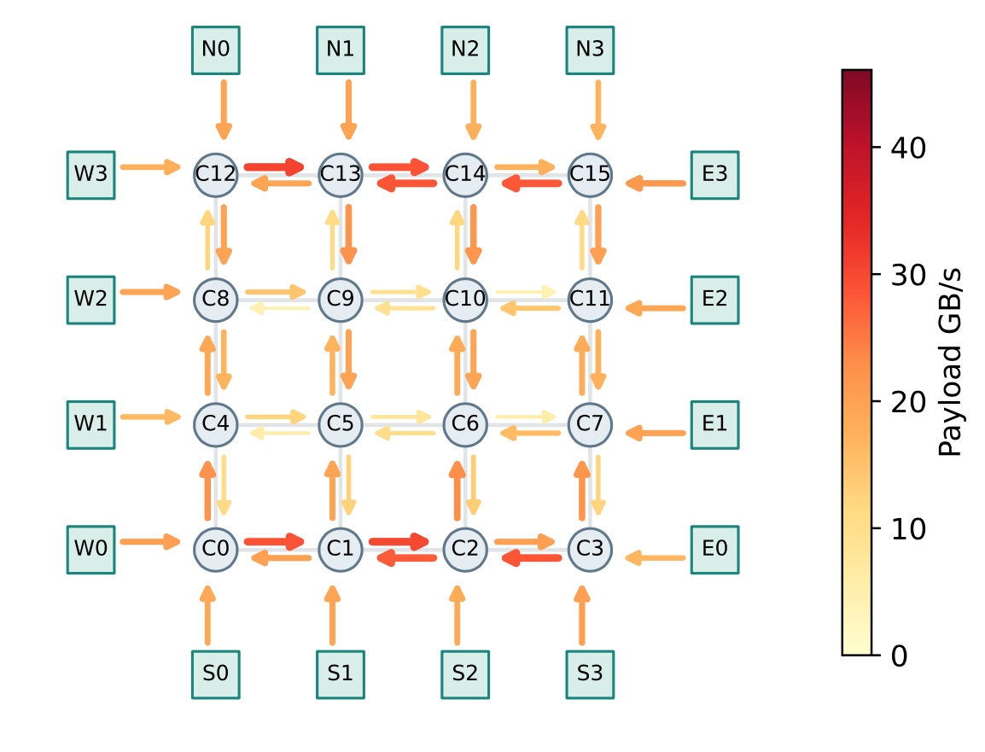
Visualizing NoC traffic
Core-loop
Baseline result analysis
  Core-loop implementation consistently shows less efficient gathering
  NoC traffic is far from being saturated, throughput is limited by DMA request issuing frequency, achieving avg. 212.43 GiB/s HBM throughput (23.07% HBM util.)
  Inline-loop implementation increased the NoC traffic through software optimizations, improved HBM throughput to 302.01 GiB/s (32.80% HBM util.)
  The improvement is aligned with the single-node benchmark
Inline-loop

Slide 7
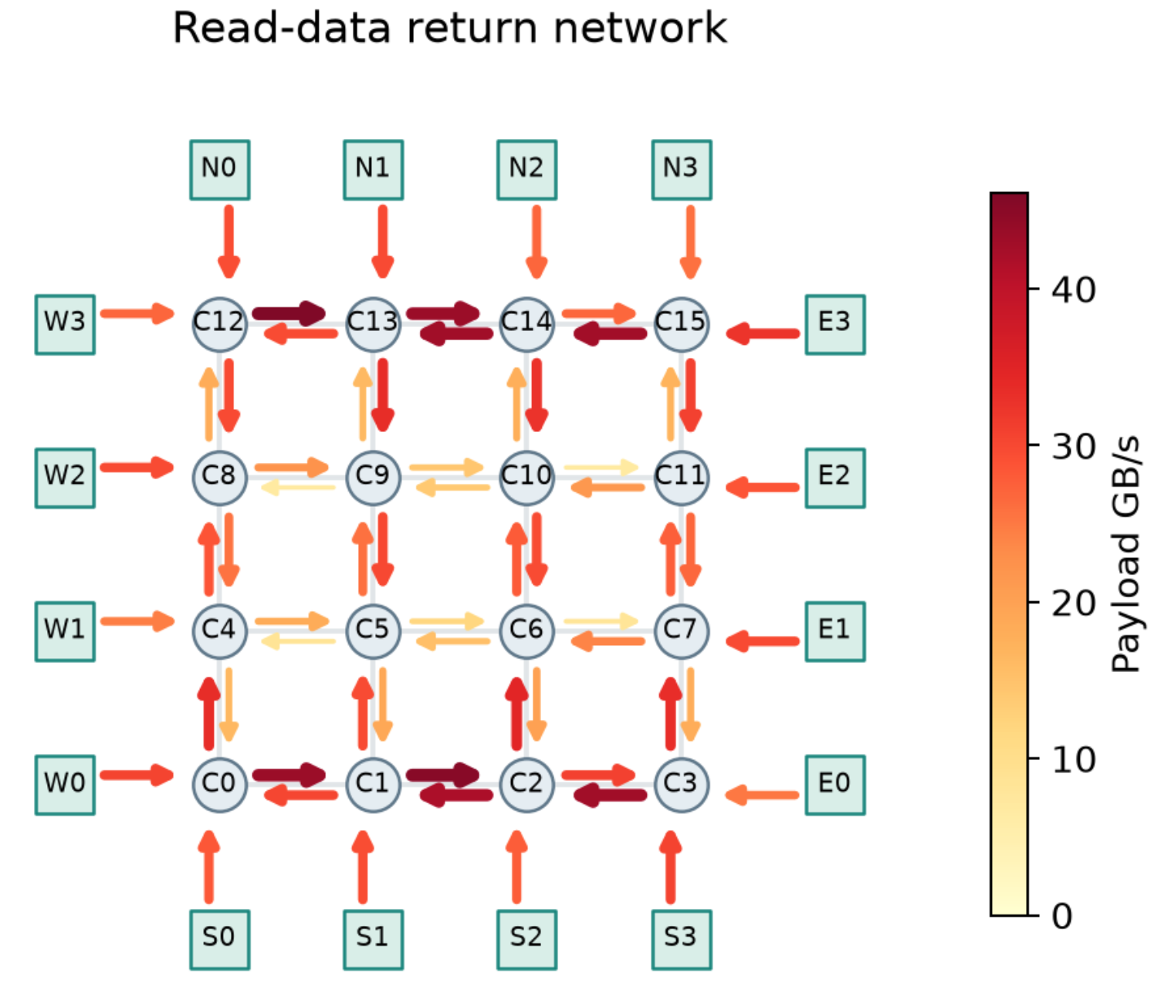
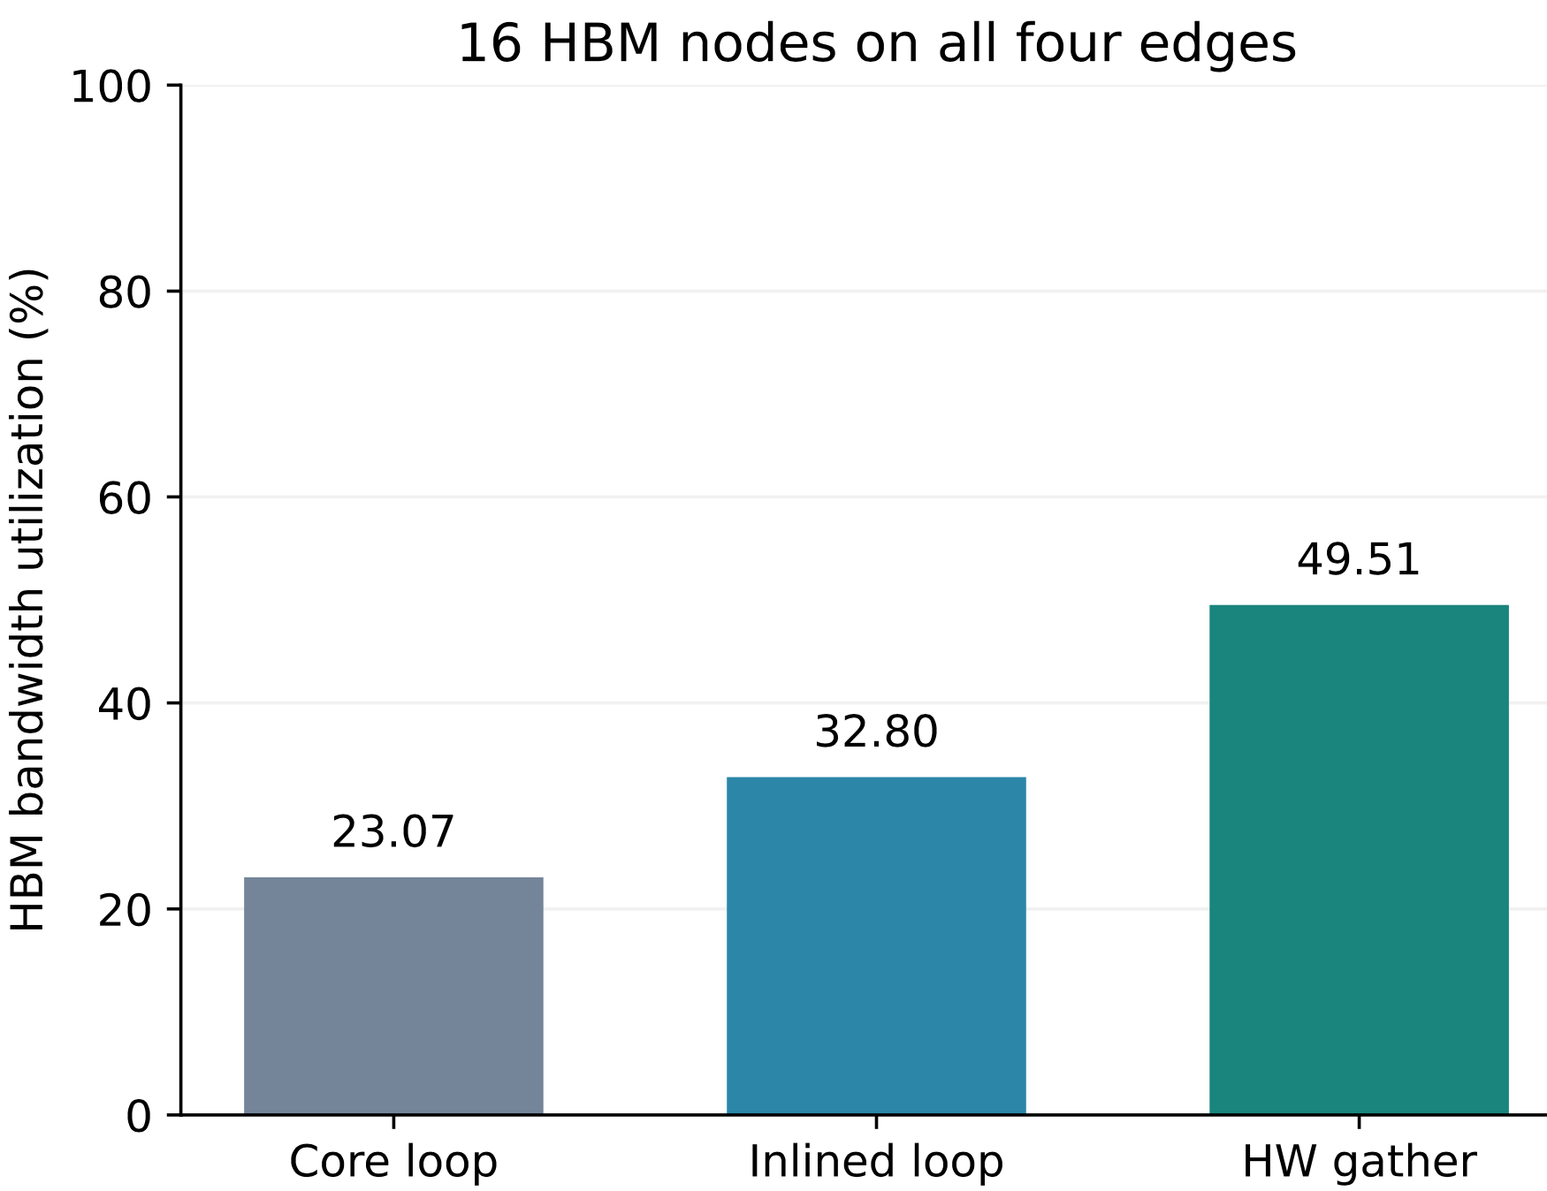
Visualizing NoC traffic
Sparse-DMA result analysis
  Increased the NoC traffic by offloading the request generation to DMA midend, achieving avg. 455.90 GiB/s HBM throughput (49.51% HBM util.)
  Achieved 2.14x improvement comparing with core-loop implementation
  Comparing with the single-node results, the HBM avg. utilization reduced from 63.8% to 49.5%
  Potential reasons:
    NoC request contention
    Larger gathering context reduced memory endpoint serving efficiency
Next step:
  Impact of KV mapping and context range
  Serving mythology (e.g., all cluster serve the same user)
2.14x

Slide 8
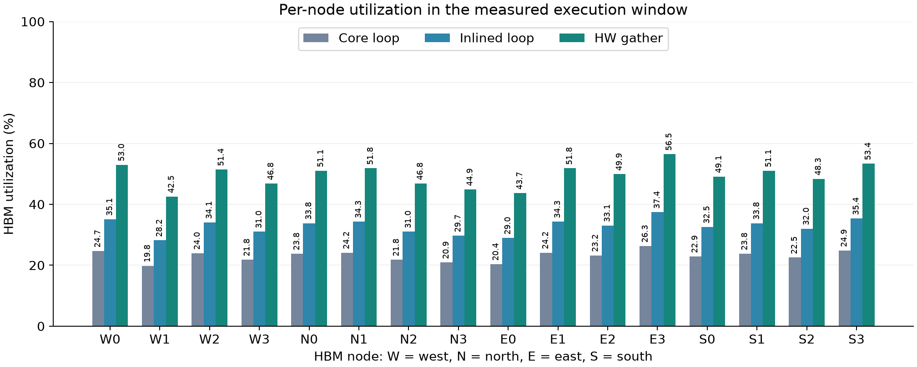
Backup: Individual HBM Utilization Breakdown

Slide 9
Backup: Core-Loop Read Request & Response Visualization

Slide 10
Backup: Inline-Loop Read Request & Response Visualization

Slide 11
Backup: HW-Gather Read Request & Response Visualization

