Slide 1
SoftHier Bi-Weekly Meeting
Chi Zhang chizhang@iis.ee.ethz.ch
Thomas Benz tbenz@iis.ee.ethz.ch
Luca Colagrande colluca@iis.ee.ethz.ch

Slide 2
SoftHier Progress General Updates
We first show our preliminary Journal plan
  Preliminary title:
    Dataflow and Fabric Collectives Co-Optimization for Efficiently Serving Modern LLM on Tile-Based Many-PE Accelerators
We then discuss about the requirements for final report for SoftHier Project

Slide 3
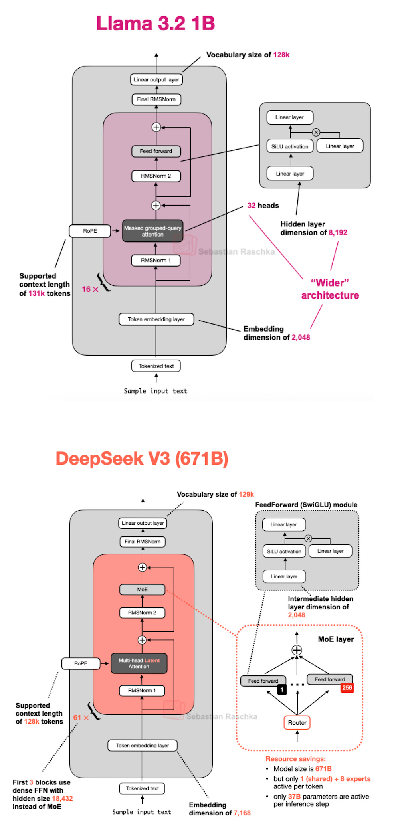
Evolution of Mainstream LLM Architectures
Classical Designs
  Multi-Head Attention (MHA) + Multi-Layer Perceptron (MLP):
  Found in early models (e.g., GPT, BERT)
Efficient Variants
  Multi-Query Attention (MQA)
  Group-Query Attention (GQA)
  Introduced in the LLaMA series
Advanced Mechanisms
  Multi-Latent Attention (MLA)
  Mixture-of-Experts (MoE) integration
  Adopted in DeepSeek-v3 and Kimi v2

Slide 4
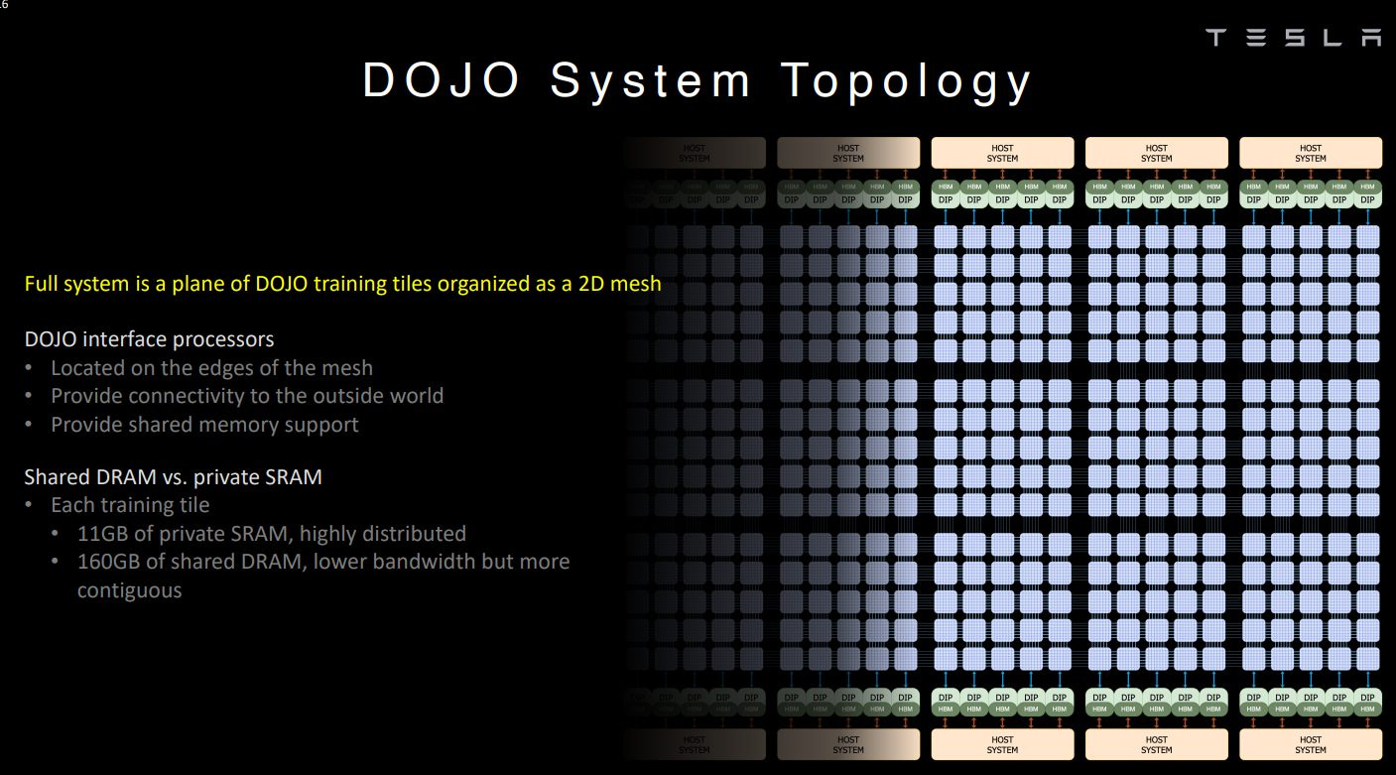
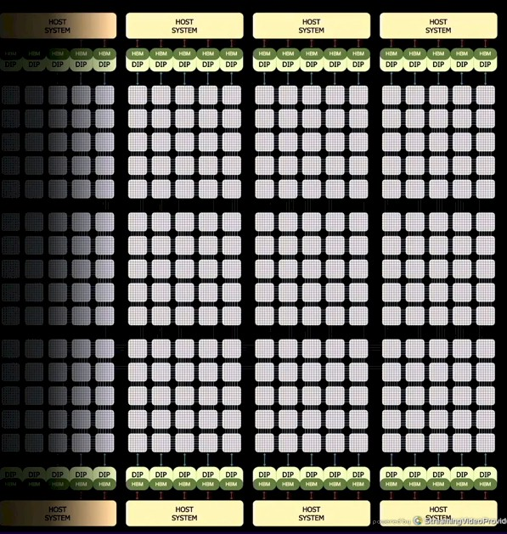
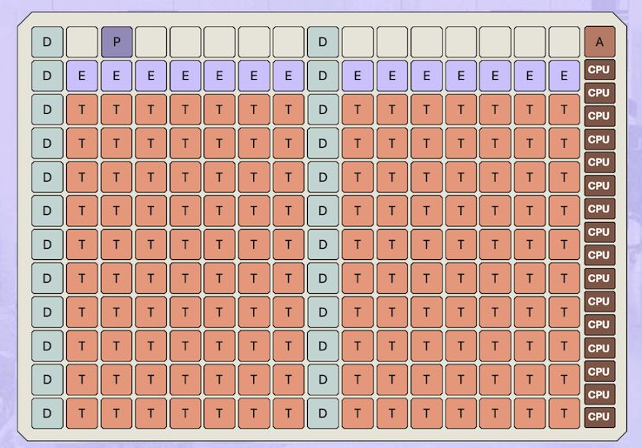

Scalable Accelerator Design for LLM Inference
Emerging Inference Trend
  Inference as primary workload in reasoning-centric applications
Tile-Based Many-PE Accelerator Architecture
  Structured as meshes of compute tiles
    Matrix, vector and scalar engines
    Local explicitly managed memories
  Interconnect with scalable NoC topology
  Main memory positioned at die boundaries
Favors silicon efficiency and scalability
  A dense compute tile placement
  Software-controlled partitioned memory hierarchy
  Eliminates L2 on-chip cache for area efficiency
Matrix engine
L1 local memory
Vector engine
I$
interconnect
Scalar core
DMA
To Router
CH0
CH1
…
CHn
HBM CTRL
Tile
Tile
Tile
Tile
R
R
R
R
Tile
Tile
Tile
Tile
R
R
R
R
CH0
CH1
…
CHn
HBM CTRL
HBM CTRL
Tile
Tile
Tile
Tile
CH0
CH1
…
CHn
R
R
R
R
Tile
Tile
Tile
Tile
R
R
R
R
HBM CTRL
CH0
CH1
…
CHn
Tile-Based Many-PE
vs Nvidia GPU Arch
HBM CTRL
HBM CTRL
HBM CTRL
SM
SM
L2 Cache
SM
SM
L1
L1
L1
L1
SM
SM
SM
SM
L1
L1
L1
L1
SM
SM
SM
SM
L1
L1
L1
L1
SM
SM
SM
SM
L1
L1
L1
L1
HBM CTRL
HBM CTRL
HBM CTRL

Slide 5
Challenges & Contributions
Key Challenges
  Mapping modern attention variants (GQA, MQA, MLA) efficiently
    MLA takes >60% runtime (in CloudMatrix DeepSeek paper)
  Balancing inter-tile and tile-to-HBM dataflow
  Minimizing costly off-chip accesses
Proposed Approach
  Utilize collective communication primitives in NoC
Contributions of the Work
  Efficient dataflows for MHA and variants (GQA, MQA, MLA)
  End-to-end LLM inference dataflow on a single chip
  Extension to multi-chiplet systems via network-on-interposer

Slide 6
Detailed Contributions
Contribution 1:
  A modelling and simulation framework that enables both performance estimation across a wide range of tile-based accelerator designs and the co-design of NoC collective communication primitives.
  The framework’s components are calibrated against an RTL reference model, which in turn allows accurate estimation of area and power consumption.
Contribution 2:
  An efficient MHA workload allocation and scheduling strategy, termed FlatAttention, which exploits collective communication primitives in the on-chip network fabric to improve compute utilization and reduce HBM traffic.
  By generalizing FlatAttention to MQA, GQA, and MLA, we demonstrate substantial performance speedups and energy savings compared to the widely adopted FlashAttention implementation, both on tile-based accelerators and on state-of-the-art (SoA) NVIDIA H100 GPUs.

Slide 7
Detailed Contributions
Contribution 3:
  An end-to-end LLM serving dataflow on a single tile-based accelerator, using a small-scale DeepSeek-v3 model as a case study. We demonstrate the inference speedup achieved by FlatAttention compared to FlashAttention in both the prefill and decode phases.
Contribution 4:
  Modelling of a system-in-package scenario in which multiple chiplets are interconnected via a network-on-interposer to support full DeepSeek-v3 serving. Leveraging expert parallelism, we demonstrate up to xx\% and xx\% utilization in the prefill and decode phases, respectively, achieving xx tokens/s/chip throughput in prefill and xx tokens/s/chip in decode under a 50 ms TPOT constraint. This corresponds to a xx× speedup over state-of-the-art (SoA) solutions.

Slide 8
Preliminary Timeline
Till Mid-Oct:
  Kernel finalization and validation (FP16 + FP8):
    Flat/Flash-MHA/MQA/GQA/MLA
    All kernels of DeepSeekv3 dataflow
Till Beginning of Nov:
  Finish collecting results of experiments
Till End of Nov:
  First draft of journal paper ready:
    Results data processing and plotting
    Making figures and writing

