Slide 1
QuantSparse3D 2026-09-10 Bi-weekly
Integrated Systems Laboratory (ETH Zürich)
Bowen Wang bowwang@iis.ee.ethz.ch
Chi Zhang chizhang@iis.ee.ethz.ch
Luca Benini lbenini@iis.ee.ethz.ch

Slide 2
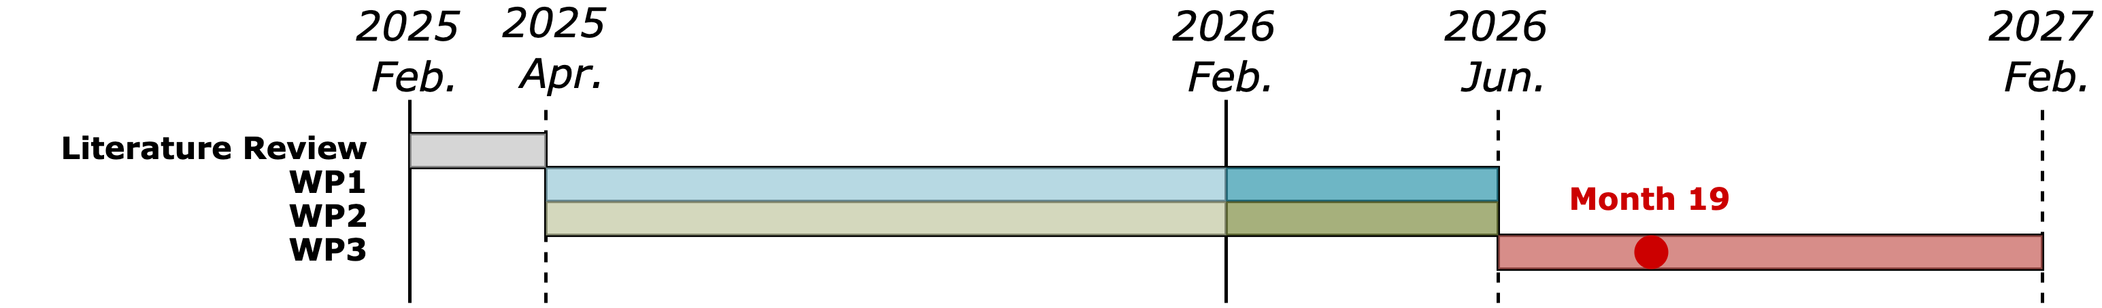
Agenda
Progress Update
Sparsity handling in memory endpoints, RTL and GVSoC model
Timeline
Discussion

Slide 3
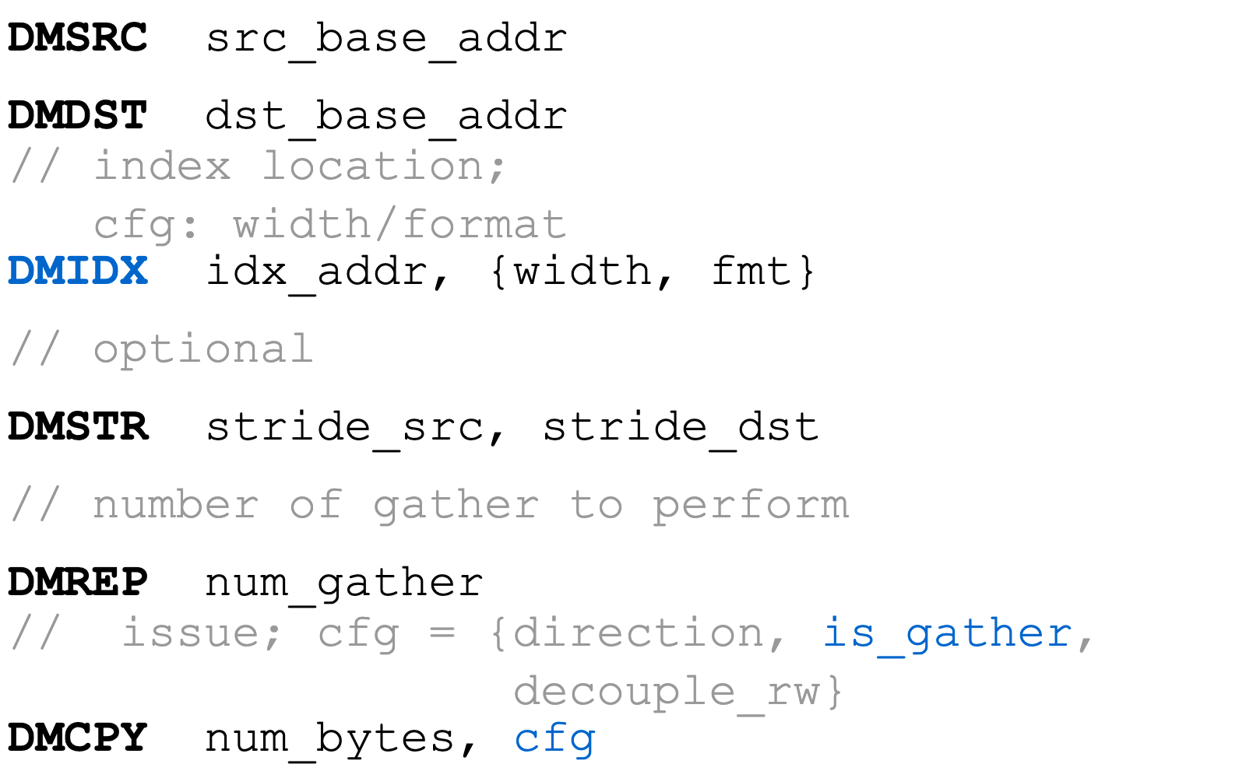
Recap: Sparse-capable DMA Extension
Idea
Core configures the sparse transaction once
DMA engine fetches the index stream and generate disaggregated AXI requests
Additional semantics to cover:
Address pointer to index stream in L1
Per-index bit-width
Index format (offset, bitmap…)

Slide 4
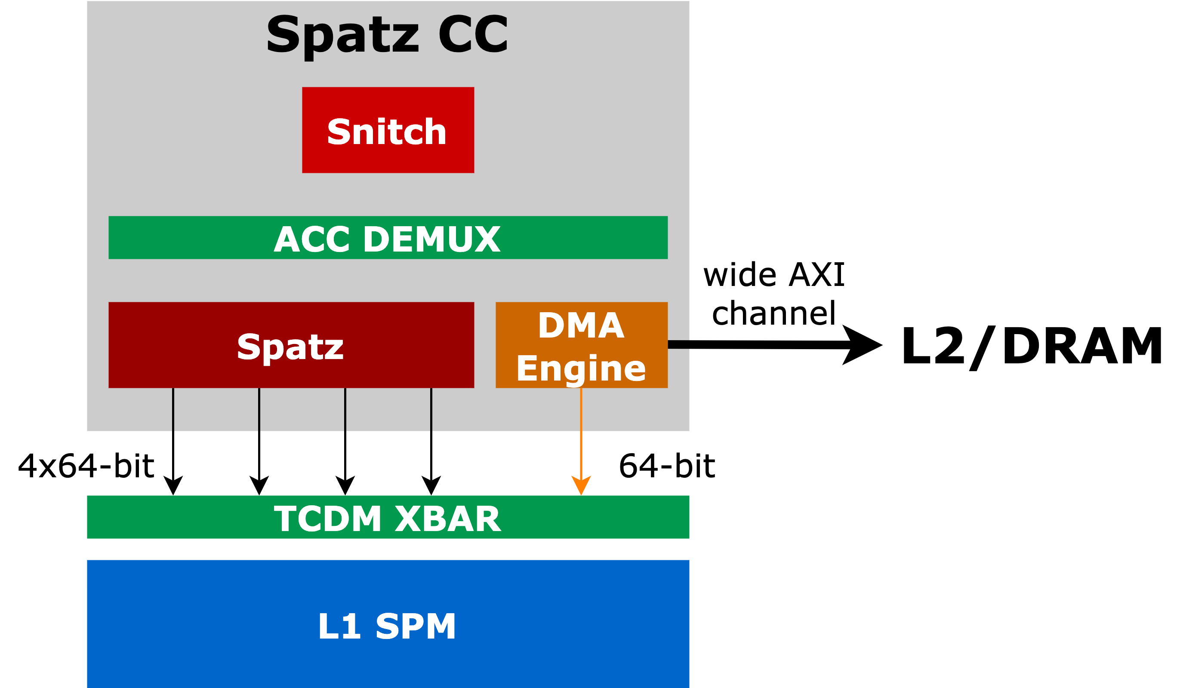
Status: Sparse DMA Microarchitecture
Implementation status
Frontend:
New instruction added, decoder in frontend done;
Verified sparse configurations captured by frontend;
Midend:
Standalone implementation finished
Integrated in Spatz DMA engine
Passed functional verification
Gather kernel implementation with the new DMA instructions
KV gather in Top-K sparse attention, with the same index stream
Reached the same channel utilization (62.7%) as using AXI master

Slide 5
Sparse DMA in GVSoC: Methodology
Goal
Same benchmark + input data
Reproduce RTL gather behavior in GVSoC
Target: within 10% cycle deviation
RTL reference
GVSoC model
Approach
Same benchmark binaries and input data
Match the cluster and DRAM setup
Compare data + execution cycles
One shared configuration for all cases
Refine shared timing

Slide 6
Sparse DMA in GVSoC: Model Overview
Implementation
Sparse gather added to the GVSoC iDMA model
Spatz cores
Indices select scattered source rows
DMA gathers rows into local memory
Configure
Read rows
Sparse DMA
DRAMSys HBM
Matched test system
Spatz cores, local memory and DRAMSys
Indices
Gathered rows
Runs the same three benchmark variants
Local memory (TCDM)

Slide 7
Sparse DMA in GVSoC: Test Coverage
Calibration matrix
Four workloads × three variants
3 variants × 4 workloads = 12 RTL / GVSoC comparisons
Workload
Core loop
Inlined loop
HW gather
Gather sizes: 64, 128 and 256 rows
128 rows / sorted
PASS
PASS
PASS
Sorted and shuffled index patterns
64 rows / sorted
PASS
PASS
PASS
256 rows / sorted
PASS
PASS
PASS
Functional checks
128 rows / shuffled
PASS
PASS
PASS
12 cases: indices, transfers and queuing
All data and completion checks pass
PASS = correct data + timing within 10%
Original DRAMSys example also passes

Slide 8
Sparse DMA in GVSoC: Calibration Results
Target achieved
Original gather experiment
All 12 comparisons within 10%
RTL
GVSoC
Worst cycle deviation: 8.80%
3099
3056
3,000
Worst DMA-window deviation: 8.94%
1952
1914
2,000
1236
1159
Original hardware gather
1,000
1,236 RTL → 1,159 GVSoC cycles
0
-6.23% cycle deviation
Core loop
Inlined loop
HW gather
Accuracy validated on the measured gather workloads.
Software-measured cycles • 128 gathered rows

Slide 9
Next Step: Sparse DMA
RTL model
Backend implementation, area overhead analysis
GVSoC model
Scale to multi-node system

