Slide 1
SoftHier Bi-Weekly Meeting
Chi Zhang chizhang@iis.ee.ethz.ch
Thomas Benz tbenz@iis.ee.ethz.ch
Luca Colagrande colluca@iis.ee.ethz.ch

Slide 2
SoftHier Project Overview – PULP Side
Year 2 work package
  Architectural Optimization and Tuning (WP1):
    Based on the insight gathered in the first year of work, the data motion engines, the interconnect, and memory endpoints will be tuned and optimized to facilitate program-ming and boost performance. Hardware costs of the enhancements will be closely monitored to ensure that efficiency remains highly competitive with cache-based tech-niques, both in terms of system performance and energy efficiency. A specific focus area will be in supporting data-transformations that do not require extensive computation and can be done “on the fly” during communication, aiming at reducing data vol-ume and improving bandwidth utilization.
Milestones
  Specification and preliminary modelling and analysis of optimized architecture (M3-WP1)
    The proposed hardware enhancements will be prototyped and their cost performance benefits will be assessed with microkernels. (Report)
  Performance and Energy estimation and benchmarking (M4-WP1-WP2)
    Benchmarking report on hardware-software integration between the two WPs, demon-strating targeted transformations to optimize and streamline performance for CLOUDSC cloud microphysics scheme and the LULESH hydrodynamics solver as well as ML applications. Detailed performance study with different application configu-rations and comparing various workflow options. For Ascend, we will aim at mapping DeepLearning kernels such as Transformer Decoders. (Report & Open-source release)

Slide 3
SoftHier Project Overview – PULP Side
For the 2nd Year, We have done
  Proposed Architectural Optimization (M3-WP1):
    Lightweight high-throughput collective capable NoC
    RTL prototyping
  Dataflow and NoC collective primitives co-design for key LLM kernels (M4-WP1-WP2)
    FlatAttention for MHA and variants for GQA, MQA, DeepSeek MLA
    Summa GEMM variants with NoC collective primitives
  End-to-End Performance analysis for DeepSeekV3 inference (M4-WP1-WP2)

Slide 4
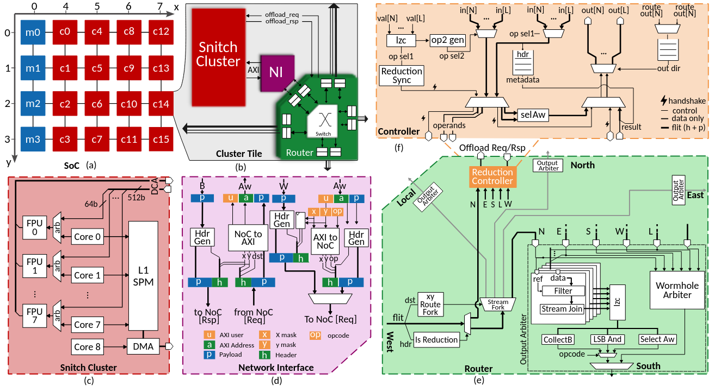
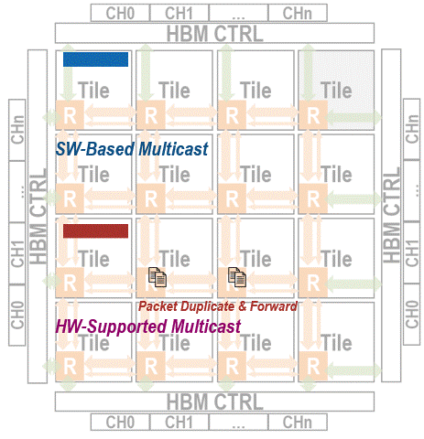
Lightweight high-throughput collective capable NoC
RTL Extension on NoC
  Leverage FPUs in snitch cores for reduction operations

Slide 5
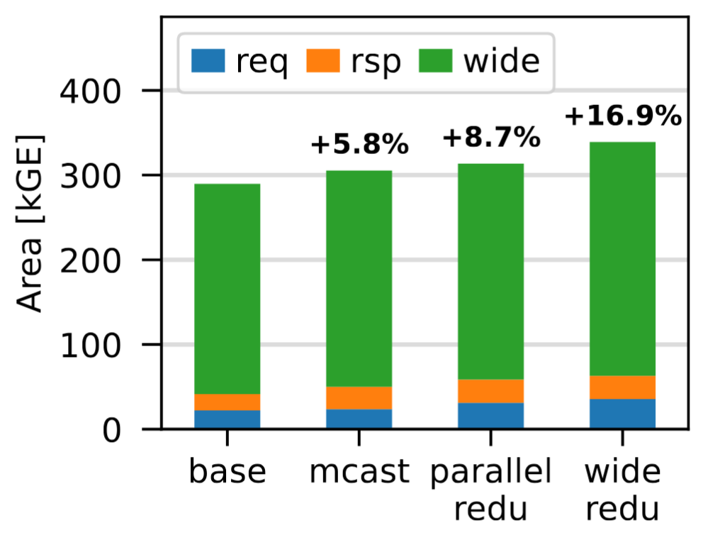
Lightweight high-throughput collective capable NoC
Model in GVSoC for SoftHier
  Calibration with RTL, Average Runtime cycle deviation is around 16%
RTL Area analysis
  Multicast adds 5.8% area overhead on each router
  Full Multicast + Reduction adds 16.9% area overhead on each router

Slide 6
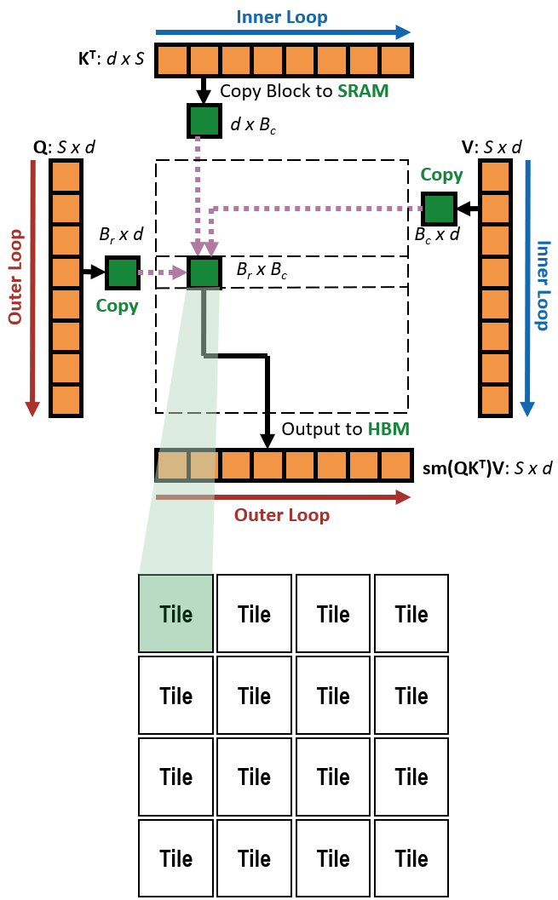
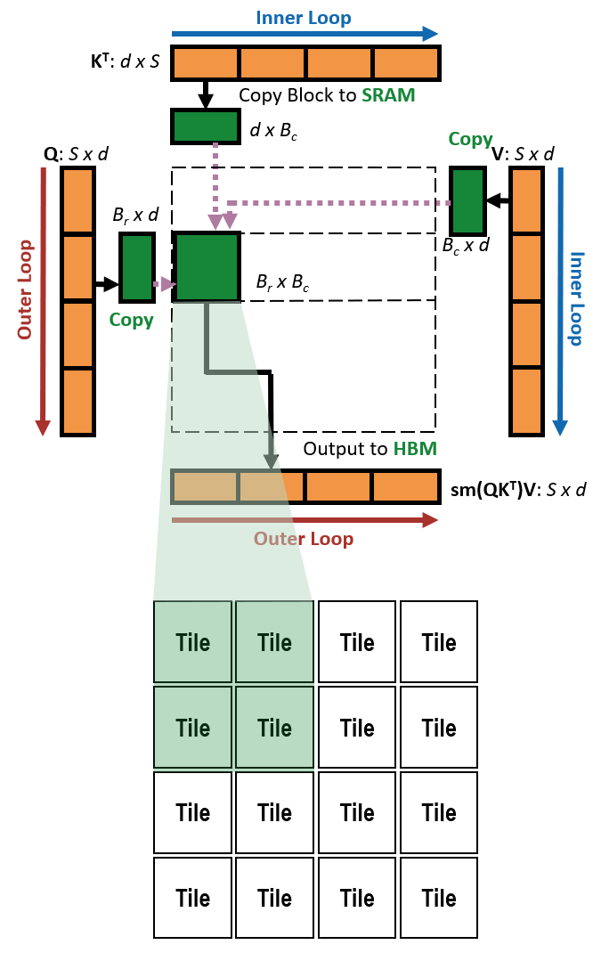
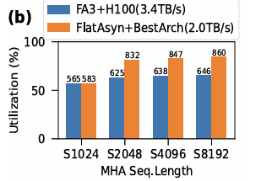
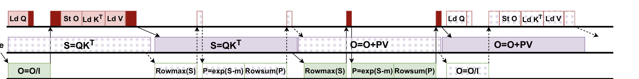
Dataflow and NoC Collective Primitives Co-Design
We propose FlatAttention
  An optimized dataflow for MHA on tile-based many-PE accelerators
    Co-designed with NoC collective primitives
  FlatAttention vs. FlashAttention-3 on tile-based accelerator
    Up to 89.3% utilization, 4.1× performance speedup, 16x HBM traffic reduction
  vs. FlashAttention-3 on H100
    Up to 1.3× utilization speedup in MHA , Require 40% less available HBM BW to H100
  The key idea of FlatAttention is general for other MHA variants
    Tile groups collectively handle larger MHA Blocks
    GQA, MQA, and FlashMLA in DeepSeek
Flatten
NoC Collectives
& Async

Slide 7
End-to-End Performance Analysis DeepSeekV3 Inference
SoftHier Configuration
  32 x 32 Clusters
  Cluster Spec:
    One RedMule with 32 x 16 CE arrays
    4 Spatz Vector Engine each with 4 FPUs
    8 snitch cores
    L1 memory with 384KB SRAM capacity
  Off-Chip HBM bandwidth of 4TB/s, 64GB per Chip
  Chip run at 1.9 GHz frequence, 1976 TFLOPS @ FP8
    Same spec with Nvidia H100

Slide 8
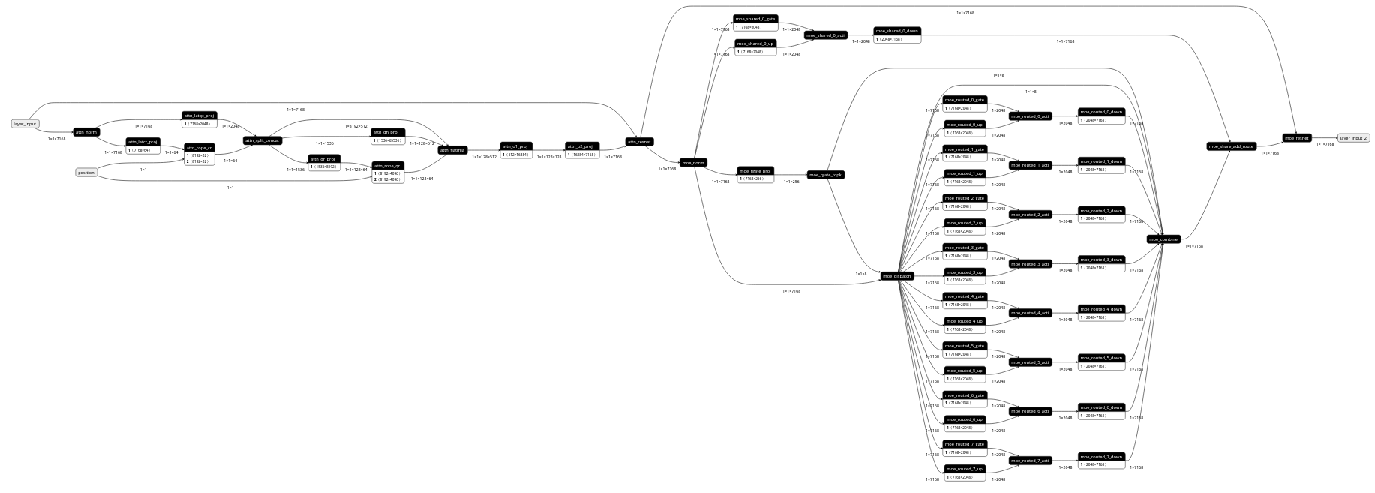
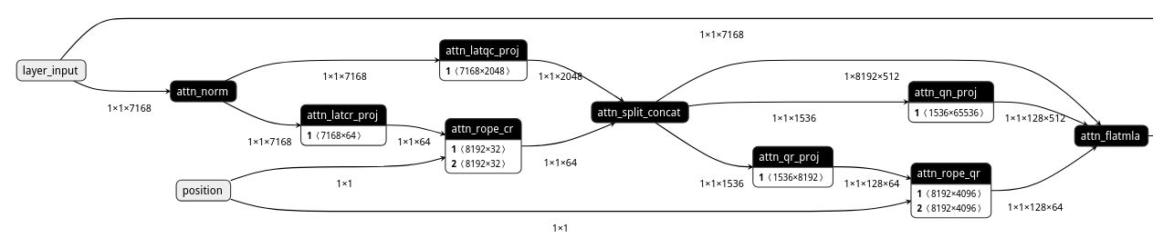
DeepSeek Flow Automation: Generate Layer Kernel Flow
Example of decode batch_size = 1
Shared Experts
Routed Experts

Slide 9
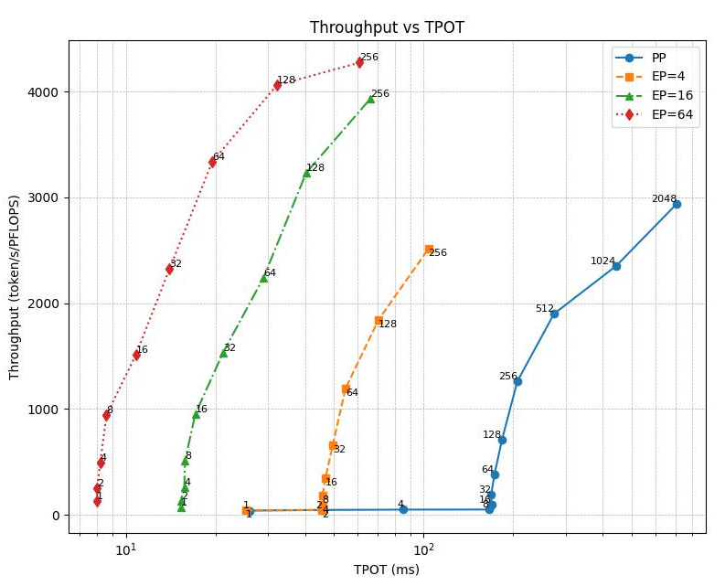
Decoding Performance Overview – Full DeepSeekv3-671B
Decode Mode
  Discuss Pipeline parallelism and Expert Parallelism
  Collect data with varial batch sizes
Better
Target TPOT = 50ms

Slide 10
Decoding Performance Overview – Full DeepSeekv3-671B
Decode Mode
  Discuss Pipeline parallelism and Expert Parallelism
  Collect data with varial batch sizes
Better
CloudMatrix-Infer
Best Throughput
CloudMatrix-Infer
Best TPOT
Target TPOT = 50ms

Slide 11
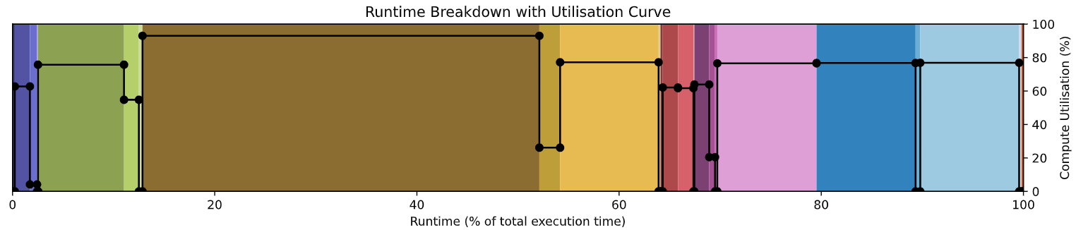
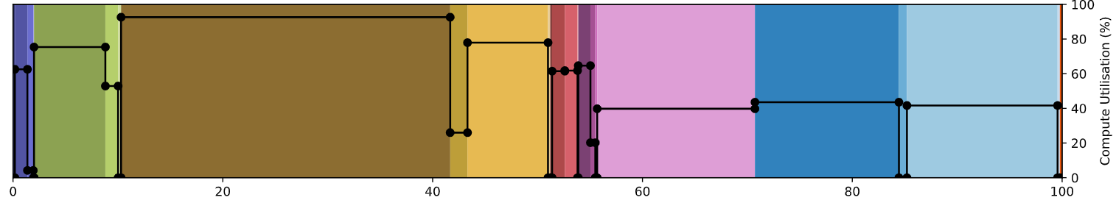
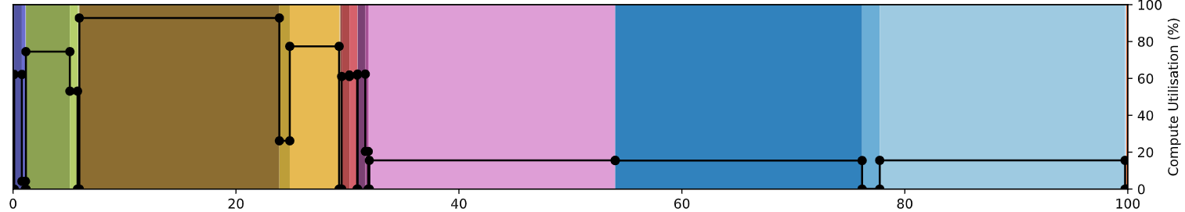
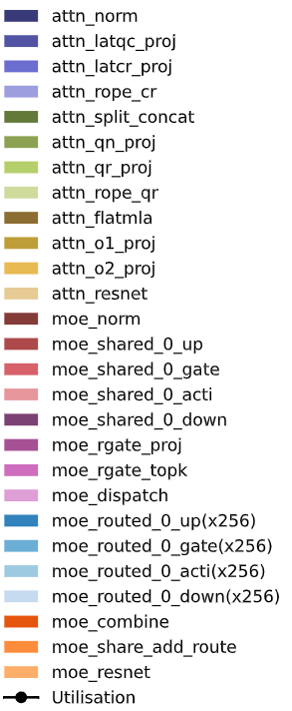
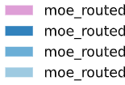
Decoding Performance Overview – Full DeepSeekv3-671B
Expert Parallelism makes Attention more important for decoding

Slide 12
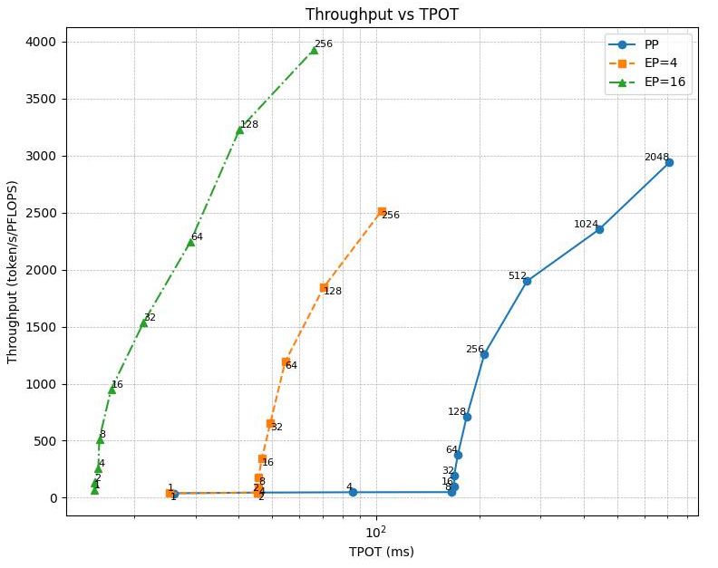
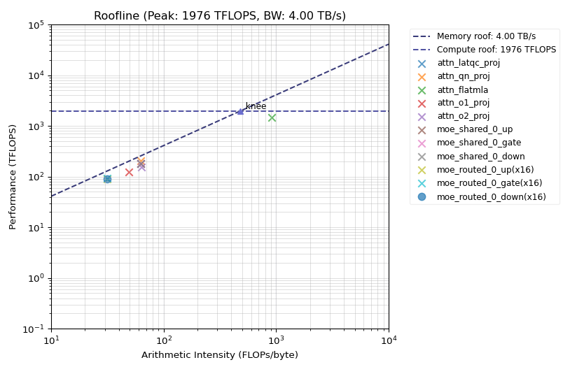
Decoding Performance Overview – Full DeepSeekv3-671B
NoC Collective Co-designed Kernels are the Key to high performance
  Close to roofline

Slide 13
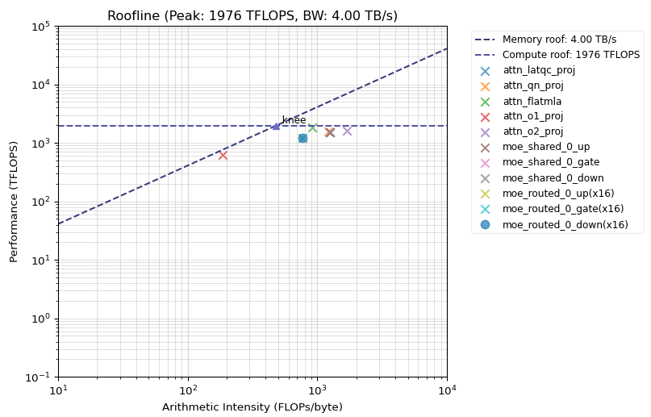
Decoding Performance Overview – Full DeepSeekv3-671B
NoC Collective Co-designed Kernels are the Key to high performance
  Close to roofline

Slide 14
For Next
Slides for the final presentation
  Revise internally first, The 1st version plan to be ready on next Monday if everything goes well

