Slide 1
SoftHier Bi-Weekly Meeting
Chi Zhang chizhang@iis.ee.ethz.ch
Thomas Benz tbenz@iis.ee.ethz.ch
Luca Colagrande colluca@iis.ee.ethz.ch

Slide 2
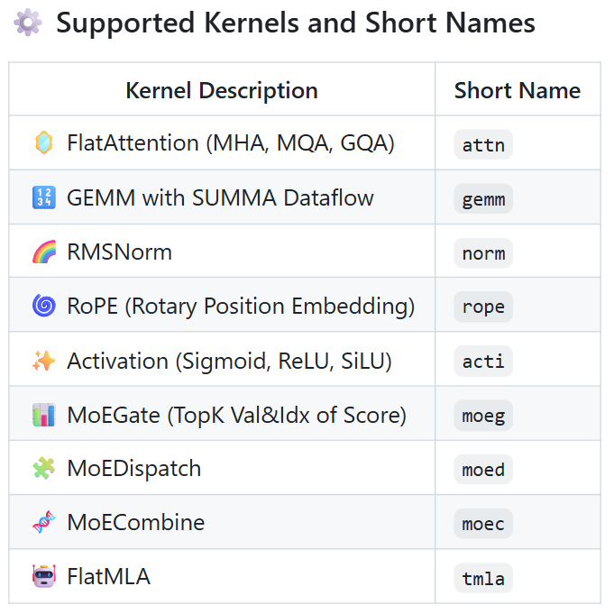
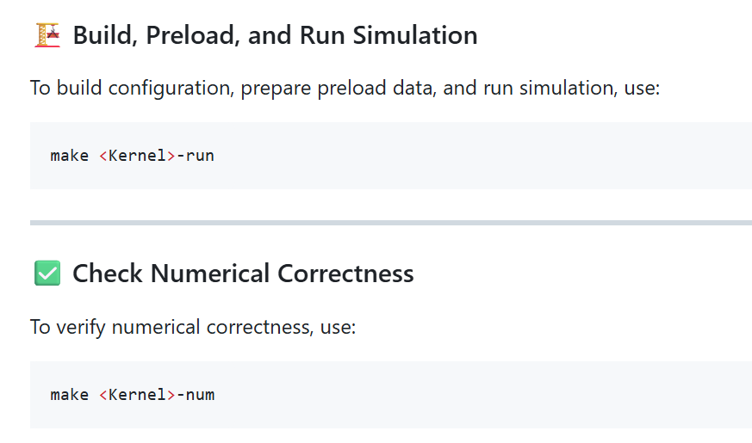
Journal progress: LLM Kernels
Fully Parameterized Kernels
  Adapted to any tensor shapes
Numerical Check Enabled
  Compare with golden from pytorch
Kernels for LLM and DeepSeek
  https://github.com/gvsoc/gvsoc/tree/soft_hier_je/implementation

Slide 3
Kernels Update: HBM Direction Agnostic
C
Cluster load from HBM and multicast
C
Cluster receive multicast
For FlatAttn, FlatMLA, GEMM
  load from HBM & Multicast, reduction
  We can fairly discuss different HBM locations without change much kernel code
load from HBM and multicast
multicast
Previous Scheme
Current Scheme
C
C
C
C
C
C
C
C
C
C
C
C
C
C
C
C
C
C
C
C
C
C
C
C
C
C
C
C
C
C
C
C
C
C
C
C
C
C
C
C
C
C
C
C
C
C
C
C
West HBM
C
C
C
C
C
C
C
C
C
C
C
C
C
C
C
C
C
C
C
C
C
C
C
C
C
C
C
C
C
C
C
C
C
C
C
C
C
C
C
C
C
C
C
C
C
C
C
C
C
C
C
C
C
C
C
C
C
C
C
C
C
C
C
C
C
C
C
C
C
C
C
C
C
C
C
C
C
C
C
C
C
C
C
C
C
C
C
C
C
C
C
C
C
C
C
C
C
C
C
C
C
C
C
C
C
C
C
C
C
C
C
C
C
C
C
C
C
C
C
C
C
C
C
C
C
C
C
C
C
C
C
C
C
C
C
C
C
C
C
C
C
C
C
C
South HBM
HBM
SoftHier chip
HBM
SoftHier chip
HBM
SoftHier chip
HBM
HBM

Slide 4
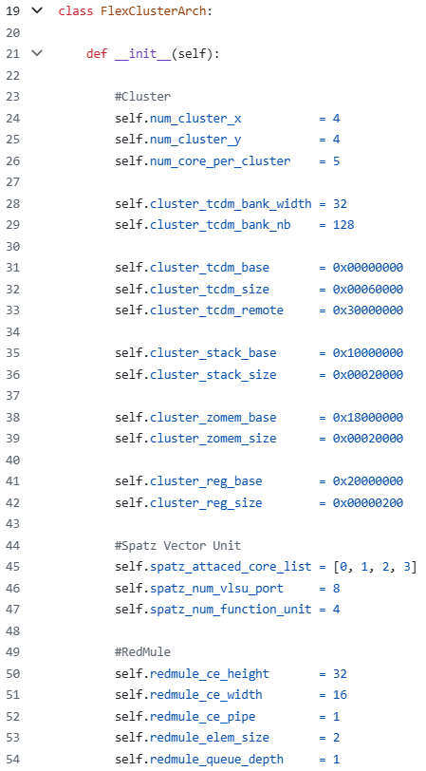
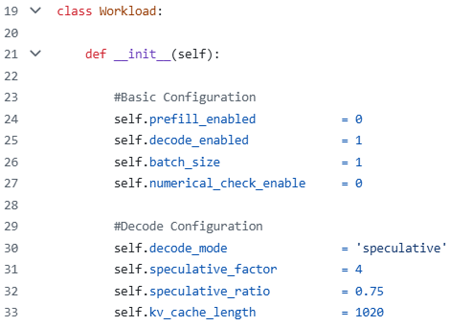
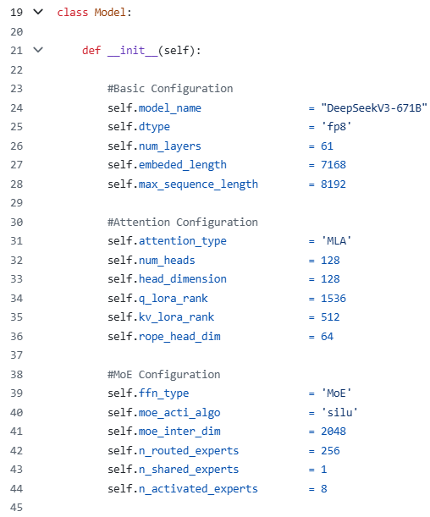
Journal progress: DeepSeek Flow Automation
Example Usage:
  arch=example/south_only_arch_scale/arch_4x4.py work=example/deepseek_decode/work.py model=config/models/dsv3.py make llm

Slide 5
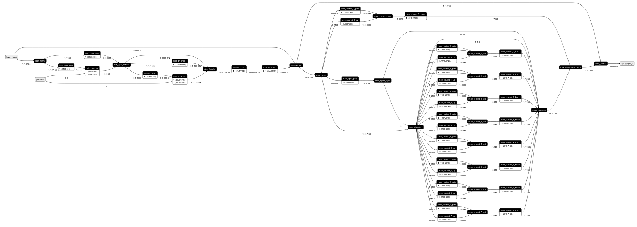
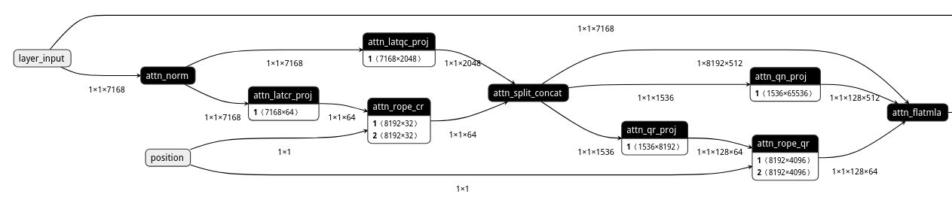
DeepSeek Flow Automation: Generate Layer Kernel Flow
Example of decode batch_size = 1
Shared Experts
Routed Experts

Slide 6
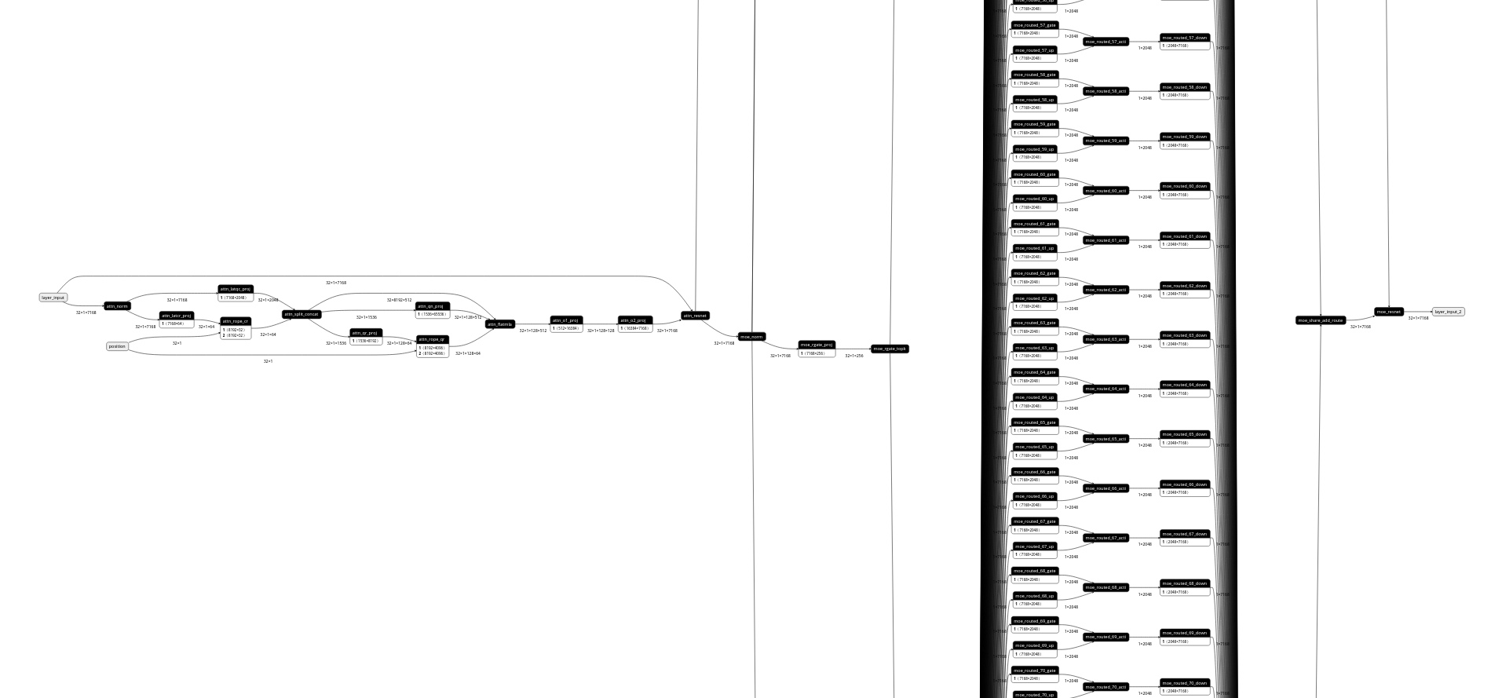
DeepSeek Flow Automation: Generate Layer Kernel Flow
Example of decode batch_size = 32

Slide 7
DeepSeek Flow Automation: SoftHier Simulation Time
Simulation time for finishing one decoding layer of full DeepSeek-671B
4x4 Clusters
16 TFLOPS
8x8 Clusters
64 TFLOPS
16x16 Clusters
256 TFLOPS
32x32 Clusters
1024 TFLOPS
4hr
1hr

Slide 8
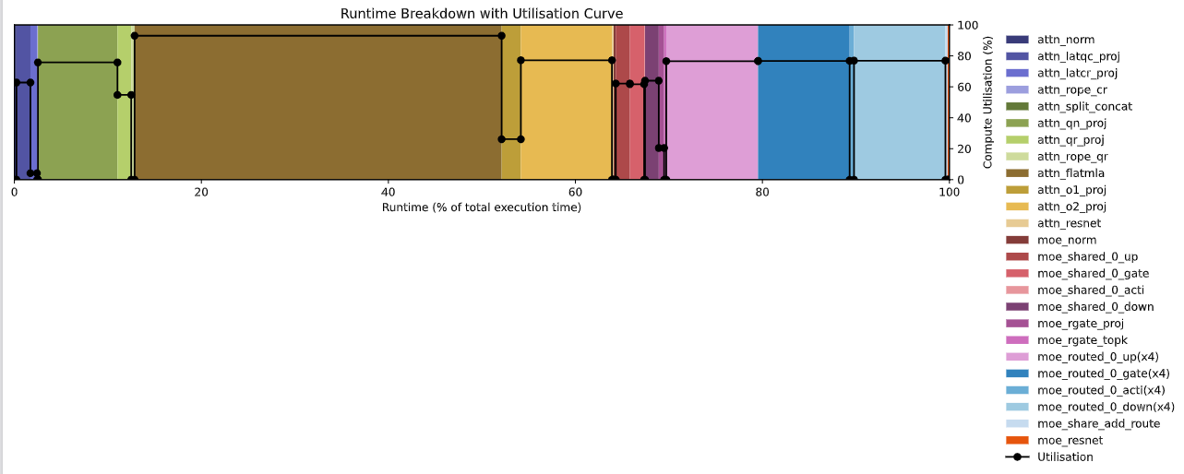
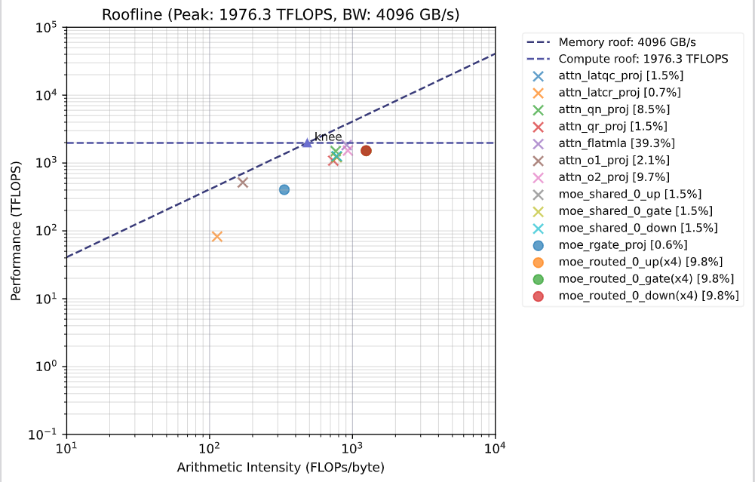
DeepSeek Flow Automation: Generate Plots
The flow automatically generate roofline and runtime breakdown plots
  DeepSeekv3-671B decode layer batch_size=128, kv=4096, speculative=4, EP=64

Slide 9
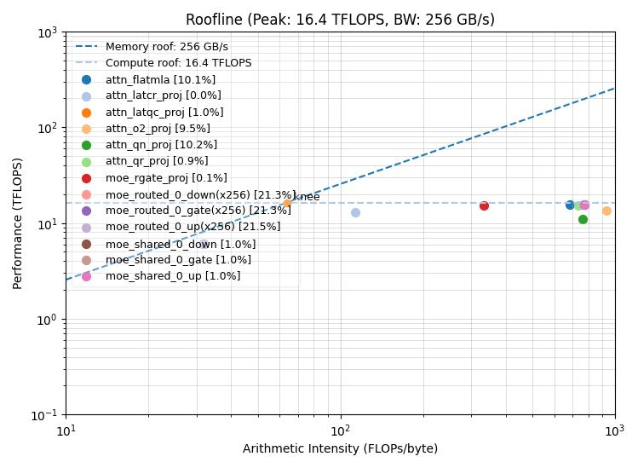
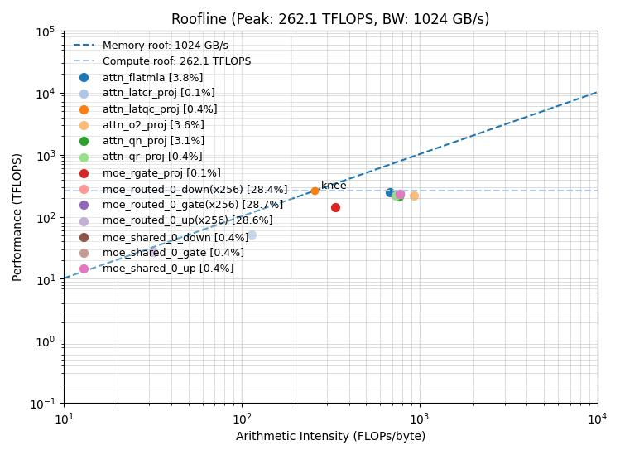
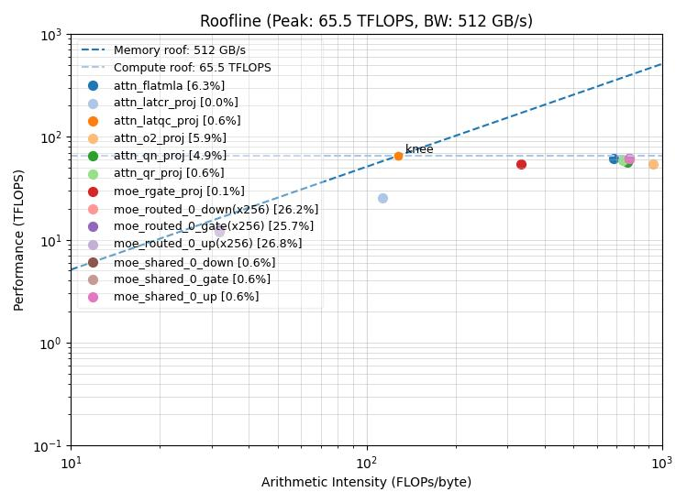
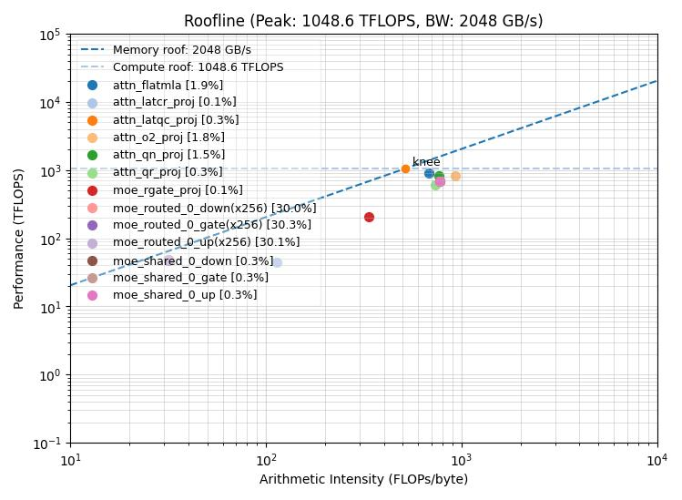
DeepSeek Flow Automation: Generate Plots
Strong Scaling
  Decode batch_size=128, kv_cache_length=1024, PP, Speculative=4
4x4 Clusters
16.4 TFLOPS
16x16 Clusters
262.1 TFLOPS
8x8 Clusters
65.5 TFLOPS
32x32 Clusters
1048.6 TFLOPS

Slide 10
For Next
We have launched massive testes, collecting results
Details for the final presentation?
  Is the presentation date scheduled?
  Do we need to have an internal DDL (eg one week before presentation) to double-check slide?
    As we did for the 1st year stage report and FlatAttention presentation

