Slide 1
AutoAlert:
An Automated Student Alert System.
Guided By:
Dr.Hussain Syed
By:
GVS SAI MADHAV -19BCN7228
S REVANTH KUMAR -19BCE7333
HEMANTH K RATHORE -19BCE7472
ANOOHYA N -19BCE7530

Slide 2
Motivation:
Our Main Motivation and Idea behind the thought of doing this app is
As a student, we always forget which class are we needed to attend next and then searching for the timetable to know which is the next class becomes clumsy sometimes.
So to make this task easy this application will be very helpful.
You Can Know the following things by using our app.
What classes am I taking today?
When will my next class be?
How often do I show up for this class?
What am I supposed to do today?
The AutoAlert app can manage all these things and more, so you'll never have to ask these questions again.

Slide 3
Module Identification
Daily Schedule Notifier.
Attendance Calculator
To-do list
Academic Website Link redirection.

Slide 4
Workflow of the App
In the first page, User will get option to edit timetable based on user priority for work and set reminders, add their university website for quick access.
User’s can also add -to do list, and update the details whether they attended the class or not, so that they can see their attendance percentage.
In The Settings of the app, User need to set the link of their university web-page, so that he can see that website, whenever he open’s the Web-Page Tab
In timetable page,
User need to setup his timetable, add reminders, and priorities of work.
Then, need to choose an option of whether its repetitive or its just for a temporary duration.
User can choose the amount of time he needs to be notified earlier.
After setting up all these , the app will start to function.

Slide 5
Features:
The student will be notified with his day schedule everyday in the morning for
the selected time and student will receive notification of work before
5 min of scheduled time.
The student also notified with the timetable he updated.
The student will be notified with the customized names for the remainders.
The additional features in this is there will a todo list for the student.

Slide 6
Tools And Technologies
Android API Level Greater than 7.0 (Nougat- Decided this level keeping in view of security concerns)
We Decided to Use Flutter Framework
A PC With Greater than or = 8GB Ram.
Android Studio
Latest Java JDK Installed.
VS Code Text Editor, With - Flutter and Dart Plugins Installed.
Android Virtual Device Or a Physical Mobile with- Debugging and installing apps from USB Enabled to emulate the app.
An Android Device With At Least 2 GB Of Free Space.

Slide 7
Timeline
We Are Using Trello Boards, A Kanban Board simulation tool,widely used in the industry to constantly update each task and manage timeline and track progress.
You Can See the current trello board screenshots in the next slide, and if we’ve also provided the invite link to our trello board below.
Invite link:
https://trello.com/invite/b/mFa4pfHq/a29fd82b76d58254128cd00a20585648/mad-project
We Support Open Source

Slide 8
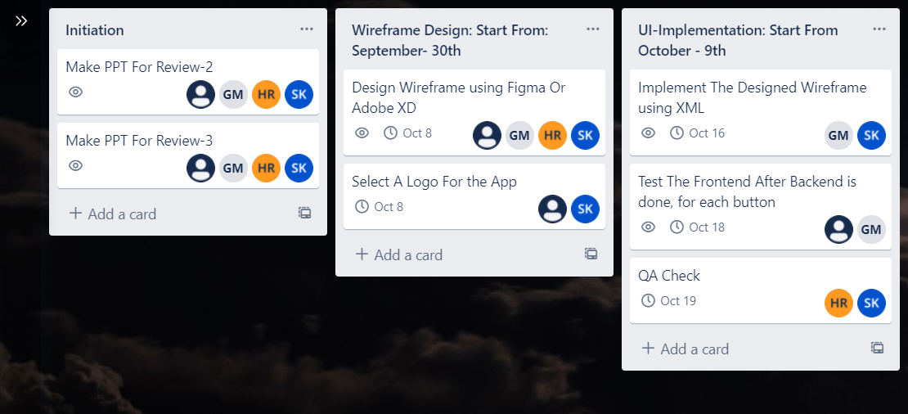

Slide 9
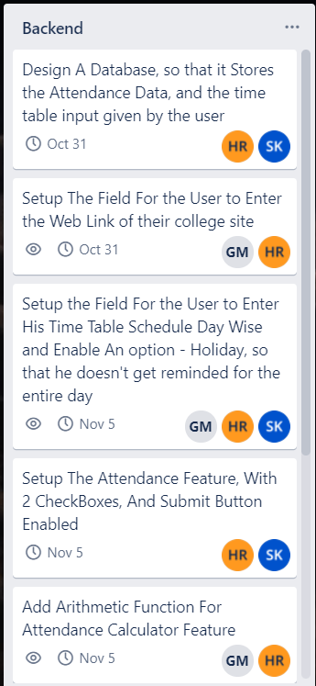
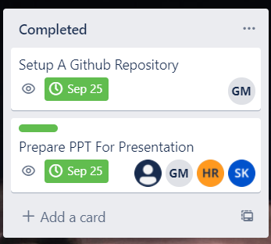
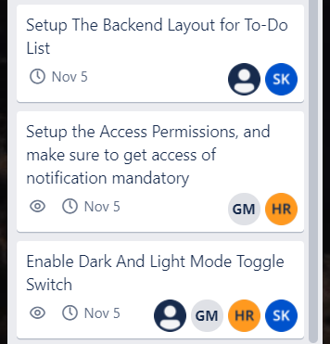

Slide 10
Thank You

