Slide 1
AWAT:
An User Friendly Alert System
Guided By: Dr.Hussain Syed
By
GVS SAI MADHAV 19BCN7228
HEMANTH RATHORE 19BCE7472
S REVANTH KUMAR 19BCE7333
ANOOHYA N 19BCE7530

Slide 2
AGENDA
Introduction
Modules
UI/UX Work
UML Diagrams
Project Demo
Current Status
Conclusion

Slide 3
INTRODUCTION
People overlook critical tasks that must be completed on a specific day and at a specific time. This is due to today's hectic work schedule. In this chaotic circumstance, our AWAT app is quite helpful. Users may set reminders for a specific day and time with this application.
The AWAT app also has a to-do list that allows users to keep track of their chores that must be completed.
Our application assists users in time management and helps them to make their day more productive.

Slide 4
MODULES
Specific Task Notifier
Attendance Counter (Useful for Students And Working Professionals)
To-do list
Professional Site In-App Browser

Slide 5
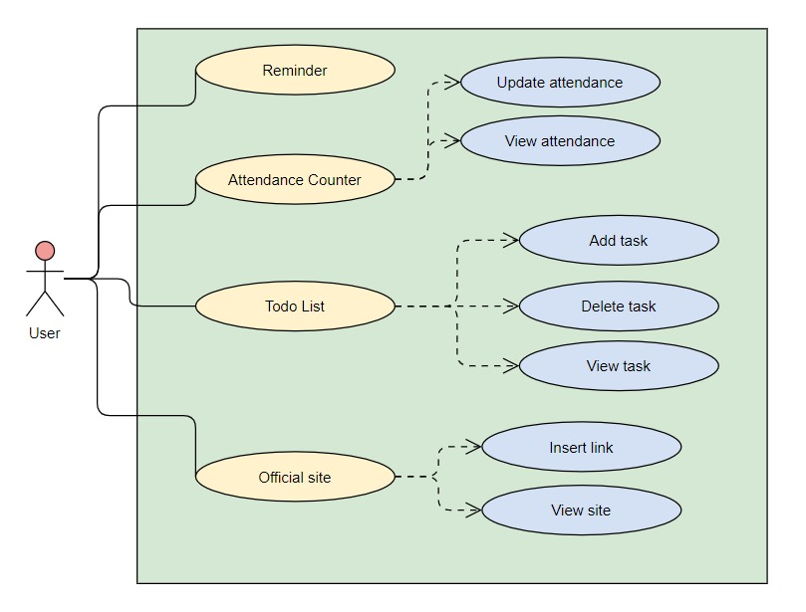
USE CASE
DIAGRAM

Slide 6
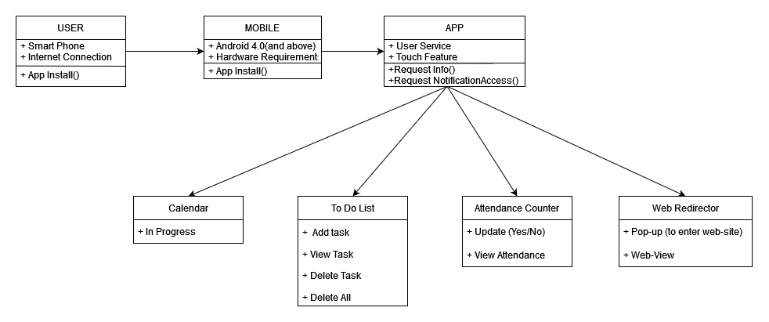
CLASS DIAGRAM
Class Diagram

Slide 7
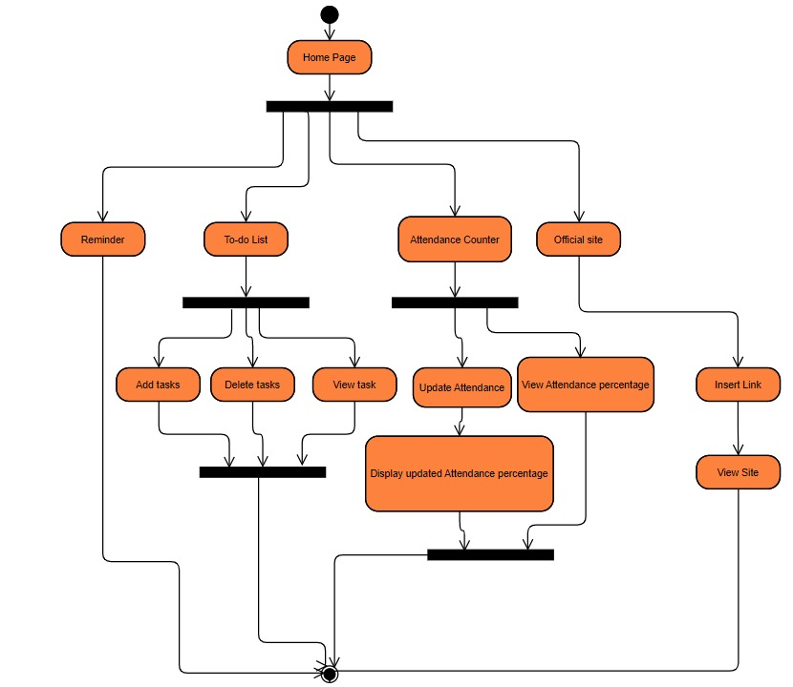
ACTIVITY DIAGRAM

Slide 8
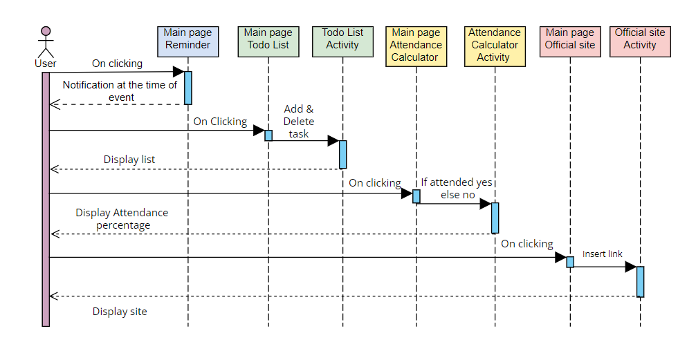
SEQUENCE DIAGRAM
Sequence Diagram

Slide 9
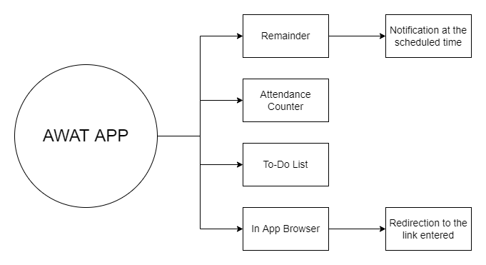
Data Flow Diagram

Slide 10
UI DESIGN
UI Design For- ToDo List, Attendance Counter, Web Browser Is Completed (You Can View it in the App Demo)
The Current UI Of Landing Page We Have is Temporary. Work Of That is in Progress and will be completed in next 2-3 days.
A Splash Design Is Being Done and it will also be implemented.
Multiple Icon Designs Were Done and An Optimal one will be chosen soon.

Slide 11
App Demonstration

Slide 12
Time Line Current Status
Link To TimeLine (Kanban Board) : https://trello.com/invite/b/Wohvlq5e/8cb67253e22008b30111af442e1e5c60/mad-updated-schedule

Slide 13
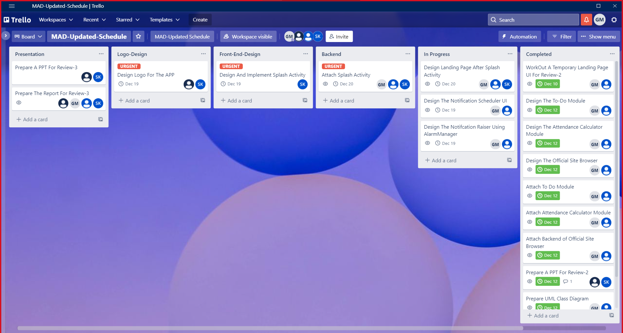

Slide 14
CONCLUSION
AWAT is a user-friendly programme.
That assists People(Students & Employees) in managing their day to day classes and activities, such as alerting them for their classes on time or alerting them to do some particular task and this is also useful for tracking their attendance percentage
There is also a feature of ToDo list which is very much useful for us.
There is a option visiting their official websites.

Slide 15

THANK YOU

