Slide 1

ARSS IT SOLUTIONS

Slide 2


Who Are We?
An excellent provider of data engineering training and career guidance.
A team of experienced industry professionals passionate about data and education.
Dedicated to empowering individuals with in-demand data engineering skills.
Committed to student success with a strong focus on job placement.

Slide 3
What We Do?
Offer comprehensive data engineering training programs.
Provide in-depth knowledge of core data engineering technologies and tools.
Equip students with practical skills through hands-on projects and real-world case studies.
Prepare students for the job market through resume building, interview preparation, and job search assistance.
Deliver high-quality training with a focus on student success and career growth.

Slide 4












How Many Batches We Have Completed Successfully?
We have successfully facilitated career transitions for over 200+ professionals, showcasing our significant impact on the careers of many individuals.
Many of our students have been placed in companies like TCS, Virtusa, Accenture, Genpact, IBM, Amazon, Randstad, NetApp, Granicus, PayPal, HCL, Cognizant, Capgemini, Infosys, CGI, Sonata, Bank of America, Nokia, Mindtree, L&T.

Slide 5









Course Curriculum
Cloud, SQL, Python, Snowflake, Redshift, Kafka, Spark, Hadoop.
Jira, ServiceNow, Confluence, GitHub, Bitbucket, Hive, Sqoop, NoSQL, Data Pipelines, Databricks.
AWS, Microsoft Azure, GCP & Snowflake

Slide 6
How Many Years of Experience We Have?
Our program has 2 years of successful history in training and placing professionals in data engineering roles.
We have experienced professionals with 6-8 years of experience in the IT industry.

Slide 7
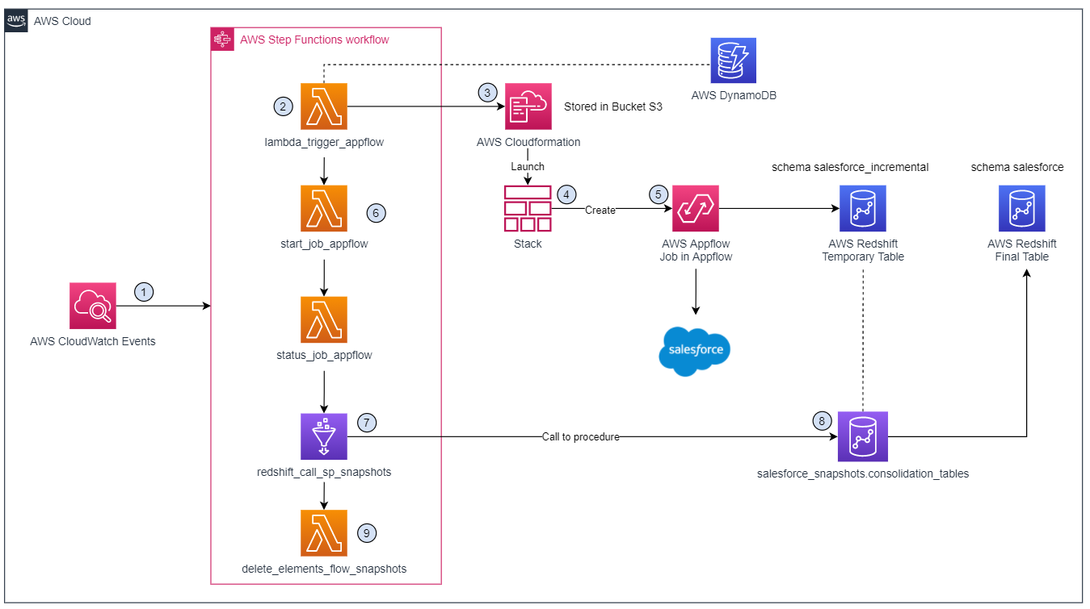
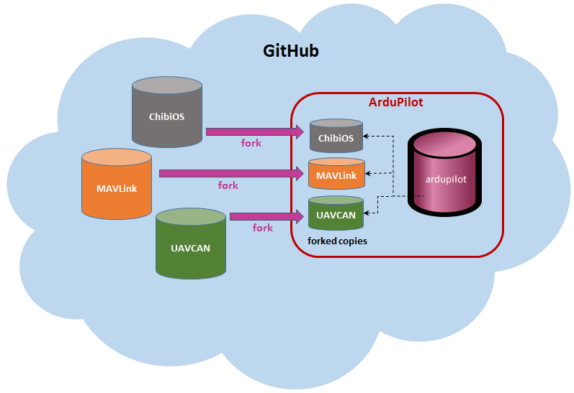
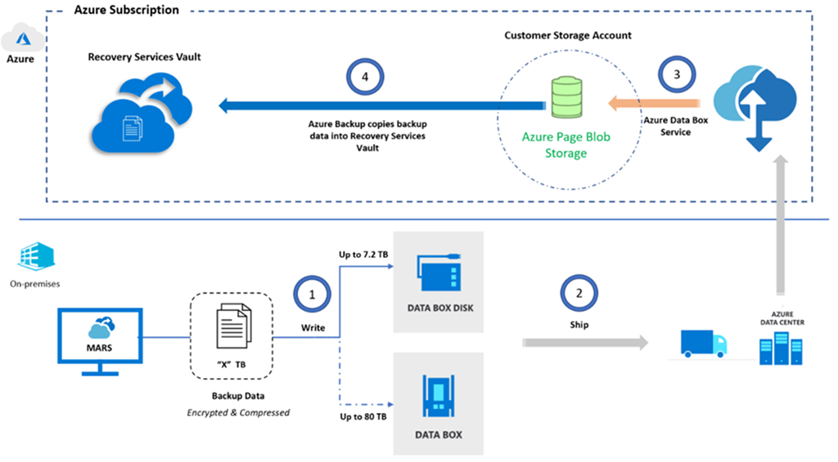

Slide 8
Why Data Engineering?
High Demand & Growing Field:
- Data is the New Oil: Data is the most valuable asset for businesses today.
- Data Engineers are in High Demand: Companies across industries are seeking skilled data engineers to manage their growing data needs.
- Exciting and Challenging Career: Data engineering offers a dynamic career path with opportunities to work on cutting-edge technologies.
Impactful Career:
- Drive Business Decisions: Data engineers enable data-driven decision-making, significantly impacting business outcomes.
- Solve Real-World Problems: Work on projects that address real-world challenges and contribute to innovation.
- Make a Difference: Help businesses improve customer experiences, develop new products, and gain a competitive advantage.
Lucrative Career Opportunities:
- High Salaries and Benefits: Data engineers are in high demand, leading to competitive salaries and attractive benefits.
- Career Growth Potential: Advance to senior roles like Data Architect, Lead Data Engineer, or Chief Data Officer.
- Global Career Opportunities: Data engineering skills are transferable across industries and geographies.

Slide 9
Summary
Our comprehensive data engineering training program is designed to empower individuals with the technical and practical skills needed to excel in the growing field of data engineering.
With experienced instructors, industry-relevant curriculum, hands-on projects, and a career-focused approach, we have successfully transformed the careers of over 200+ professionals in last one year.
We are committed to student success, offering continuous support and guidance to ensure a smooth transition into rewarding data engineering roles.

Slide 10

THANK YOU
FROM
ARSS IT SOLUTIONS

